Slide 2

content
Triangular Numbers in higher dimensions
$1−\frac{1}{2}+\frac{1}{3}−\frac{1}{4}+...=ln2$
$\sqrt[n]{a_{1}a_{2}a_{3}...a_{n}}≤\frac{a_{1}+a_{2}+a_{3}+...+a_{n}}{n}$

Slide 3
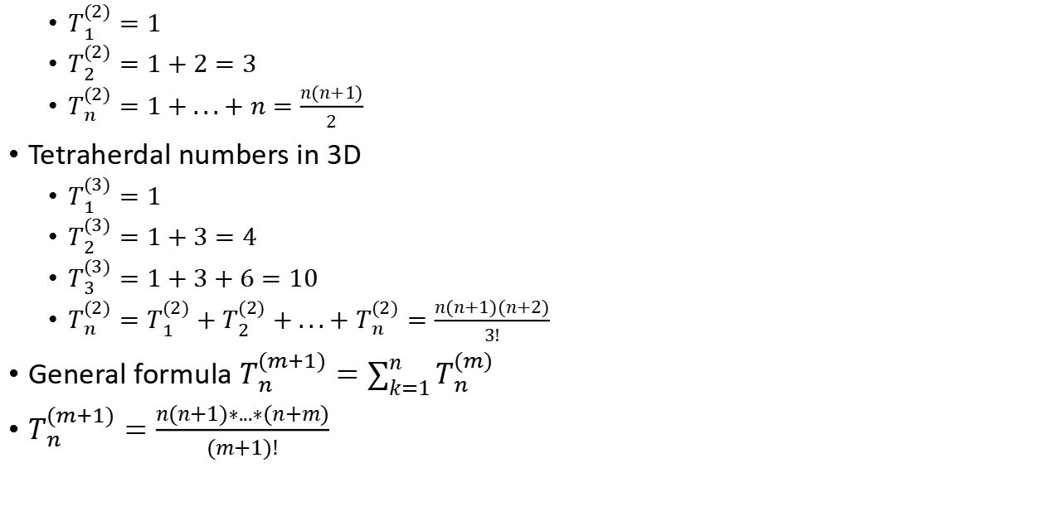
Triangular Numbers in higher dimensions
$T_{1}^{(2)}=1$
$T_{2}^{(2)}=1+2=3$
$T_{n}^{(2)}=1+...+n=\frac{n(n+1)}{2}$
Tetraherdal numbers in 3D
$T_{1}^{(3)}=1$
$T_{2}^{(3)}=1+3=4$
$T_{3}^{(3)}=1+3+6=10$
$T_{n}^{(2)}=T_{1}^{(2)}+T_{2}^{(2)}+...+T_{n}^{(2)}=\frac{n(n+1)(n+2)}{3!}$
General formula $T_{n}^{(m+1)}=\sum_{k=1}^{n}{T_{n}^{(m)}}$
$T_{n}^{(m+1)}=\frac{n(n+1)∗...∗(n+m)}{(m+1)!}$

Slide 4
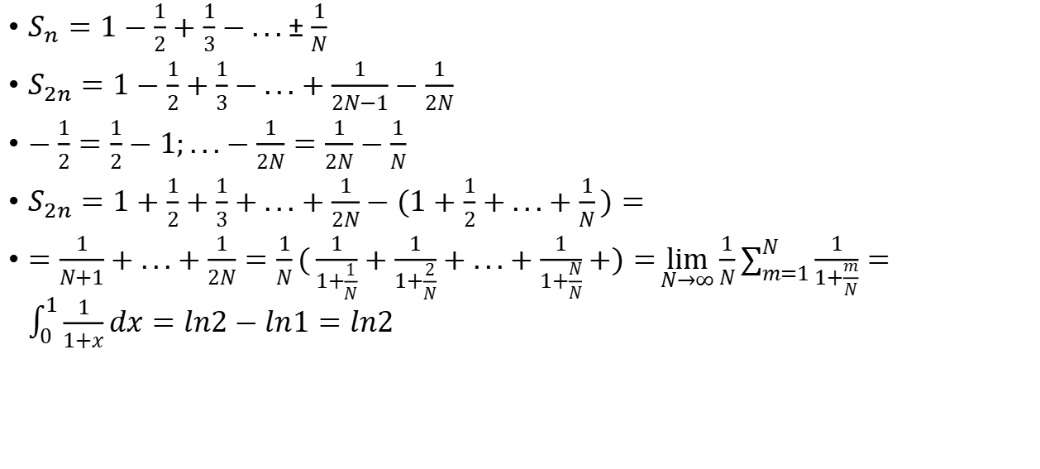

$$1−\frac{1}{2}+\frac{1}{3}−\frac{1}{4}+...=ln2$$
$S_{n}=1−\frac{1}{2}+\frac{1}{3}−...±\frac{1}{N}$
$S_{2n}=1−\frac{1}{2}+\frac{1}{3}−...+\frac{1}{2N−1}−\frac{1}{2N}$
$−\frac{1}{2}=\frac{1}{2}−1;...−\frac{1}{2N}=\frac{1}{2N}−\frac{1}{N}$
$S_{2n}=1+\frac{1}{2}+\frac{1}{3}+...+\frac{1}{2N}−(1+\frac{1}{2}+...+\frac{1}{N})=$
$=\frac{1}{N+1}+...+\frac{1}{2N}=\frac{1}{N}(\frac{1}{1+\frac{1}{N}}+\frac{1}{1+\frac{2}{N}}+...+\frac{1}{1+\frac{N}{N}}+)=\lim_{N→∞}{\frac{1}{N}\sum_{m=1}^{N}{\frac{1}{1+\frac{m}{N}}}}=\int_{0}^{1}{\frac{1}{1+x}dx}=ln2−ln1=ln2$

Slide 5

$$\sqrt[n]{a_{1}a_{2}a_{3}...a_{n}}≤\frac{a_{1}+a_{2}+a_{3}+...+a_{n}}{n}$$
Usage: prove $n!≤{\left(\frac{n+1}{2}\right)}^{n}$
$let a_{n}=n;so$
$\sqrt[n]{a_{1}a_{2}a_{3}...a_{n}}=\sqrt[n]{n!}≤\frac{1+2+...+n}{n}=\frac{n(n+1)}{2n}=\frac{n+1}{2}$
$n!≤{\left(\frac{n+1}{2}\right)}^{n}$

Slide 6
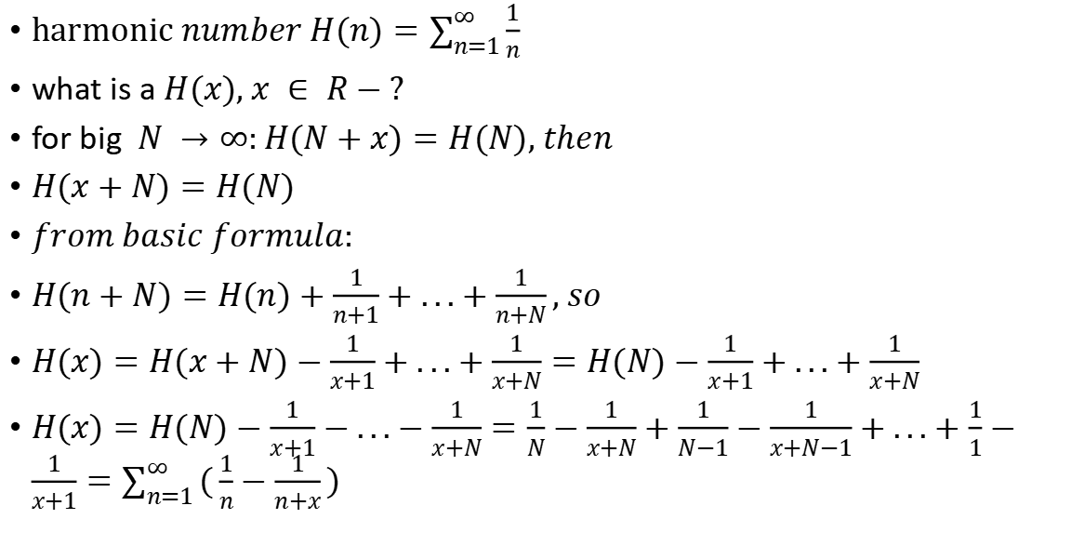
$$H(n)non−recursive$$
harmonic $number H(n)=\sum_{n=1}^{∞}{\frac{1}{n}}$
what is a $H(x), x ∈ R−?$
for big $N →∞:H(N+x)=H(N), then$
$H(x+N)=H(N)$
$from basic formula:$
$H(n+N)=H(n)+\frac{1}{n+1}+...+\frac{1}{n+N}, so$
$H(x)=H(x+N)−\frac{1}{x+1}+...+\frac{1}{x+N}=H(N)−\frac{1}{x+1}+...+\frac{1}{x+N}$
$H(x)=H(N)−\frac{1}{x+1}−...−\frac{1}{x+N}=\frac{1}{N}−\frac{1}{x+N}+\frac{1}{N−1}−\frac{1}{x+N−1}+...+\frac{1}{1}−\frac{1}{x+1}=\sum_{n=1}^{∞}{(\frac{1}{n}−\frac{1}{n+x})}$

