Slide 1

Telescoping series
$\frac{1}{1∗2}+\frac{1}{2∗3}+\frac{1}{3∗4}=\frac{1}{1}−\frac{1}{2}+\frac{1}{2}−\frac{1}{3}+...+\frac{1}{n}−\frac{1}{n+1}=\frac{1}{1}−\frac{1}{n+1}=1$
при n-> inf, синее становится 0
Telescoping trick:
$\frac{1}{n(n+1)}=\frac{1}{n}−\frac{1}{n+1}$

Slide 2
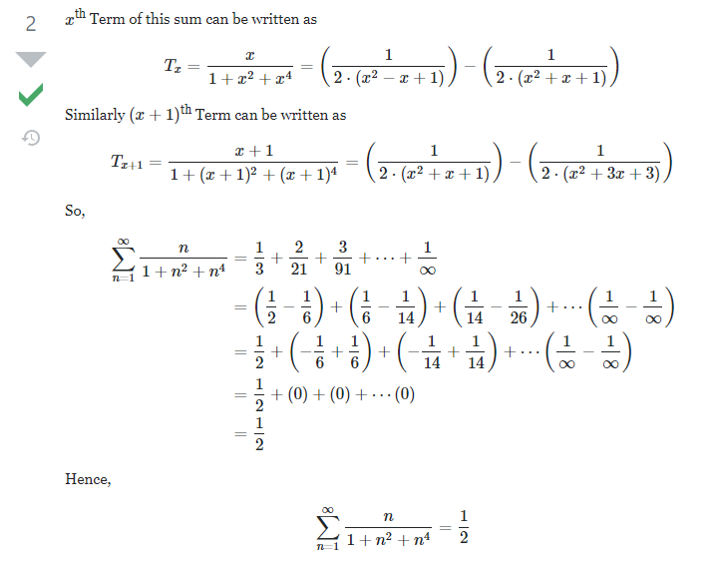

Slide 3
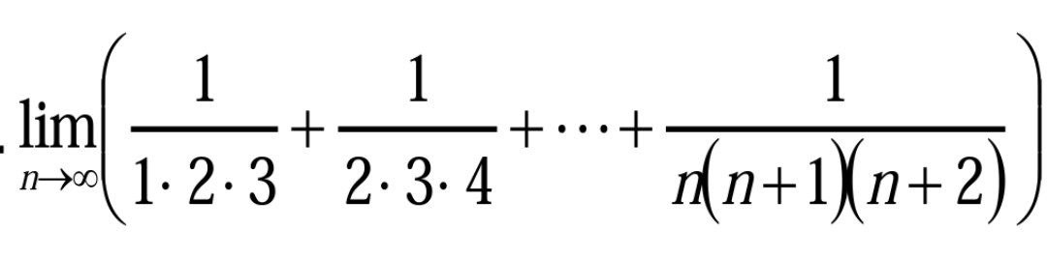
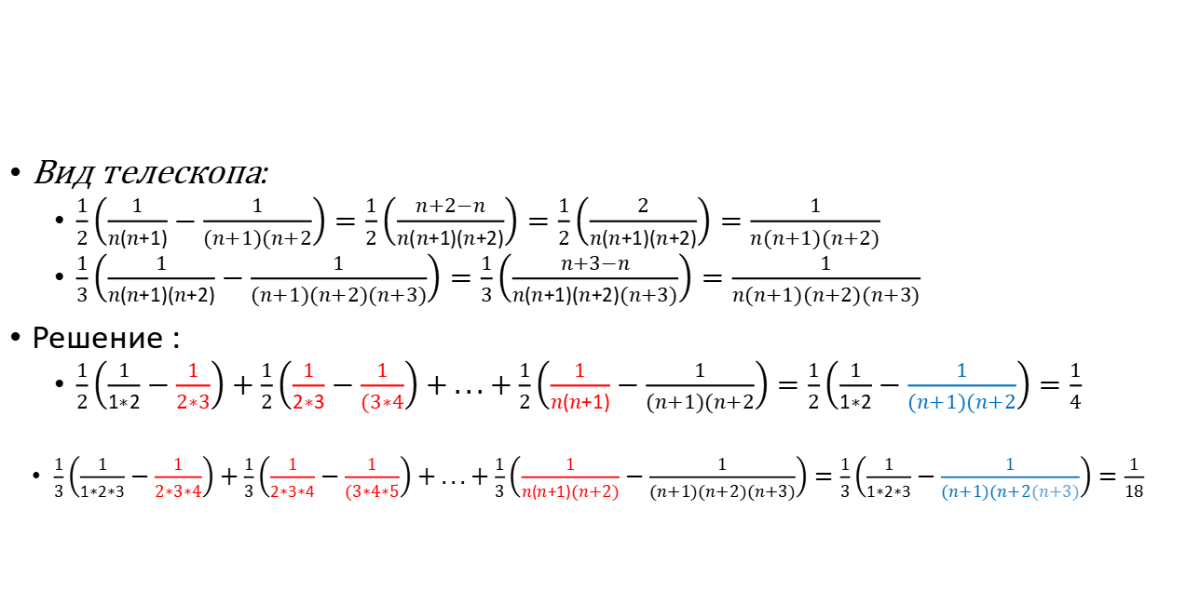
Telescoping tricks 2:
Вид телескопа:
$\frac{1}{2}\left(\frac{1}{n(n+1)}−\frac{1}{(n+1)(n+2}\right)=\frac{1}{2}\left(\frac{n+2−n}{n(n+1)(n+2)}\right)=\frac{1}{2}\left(\frac{2}{n(n+1)(n+2)}\right)=\frac{1}{n(n+1)(n+2)}$
$\frac{1}{3}\left(\frac{1}{n(n+1)(n+2)}−\frac{1}{(n+1)(n+2)(n+3)}\right)=\frac{1}{3}\left(\frac{n+3−n}{n(n+1)(n+2)(n+3)}\right)=\frac{1}{n(n+1)(n+2)(n+3)}$
Решение :
$\frac{1}{2}\left(\frac{1}{1∗2}−\frac{1}{2∗3}\right)+\frac{1}{2}\left(\frac{1}{2∗3}−\frac{1}{(3∗4}\right)+...+\frac{1}{2}\left(\frac{1}{n(n+1)}−\frac{1}{(n+1)(n+2}\right)=\frac{1}{2}\left(\frac{1}{1∗2}−\frac{1}{(n+1)(n+2}\right)=\frac{1}{4}$
$\frac{1}{3}\left(\frac{1}{1∗2∗3}−\frac{1}{2∗3∗4}\right)+\frac{1}{3}\left(\frac{1}{2∗3∗4}−\frac{1}{(3∗4∗5}\right)+...+\frac{1}{3}\left(\frac{1}{n(n+1)(n+2)}−\frac{1}{(n+1)(n+2)(n+3)}\right)=\frac{1}{3}\left(\frac{1}{1∗2∗3}−\frac{1}{(n+1)(n+2(n+3)}\right)=\frac{1}{18}$

Slide 4
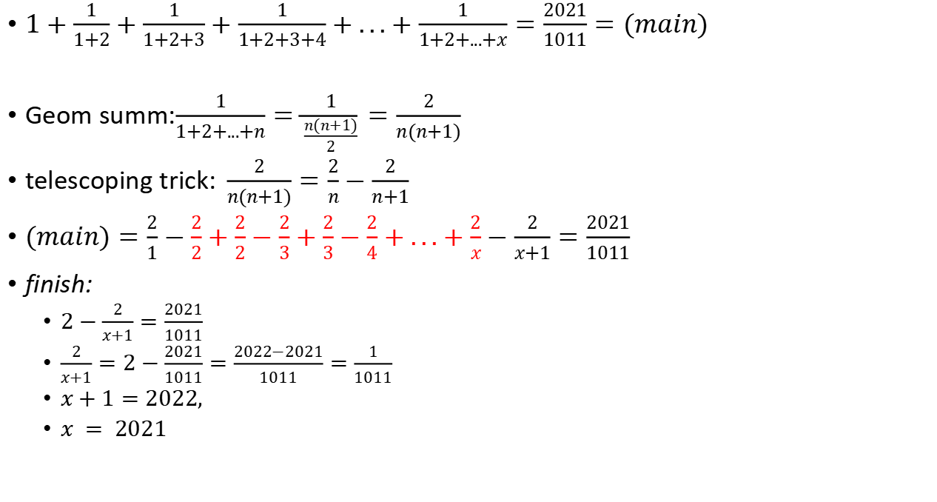
Telescoping tricks 3:
$1+\frac{1}{1+2}+\frac{1}{1+2+3}+\frac{1}{1+2+3+4}+...+\frac{1}{1+2+...+x}=\frac{2021}{1011}=(main)$
Geom summ:$\frac{1}{1+2+...+n}=\frac{1}{\frac{n(n+1)}{2}}=\frac{2}{n(n+1)}$
telescoping trick:$\frac{2}{n(n+1)}=\frac{2}{n}−\frac{2}{n+1}$
$(main)=\frac{2}{1}−\frac{2}{2}+\frac{2}{2}−\frac{2}{3}+\frac{2}{3}−\frac{2}{4}+...+\frac{2}{x}−\frac{2}{x+1}=\frac{2021}{1011}$
finish:
$2−\frac{2}{x+1}=\frac{2021}{1011}$
$\frac{2}{x+1}=2−\frac{2021}{1011}=\frac{2022−2021}{1011}=\frac{1}{1011}$
$x+1=2022,$
$x = 2021$

Slide 5
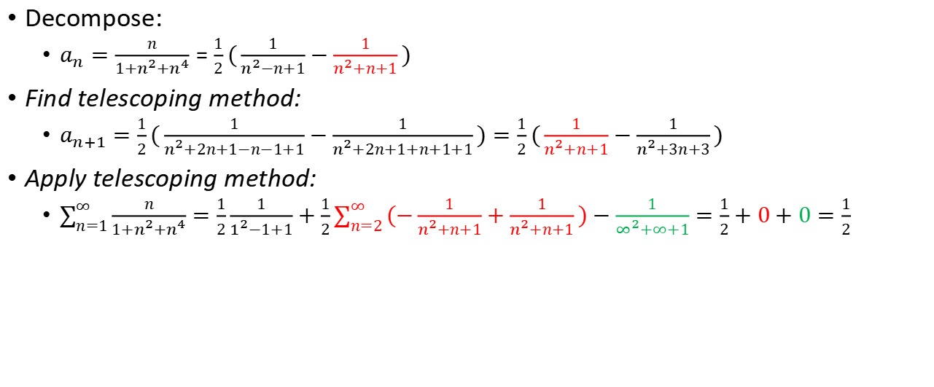

$$\sum_{n=1}^{∞}{\frac{n}{1+n^{2}+n^{4}}}$$
Decompose:
$a_{n}=\frac{n}{1+n^{2}+n^{4}}=\frac{1}{2}(\frac{1}{n^{2}−n+1}−\frac{1}{n^{2}+n+1})$
Find telescoping method:
$a_{n+1}=\frac{1}{2}(\frac{1}{n^{2}+2n+1−n−1+1}−\frac{1}{n^{2}+2n+1+n+1+1})=\frac{1}{2}(\frac{1}{n^{2}+n+1}−\frac{1}{n^{2}+3n+3})$
Apply telescoping method:
$\sum_{n=1}^{∞}{\frac{n}{1+n^{2}+n^{4}}}=\frac{1}{2}\frac{1}{1^{2}−1+1}+\frac{1}{2}\sum_{n=2}^{∞}{(−\frac{1}{n^{2}+n+1}+\frac{1}{n^{2}+n+1}})−\frac{1}{∞^{2}+∞+1}=\frac{1}{2}+0+0=\frac{1}{2}$

Slide 6
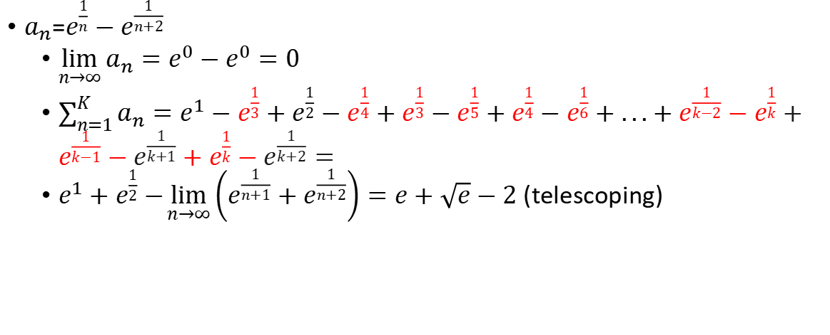
$a_{n}$=$e^{\frac{1}{n}}−e^{\frac{1}{n+2}}$
$\lim_{n→∞}{a_{n}}=e^{0}−e^{0}=0$
$\sum_{n=1}^{K}{a_{n}=e^{1}}−e^{\frac{1}{3}}+e^{\frac{1}{2}}−e^{\frac{1}{4}}+e^{\frac{1}{3}}−e^{\frac{1}{5}}+e^{\frac{1}{4}}−e^{\frac{1}{6}}+...+e^{\frac{1}{k−2}}−e^{\frac{1}{k}}+e^{\frac{1}{k−1}}−e^{\frac{1}{k+1}}+e^{\frac{1}{k}}−e^{\frac{1}{k+2}}=$
$e^{1}+e^{\frac{1}{2}}−\lim_{n→∞}\left(e^{\frac{1}{n+1}}+e^{\frac{1}{n+2}}\right)=e+\sqrt{e}−2$ (telescoping)

Slide 7
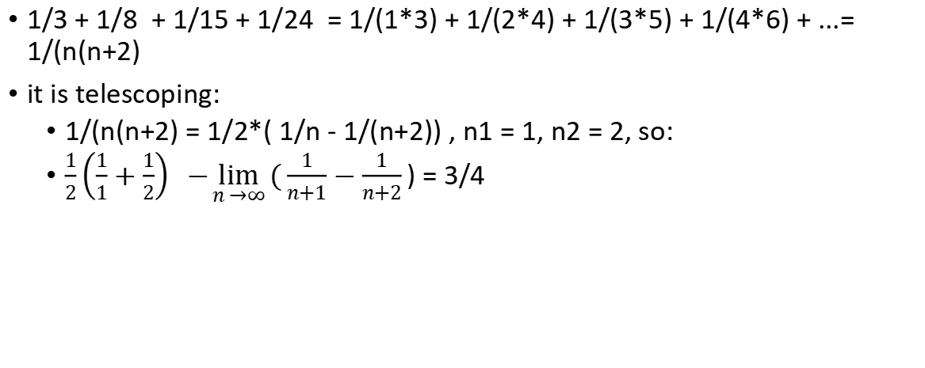
1/3 + 1/8 + 1/15 + 1/24 = 1/(1*3) + 1/(2*4) + 1/(3*5) + 1/(4*6) + ...= 1/(n(n+2)
it is telescoping:
1/(n(n+2) = 1/2*( 1/n - 1/(n+2)) , n1 = 1, n2 = 2, so:
$\frac{1}{2}\left(\frac{1}{1}+\frac{1}{2}\right) −\lim_{n →∞}{(\frac{1}{n+1}−\frac{1}{n+2})}$ = 3/4

Slide 8
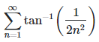
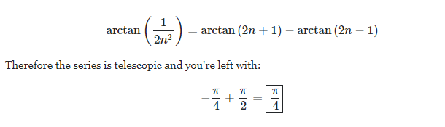

Slide 9
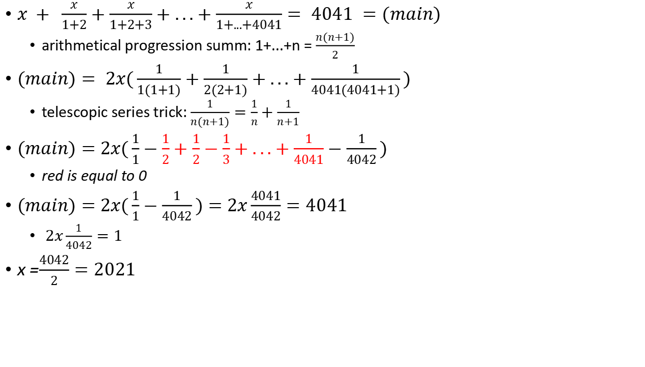
Summ row and telescopic:
$x + \frac{x}{1+2}+\frac{x}{1+2+3}+...+\frac{x}{1+...+4041}= 4041 =(main)$
arithmetical progression summ: 1+...+n = $\frac{n(n+1)}{2}$
$(main)= 2x(\frac{1}{1(1+1)}+\frac{1}{2(2+1)}+...+\frac{1}{4041(4041+1)})$
telescopic series trick: $\frac{1}{n(n+1)}=\frac{1}{n}+\frac{1}{n+1}$
$(main)=$ $2x(\frac{1}{1}−\frac{1}{2}+\frac{1}{2}−\frac{1}{3}+...+\frac{1}{4041}−\frac{1}{4042})$
red is equal to 0
$(main)=$ $2x(\frac{1}{1}−\frac{1}{4042})=$ $2x\frac{4041}{4042}=4041$
$2x\frac{1}{4042}=1$
x =$\frac{4042}{2}=2021$

Slide 10
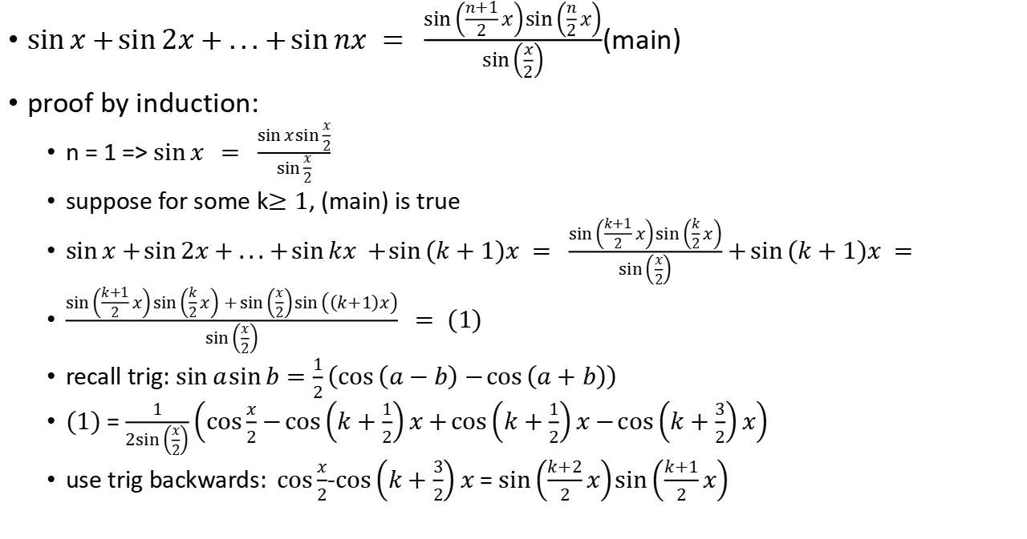
Trigonometry row:
$\sin{x}+\sin{2x}+...+\sin{nx = \frac{\sin\left(\frac{n+1}{2}x\right)\sin\left(\frac{n}{2}x\right)}{\sin\left(\frac{x}{2}\right)}}$(main)
proof by induction:
n = 1 => $\sin{x} = \frac{\sin{x}\sin{\frac{x}{2}}}{\sin{\frac{x}{2}}}$
suppose for some k$≥1$, (main) is true
$\sin{x}+\sin{2x}+...+\sin{kx +}\sin{(k+1)x = }\frac{\sin\left(\frac{k+1}{2}x\right)\sin\left(\frac{k}{2}x\right)}{\sin\left(\frac{x}{2}\right)}+\sin{(k+1)x = }$
$\frac{\sin\left(\frac{k+1}{2}x\right)\sin\left(\frac{k}{2}x\right)+\sin\left(\frac{x}{2}\right)\sin\left(\left(k+1\right)x\right)}{\sin\left(\frac{x}{2}\right)} = (1)$
recall trig: $\sin{a}\sin{b}=\frac{1}{2}\left(\cos\left(a−b\right)−\cos\left(a+b\right)\right)$
$(1)$ = $\frac{1}{2sin\left(\frac{x}{2}\right)}\left(\cos{\frac{x}{2}}−\cos\left(k+\frac{1}{2}\right)x+\cos\left(k+\frac{1}{2}\right)x−\cos\left(k+\frac{3}{2}\right)x\right)$
use tr$ig backwards: \cos{\frac{x}{2}}$-$\cos\left(k+\frac{3}{2}\right)x$ = $\sin\left(\frac{k+2}{2}x\right)\sin\left(\frac{k+1}{2}x\right)$

Slide 11

Row of inverse radicals:
$\frac{1}{\sqrt{x+2}+\sqrt{x+3}}+\frac{1}{\sqrt{x+3}+\sqrt{x+4}}+...+\frac{1}{\sqrt{x+2017}+\sqrt{x+2018}}=42$
$\frac{\sqrt{x+3}−\sqrt{x+2}}{x+3−x−2}+\frac{\sqrt{x+4}−\sqrt{x+3}}{x+4−x−3}+...\frac{\sqrt{x+2018}−\sqrt{x+2017}}{x+3−x−2}=42$
$\sqrt{x+2018}−\sqrt{x+2}=42$

Slide 12
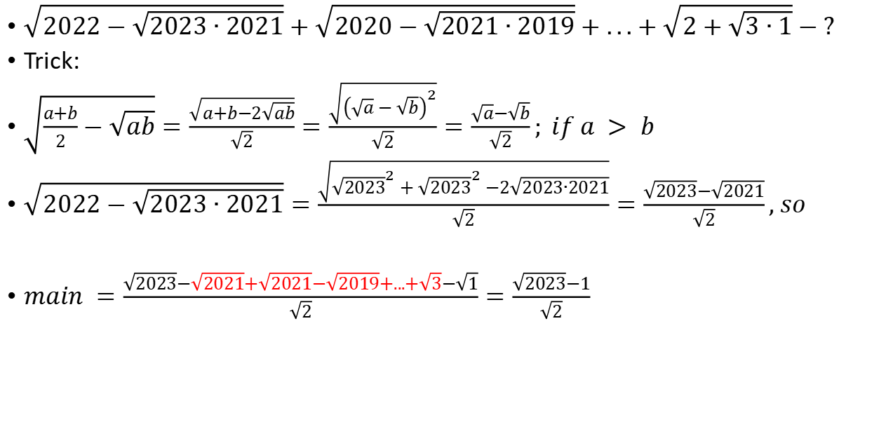
Middle inside radical trick
$\sqrt{2022−\sqrt{2023∙2021}}+\sqrt{2020−\sqrt{2021∙2019}}+...+\sqrt{2+\sqrt{3∙1}}−?$
Trick:
$\sqrt{\frac{a+b}{2}−\sqrt{ab}}=\frac{\sqrt{a+b−2\sqrt{ab}}}{\sqrt{2}}=\frac{\sqrt{{\left(\sqrt{a}−\sqrt{b}\right)}^{2}}}{\sqrt{2}}=\frac{\sqrt{a}−\sqrt{b}}{\sqrt{2}}; if a > b$
$\sqrt{2022−\sqrt{2023∙2021}}=\frac{\sqrt{{\sqrt{2023}}^{2}+{\sqrt{2023}}^{2}−2\sqrt{2023∙2021}}}{\sqrt{2}}=\frac{\sqrt{2023}−\sqrt{2021}}{\sqrt{2}}, so$
$main =\frac{\sqrt{2023}−\sqrt{2021}+\sqrt{2021}−\sqrt{2019}+...+\sqrt{3}−\sqrt{1}}{\sqrt{2}}=\frac{\sqrt{2023}−1}{\sqrt{2}}$

Slide 13

Row of radicals 2:
$\sum_{k=1}^{99}{\frac{1}{\sqrt{k}+\sqrt{k+1}} =}\sum_{k=1}^{99}{\frac{\sqrt{k+1}−\sqrt{k}}{k+1−k} =}\sum_{k=1}^{99}{\frac{\sqrt{k+1}−\sqrt{k}}{k+1−k} =}\sqrt{99+1}−\sqrt{1}=9$

Slide 14

Telescoping exponent by difference of squares
$\left(7^{2^{1}}+1\right)\left(7^{2^{2}}+1\right)\left(7^{2^{3}}+1\right)...\left(7^{2^{2033}}+1\right) = main$
$main∙(7^{2}−1)=(7^{2}−1)\left(7^{2^{1}}+1\right)\left(7^{2^{2}}+1\right)\left(7^{2^{3}}+1\right)...\left(7^{2^{2033}}+1\right)=$
$(7^{4}−1)\left(7^{2^{2}}+1\right)\left(7^{2^{4}}+1\right)...\left(7^{2^{2033}}+1\right)$=...=$\left(7^{2^{2033}}−1\right)\left(7^{2^{2033}}+1\right)=$
$\left(7^{2^{2034}}−1\right)$
$main$ = $\frac{\left(7^{2^{2034}}−1\right)}{(7^{2}−1)}$

