Slide 2

$$T(n)=T(\frac{9n}{10})+n$$
$T(\frac{9n}{10})=T(\frac{81n}{100})+\frac{9n}{10}$
$T(\frac{81n}{100})=T({\left(\frac{9}{10}\right)}^{3}n)+\frac{81n}{100}$
put it together:
$T(n)=n+\frac{9n}{10}+\frac{81n}{100}+{\left(\frac{9}{10}\right)}^{3}n+...=n(1+\frac{9}{10}+\frac{81}{100}+{\left(\frac{9}{10}\right)}^{3}+...)=n\frac{1}{1−\frac{9}{10}}=10n$

Slide 3
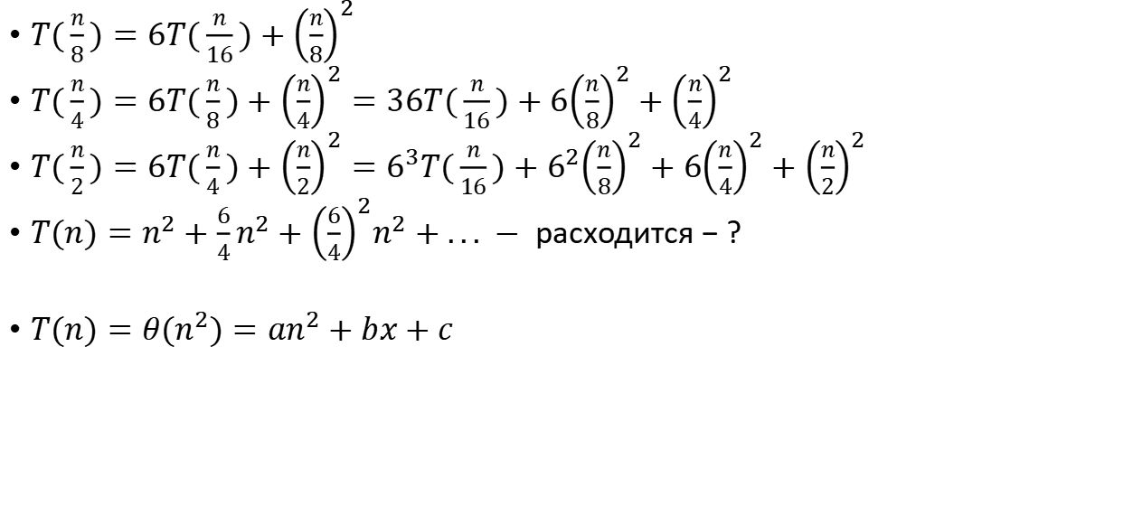
$$T(n)=6T(\frac{n}{2})+n^{2}$$
$T(\frac{n}{8})=6T(\frac{n}{16})+{\left(\frac{n}{8}\right)}^{2}$
$T(\frac{n}{4})=6T(\frac{n}{8})+{\left(\frac{n}{4}\right)}^{2}=36T(\frac{n}{16})+6{\left(\frac{n}{8}\right)}^{2}+{\left(\frac{n}{4}\right)}^{2}$
$T(\frac{n}{2})=6T(\frac{n}{4})+{\left(\frac{n}{2}\right)}^{2}=6^{3}T(\frac{n}{16})+6^{2}{\left(\frac{n}{8}\right)}^{2}+6{\left(\frac{n}{4}\right)}^{2}+{\left(\frac{n}{2}\right)}^{2}$
$T(n)=n^{2}+\frac{6}{4}n^{2}+{\left(\frac{6}{4}\right)}^{2}n^{2}+... − расходится−?$
$T(n)=θ(n^{2})=an^{2}+bx+c$

Slide 4

$$T(n)=6T(\frac{n}{2})+n^{2}$$
$T(n)=θ(n^{2})=an^{2}+bx+c$
$T(1)=a+b+c$
$T(2)=4a+2b+c=6(a+b+c)+4=6a+6b+6c+4$
$T(4)=16a+4b+c=6(4a+2b+c)+16=24a+12b+6c+16$
$T(8)=64a+8b+c=6(16a+4b+c)+64$

Slide 5
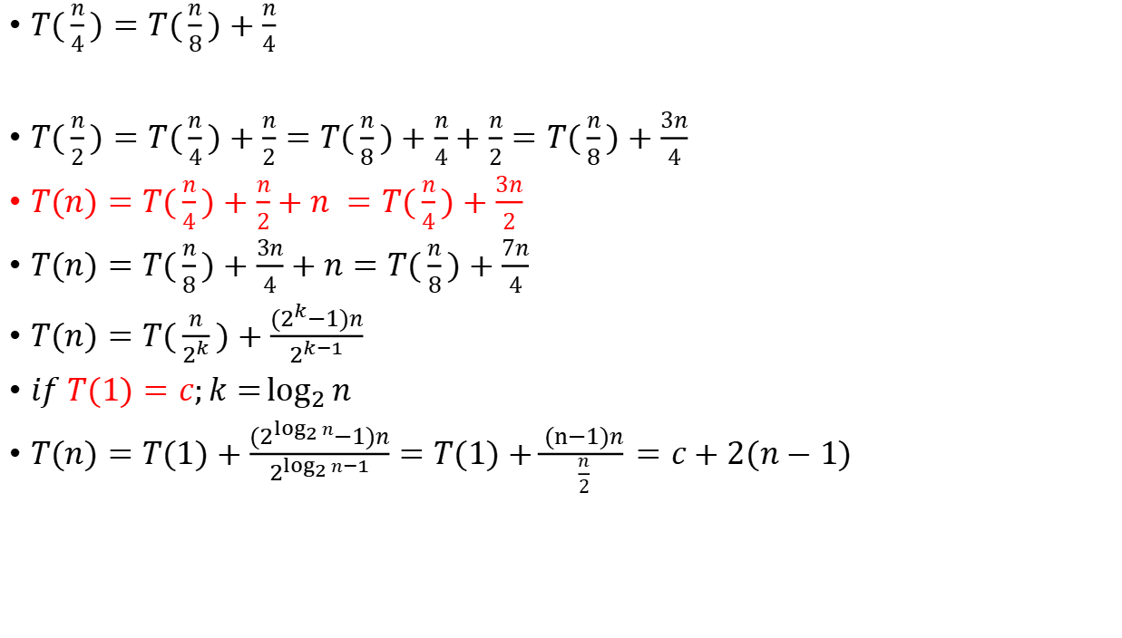
$$T(n)=T(\frac{n}{2})+n$$
$T(\frac{n}{4})=T(\frac{n}{8})+\frac{n}{4}$
$T(\frac{n}{2})=T(\frac{n}{4})+\frac{n}{2}=T(\frac{n}{8})+\frac{n}{4}+\frac{n}{2}=T(\frac{n}{8})+\frac{3n}{4}$
$T(n)=T(\frac{n}{4})+\frac{n}{2}+n =T(\frac{n}{4})+\frac{3n}{2}$
$T(n)=T(\frac{n}{8})+\frac{3n}{4}+n=T(\frac{n}{8})+\frac{7n}{4}$
$T(n)=T(\frac{n}{2^{k}})+\frac{(2^{k}−1)n}{2^{k−1}}$
$if T(1)=c;k=\log_{2}{n}$
$T(n)=T(1)+\frac{(2^{\log_{2}{n}}−1)n}{2^{\log_{2}{n}−1}}=T(1)+\frac{(n−1)n}{\frac{n}{2}}=c+2(n−1)$

Slide 6
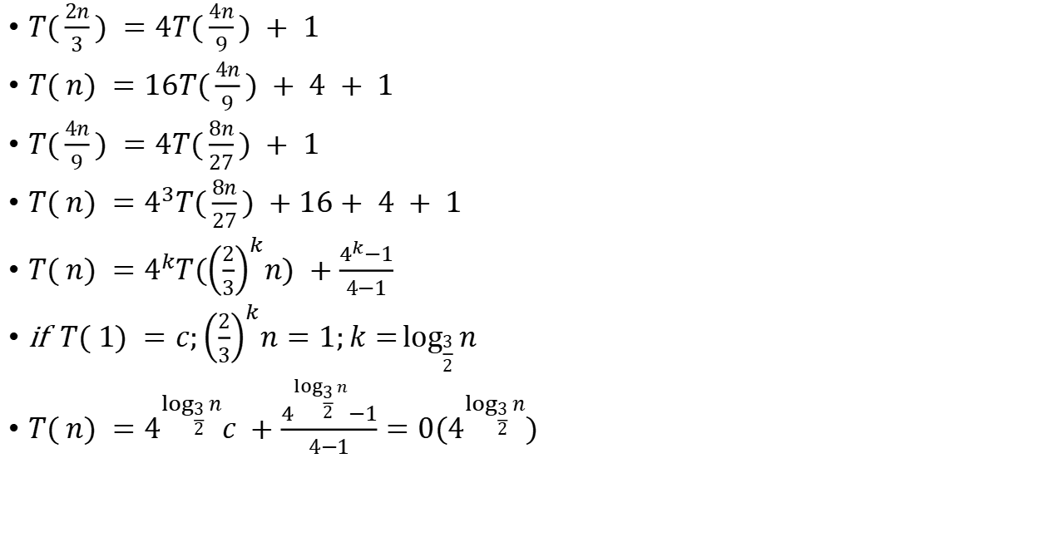

$$T( n) =4T(\frac{2n}{3}) + 1$$
$T(\frac{2n}{3}) =4T(\frac{4n}{9}) + 1$
$T( n) =16T(\frac{4n}{9}) + 4 + 1$
$T(\frac{4n}{9}) =4T(\frac{8n}{27}) + 1$
$T( n) =4^{3}T(\frac{8n}{27}) +16+ 4 + 1$
$T( n) =4^{k}T({\left(\frac{2}{3}\right)}^{k}n) +\frac{4^{k}−1}{4−1}$
if $T( 1) =c;{\left(\frac{2}{3}\right)}^{k}n=1;k=\log_{\frac{3}{2}}{n}$
$T( n) =4^{\log_{\frac{3}{2}}{n}}c +\frac{4^{\log_{\frac{3}{2}}{n}}−1}{4−1}=0(4^{\log_{\frac{3}{2}}{n}})$

Slide 7
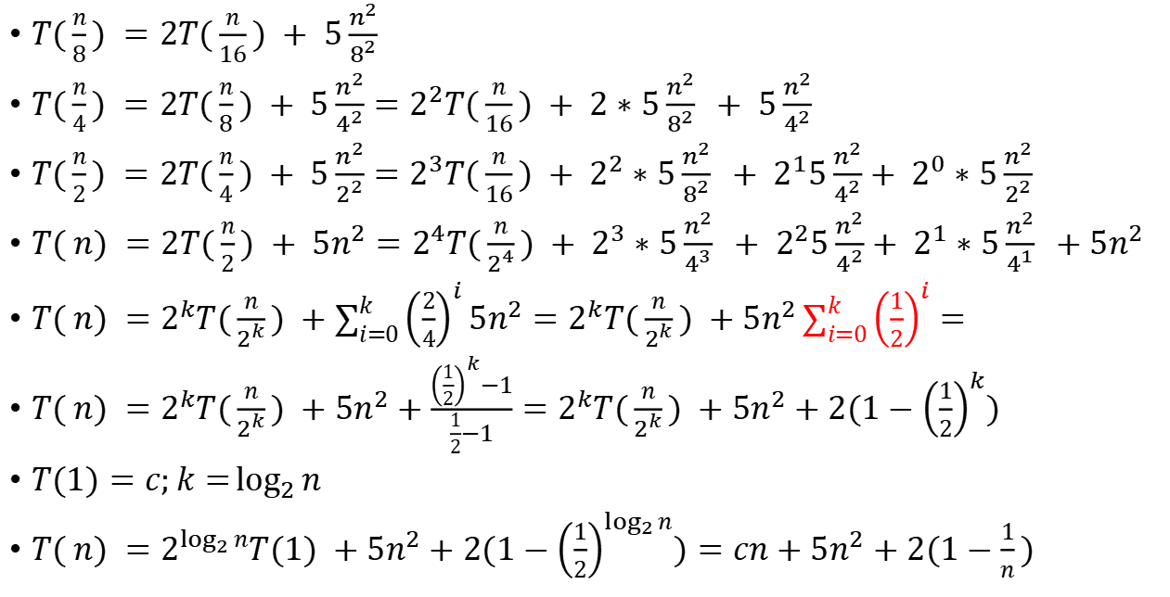
$$T( n) =2T(\frac{n}{2}) + 5n^{2}$$
$T(\frac{n}{8}) =2T(\frac{n}{16}) + 5\frac{n^{2}}{8^{2}}$
$T(\frac{n}{4}) =2T(\frac{n}{8}) + 5\frac{n^{2}}{4^{2}}=2^{2}T(\frac{n}{16}) + 2∗5\frac{n^{2}}{8^{2}} + 5\frac{n^{2}}{4^{2}}$
$T(\frac{n}{2}) =2T(\frac{n}{4}) + 5\frac{n^{2}}{2^{2}}=2^{3}T(\frac{n}{16}) + 2^{2}∗5\frac{n^{2}}{8^{2}} + 2^{1}5\frac{n^{2}}{4^{2}}+ 2^{0}∗5\frac{n^{2}}{2^{2}}$
$T( n) =2T(\frac{n}{2}) + 5n^{2}=2^{4}T(\frac{n}{2^{4}}) + 2^{3}∗5\frac{n^{2}}{4^{3}} + 2^{2}5\frac{n^{2}}{4^{2}}+ 2^{1}∗5\frac{n^{2}}{4^{1}} +5n^{2}$
$T( n) =2^{k}T(\frac{n}{2^{k}}) +\sum_{i=0}^{k}{{\left(\frac{2}{4}\right)}^{i}}5n^{2}=2^{k}T(\frac{n}{2^{k}}) +5n^{2}\sum_{i=0}^{k}{{\left(\frac{1}{2}\right)}^{i}}=$
$T( n) =2^{k}T(\frac{n}{2^{k}}) +5n^{2}+\frac{{\left(\frac{1}{2}\right)}^{k}−1}{\frac{1}{2}−1}=2^{k}T(\frac{n}{2^{k}}) +5n^{2}+2(1−{\left(\frac{1}{2}\right)}^{k})$
$T(1)=c;k=\log_{2}{n}$
$T( n) =2^{\log_{2}{n}}T(1) +5n^{2}+2(1−{\left(\frac{1}{2}\right)}^{\log_{2}{n}})=cn+5n^{2}+2(1−\frac{1}{n})$

Slide 8
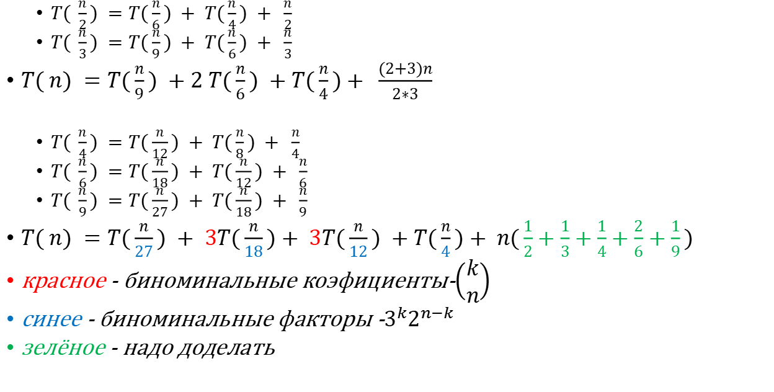
$$T( n) =T(\frac{n}{3}) + T(\frac{n}{2}) + n$$
$T( \frac{n}{2}) =T(\frac{n}{6}) + T(\frac{n}{4}) + \frac{n}{2}$
$T( \frac{n}{3}) =T(\frac{n}{9}) + T(\frac{n}{6}) + \frac{n}{3}$
$T( n) =T(\frac{n}{9}) +2 T(\frac{n}{6}) +T(\frac{n}{4})+ \frac{(2+3)n}{2∗3}$
$T( \frac{n}{4}) =T(\frac{n}{12}) + T(\frac{n}{8}) + \frac{n}{4}$
$T( \frac{n}{6}) =T(\frac{n}{18}) + T(\frac{n}{12}) + \frac{n}{6}$
$T( \frac{n}{9}) =T(\frac{n}{27}) + T(\frac{n}{18}) + \frac{n}{9}$
$T( n) =T(\frac{n}{27}) + 3T(\frac{n}{18})+ 3T(\frac{n}{12}) +T(\frac{n}{4})+ n(\frac{1}{2}+\frac{1}{3}+\frac{1}{4}+\frac{2}{6}+\frac{1}{9})$
красное - биноминальные коэфициенты-$\left(\begin{matrix}k \\ n\end{matrix}\right)$
синее - биноминальные факторы -$3^{k}2^{n−k}$
зелёное - надо доделать

Slide 9
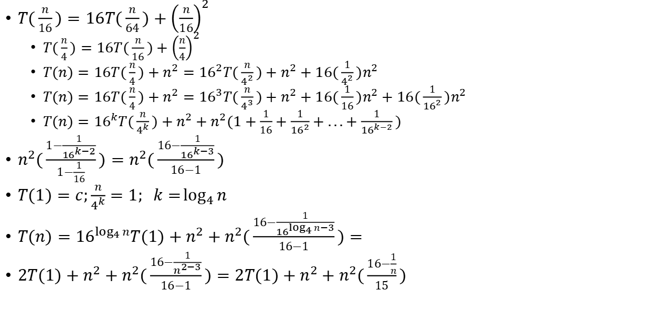
$$T(n)=16T(\frac{n}{4})+n^{2}$$
$T(\frac{n}{16})=16T(\frac{n}{64})+{\left(\frac{n}{16}\right)}^{2}$
$T(\frac{n}{4})=16T(\frac{n}{16})+{\left(\frac{n}{4}\right)}^{2}$
$T(n)=16T(\frac{n}{4})+n^{2}={16}^{2}T(\frac{n}{4^{2}})+n^{2}+16(\frac{1}{4^{2}})n^{2}$
$T(n)=16T(\frac{n}{4})+n^{2}={16}^{3}T(\frac{n}{4^{3}})+n^{2}+16(\frac{1}{16})n^{2}+16(\frac{1}{{16}^{2}})n^{2}$
$T(n)={16}^{k}T(\frac{n}{4^{k}})+n^{2}+n^{2}(1+\frac{1}{16}+\frac{1}{{16}^{2}}+...+\frac{1}{{16}^{k−2}})$
$n^{2}(\frac{1−\frac{1}{{16}^{k−2}}}{1−\frac{1}{16}})=n^{2}(\frac{16−\frac{1}{{16}^{k−3}}}{16−1})$
$T(1)=c;\frac{n}{4^{k}}=1; k=\log_{4}{n}$
$T(n)={16}^{\log_{4}{n}}T(1)+n^{2}+n^{2}(\frac{16−\frac{1}{{16}^{\log_{4}{n}−3}}}{16−1})=$
$2T(1)+n^{2}+n^{2}(\frac{16−\frac{1}{n^{2−3}}}{16−1})=2T(1)+n^{2}+n^{2}(\frac{16−\frac{1}{n}}{15})$

