Slide 2
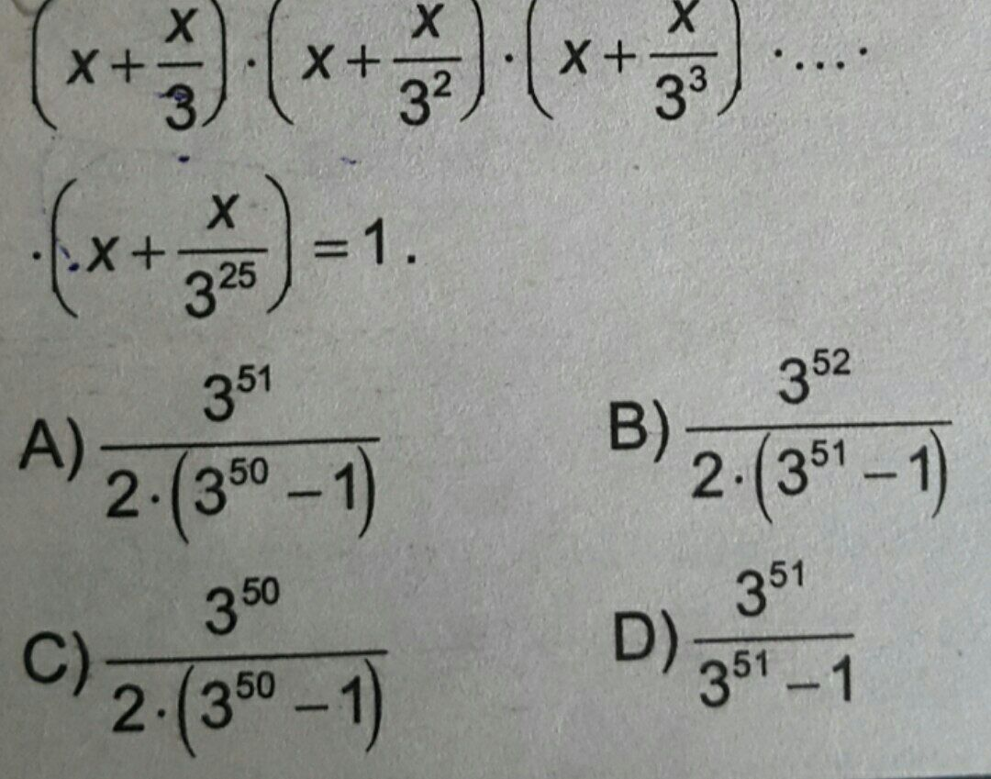

Slide 3

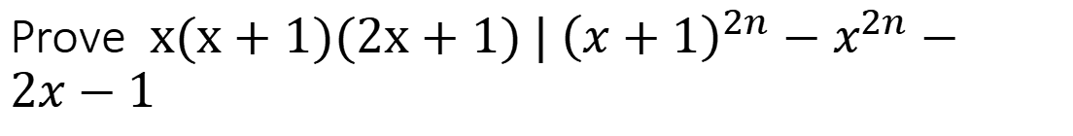
Prove $x(x+1)(2x+1) | {\left(x+1\right)}^{2n}−x^{2n}−2x−1$
$x^{4n}+2x^{n}+1−x^{2n}−2x−1=x^{4n}+2x^{n}−x^{2n}−2x$

Slide 4


$$\sqrt{1\sqrt{2\sqrt{3\sqrt{4...}}}}=L$$
lnL=$\frac{1}{2}ln1+\frac{1}{4}ln2+\frac{1}{8}ln3+...$
-lnL=$\frac{1}{2}ln\frac{1}{1}+\frac{1}{4}ln\frac{1}{2}+\frac{1}{8}ln\frac{1}{3}+..$

Slide 5

$${16}^{x^{2}+y}+{16}^{x+y^{2}}=1$$
${16}^{x^{2}+y},{16}^{x+y^{2}}<1 then$
$x^{2}+y$ and $x+y^{2}$ < 0 means
$−1<x,y<0$
suits x=-1/2, y =-1/2
further solutions - ?

Slide 6
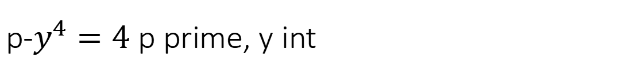
p-$y^{4}=4$ p prime, y int

Slide 7
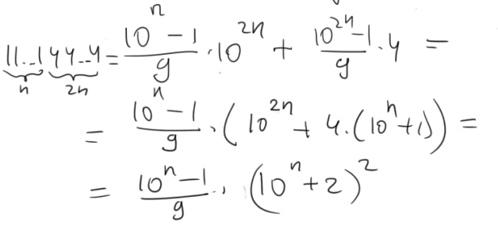
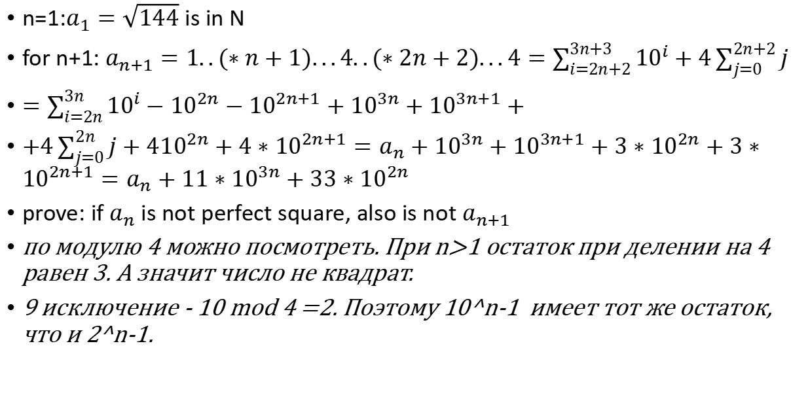
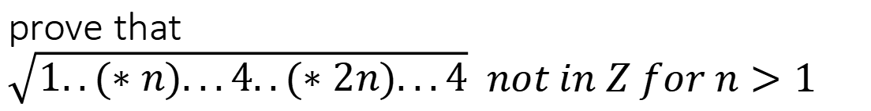
prove that $\sqrt{1..(∗n)...4..(∗2n)...4} not in Z for n>1$
n=1:$a_{1}=\sqrt{144}$ is in N
for n+1:$a_{n+1}=1..(∗n+1)...4..(∗2n+2)...4=\sum_{i=2n+2}^{3n+3}{{10}^{i}}+4\sum_{j=0}^{2n+2}{j}$
$=\sum_{i=2n}^{3n}{{10}^{i}}−{10}^{2n}−{10}^{2n+1}+{10}^{3n}+{10}^{3n+1}+$
$+4\sum_{j=0}^{2n}{j}+4{10}^{2n}+4∗{10}^{2n+1}=a_{n}+{10}^{3n}+{10}^{3n+1}+3∗{10}^{2n}+3∗{10}^{2n+1}=a_{n}+11∗{10}^{3n}+33∗{10}^{2n}$
prove: if $a_{n}$ is not perfect square, also is not $a_{n+1}$
по модулю 4 можно посмотреть. При n>1 остаток при делении на 4 равен 3. А значит число не квадрат.
9 исключение - 10 mod 4 =2. Поэтому 10^n-1 имеет тот же остаток, что и 2^n-1.

Slide 8

$$a^{2}+b^{2}+c^{2}≥ab+ac+bc$$

Slide 9
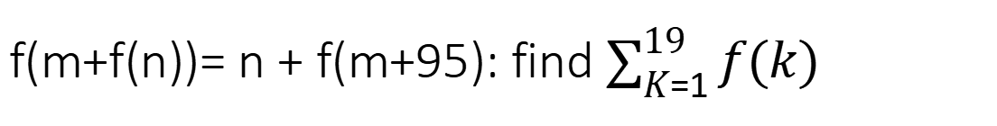
f(m+f(n))= n + f(m+95): find $\sum_{K=1}^{19}{f(k)}$
m =0: f(f(n))=n+f(95)
n = 95: f(m+f(95))= 95+f(m+95)
f(f(95))= 95+f(95)

Slide 10
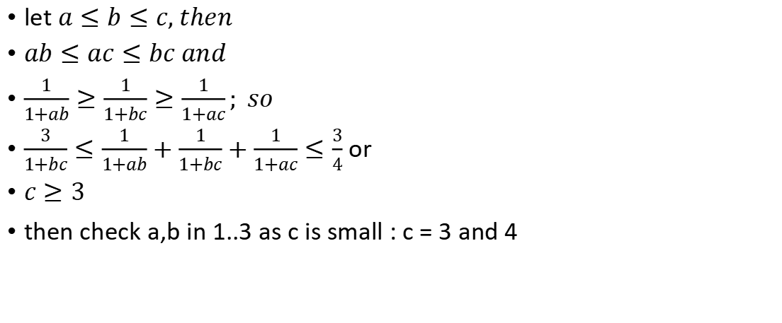

$$\frac{1}{1+ab}+\frac{1}{1+bc}+\frac{1}{1+ac}≤\frac{3}{4}$$
let $a≤b≤c, then$
$ab≤ac≤bc and$
$\frac{1}{1+ab}≥\frac{1}{1+bc}≥\frac{1}{1+ac}; so$
$\frac{3}{1+bc}≤\frac{1}{1+ab}+\frac{1}{1+bc}+\frac{1}{1+ac}≤\frac{3}{4}$ or
$c≥3$
then check a,b in 1..3 as c is small : c = 3 and 4

Slide 11
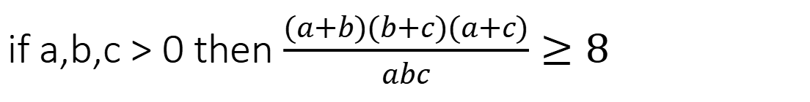
if a,b,c > 0 then $\frac{(a+b)(b+c)(a+c)}{abc}≥8$

Slide 12
average distance between 2 points in square

Slide 13
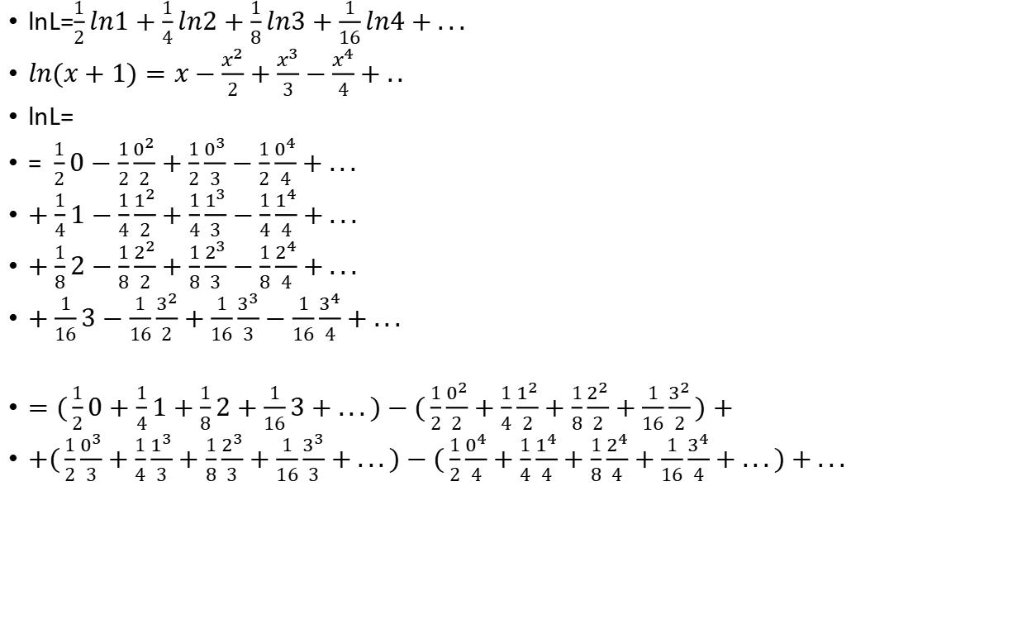
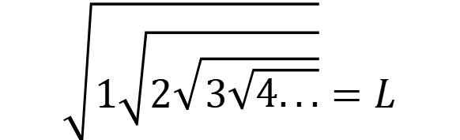
$$\sqrt{1\sqrt{2\sqrt{3\sqrt{4...}}}}=L$$
lnL=$\frac{1}{2}ln1+\frac{1}{4}ln2+\frac{1}{8}ln3+\frac{1}{16}ln4+...$
$ln(x+1)=x−\frac{x^{2}}{2}+\frac{x^{3}}{3}−\frac{x^{4}}{4}+..$
lnL=
= $\frac{1}{2}0−\frac{1}{2}\frac{0^{2}}{2}+\frac{1}{2}\frac{0^{3}}{3}−\frac{1}{2}\frac{0^{4}}{4}+...$
$+\frac{1}{4}1−\frac{1}{4}\frac{1^{2}}{2}+\frac{1}{4}\frac{1^{3}}{3}−\frac{1}{4}\frac{1^{4}}{4}+...$
$+\frac{1}{8}2−\frac{1}{8}\frac{2^{2}}{2}+\frac{1}{8}\frac{2^{3}}{3}−\frac{1}{8}\frac{2^{4}}{4}+...$
$+\frac{1}{16}3−\frac{1}{16}\frac{3^{2}}{2}+\frac{1}{16}\frac{3^{3}}{3}−\frac{1}{16}\frac{3^{4}}{4}+...$
$=(\frac{1}{2}0+\frac{1}{4}1+\frac{1}{8}2+\frac{1}{16}3+...)−(\frac{1}{2}\frac{0^{2}}{2}+\frac{1}{4}\frac{1^{2}}{2}+\frac{1}{8}\frac{2^{2}}{2}+\frac{1}{16}\frac{3^{2}}{2})+$
$+(\frac{1}{2}\frac{0^{3}}{3}+\frac{1}{4}\frac{1^{3}}{3}+\frac{1}{8}\frac{2^{3}}{3}+\frac{1}{16}\frac{3^{3}}{3}+...)−(\frac{1}{2}\frac{0^{4}}{4}+\frac{1}{4}\frac{1^{4}}{4}+\frac{1}{8}\frac{2^{4}}{4}+\frac{1}{16}\frac{3^{4}}{4}+...)+...$

Slide 14
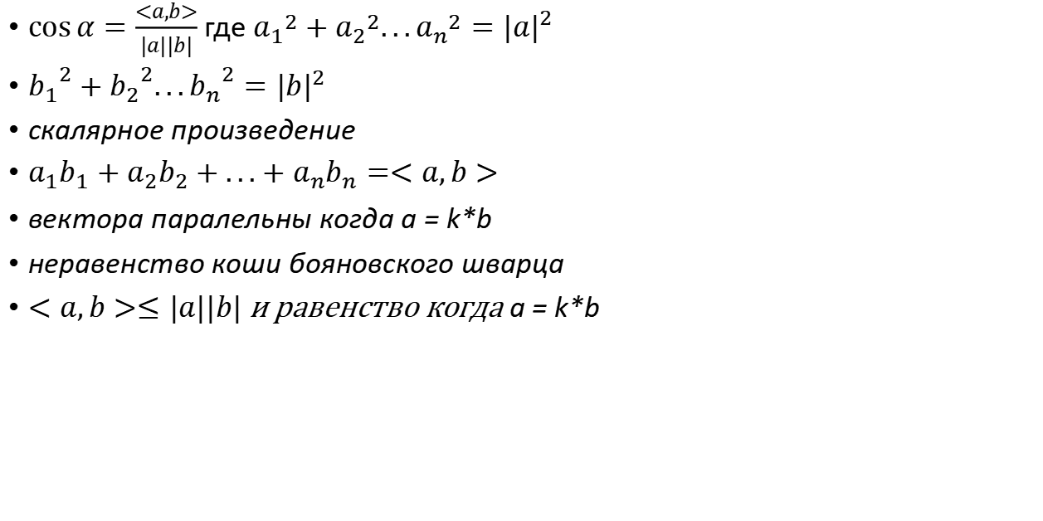
куда это девать
$\cos{α}=\frac{<a,b>}{|a||b|}$ где ${a_{1}}^{2}+{a_{2}}^{2}...{a_{n}}^{2}={|a|}^{2}$
${b_{1}}^{2}+{b_{2}}^{2}...{b_{n}}^{2}={|b|}^{2}$
скалярное произведение
$a_{1}b_{1}+a_{2}b_{2}+...+a_{n}b_{n}=<a,b>$
вектора паралельны когда a = k*b
неравенство коши бояновского шварца
$<a,b>≤|a||b|$ и равенство когда a = k*b

Slide 15

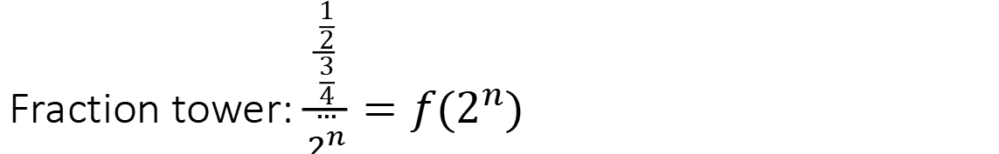
Fraction tower: $\frac{\frac{\frac{1}{2}}{\frac{3}{4}}}{\begin{aligned}... \\ 2^{n}\end{aligned}}=f(2^{n})$
Lets see what elements go top - T and what go down:
$\frac{T_{1}=1}{D_{2}=2}=>\frac{\frac{T}{D}}{\frac{D_{3}=3}{T_{4}=4}}$ we invert sequence of $2^{n}$
number | Top/down | bit representation-1 | bit count | Is bit count Even?
1 | T | 0 | 0 | Y
2 | D | 1 | 1 | N
3 | D | 10 | 1 | N
4 | T | 11 | 2 | Y
5 | D | 100 | 1 | N
6 | T | 101 | 2 | Y
7 | T | 110 | 2 | Y
8 | D | 111 | 3 | N
9 | D | 1000 | 1 | N

Slide 16
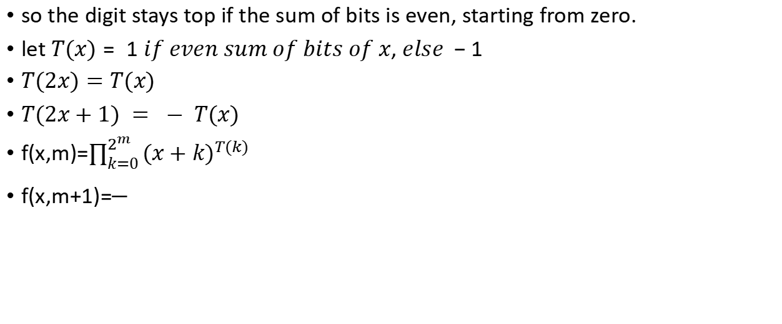
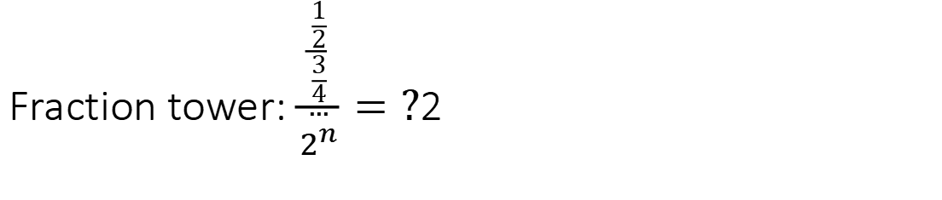
Fraction tower: $\frac{\frac{\frac{1}{2}}{\frac{3}{4}}}{\begin{aligned}... \\ 2^{n}\end{aligned}}=?$2
so the digit stays top if the sum of bits is even, starting from zero.
let $T(x)= 1 if even sum of bits of x, else −1$
$T(2x)=T(x)$
$T(2x+1) = − T(x)$
f(x,m)=$\prod_{k=0}^{2^{m}}{{(x+k)}^{T(k) }}$
f(x,m+1)=

