Slide 2


Slide 3
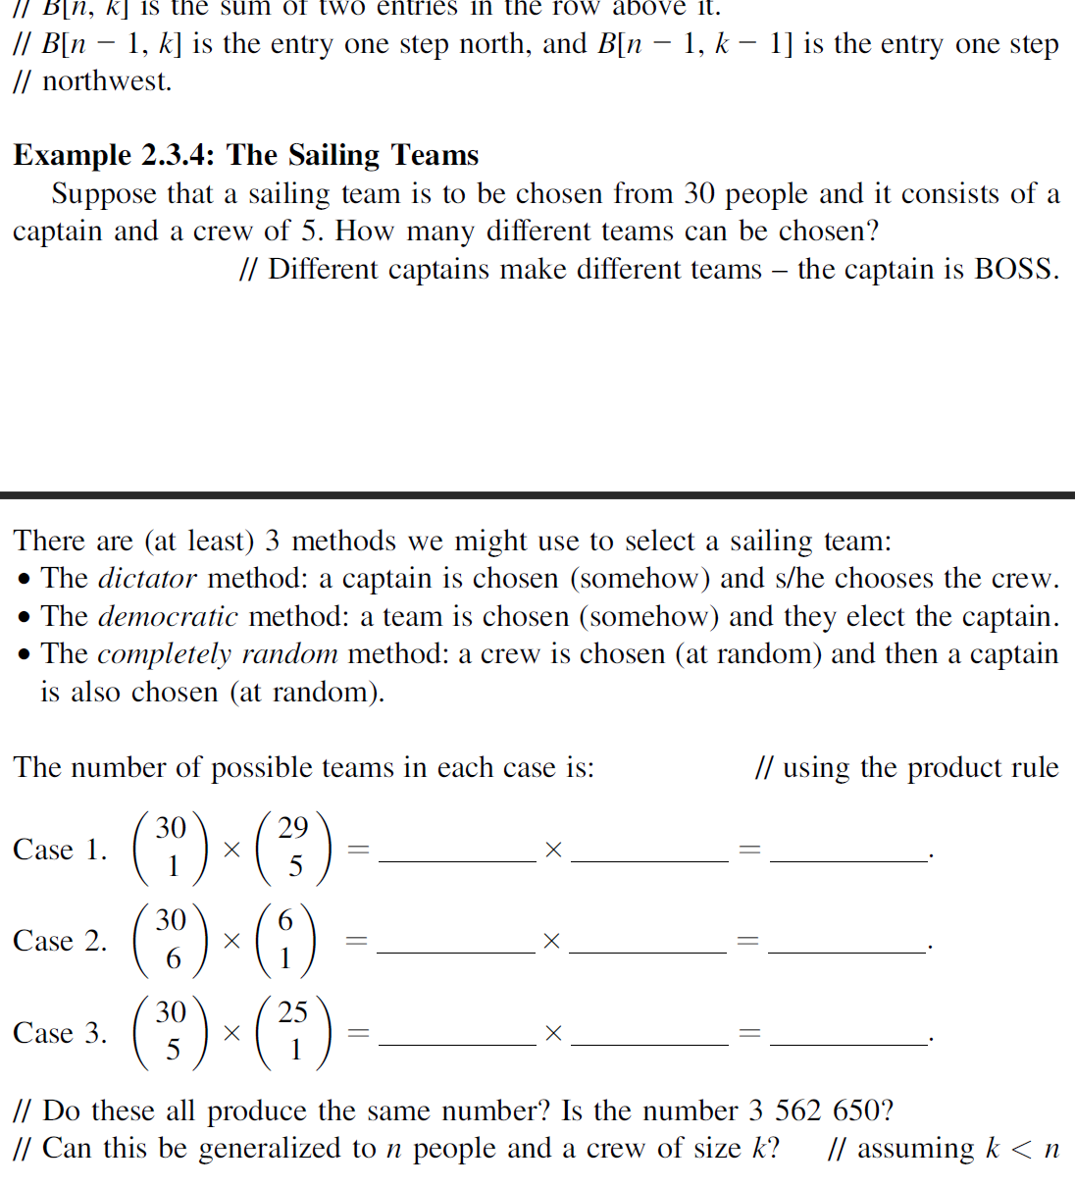

Slide 4

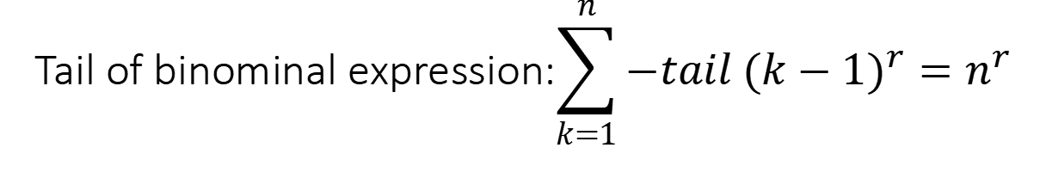
Tail of binominal expression:$$\sum_{k=1}^{n}{−tail {(k−1)}^{r}}=n^{r}$$
where $tail {(k−1)}^{r}$ =${(k−1)}^{r}$-$k^{r}$so
$\sum_{k=1}^{n}{−tail {(k−1)}^{r}}=\sum_{k=1}^{n}{k^{r}−{(k−1)}^{r}}$
$= 1^{r}+2^{r}+3^{r}+...+{(n−1)}^{r}+n^{r}$
$−(0^{r}+1^{r}+2^{r}+3^{r}+...+{(n−1)}^{r})=n^{r}$

