Slide 2

Content
Root of comple$$x:\sqrt{a+bi}$$

Slide 3
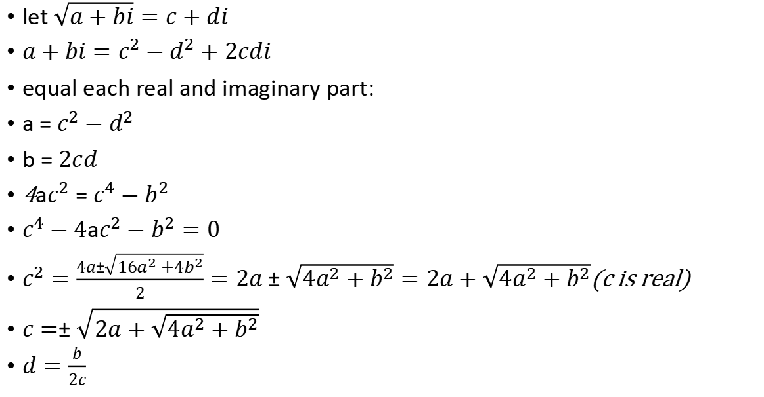
Root of comple$x:\sqrt{a+bi}$
let $\sqrt{a+bi}=c+di$
$a+bi=c^{2}−d^{2}+2cdi$
equal each real and imaginary part:
a = $c^{2}−d^{2}$
b = $2cd$
4a$c^{2}$ = $c^{4}−b^{2}$
$c^{4}−4ac^{2}−b^{2}=0$
$c^{2}=\frac{4a±\sqrt{16a^{2}+4b^{2}}}{2}=2a±\sqrt{4a^{2}+b^{2}}=2a+\sqrt{4a^{2}+b^{2}}$(c is real)
$c=±\sqrt{2a+\sqrt{4a^{2}+b^{2}}}$
$d=\frac{b}{2c}$

