Slide 2
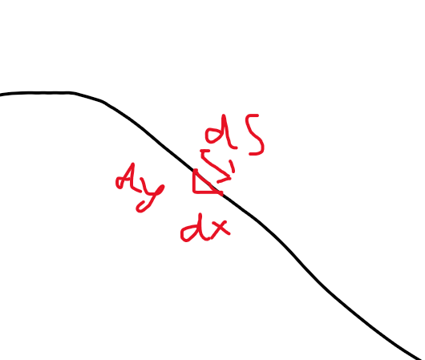
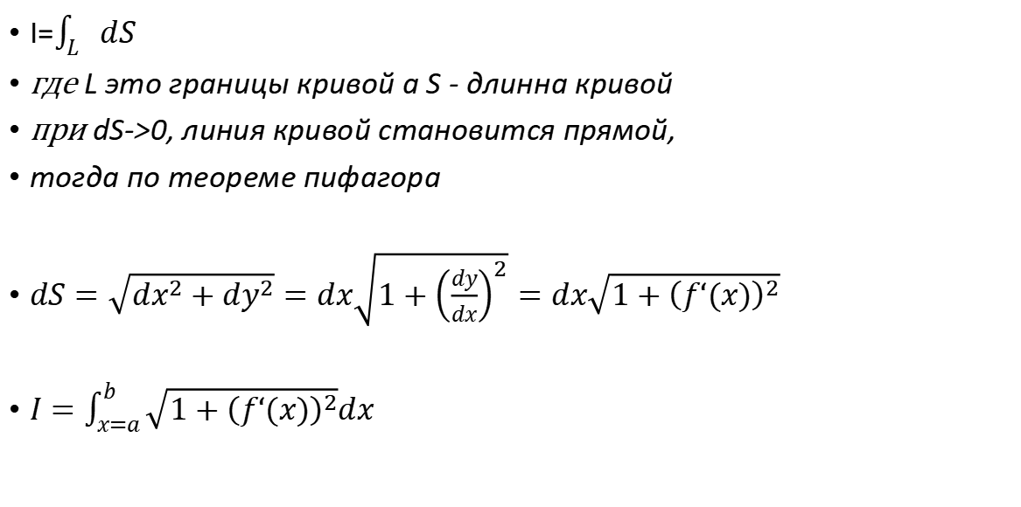
Path integral

Slide 3
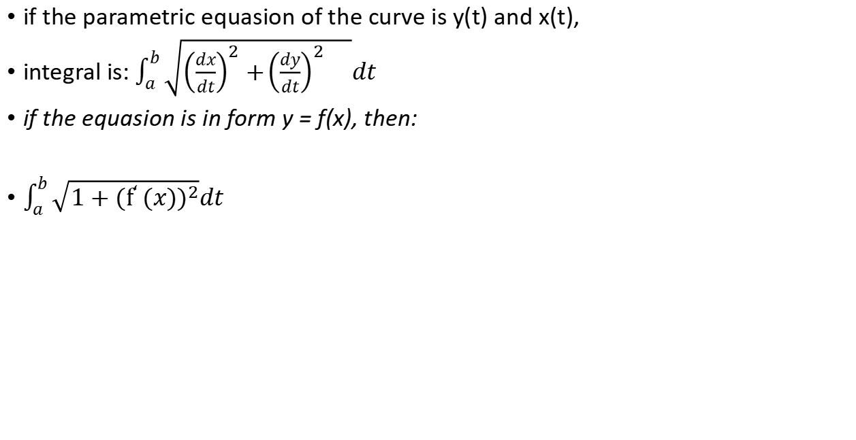
Integral along curve

Slide 4

Dif. Equasion: derivative eqhals arclength

Slide 5
Area under the curve equals to the arc length?

Slide 6
Integral over plane?

