Slide 2
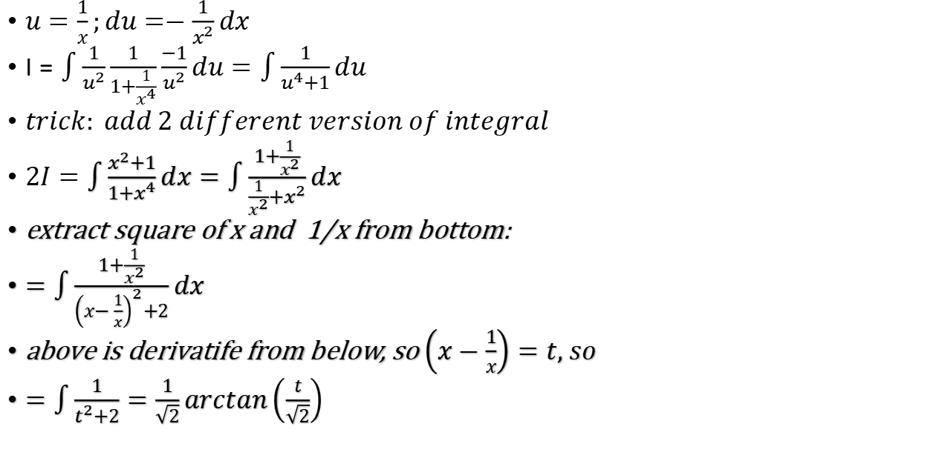

$$\int{\frac{x^{2}}{1+x^{4}}dx}=I$$
$u=\frac{1}{x};du=−\frac{1}{x^{2}}dx$
$I=\int{\frac{1}{u^{2}}\frac{1}{1+\frac{1}{x^{4}}}\frac{−1}{u^{2}}du}=\int{\frac{1}{u^{4}+1}}du$
$trick: add 2 different version of integral$
$2I=\int{\frac{x^{2}+1}{1+x^{4}}dx}=\int{\frac{1+\frac{1}{x^{2}}}{\frac{1}{x^{2}}+x^{2}}dx}$
extract square of x and 1/x from bottom:
$=\int{\frac{1+\frac{1}{x^{2}}}{{\left(x−\frac{1}{x}\right)}^{2}+2}dx}$
above is derivatife from below, so $\left(x−\frac{1}{x}\right)=t, so$
$=\int{\frac{1}{t^{2}+2}=\frac{1}{\sqrt{2}}}arctan\left(\frac{t}{\sqrt{2}}\right)$

