Slide 2

substitution examples
$\int{e^{\sqrt{x}}dx}$
$\sqrt{x}=t$
$\frac{dx}{2\sqrt{x}}=dt$, $dx=2\sqrt{x}dt=2tdt$
main=$2\int{e^{t}tdt=2(te^{t}−\int{e^{t}dt})=}2(te^{t}−e^{t})=2e^{\sqrt{x}}(\sqrt{x}−1)$
$\int{\frac{x^{2}}{{\left(1−x\right)}^{100}}dx}$
t = 1-x; x = 1-t; dx = -dt
$−\int{\frac{{\left(1−t\right)}^{2}}{t^{100}}dt}=−\int{\frac{1−2t+t^{2}}{t^{100}}dt}$
now you can split easily:
(main)= $−\int{\frac{1}{t^{100}}dt}−\int{\frac{−2}{t^{99}}dt}−\int{\frac{1}{t^{98}}dt}$

Slide 3
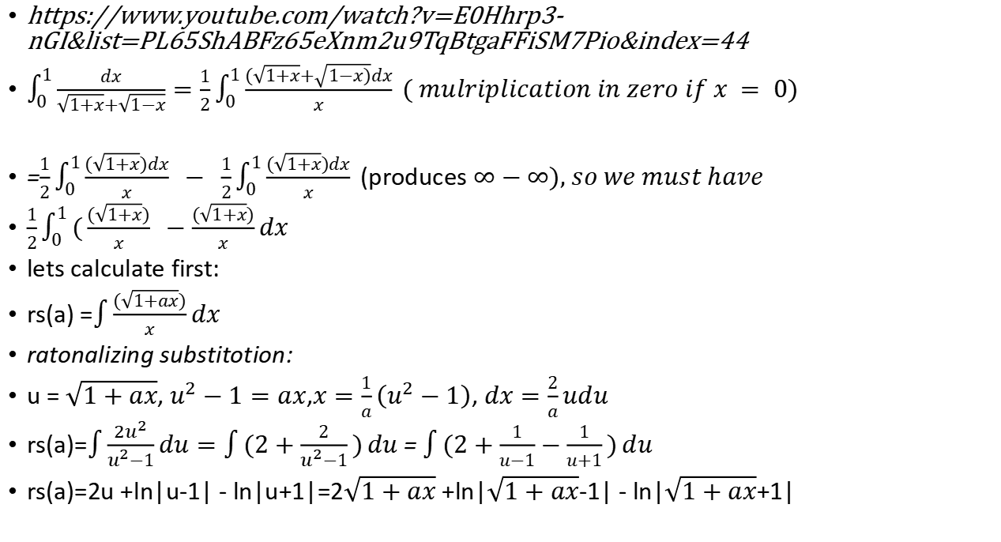
A very unfriendly integral problem!
https://www.youtube.com/watch?v=E0Hhrp3-nGI&list=PL65ShABFz65eXnm2u9TqBtgaFFiSM7Pio&index=44
$\int_{0}^{1}{\frac{dx}{\sqrt{1+x}+\sqrt{1−x}}}=\frac{1}{2}\int_{0}^{1}{\frac{(\sqrt{1+x}+\sqrt{1−x)}dx}{x}} ( mulriplication in zero if x = 0)$
=$\frac{1}{2}\int_{0}^{1}{\frac{(\sqrt{1+x})dx}{x}} − \frac{1}{2}\int_{0}^{1}{\frac{(\sqrt{1+x})dx}{x}}$(produces $∞−∞), so we must have$
$\frac{1}{2}\int_{0}^{1}{(\frac{(\sqrt{1+x})}{x}} −\frac{(\sqrt{1+x})}{x}dx$
lets calculate first:
rs(a) =$\int{\frac{(\sqrt{1+ax})}{x}}dx$
ratonalizing substitotion:
u = $\sqrt{1+ax}$, $u^{2}−1=ax$,$x=\frac{1}{a}\left(u^{2}−1\right)$, $dx=\frac{2}{a}udu$
rs(a)=$\int{\frac{{2u}^{2}}{u^{2}−1}}du=\int{(2+\frac{2}{u^{2}−1})}du$ = $\int{(2+\frac{1}{u−1}−\frac{1}{u+1})}du$
rs(a)=2u +ln|u-1| - ln|u+1|=2$\sqrt{1+ax}$ +ln|$\sqrt{1+ax}$-1| - ln|$\sqrt{1+ax}$+1|

Slide 4
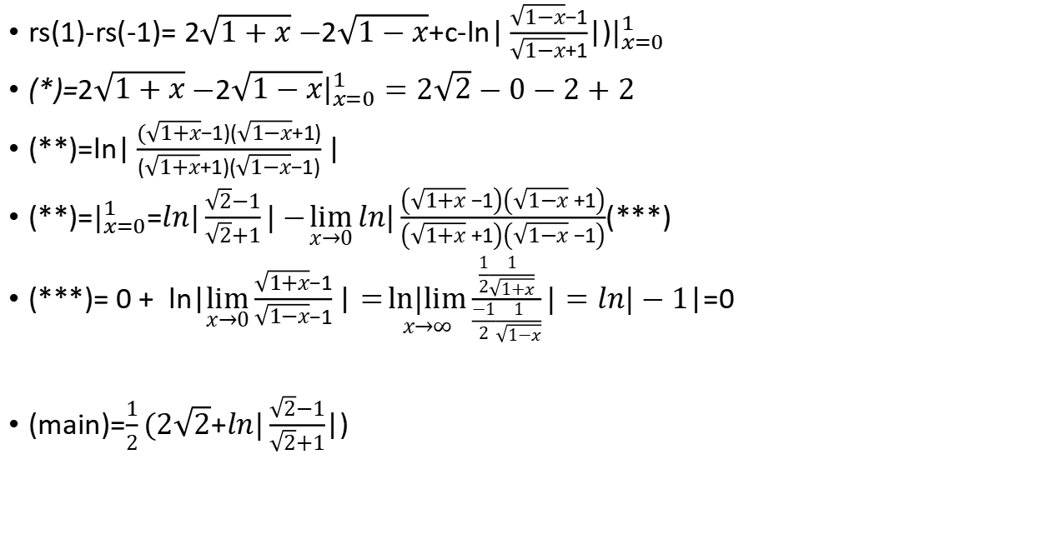
A very unfriendly integral problem! 2
rs(1)-rs(-1)= 2$\sqrt{1+x}−$2$\sqrt{1−x}$+c-ln$|\frac{\sqrt{1−x}−1}{\sqrt{1−x}+1}$|)$|_{x=0}^{1}$
(*)=2$\sqrt{1+x}−$2$\sqrt{1−x}|_{x=0}^{1}=2\sqrt{2}−0−2+2$
(**)=$ln|\frac{(\sqrt{1+x}−1)(\sqrt{1−x}+1)}{(\sqrt{1+x}+1)(\sqrt{1−x}−1)}|$
(**)=$|_{x=0}^{1}$=$ln|\frac{\sqrt{2}−1}{\sqrt{2}+1}|−\lim_{x→0}{ln|\frac{\left(\sqrt{1+x}−1\right)\left(\sqrt{1−x}+1\right)}{\left(\sqrt{1+x}+1\right)\left(\sqrt{1−x}−1\right)}}$(***)
(***)= $0+ ln|\lim_{x→0}{\frac{\sqrt{1+x}−1}{\sqrt{1−x}−1}|}=\underset{x→∞}{ln|lim}{\frac{\frac{1}{2}\frac{1}{\sqrt{1+x}}}{\frac{−1}{2}\frac{1}{\sqrt{1−x}}}}|=ln|−1$|=0
(main)=$\frac{1}{2}(2\sqrt{2}$+$ln|\frac{\sqrt{2}−1}{\sqrt{2}+1}$|)

Slide 5
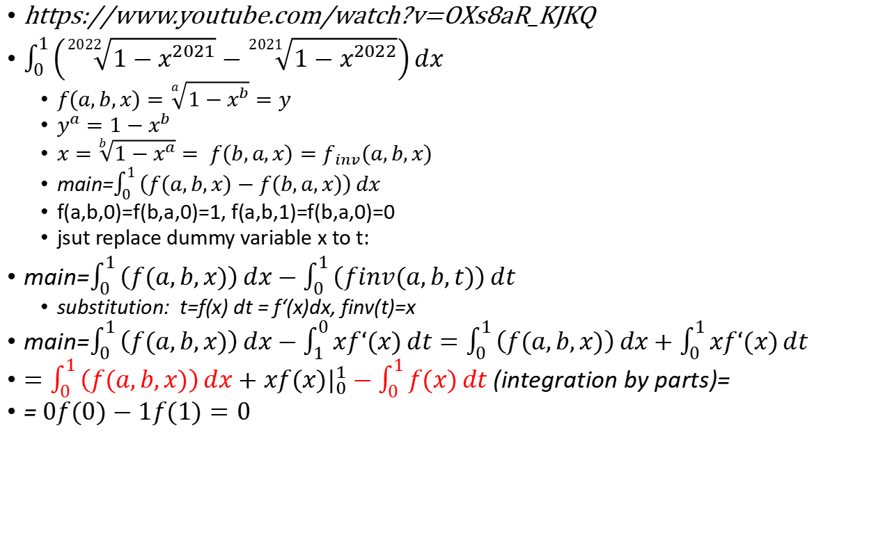
Just solve a much more general problem...
https://www.youtube.com/watch?v=OXs8aR_KJKQ
$\int_{0}^{1}{\left(\sqrt[2022]{1−x^{2021}}−\sqrt[2021]{1−x^{2022}}\right)}dx$
$f(a,b,x)=\sqrt[a]{1−x^{b}}=y$
$y^{a}=1−x^{b}$
$x=\sqrt[b]{1−x^{a}}= f(b,a,x)=f_{inv}(a,b,x)$
main=$\int_{0}^{1}{\left(f(a,b,x)−f(b,a,x)\right)}dx$
f(a,b,0)=f(b,a,0)=1, f(a,b,1)=f(b,a,0)=0
jsut replace dummy variable x to t:
main=$\int_{0}^{1}{\left(f(a,b,x)\right)}dx−\int_{0}^{1}{\left(finv(a,b,t)\right)}dt$
substitution: t=f(x) dt = f‘(x)dx, finv(t)=x
main=$\int_{0}^{1}{\left(f(a,b,x)\right)}dx−\int_{1}^{0}{xf‘(x)}dt=\int_{0}^{1}{\left(f(a,b,x)\right)}dx+\int_{0}^{1}{xf‘(x)}dt$
$=\int_{0}^{1}{\left(f(a,b,x)\right)}dx+xf(x)|_{0}^{1}−\int_{0}^{1}{f(x)}dt$ (integration by parts)=
= $0f(0)−1f(1)=0$

Slide 6
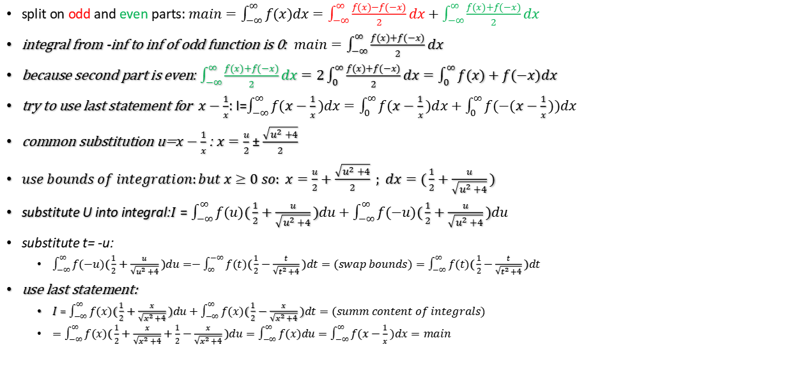

$$\int_{−∞}^{∞}{f(x)dx}=\int_{−∞}^{∞}{f(x−\frac{1}{x}})dx$$
split on odd and even parts: $main=\int_{−∞}^{∞}{f(x)dx}=\int_{−∞}^{∞}{\frac{f(x)−f(−x)}{2}dx}+\int_{−∞}^{∞}{\frac{f(x)+f(−x)}{2}dx}$
integral from -inf to inf of odd function is 0: $main=\int_{−∞}^{∞}{\frac{f(x)+f(−x)}{2}dx}$
because second part is even: $\int_{−∞}^{∞}{\frac{f(x)+f(−x)}{2}dx}=2\int_{0}^{∞}{\frac{f(x)+f(−x)}{2}dx}=\int_{0}^{∞}{f(x)+f(−x)dx}$
try to use last statement for $x−\frac{1}{x}$: I=$\int_{−∞}^{∞}{f(x−\frac{1}{x})dx}=\int_{0}^{∞}{f(x−\frac{1}{x})dx}+\int_{0}^{∞}{f(−(x−\frac{1}{x}))dx}$
common substitution u=$x−\frac{1}{x}$ : $x=\frac{u}{2}±\frac{\sqrt{u^{2}+4}}{2}$
$use bounds of integration:but x≥0 so: x=\frac{u}{2}+\frac{\sqrt{u^{2}+4}}{2} ; dx=(\frac{1}{2}+\frac{u}{\sqrt{u^{2}+4}})$
substitute U into integral:$I=\int_{−∞}^{∞}{f(u)(\frac{1}{2}+\frac{u}{\sqrt{u^{2}+4}})du}+\int_{−∞}^{∞}{f(−u)(\frac{1}{2}+\frac{u}{\sqrt{u^{2}+4}})du}$
substitute t= -u:
$\int_{−∞}^{∞}{f(−u)(\frac{1}{2}+\frac{u}{\sqrt{u^{2}+4}})du}=−\int_{∞}^{−∞}{f(t)(\frac{1}{2}−\frac{t}{\sqrt{t^{2}+4}})dt}=(swap bounds)=\int_{−∞}^{∞}{f(t)(\frac{1}{2}−\frac{t}{\sqrt{t^{2}+4}})dt}$
use last statement:
$I=\int_{−∞}^{∞}{f(x)(\frac{1}{2}+\frac{x}{\sqrt{x^{2}+4}})du}+\int_{−∞}^{∞}{f(x)(\frac{1}{2}−\frac{x}{\sqrt{x^{2}+4}})dt}=(summ content of integrals)$
$=\int_{−∞}^{∞}{f(x)(\frac{1}{2}+\frac{x}{\sqrt{x^{2}+4}}+\frac{1}{2}−\frac{x}{\sqrt{x^{2}+4}})du}=\int_{−∞}^{∞}{f(x)du}=\int_{−∞}^{∞}{f(x−\frac{1}{x})dx}=main$

Slide 7
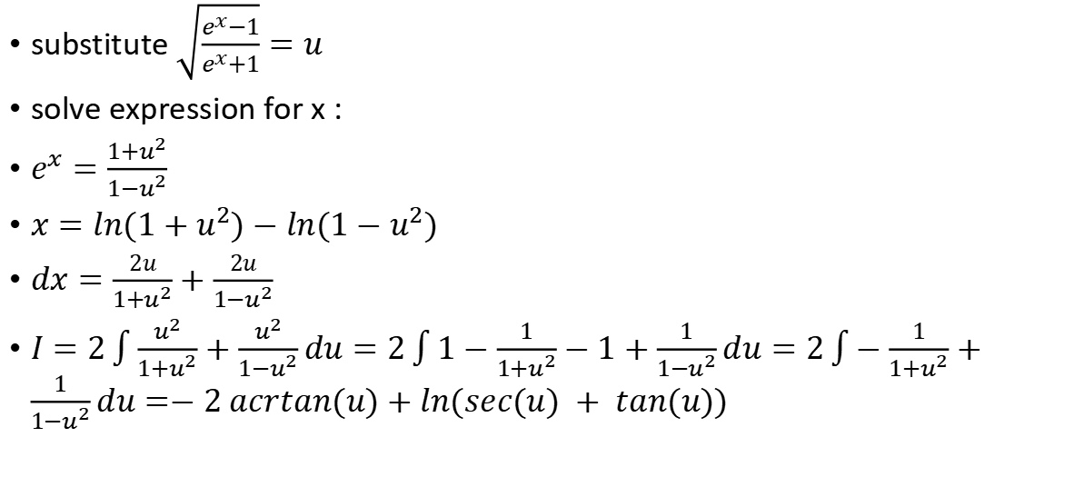

$$I=\int{\sqrt{\frac{e^{x}−1}{e^{x}+1}}dx}$$
substitute $\sqrt{\frac{e^{x}−1}{e^{x}+1}}=u$
solve expression for x :
$e^{x}=\frac{1+u^{2}}{1−u^{2}}$
$x=ln(1+u^{2})−ln(1−u^{2})$
$dx=\frac{2u}{1+u^{2}}+\frac{2u}{1−u^{2}}$
$I=2\int{\frac{u^{2}}{1+u^{2}}}+\frac{u^{2}}{1−u^{2}}du=2\int{1−\frac{1}{1+u^{2}}}−1+\frac{1}{1−u^{2}}du=2\int{−\frac{1}{1+u^{2}}}+\frac{1}{1−u^{2}}du=−2 acrtan(u)+ln(sec(u) + tan(u))$

