Slide 1
Awsome integrall solutions

Slide 2
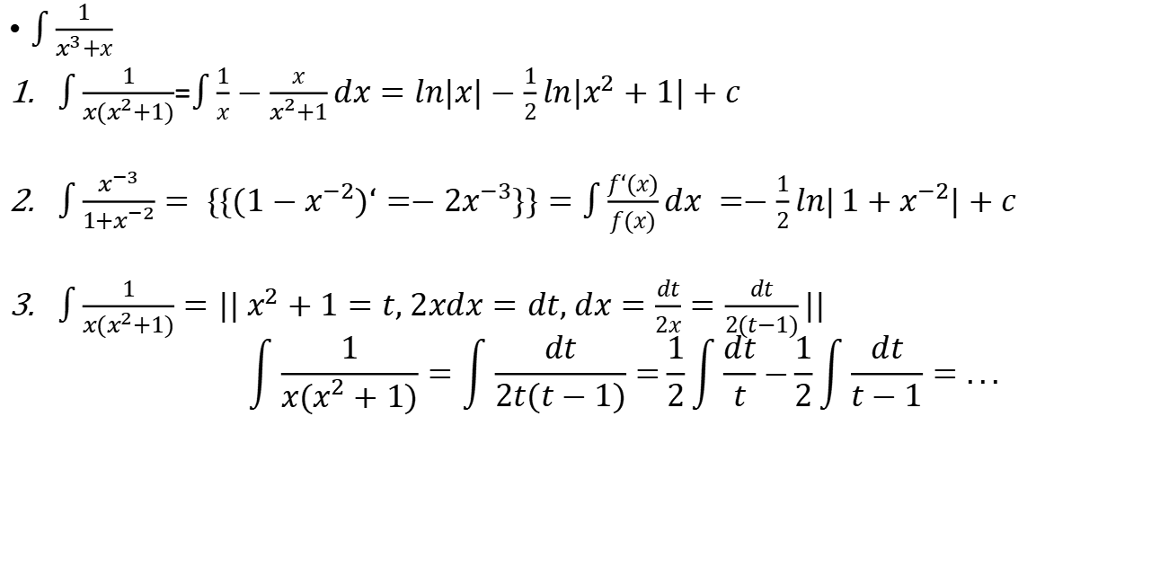
One integral in many ways :
$\int{\frac{1}{x^{3}+x}}$
$\int{\frac{1}{{x(x}^{2}+1)}}$=$\int{\frac{1}{x}−\frac{x}{x^{2}+1}dx=ln|x|−\frac{1}{2}}ln|x^{2}+1|+c$
$\int{\frac{x^{−3}}{1+x^{−2}}}= \{\{{(1−x}^{−2})‘=−2x^{−3}\}\}=\int{\frac{f‘(x)}{f(x)}dx =−\frac{1}{2}ln|}1+x^{−2}|+c$
$\int{\frac{1}{{x(x}^{2}+1)}}=|| x^{2}+1=t, 2xdx=dt, dx=\frac{dt}{2x}=\frac{dt}{2(t−1)}||$ $$\int{\frac{1}{{x(x}^{2}+1)}}=\int{\frac{dt}{2t(t−1)}=}\frac{1}{2}\int{\frac{dt}{t}−}\frac{1}{2}\int{\frac{dt}{t−1}=...}$$

Slide 3

champion integral :
$\int_{e}^{π}{\frac{1}{x}}\sqrt{\frac{1+x}{1−x}}ln\frac{2x^{2}+2x+1}{2x^{2}+2x+1}dx$
dexomposition n odd/even terms =
f(x) = $\frac{f(x)+f(−x)}{2}+\frac{f(x)−f(−x)}{2}: even(x) + odd(x)$

Slide 4
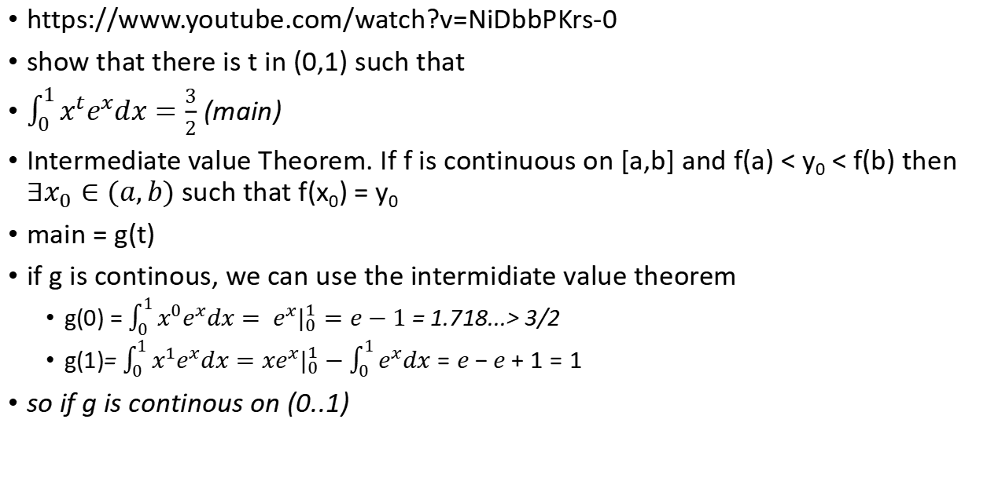
a nice "advanced" calculus problem
https://www.youtube.com/watch?v=NiDbbPKrs-0
show that there is t in (0,1) such that
$\int_{0}^{1}{x^{t}e^{x}dx}=\frac{3}{2}$ (main)
Intermediate value Theorem. If f is continuous on [a,b] and f(a) < y₀ < f(b) then $∃x_{0}∈(a,b)$ such that f(x₀) = y₀
main = g(t)
if g is continous, we can use the intermidiate value theorem
g(0) = $\int_{0}^{1}{x^{0}e^{x}dx}= {e^{x}|}_{0}^{1}=e−1$ = 1.718...> 3/2
g(1)= $\int_{0}^{1}{x^{1}e^{x}dx}={{xe}^{x}|}_{0}^{1}−\int_{0}^{1}{e^{x}dx}=e−e+1=1$
so if g is continous on (0..1)

Slide 5
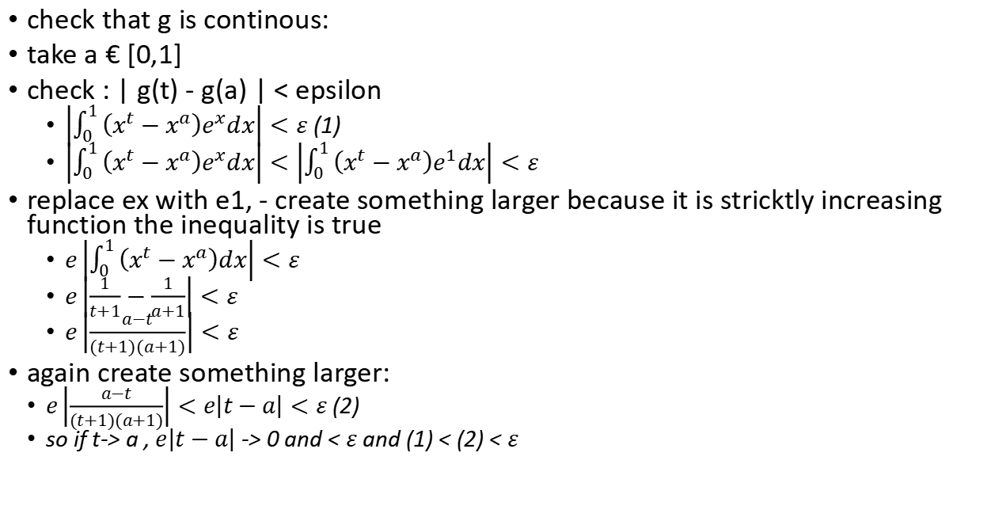
check that g is continous:
take a € [0,1]
check : | g(t) - g(a) | < epsilon
$\left|\int_{0}^{1}{\left(x^{t}−x^{a}\right)e^{x}dx}\right|<ε$ (1)
$\left|\int_{0}^{1}{\left(x^{t}−x^{a}\right)e^{x}dx}\right|<\left|\int_{0}^{1}{\left(x^{t}−x^{a}\right)e^{1}dx}\right|<ε$
replace ex with e1, - create something larger because it is stricktly increasing function the inequality is true
$e\left|\int_{0}^{1}{\left(x^{t}−x^{a}\right)dx}\right|<ε$
$e\left|\frac{1}{t+1}−\frac{1}{a+1}\right|<ε$
$e\left|\frac{a−t}{(t+1)(a+1)}\right|<ε$
again create something larger:
$e\left|\frac{a−t}{(t+1)(a+1)}\right|<e\left|t−a\right|<ε$ (2)
so if t-> a , $e\left|t−a\right|$ -> 0 and < $ε$ and (1) < (2) < $ε$

Slide 7
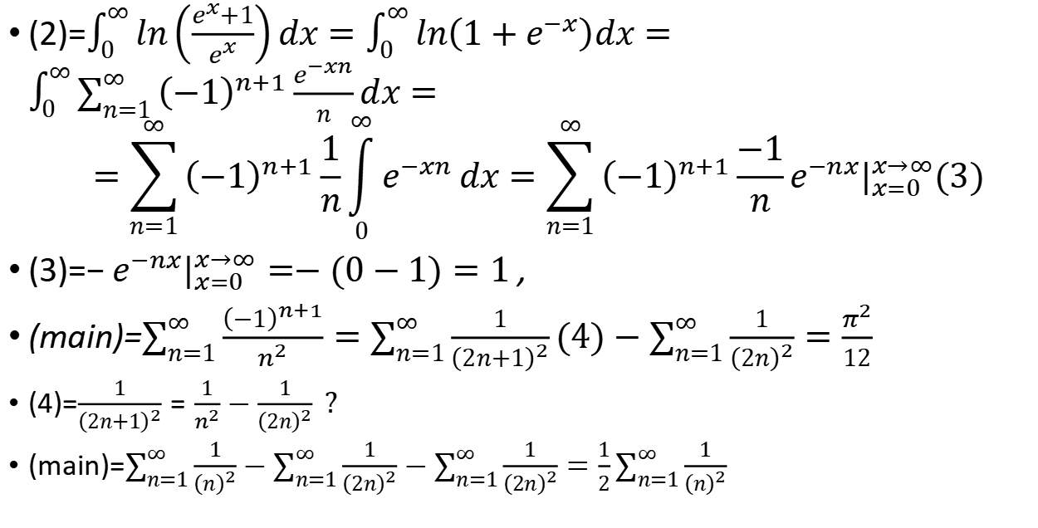
A viewer suggested integral.- 2 - TODO - find start
(2)=$\int_{0}^{∞}{ln\left(\frac{e^{x}+1}{e^{x}}\right)dx}=\int_{0}^{∞}{ln\left(1+e^{−x}\right)dx}=\int_{0}^{∞}{\sum_{n=1}^{∞}{{\left(−1\right)}^{n+1}\frac{e^{−xn}}{n}}dx}=$ $$=\sum_{n=1}^{∞}{{\left(−1\right)}^{n+1}\frac{1}{n}\int_{0}^{∞}{e^{−xn}}}dx=\sum_{n=1}^{∞}{{\left(−1\right)}^{n+1}\frac{−1}{n}}e^{−nx}|_{x=0}^{x→∞}(3)$$
(3)=$−e^{−nx}|_{x=0}^{x→∞}=−(0−1)=1$ ,
(main)=$\sum_{n=1}^{∞}{\frac{{\left(−1\right)}^{n+1}}{n^{2}}}=\sum_{n=1}^{∞}{\frac{1}{{\left(2n+1\right)}^{2}}}(4)−\sum_{n=1}^{∞}{\frac{1}{{\left(2n\right)}^{2}}}=\frac{π^{2}}{12}$
(4)=$\frac{1}{{\left(2n+1\right)}^{2}}=\frac{1}{n^{2}}−\frac{1}{{\left(2n\right)}^{2}} ?$
(main)=$\sum_{n=1}^{∞}{\frac{1}{{\left(n\right)}^{2}}}−\sum_{n=1}^{∞}{\frac{1}{{\left(2n\right)}^{2}}}−\sum_{n=1}^{∞}{\frac{1}{{\left(2n\right)}^{2}}}=\frac{1}{2}\sum_{n=1}^{∞}{\frac{1}{{\left(n\right)}^{2}}}$

Slide 8

$\int{\frac{x^{3}}{{\left(x^{2}+1\right)}^{3}}}dx$
1)partial fraction decompiosition:
$\frac{x^{3}}{{\left(x^{2}+1\right)}^{3}}=\frac{x^{3}}{{\left(x^{2}−1\right)}^{}\left(x^{4}+x^{2}−1\right)}=(wrong)$

Slide 9
Literature
you tube channels:
blackpenredpen
michael penn

