Slide 1

$\int{\frac{1}{x^{3}+x}}$ One integral in many ways 2 :
$\int{\sin^{n}xdx}$
$\int{\frac{dx}{1+x^{2n}}}$
$\int{\frac{dx}{1+tgx}}$ Addition-substraction to fraction trick
$\int_{0}^{π}{\frac{2x^{3}−3πx^{2}}{{\left(1+\sin{x}\right)}^{2}}dx}$
$\int{\frac{x^{2}}{{\left(xsinx+cosx\right)}^{2}}}dx$
$\int_{0}^{0.5}{\frac{\sqrt{x}}{1+x^{2}}}dx$
$\int_{0}^{π}{\frac{dx}{t+cos(x)}}$
$\int{\frac{dx}{1+cosx}}$

Slide 2

$\int{\frac{1}{x^{3}+x}}$ One integral in many ways 2 :
4. $|| tga=x; {tg}^{2}a+1=\frac{1}{\cos^{2}a}; {(tga)}^{‘a}=\frac{da}{\cos^{2}a}=dx||$
$main=\int{\frac{1}{tga}\frac{1}{\frac{1}{\cos^{2}a}}}\frac{da}{\cos^{2}a}=\int{ctga da =}ln|sina| +c$
$sina=\frac{{tg}^{2}a}{{tg}^{2}a+1}$
$main=ln|\sqrt{\frac{x^{2}}{x^{2}+1}}|+c=\frac{1}{2}ln|\frac{x^{2}}{x^{2}+1}|+c =−\frac{1}{2}ln|\frac{x^{2}+1}{x^{2}}|+c$

Slide 3
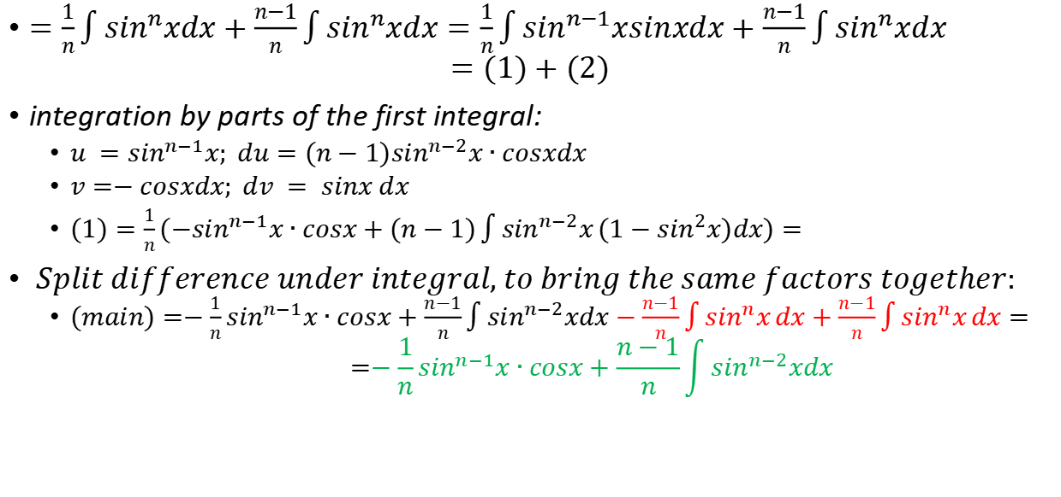
$$\int{\sin^{n}xdx}$$
$=\frac{1}{n}\int{\sin^{n}xdx}+\frac{n−1}{n}\int{\sin^{n}xdx}=\frac{1}{n}\int{\sin^{n−1}xsinxdx}+\frac{n−1}{n}\int{\sin^{n}xdx}$
$$=(1)+(2)$$
integration by parts of the first integral:
$u =\sin^{n−1}x; du=(n−1)\sin^{n−2}x∙cosxdx$
$v=−cosxdx; dv = sinx dx$
$(1)=\frac{1}{n}(−\sin^{n−1}x∙cosx+(n−1)\int{\sin^{n−2}x}(1−\sin^{2}x)dx)=$
$Split difference under integral, to bring the same factors together:$
$(main)=−\frac{1}{n}\sin^{n−1}x∙cosx+\frac{n−1}{n}\int{\sin^{n−2}xdx}−\frac{n−1}{n}\int{\sin^{n}x}dx+\frac{n−1}{n}\int{\sin^{n}x}dx=$ $$=−\frac{1}{n}\sin^{n−1}x∙cosx+\frac{n−1}{n}\int{\sin^{n−2}xdx}$$

Slide 4


$$\int{\frac{dx}{1+x^{2n}}}$$
$x^{n}=\tan{y}$
$nx^{n−1}dx=\frac{dy}{\cos^{2}{y}}=(1+\tan^{2}{y})dy=(1+x^{2n})dy$
$\frac{dx}{1+x^{2n}}=\frac{dy}{nx^{n−1}}=\frac{1}{n}\tan^{\frac{n−1}{n}}ydy$
or:
$atan(x^{n})=y$
$\frac{dxnx^{n−1}}{1+x^{2n}}=dy$
$\frac{1}{n}\int{\tan^{n−1}ydy}$

Slide 5

$\frac{1}{1+x^{2n}}=\frac{1}{1+ix^{n}}∙\frac{1}{1−ix^{n}}=\frac{1}{2}(\frac{1}{1+ix^{n}}+\frac{1}{1−ix^{n}})$
$\int{\frac{1}{1+ix^{n}}}dx=−?$
пусть n =2m чётное тогда
$\int{\frac{1}{1+ix^{2m}}}dx=\int{\frac{1}{1+ix^{2m}}}dx=$
or:
$\frac{1}{1+x^{2n}}=\sum_{k=0}^{∞}{{{(−1)}^{k}x}^{2k}}$

Slide 6

$\int{\frac{1+x^{2n}−x^{2n}}{1+x^{2n}}}dx=\int{1−\frac{xx^{2n−1}}{1+x^{2n}}}dx=x−\frac{1}{2n}\int{x(ln(}1+x^{2n}))’dx(1)$
(1)=$\int{x(ln(}1+x^{2n}))’dx$
$du=(ln(1+x^{2n}))’dx;$ dv = dx
$u=ln(1+x^{2n}) ;v = x$
$(1)=xln(1+x^{2n}) −\int{ln(1+x^{2n})dx }$

Slide 7
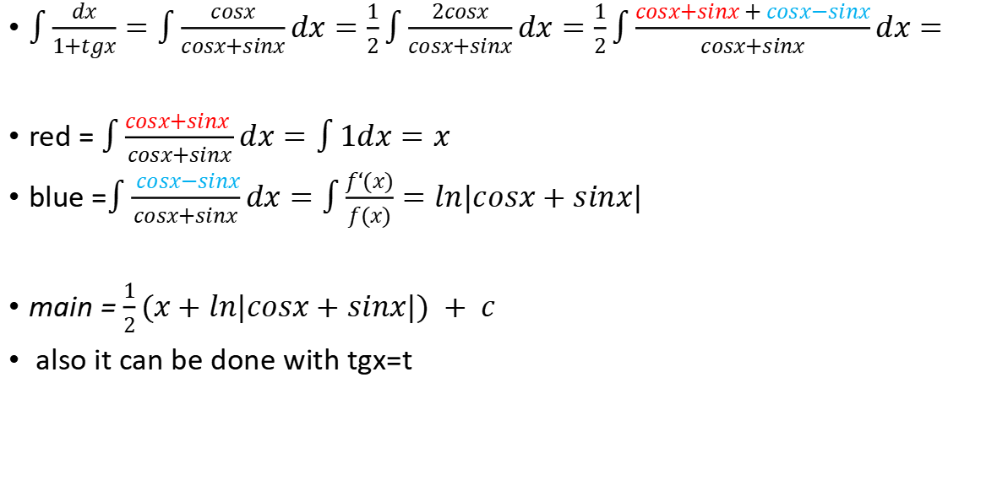
$\int{\frac{dx}{1+tgx}}$ Addition-substraction to fraction trick
$\int{\frac{dx}{1+tgx}}=\int{\frac{cosx}{cosx+sinx}dx}=\frac{1}{2}\int{\frac{2cosx}{cosx+sinx}dx}=\frac{1}{2}\int{\frac{cosx+sinx + cosx−sinx}{cosx+sinx}dx}=$
red = $\int{\frac{cosx+sinx }{cosx+sinx}dx}=\int{1dx=x}$
blue =$\int{\frac{ cosx−sinx}{cosx+sinx}dx}=\int{\frac{f‘(x)}{f(x)}}=ln|cosx+sinx|$
main = $\frac{1}{2}(x+ln|cosx+sinx|) + c$
also it can be done with tgx=t

Slide 8
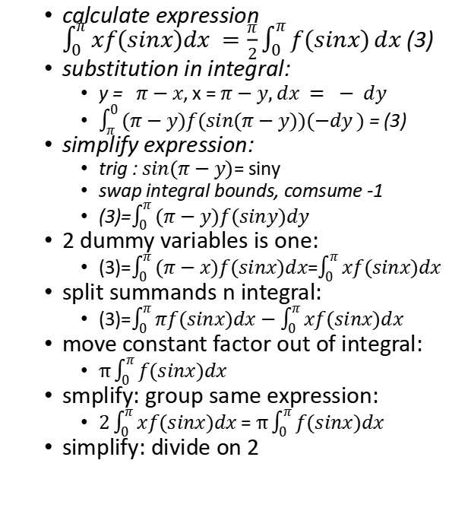
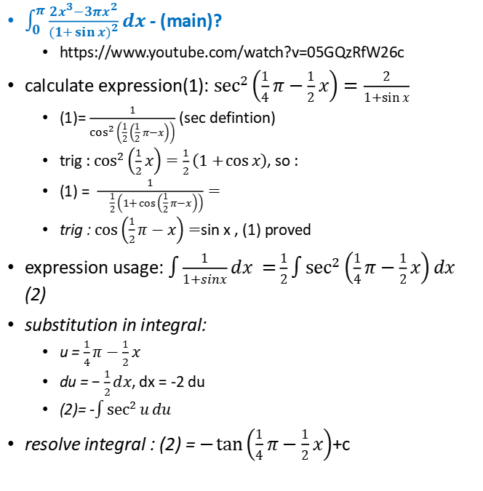
2015 Cambridge Step2, Q6
$\int_{0}^{π}{\frac{2x^{3}−3πx^{2}}{{\left(1+\sin{x}\right)}^{2}}dx}$ - (main)?
https://www.youtube.com/watch?v=05GQzRfW26c
calculate expression(1): $\sec^{2}\left(\frac{1}{4}π−\frac{1}{2}x\right)=\frac{2}{1+\sin{x}}$
(1)= $\frac{1}{\cos^{2}\left(\frac{1}{2}\left(\frac{1}{2}π−x\right)\right)}$ (sec defintion)
trig : $\cos^{2}\left(\frac{1}{2}x\right)=\frac{1}{2}\left(1+\cos{x}\right)$, so :
(1) = $\frac{1}{{\frac{1}{2}\left(1+\cos\left(\frac{1}{2}π−x\right)\right)}}=$
trig : $\cos\left(\frac{1}{2}π−x\right)=$sin x , (1) proved
expression usage: $\int{\frac{1}{1+sinx}dx =}\frac{1}{2}\int{\sec^{2}\left(\frac{1}{4}π−\frac{1}{2}x\right)dx}$ (2)
substitution in integral:
u = $\frac{1}{4}π−\frac{1}{2}x$
du = $−\frac{1}{2}dx$, dx = -2 du
(2)= -$\int{\sec^{2}{u}du}$
resolve integral : (2) = $−\tan\left(\frac{1}{4}π−\frac{1}{2}x\right)$+c
calculate expression $\int_{0}^{π}{xf(sinx)dx =\frac{π}{2}\int_{0}^{π}{f(sinx)}}dx$ (3)
substitution in integral:
y = $π−x$, x = $π−y, dx = − dy$
$\int_{π}^{0}{(π−y)f(sin(π−y))(−dy})$ = (3)
simplify expression:
trig : $sin(π−y)$= siny
swap integral bounds, comsume -1
(3)=$\int_{0}^{π}{(π−y)f(siny)dy}$
2 dummy variables is one:
(3)=$\int_{0}^{π}{(π−x)f(sinx)dx}$=$\int_{0}^{π}{xf(sinx)dx }$
split summands n integral:
(3)=$\int_{0}^{π}{πf(sinx)dx}−\int_{0}^{π}{xf(sinx)dx}$
move constant factor out of integral:
$π\int_{0}^{π}{f(sinx)dx}$
smplify: group same expression:
$2\int_{0}^{π}{xf(sinx)dx}$ = $π\int_{0}^{π}{f(sinx)dx}$
simplify: divide on 2

Slide 9
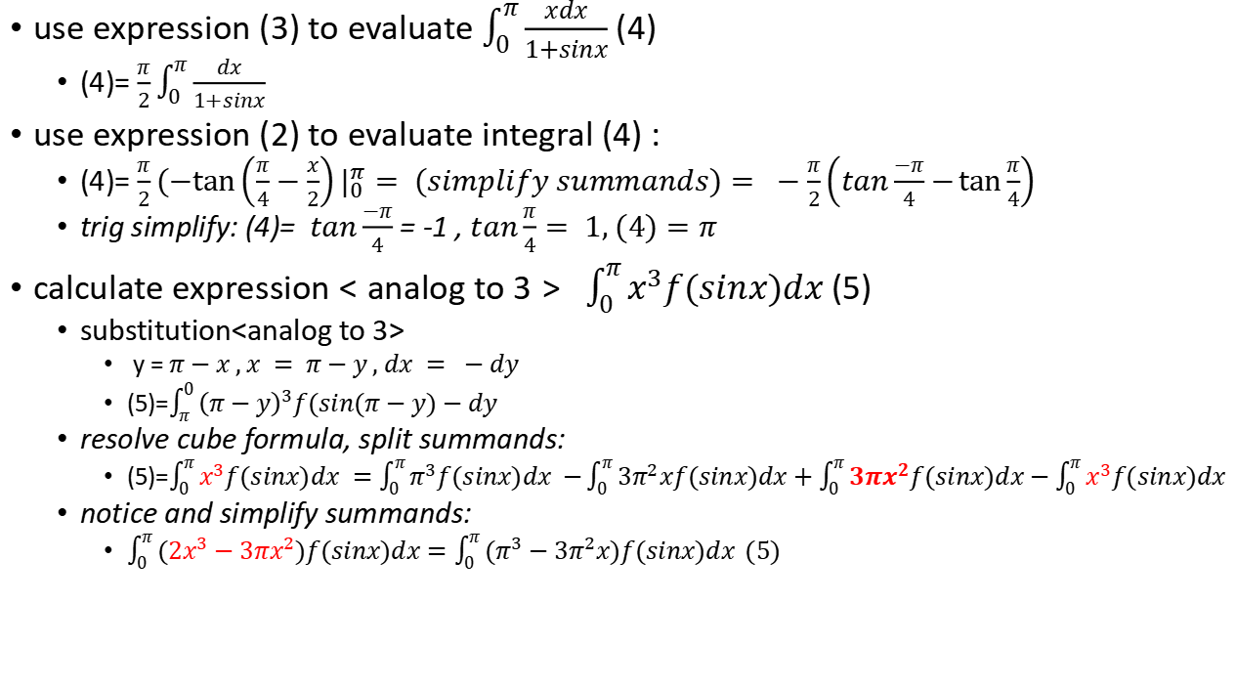
2015 Cambridge Step2, Q6 - 2
use expression (3) to evaluate $\int_{0}^{π}{\frac{xdx}{1+sinx}}$ (4)
(4)= $\frac{π}{2}\int_{0}^{π}{\frac{dx}{1+sinx}}$
use expression (2) to evaluate integral (4) :
(4)= $\frac{π}{2}(−\tan\left(\frac{π}{4}−\frac{x}{2}\right)|_{0}^{π}= (simplify summands)= −\frac{π}{2}\left(tan\frac{−π}{4}−\tan{\frac{π}{4}}\right)$
trig simplify: (4)= $tan\frac{−π}{4}$ = -1 , $tan\frac{π}{4}= 1, (4)=π$
calculate expression $<analog to 3> \int_{0}^{π}{x^{3}f(sinx)dx }$(5)
substitution<analog to 3>
y = $π−x , x = π−y , dx = −dy$
(5)=$\int_{π}^{0}{{\left(π−y\right)}^{3}f(sin(π−y)−dy}$
resolve cube formula, split summands:
(5)=$\int_{0}^{π}{x^{3}f(sinx)dx }=\int_{0}^{π}{π^{3}f(sinx)dx −}\int_{0}^{π}{3π^{2}xf(sinx)dx}+\int_{0}^{π}{3πx^{2}f(sinx)dx−\int_{0}^{π}{x^{3}f(sinx)dx}}$
notice and simplify summands:
$\int_{0}^{π}{({2x}^{3}−3πx^{2})f(sinx)dx}=\int_{0}^{π}{(π^{3}−3π^{2}x)f(sinx)dx }(5)$

Slide 10
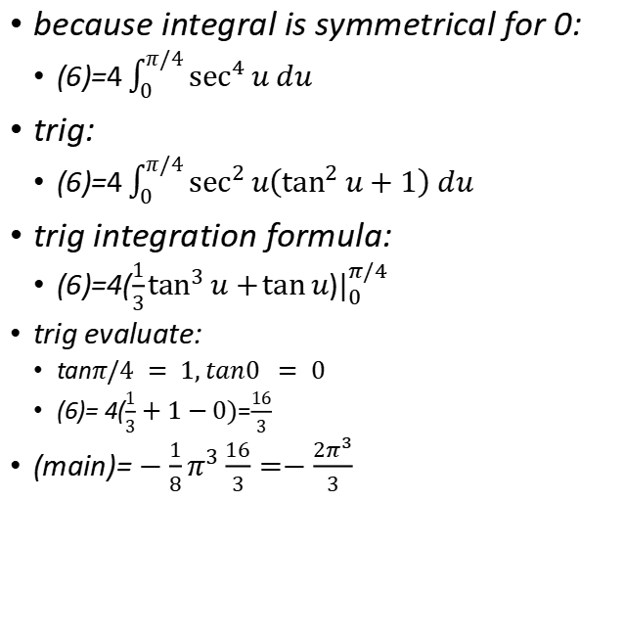
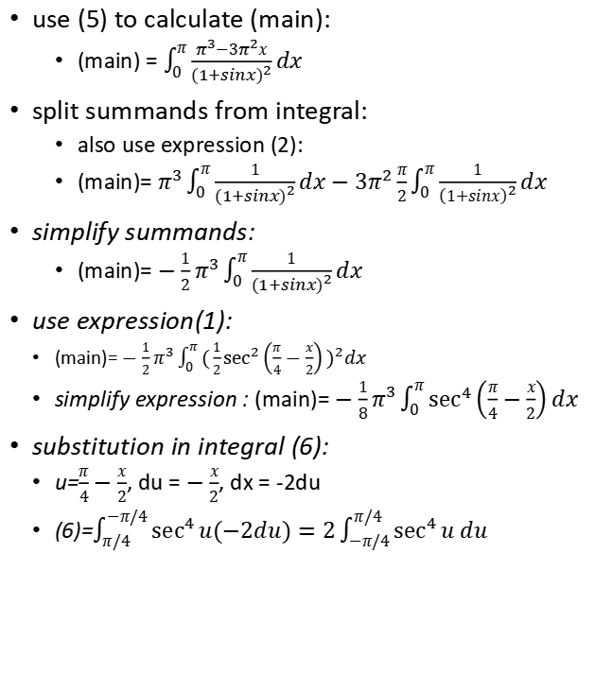
2015 Cambridge Step2, Q6 - 3
use (5) to calculate (main):
(main) = $\int_{0}^{π}{\frac{π^{3}−3π^{2}x}{{(1+sinx)}^{2}}}dx$
split summands from integral:
also use expression (2):
(main)= $π^{3}\int_{0}^{π}{\frac{1}{{(1+sinx)}^{2}}}dx−3π^{2}\frac{π}{2}\int_{0}^{π}{\frac{1}{{\left(1+sinx\right)}^{2}}}dx$
simplify summands:
(main)= ${−\frac{1}{2}π}^{3}\int_{0}^{π}{\frac{1}{{(1+sinx)}^{2}}}dx$
use expression(1):
(main)= ${−\frac{1}{2}π}^{3}\int_{0}^{π}{(\frac{1}{2}\sec^{2}\left(\frac{π}{4}−\frac{x}{2}\right)})^{2}dx$
simplify expression : (main)= ${−\frac{1}{8}π}^{3}\int_{0}^{π}{\sec^{4}\left(\frac{π}{4}−\frac{x}{2}\right)}dx$
substitution in integral (6):
u=$\frac{π}{4}−\frac{x}{2}$, du = $−\frac{x}{2}$, dx = -2du
(6)=$\int_{π/4}^{−π/4}{\sec^{4}{u(−2du)}}=2\int_{−π/4}^{π/4}{\sec^{4}{u du}}$
because integral is symmetrical for 0:
(6)=$4\int_{0}^{π/4}{\sec^{4}{u du}}$
trig:
(6)=$4\int_{0}^{π/4}{\sec^{2}{u\left(\tan^{2}{u}+1\right) du}}$
trig integration formula:
(6)=4($\frac{1}{3}\tan^{3}{u}+\tan{u}$)$|_{0}^{π/4}$
trig evaluate:
tan$π/4 = 1, tan0 = 0$
(6)= 4($\frac{1}{3}+1−0)$=$\frac{16}{3}$
(main)= ${−\frac{1}{8}π}^{3}\frac{16}{3}=−\frac{2π^{3}}{3}$

Slide 11
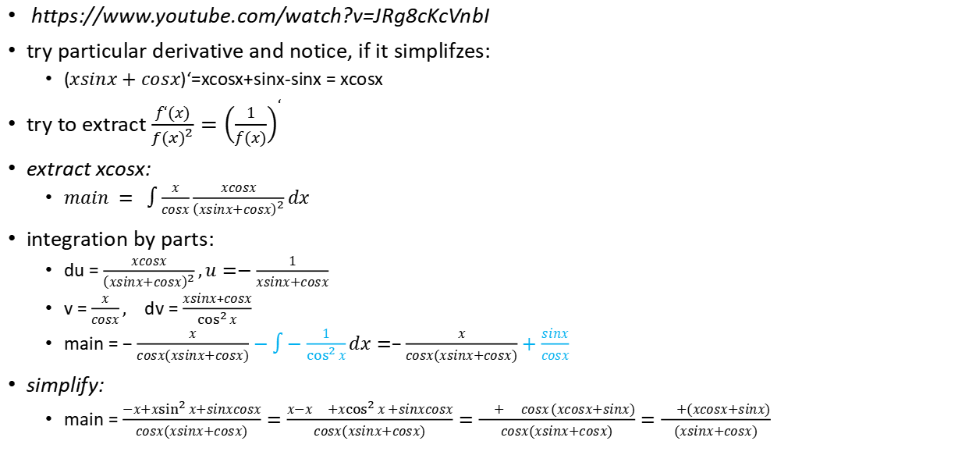
$\int{\frac{x^{2}}{{\left(xsinx+cosx\right)}^{2}}}dx$
https://www.youtube.com/watch?v=JRg8cKcVnbI
try particular derivative and notice, if it simplifzes:
($xsinx+cosx$)‘=xcosx+sinx-sinx = xcosx
try to extract $\frac{f‘(x)}{{f(x)}^{2}}={\left(\frac{1}{f(x)}\right)}^{‘}$
extract xcosx:
$main = \int{\frac{x}{cosx}\frac{xcosx}{{\left(xsinx+cosx\right)}^{2}}}dx$
integration by parts:
du = $\frac{xcosx}{{\left(xsinx+cosx\right)}^{2}},u=−\frac{1}{xsinx+cosx}$
v = $\frac{x}{cosx},$ dv = $\frac{xsinx+cosx}{\cos^{2}{x}}$
main = $−\frac{x}{cosx(xsinx+cosx)}−\int{−\frac{1}{\cos^{2}{x}}}dx=−\frac{x}{cosx(xsinx+cosx)}+\frac{sinx}{cosx}$
simplify:
main = $\frac{−x+x\sin^{2}{x+sinxcosx}}{cosx(xsinx+cosx)}=\frac{x−x{+x\cos^{2}{x}+sinxcosx}}{cosx(xsinx+cosx)}=\frac{{+{cosx}(xcosx+sinx)}}{cosx(xsinx+cosx)}=\frac{{+(xcosx+sinx)}}{(xsinx+cosx)}$

Slide 12
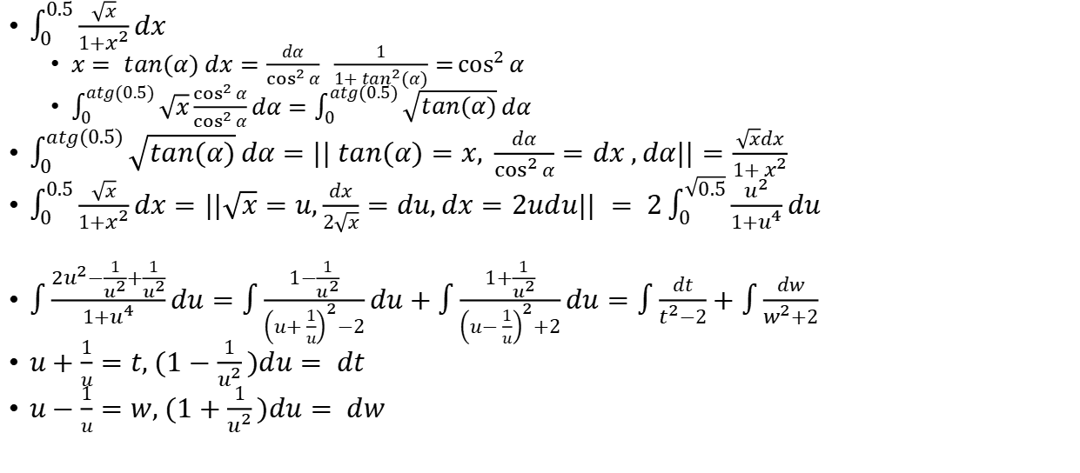

$$\int_{0}^{0.5}{\frac{\sqrt{x}}{1+x^{2}}}dx$$
$\int_{0}^{0.5}{\frac{\sqrt{x}}{1+x^{2}}}dx$
$x= tan(α) dx=\frac{dα}{\cos^{2}{α}} \frac{1}{1+ tan^{2}(α)}=\cos^{2}{α}$
$\int_{0}^{atg(0.5)}{\sqrt{x}\frac{\cos^{2}{α}}{\cos^{2}{α}}}dα=\int_{0}^{atg(0.5)}{\sqrt{tan(α)}}dα$
$\int_{0}^{atg(0.5)}{\sqrt{tan(α)}}dα=|| tan(α)=x, \frac{dα}{\cos^{2}{α}}=dx ,dα||=\frac{\sqrt{x}dx}{1+ x^{2}}$
$\int_{0}^{0.5}{\frac{\sqrt{x}}{1+x^{2}}}dx=||\sqrt{x}=u,\frac{dx}{2\sqrt{x}}=du,dx=2udu|| = 2\int_{0}^{\sqrt{0.5}}{\frac{u^{2}}{1+u^{4}}}du$
$\int{\frac{{2u}^{2}−\frac{1}{u^{2}}+\frac{1}{u^{2}}}{1+u^{4}}du=\int{\frac{1−\frac{1}{u^{2}}}{{\left(u+\frac{1}{u}\right)}^{2}−2}du}}+\int{\frac{1+\frac{1}{u^{2}}}{{\left(u−\frac{1}{u}\right)}^{2}+2}du}=\int{\frac{dt}{t^{2}−2}}+\int{\frac{dw}{w^{2}+2}}$
$u+\frac{1}{u}=t, (1−\frac{1}{u^{2}})du= dt$
$u−\frac{1}{u}=w, (1+\frac{1}{u^{2}})du= dw$

Slide 14
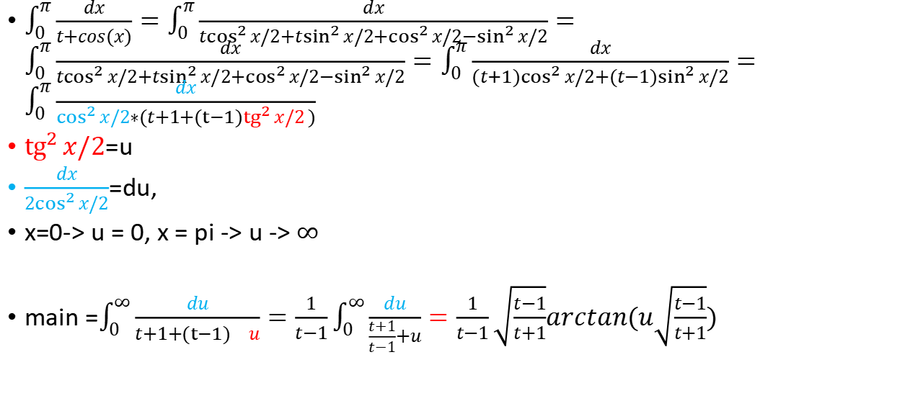

$$\int_{0}^{π}{\frac{dx}{t+cos(x)}}$$
$\int_{0}^{π}{\frac{dx}{t+cos(x)}}=\int_{0}^{π}{\frac{dx}{t\cos^{2}{x}/2+t\sin^{2}{x/2}+\cos^{2}{x/2}−\sin^{2}{x/2}}}=\int_{0}^{π}{\frac{dx}{t\cos^{2}{x/2}+t\sin^{2}{x/2}+\cos^{2}{x/2}−\sin^{2}{x/2}}}=\int_{0}^{π}{\frac{dx}{(t{+1)cos}^{2}{x/2}+(t−1)\sin^{2}{x/2}}}=\int_{0}^{π}{\frac{dx}{\cos^{2}{x/2}∗(t+1+{(t−1)tg}^{2}{x/2})}}$
${tg}^{2}{x/2}$=u
$\frac{dx}{2\cos^{2}{x/2}}$=du,
x=0-> u = 0, x = pi -> u -> $∞$
main =$\int_{0}^{∞}{\frac{du}{t+1+{(t−1)}^{}{u}}}=\frac{1}{t−1}\int_{0}^{∞}{\frac{du}{\frac{t+1}{t−1}+u}}=\frac{1}{t−1}\sqrt{\frac{t−1}{t+1}}arctan(u\sqrt{\frac{t−1}{t+1}})$

Slide 15


$$\int{\frac{dx}{1+cosx}}=I$$
$z=tan\frac{x}{2}$
$\frac{x}{2}=atan z$
$dx =\frac{2}{1+z^{2}}dz$
$cosx =\frac{1−z^{2}}{1+z^{2}}=\frac{1−\tan^{2}\frac{x}{2}}{1+\tan^{2}\frac{x}{2}}=\frac{\cos^{2}\frac{x}{2}−\sin^{2}\frac{x}{2}}{\cos^{2}\frac{x}{2}+\sin^{2}\frac{x}{2}}=2\cos^{2}\frac{x}{2}−1$
$I=\frac{\frac{2}{1+z^{2}}dz}{1+\frac{1−z^{2}}{1+z^{2}}}=\int{\frac{2}{1+z^{2}+1−z^{2}}}dz=\int{dz}=tan\frac{x}{2}+C$

Slide 16
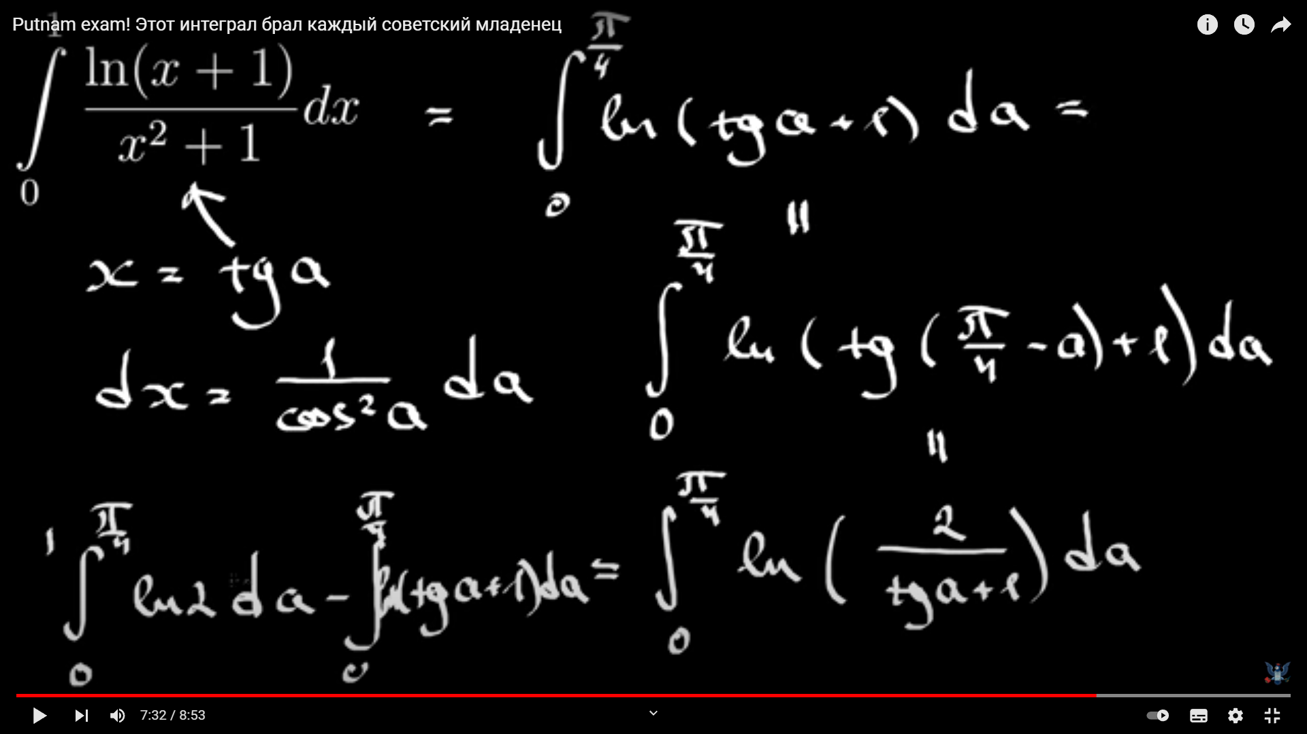
trig - tan integral

Slide 17


$$\int_{0}^{∞}{\frac{x^{2}+1}{x^{4}+7x^{2}+1}}$$
$I=\int_{0}^{∞}{\frac{x^{2}+1}{9x^{2}+{\left(x^{2}+1\right)}^{2}}}=\int_{0}^{∞}{\frac{1+\frac{1}{x^{2}}}{9+{\left(1−\frac{1}{x}\right)}^{2}}}=(above is derivative)$
$\frac{1}{3}arctan{\left(\frac{1−\frac{1}{x}}{3}\right)|}_{−∞}^{∞}=\frac{1}{3}arctan{\left(\frac{u}{3}\right)|}_{0}^{∞}=\frac{π}{3}$

Slide 18


$$\int_{0}^{\frac{π}{2}}{e^{−\tan^{2}x}dx}$$
$u=tanx$
$dx=\frac{du}{1+u^{2}}$
$I=\int_{0}^{∞}{\frac{e^{−u^{2}}}{1+u^{2}}}du$
https://www.youtube.com/watch?v=cl_nunXkyY4&ab_channel=MichaelPenn

