Slide 3
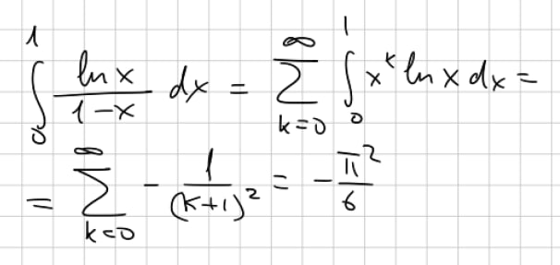
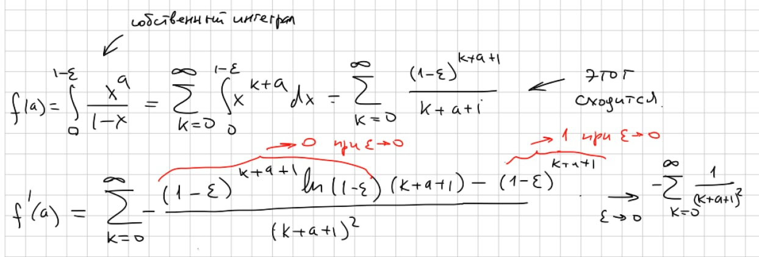
Row inside integral usage

Slide 4
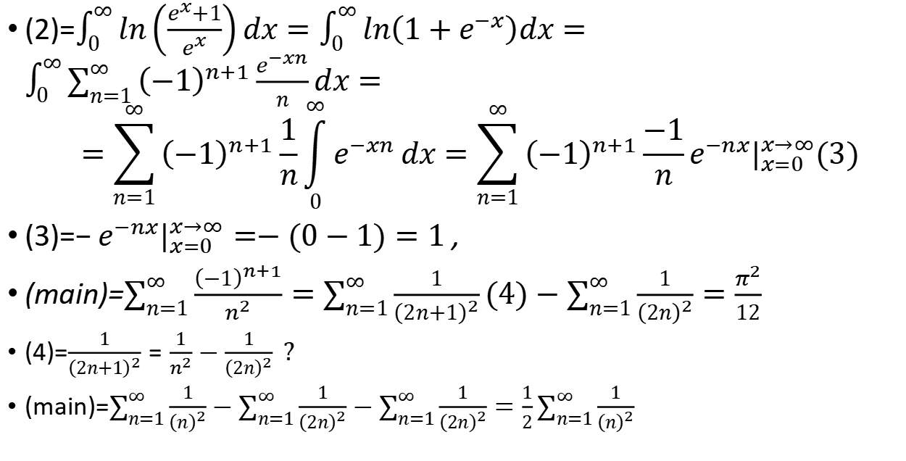
A viewer suggested integral.- 2
(2)=$\int_{0}^{∞}{ln\left(\frac{e^{x}+1}{e^{x}}\right)dx}=\int_{0}^{∞}{ln\left(1+e^{−x}\right)dx}=\int_{0}^{∞}{\sum_{n=1}^{∞}{{\left(−1\right)}^{n+1}\frac{e^{−xn}}{n}}dx}=$ $$=\sum_{n=1}^{∞}{{\left(−1\right)}^{n+1}\frac{1}{n}\int_{0}^{∞}{e^{−xn}}}dx=\sum_{n=1}^{∞}{{\left(−1\right)}^{n+1}\frac{−1}{n}}e^{−nx}|_{x=0}^{x→∞}(3)$$
(3)=$−e^{−nx}|_{x=0}^{x→∞}=−(0−1)=1$ ,
(main)=$\sum_{n=1}^{∞}{\frac{{\left(−1\right)}^{n+1}}{n^{2}}}=\sum_{n=1}^{∞}{\frac{1}{{\left(2n+1\right)}^{2}}}(4)−\sum_{n=1}^{∞}{\frac{1}{{\left(2n\right)}^{2}}}=\frac{π^{2}}{12}$
(4)=$\frac{1}{{\left(2n+1\right)}^{2}}=\frac{1}{n^{2}}−\frac{1}{{\left(2n\right)}^{2}} ?$
(main)=$\sum_{n=1}^{∞}{\frac{1}{{\left(n\right)}^{2}}}−\sum_{n=1}^{∞}{\frac{1}{{\left(2n\right)}^{2}}}−\sum_{n=1}^{∞}{\frac{1}{{\left(2n\right)}^{2}}}=\frac{1}{2}\sum_{n=1}^{∞}{\frac{1}{{\left(n\right)}^{2}}}$

Slide 5
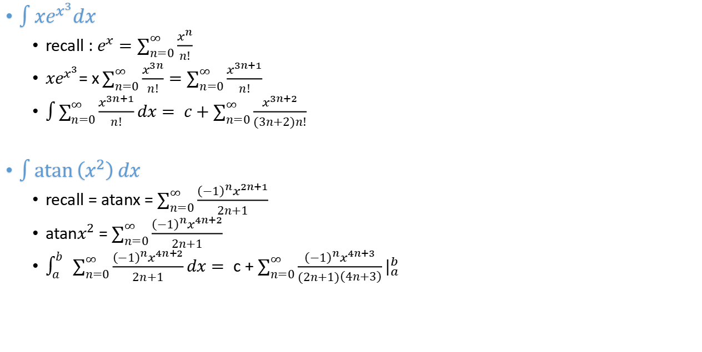
Integrate by series:
$\int{xe^{x^{3}}dx}$
recall : $e^{x}=\sum_{n=0}^{∞}{\frac{x^{n}}{n!}}$
$xe^{x^{3}}$= $x\sum_{n=0}^{∞}{\frac{x^{3n}}{n!}}=\sum_{n=0}^{∞}{\frac{x^{3n+1}}{n!}}$
$\int{\sum_{n=0}^{∞}{\frac{x^{3n+1}}{n!}}}dx= c+\sum_{n=0}^{∞}{\frac{x^{3n+2}}{(3n+2)n!}}$
$\int{\operatorname{atan}\left(x^{2}\right)}dx$
recall = atanx = $\sum_{n=0}^{∞}{\frac{{\left(−1\right)}^{n}x^{2n+1}}{2n+1}}$
atan$x^{2}$ = $\sum_{n=0}^{∞}{\frac{{\left(−1\right)}^{n}x^{4n+2}}{2n+1}}$
$\int_{a}^{b}{ \sum_{n=0}^{∞}{\frac{{\left(−1\right)}^{n}x^{4n+2}}{2n+1}}}dx= c+\sum_{n=0}^{∞}{\frac{{\left(−1\right)}^{n}x^{4n+3}}{(2n+1)\left(4n+3\right)}}|_{a}^{b}$

Slide 6
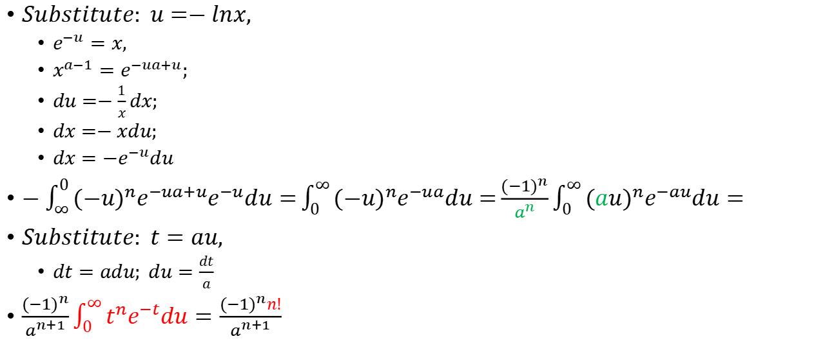

$$\int_{0}^{1}{x^{a−1}\ln^{n}xdx}$$
$Substitute: u=−lnx,$
$e^{−u}=x,$
$x^{a−1}=e^{−ua+u};$
$du=−\frac{1}{x}dx;$
$dx=−xdu;$
$dx={−e}^{−u}du$
$−\int_{∞}^{0}{{{(−u)}^{n}e}^{−ua+u}e^{−u}du=}\int_{0}^{∞}{{{(−u)}^{n}e}^{−ua}du=}\frac{{(−1)}^{n}}{a^{n}}\int_{0}^{∞}{{{(au)}^{n}e}^{−au}du=}$
$Substitute: t=au,$
$dt=adu; du=\frac{dt}{a}$
$\frac{{(−1)}^{n}}{a^{n+1}}\int_{0}^{∞}{{t^{n}e}^{−t}du}=\frac{{(−1)}^{n}n!}{a^{n+1}}$

Slide 7
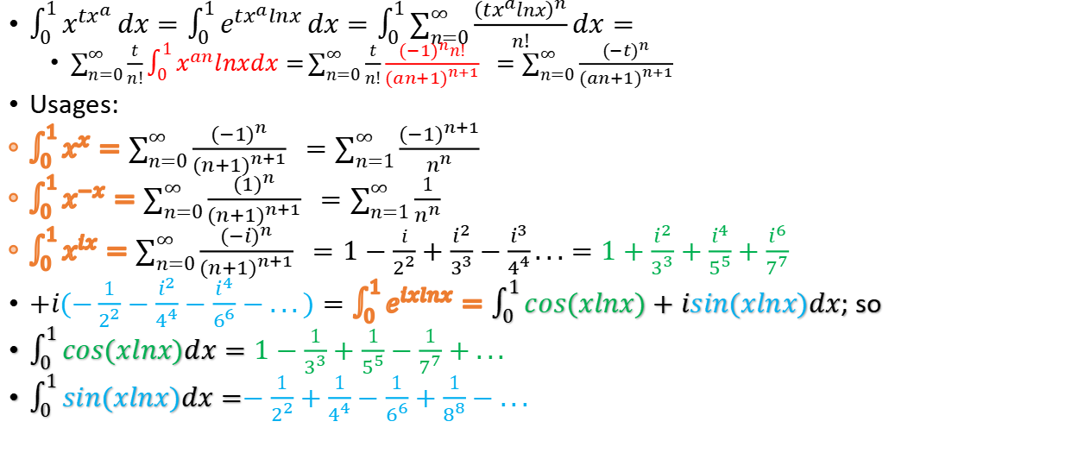

$$\int_{0}^{1}{x^{tx^{a}}}dx;a>0; t in ℂ$$
$\int_{0}^{1}{x^{tx^{a}}}dx=\int_{0}^{1}{e^{{tx}^{a}lnx}}dx=\int_{0}^{1}{\sum_{n=0}^{∞}{\frac{{\left({tx}^{a}lnx\right)}^{n}}{n!}}}dx=$
$\sum_{n=0}^{∞}{\frac{t}{n!}\int_{0}^{1}{x^{an}lnxdx}=}\sum_{n=0}^{∞}{\frac{t}{n!}\frac{{(−1)}^{n}n!}{{(an+1)}^{n+1}} }=\sum_{n=0}^{∞}{\frac{{(−t)}^{n}}{{(an+1)}^{n+1}} }$
Usages:
$\int_{0}^{1}{x^{x}}=\sum_{n=0}^{∞}{\frac{{(−1)}^{n}}{{(n+1)}^{n+1}} }=\sum_{n=1}^{∞}{\frac{{(−1)}^{n+1}}{n^{n}} }$
$\int_{0}^{1}{x^{−x}}=\sum_{n=0}^{∞}{\frac{{(1)}^{n}}{{(n+1)}^{n+1}} }=\sum_{n=1}^{∞}{\frac{1}{n^{n}} }$
$\int_{0}^{1}{x^{ix}}=\sum_{n=0}^{∞}{\frac{{(−i)}^{n}}{{(n+1)}^{n+1}} }=1−\frac{i}{2^{2}}+\frac{i^{2}}{3^{3}}−\frac{i^{3}}{4^{4}}...=1+\frac{i^{2}}{3^{3}}+\frac{i^{4}}{5^{5}}+\frac{i^{6}}{7^{7}}$
$+i(−\frac{1}{2^{2}}−\frac{i^{2}}{4^{4}}−\frac{i^{4}}{6^{6}}−...)=\int_{0}^{1}{e^{ixlnx}}=\int_{0}^{1}{cos(xlnx)+isin(xlnx)dx}$; so
$\int_{0}^{1}{cos(xlnx)dx}=1−\frac{1}{3^{3}}+\frac{1}{5^{5}}−\frac{1}{7^{7}}+...$
$\int_{0}^{1}{sin(xlnx)dx}=−\frac{1}{2^{2}}+\frac{1}{4^{4}}−\frac{1}{6^{6}}+\frac{1}{8^{8}}−...$

