Slide 1
This is a quick tutorial for the Windows version of TNT. It shows several screen-shots of TNT
Recall that this is a PowerPoint presentation;
you can begin the presentation pressing F5, and advance pressing <Enter> or clicking the left mouse button. You can exit the presentation at any time by hitting the <Escape> key.

Slide 2
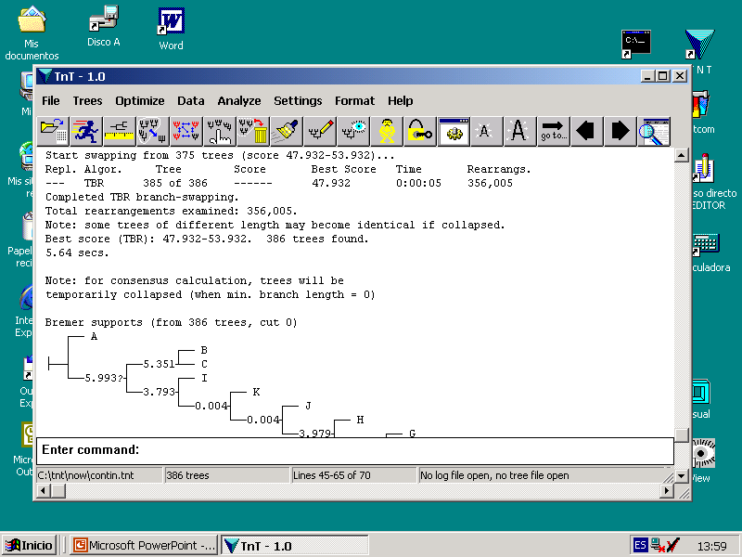
All output produced by the program is saved to an internal text-buffer.
The text-buffer is displayed in this window. The size of the buffer can
be changed with Settings / Memory. The text-buffer can be saved to
file at any time.
Help calls the explorer and displays the contents
of the file tnt.htm. For this, the file tnt.htm must
be copied to your windows directory. This provides
detailed descriptions of many commands and options.
For proper viewing of trees, the font Tred
should be installed in the system (go to
Control Panel / Fonts / Install New Font)

Slide 3
This icon switches to “tree-viewing”
mode. Under tree-viewing, you can
view and edit trees, and mark nodes
to determine taxon selections.

Slide 4
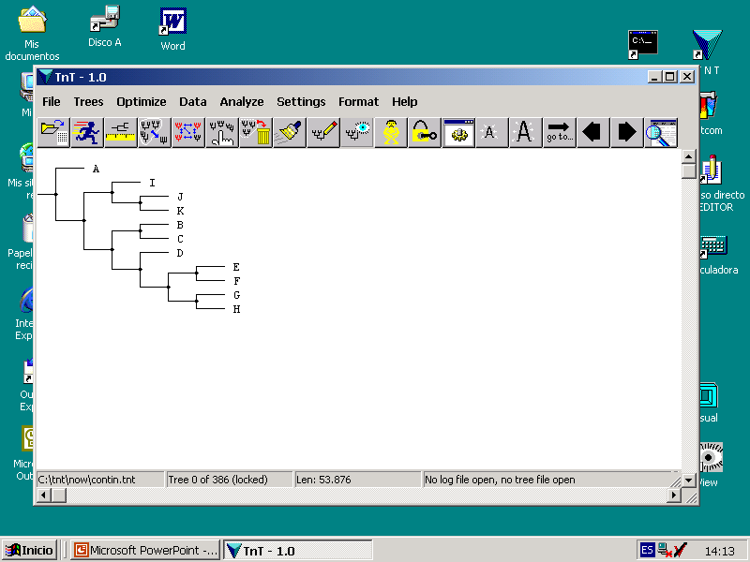
When you are in tree-viewing mode, you can
move between trees using these arrows.
This is the number of tree you are
currently looking at
Clicking on a node (left button), marks the
node in red; clicking again, marks it in green;
clicking again, unmarks it.
When the node is marked in red, all the taxa belonging to the node are
included in selections (e.g. to exclude taxa); when the node is marked in
green, all the taxa belonging to the node are excluded from selections.

Slide 5
If the tree is unlocked, it can be edited. If a node is marked,
clicking the right mouse button on another node moves the
marked node to be sister of the node. If the destination node is
a descendant of the marked node, then that part of the tree is
rerooted. Clicking the right button on the marked node istelf
deletes the node (and all its descendants) from the tree (if the
node is marked in red), or adds taxa not included in the tree(if
the node is marked in green and tree is incomplete). Clicking
on the immediate ancestor of the marked node, collapses the
node. Up to ten instances of undo/redo are possible (pressing
U or R). Double clicking on a node allows to define it as
“contractible.” Double clicking on the root contracts all
contractible nodes. Contractible nodes are marked on the
tree with a little arrow.
This tool locks/unlocks the tree. If the tree is locked, clicking
on the right mouse button produces a list of synapomorphies
of the node. Lists of synapomorphies can be done using
character names (if defined) or with numbers; this is
changed with Format / UseCharacterNames.

Slide 6
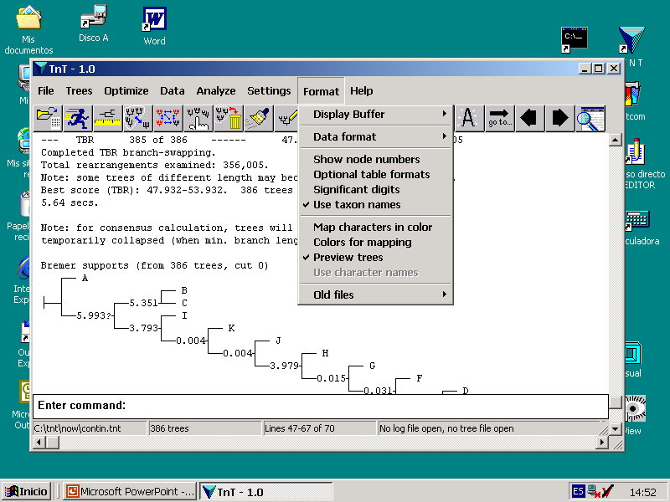
If the pre-viewing of trees is OFF, tree diagrams
are written to text-buffer automatically. If the
pre-viewing is ON, then before writing a tree
diagram to the text-buffer the tree is displayed
in a separate (full-screen) window.
Characters can be mapped
in color only when pre-viewing
is ON. Colors are defined with
Colors For Mapping.

Slide 7
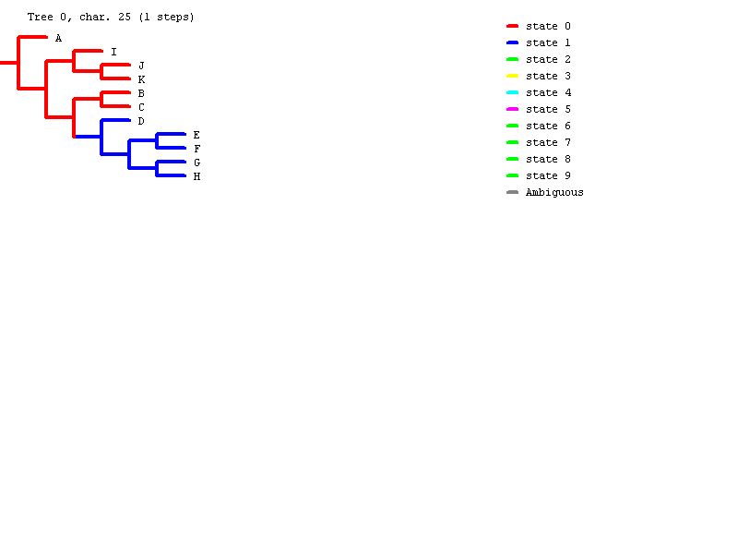
When in pre-view screen, pressing H dispays the help
screen. Pressing P prints the tree, pressing M saves it
to a metafile, pressing S saves tree-diagram to text-buffer.
Keys F1 – F2 make the branches thinner / thickker, F3 – F4
shorter / longer. Keys F 5 – F6 make tree shorter / longer.
<Enter> and <backspace> move to next / previous tree.
Pressing <Escape> leaves the pre-viewing
screen and goes back to the text-buffer.

Slide 8
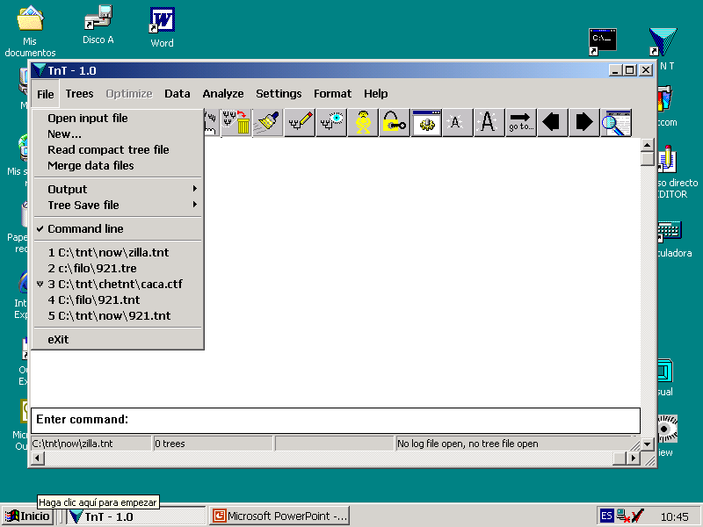
Read commands from a file. The
file will possibly contain a data set
(the data can be in DNA, protein,
alphanumeric, or continuous formats).
Alphanumeric discrete characters can
have up to 32 states; continuous cha-
racters can have states 0-65, with 3
decimals (i.e. 65,000 possible values).
It is possible to have data sets with
mixed formats. See Data Input in the
help file for detais. The file may also
contain any legal command, including
trees in parenthetical notation, cha-
racter settings, and general options.
Simple NEXUS files can also be read.
Create a new data set (only
missing entries; it can be edited
with Data/EditData)
This opens an output file. After opening the file, all output is
(by default) written also to file. You can also save previous
output to the file, or print it.
This opens a tree-file. Trees are not saved
to files unless requested.
You can type commands here.
<Enter> and <Tab> move into
and out of this sector

Slide 9
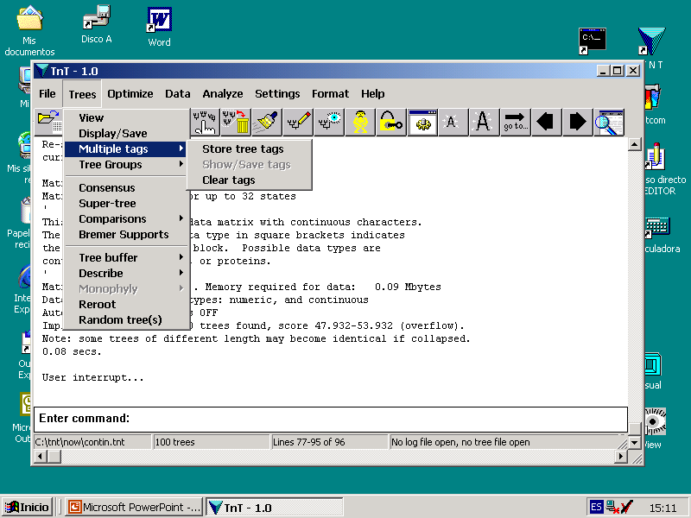
The Trees submenu contains options for displaying,
comparing, rerooting, selecting, and condensing trees.
The “multiple-tags” option allows superimposing
labels on branches (e.g. to show both bremer and
jacknife values on the same tree). The commands
that draw tree-diagrams copy the labels instead of
displaying the trees. Then, with Show/Save Tags,
the tree is displayed with all the labels together.

Slide 10
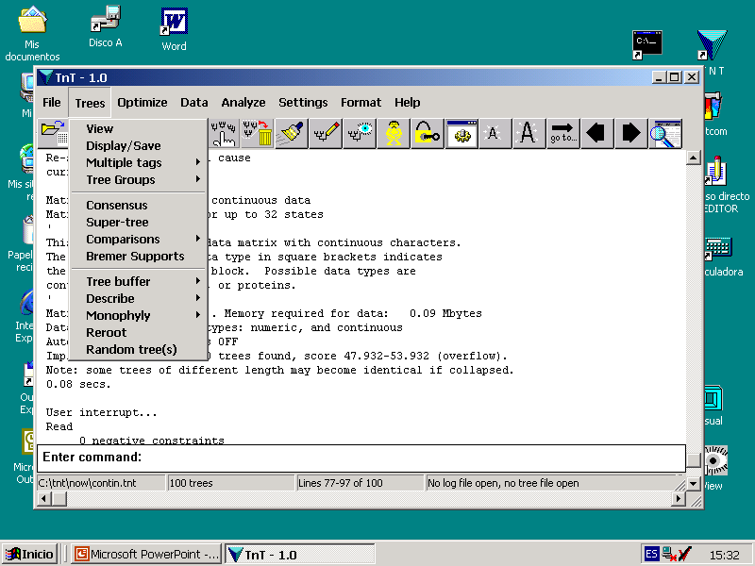
Tree consensus and comparisons can be carried out
eliminating some taxa fromt he consensus. Taxa are
eliminated only from the trees, not from the data matrix.
By default, most tree-comparing options (consensus, etc.)
are carried out temporarily collapsing the trees, eliminating
the branches unsupported under collapsing criterion in
effect. The temporary collapsing of trees can be changed
with Settings / Consense Options.
If temporary collapsing is to be turned off (e.g. whenever you
are reading trees from a different matrix), make sure the
trees to be used have been collapsed before (e.g. by checking
the “Collapse trees after search” option in the search dialogs).
The tree-buffer can be cleaned (discarding duplicate and
suboptimal trees), condensed, sorted, or converted into MRP.
If constraints have been defined (with Data / Define Constraints),
you can have the program reporting the trees that fulfill the
constraints.

Slide 11
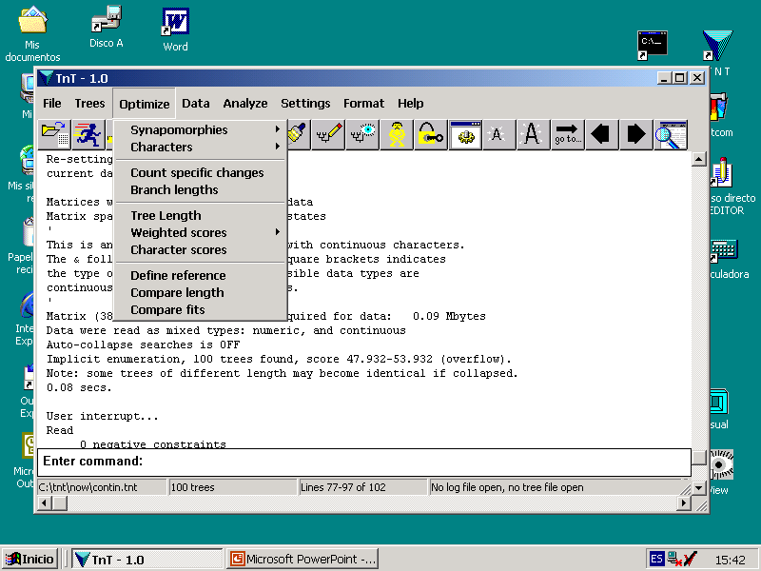
The Optimize submenu contains the options
that refer to tree diagnosis and evaluation, and
character optimization.
Synapomorphies and character mapping can be done
on individual trees, or on sets of trees. The latter is
useful when you have multiple trees for your data set
(avoids the need to optimize the consensus, which
is usually longer).
If both the “Map Characters in Color” and the “Preview
Trees” options are ON, then characters are mapped using
colors. Otherwise, the characters are mapped using
either state names or numbers.
This option can be used to count minimum and maximum
numbers of specific types of transformations, among
different optimizations. For example, you can use this to
count transitions/transversions separately.
Calculate tree lengths or scores. Lengths are calculated
using the taxa included in the trees (trees with fewer taxa
are obviously shorter). Weighted scores can be calculated
only for trees having all the active taxa.
These routines allow comparing the fit of different trees
character by character. Before comparing, a tree must
be defined as “reference”

Slide 12
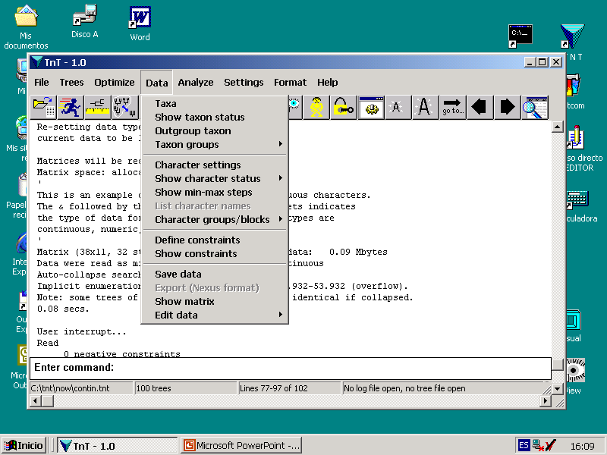
The Data submenu allows defining active taxa, character
types (and weights), etc.
This defines the set of active taxa. Tree searches work
only with this set of taxa.
This defines character weights, activities, etc.
Once defined, those settings are used for all
subsequent operations. This also allows defining
step matrices and character-state trees. Step
matrix characters are optimized with slower
algorithms. Characters with character-state trees
are internally recoded in binary form.
Define constraints. Groups can be constrained to
be monophyletic or non-monophyletic. The
constraints are defined only as a reference list of
groups. Subsequent searches will not enforce
these constraints, unless requested to do so.
Character and taxon names, and
data matrix, can be edited.

Slide 13
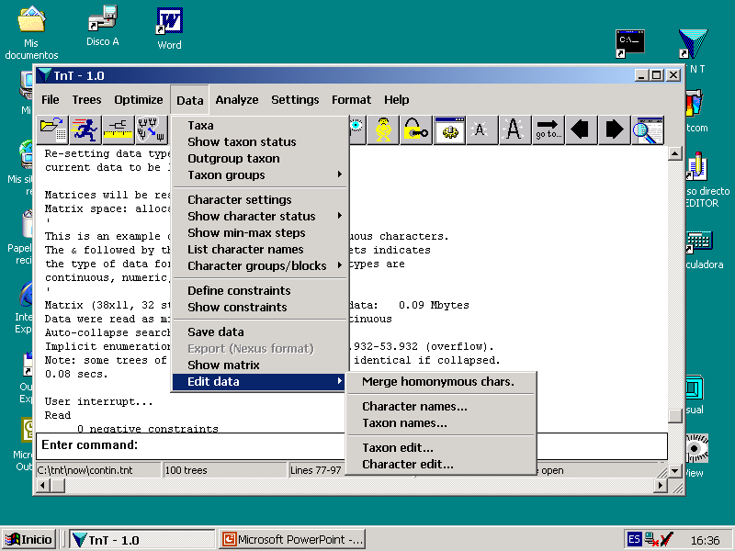
Matrix can be edited either on a
taxon by taxon, or a character
by character basis.

Slide 14
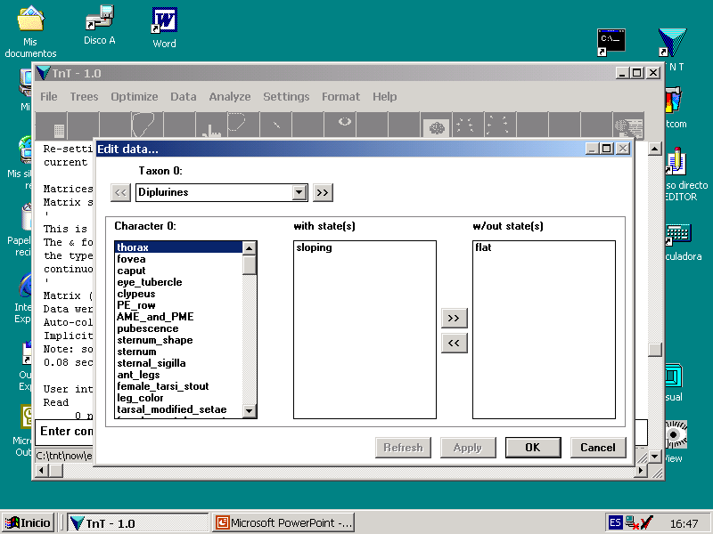
Editing on a taxon by taxon basis, you edit
taxa one at a time. The taxon being edited
now is Diplurines.
The character being edited now is thorax.
These boxes display the state(s) of character
thorax for taxon Diplura, and the alternatives.
Double-clicking on a state moves it to the other
box.

Slide 15
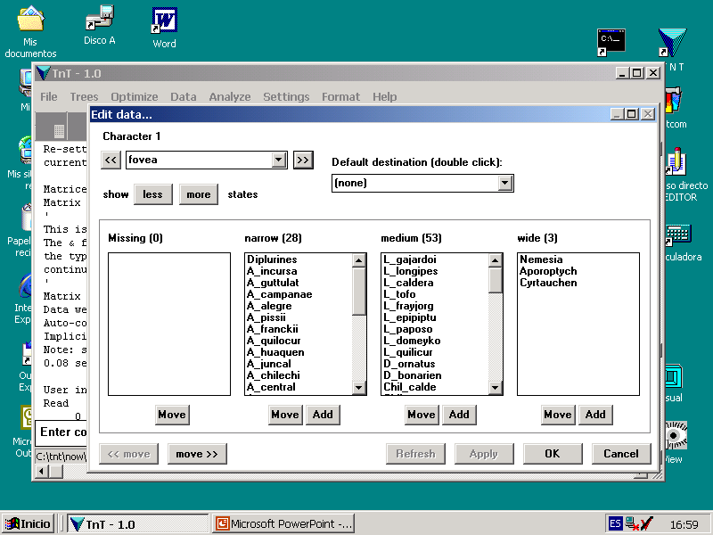
Editing on a character by character basis, lists of the taxa having each
alternative state are displayed in separate boxes. The character being
edited now is fovea.
28 taxa have state narrow, 53 have state medium, and 3
have state wide. Clicking on the Move button below a box,
all the taxa selected are moved to that box. Clicking
instead on the Add button, the taxa are added (i.e. made
polymorphic).
You can use these buttons to move
the lists of taxa with each state, or
to display fewer or more states.

Slide 16
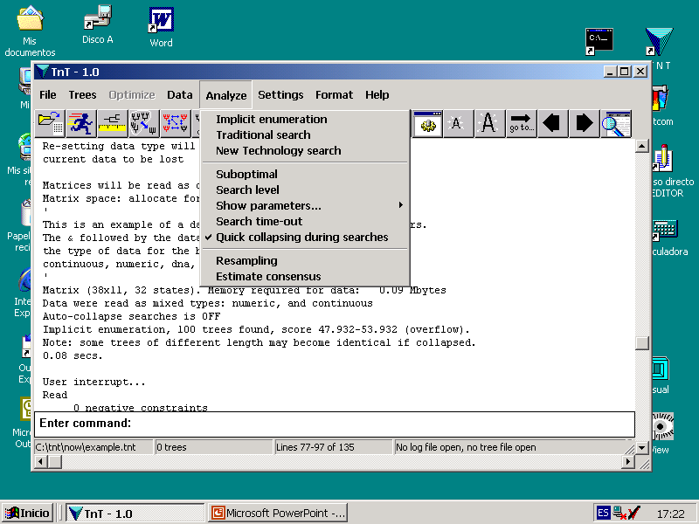
The Analyze submenu contains the search and data resampling
routines, as well as settings specific for searches.
Exact solutions (i.e. solutions guaranteed
to be optimal). This may be time consuming!
Heuristic searches, using multiple random addition
sequences and/or branch swapping. Useful for
medium numbers of taxa (20-80 taxa). Larger
data sets may require New Tech Searches.
These options search for
most parsimonious trees.
The searches compare trees according to the co-
llapsing criterion in effect
(the strictest that can be
applied during searches is
“min.length=0”). Unless
requested, the trees them- selves are not collapsed (so that they can be used for subsequent optimiza- tion).
New Tech Searches combine several types of
algorithms (ratchet, sectorial searches, drifting,
and fusing). For larger data sets (i.e. above 150
taxa), they are much more effective than traditional
searches.

Slide 17
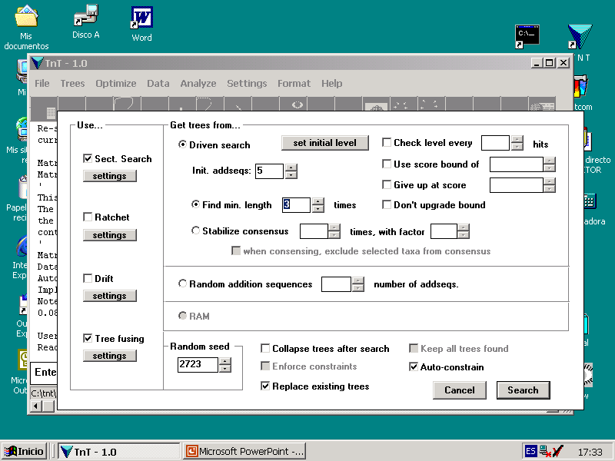
This dialog controls the settings
for New Tech Searches
Select the type of algorithms to be used
Create reduced data sets from parts of the tree
(using the HTU’s), analyze, and if a better solution
is found, re-insert into main tree.
settings

Slide 18
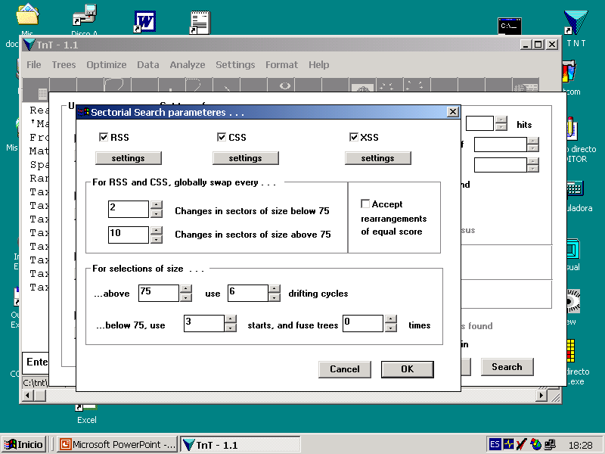
Exclusive Sectorial Searches (XSS), select groups by dividing tree
in sectors that cover the entire tree but have no overlap. They have
the advantage (over the other two) of guaranteeing that no part of the
tree will remain unanalyzed. They work best when limits between
sectors vary slightly among rounds (default), instead of selecting
the sectors of as even a size as possible.
Constrained Sectorial Searches (CSS), select groups by reference
to groups in constraints. The constraints can be defined by the
user (as positive constraints with no floating taxa), or calculated
during multiple addition sequences by consensing the previous tree
and the initial stages of the current replication. The latter is done
checking the “Auto-Constrain” option.
Random sectorial searches (RSS), select sectors at random.
The min/max possible size of the sectors, as well as the
number of selections to do for different sizes, is determined
with the “Settings” button. The number of selections is
determined with the “Factor” (larger numbers, more selections).
Sectorial searches can be of three types...
After making several changes to the tree in
different sectors, a round of global TBR is done
to insure global optimality. This determines the
number of sectors to change before global TBR.
Small sectors are analyzed with multiple random addition sequences plus
TBR. Larger sectors are analyzed with several cycles of tree-drifting. This
determines the size above which a sector is to be analyzed with drift.

Slide 19
The ratchet alternates phases of perturbation and search.
Perturbation is done by duplicating character weights, or
deleting characters. A phase where the ratchet moves
among trees of equal fit, until a certain number of
rearrangements is done, is sandwiched in the middle of the
perturbated phases. Except for the search phase (which
stops when no better trees can be found), the other phases
stop when a certain number of rearrangements have been
done, or when a certain proportion of the swapping has been
completed.
settings

Slide 20
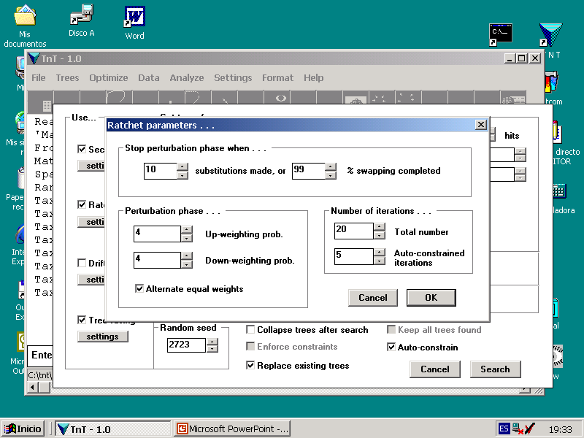
Every character has its weight duplicated (in the up-weighting phase),
or it is deleted (in the down-weighting phase), with an independent
probability. Setting the probability to zero, the corresponding phase is
skipped.
The up and down weighting phases alternate with a
phase where the swapping accepts only rearrangements
of equal/better fit. This phase can be skipped.
Auto-constrained iterations are done by consensing the result
of the perturbation phase (which is unconstrained, or uses only
user-defined constraints), with the tree resulting from the previous
search phase, and using that tree as constraint. This speeds up
the search phase, although it makes it somewhat less likely that
it will find shorter trees. Every certain number of auto-constrained
iterations, 5 in this case, an iteration without constraints (or using
only user-defined constraints) is done.

Slide 21
Tree-drifting is similar to the ratchet, in having a perturbation phase
and a search phase. The perturbation phase, in the case of drifting,
accepts suboptimal rearrangement with a probability that depends
on the ratio of steps saved/gained in all the characters, when doing the
rearrangement. As this ratio approaches unity (i.e. closer to a tie), the
more likely it is to accept the rearrangement.
settings

Slide 22
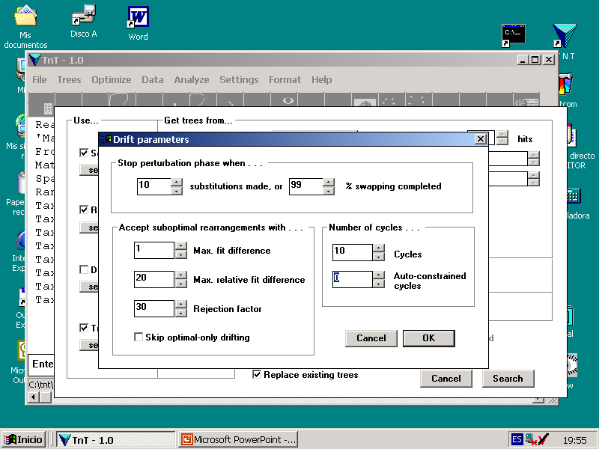
The dialog box for tree-drifting parameters is quite
similar to the one for the ratchet...
These options determine the maximum absolute (step or fit, if doing implied weights)
and relative differences that a rearrangement can have to be acceptable. Rearrangements
that exceed length of tree being swapped in more than 1 step, or with a ratio of steps
( saved – gained ) / saved greater than 0.20, are ignored. Data sets with many characters
(or very messy ones) may require that trees more than one step longer are accepted.
For suboptimal trees that are within the specified fit and
relative fit difference, this factor makes acceptance less
likely as it increases.

Slide 23
Tree-fusing takes several trees, and mixes them. The fusion of two trees
is done by inserting all the clades of the “source” into the “target” tree,
and if this produces a better tree, the exchange is accepted.
settings

Slide 24
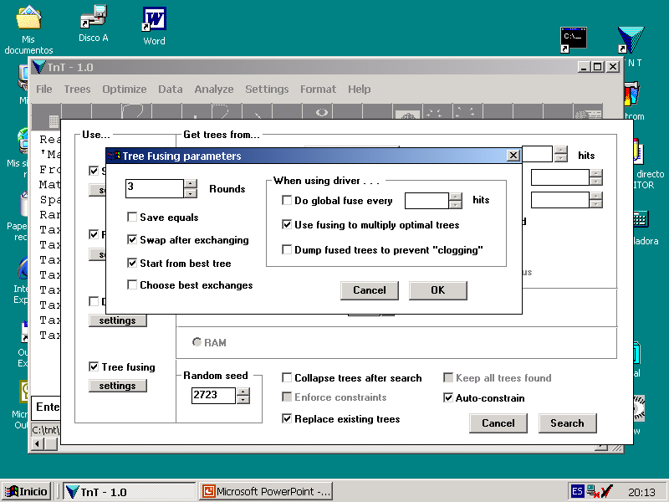
The dialog for tree-fusing determines the number of rounds. A round consists
of taking one tree (optionally, the best can be used in the first round) and then
fusing that tree with every one of the remaining trees. The next round, a new tree
is chosen, and all the remaining trees (ncluding the one produced in the previous
round) are fused with that tree.
If a driven search is being done, then fusing every certain number of
hits all the trees found provides an additional criterion to insure
that optimality has been reached.
After minimum length is hit, fusing the suboptimal trees
with the optimal trees may produce additional most
parsimonious trees, which make it less likely that the
consensus is overresolved.
If several fuses fail to produce shortest trees, the (suboptimal)
trees produced by fusing may accumulate and make more difficult,
for subsequent fuses, to find optimal trees (the trees produced by
fusing do not actually add new variation, but simply different
combinations of the preexisting groups). With this option, the trees
produced by fusing, if suboptimal, are discarded.

Slide 25
With this option, the program checks whether
minimum length was hit in previous hits easily
or with difficulty (i.e. with many new builds
subjected to fusing), and changes the parameters
of the search to make it more or less aggressive.
This makes the search more or less aggresive,
changing the parameters of the search in a more
or less harmonious manner.
The search can proceed until minimum length is hit a given number
of times, or the consensus becomes stable ...
... or it can use a given number of
random addition sequences as
starting point, and then stop...
... or (when there are trees in memory) it can
use the trees already in memory as starting point...
16218
A given replication will continue until the best length
found so far is hit again. This option provides an initial
minimum length (otherwise, the first hits may give up
at suboptimal lengths).
When checking this box, a replication will move to the
next as soon as the length specified here is found.
This produces hits to minimum length in as short as
possible. This should be used when minimum length is
known with some confidence, and the search is trying
to produce many hits to calculate the consensus.

Slide 26
This determines a value of suboptimal, to be used during searches.
Two values can be defined: the absolute and relative fit difference.
If no relative fit difference is defined, then all the trees within the
specified absolute fit difference are accepted; otherwise, they are
accepted only when the ratio of steps ( saved – gained ) / saved is
within the specified value. This values also have effect when
collapsing trees with SPR or TBR (e.g. for consensus calculation).
This can be used to provide more reliable (although less resolved)
estimations.
If a time-out is defined, then the search
will stop when the time-out is reached.
Evaluate support by means of resampling
Estimate the consensus, by comparing the results of several
independent searches. This can be used to have a quick idea
of what groups are supported by your data (it may miss some
poorly supported groups, it produces few or no spurious groups ).

Slide 27
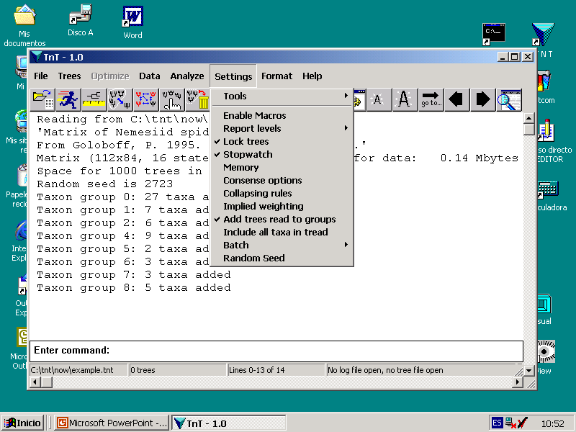
The Settings submenu allows choosing tools, report and
warning level, general collapsing options, implied weighting,
and controls the batch mode.
TNT has an interpreter for a scripting
language. This language allows the user
to automate complex tasks, so that TNT
can make decisions, loops, and access
values of internal variables. It also lets
you define your own dialogs. See the
section on Scripting, under Help.
Use this to select the tools you want
to be displayed. The tool selection is
automatically saved and used in
future sessions.
This allows warnings to be displayed or
not, and the report levels to be set.
Choosing Report Progress, you can set
the program to record progress during
searches, every certain number of
seconds, trees swapped, or replications.
The Memory dialog controls the general
RAM used by the program, the size of
the text-buffer, and the number of trees
that the internal tree file can hold (this
is equivalent to the MaxTrees of PAUP).
This controls whether trees are collapsed
temporarily for consensing/comparing,
and whether unshared taxa are pruned
off the trees (temporarily) for consensing.
Temporary collapsing is done according
to the criterion in effect.
Tree collapsing can be done in several ways.
The strictest is TBR-collapsing (i.e. swap the
tree to be collapsed, and if a rearrangement
produces a tree as good, or within the value
of suboptimal, all the nodes between original
and final destination are collapsed). If cons-
traints are being enforced, collapsing takes
constraints into account (keeping constrained
groups, regardless of support). The strictest
collapsing that can be applied during searches
is “min. length = 0” (if a stricter collapsing is
in effect, it is ignored).
This turns implied weighting ON and OFF. Implied
weighting evaluates trees with a criterion that takes
into account the homoplasy. If turned ON, all the search
and tree comparison routines are done under implied
weights. With the default weighting function, a concavity
constant determines how strongly to weight against
characters with homoplasy (the larger the constant, the
closer to equal weights). This function can be used for
continuous, Sankoff, or standard characters. It is also
possible to define a function, by storing the (relative)
weights to assign to each possible number of extra
steps in a file (preceded by the string piwe[ ).
User-weighting functions can be defined only if the data
set has been read with implied weights turned ON, and
cannot be applied to continuous/Sankoff characters.
Note that implied weighting uses floating-point (=exact)
calculations, instead of integer (=approximate) calcula-
tions, as in Pee-Wee. Bear in mind that exact ties are
much less likely when using floating-point, so that few
trees are strictly optimal. Many of the groups in the
optimal trees, however, may be very poorly supported,
so that when using implied weights, it is very important
to collapse groups with poor support.
If you set the batch mode ON, then clicking on any
option, instead of executing the action, stores it
in memory. The actions can be later executed, in the
same sequence. The sequence of actions can be
changed with Edit Actions Stored. The actions can be
saved to a file, and read again in future sessions.

Slide 28
Aside from “traditional” implied weighting, TNT
also implements a method to weight dynamically
(during optimization, and thus during searches)
the different character-state transformations,
individually. This is computationally very complex,
and can be time consuming for medium or large
sized data sets, or data sets where some characters
can have large numbers of possible states.

Slide 29
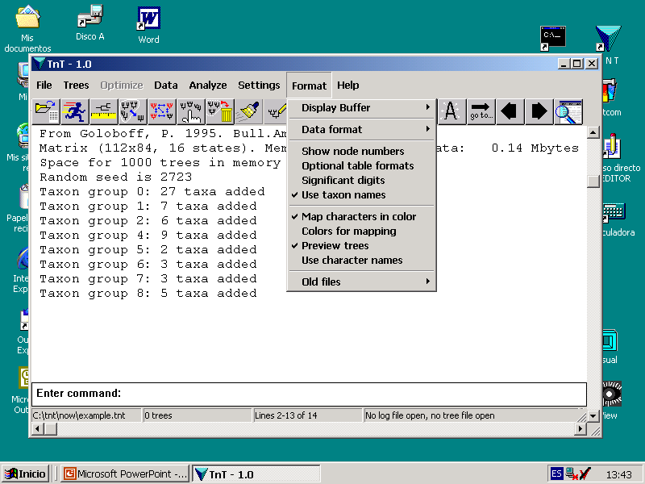
The Format submenu controls the general
display options (some of which were shown
in earlier slides)
This determines how to read data files.
If the string “nstates format;” (where
format can be dna, prot, num, or cont)
is included in the file itself, before the
data, then there is no need to select
the data type from the menus.
The tables can be displayed in an
optional format. The optional format
may be more compact in some cases.
When implied weighting is ON, tree
scores are displayed as floating
point, using the number of decimals
specified here (default is 2).

Slide 30
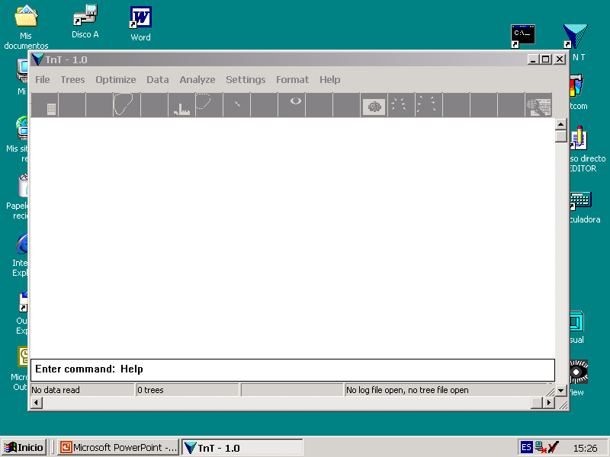
Most of the operations shown so far (and
others not shown in this quick tutorial) can
also be done using commands. If you plan to
use TNT seriously, you should learn the syntax
for commands. For a complete list of all the
commands, type Help at the command line.

Slide 31
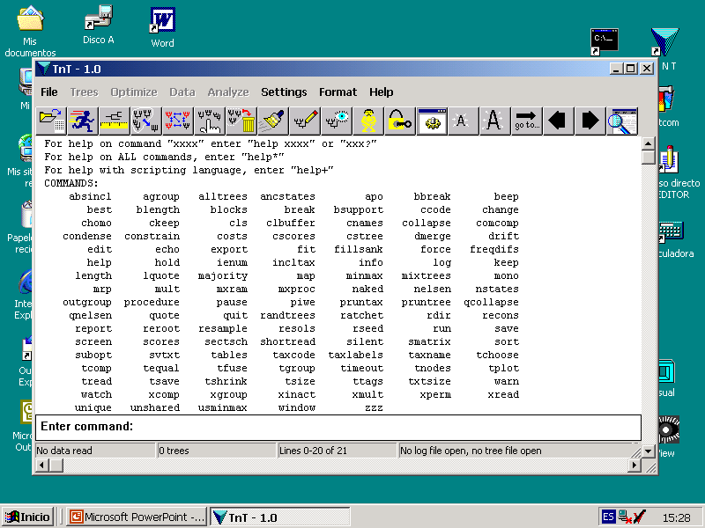

Slide 32
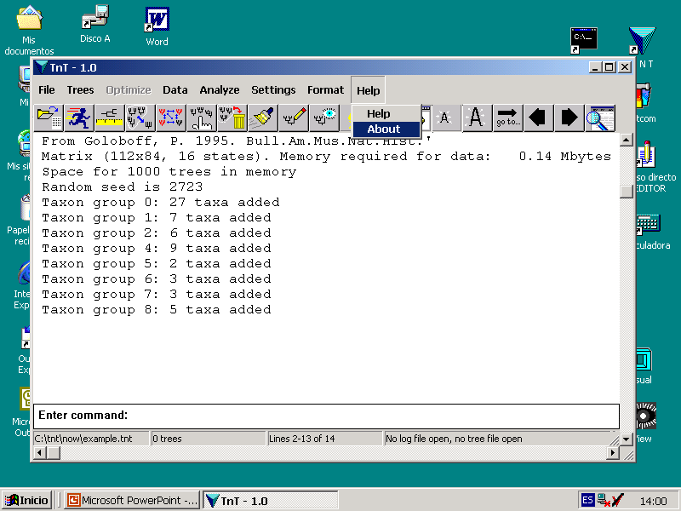
The About option contains basic info
on TNT, as well as the acknowledgments,
and the proper way to cite the program.
If you use TNT and publish results obtained
using the program (even if a demo version)
you should cite the program.
This concludes the quick
tutorial on T N T . . .

