Slide 1
Transfer Learning
Concept of transfer learning, its benefits, and examples of its application in NLP and computer vision

Slide 2
Table of contents
What is transfer learning?
Traditional vs. Transfer Learning
Types of Transfer Learning
Process
Benefits of Transfer Learning
Transfer Learning Applications
Applications in NLP
Applications in Computer Vision
Conclusion

Slide 3
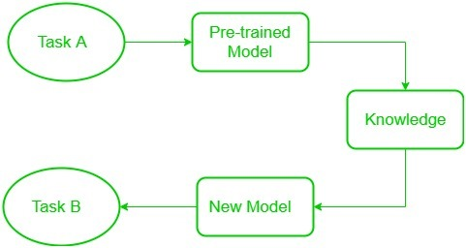
What is transfer learning?

Slide 4
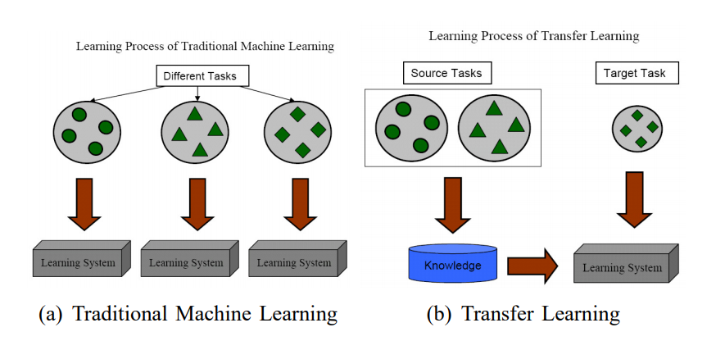
Traditional vs. Transfer Learning

Slide 5
Types of Transfer Learning
Inductive Transfer Learning
Transductive Transfer Learning
Unsupervised Transfer Learning

Slide 6
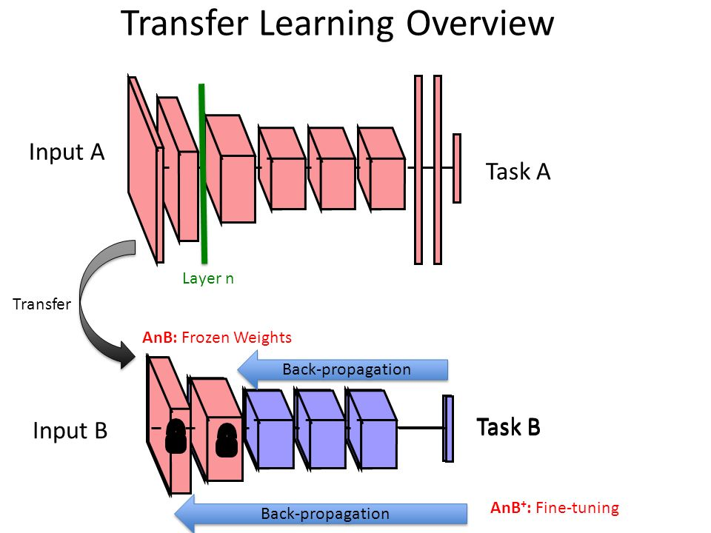
Process
Start with pre-trained network
Partition network into:
Featurizers: identify which layers to keep
Classifiers: identify which layers to replace
Re-train classifier layers with new data
Unfreeze weights and fine-tune whole network with smaller learning rate

Slide 7

Benefits of Transfer Learning
Improved Model Performance
Efficient Use of Resources
Practical Applications

Slide 8
Transfer Learning Applications
Image classification (most common): learn new image classes
Text sentiment classification
Text translation to new languages
Speaker adaptation in speech recognition
Question answering

Slide 9
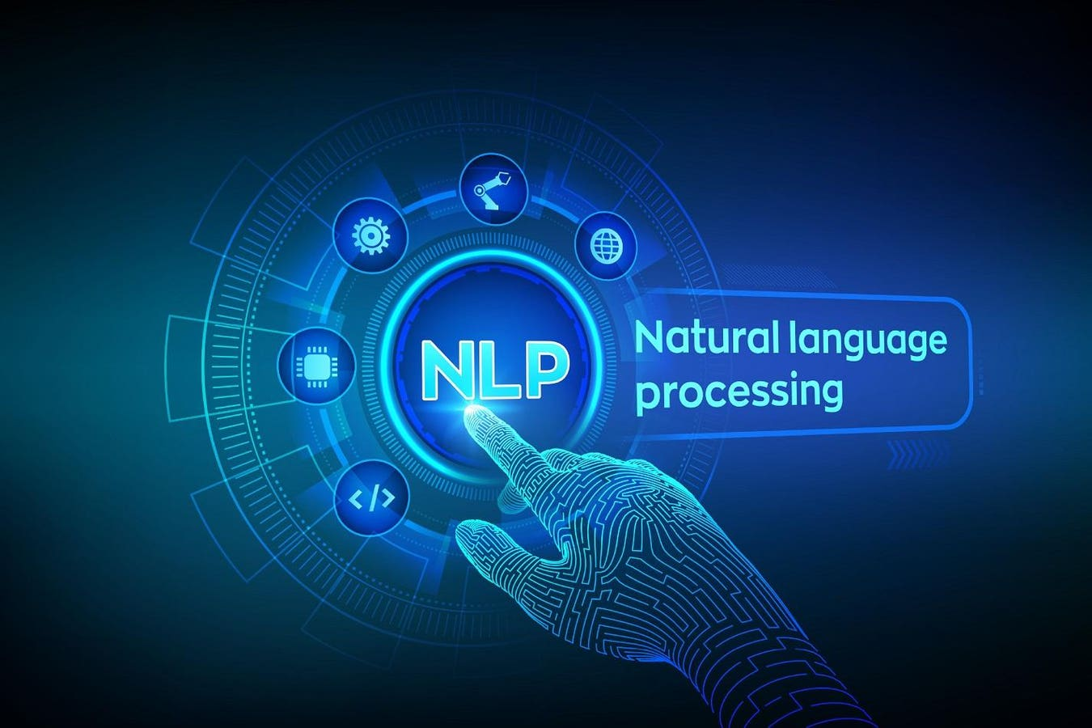
Applications in NLP
Pre-trained Language Models
BERT (Bidirectional Encoder Representations from Transformers)
GPT (Generative Pre-trained Transformer)
Text Classification
Named Entity Recognition (NER)

Slide 10
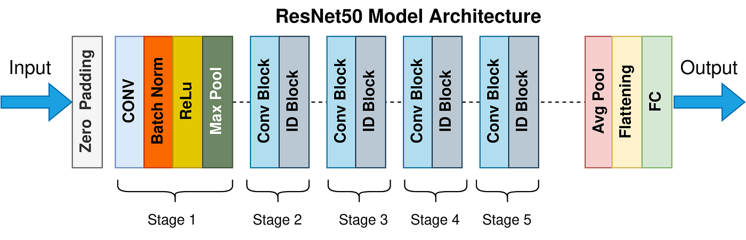
Applications in Computer Vision
Image Classification
ResNet (Residual Networks)
VGGNet
Object Detection
YOLO (You Only Look Once)
Faster R-CNN
Image Segmentation
U-Net
DeepLab

Slide 11
Conclusion
Transfer learning enhances model performance and efficiency across NLP and Computer Vision by leveraging pre-trained models for specific tasks.

