Slide 1
Memory and Caching
Chapter 6

Slide 2
Chapter 6 Objectives
Master the concepts of hierarchical memory organization.
Understand how each level of memory contributes to system performance, and how the performance is measured.
Master the concepts behind cache memory
  Skipping virtual memory, memory segmentation, paging and address translation. Cover in OS class.

Slide 3
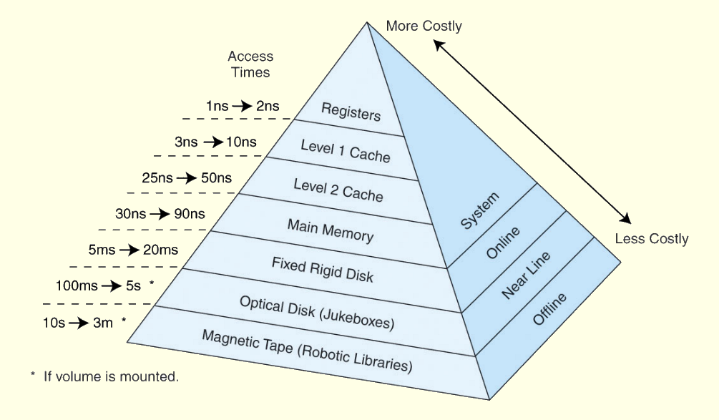
The Memory Hierarchy
This storage organization can be thought of as a pyramid:

Slide 4
Hierarchy List
Registers
L1 Cache
L2 Cache
Main memory
Disk cache
Disk
Optical
Tape
As one goes down the hierarchy
  Decreasing cost per bit
  Increasing capacity
  Increasing access time
  Decreasing frequency of access of the memory by the processor – locality of reference

Slide 5
Locality of Reference
Temporal Locality
  Programs tend to reference the same memory locations at a future point in time
  Due to loops and iteration, programs spending a lot of time in one section of code
Spatial Locality
  Programs tend to reference memory locations that are near other recently-referenced memory locations
  Due to the way contiguous memory is referenced, e.g. an array or the instructions that make up a program
  Sequential Locality
    Instructions tend to be accessed sequentially
Locality of reference does not always hold, but it usually holds

Slide 6
Semiconductor Memory
RAM – Random Access Memory
  Misnamed as all semiconductor memory is random access
  Read/Write
  Volatile
  Temporary storage
  Two main types: Static or Dynamic

Slide 7
Dynamic RAM
Bits stored as charge in semiconductor capacitors
Charges leak
Need refreshing even when powered
Simpler construction
Smaller per bit
Less expensive
Need refresh circuits (every few milliseconds)
Slower
Main memory

Slide 8
Static RAM
Bits stored as on/off switches via flip-flops
No charges to leak
No refreshing needed when powered
More complex construction
Larger per bit
More expensive
Does not need refresh circuits
Faster
Cache

Slide 9
So you want fast?
It is possible to build a computer which uses only static RAM (the memory used to build a cache)
This would be very fast
This would need no cache
  How can you cache cache?
This would cost a very large amount

Slide 10
Read Only Memory (ROM)
Permanent storage
Microprogramming
Library subroutines
Systems programs (BIOS)
Function tables

Slide 11
Types of ROM
Written during manufacture
  Very expensive for small runs
Programmable (once)
  PROM
  Needs special equipment to program
Read “mostly”
  Erasable Programmable (EPROM)
    Erased by UV
  Electrically Erasable (EEPROM)
    Takes much longer to write than read
  Flash memory
    Erase whole memory electrically

Slide 12

Cache
Small amount of fast memory
Sits between normal main memory and CPU
May be located on CPU chip or module
  An entire blocks of data is copied from memory to the cache because the principle of locality tells us that once a byte is accessed, it is likely that a nearby data element will be needed soon.

Slide 13
Cache operation - overview
CPU requests contents of memory location
Check cache for this data
If present, get from cache (fast)
If not present, read required block from main memory to cache
Then deliver from cache to CPU
Cache includes tags to identify which block of main memory is in each cache slot

Slide 14
Cache Definitions
This leads us to some definitions.
  A hit is when data is found at a given memory level.
  A miss is when it is not found.
  The hit rate is the percentage of time data is found at a given memory level.
  The miss rate is the percentage of time it is not.
  Miss rate = 1 - hit rate.
  The hit time is the time required to access data at a given memory level.
  The miss penalty is the time required to process a miss, including the time that it takes to replace a block of memory plus the time it takes to deliver the data to the processor.

Slide 15
Cache Example
Consider a Level 1 cache capable of holding 1000 words with a 0.1 μs access time. Level 2 is memory with a 1 μs access time.
If 95% of memory access is in the cache:
  T=(0.95)*(0.1 μs) + (0.05)*(0.1+1 μs) = 0.15 μs
If 5% of memory access is in the cache:
  T=(0.05)*(0.1 μs) + (0.95)*(0.1+1 μs) = 1.05 μs
Want as many cache hits as possible!
1.1 μs
0.1 μs
0%
100%

Slide 16
Cache Design
If memory contains 2^{n} addressable words
  Memory can be broken up into blocks with K words per block. Number of blocks = 2^{n} / K
  Cache consists of C lines or slots, each consisting of K words
  C << M
  How to map blocks of memory to lines in the cache?
Memory
Block 0
Block 1
…
Block (2^{n}/K)-1
Cache
Line 0
Line 1
…
Line C-1

Slide 17
Cache Design
Size
Mapping Function
Replacement Algorithm
Write Policy
Block Size
Number of Caches

Slide 18
Size does matter
Cost
  More cache is expensive
Speed
  More cache is faster
  Up to a point - diminishing returns as cache increases in size
    Also can take longer to search the more cache there is

Slide 19
Mapping Function
Suppose we have the following configuration
  Word size of 1 byte
  Cache of 16 bytes
  Cache line / Block size is 2 bytes
    i.e. cache is 16/2 = 8 (2³) lines of 2 bytes per line
    Will need 8 addresses for a block in the cache
  Main memory of 64 bytes
    6 bit address needed to reference 64 bytes
    (2⁶= 64)
    64 bytes / 2 bytes-per-block → 32 Memory Blocks
  Somehow we have to map the 32 memory blocks to the 8 lines in the cache. Multiple memory blocks will have to map to the same line in the cache!

Slide 20
Mapping Function – 64K Cache Example
Suppose we have the following configuration
  Word size of 1 byte
  Cache of 64 KByte
  Cache line / Block size is 4 bytes
    i.e. cache is 64 Kb / 4 bytes = 16,384 (2¹⁴) lines of 4 bytes
  Main memory of 16MBytes
    24 bit address
    (2²⁴=16M)
    16Mb / 4bytes-per-block → 4 Meg of Memory Blocks
  Somehow we have to map the 4 Meg of blocks in memory onto the 16K of lines in the cache. Multiple memory blocks will have to map to the same line in the cache!

Slide 21
Direct Mapping
Simplest mapping technique - each block of main memory maps to only one cache line
  i.e. if a block is in cache, it must be in one specific place
Formula to map a memory block to a cache line:
  i = j mod c
    i=Cache Line Number
    j=Main Memory Block Number
    c=Number of Lines in Cache
  i.e. we divide the memory block by the number of cache lines and the remainder is the cache line address

Slide 22
Direct Mapping with C=4
Shrinking our example to a cache line size of 4 slots (each slot/line/block still contains 4 words):
  Cache Line Memory Block Held
    0 0, 4, 8, …
    1 1, 5, 9, …
    2 2, 6, 10, …
    3 3, 7, 11, …
  In general:
    0 0, C, 2C, 3C, …
    1 1, C+1, 2C+1, 3C+1, …
    2 2, C+2, 2C+2, 3C+2, …
    3 3, C+3, 2C+3, 3C+3, …

Slide 23
Direct Mapping with C=4
Valid Dirty Tag
Block 0
Main
Memory
Slot 0
Block 1
Slot 1
Block 2
Slot 2
Block 3
Slot 3
Block 4
Cache Memory
Block 5
Each slot contains K words
Tag: Identifies which memory block is in the slot
Valid: Set after block copied from memory to indicate the cache line has valid data
Block 6
Block 7

Slide 24
Direct Mapping Address Structure
There is an easy way to compute
i = j mod c
based upon the bits in the address we are trying to access
Address is in three parts
  Least Significant w bits identify unique word within a cache line
    w must be enough bits to address a specific word in a cache line; e.g. if 4 words per cache line, then we need 2 bits for w
  Next Significant s bits specify which line this address maps into
    s must be enough bits to address a specific line in the cache; e.g. if 16 cache lines, then we need 4 bits for s
  Remaining t bits used as a tag to identify the memory block
Tag t
Line or Slot s
Word w
2
4
2
8 bit address

Slide 25
Direct Mapping Address 64K Cache Example
cache only
memory address
V D
Tag t
Line or Slot s
Word w
1
1
8
14
2
Given a 24 bit address (to access 16Mb)
2 bit word identifier (4 byte block)
Need 14 bits to address the cache slot/line
Leaves 8 bits left for tag (=22-14)
No two blocks in the same line have the same Tag field
Check contents of cache by finding line and checking Tag
Also need a Valid bit and a Dirty bit
  Valid – Indicates if the slot holds a block belonging to the program being executed
  Dirty – Indicates if a block has been modified while in the cache. Will need to be written back to memory before slot is reused for another block

Slide 26
Direct Mapping Example, 64K Cache
Cache Memory
Main Memory
Addr Tag W0 W1 W2 W3
Addr (hex) Data
00 F1 F2 F3 F4
000000 F1
000001 F2
000002 F3
000003 F4
000004 AB
…
1B0004 11
1B0005 12
1B0006 13
1B0007 14
0
1
2
3
4
5
..
..
2¹⁴-1
1B 11 12 13 14
Line 0
Line 1
Line 1
1B0007 = 0001 1011 0000 0000 0000 0111
Word = 11, Line = 0000 0000 0000 01, Tag= 0001 1011

Slide 27
Cache Example
The website for the textbook includes a link to CAMERA, a cache simulator
Example for direct-mapped cache

Slide 28
Direct Mapping pros & cons
Simple
Inexpensive
Fixed location for given block
  If a program accesses 2 blocks that map to the same line repeatedly, cache misses are very high – condition called thrashing

Slide 29
Fully Associative Mapping
A fully associative mapping scheme can overcome the problems of the direct mapping scheme
  A main memory block can load into any line of cache
  Memory address is interpreted as tag and word
  Tag uniquely identifies block of memory
  Every line’s tag is examined for a match
  Also need a Dirty and Valid bit
But Cache searching gets expensive!
  Ideally need circuitry that can simultaneously examine all tags for a match
  Lots of circuitry needed, high cost
Need replacement policies now that anything can get thrown out of the cache (will look at this shortly)

Slide 30
Associative Mapping Example
Valid Dirty Tag
Block 0
Main
Memory
Slot 0
Block 1
Slot 1
Block 2
Slot 2
Block 3
Slot 3
Block 4
Cache Memory
Block 5
Block 6
Block can map to any slot
Tag used to identify which block is in which slot
All slots searched in parallel for target
Block 7

Slide 31
Associative Mapping 64K Cache Example
Word
2 bit
Tag 22 bit
22 bit tag stored with each slot in the cache – no more bits for the slot line number needed since all tags searched in parallel
Compare tag field of a target memory address with tag entry in cache to check for hit
Least significant 2 bits of address identify which word is required from the block, e.g.:
  Address: FFFFFC = 1111 1111 1111 1111 1111 1100
    Tag: Left 22 bits, truncate on left:
      11 1111 1111 1111 1111 1111
      3FFFFF
  Address: 16339C = 0001 0110 0011 0011 1001 1100
    Tag: Left 22 bits, truncate on left:
      00 0101 1000 1100 1110 0111
      058CE7

Slide 32
CAMERA Example
CAMERA simulator for a fully-associative cache

Slide 33
Set Associative Mapping
Compromise between fully-associative and direct-mapped cache
  Cache is divided into a number of sets
  Each set contains a number of lines
  A given block maps to any line in a specific set
    Use direct-mapping to determine which set in the cache corresponds to a set in memory
    Memory block could then be in any line of that set
  e.g. 2 lines per set
    2 way associative mapping
    A given block can be in either of 2 lines in a specific set
  e.g. K lines per set
    K way associative mapping
    A given block can be in one of K lines in a specific set
    Much easier to simultaneously search one set than all lines

Slide 34
Set Associative Mapping
To compute cache set number:
  SetNum = j mod v
    j = main memory block number
    v = number of sets in cache
Main Memory
Block 0
Block 1
Set 0
Slot 0
Block 2
Slot 1
Block 3
Set 1
Slot 2
Block 4
Slot 3
Block 5

Slide 35
Set Associative Mapping
64K Cache Example
Word
2 bit
Tag 9 bit
Set 13 bit
E.g. Given our 64Kb cache, with a line size of 4 bytes, we have 16384 lines. Say that we decide to create 8192 sets, where each set contains 2 lines. Then we need 13 bits to identify a set (2¹³=8192)
Use set field to determine cache set to look in
Compare tag field of all slots in the set to see if we have a hit, e.g.:
  Address = 16339C = 0001 0110 0011 0011 1001 1100
    Tag = 0 0010 1100 = 02C
    Set = 0 1100 1110 0111 = 0CE7
    Word = 00 = 0
  Address = 008004 = 0000 0000 1000 0000 0000 0100
    Tag = 0 0000 0001 = 001
    Set = 0 0000 0000 0001 = 0001
    Word = 00 = 0

Slide 36
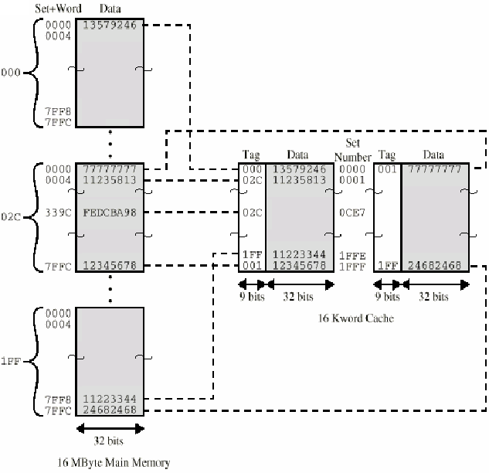
Two Way Set Associative Example
Address
16339C

Slide 37
CAMERA Example
CAMERA simulator for a k-way set associative cache

Slide 38
K-Way Set Associative
Two-way set associative gives much better performance than direct mapping
  Just one extra slot avoids the thrashing problem
Four-way set associative gives only slightly better performance over two-way
Further increases in the size of the set has little effect other than increased cost of the hardware!

Slide 39
Replacement Policy (1)
The replacement policy is the technique we use to determine which line in the cache should be thrown out when we want to put a new block in from memory
Direct mapping
  No choice
  Each block only maps to one line
  Replace that line

Slide 40
Replacement Algorithms (2)
Associative & Set Associative
Algorithm must be implemented in hardware (speed)
Least Recently used (LRU)
  e.g. in 2 way set associative, which of the 2 block is LRU?
    For each slot, have an extra bit, USE. Set to 1 when accessed, set all others to 0.
  For more than 2-way set associative, need a time stamp for each slot - expensive
First in first out (FIFO)
  Replace block that has been in cache longest
  Easy to implement as a circular buffer
Least frequently used
  Replace block which has had fewest hits
  Need a counter to sum number of hits
Random
  Almost as good as LFU and simple to implement

Slide 41
Write Policy
So far we’ve only discussed reading memory, we may also write back to memory
If a memory write only updates the cache, then the cache is now inconsistent with main memory
  Could cause problems
  Reading in another memory block that maps to the same cache line
  I/O device or another processor might directly try to read/write to memory

Slide 42
Write through
Simplest technique to handle the cache inconsistency problem - All writes go to main memory as well as cache.
Multiple CPUs must monitor main memory traffic (snooping) to keep local cache local to its CPU up to date in case another CPU also has a copy of a shared memory location in its cache
Simple but Lots of traffic
Slows down writes

Slide 43
Write Back
Updates initially made in cache only
  Dirty bit is set when we write to the cache, this indicates the cache is now inconsistent with main memory
Dirty bit for cache slot is cleared when update occurs
If cache line is to be replaced, write the existing cache line to main memory if dirty bit is set before loading the new memory block

Slide 44
Cache Performance
Two measures that characterize the performance of a cache are the hit ratio and the effective access time
  (Num times referenced words are in cache)
  Hit Ratio = -----------------------------------------------------
  (Total number of memory accesses)
  (# hits)(TimePerHit)+(# misses) (TimePerMiss)
  Eff. Access Time = --------------------------------------------------------
  (Total number of memory accesses)

Slide 45
Cache Performance Example
Direct-Mapped Cache
Memory
0-15
Block 0
Slot 0
Block 1
16-31
Slot 1
Block 2
32-47
Slot 2
Block 3
48-63
Slot 3
Block 4
64-79
Cache Memory
Block 5
80-95
Cache access time = 80ns
Main Memory time = 2500 ns
Block 6
…
Block 7

Slide 46
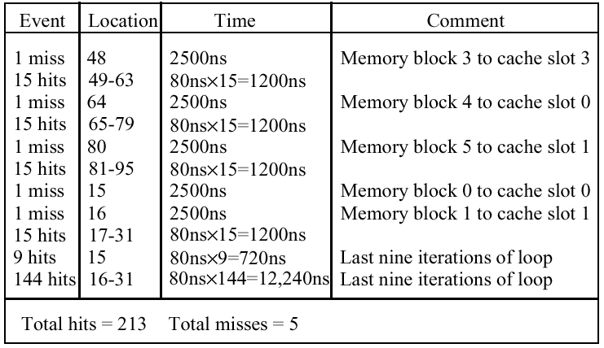
Cache Performance Example
Sample program executes from memory location 48-95 once. Then it executes from 15-31 in a loop ten times before exiting.

Slide 47
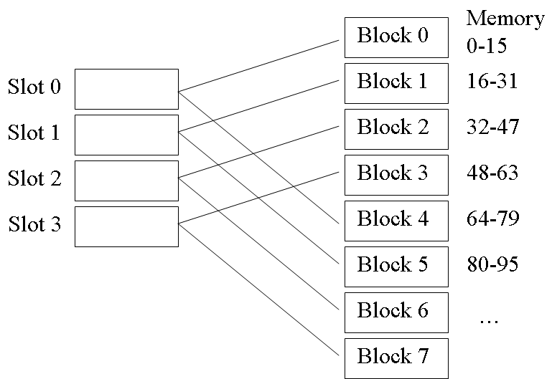
Once:
48-95
Ten Times:
15-31

Slide 48
Cache Performance Example
Hit Ratio: 213 / 218 = 97.7%
Effective Access Time: ((213)*(80ns)+(5)(2500ns)) / 218 = 136 ns
Although the hit ratio is high, the effective access time in this example is 75% longer than the cache access time due to the large amount of time spent during a cache miss
What sequence of main memory block accesses would result in much worse performance?

