Slide 1
Variational autoencoder
2023-08-13

Slide 2
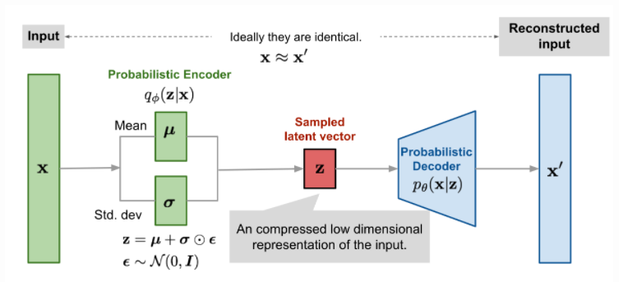
VAE structure

Slide 3
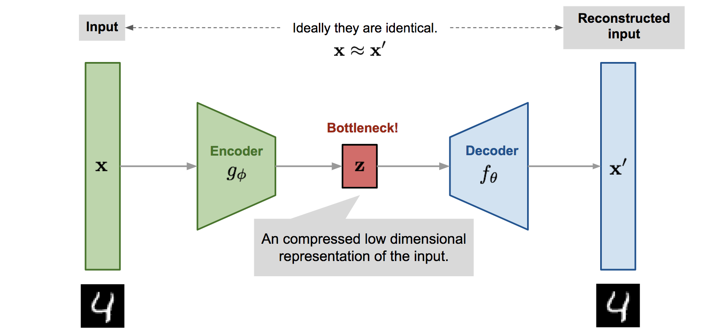
AE vs VAE
Make a latent vector
Make a distribution

Slide 4
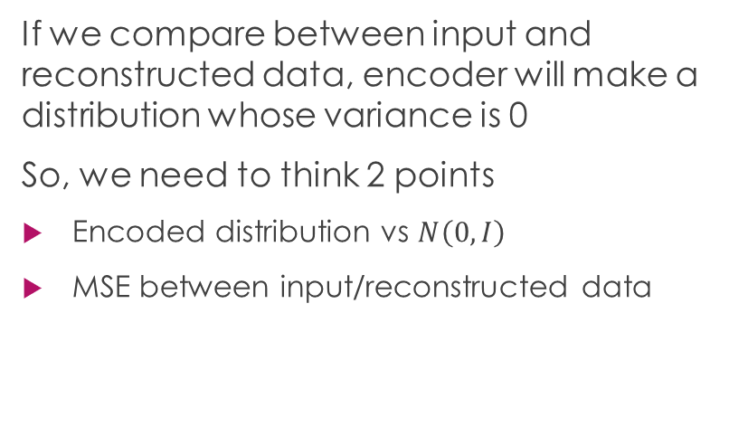
AE vs VAE (Loss function)
Autoencoder
Variational autoencoder
We compare between input and reconstructed data
MSE between input/reconstructed data
If we compare between input and reconstructed data, encoder will make a distribution whose variance is 0
So, we need to think 2 points
Encoded distribution vs $N\left(0, I\right)$
MSE between input/reconstructed data

Slide 5
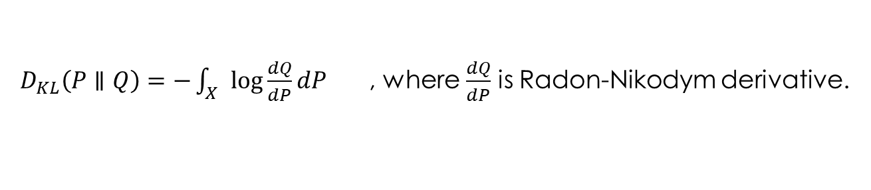

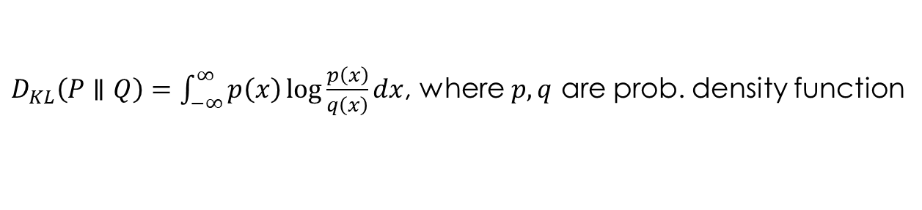
VAE Loss
MSE between input data and reconstructed data
Compare encoded distribution $P$ and $N\left(0, I\right)$
Use KL-divergence
$D_{KL}\left(P∥Q\right)=−\int_{X}{\log{\frac{dQ}{dP}dP}}$ , where $\frac{dQ}{dP}$ is Radon-Nikodym derivative.
$D_{KL}\left(P∥Q\right)=\int_{−∞}^{∞}{p\left(x\right)\log{\frac{p\left(x\right)}{q\left(x\right)}dx}}$, where $p, q$ are prob. density function

Slide 6
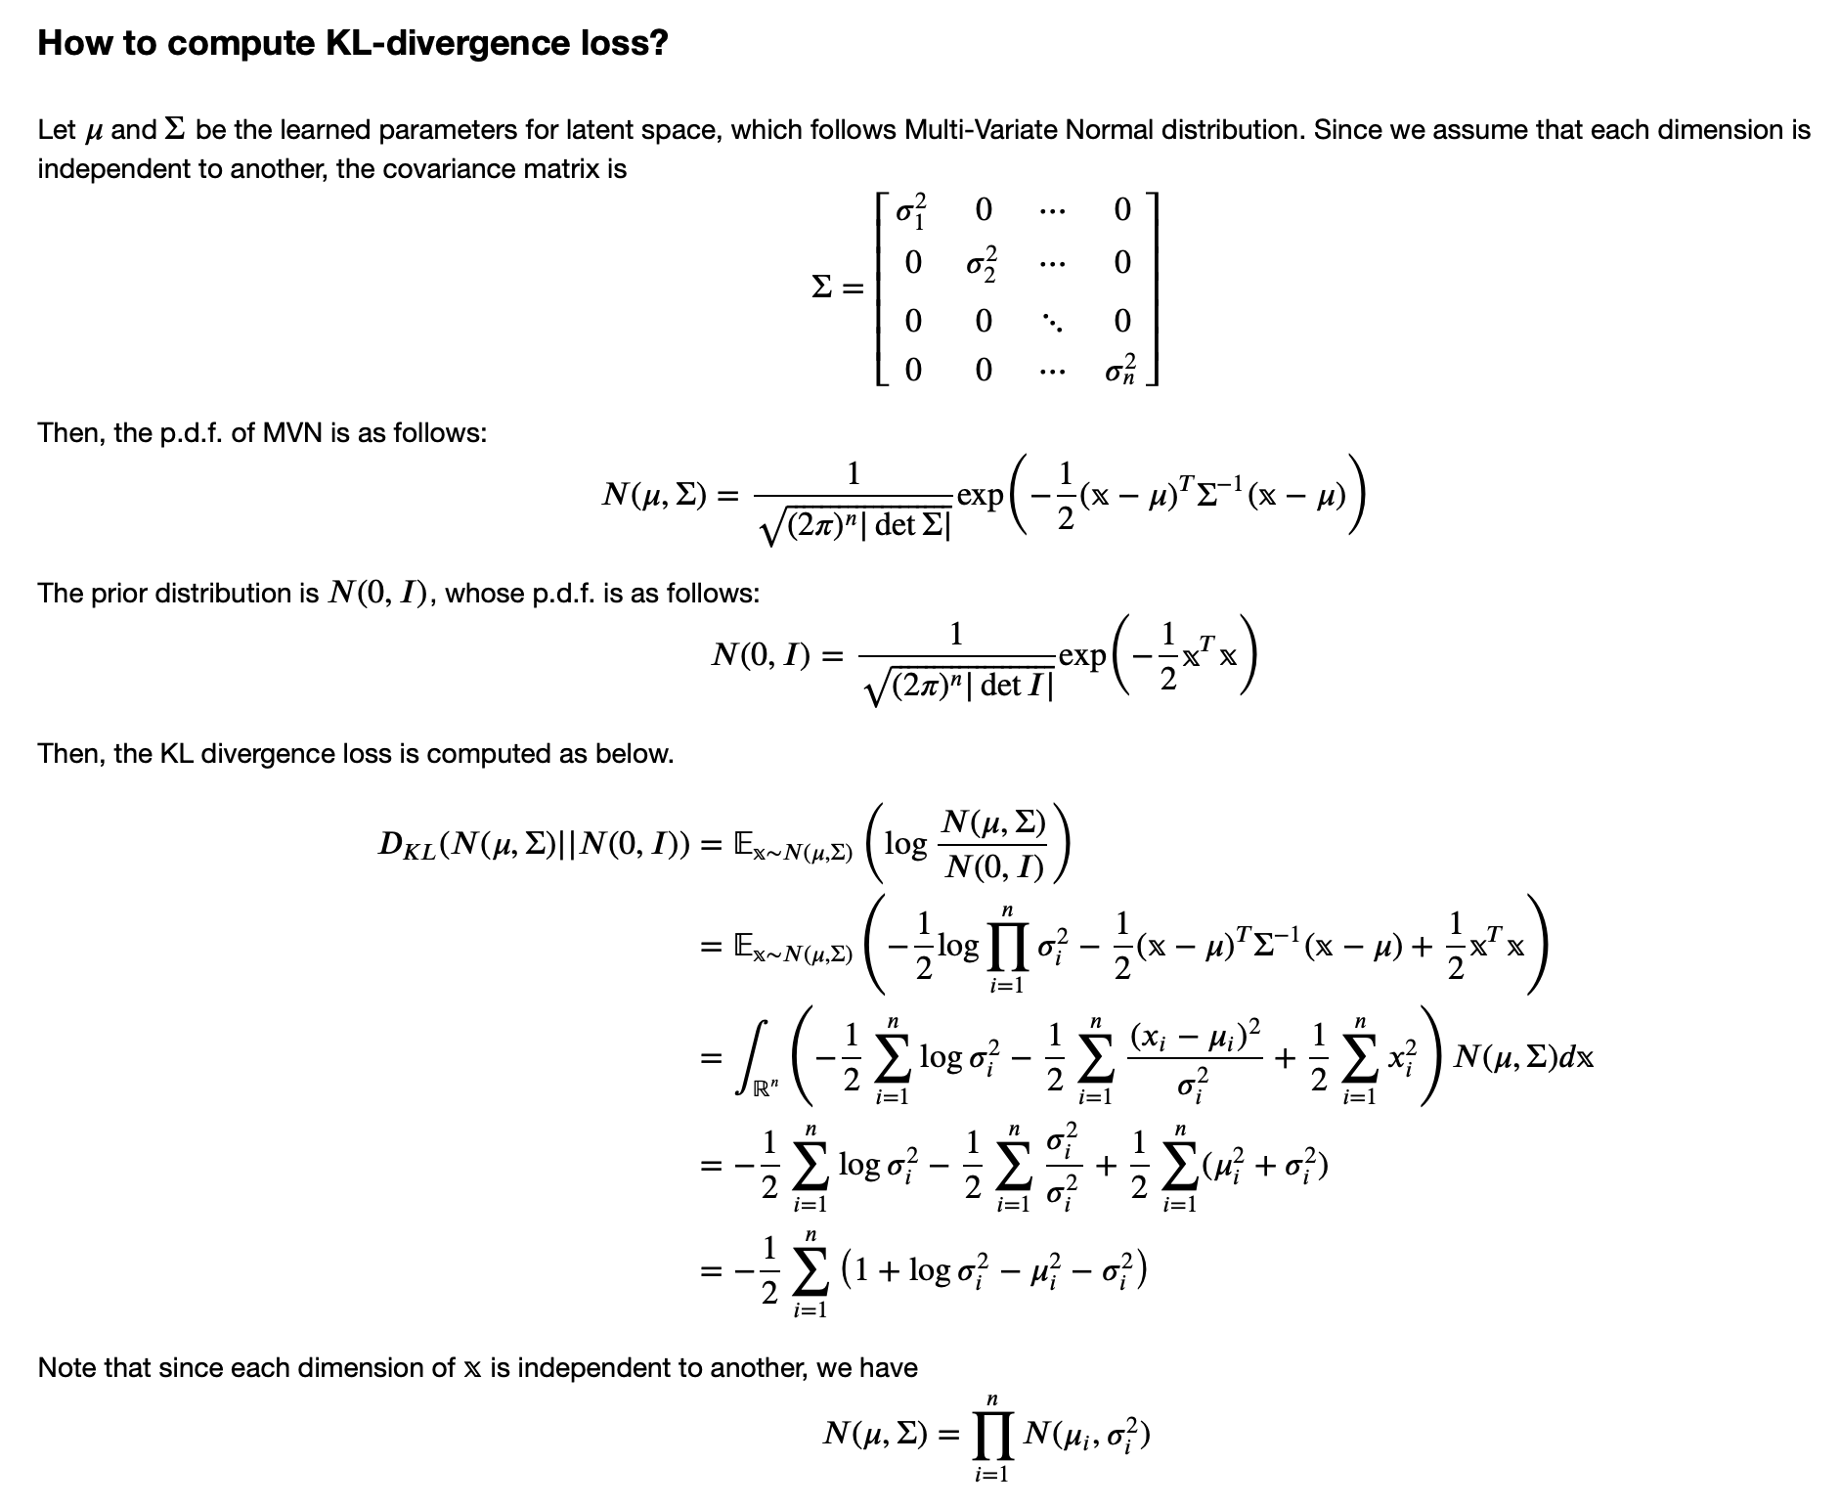
KL div

