Slide 1
Crimes in Chicago 2001-23 Data Analysis and Prediction
Prof. Haritha Yanam
Names-
Shubham Manoj Gengaje
Manisha Karnati

Slide 2
Contents
Introduction
Problem statement
Summary of data
Correlation Matrix of Data
Executive Summary
Exploratory Data Analysis
Feature engineering
PySpark ML algorithms and metrics
Conclusion
Recommendations
References

Slide 3
Introduction
The main goal of the project is to use the PySpark to clean the data, perform data exploration and visualization using PySpark and its libraries.
After data visualization, we will be using PySpark ML to make predictions.
PySpark: A python library for Apache Spark, an open-source, distributed computing system used for big data processing and analytics.
Exploratory Data Analysis(EDA): the process of visually and statistically analyzing datasets to uncover patterns, relationships, and insights, aiding in the understanding and preparation of data for further analysis or modeling.
Machine Learning(ML): a field of artificial intelligence that focuses on the development of algorithms and models that enable computers to learn patterns from data and make predictions or decisions without being explicitly programmed.

Slide 4
Problem Statement
Given a dataset containing information about Criminal incidents in Chicago from 2001-23, the goal is to develop a machine learning model using PySpark ML that can predict the primary type of crime based on various features associated with each incident. The features include details such as the date and time of the incident, location description, whether an arrest was made, and geographical coordinates.

Slide 5
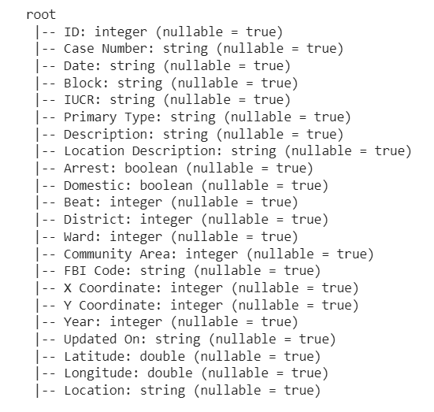
Summary of Data
Number of columns: 22
Number of rows: 708893
Type of data: single file csv
Size of data: Approx 2 GB

Slide 6
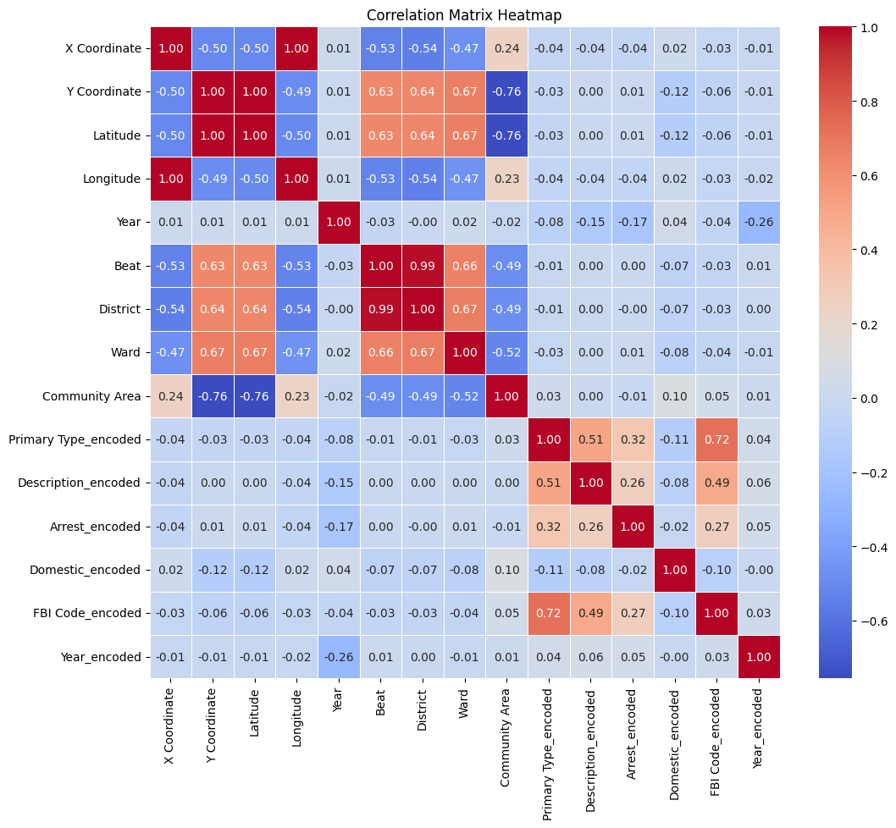
Correlation Matrix of Data

Slide 7
Executive Summary
From correlation, feature variables(‘Description’, ’Location Description’, ‘Arrest’, ‘Domestic’, ‘FBI Codes’, ‘Year’) are related to target(‘Primary type of crime’) by 50 to 70%.
Most of the crimes has been of type theft and battery which contributes to around 18% of total crimes.
Majority of the crimes have taken place at locations like streets, residence and apartment areas contributing around
According the data, more than 80% of criminals were not been arrested.
Application of certain FBI codes has resulted in lot of arrests like Code 18, 08B, 26 and 15 resulting in almost 60% of total arrests.

Slide 8
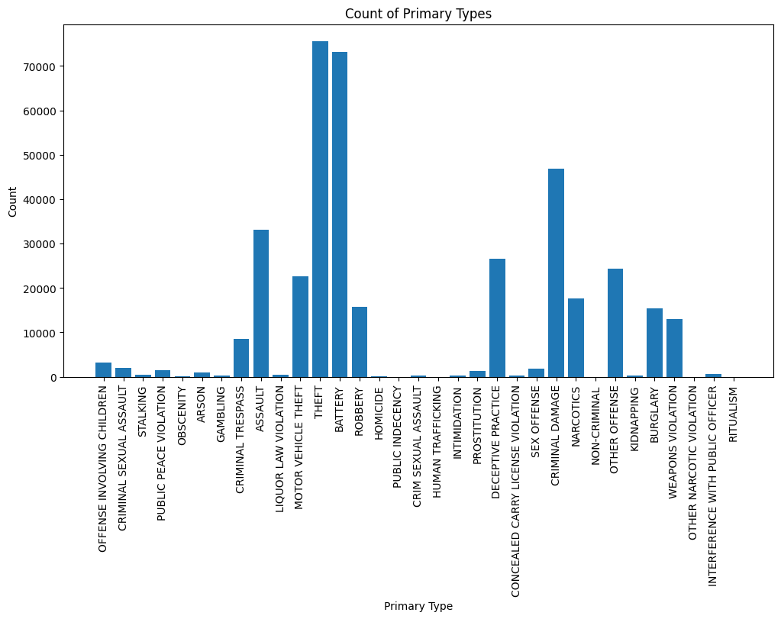
Exploratory Data Analysis
Count of primary types of crime happened over the years:
From this image we can conclude that most happened crime is theft (count=75656) and battery(offensive physical contact) (count=73198).
Least occurring crime is public indecency (count=9), human trafficking (count=14), narcotic violation (count=60) and ritualism (count=75).

Slide 9
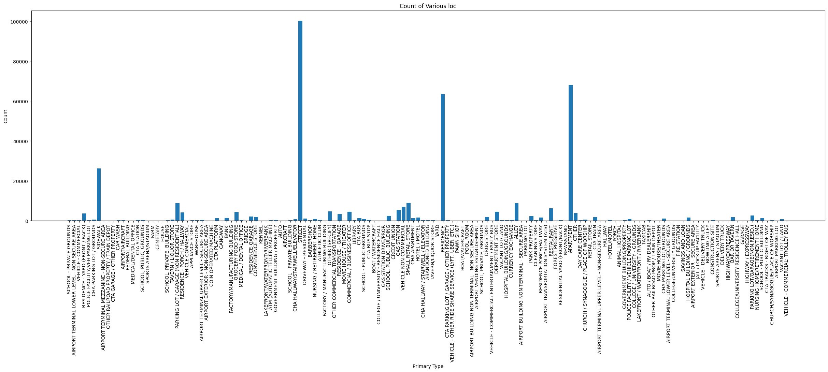
Which location is tending to have more crime?
Locations having maximum crime:
1.Street- (99668)
2.Apartment- (62453)
3.Residence- (61089)
Locations having minimum crime:
School
CTA Garage
Car wash
Farm
Cemetery
Aircraft
Manufacturing building

Slide 10
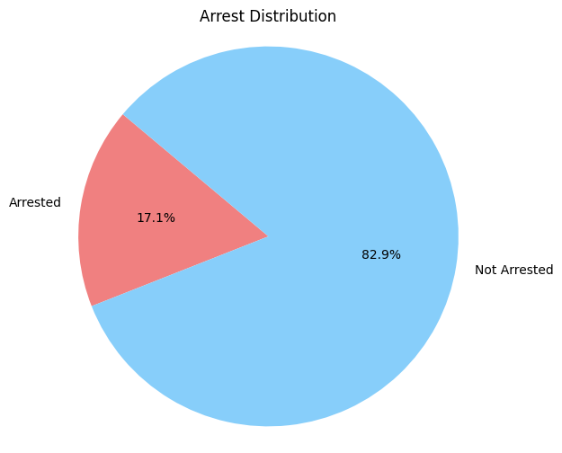
Arrest Distribution

Slide 11
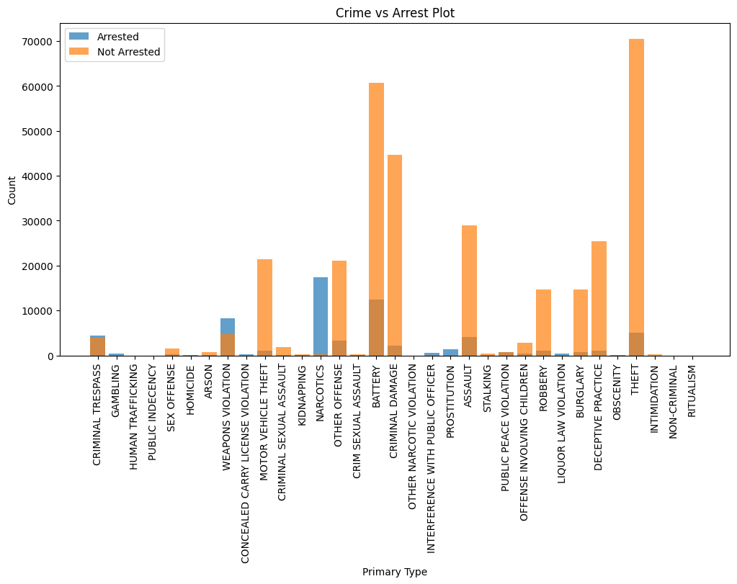
Which type of crime is getting arrest-count
Crimes getting most arrests:
1.Narcotics (count=18872)
2.Battery (count=14988)
3.Weapons violation (count=9127)
Crimes getting least arrests:
1.Homicide
2.Ritualism
3.Obscenity
4.Human Trafficking

Slide 12
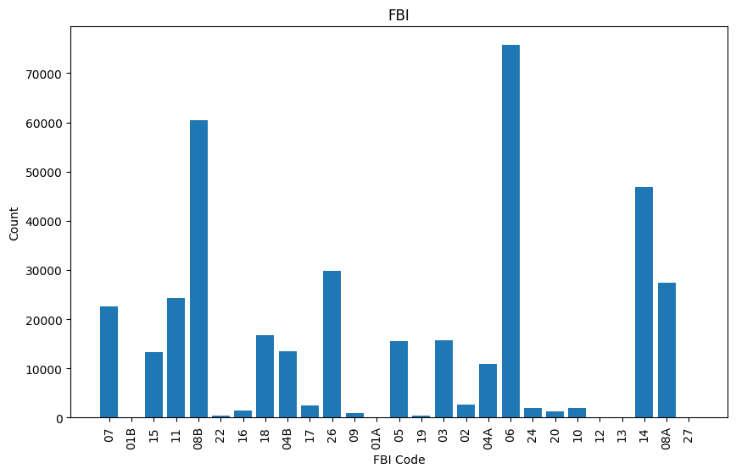
Which FBI codes were used for crimes-count
FBI codes used most:
1.Code 06 (count=79743)
2.Code 08B (count= 60665)
3.Code 14 (count= 48896)
FBI codes used least:
1.Code 12
2.Code 13
3.Code 27
4.Code 01B
5.Code 01A

Slide 13
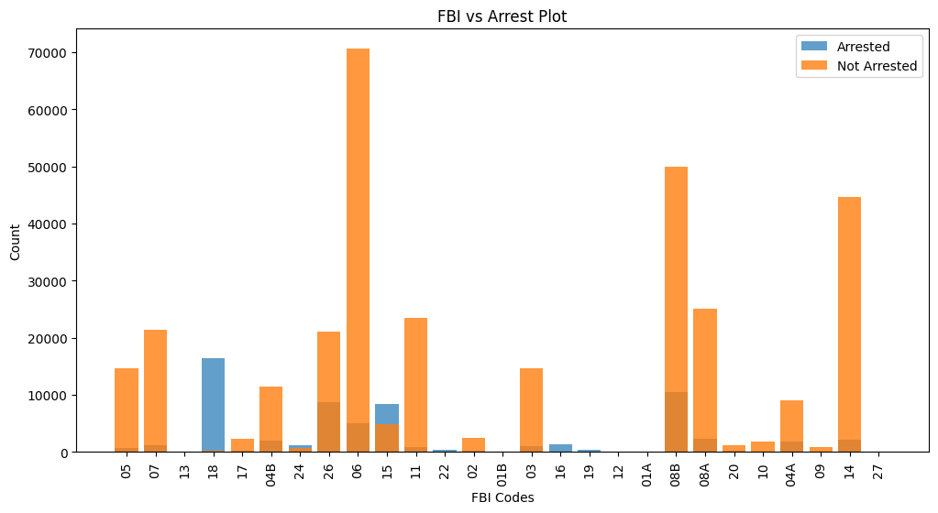
FBI codes used and their arrests
FBI codes resulted in most arrests:
1.Code 18 (count=17936)
2.Code 08B (count= 11208)
3.Code 26 (count= 9967)
4.Code 15 (count=9893)
FBI codes resulted in least arrests:
1.Code 05
2.Code 11
3.Code 22
4.Code 19
5.Code 09

Slide 14
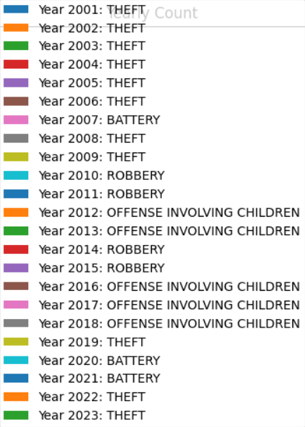
Which type of crime happened most year-wise?
Count of crime happened most in a year:
2001- Theft (count=260)
2002- Theft (count=300)
2003-Theft (count=490)
2004- Theft (count=122)
2005- Theft (count=17874)
2006- Theft (count=1066)
2007- Battery (count=300)
2008- Theft (count=870)
2009- Theft (count=119)
2010-Robbery (count=140)
2011-Robbery (count=160)
2012- Offense involving children (count=110)
2013- Offense involving children (count=107)
2014- Robbery (count=310)
2015- Robbery (count=180)
2016- Offense involving children (count=98)
2017- Offense involving children (count=130)
2018- Offense involving children (count=250)
2019- Theft (count=186)
2020- Battery (count=12351)
2021- Battery (count=32716)
2022- Theft (count=3896)
2023- Theft (count=9206)

Slide 15
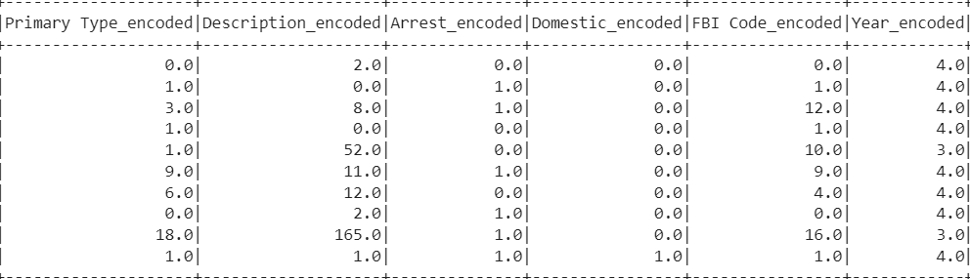
Feature Engineering
Feature engineering is the process of transforming raw data into features that can better represent the underlying problem to the predictive models.
In this project, we have performed feature engineering techniques such as:
• Encoding categorical variables(‘Primary Type, ‘Description’, ’Location Description’, ‘Arrest’, ‘Domestic’, ‘FBI Codes’, ‘Year’)

Slide 16
Machine Learning Algorithms Used
Since this is a classification problem, we have used various classification algorithms which are:
Logistic Regression
Support Vector Classifier
Gradient Boosting Classifier
Random Forest Classifier
Naive bayes classification
Target : ‘Primary type of crime’
Features : ‘Description’, ’Location Description’, ‘Arrest’, ‘Domestic’, ‘FBI Codes’, ‘Year’

Slide 17
Metrics
Metrics | Logistic Regression | Random Forest Classifier | Naive Bayes Classifier | Support Vector Classifier | Gradient Boosting Classifier
Accuracy | 0.5864 | 0.7430 | 0.8118 | 0.8508 | 0.9204
Weighted Precision | 0.5831 | 0.6898 | 0.7961 | 0.7238 | 0.9195
Weighted Recall | 0.5864 | 0.7434 | 0.8120 | 0.8508 | 0.9203
F1 Score | 0.5369 | 0.7004 | 0.8032 | 0.7822 | 0.9109

Slide 18
Conclusion
In this project, we have analyzed crime data and used machine learning techniques to predict the occurrence of primary type of crime. We have obtained valuable insights that can be useful for police and the associate safety guards so that they can create alerts and policies according to that. Overall, this project demonstrates the potential of machine learning techniques in analyzing and prediction of crime.

Slide 19
Recommendations
Police county and administration can make policies such as stricter police actions required to use for crime types happening more frequently.
FBI codes (18,15,08B) which are leading towards more arrests should be implemented in maximum cases.
Locations which are prone to more crimes (streets, residential areas) should be provided more security by the respective forces.
Crimes having less arrest ratio (theft, battery) should be focused more.
There are more than five years where most crime happened on children. Stricter policies for protection of children is necessary.

Slide 20
REFERENCES
Data source- https://catalog.data.gov/dataset/crimes-2001-to-present

Slide 21
THANKYOU

