Slide 1
Final Engagement:
Attack, Defense & Analysis of a Vulnerable Network
Scott Gannon | Nik Dundon | Brad Richardson | Genevieve Pyslarou 11.23.2021

Slide 2
Overview
This document contains the following resources:
Network Topology & Critical Vulnerabilities
Traffic Profile
Alerts Implemented
Exploits Used
Remaining Undetected

Slide 3
Network Topology & Critical Vulnerabilities

Slide 4
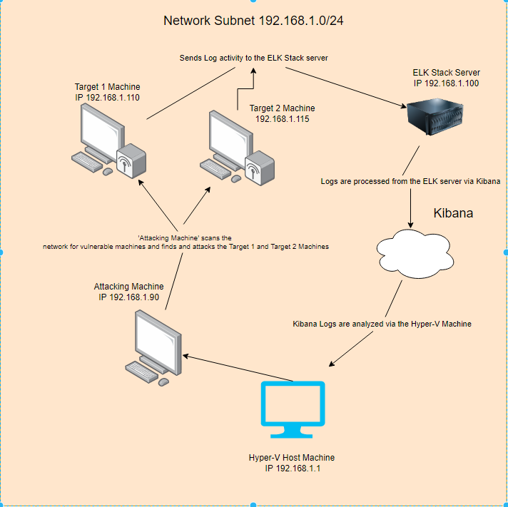
Network Topology
Network:
Address Range: 192.168.1.0/24
Netmask: 255.255.255.0
Gateway: Hyper-V Host Machine - 192.168.1.1
Machines:
IPv4: 192.168.1.90
OS: Linux
Hostname: Kali
IPv4: 192.168.1.110
OS: Linux
Hostname: Target1
IPv4: 192.168.1.115
OS: Linux
Hostname: Target2

Slide 5
Critical Vulnerabilities: Target 1
Vulnerability | Description | Impact
Open SSH (port 22) | SSH, Secure Shell, is a way to remote into other devices and gain access to machines. | Hackers can use port 22 to have direct access to the server and exploit the server.
Unpatched Web Servers | Unpatched software on the web servers are easily exploitable | Hackers can run publicly known exploits on the server to eventually gain root level access due to servers not being regularly updated.
Unrestricted file access | Files contained confidential information such as the credentials to log into MySQL are accessible without root permissions | Hackers were able to access MySQL without having to brute force or exploit any system files due to the fact that they had no strict permissions attached to them
Weak password culture | Both users had weak passwords that were easily guessed/brute forced. | Hackers were able to guess michaels password with no tools required in order to gain access. Steven’s password was able to be comprised in a matter of seconds using a password cracking software. If he had a more complex password the software might not have been able to compromise his information.

Slide 6
Critical Vulnerabilities: Target 2
Vulnerability | Description | Impact
Exposed Ports | Although not a critical vulnerability, the ability to see which ports are open can make it slightly easier for a malicious users to exploit the network. | Firewall rules that block inbound traffic will help with not showing the ports the server currently has open.
Netcat reverse shell | Able to combine a listener on one window, while creating a bash script in a different terminal. Could then use the web browser access to execute the script. | Gives unauthorized remote access to the system.
Access to Wordpress Directories | Gained unauthorized access to directories and we then were able to traverse through the system because they weren’t secure. | Once a user has access to the Wordpress directories, they have access to all files/directories on the system.

Slide 7
Traffic Profile

Slide 8
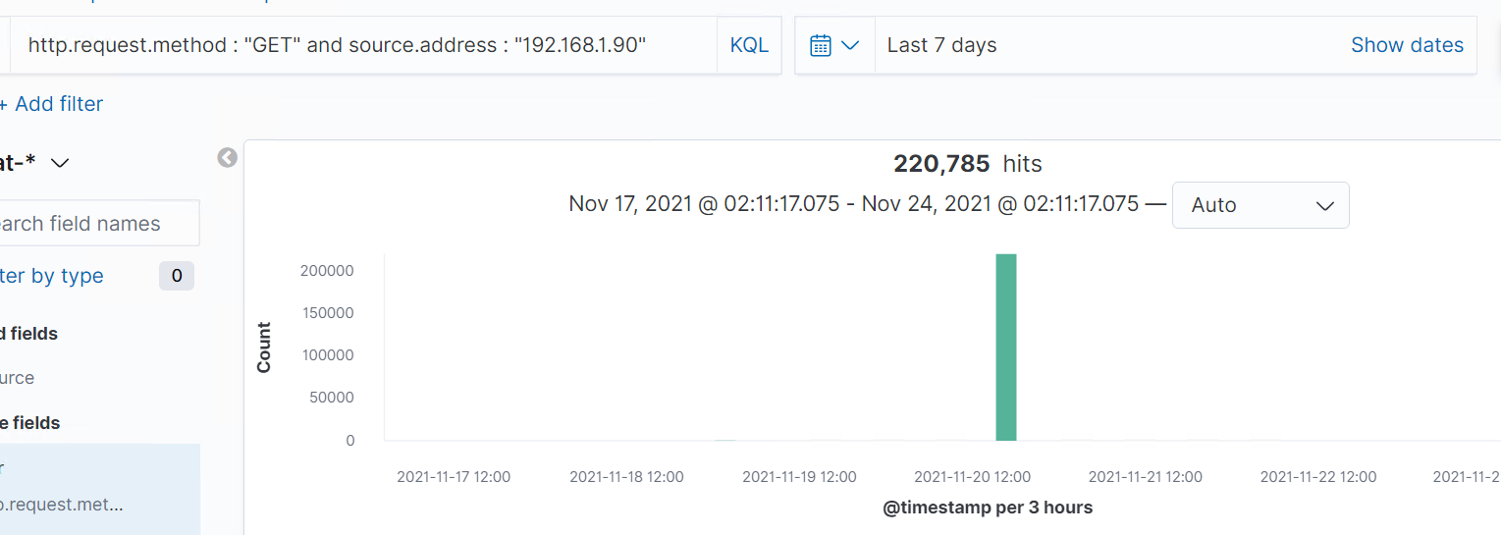
Traffic Profile
Feature | Value | Description
Top Talkers (IP Addresses) | 192.168.1.90 | This IP address is from the attacking machine.
Most Common Protocol | “GET” | The HTTP request method “GET” is used when we are requesting data from a specified source.
# of Unique IP Addresses | >8 | I’ve noticed that most of the unique IP Addresses are outbound so I believe this may be correlated to a listener on the server.
Subnets | 192.168.1.0/24 | These subnets were those of the servers.
# of Malware Species | 0 | We were unable to find any malware.

Slide 9
Alerts Implemented

Slide 10
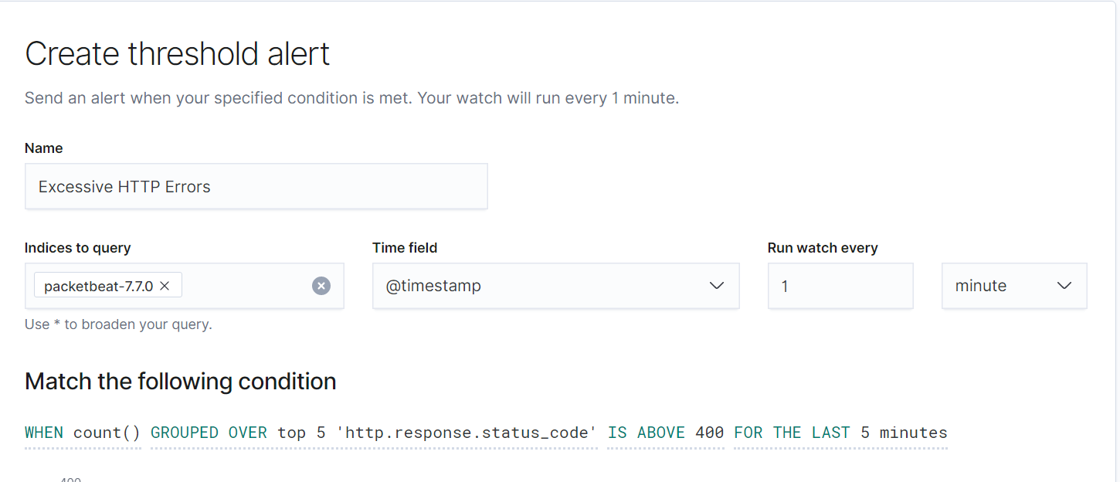
Excessive HTTP Errors
We used Packetbeat-7.7.0 to trigger an alert when the amount of ‘http.response.status_code’ reaches over 400 groups over the top 5 activity within the last five minutes. This protects against a Brute Force Attack.

Slide 11
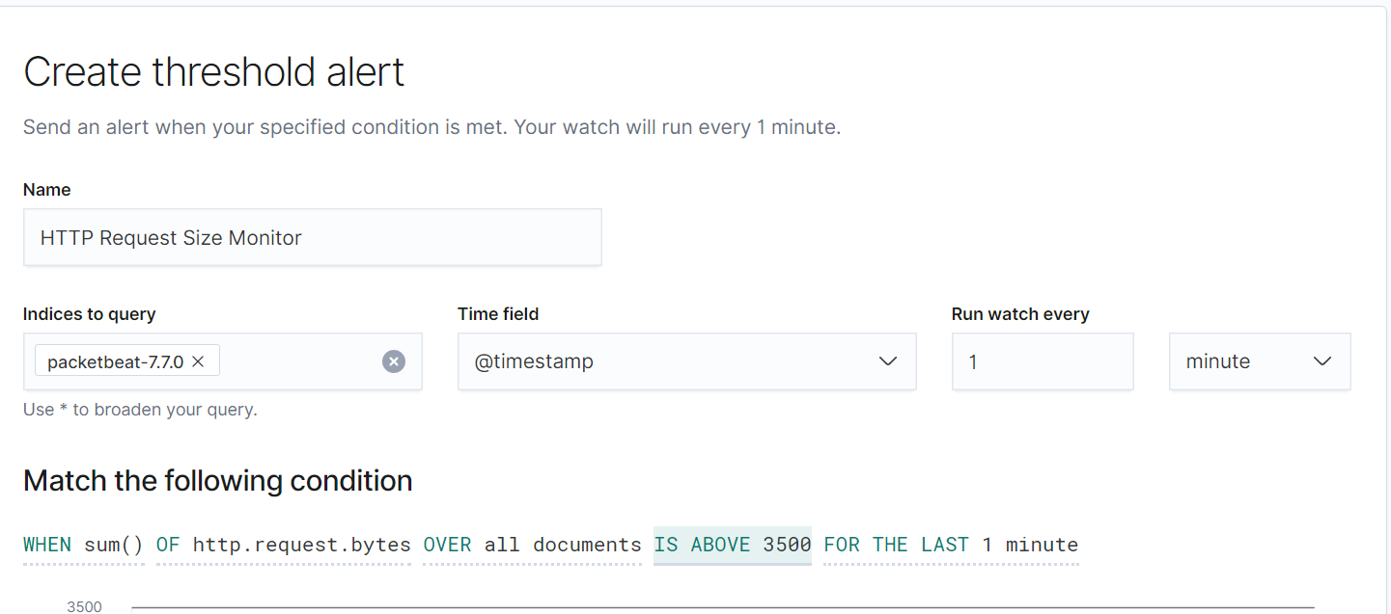
HTTP Request Size Monitor
For our second alert, we used the Packetbeat-7.7.0 metric. The threshold for this alert is triggered when the sum of ‘HTTP.request.bytes’ over all documentation of events is above 3500 over the past five minutes. This could alert the team when there is a potential DoS attack.

Slide 12
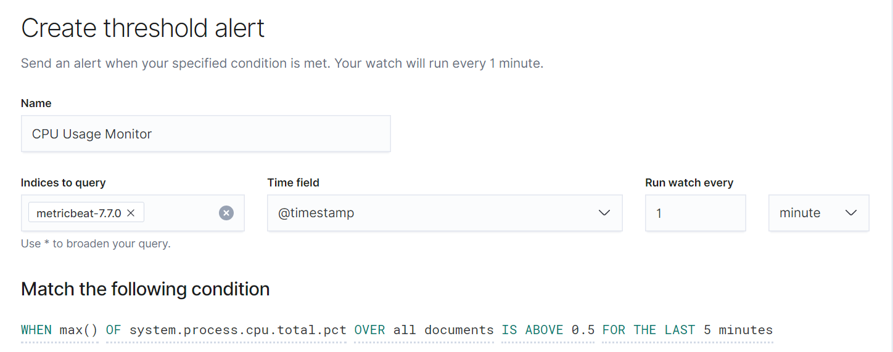
CPU Usage Monitor
The last alert we’ve implemented is triggered when the max ‘system.process.cpu.total.pc’ over all documents is above .5 for the past five minutes. This alert uses the metric ‘metricbeat-7.7.0’. When this alert is triggered, the team will be alerted when a malware takes advantage of a system’s hardware.

Slide 13
Exploits Used

Slide 14
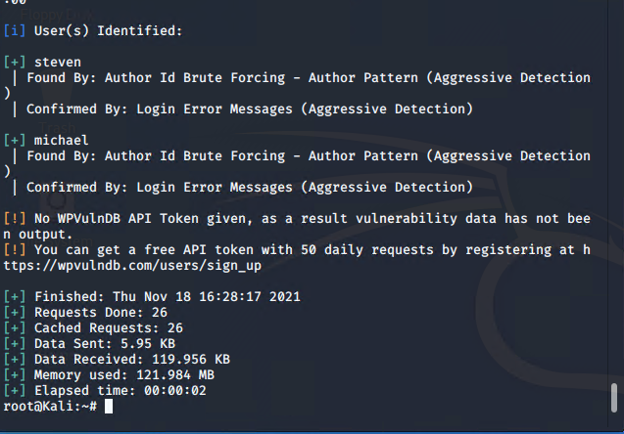
Exploitation: Vulnerable Web Server
After identifying that the target machine was running wordpress we we were able to exploit the wordpress software by running a ‘wpscan’ which searches the wordpress software for information
The exploit allowed us to acquire the usernames of two users on the target machine

Slide 15

Exploitation: Escalating Privileges
The user ‘Steven’ was discovered to have sudo access via python which we were able to exploit to gain a higher privilege level
Using the exploit we were able to escalate our privilege within the linux system from Steven to root

Slide 16
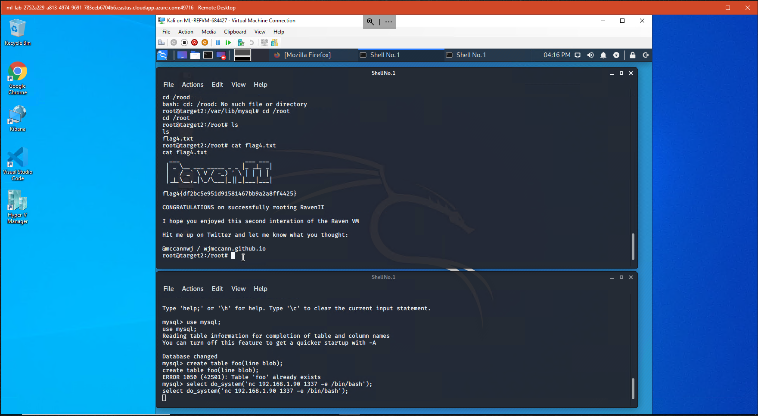
Exploitation: Escalating Privileges - Target 2
Target 2’s mySQL had root privileges and was unpatched so once we were able to gain access to the server, we could take advantage of the vulnerability
Using a UDF exploit for mySQL we were able to open a reverse shell with root access

Slide 17
Remaining Undetected

Slide 18
Stealth Exploitation of Excessive HTTP Requests
Monitoring Overview:
This alert is triggered when there are more than 3500 requests over the past five minutes (in real time). This alert measures the amount of HTTP requests sent over the server. This specific alert is designed to mitigate against a DDoS attack.
Mitigating Detection:
We were able to mitigate detection by playing the role of an end user. Once we gained the information we needed, we were able to create a remote session with Michael’s credentials onto the server.

Slide 19
Stealth Exploitation of Excessive HTTP Errors
Monitoring Overview:
This alert is triggered when the “http.response.status_code” is above 400 in the past five minutes (in real time). Status requests over 400 are known as bad requests.
Mitigating Detection:
We were able to guess Michael’s password and, due to the weak password policies, we were able to do a simple brute force that would not have triggered the alert.

Slide 20
Stealth Exploitation of CPU Usage Monitor
Monitoring Overview:
This alert is triggered when the system CPU total percentage of a single process is over .5% for more than 5 minutes
Mitigating Detection:
This alert is designed to mitigate against any sort of botnet type attack designed to take advantage of the target computers cpu power such as a cryptominer. It can also be used to detect when the server is receiving multiple requests in quick succession which would cause the cpu to throttle.

