Slide 1
Spatial Data Interpolation
How to use data to support decisions deploying GIS?

Slide 2
Lecture Outline
Spatial analysis of geospatial data
Modeling and Storing Spatial Data
Spatial Interpolation

Slide 3
Information
What is it? Why do we need it?
Data
Information
Knowledge
Understanding

Slide 4
Spatial Analysis
Turns raw data into useful information
by adding greater informative content and
value
Reveals patterns, trends, and anomalies
that might otherwise be missed
Provides a check on human intuition
by helping in situations where the eye might deceive

Slide 5
Spatial Analysis
A method of analysis is spatial if the results depend on the locations of the objects being analyzed
move the objects and the results change
results are not invariant under relocation
Spatial analysis requires both attributes and locations of objects
a GIS has been designed to store both

Slide 6
Spatial Analysis
Solving Spatial Problems
Problem definition
Problem breakdown
Explore inputs
Perform analysis
Verify results
Implement results

Slide 7
Measurements (as a simple case of spatial analysis)
Definition
Examples
  Individual operators
  Relationship operators

Slide 8
Area
How to Determine Area of Polygon?
Measurements – Area

Slide 9
Area
Area by Coordinates
Measurements – Area
(X_{B},Y_{B})
(X_{C},Y_{C})
(X_{D},Y_{D})
(X_{A},Y_{A})

Slide 10
Area by Coordinates
Measurements – Area
Area of polygon ABCD =
½ [X_{A}Y_{B} + X_{B}Y_{C} + X_{C}Y_{D} + X_{D}Y_{A} –
X_{B}Y_{A} – X_{C}Y_{B} – X_{D}Y_{C} – X_{A}Y_{D}]
C
X_{A}
Y_{A}
B
X_{B}
Y_{B}
X_{C}
Y_{C}
D
X_{D}
Y_{D}
A
X_{A}
Y_{A}

Slide 11
Distance and Length
Planar
Measurements – Length
Shortest distance between two points in a plane
  Pythagoras Theorem
(X_{D},Y_{D})
(X_{A},Y_{A})

Slide 12
Distance and Length
Planar
Measurements – Length
Distance of line AD =
(X
−
X
)
2
+
(Y
−
Y
)
2
D
A
D
A
(X_{D},Y_{D})
(X_{A},Y_{A})

Slide 13
Distance and Length
Spherical
Measurements – Length
Shortest distance between two points on sphere
  Great circle route

Slide 14
Distance and Length
Spherical
Measurements – Length
Distance of line AB (great circle route) =
Where R = Radius of earth
ϕ_{A} = latitude of point A ϕ_{B} = latitude of point B
λ_{A} = longitude of point A λ_{B} = longitude of point B
−
1
[
+
−
]
R
cos
sin
φ
sin
φ
cos
φ
cos
φ
cos(
λ
λ
A
B
A
B
A
B

Slide 15
Equation of Straight Line
Measurements – Relationships
(X_{B},Y_{B})
(X_{A},Y_{A})

Slide 16
Equation of Straight Line cont.
Measurements – Relationships
From initial equation
X – X_{A} = Y – Y_{A}
X_{B} – X_{A} Y_{B} – Y_{A}
Rearrange to give general form
aX + bY + c = 0
Then
Direction (bearing angle β) = tan⁻¹(-^{b}/_{a})
X intercept = -^{c}/_{a} Y intercept = -^{c}/_{b}

Slide 17
Equation of a Line cont.
Normal Form
Measurements – Relationships
Initial form
aX + bY + c = 0
Normal form
a
b
c
X
+
Y
+
=
0
±
a
2
+
b
2
±
a
2
+
b
2
±
a
2
+
b
2

Slide 18
Equation of a Line cont.
Use of Normal Form
Measurements – Relationships
aX + bY + c = 0
a
b
c
N =
X_{p}
+
Y_{p}
+
±
a
2
+
b
2
±
a
2
+
b
2
±
a
2
+
b
2

Slide 19
Translation of Origin
Measurements – Relationships
Y'
X'_{p} = X_{p} – C_{x}
Y
Y'_{p} = Y_{p} – C_{Y}
(X'_{P},Y'_{P})
(X_{P},Y_{P})
X'
X

Slide 20
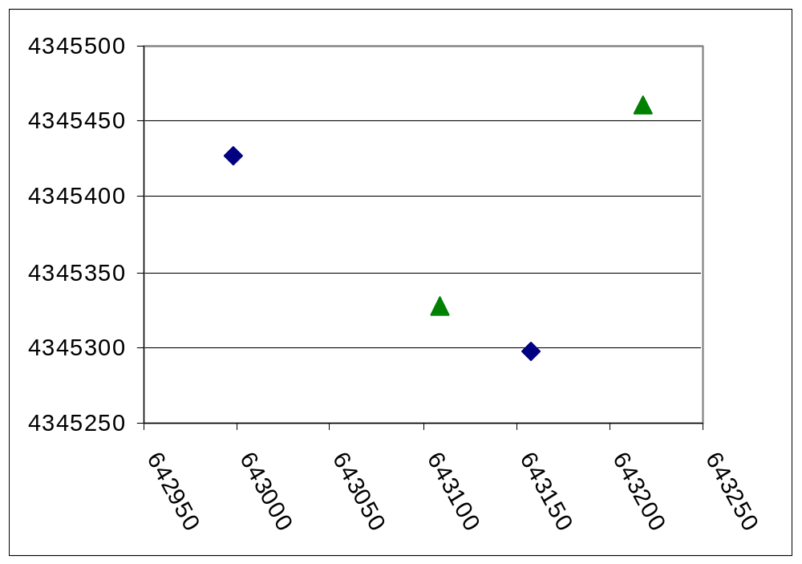
Line Equations
Evaluating Intersections
Measurements – Relationships
A | 643109 | 4345327
B | 643218 | 4345461
C | 643158 | 4345298
D | 642998 | 4345427
B
D
A
C
Question: Does the line segment AB intersect the line segment CD?

Slide 21
Evaluating Intersections
Measurements – Relationships
Translate origin to make coordinates smaller
  Subtract 642,990 from X
  Subtract 4,345,290 from Y
A | 643109 | 4345327
B | 643218 | 4345461
C | 643158 | 4345298
D | 642998 | 4345427
A' | 119 | 37
B' | 228 | 171
C' | 168 | 8
D' | 8 | 137

Slide 22
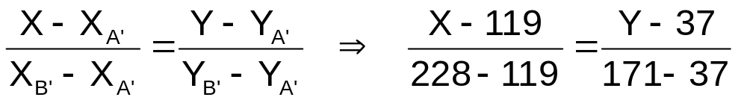
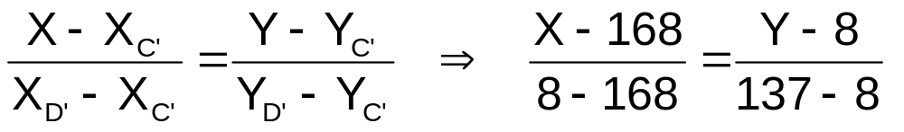
Evaluating Intersections cont.
Measurements – Relationships
Form equations for lines containing A'B' and C'D‘
Rearrange to general form
134X – 109Y – 11913 = 0
129X + 160Y – 22952 = 0

Slide 23

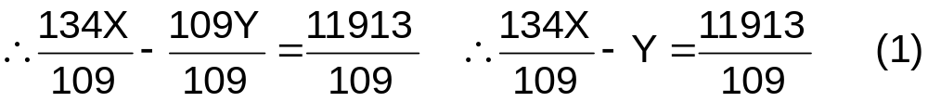

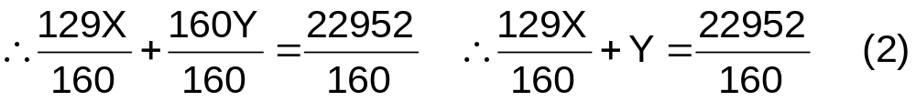
Evaluating Intersections cont.
Measurements – Relationships
Solve simultaneous equations
(1)+ (2) → X = 124.161
Substitute into (1) and solve for Y
→ Y = 43.345

Slide 24
Evaluating Intersections cont.
Measurements – Relationships
Solution
A' | 119 | 37
B' | 228 | 171
C' | 168 | 8
D' | 8 | 137
Test

Slide 25
Shape Measurement
Measurements – Shape
Region shape is of particular interest for political issues
P
Where S = Shape
P = Perimeter
A = Area
S
=
2
πA

Slide 26
Elevation Derivatives
Slope and Aspect
Measurements – Elevation
Slope
Aspect

Slide 27
Elevation Derivatives
Average Slope Between Two Points
Measurements – Elevation
A
B

Slide 28
Calculating Slope and Aspect
3 x 3 Window
Measurements – Elevation
Calculate components of slope
slope_{x} = (z₃ + 2z₆ + z₉ – z₁ – 2z₄ – z₇)/8D
slope_{y} = (z₁ + 2z₂ + z₃ – z₇ – 2z₈ – z₉)/8D
1 | 2 | 3
4 | 5 | 6
7 | 8 | 9
Calculate overall slope
Tan(slope) = slope_{x}² + slope_{y}²
Tan(aspect) = slope_{x} / slope_{y}

Slide 29
SPATIAL INTERPOLATION

Slide 30
1. Spatial Interpolation
Field view: the world consists of attributes that are continuously variable and measurable across space (e.g. elevation, population density)
Object view: the world consists point, line, and area objects each with a bundle of properties (attributes).

Slide 31
Spatial Interpolation
The First Law of Geography by Waldo Tobler:
Everything is related to everything else, but near things are more related than distant things.
The formal property that measures the degree to which near and distant things are related is spatial autocorrelation.

Slide 32
Spatial Autocorrelation
Spatial Autocorrelation – correlation of a variable with itself through space.
  If there is any systematic pattern in the spatial distribution of a variable, it is said to be spatially autocorrelated
  If nearby or neighboring areas are more alike, this is positive spatial autocorrelation
  Negative autocorrelation describes patterns in which neighboring areas are unlike
  Random patterns exhibit no spatial autocorrelation

Slide 33
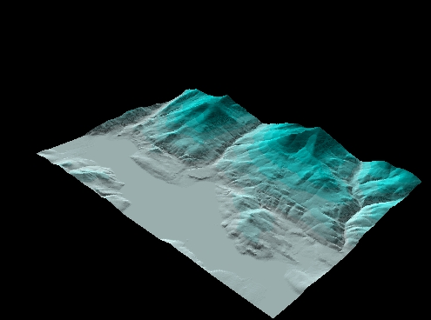
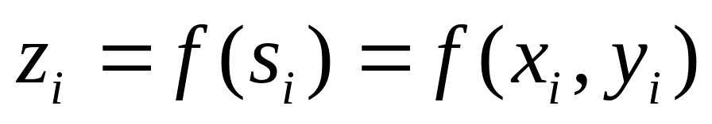
1. Spatial Interpolation
Assumptions
continuity: for every location s_{i}, there is a measurable z_{i} at the same place
Single-valued: for each location, there is only one value of z

Slide 34
Point Interpolation/Areal Interpolation
Point based
given a number of points whose locations and values are known, determine the values of other points at predetermined locations
diagram
point interpolation is used for data which can be collected at point locations e.g. weather station readings, spot heights, oil well readings, porosity measurements
interpolated grid points are often used as the data input to computer contouring algorithms

Slide 35
Point Interpolation/Areal Interpolation
Areal interpolation
given a set of data mapped on one set of source zones determine the values of the data for a different set of target zones
  e.g. given population counts for census tracts, estimate populations for electoral districts diagram

Slide 36
Global/Local Interpolations
global interpolators determine a single function which is mapped across the whole region
  a change in one input value affects the entire map
local interpolators apply an algorithm repeatedly to a small portion of the total set of points
  a change in an input value only affects the result within the window

Slide 37
Global/Local Interpolations
global algorithms tend to produce smoother surfaces with less abrupt changes
  are used when there is an hypothesis about the form of the surface, e.g. a trend
some local interpolators may be extended to include a large proportion of the data points in set, thus making them in a sense global
the distinction between global and local interpolators is thus a continuum and not a dichotomy
  this has led to some confusion and controversy in the literature

Slide 38
Exact/Approximate Interpolation
exact interpolators honor the data points upon which the interpolation is based
  the surface passes through all points whose values are known
  honoring data points is seen as an important feature in many applications e.g. the oil industry
  proximal interpolators, B-splines and Kriging methods all honor the given data points
    Kriging, as it will be discussed further, may incorporate a nugget effect and if this is the case the concept of an exact interpolator ceases to be appropriate

Slide 39
Exact/Approximate Interpolation
approximate interpolators are used when there is some uncertainty about the given surface values
  this utilizes the belief that in many data sets there are global trends, which vary slowly, overlain by local fluctuations, which vary rapidly and produce uncertainty (error) in the recorded values
  the effect of smoothing will therefore be to reduce the effects of error on the resulting surface

Slide 40
Exact versus Approximate
Exact interpolators honor the input data points (which doesn't mean that the surface is 'exact')
Approximate interpolators allow for uncertainty in the input data points, which allows for smoothing

Slide 41
Stochastic/Deterministic Interpolators
stochastic methods incorporate the concept of randomness
  the interpolated surface is conceptualized as one of many that might have been observed, all of which could have produced the known data points
stochastic interpolators include trend surface analysis, Fourier analysis and Kriging
  procedures such as trend surface analysis allow the statistical significance of the surface and uncertainty of the predicted values to be calculated
deterministic methods do not use probability theory (e.g. proximal)

Slide 42
Stochastic versus Deterministic
Stochastic methods incorporate the concept of randomness (similar to a linear regression model—a surface of ‘best fit’)
Deterministic methods do not use probability theory

Slide 43
Gradual/Abrupt Interpolators
a typical example of a gradual interpolator is the distance weighted moving average
  usually produces an interpolated surface with gradual changes
  however, if the number of points used in the moving average is reduced to a small number, or even one, there would be abrupt changes in the surface
it may be necessary to include barriers in the interpolation process
  semipermeable, e.g. weather fronts
    will produce quickly changing but continuous values
  impermeable barriers, e.g. geologic faults
    will produce abrupt changes

Slide 44
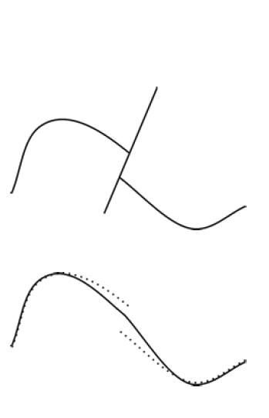
Abrupt versus Smooth
Abrupt interpolators allow for barriers (e.g., faults, fronts)
Smooth interpolators produce a smooth surface

Slide 45
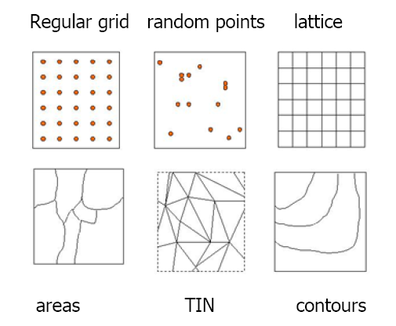
Six field geospatial data representations

Slide 46
2. Modeling and Storing Field Data
Step1: Sampling the Real Surface
The data constitute a sample of the underlying, continuous field.
For example:
Weather station (e.g. temperature)
Pollution monitor station (e.g. CO₂ concentration)
Sampling points

Slide 47
2. Modeling and Storing Field Data
Step2: Continuous Surface Description
Interpolation: reconstruct the underlying continuous field of data from the limited evidence of the control points (samples)

Slide 48
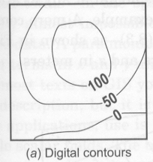
2. Modeling and Storing Field Data
Step2: Continuous Surface Description
1. Digital contours
The most common method for terrain mapping
Contour lines connect points of equal elevation
Contour interval represents the vertical distance between contour lines
The arrangement and pattern of contour lines reflect the topography

Slide 49
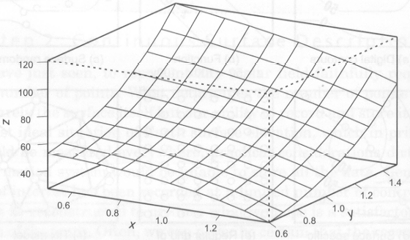
2. Modeling and Storing Field Data
Step2: Continuous Surface Description
2. Mathematical Functions

Slide 50
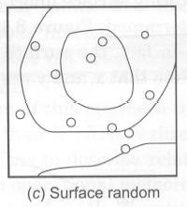
2. Modeling and Storing Field Data
Step2: Continuous Surface Description
3. Point systems
1) Surface random samples: the control point locations are chosen without reference to the shape of the surface being sampled.
2) Surface specific sampling: points are located at places judged to be important in defining the surface detail (e.g. peaks, saddle points)

Slide 51
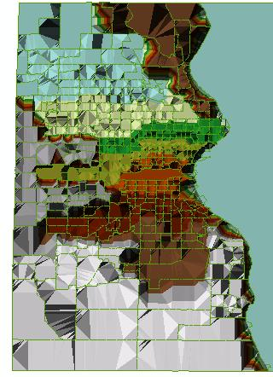
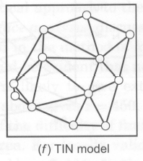
2. Modeling and Storing Field Data
Step2: Continuous Surface Description
4. Triangulated Irregular Networks
approximates the land surface with a series of nonoverlapping triangles
Elevation values along with x-, y-coordinates are stored at nodes that make up triangles.
TIN is based on an irregular distribution of elevation points

Slide 52
2. Modeling and Storing Field Data
Step2: Continuous Surface Description
5. Digital Elevation Model (DEM)
represents a regular array of elevation points
Can be obtained from U.S.G.S.
Alternative sources for DEMs come from satellite images, radar data, and LIDAR (light detection and ranging) data
Point-based
Raster-based

Slide 53
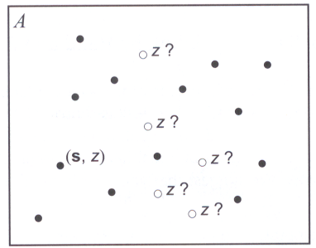
3. Spatial Interpolation
Spatial interpolation is the prediction of exact values of attributes at unsampled locations from measurements made at control points within the same area
In GIS, interpolation always converts a sample of observations into a contour map or a digital elevation model (raster format)

Slide 54
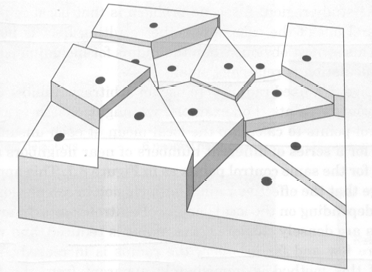
3. Spatial Interpolation
1. Proximity Polygons
Construct proximity polygons for the sample locations.
Assuming each polygon has a uniform height value equal to the value at the control point for that polygon

Slide 55
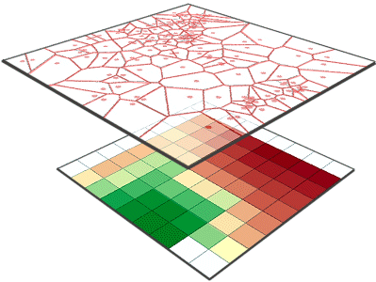
Nearest Neighbor

Slide 56
3. Spatial Interpolation
1. Proximity Polygons
Advantages
Simple, follows the first law of geography
Disadvantages
It does not produce a continuous field of estimates

Slide 57
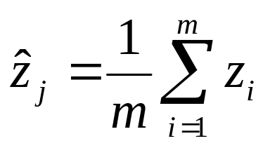
3. Spatial Interpolation
2. Local Spatial Average
Instead of using only the nearest control point, the local spatial average utilizes the points within a fixed distance of the location which value to be determined.
The value equals the average value of the points who are within the fixed distance
10
8
10
5
Point with known value
Point with unknown value

Slide 58
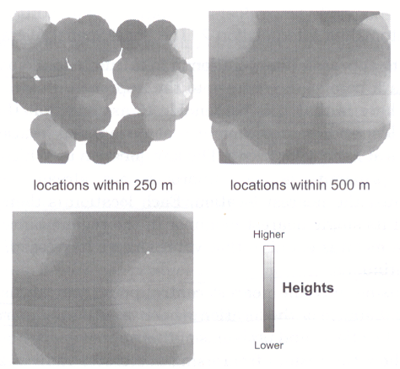
3. Spatial Interpolation
2. Local Spatial Average
Problems
Some locations are not within the chosen distance of any sample locations, it is not possible to derive a surface
The result surface is not properly continuous, dependent on the number of points within the distance

Slide 59
3. Spatial Interpolation
2. Local Spatial Average
An alternative way is to use a specified number of nearest neighbors to estimate the value of a point.
10
8
10
5
3 nearest neighbor
6 nearest neighbor
12
…
5
Point with known value
Point with unknown value

Slide 60
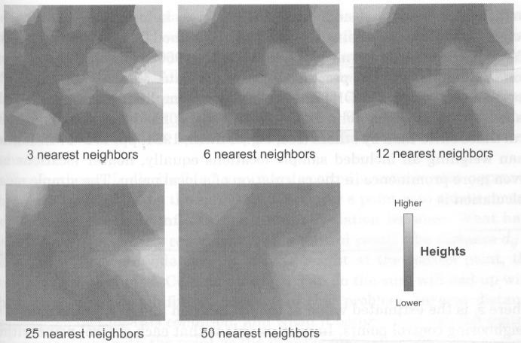
3. Spatial Interpolation
2. Local Spatial Average

Slide 61
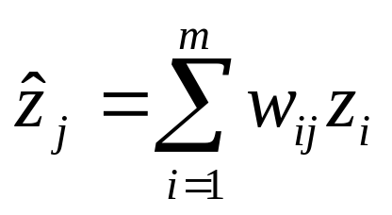
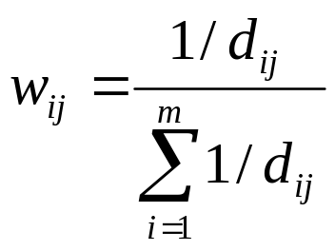
3. Spatial Interpolation
3. Inverse-Distance-Weighted Spatial Average
Local spatial average:
IDW:

Slide 62
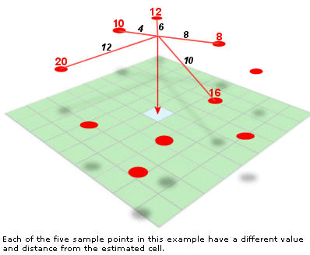
IDW
Inverse Distance Weighting cannot make estimates above the maximum or below the minimum sample values. For an elevation surface, this has the effect of flattening peaks and valleys (unless their high and low points are part of the sample). Because the estimated values are averages, the resulting surface will not pass through the sample points.

Slide 63
3. Spatial Interpolation
3. Inverse-Distance-Weighted Spatial Average
Parameters change results of IDW interpolation
The grid size (finer or coarser)
The choices of neighboring control points (how many neighbors, or circle radius)
The distance weighting ( distance (1/d_{ij}) or distance squares (1/d²_{ij}))
The form of distance functions (e.g. inverse negative exponential (exp(-kd_{ij}))

Slide 64
Issues with IDW: Profile estimation
Elevation
Distance

Slide 65
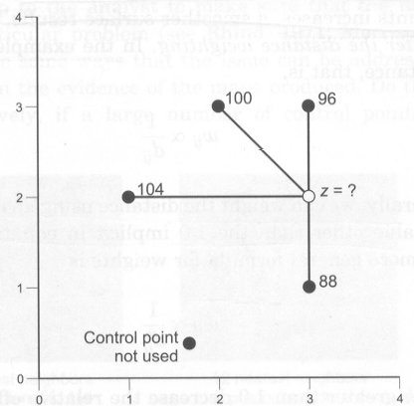
3. Spatial Interpolation
3. Inverse-Distance-Weighted Spatial Average
What is the value of z
With IDW method?
With Local spatial average?

Slide 66
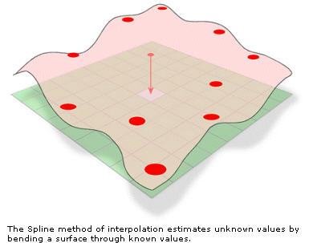
Spline
Instead of averaging values, like IDW does, the Spline interpolation method fits a flexible surface, as if it were stretching a rubber sheet across all the known point values.

Slide 67
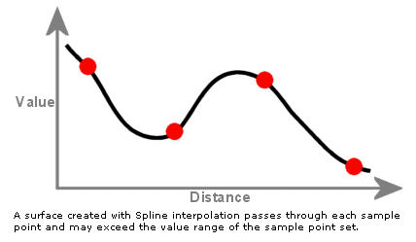
Spline
This stretching effect is useful if you want estimated values that are below the minimum or above the maximum values found in the sample data. This makes the Spline interpolation method good for estimating lows and highs where they are not included in the sample data.
http://en.wikipedia.org/wiki/Spline_interpolation
Specific functions descriptions

Slide 68
Kringing
An interpolation technique in which the surrounding measured values are weighted to derive a prediction for an unmeasured location.
Weights are based on the distance between the measured points, the prediction locations, and the overall spatial arrangement among the measured points.
Kriging is based on regionalized variable theory, which assumes that the spatial variation in the data being modeled is statistically homogeneous throughout the surface. That is, the same pattern of variation can be observed at all locations on the surface.

Slide 69
Kriging method at glance
Kriging
• stochastic, exact, smooth or abrupt, global or local
Natural data are difficult to model using smooth functions because normally random fluctuations and measurement error combine to cause irregularities in sampled data values.
Kriging was developed to model those stochastic concepts.
It is based on the concept of a regionalized variable that has three components:

Slide 70
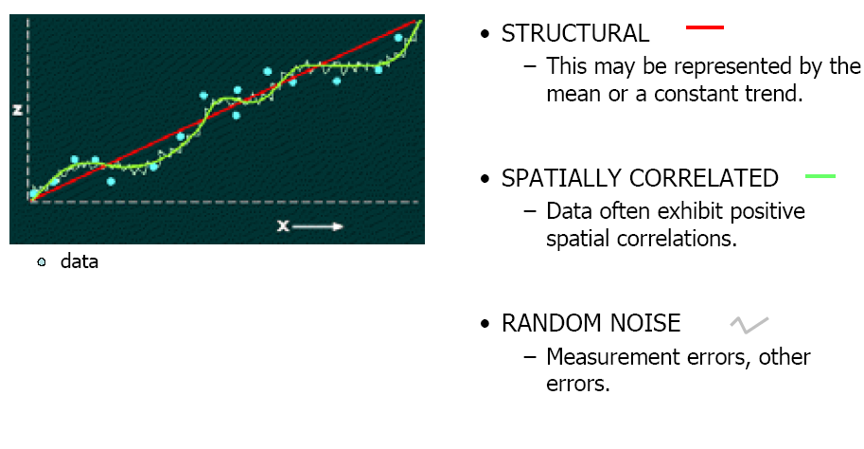
Components of a Regionalized Variable

Slide 71
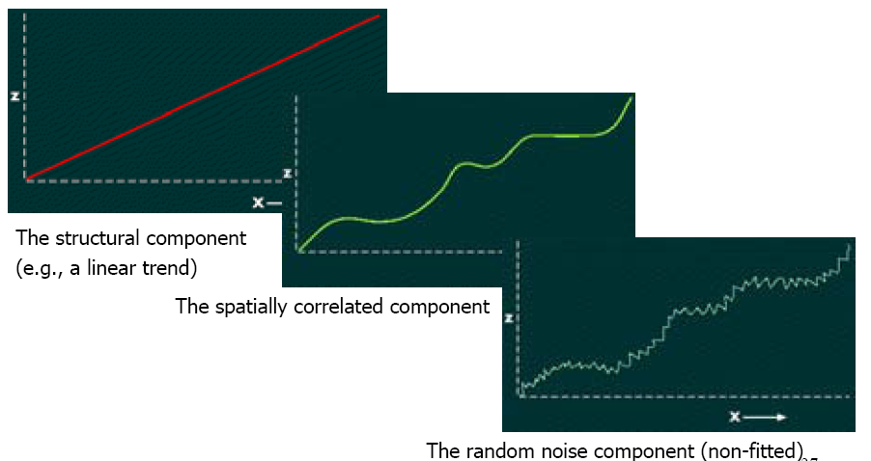
Components of a Regionalized Variable

Slide 72
Kriging
Kriging is implemented using a semivariogram
There are many different varieties of kriging,and selecting the appropriate one requires careful consideration of the data.
ArcGIS's help file--look up the term kriging—provides a lot of information on the various types of kriging that are commonly used in spatial analysis.

Slide 73
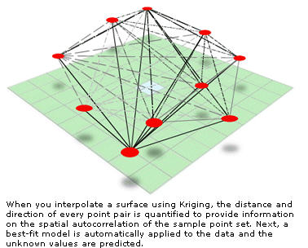
Kriging

Slide 74
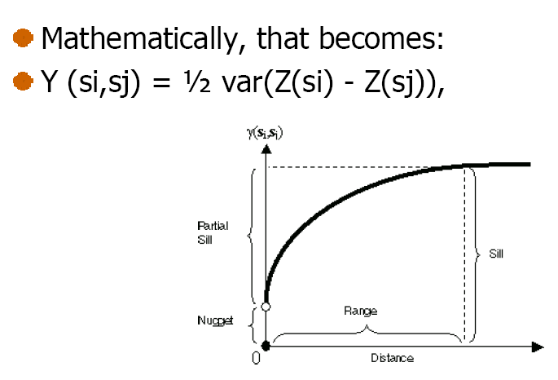
Kriging
The semi-variogram is based on modelling the (squared) differencesin the z-values as a function of the distances between all of the known points.

Slide 75
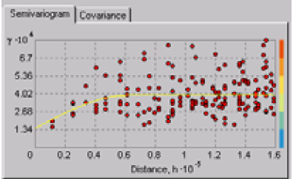
Kriging
This is an example of a variogram produced using ArcGIS's Geostatistical Analyst.

Slide 76
SUMMARY
Interpolation is a very important process in GIS, and in particular in spatial analysis. ArcGIS's help files provide a lot of useful information.
It is important to know, first, about your data ( how was it collected, the spatial distribution of the collection points, the process responsible for creating the 'field' you are mapping), and second, about the spatial interpolation method (its assumptions, faults and fine points).

