Slide 1


Dissection of Advanced Exploits (Document & Browser exploitation)
Changing Endpoint Security, For Good!
Michael Gorelik
Chief Technology Officer
People’s Choice
Award 2016
Cool Vendor

Slide 2
CVE-2018-4878 (Flash exploit)
A critical vulnerability (CVE-2018-4878) exists in Adobe Flash Player 28.0.0.137 and earlier versions. Successful exploitation could potentially allow an attacker to take control of the affected system.
Adobe is aware of a report that an exploit for CVE-2018-4878 exists in the wild, and is being used in limited, targeted attacks against Windows users. These attacks leverage Office documents with embedded malicious Flash content distributed via email.

Slide 3
Preparation
Download Adobe flash 28.0.0.137 (https://helpx.adobe.com/flash-player/kb/archived-flash-player-versions.html )
Install the flashplayer28_0r0_137_winax.exe (activeX)
Choose “never check for updates”
Download the Exploit and Calculator PoC (https://github.com/smgorelik/Windows-RCE-exploits/blob/master/Documents/Office%2BFlash/CVE-2018-4878_%23PoC%23.zip )
Password: infected
Notes:
Additional tools need to be downloaded as described in the meetup (oletools, JPEX and more)

Slide 4
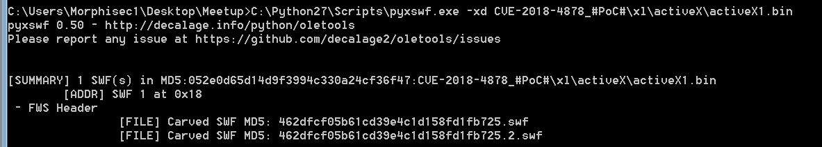
Extract the flash content from .xlsx
-x : extract flash content based on magic header from the ole file
-d : try to decompress the stream
Notes:
Note that the excel is of compound type, we decompressed it using the basic unzip tools.
In our PoC the stream is already decompressed and therefore we get similar hashes

Slide 5
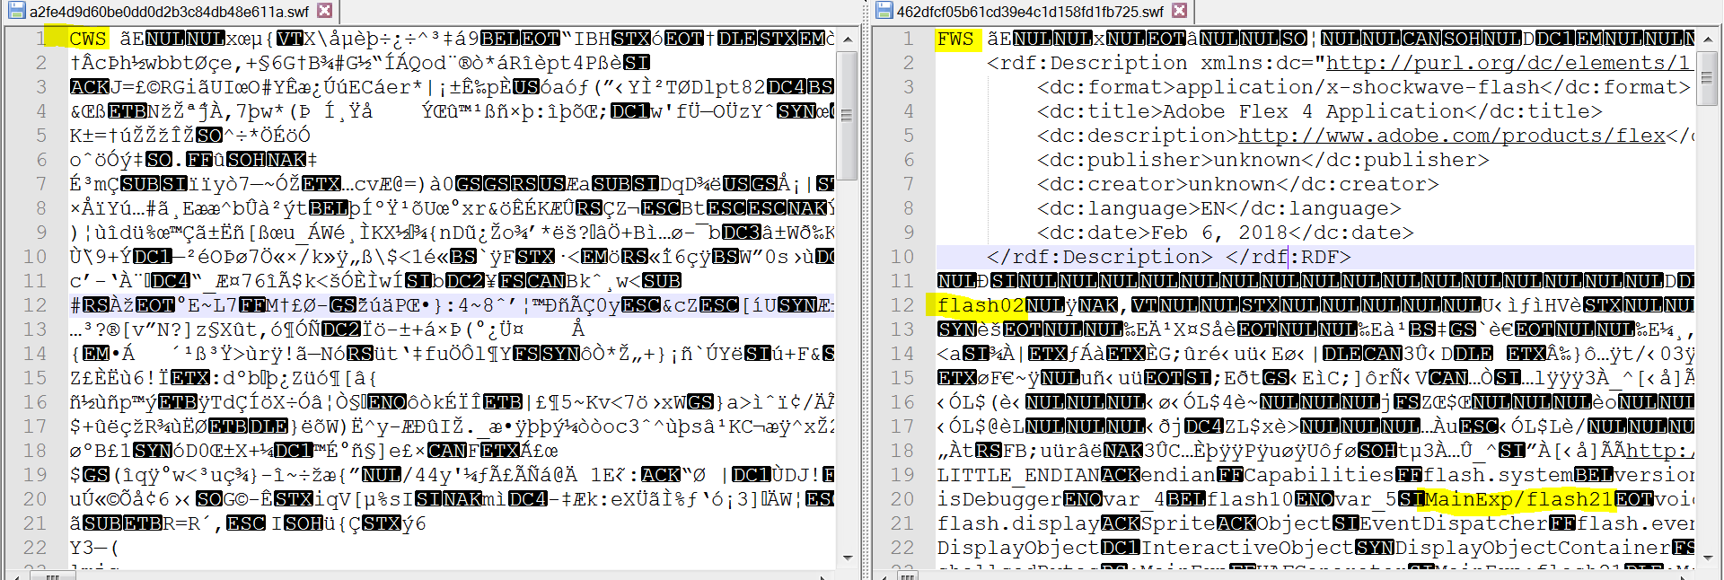
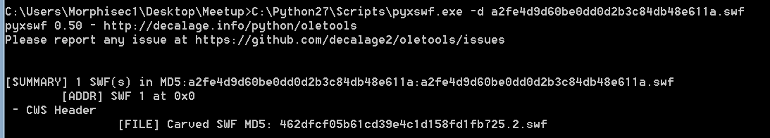
Decompress the CWS to FWS (if needed)
Notes:
Decompressing the flash is useful for looking for strings, sometimes people upload decompressed PoC to be able to later intercept the criminals, many of the security solutions already implemented decompressors as part of their static analysis tools

Slide 6
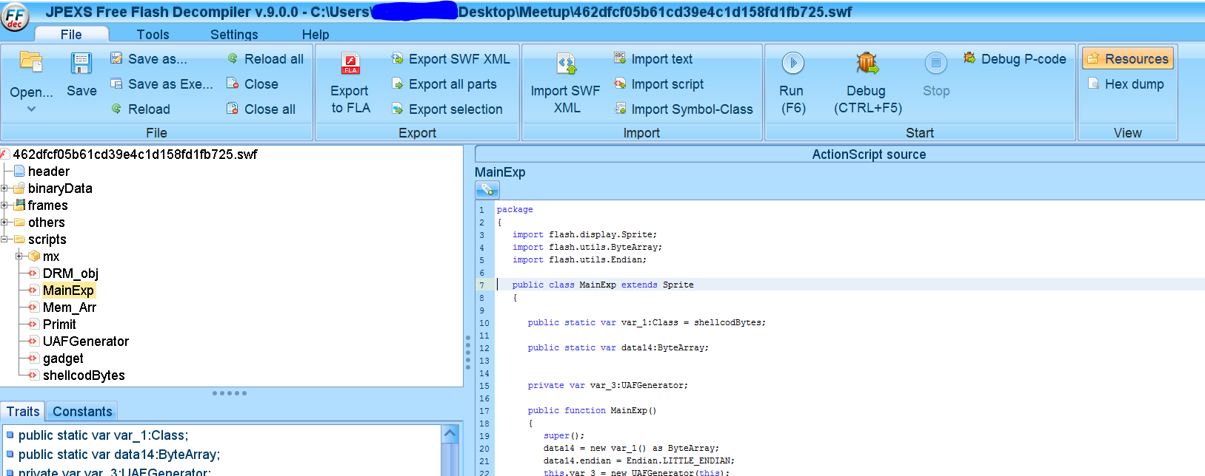
Runtime analysis - JPEX

Slide 7
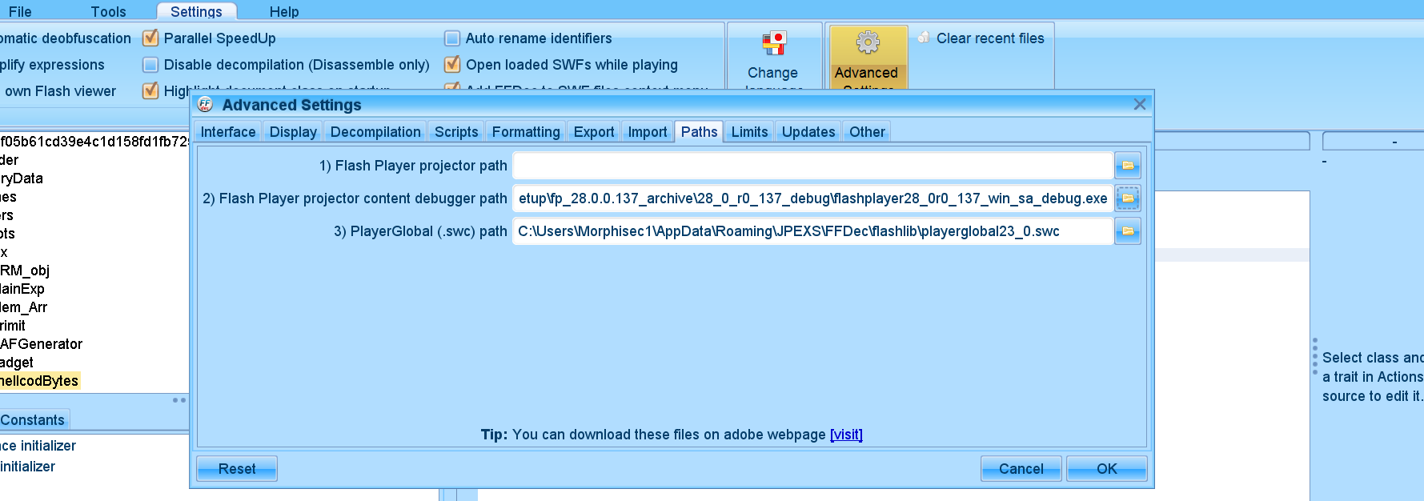
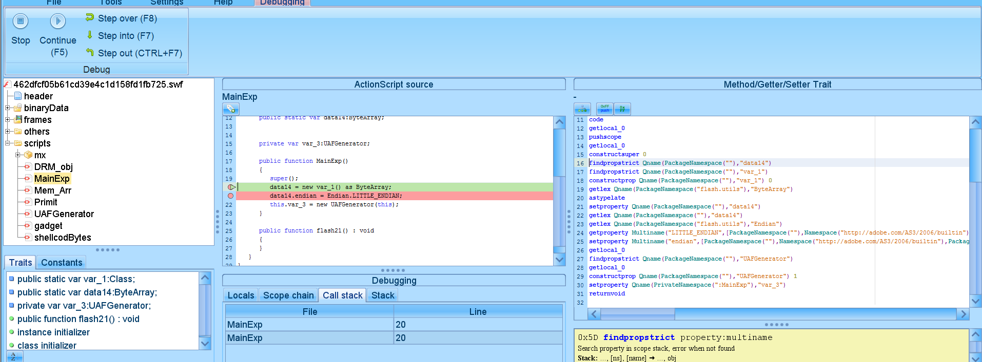
Debugging flash (configure environment)
Notes:
Debug version need to be installed , its usually in the same archive that is downloaded from adobe

Slide 8
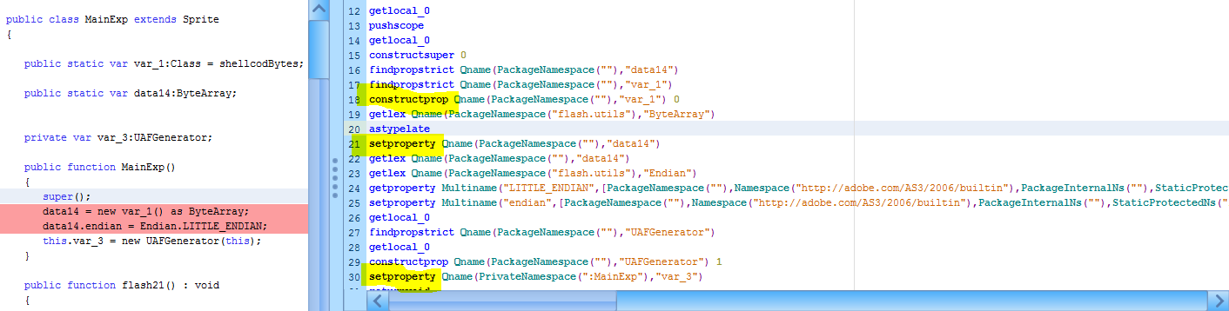
P-code (portable code) deobfuscation
Instruction set designed for efficient execution by software interpreter.
Read - https://www.free-decompiler.com/flash/docs/as3_pcode_instructions.en.html

Slide 9
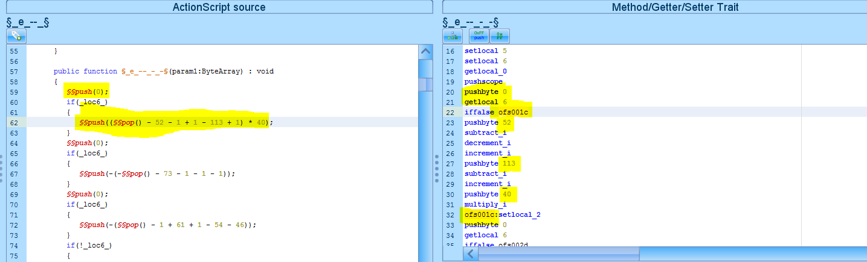
Editing P-code using JPEX
Remove redundant loops
Remove false evaluated condition control flows (never happen)

Slide 10
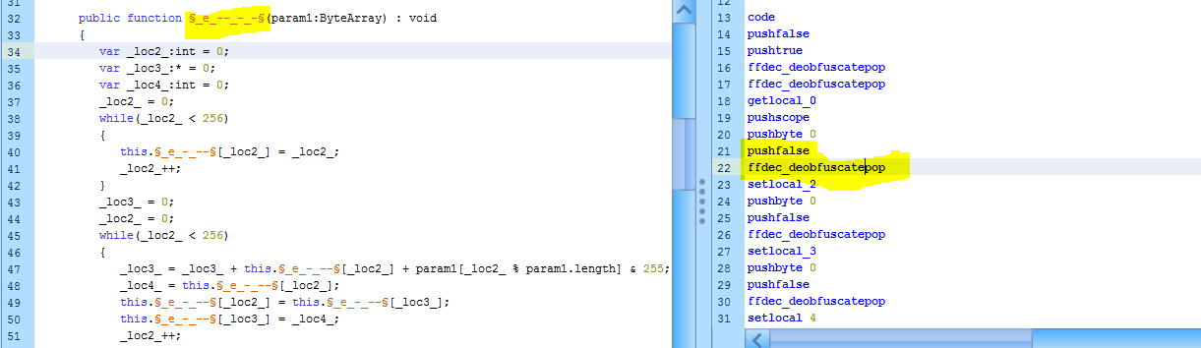
Automatic P-code deobfuscation
More intuitive for reversing and understanding the code
More prone to damage the control flow (we would like to debug it)

Slide 11
Identifying the shellcode - runtime
Runtime – sometimes easier and faster (use windbg or other debuggers)
Look for new process creation
Allocation of memory chunks
Thread creation
Configure the most convenient environment to run the exploit
Search for strings/patterns during runtime

Slide 12
Identifying the shellcode - static
Static – slower but sometimes more effective due to anti-debugging manipulations, sometimes not feasible due to shellcode decryption in runtime
Look for big hex or decimal blobs (either binary blobs or code embedded arrays)
Write XOR decompressors (use python) – apply the blob with all possible one byte xors.
Use Yara to identify shellcode patterns
Modify different bytes to cause runtime crash during runtime analyze

Slide 13
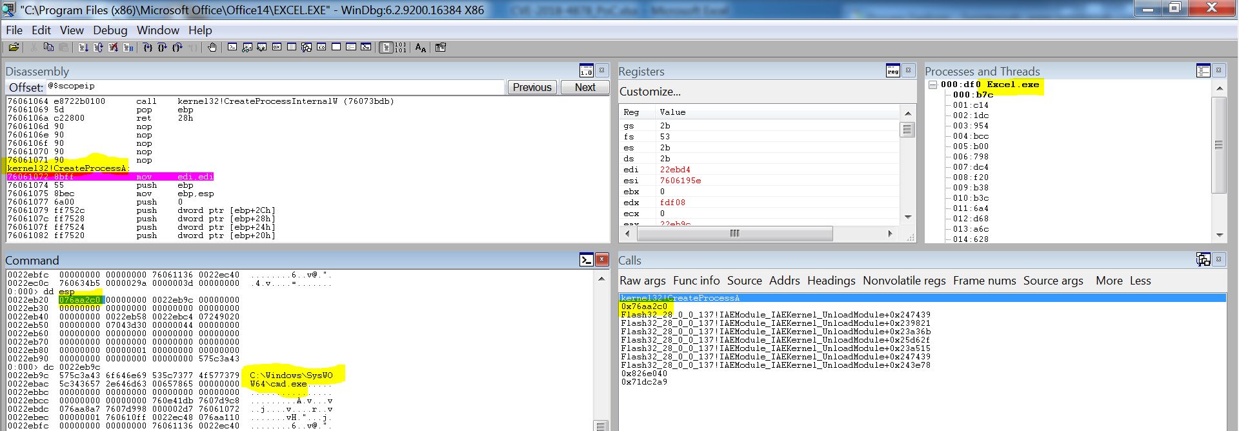
Runtime interception example
CreateProcess interception – look for return addresses

Slide 14
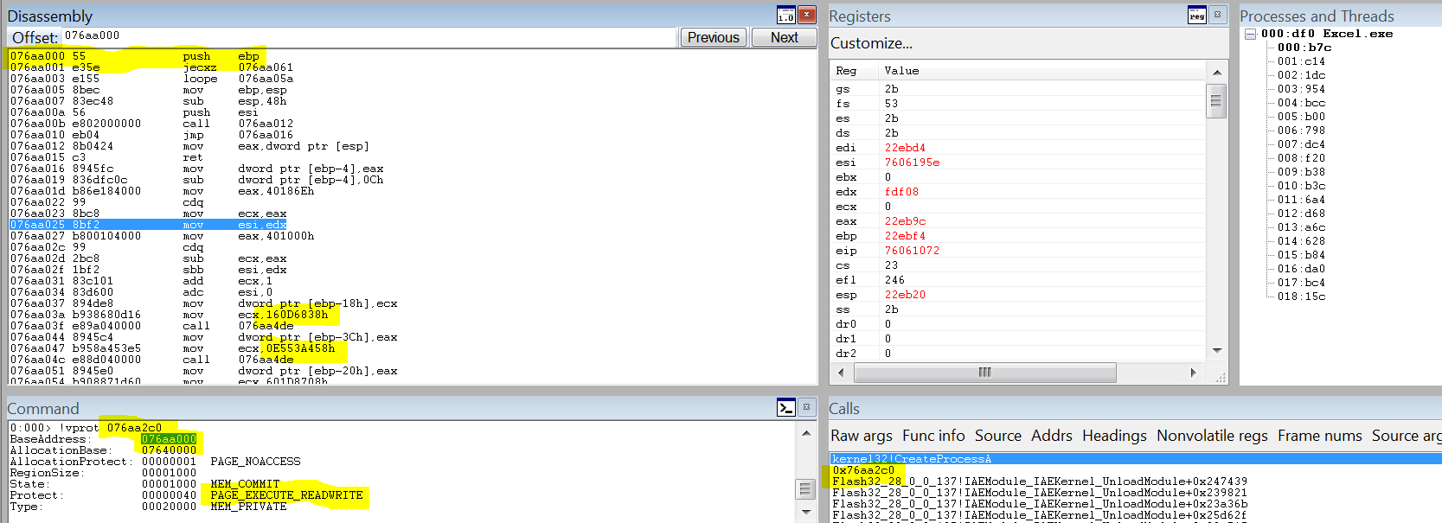
Allocation Base and protection flags
Shellcode was identified and so as the XORed function names (createthread, virtualalloc, waitforsingleobject)

Slide 15
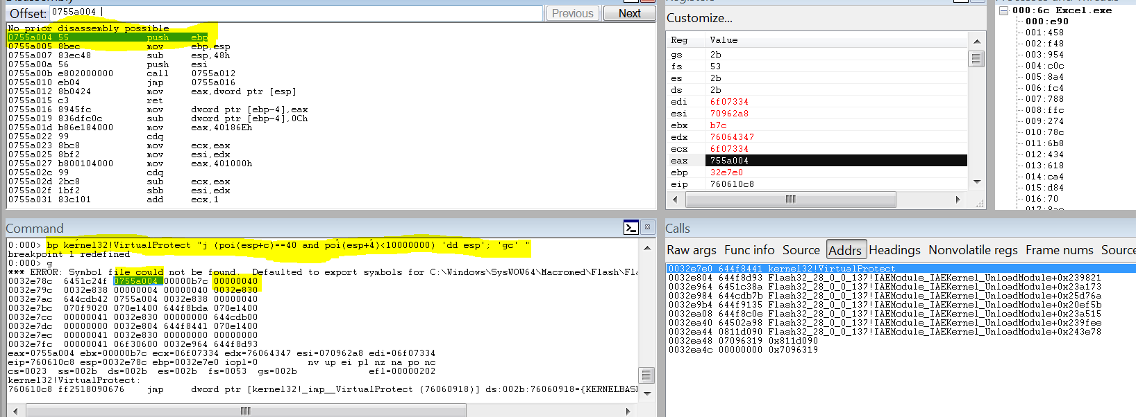
Interception by looking at page protection
Recover the encrypted shellcode- look for RWE in the heap jitting

Slide 16
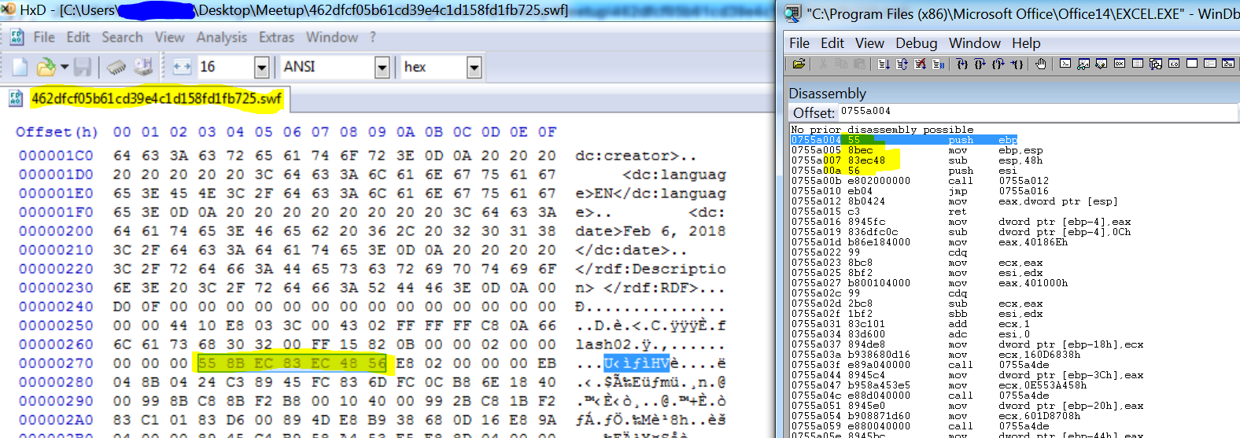
Look for the shellcode inside flash
Self modifying shellcode found – non encrypted
Notes:
Usually the hackers also encrypt the shellcode with some type of rsa with a key delivered online – this prevents also runtime analysis unless you have the key for decryption or a way to brut force it

Slide 17
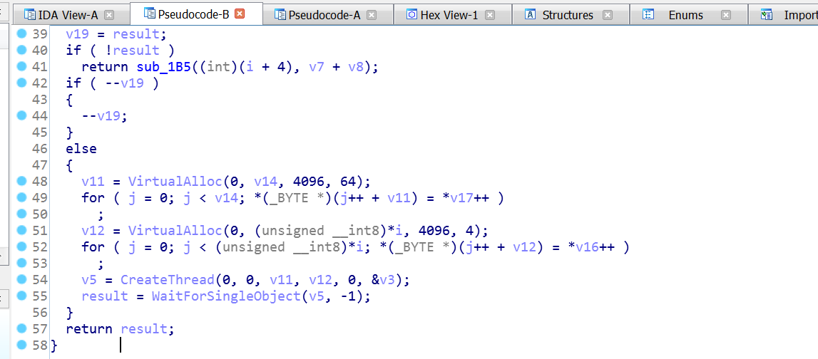
Shellcode decryptor (shellcode loader)

Slide 18
Anti-reversing techniques
Self modifying shellcode –
look for code entry before depacking
search for allocated pages with RWX (Read write execute) privileges
use debug registers to intercept the writing to those pages
Be careful with software breakpoints that may influence the decryption
Encrypted shellcode within flash –
search for the encryption algorithm
Identify if the key is delivered online
Identify if the algorithm or how it is being used has weaknesses

Slide 19
CVE-2018-4990
Double free vulnerability in Adobe Reader which allows attackers to perform a Remote Code Execution on targeted machines. After successful exploitation, attackers can take control of the vulnerable systems and download and execute malware on them.
The vulnerability is currently being exploited in the wild through a malicious PDF (Portable Document Format) file. The PDF sample embeds a JavaScript code which manipulates Button1 object. This object contains a crafted JPEG2000 image, which triggers the double-free vulnerability in Adobe Reader.

Slide 20
Preparation
Download Acrobat Reader DC (ftp://ftp.adobe.com/pub/adobe/reader/win/AcrobatDC/1800920044/AcroRdrDC1800920044_en_US.exe )
Update it to the latest vulnerable version ftp://ftp.adobe.com/pub/adobe/reader/win/AcrobatDC/1801120038/AcroRdrDCUpd1801120038.msp,
Choose “never check for updates”, preferably disconnect the network
Download the Exploit and Calculator PoC (https://github.com/smgorelik/Windows-RCE-exploits/blob/master/Documents/Acrobat/CVE-2018-4990_%23PoC%23.zip )
Password: infected
Notes:
Additional tools need to be downloaded as described in the meetup (oletools, JPEX and more)

Slide 21
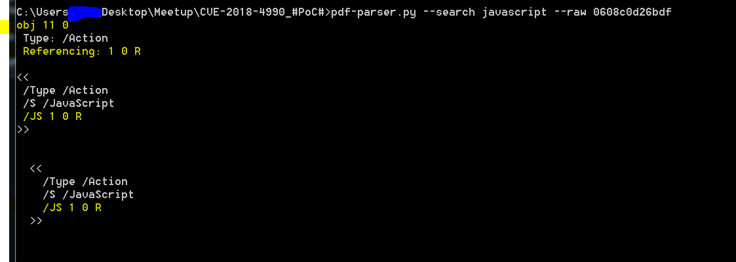
Search for javascript in the PDF

Slide 22
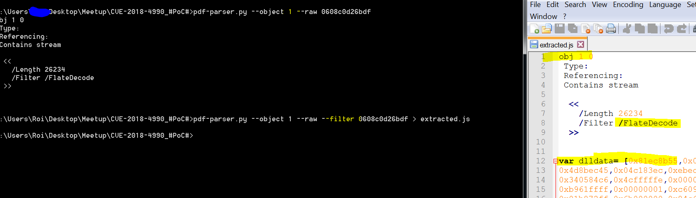
Extract and decompress Javascript stream

Slide 23
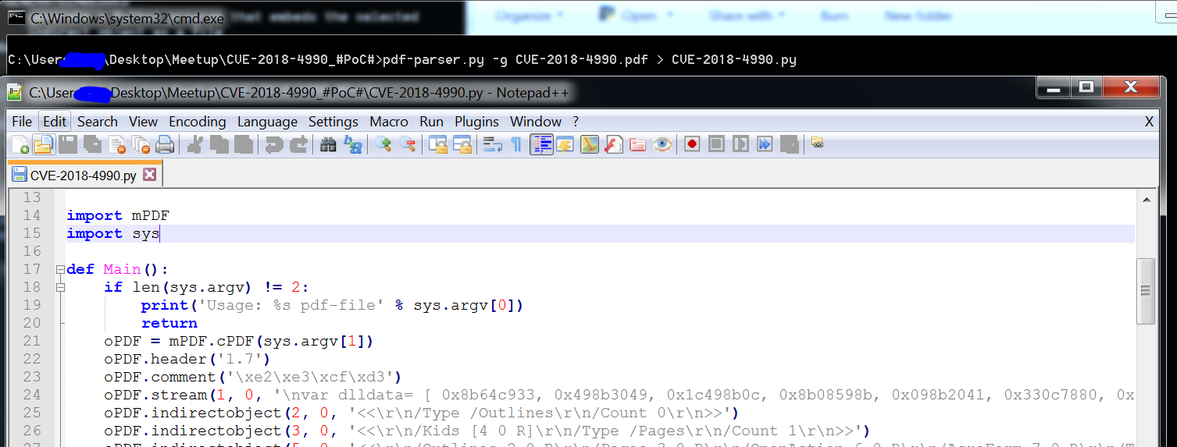
Debug by inserting logs – generate new PDF

Slide 24
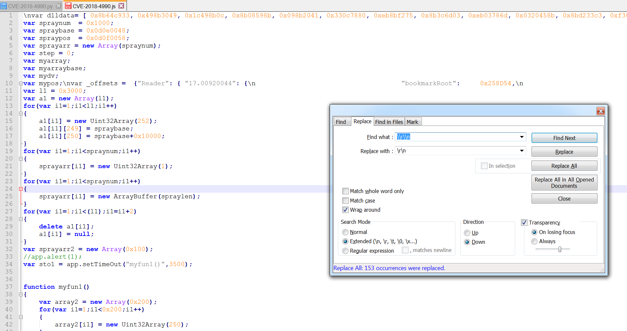
Beatify the stream

Slide 25
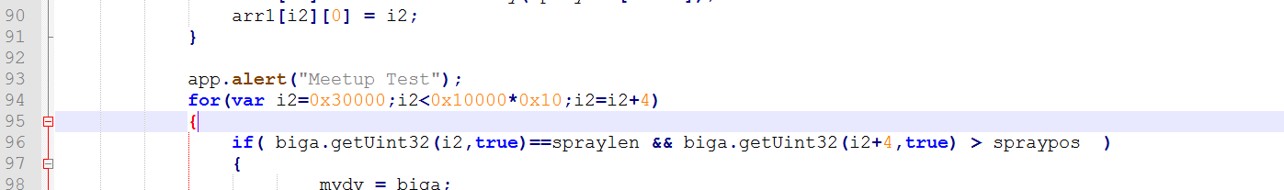
Insert debug log lines

Slide 26
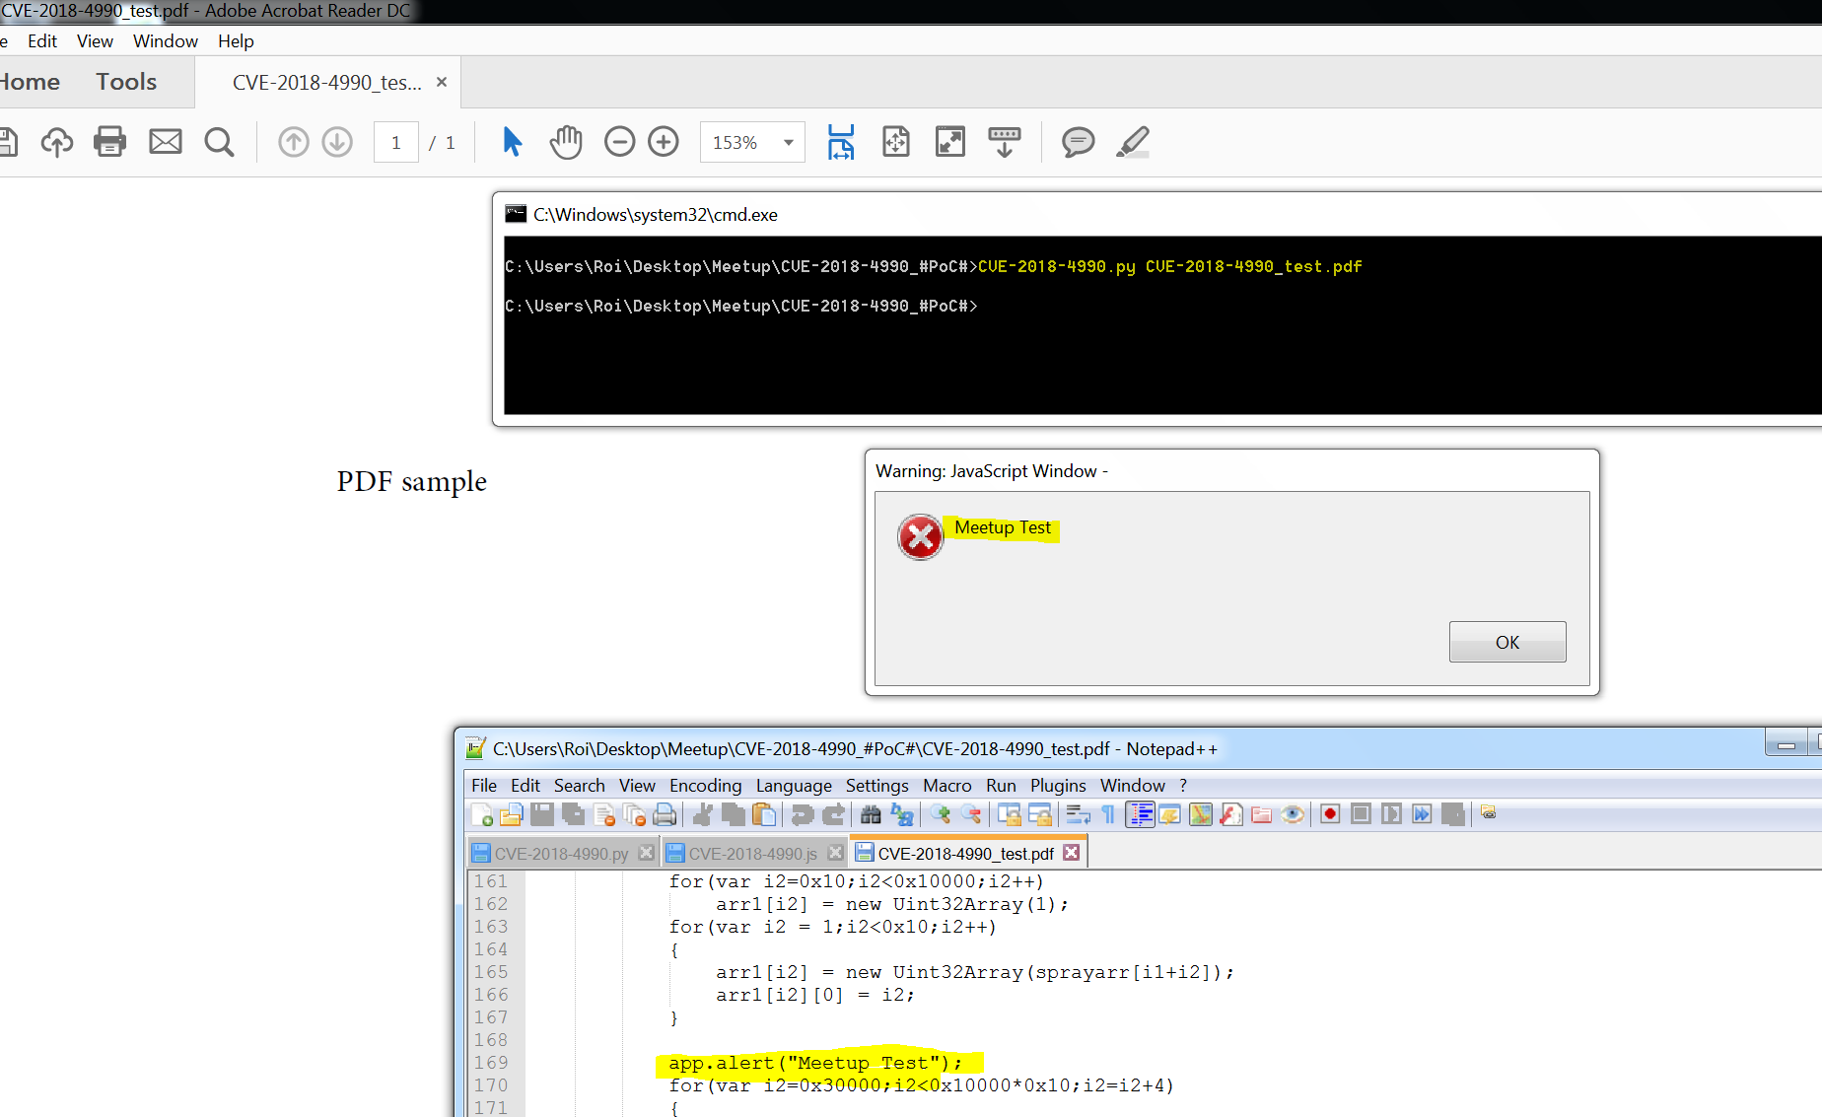
Generate new PDF from the python script

Slide 27
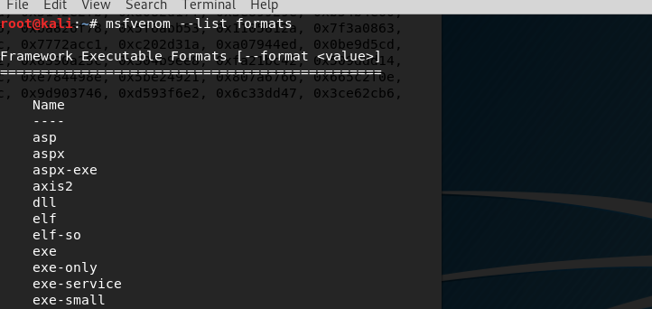
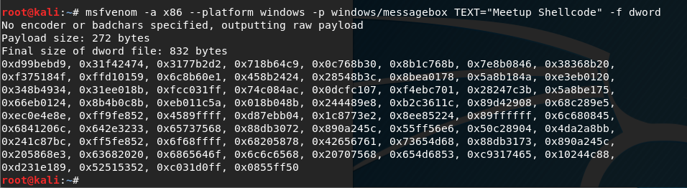
Just for Fun – Generate alternative Shellcode

