Slide 1


Dissection of Advanced Persistent Threat (APT) – Semi-Workshop
Michael Gorelik
Chief Technology Officer at Morphisec

Slide 2
Agenda
We will dissect a full end-to-end attack that leads to full compromise of the computer with installed Remcos RAT
The attack is composed of Macro Visual Basic delivery, white listing bypass + JavaScript scriplet dropper, dll payload, JavaScript downloader, Javascript Backdoor , Remcos RAT executable

Slide 3
Overview
Macro VB
JavaScript dropper
Dll payload (masquerading as legitimate software)
JavaScript downloader
Backdoor->Remcos RAT

Slide 4
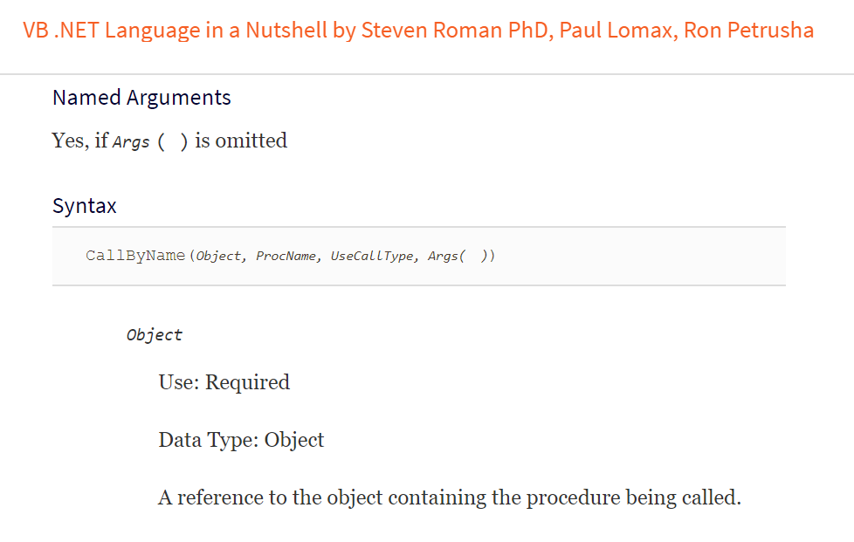
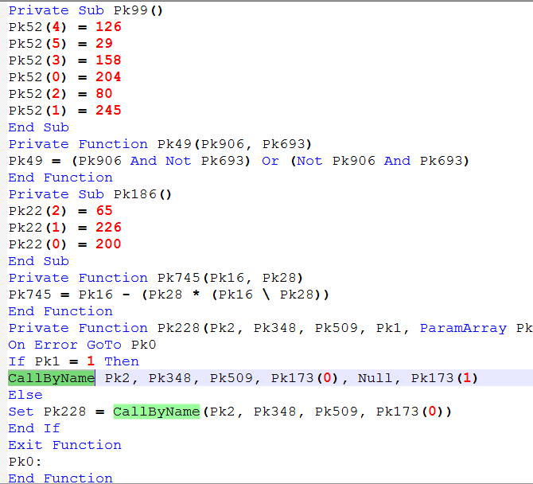
VBA Macro – Identify Execution Functions

Slide 5
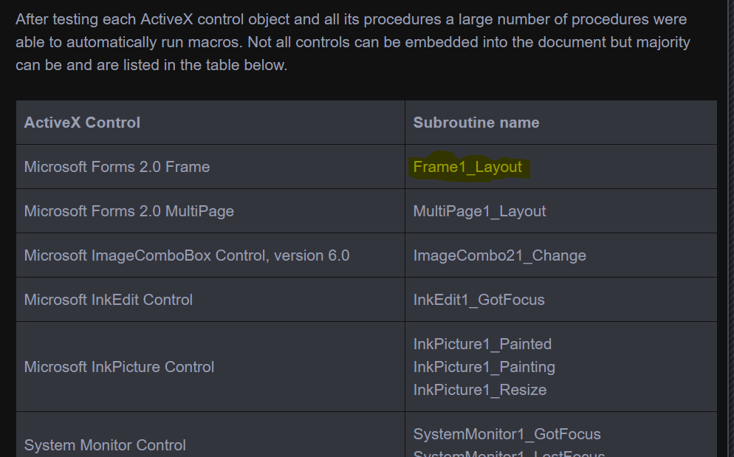
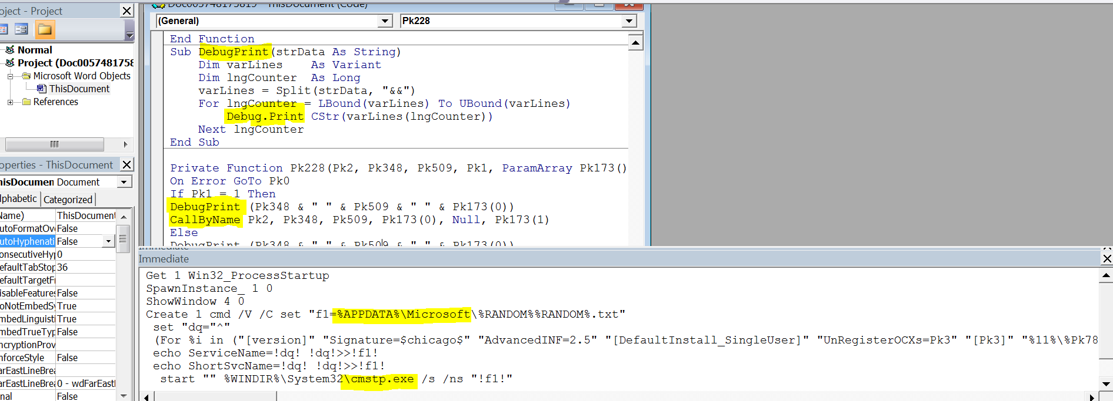
VBA Macro – Use Debug.Print as Helper, Look for entry

Slide 6
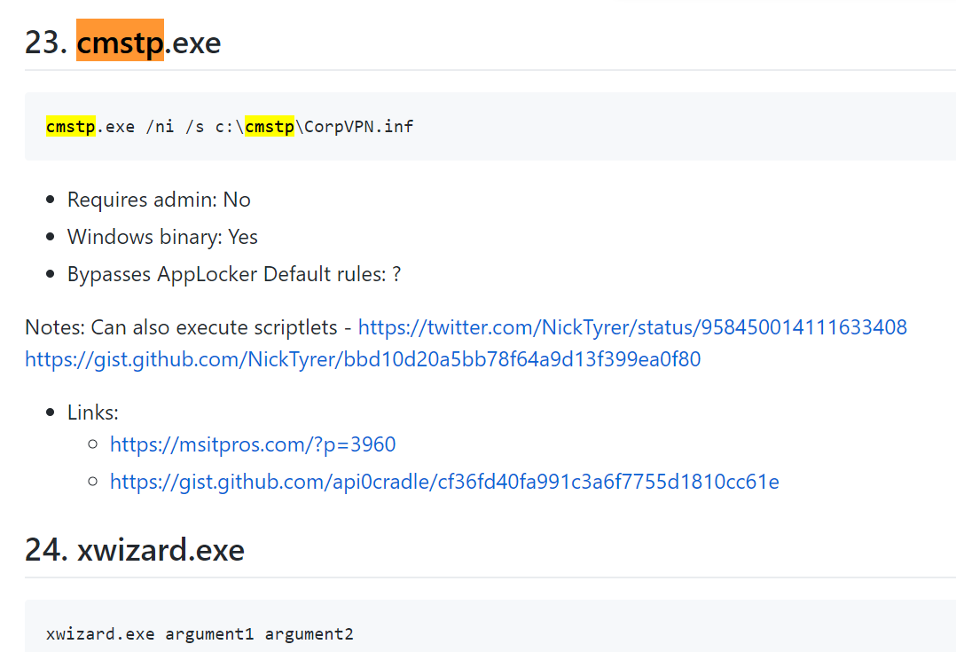
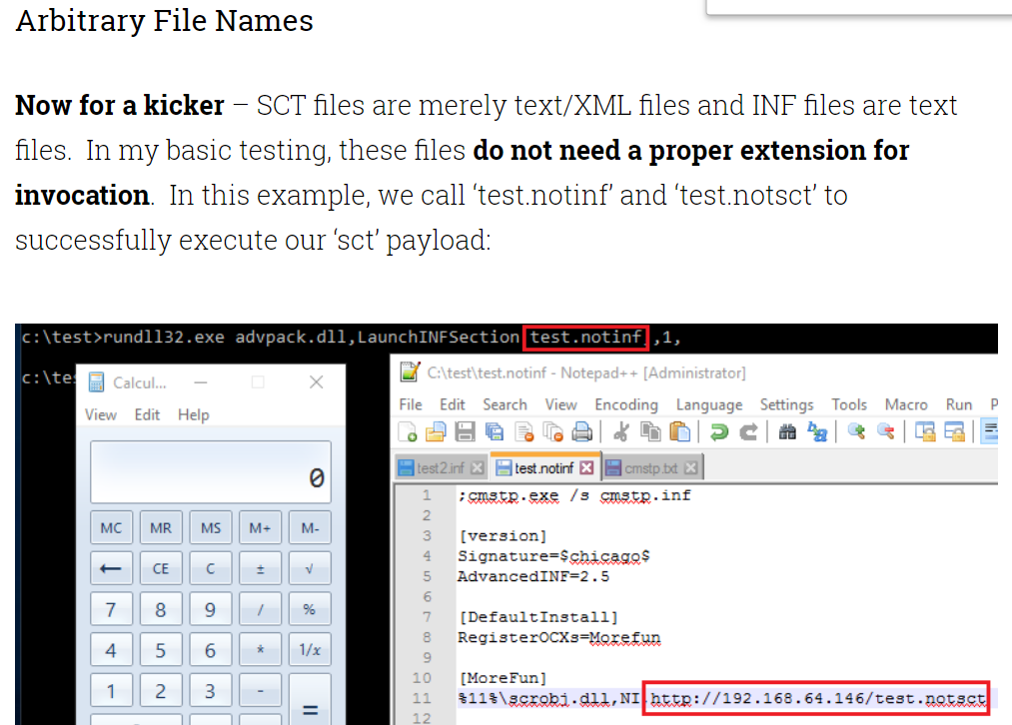
Whitelist Bypass – cmstp.exe

Slide 7
Overview
Macro VB
JavaScript dropper
Dll payload (masquerading as legitimate software)
JavaScript downloader
Backdoor->Remcos RAT

Slide 8
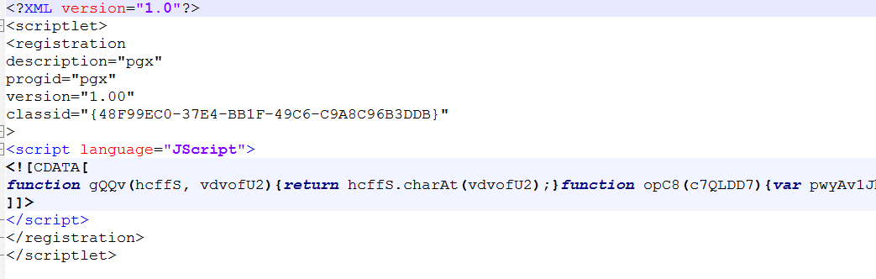
Dropped JavaScript Scriplet

Slide 9
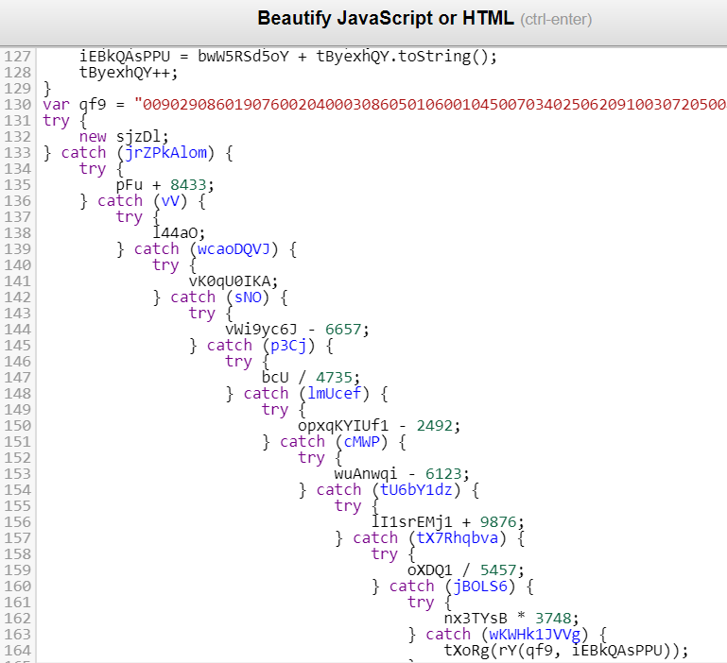
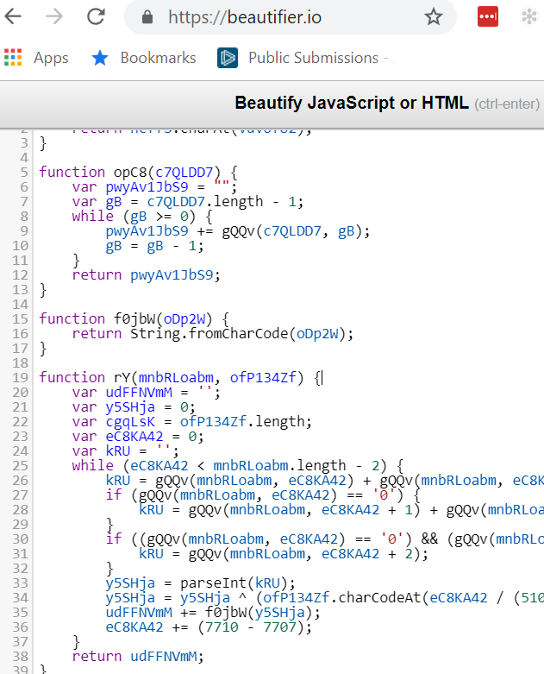
Try Beautify first

Slide 10
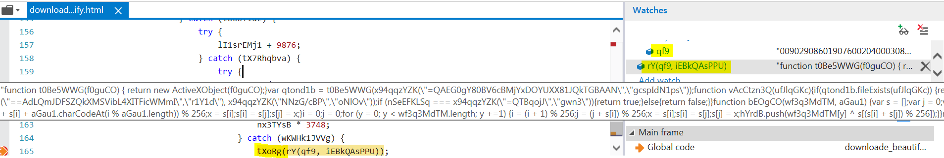
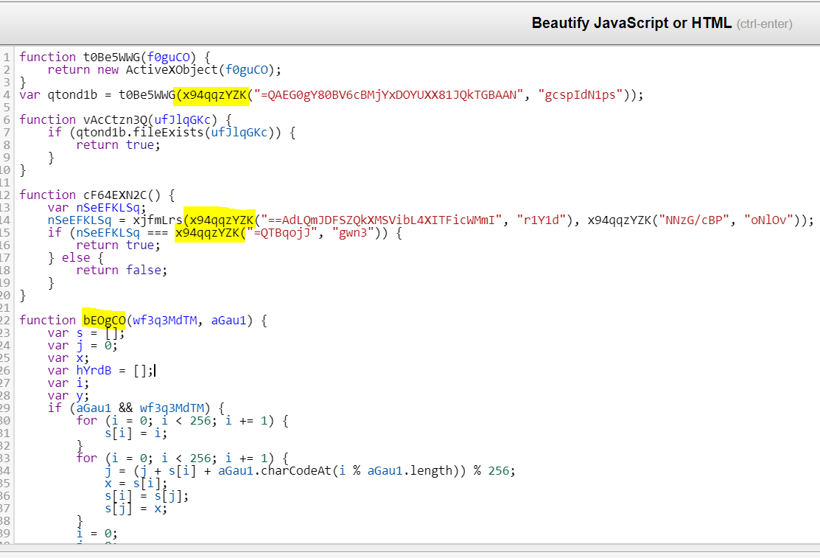
If going to debug, then try using IE

Slide 11
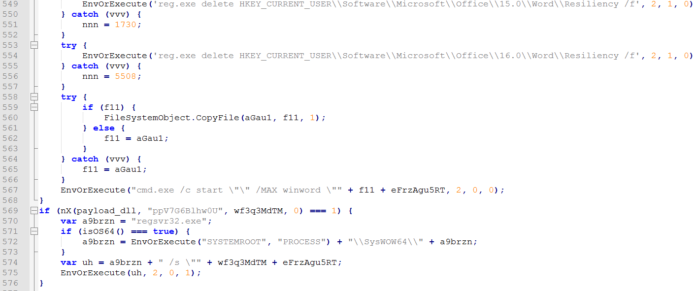
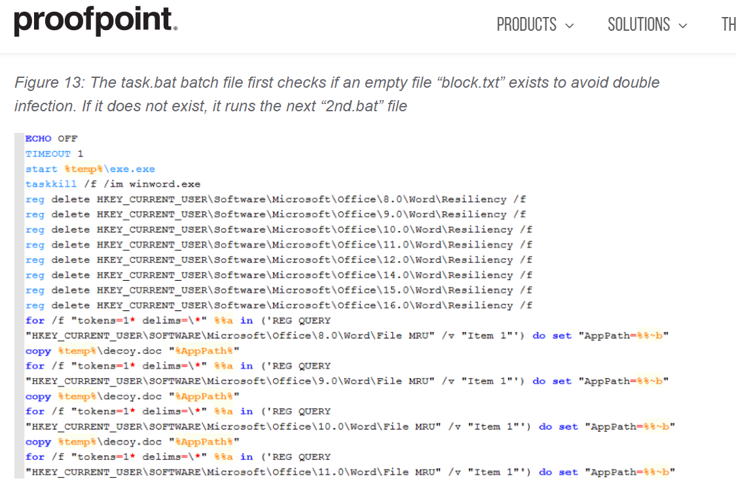
Deobfuscate (reminds threadkit)

Slide 12
Overview
Macro VB
JavaScript dropper
Dll payload (masquerading as legitimate software)
JavaScript downloader
Backdoor->Remcos RAT

Slide 13
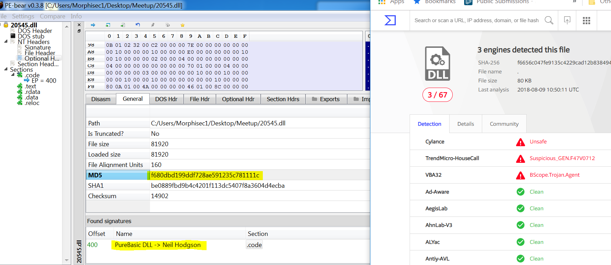
Look for hash and signatures
https://hshrzd.wordpress.com/pe-bear/

Slide 14
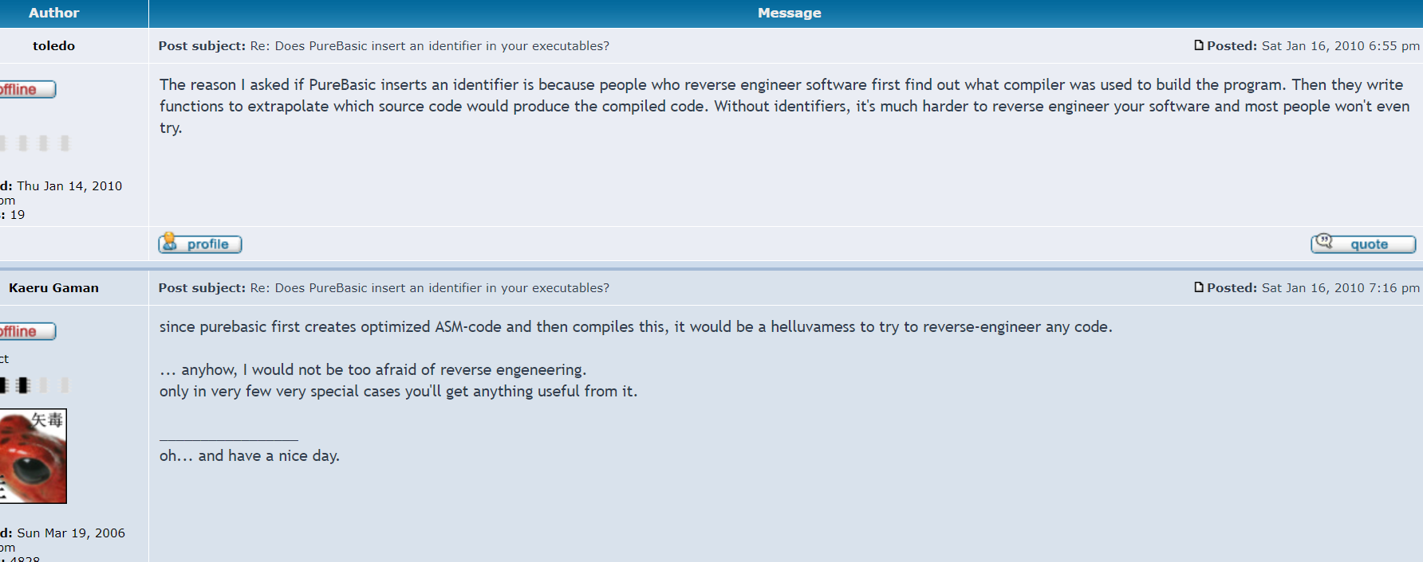
Look for strings and code signatures

Slide 15
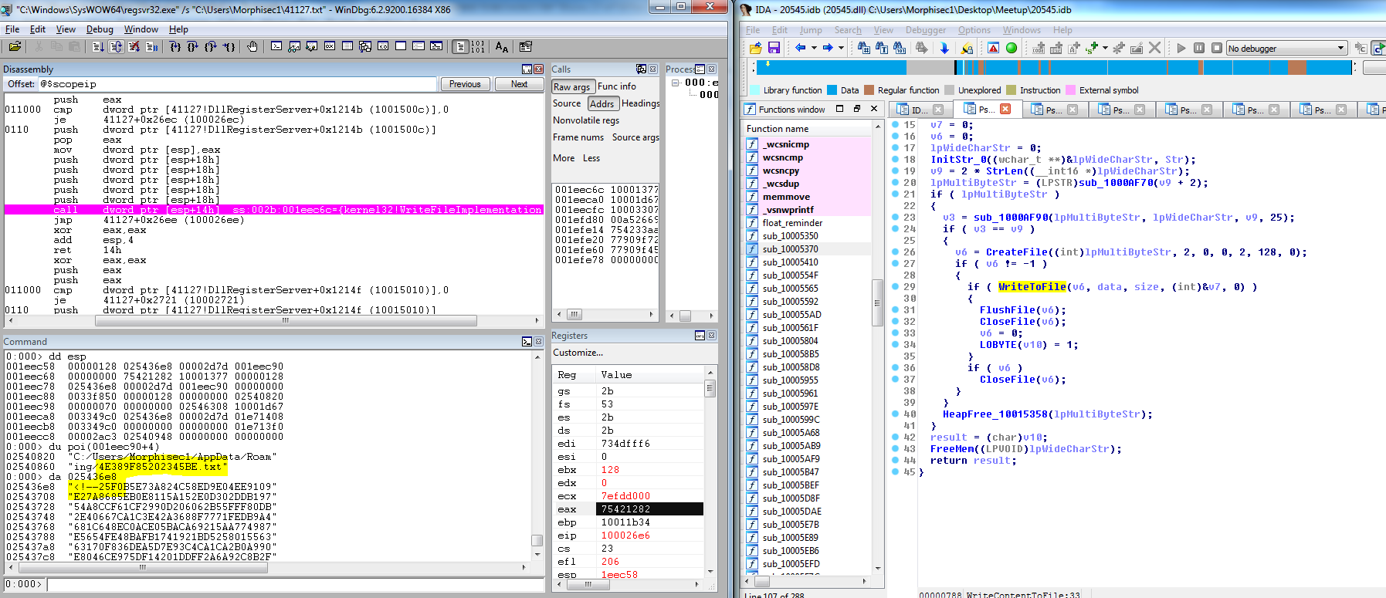
Ida+windbg -> new scriplet

Slide 16
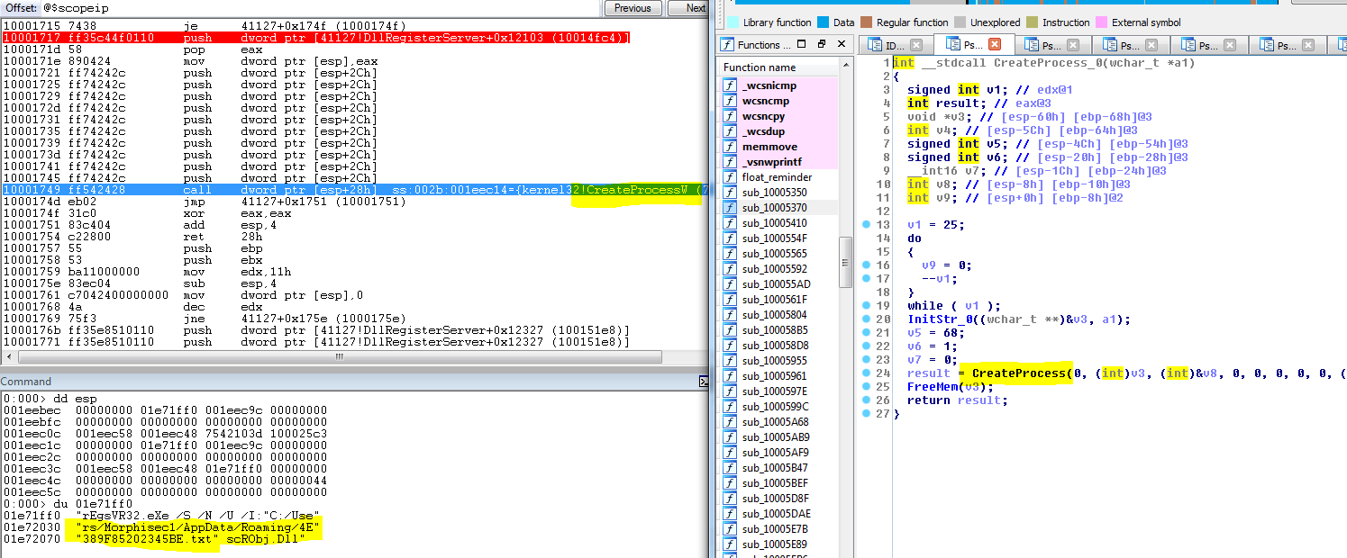
Again whitelist bypass

Slide 17
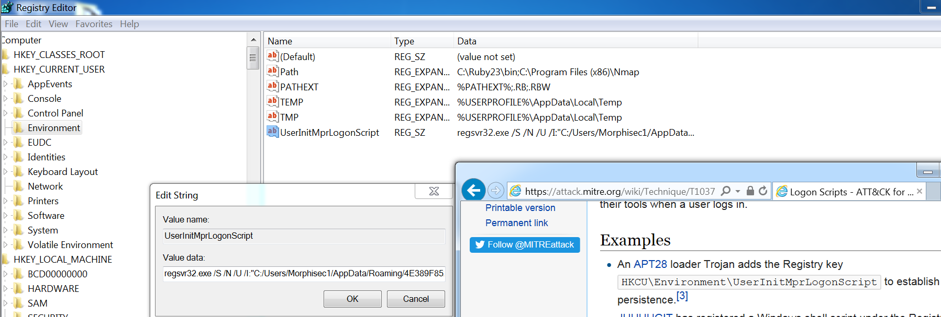
Persistency

Slide 18
Overview
Macro VB
JavaScript dropper
Dll payload (masquerading as legitimate software)
JavaScript downloader
Backdoor->Remcos RAT

Slide 19
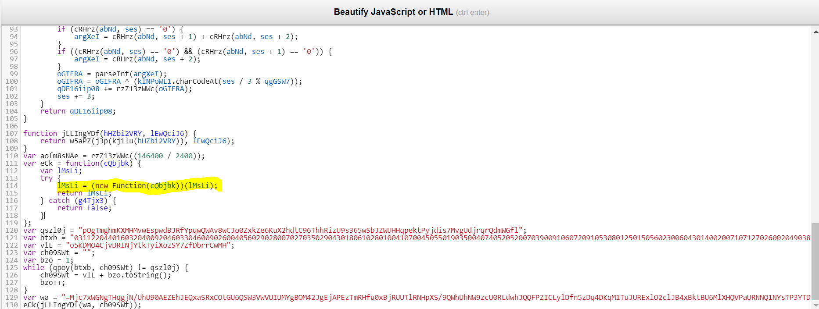
Encrypted JavaScript payload

Slide 20
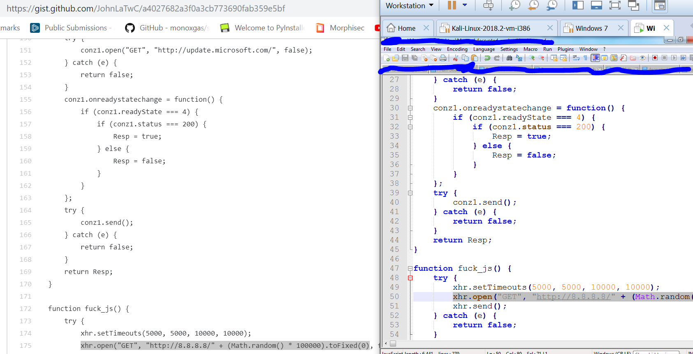
Decrypted downloader (active 8 month ago?)

Slide 21
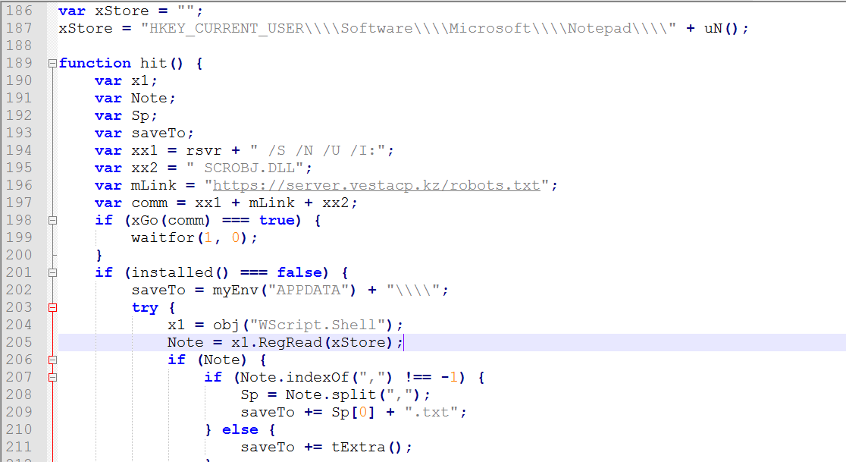
Download Backdoor Beacon

Slide 22
Overview
Macro VB
JavaScript dropper
Dll payload (masquerading as legitimate software)
JavaScript downloader
Backdoor->Remcos RAT

Slide 23
Last part will be presented in the BLOG

