Slide 1
Visualization Design: Data Types, Tables, and Models
UVA DS2003: Communicating with Data
Fall 2026
Sarah Groves
Adapted from Hannah Bako and Rafael Alvarado

Slide 2
What you will learn today
Data components: item, attribute, relationship
Dataset Types: Multivariate, Network/Tree
Data Tables: Messy vs. Tidy Data
Attribute Types: Nominal, Ordinal, Quantitative (Interval & Ratio)
Attribute Types: Dimension and Measure
Simpson’s Paradox
Notes:
Good visualizations: Creating graphics that accurately represent data, and that are easy to read.

Slide 3
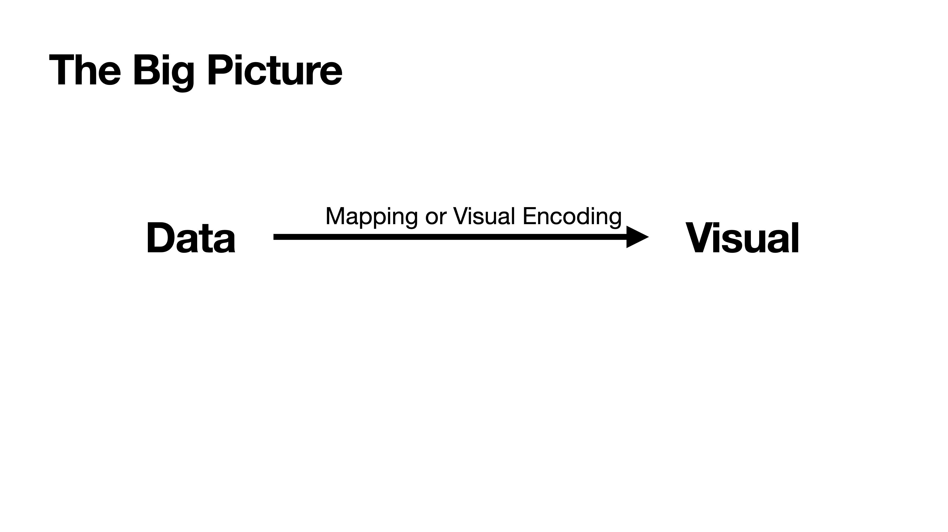
Notes:
So remember the main picture, our goal is to turn data into visual representations to enable us communicate insights with data. And this happens using visual encodings

Slide 4
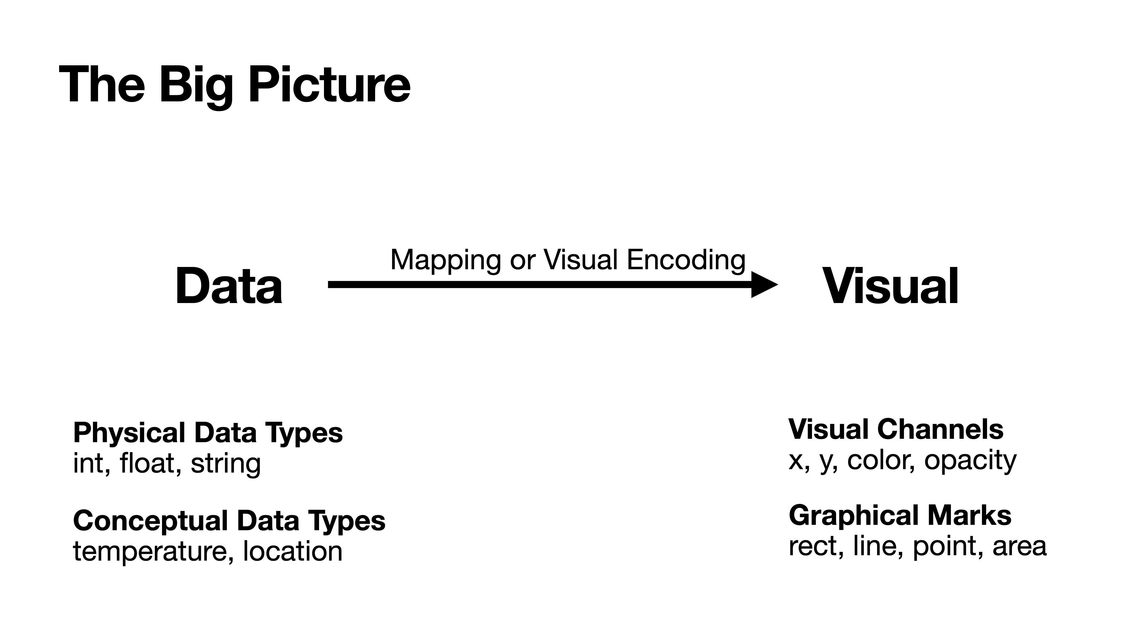
Notes:
So visual encodings map data to visual channels such as color or opacity, and graphical marks. We’ll cover visual encodings in future classes.

Slide 5
Data Components
Items aka data objects, data cases
(cars, employees, cities, countries, …)
Attributes aka data variables, fields
(mpg, age, population, GDP, …)
Relationships aka links
(parent of, owned by, have collaborated, …)
Notes:
Almost all datasets—no matter how complex—can be decomposed into these three components.
Items: the things you’re studying
Attributes: properties of those things
Relationships: how things connect
Example Cities (items), population (attribute), trade routes (relationships).
===================================
Well, first we have data items which is the smallest atomic unit of meaningful information within a dataset. For instance a car in a dataset about cars, and data about an employee
A data attribute basically refers to a column or field within a dataset, and captures an identifying piece of information about the data.
Relationships or links define how data in one table connects to the another. This mostly exists in relational databases

Slide 6
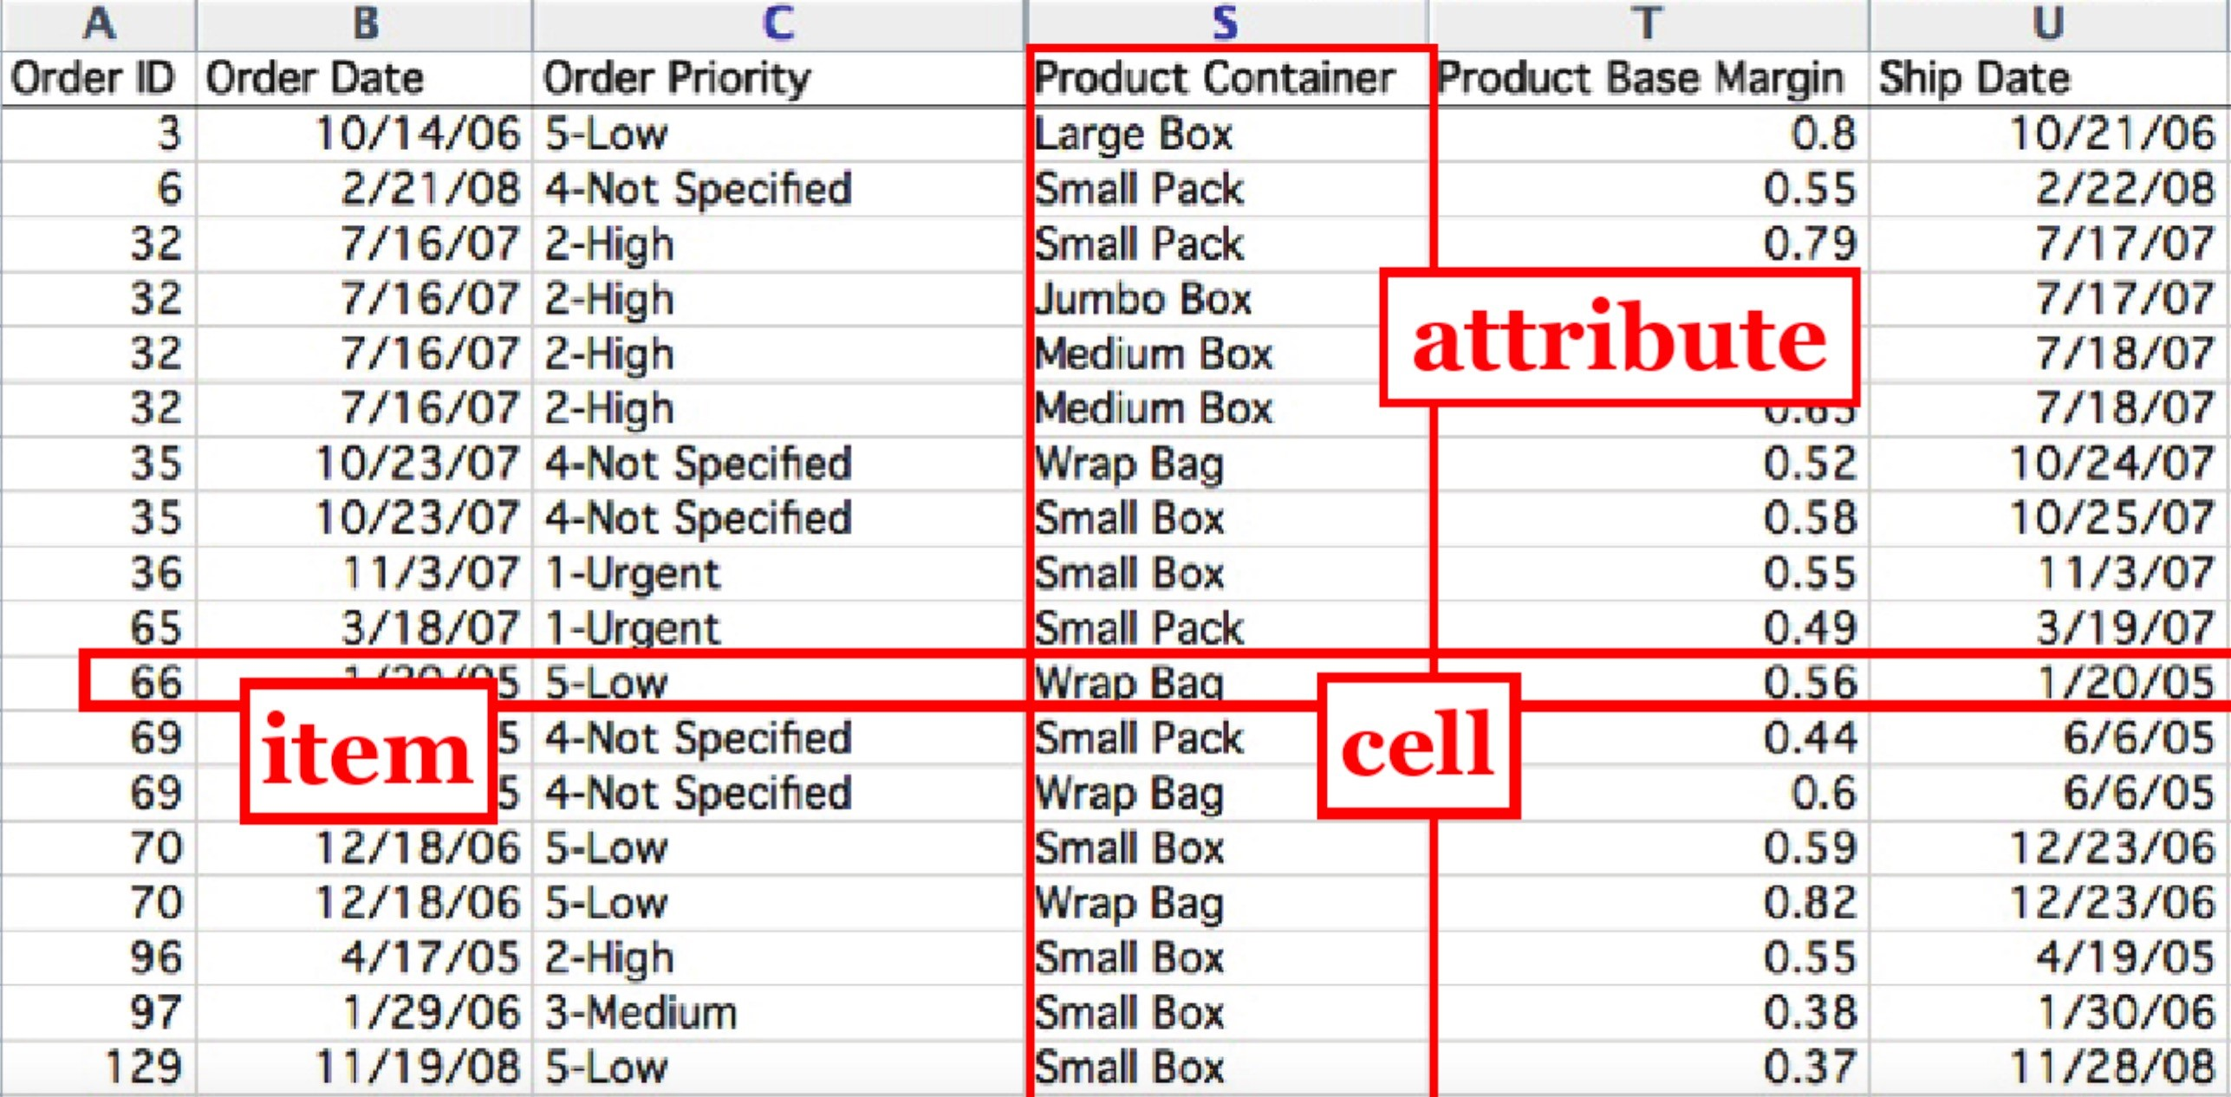

Slide 7
Dataset Types
Multivariate Data: Items and Attributes
Networks & Trees
Notes:
Multivariate data is what most people picture: rows are items, columns are attributes.

Slide 8
Dataset Types
Multivariate Data: Items and Attributes
Networks & Trees: Items, Attributes, and Relationships
Notes:
In networks and trees, the relationships between data items become a critical component
Multivariate data focuses on attributes
Networks → focus on connections

Slide 9
Attribute
Ticker
Sector
Industry
Change
Value
1.40
MSFT
Technology
Software
-
%
214.25
Item
ADBE
Technology
Software
-
3.12
%
491.94
AAPL
Technology
Consumer
Electronics
+0.07
%
120.96
V
Financial
Credit
Services
-
2.06
%
204.66
What relationship exists in this table?
Notes:
Describe the dataset
Ask students where the relationship exists here

Slide 10
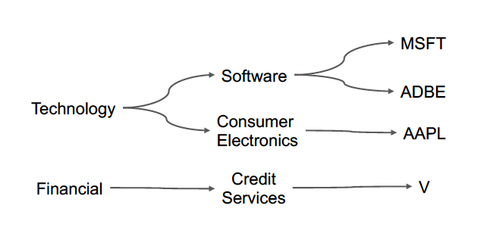
Attribute
Ticker
Sector
Industry
Change
Value
1.40
MSFT
Technology
Software
-
%
214.25
Item
ADBE
Technology
Software
-
3.12
%
491.94
AAPL
Technology
Consumer
Electronics
+0.07
%
120.96
V
Financial
Credit
Services
-
2.06
%
204.66
Notes:
This table can be represented as a tree as well [walk through tree]

Slide 11
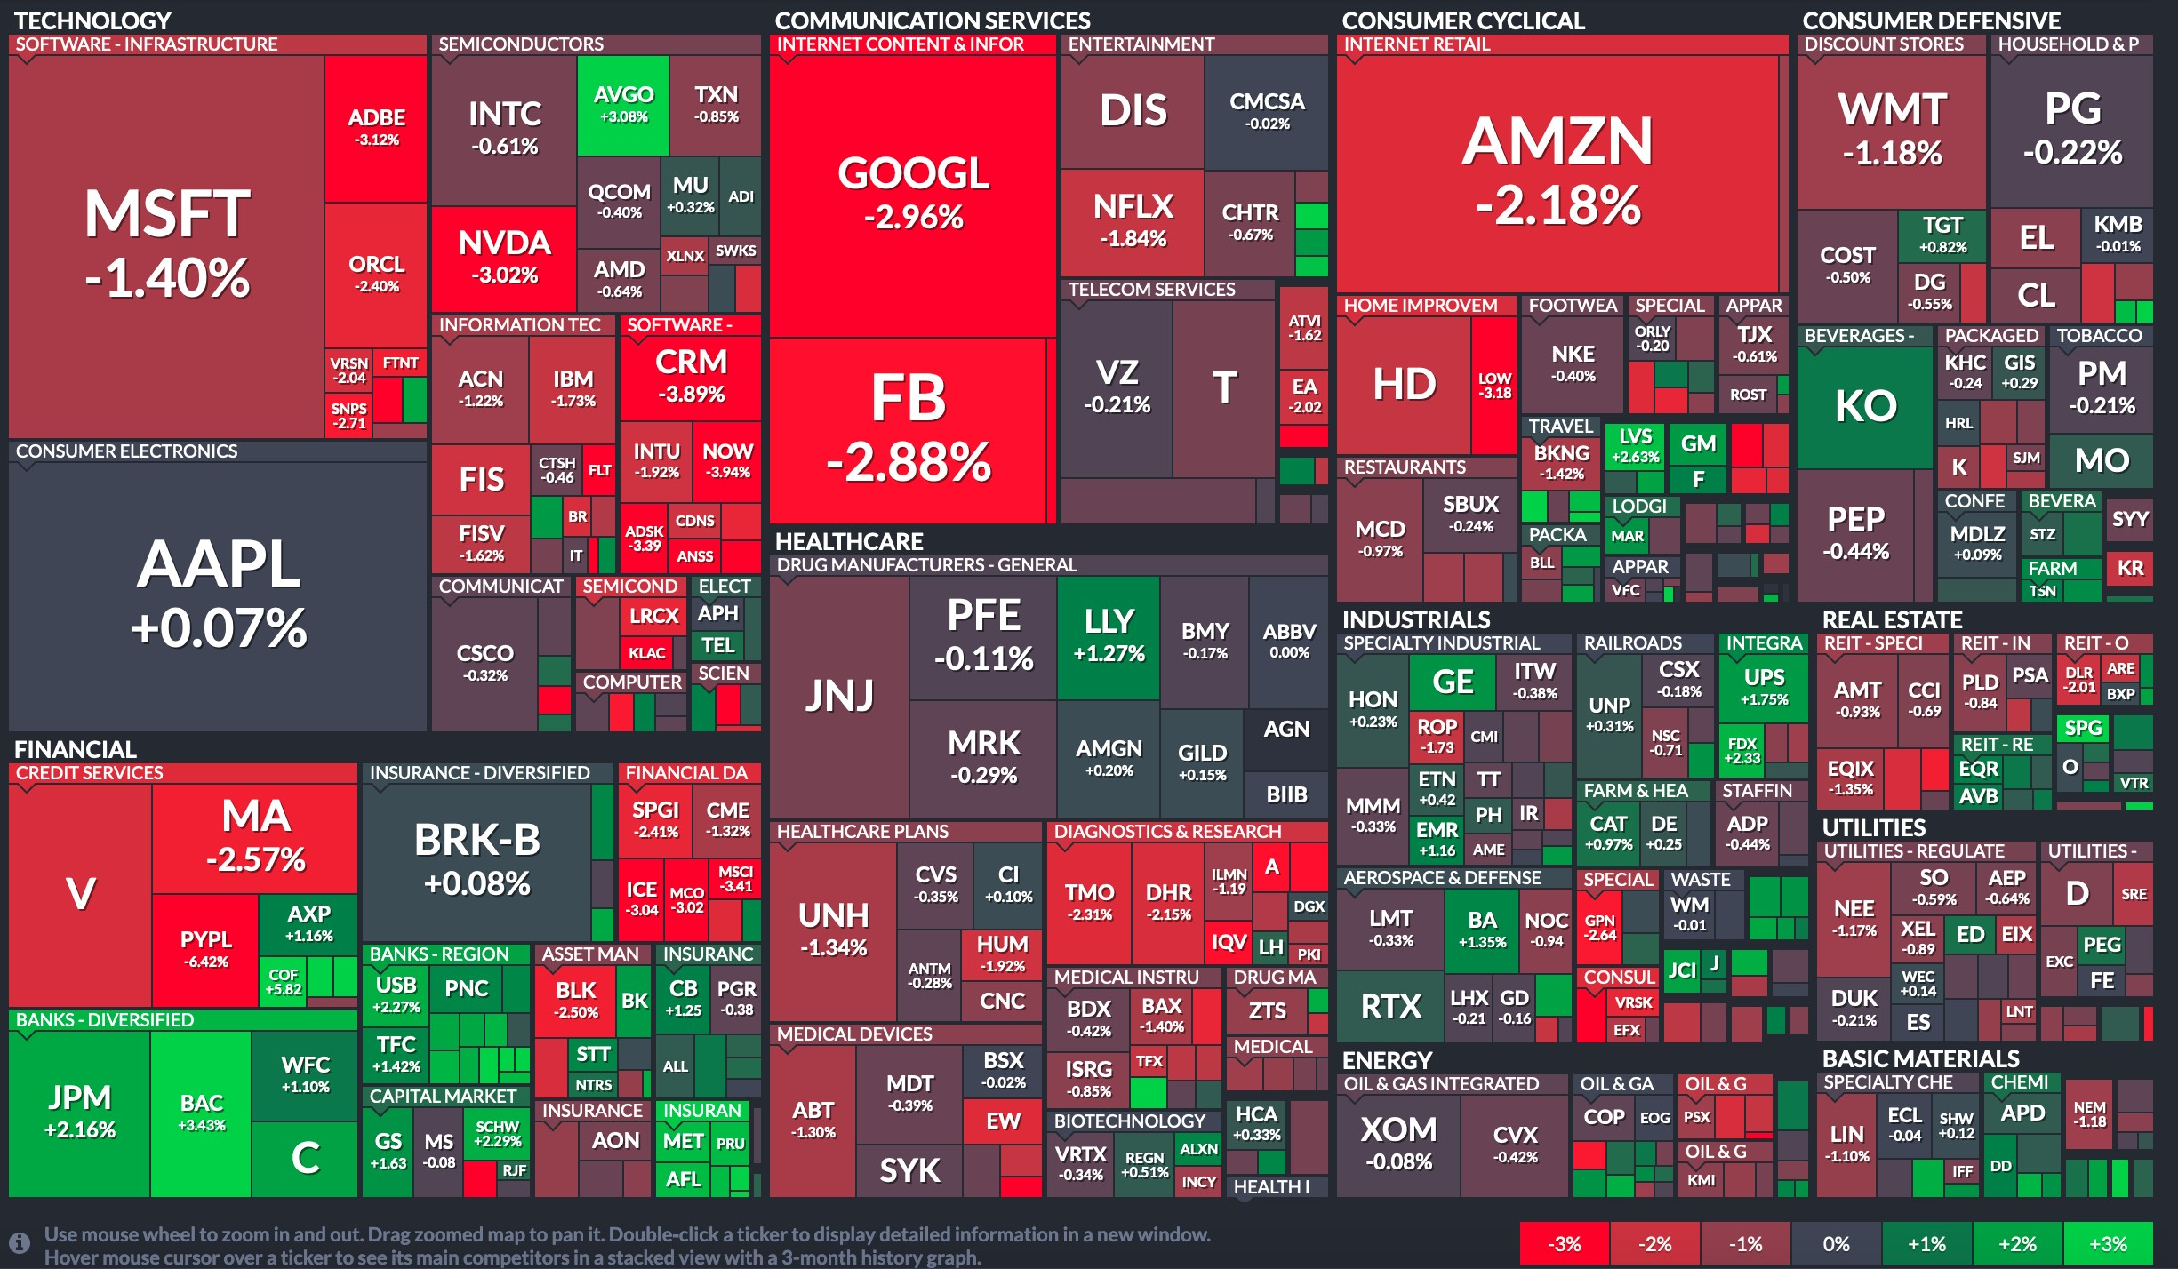
Notes:
This can then be represented in a chart like this. Can you see the relationship? How is it represented here?

Slide 12
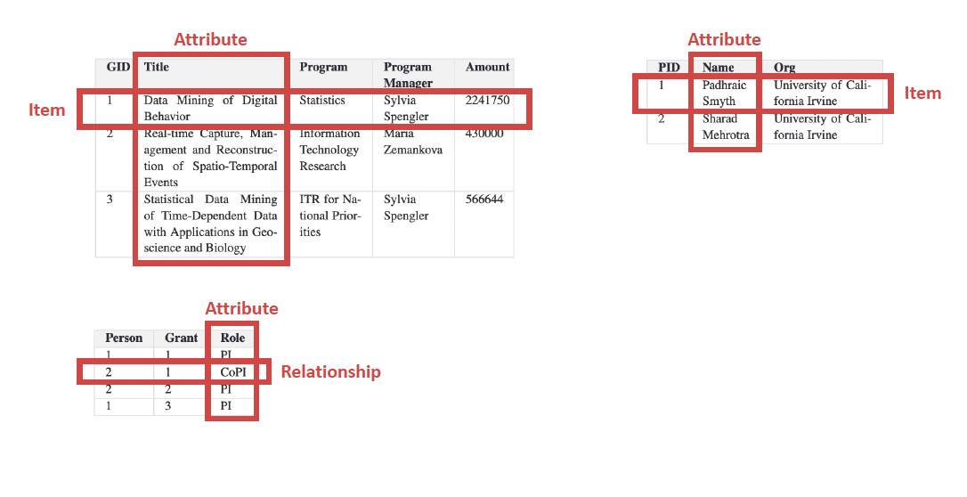
Notes:
Lets take a look at another dataset with three data tables
Top left is contains grant id, titles, the program they’re assigned in, the program manager in charge of the project and the amount awarded for each grant
The top right contains details on Pis, with the PI’s id, name and ogranizatin
The table on the bottom shows the relationship between Pis and Grants using and the role each PI plays in each grant.

Slide 13
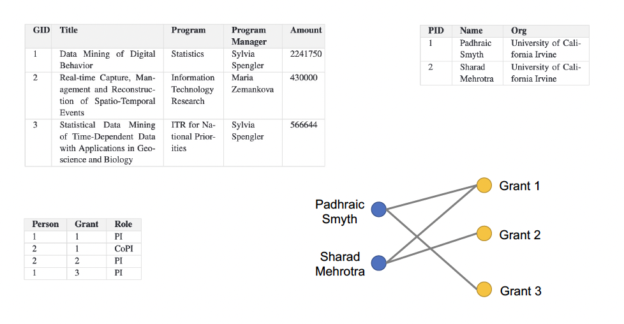
Notes:
Using this data, you can then draw this graph that shows visually this relationship these two Pis and the grant’s they’re working on.

Slide 14
Data Table
Versatile for representing different types of datasets
Often need to be transformed to explicitly represent the semantics of the data
Notes:
Tables are incredibly versatile—but they don’t always make the meaning of the data explicit.
They have to be transformed to explicitly represent the semantics of the data
A table can hide structure just as easily as it can reveal it.

Slide 15
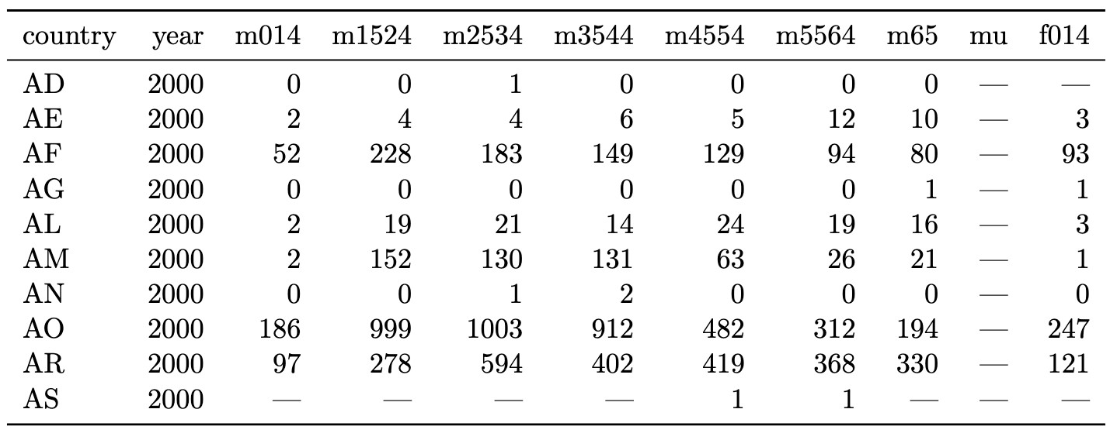
Data Table
Multiple attributes in one column
WHO: counts of confirmed tuberculosis cases by country, year, and demographic group.
Demographic groups: sex(m, f) and age(0–14, 15–25, 25–34, 35–44, 45–54, 55–64, unknown).
Notes:
Here, multiple variables—sex and age—are encoded into a column.
This table is really hard to work with and will need transformation in order for it to be visualized

Slide 16
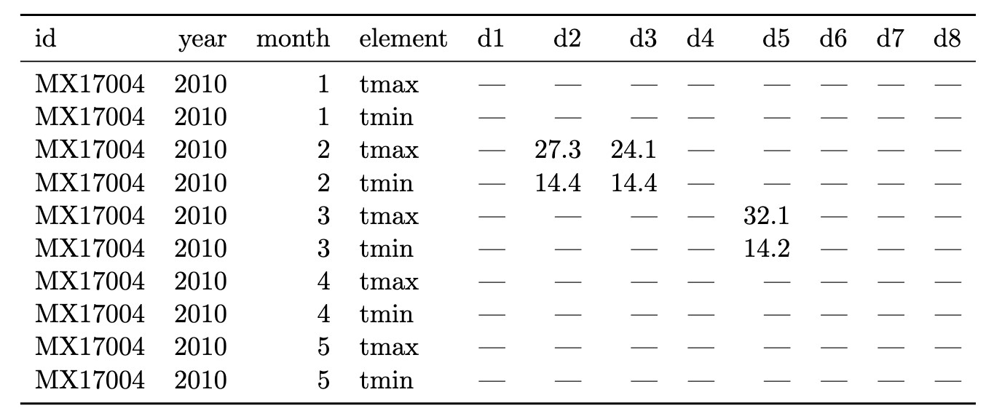
Data Table
Attributes in both rows and columns
daily weather data from the Global Historical Climatology Network for one weather station (MX17004) in Mexico for five months in 2010
Notes:
Here, the attribute names themselves are spread across rows and columns.
Both this and the previous example are tables, but neither is tidy.

Slide 17
Data Table
Versatile for representing different types of datasets
Often need to be transformed to explicitly represent the semantics of the data
A table format doesn’t mean the data is clean and usable
Notes:
A table format doesn’t mean the data is clean or usable

Slide 18
Tidy Data Tables
Each attribute forms a column
Each item forms a row
Each type of observational unit forms a table
“Tidy Data”, Journal of Statistical Software, by Hadley Wickham
Notes:
Tidy data is about making the semantics of the data explicit.
There are three rules defined by Wickham for tidy data
attributes → columns
items → rows
one observational unit per table

Slide 19
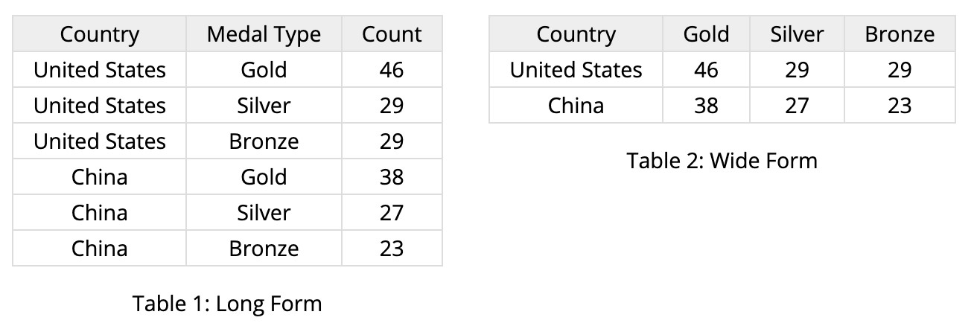
Tidy Data Tables
Wide vs. Long Data Table
Each column is an attribute
Use attribute values as columns
“Tidy Data”, Journal of Statistical Software, by Hadley Wickham
Notes:
There are two forms of tidy data tables, wide and long
Wide and long formats contain the same information—but support different operations and visualizations.
There is no correct format, you choose the format that is fit for your purpose.

Slide 20
Exercise
Discuss prompt in groups of 3
Year | Property_crime_rate
Reported crime in Alabama
2004 | 4029.3
2005 | 3900
2006 | 3937
2007 | 3974.9
Reported crime in Alaska
2004 | 3370.9
2005 | 3615
2006 | 3582
2007 | 3373.9
State | 2004 | 2005 | 2006 | 2007
Alabama | 4029.3 | 3900 | 3937 | 3974.9
Alaska | 3370.9 | 3615 | 3582 | 3373.9
Which format would make it easier to compare trends over time?
Notes:
So in groups of 3, discuss the prompt, and I’ll go through and ask people at random to tell me their thoughts.

Slide 21
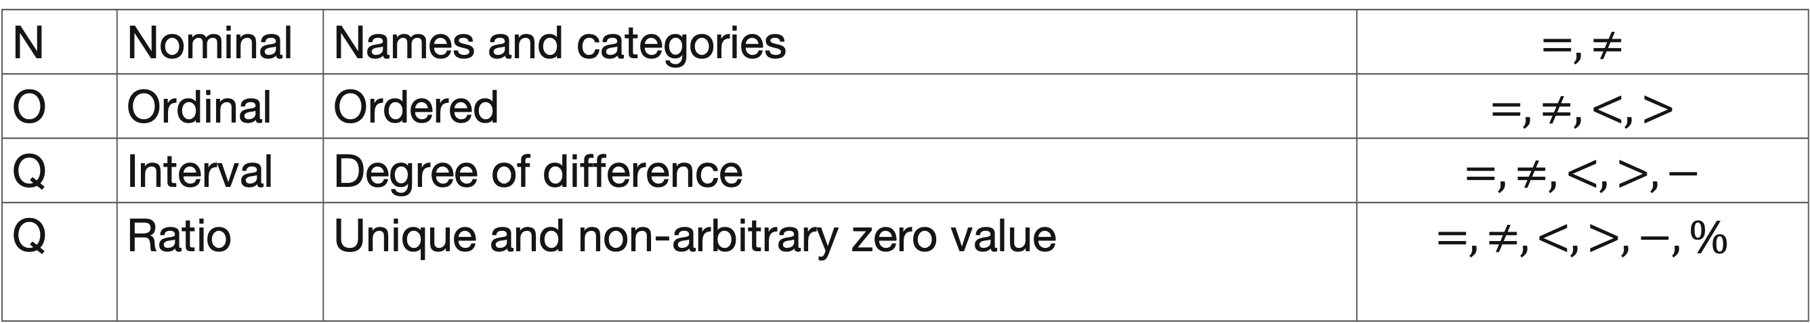
Attribute Types
N | Nominal | Names and categories | $$=,≠$$
O | Ordinal | Ordered | $$=,≠,<,>$$
Q | Interval | Degree of difference | $$=,≠,<,>,−$$
Q | Ratio | Unique and non-arbitrary zero value | $$=,≠,<,>,−, \%$$
Notes:
So. Now, let’s get into the core of data attributes. There are four different types a data attribute can take.
Read slide
Attribute types determine what comparisons are valid—and which visual encodings make sense.

Slide 22
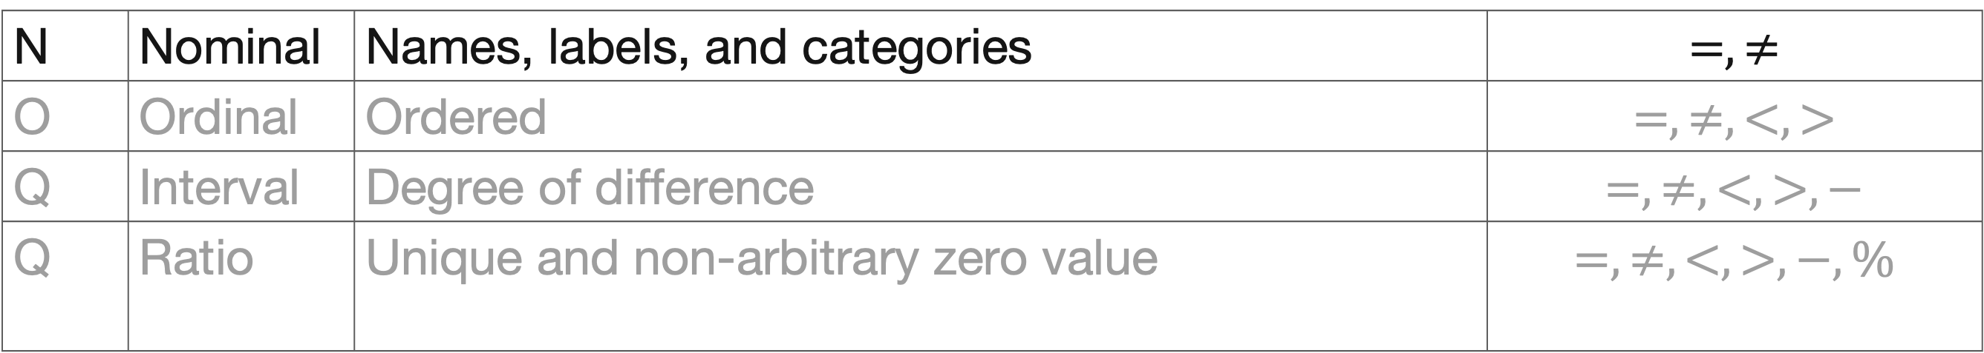
Attribute Types
Nominal
N | Nominal | Names, labels, and categories | $$=,≠$$
O | Ordinal | Ordered | $$=,≠,<,>$$
Q | Interval | Degree of difference | $$=,≠,<,>,−$$
Q | Ratio | Unique and non-arbitrary zero value | $$=,≠,<,>,−, \%$$
Nominal
Fruits: apples, oranges, ..
Notes:
Nominal attributes are categories with no inherent order.
fruit type, country, color.
You can only compare equivalence with nominal attributes

Slide 23
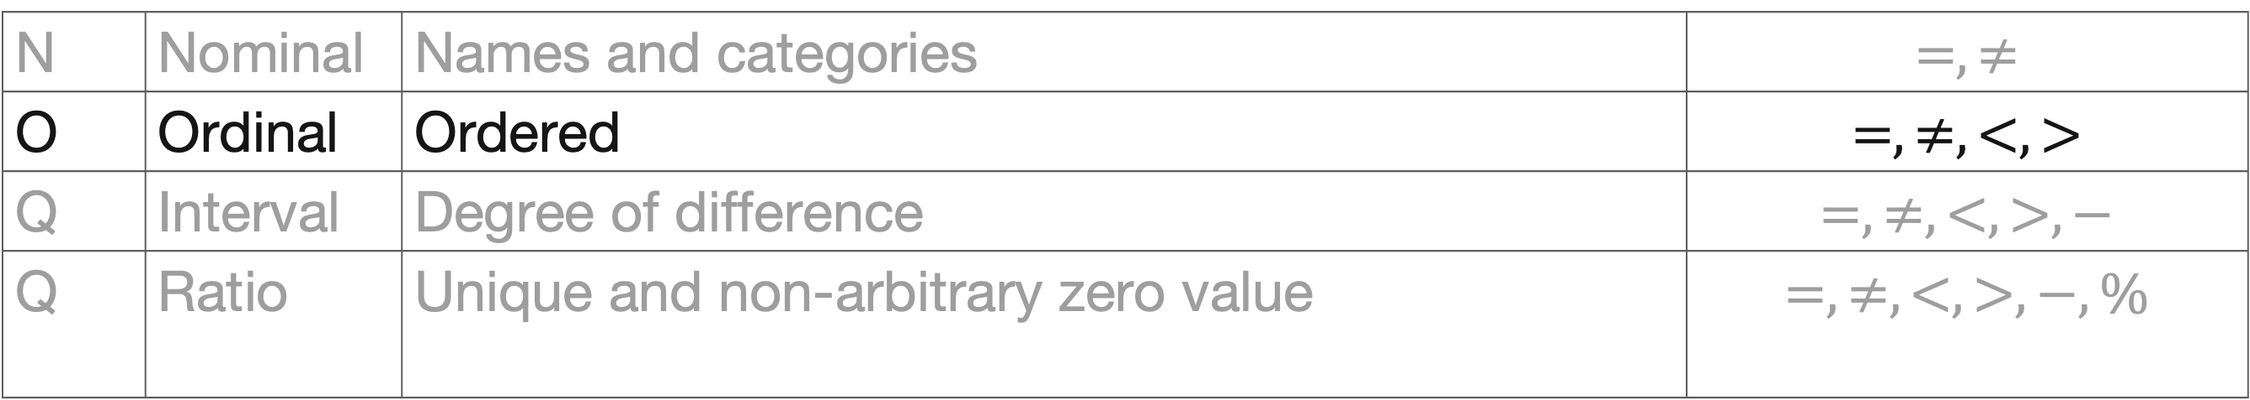
Attribute Types
Ordinal
N | Nominal | Names and categories | $$=,≠$$
O | Ordinal | Ordered | $$=,≠,<,>$$
Q | Interval | Degree of difference | $$=,≠,<,>,−$$
Q | Ratio | Unique and non-arbitrary zero value | $$=,≠,<,>,−, \%$$
Ordinal
Quality of meat (Grades): A, AA, AAA
Notes:
Ordinal attributes have order, but not meaningful distance
An example would be grades. So >93 is A <70 is an F. The grades A – F are ordinal
Be careful not to treat ordinal values as numeric

Slide 24
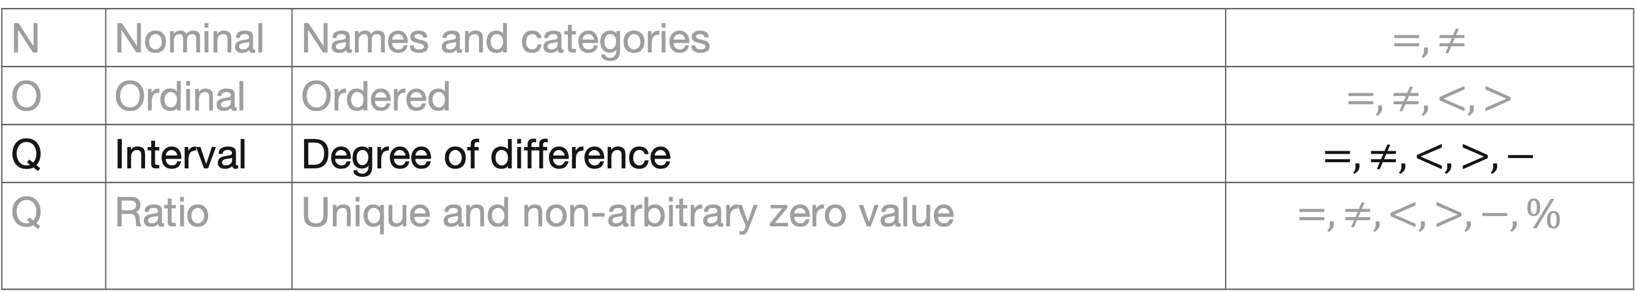
Attribute Types
Q-Interval
N | Nominal | Names and categories | $$=,≠$$
O | Ordinal | Ordered | $$=,≠,<,>$$
Q | Interval | Degree of difference | $$=,≠,<,>,−$$
Q | Ratio | Unique and non-arbitrary zero value | $$=,≠,<,>,−, \%$$
Q-interval
Dates: Jan 19, 2006
Location: Lat 33.98, long -118.45
Only differences can be calculated (e.g., distances or spans)
Notes:
Quantitative Interval data allows differences, but not ratios.
What we mean here is that 0 in quantitative intervals is arbitrary.
For instance, dates or temperature in Celsius. There is no meaningful zero in these measurements

Slide 25
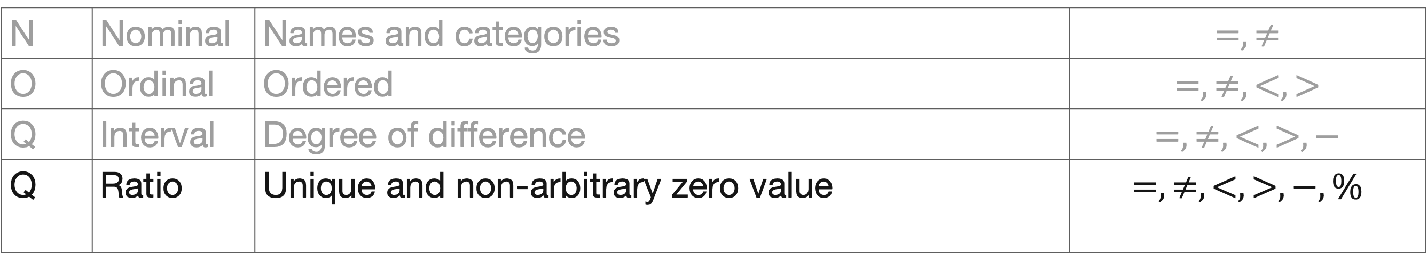
Attribute Types
Q-Ratio
N | Nominal | Names and categories | $$=,≠$$
O | Ordinal | Ordered | $$=,≠,<,>$$
Q | Interval | Degree of difference | $$=,≠,<,>,−$$
Q | Ratio | Unique and non-arbitrary zero value | $$=,≠,<,>,−, \%$$
Q-Ratio (fixed zero)
Physical measurements: Length, Mass, Temp, …
Includes counts and amounts
Can measure ratios or proportions
Notes:
On the other hand, quantitative Ratio data has a meaningful zero—so ratios and proportions make sense
Examples here include length, mass, counts
Most statistical operations assume ratio data.

Slide 26
Attribute Types
Dimension and Measure
Dimensions (~ independent variables) usually nominal or ordinal
e.g., bank branch and customer name
Measures (~dependent variables) usually quantitative, can be aggregated (sum, average, count…)
e.g., account balance
Not a strict rule
e.g. date (Q) is usually treated as a dimension
Notes:
Another way that attributes are differentiated is using dimensions and measures. You see this approach used in tools like Tableau and ggplot.
What this means is that Dimensions structure the data; measures quantify it.
Dates are quantitative but often treated as dimensions.
Note that this is a practical convention, not a hard rule

Slide 27
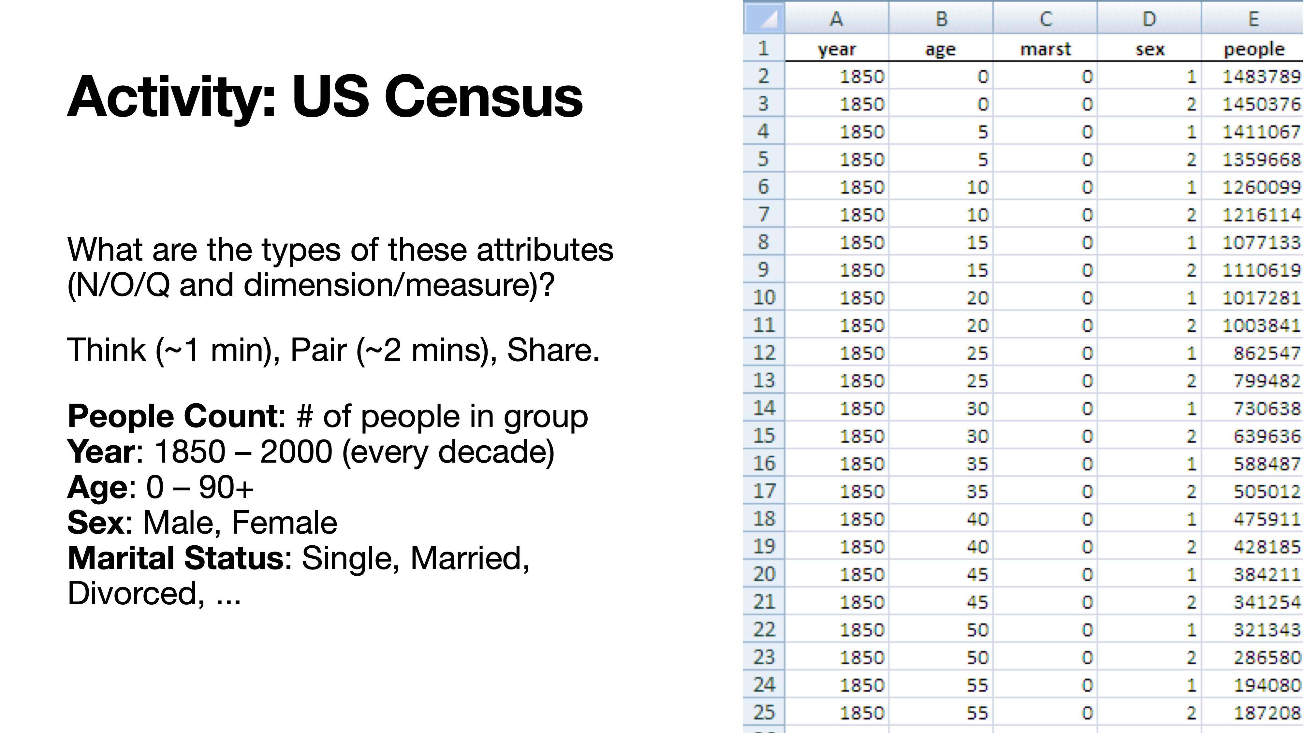

Slide 28
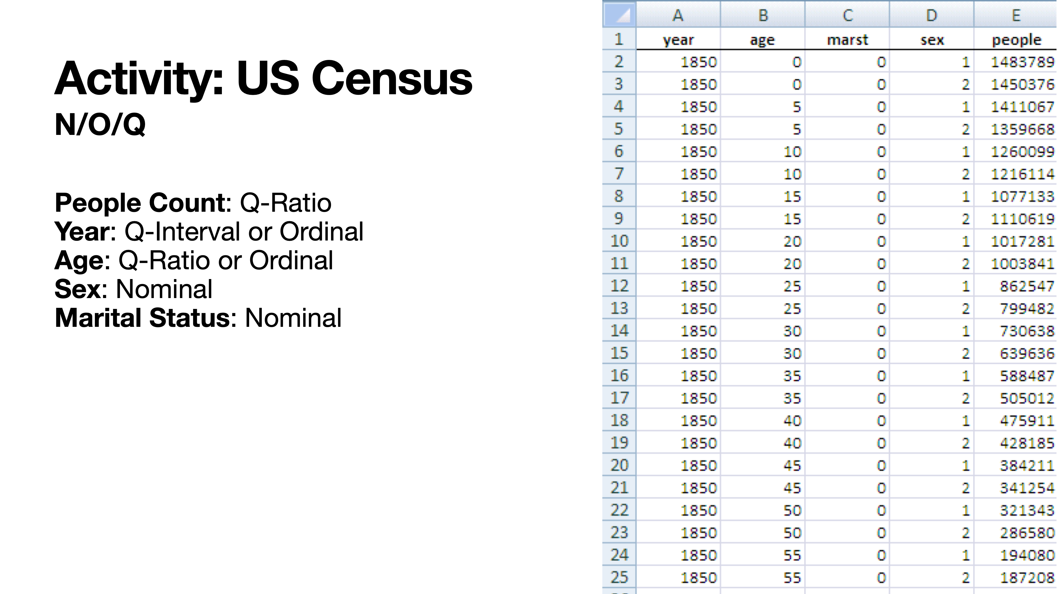

Slide 29
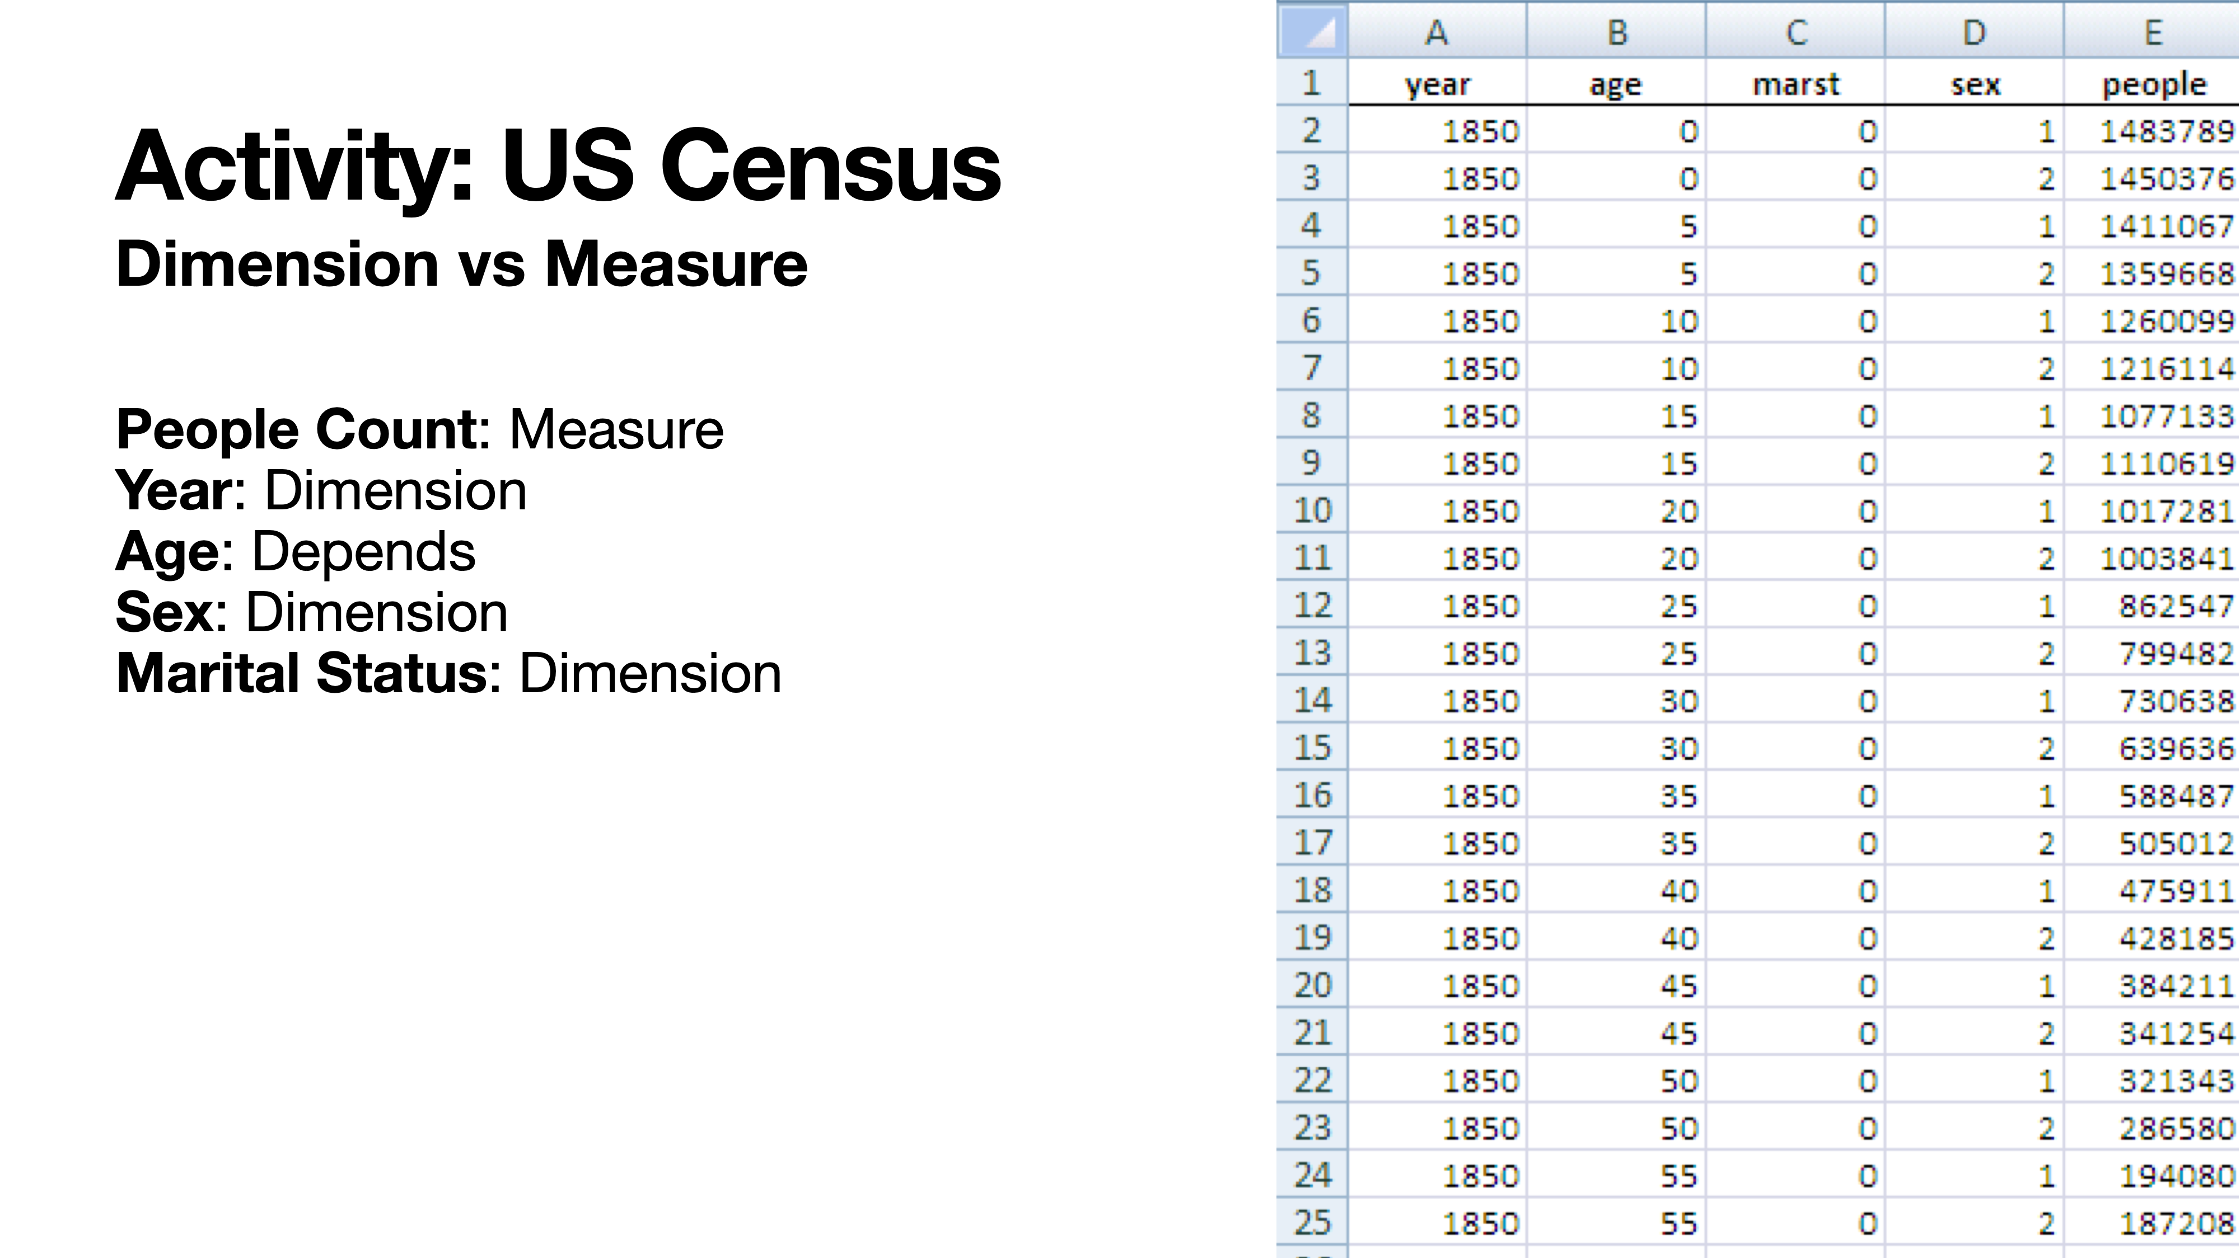

Slide 30
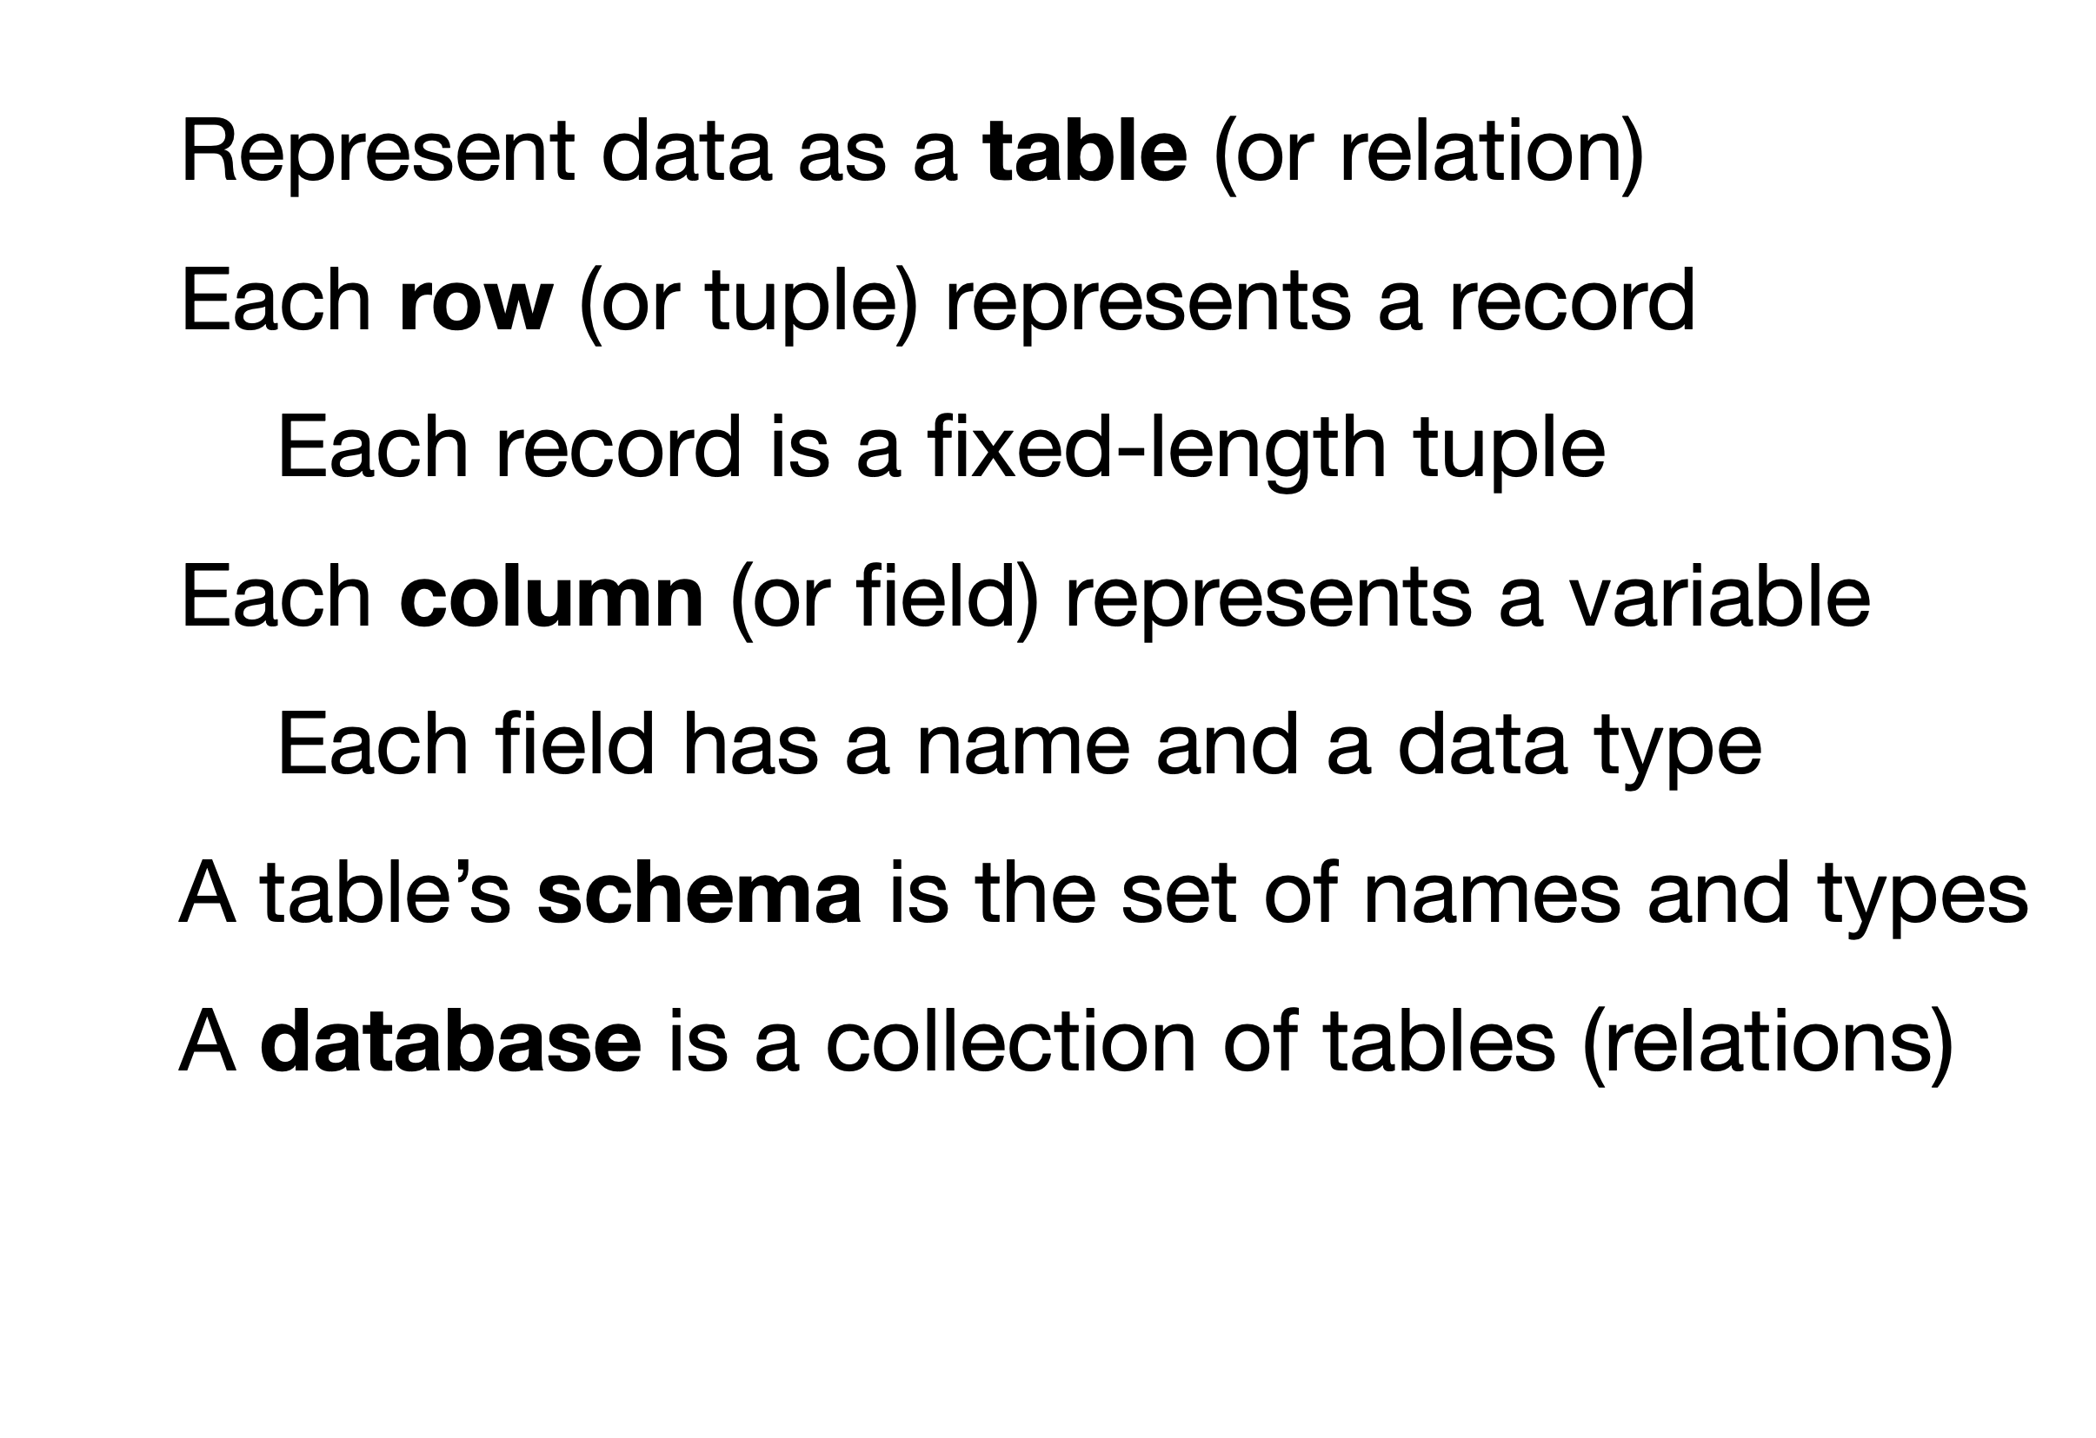

Slide 31
Simpsons Paradox
A trend/pattern appears in several groups of data but disappears or reverses when the groups are combined.
Real world examples:
Study of gender bias in graduate school admission at UC Berkeley, 1973
Success rates of two treatment for kidney stones, 1994
Batting averages for professional baseball players, 1995, 1996
Notes:
Up to this point, we’ve been treating aggregation as something neutral — even helpful. We summarize, average, and combine data all the time to “see the big picture.”
Simpson’s Paradox is a reminder that how we group data is itself a design decision — and a consequential one.
Some examples of these were seen in a study of UC Berkley admissions. Overall admissions rates suggested bias against women, but department-level data showed women were admitted at similar or higher rates in most departments. The reversal occurred because women applied more often to highly competitive departments with lower acceptance rates.
In a kidney stone study conducted in 1994 One treatment appeared better overall, even though the other was more effective for both small and large kidney stones. This happened because the less effective treatment was used more often for severe cases.
The same paradox was observed in batting averages for baseball players in 1995 and 1996. A player had higher batting averages in each season but ranked lower when seasons were combined. The reversal occurred because seasons with more difficult conditions or fewer attempts were weighted differently in the aggregate.

Slide 32
Simpsons Paradox
How Simpson’s Paradox explains weird COVID19 statistics
https://www.youtube.com/watch?v=t-Ci3FosqZs
Notes:
I’ve linked this video for you to watch on your own time that shows how Simpson’s paradox explains some weird statistics observed in data about the covid-19 pandemic.

Slide 33
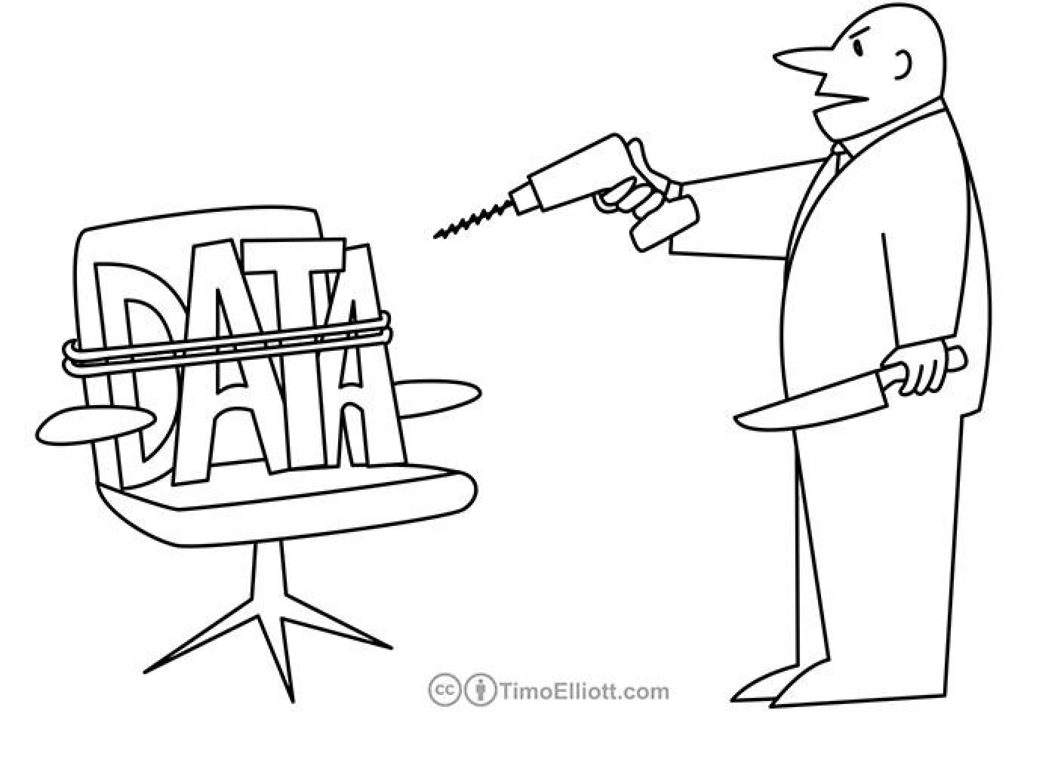
Simpsons Paradox
“If you torture the data long enough, it will confess to anything.”
- Ronald H. Coase (1975)
Notes:
This quote is funny—but also dangerous. The goal of data analysis and visualization is not to torture data, but to reveal structure honestly.

Slide 34
What’s next
Friday’s lab will explore these concepts using pandas dataframes
Next week:
Quiz on this and previous material
Read “A Tour through the Visualization Zoo”
We will discuss encodings and matplotlib on Wednesday
Your topic and dataset checkpoint for Project 1 is due Sep 13
Notes:
Good visualizations: Creating graphics that accurately represent data, and that are easy to read.

