Slide 1

Data is ART
Friday Sept 4 @ 5pm, SDS
Presentation and award ceremony

Slide 2
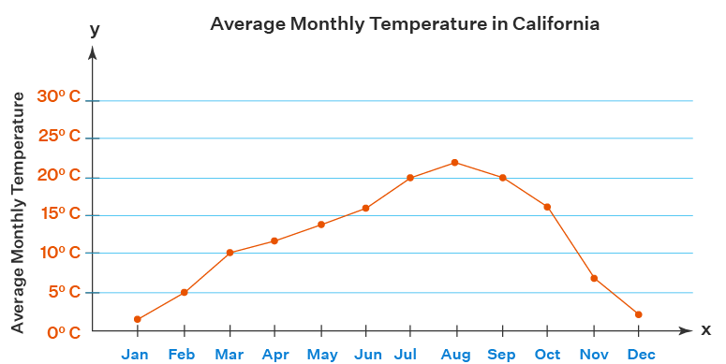
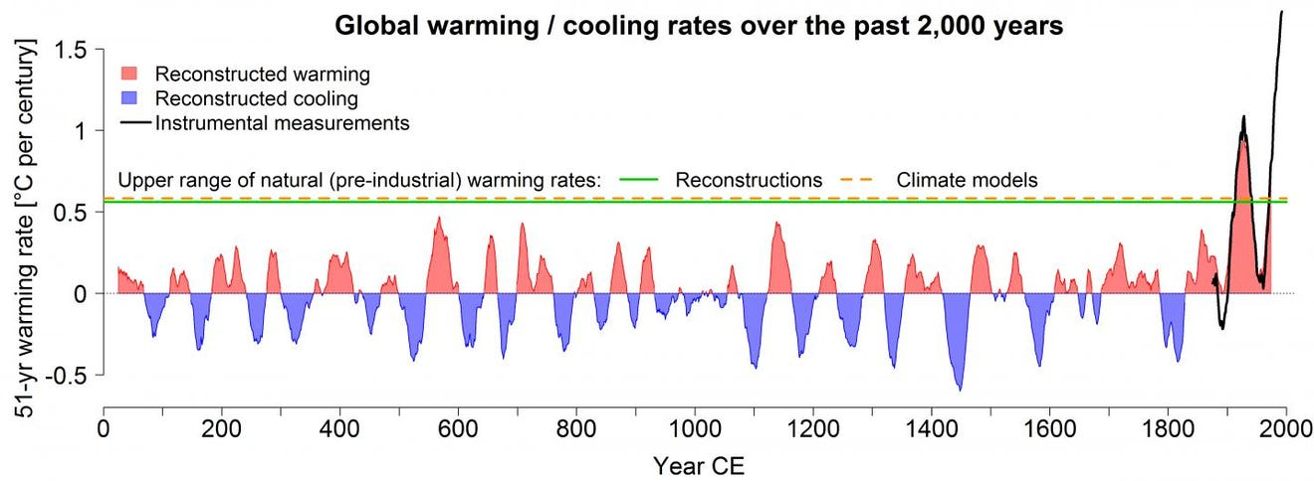
Two Kinds of Visualization
Some graphs are direct transformations of the data
These are designed to describe and explore data that has not be analyzed
We call these data visualizations exploratory
Others are highly embellished data visualizations
These are designed to communicate and explain results of analysis
These are examples of storytelling with visualization
We call these explanatory
Infographics, scientific figures, etc.

Slide 3
This structure of this course follows this pattern
The first half will focus on exploratory
data visualization
The second half will focus on explanatory
storytelling and infographics
What is the intent?
Is the graphic displaying an underlying model of the data?

Slide 4
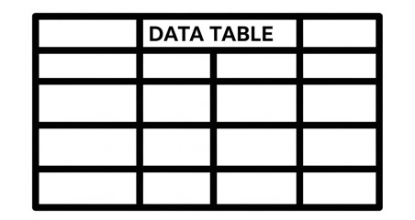

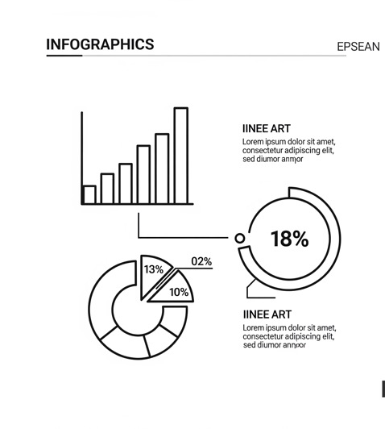
To explore data, we often need to code
Exploratory
W₁
The Real World
I
II
III
W₂
Explanatory
Interfacing with the real world
Transferring information between world and models
Models of the world

Slide 6
Introduction to Coding in Python
Files needed today:
Lab_01.ipynb [canvas]
Pre-Lab 1

Slide 7
You should have:
  Anaconda installed
  VS Code installed (or an IDE you like)
Today we will add:
  A folder location to organize your files (code files and data files for this class)
  VS Code extensions:
    Jupyter notebook extensions
    Optional extensions: CSV viewer
  Python packages needed for this class
Setting up your computer for this class
Notes:
I have tested the install process I’ll walk through today, but there will always be errors because everyone’s computer set up is different. Make sure you’re able to complete all of these steps and if not, come to office hours tomorrow or reach out to us on piazza
You should have learned coding basics (prompt students?)
What we found last semester was that a lot of students needed help with getting their computer set up in a way that made coding seamless, so they could focus on writing good code that worked well and tied all of the pieces together
We found that even if they could write a for loop or if statement, it was often hard to understand why sometimes code ran in different places, or why they needed anaconda in the first place
A lot of students also needed some coding principles or guiding practices, more than a regurgitation of syntax or basic coding structures that they could google. Where students were struggling was often, I don’t know how to interpret coding errors, writing repetitive code that then made mistakes because things were copied and pasted multiple times, just figuring out how to even structure an approach to the problem they were solving (in plain English)

Slide 8

How do coding tools fit together?
Writing code ≠ running code
Think of coding like running a restaurant
  .py files
  Jupyter notebooks
  VS Code (IDE)
  Python interpreter
  Terminal/Command Prompt
  Anaconda & environments
  GitHub and git
Your code = the recipe
  It describes ingredients and steps, but a recipe does not cook itself!
.py file
Notes:
Start by talking about my rationale for this intro based on the last two semesters of feedback and problems that arose

Slide 9

Folder Organization: The recipe book
Pick one location to make a folder for this class (Documents? UVA Box? Home?)
  Each lab will have its own subfolder that we will put in this folder
  Any extra data/files from Canvas should go here
Think about what you want to name your files!
You will open this folder every time you work on this class!
Notes:
Naming conventions for files and folders
Enumerate code in a pipeline when step-by-step (1_xxx.py, 2_xxx.py, etc)
Python files should have a clear, descriptive name for importing (numerical_solvers.py, statistical_tests.py, classification.py, etc)
No files should have “template” in the title (i.e. rename any files you get from Canvas!)

Slide 10

Python interpreter:
The Chef
The chef reads the recipe line by line and executes each instruction
Different chefs exist:
  Python 3.7
  Python 3.9
  Python 3.11 …
Same recipe with different chef → slightly different outcomes!

Slide 11

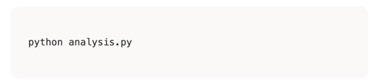
Terminal & Command Prompt:
The Order Counter
The terminal is where orders are placed
Means “Chef Python, make the analysis.py recipe”
We can access the terminal through stand-alone apps (terminal, command prompt) or within VS code
  Like different windows at the same order counter

Slide 12
The Restaurant: The Big Picture
… and put them in a recipe book (folder)…
… which you can send to the order counter (terminal)…
…which tells the chef (Python) what to cook
You write recipes (code)…
I need an analysis.py, stat!
The Restaurant (VS Code)
All of this happens inside the restaurant, VS Code!

Slide 13
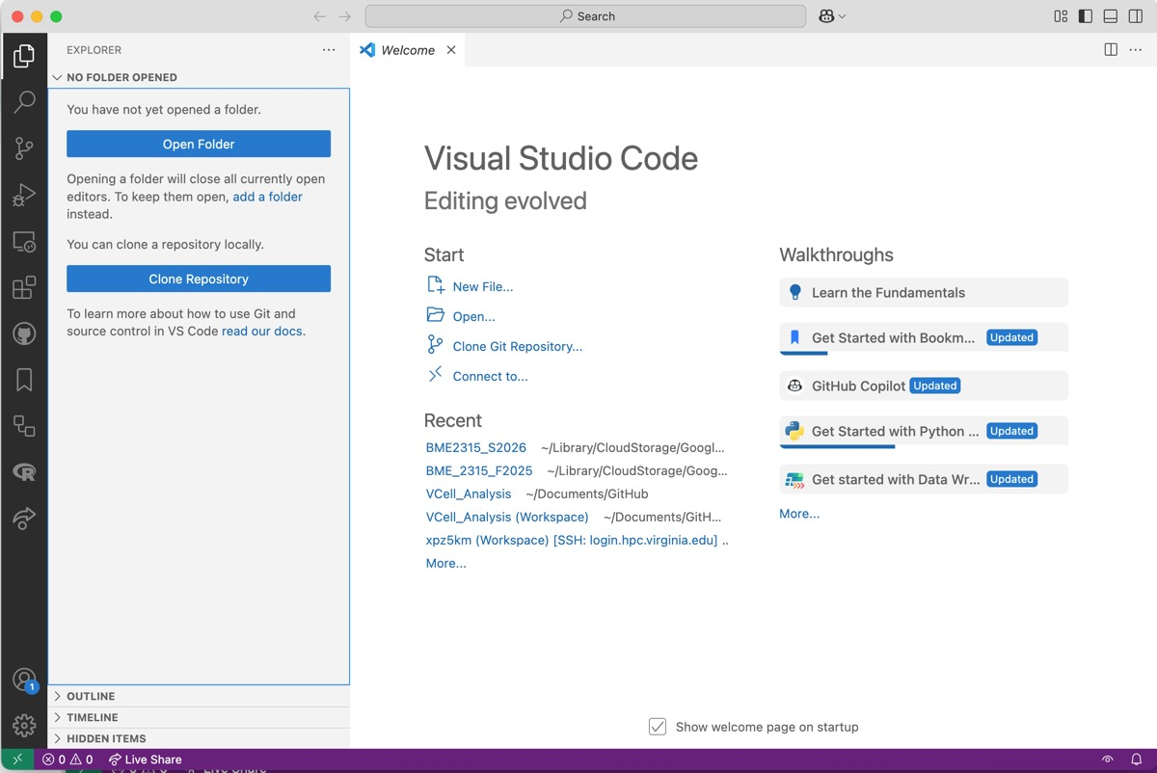
VS Code & Integrated Development Environments:
The Restaurant
VS code is a place to work on code (write recipes), view data files (peek in the kitchen), and run your code through a terminal (tell the chef what to cook)
Integrated: many tools in one place
Development: place to build code
Environment: workspace

Slide 14
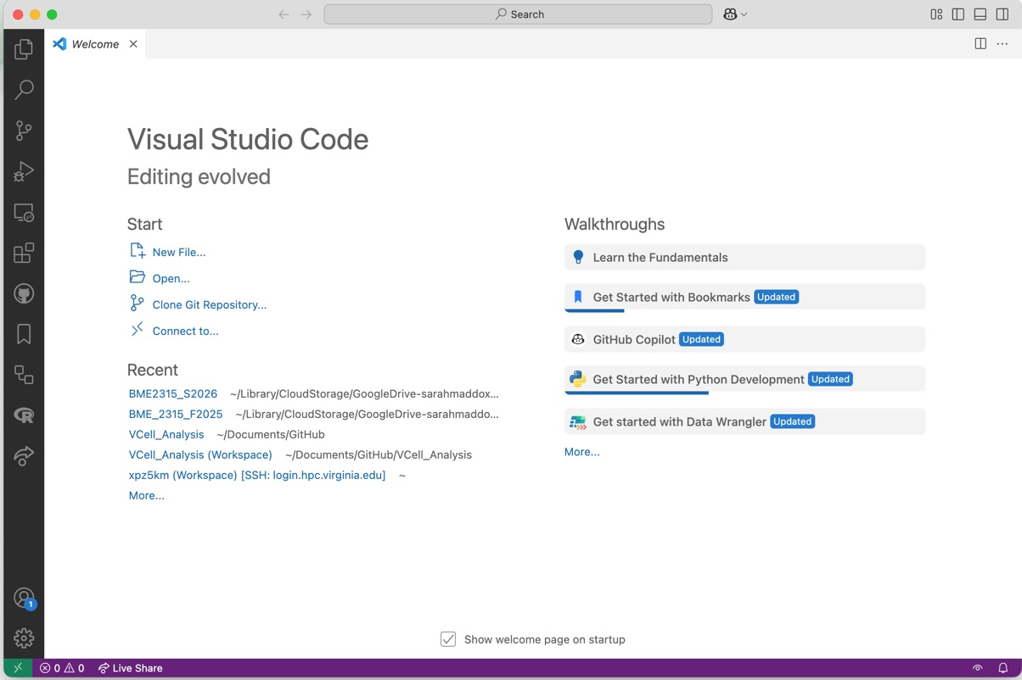
VS Code IDE
Welcome screen
Open a folder
Recently opened folders
Always start by opening your class folder from VS code!

Slide 15
Let’s practice!
Make a folder for this class on your computer (not in Downloads please!!)
Open VS Code (or another editor).
If you have a PC, open VS code THROUGH ANACONDA NAVIGATOR.
Stand your name card up on its edge when you are done. Raise your hand for help!

Slide 16
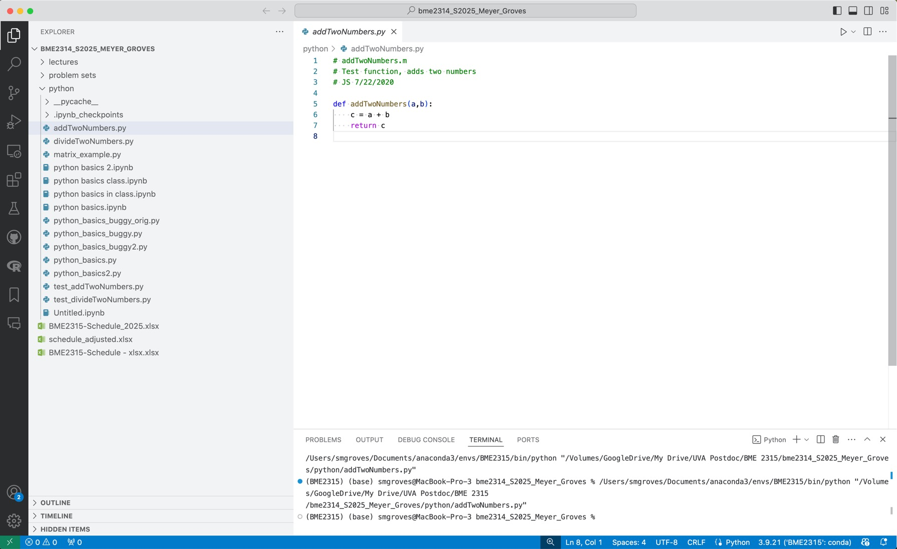

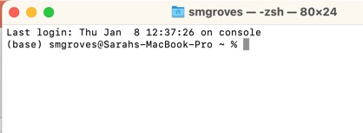
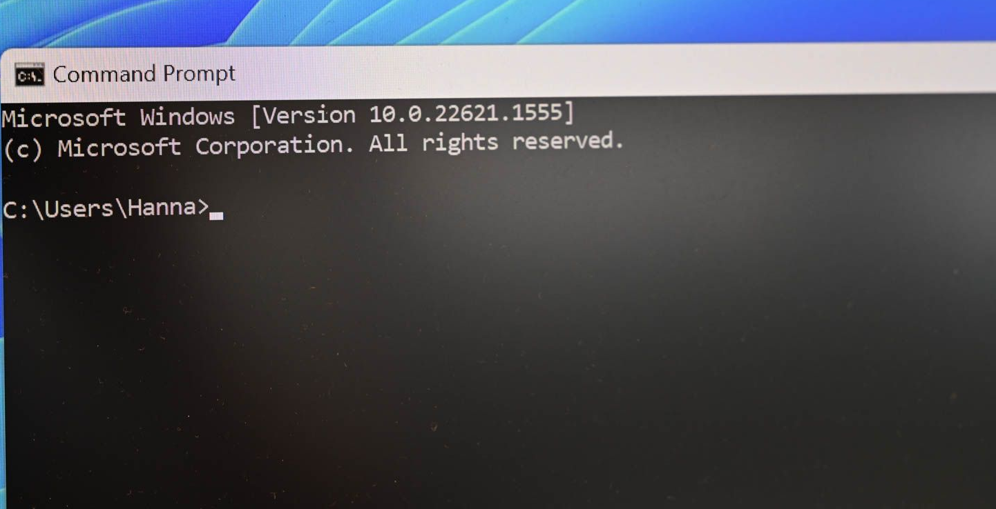
VS Code IDE
Add a file Add a folder Refresh Collapse all folders
Search or run a command
Your chosen folder!
File Explorer
Name of file
Search
Run File
Terminal (Mac)
Script Editor
Extensions
Command Prompt/
Anaconda Prompt
(Windows)
Console/Terminal/Output
Python version

Slide 17
Let’s practice!
Open the folder for this class in VS code.
Add lab0_blank_python.ipynb from canvas into this folder and open it in VS code.
Go to the extensions marketplace and download Python & Jupyter.
Stand your name card up on its edge when you are done. Raise your hand for help!
Tip: File > New Window will open a new window with the welcome page again

Slide 18
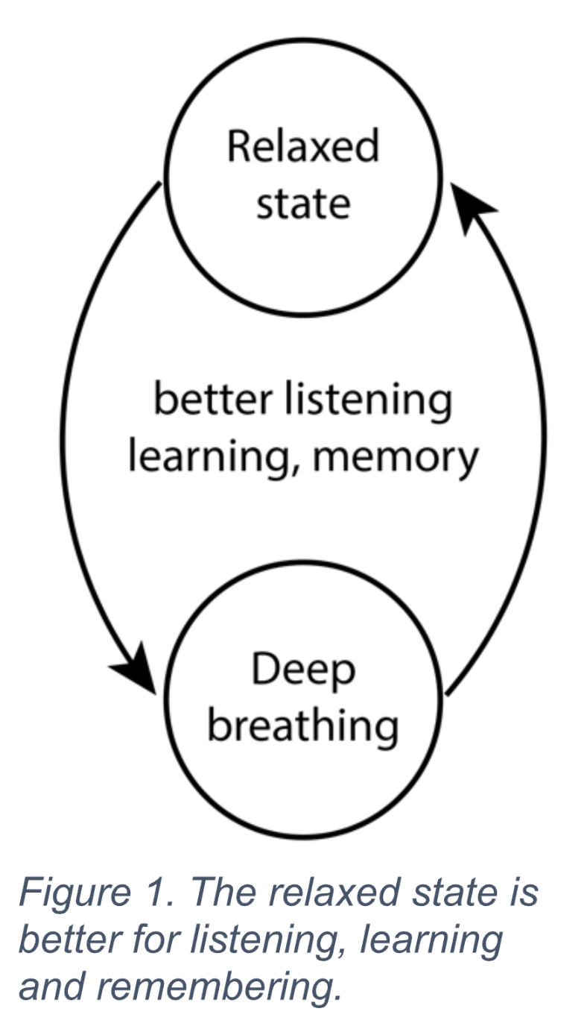
A positive feedback loop!
Adapted from Uri Alon

Slide 19


Anaconda:
The supplier & pantry
Conda environments:
The kitchens
Anaconda is the supplier that includes Python and scientific libraries
  The package manager gives you a stocked pantry
Conda environments = separate kitchens
  The base environment is the default
  You can make as many environments as you want. This is useful for organizing projects.
  Each kitchen can have different chefs (Python versions) and different pantries
  Ensures there are no “ingredient conflicts”
VS code works in one kitchen at a time
“This special package requires python 3.7”
conda create …
base (default)
special_env_1
special_env_2
Python 3.11
Numpy 2.4.0
Pandas 2.3.3
…
Python 3.7
Numpy 1.9.1
Special 1.0.0
…
Python 3.11
Matplotlib 3.10.8
Seaborn 0.13.2
…
conda activate …

Slide 20
The Restaurant: The Big Picture
…to different kitchens (environments)…
Anaconda supplies the ingredients…
I need an analysis.py from the blue kitchen!
Orange kitchen, get me a statistics.py!
You write recipes (code)…
… and put them in a recipe book (folder)…
… which you can send to the order counter (terminal)…
…with different chefs (Python versions)…
…which tells the chef (Python) what to cook
The Restaurant (VS Code/IDE)

Slide 21
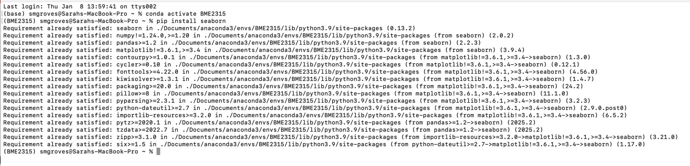
Importing packages (adding food to the pantry)
conda and pip are two major “warehouses”
  Most python packages are hosted on Python Package Index (pypi) and can be installed with pip
  Ensure the right conda environment is activated to add the package in the right location
  If a package is not available through pip, try conda (or look at the install guide)

Slide 22
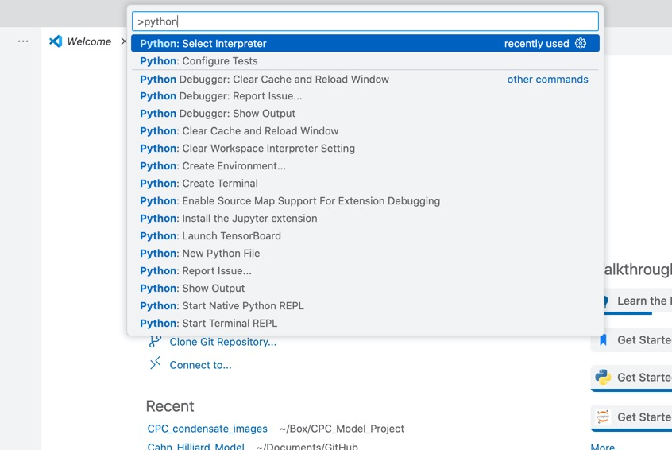
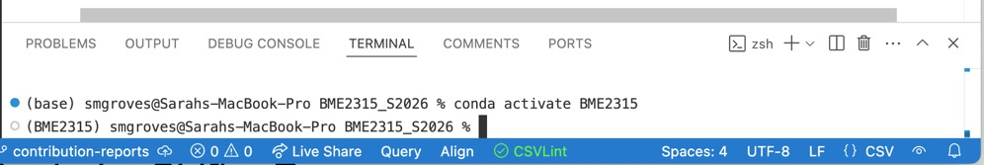
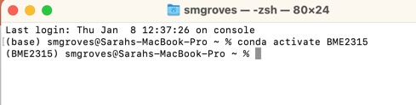
VS Code IDE
Terminal
Which kitchen, chef & pantry do we want?
The base env is already activated
I am activating a special env (BME2315)
“conda activate DS2003”
“source activate DS2003”
Command palette: Command/Control + Shift + P
Configures the right version of Python for this specific terminal session
Do this when installing packages
Configures the right version of Python for the entire IDE
Do this once!
Notes:
Selecting the interpreter via the VS Code Command Palette configures the entire IDE experience (linting, debugging, run button, etc.) for that environment, and will automatically activate that environment in any new terminal windows you create. Activating an environment directly in the terminal using commands like source activate only affects that specific, single terminal session.

Slide 23
Let’s practice!
1. Using the terminal (in VS code, anaconda prompt, or terminal), make a conda environment and activate it:
conda create --name PAX6_grn_env python=3.12
conda activate PAX6_grn_env
2. Add important packages from pip:
pip install pandas numpy scipy ipykernel matplotlib seaborn plotly
3. Using the command palette in VS code (Command/Control + Shift + P), select the base environment in VS code:
Python: Select Interpreter > choose (DS2003)
4. Open the Lab, click on Select Kernel in the top right corner, and pick (Python environments > DS2003)
Stand your name card up on its edge when you are done. Raise your hand for help!

Slide 24
A positive feedback loop!
I fully expect problems with computers
Everyone’s computer is set up in a different way
If you did not get your setup done, please see me after class or email me!
Most likely you did not mess something up and I can help you figure out what went wrong
Adapted from Uri Alon

Slide 25
Homework
You may work with others, but please add all of their names
You may use genAI, but you must cite it
  You are also accountable for all code and writing in the labs
This lab is due by Sunday at midnight

