Slide 1
Is the game of basketball broken?
Notes:
Let’s take a look at another example

Slide 2
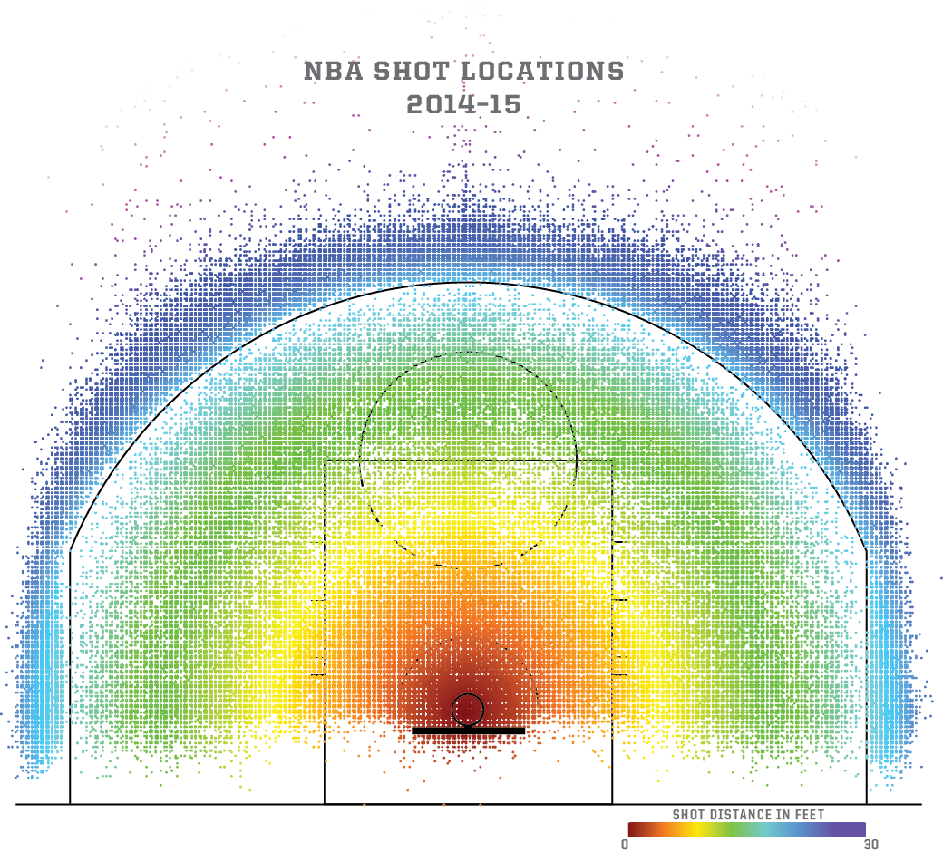
Source: Kirk Goldsberry, FiveThirtyEight, 2019
Notes:
To address this question, we can look at what’s called a shot chart
---
https://fivethirtyeight.com/features/how-mapping-shots-in-the-nba-changed-it-forever/

Slide 3
3 pts for shots outside this arc
2 pts for shots within this arc
Basket
Source: Kirk Goldsberry, FiveThirtyEight, 2019
Notes:
In case you don’t know much about basketball: the basket is here, you get 2 pts for shots within this arc and 3 pts for shots outside the arc
---
https://fivethirtyeight.com/features/how-mapping-shots-in-the-nba-changed-it-forever/

Slide 4
3 pts for shots outside this arc
2 pts for shots within this arc
If you shoot 40% from 3pt, your effective shot yield is: 0.4 * 3 = 1.2 pts
If you shoot 50% from 2pt, your effective shot yield is: 0.5 * 2 = 1 pt
Basket
Source: Kirk Goldsberry, FiveThirtyEight, 2019
Notes:
The difference between a 2-pointer and a 3-pointer is significant.
<click animations and read>
So, if you can shoot 40% from the 3 point area, it’s a more advantageous shot
---
https://fivethirtyeight.com/features/how-mapping-shots-in-the-nba-changed-it-forever/

Slide 5
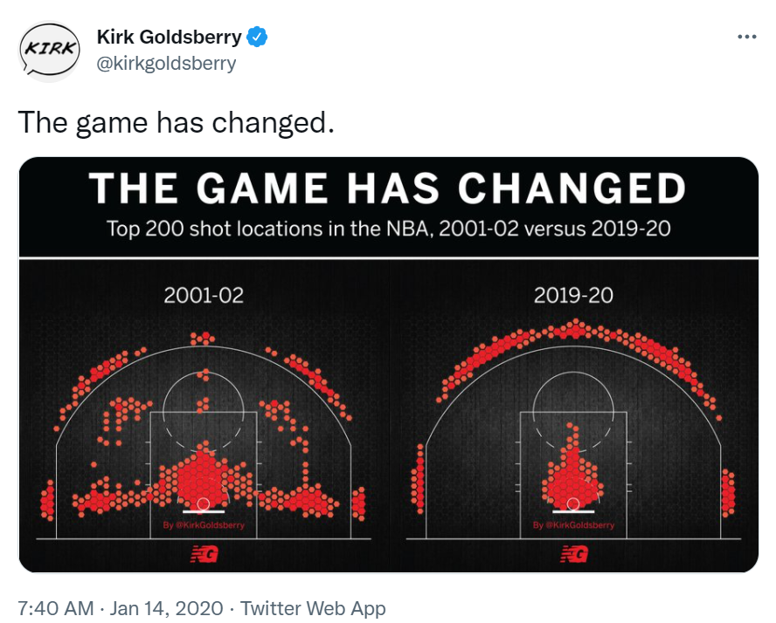
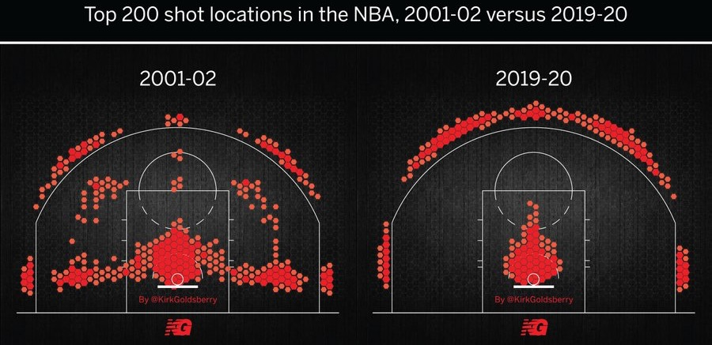
Source: Kirk Goldsberry, NBA Analyst at ESPN and Prof at UT
Notes:
And these analytics led to a massive change in professional sports, including baseball and basketball.
Here are the top 200 shot locations in the NBA in 2001-02. You’ll notice a density of shots around the basket and baseline with smaller amounts around the 3 pt line.
What do you think this looked like in 2019-2020?
---
https://twitter.com/kirkgoldsberry/status/1217109175894831105?s=20&t=Yd-E6l4UL2jO7iq5iGjPHw

Slide 6
Source: Kirk Goldsberry, NBA Analyst at ESPN and Prof at UT
Notes:
Almost no mid-range shots? Now, all shots are centered around the basket and the 3 point line? Some would argue, this is a less interesting form of the spot.
Why did this happen? It again comes down to effective yield of each shot, which was made clear via analytics
---
https://twitter.com/kirkgoldsberry/status/1217109175894831105?s=20&t=Yd-E6l4UL2jO7iq5iGjPHw

Slide 7
Project 1: Exploratory Data Analysis (EDA)
We will discuss what this entails over the next few weeks
        Checkpoint #1: Topic and dataset picked: by Sept 13 @ midnight
        Checkpoint # 2: Questions to explore picked: by Sept 27 @ midnight
        Final lightning talk due: Oct 11 @ midnight
        Final notebook due: Oct 14 @ midnight
For now, you should pick one of your interests (research or hobby!) and think of questions you have about that interest
Coffee:
Is Charlottesville coffee overpriced?
What makes for a good cup of coffee? (CQI)
Do coffee consumers tend to prefer light or dark roast?
How does the local vs global economy affect coffee prices and sales?
Public transit:
How often are Charlottesville buses late?
How much overlap is there between UTS and CAT?
How has ridership changed since COVID? Was the decision to make rides free a good one?

Slide 8
Visualization Design:
Data Types, Tables, and Models
UVA DS2003: Communicating with Data
Fall 2026
Sarah Groves
Adapted from Hannah Bako and Rafael Alvarado

Slide 9
What you will learn today
Data components: item, attribute, relationship
Dataset Types: Multivariate, Network/Tree
Data Tables: Messy vs. Tidy Data
Attribute Types: Nominal, Ordinal, Quantitative (Interval & Ratio)
Notes:
Good visualizations: Creating graphics that accurately represent data, and that are easy to read.

Slide 10
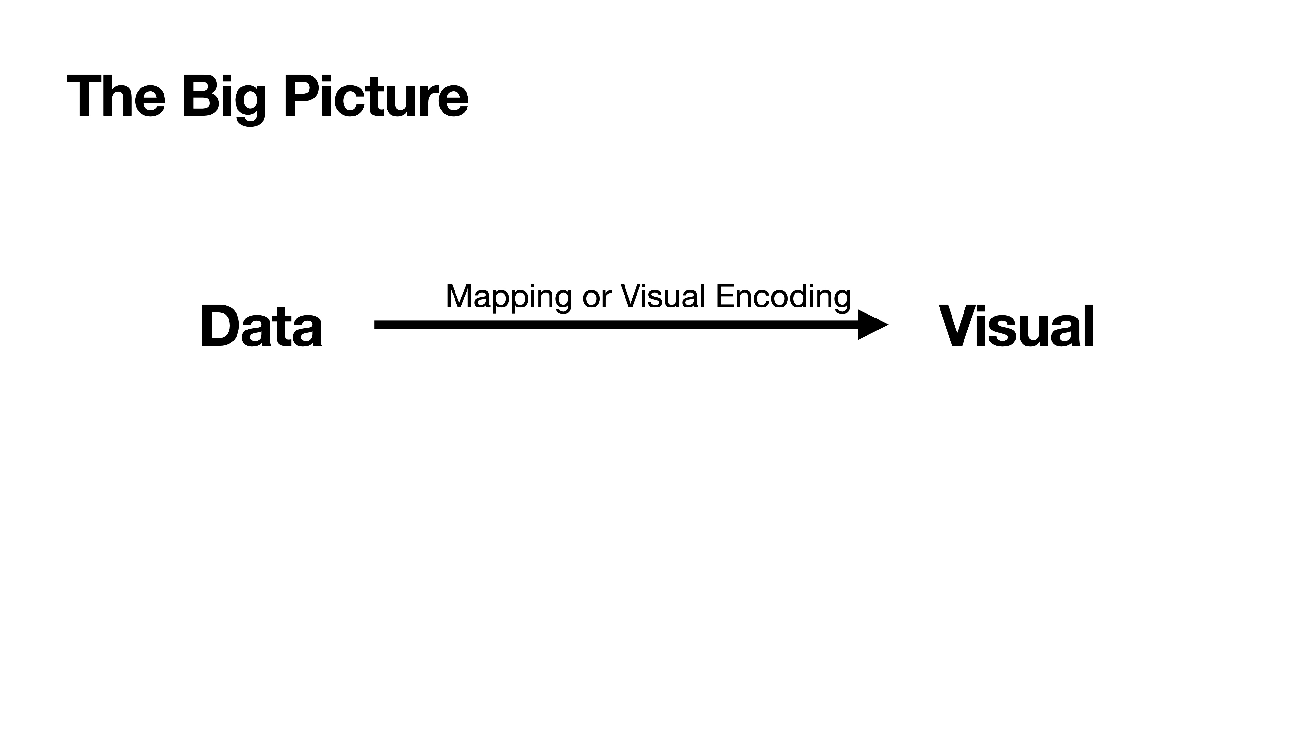
Notes:
So remember the main picture, our goal is to turn data into visual representations to enable us communicate insights with data. And this happens using visual encodings

Slide 11
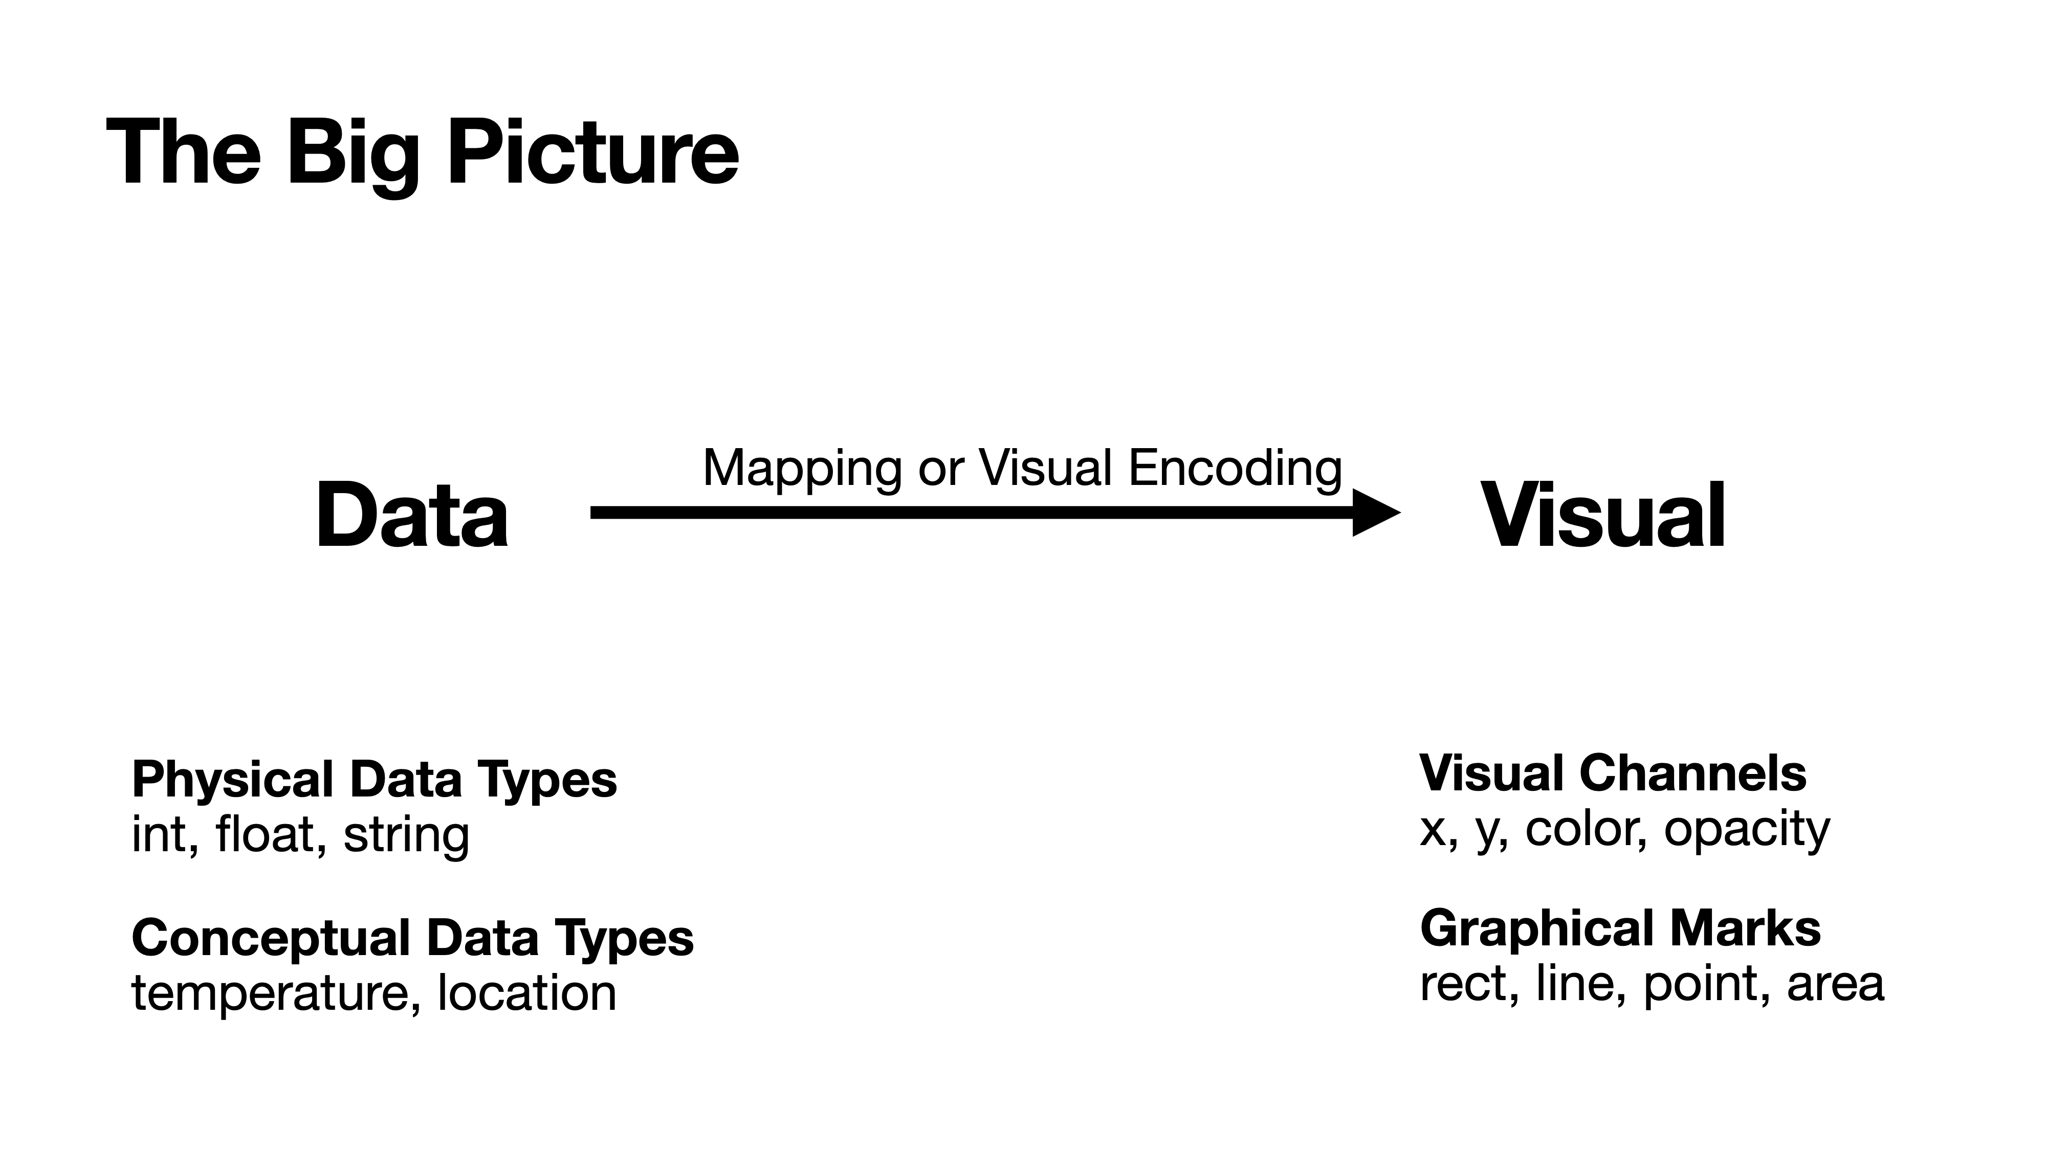
Notes:
So visual encodings map data to visual channels such as color or opacity, and graphical marks. We’ll cover visual encodings in future classes.

Slide 12
What is data?

Slide 13
Which are examples of data?
6
6 feet
height = 6 feet
Bob’s height = 6 feet

Slide 14
All are sometimes called "data"
But only the last item is genuine datum —
an elementary assertion of a fact

Slide 15
The Elementary Structure of Data
A datum is always an assertion of something about something
[Bob] [has height] [6 feet] → A, B, C
A is some unique thing in the world defined by a name (ID)
B is some property, defined by a category, connected to the thing
C is some value in the form of a data type (numeric or categorical) or a reference to another datum
Data always has this basic triadic structure
In other words, a datum is a sentence (proposition)

Slide 16
Semantic Triples
This triadic structure is called a "semantic triple"
It represents the most basic kind of "fact"
Asserting something about something
In the form of a simple sentence
In the form of a subject-predicate-object (SPO) expression
Subject: An entity or resource that the statement is about (e.g., "Bob").
Predicate: The property or relationship linking the subject and object (e.g., "has a height of").
Object: The value or related entity (e.g., "6ft").

Slide 17
Data Components
Items aka data objects, data cases
  (cars, employees, cities, countries, …)
Relationships aka links
  (parent of, owned by, have collaborated, …)
Attributes aka data variables, fields
  (mpg, age, population, GDP, …)
Notes:
Almost all datasets—no matter how complex—can be decomposed into these three components.
Items: the things you’re studying
Attributes: properties of those things
Relationships: how things connect
Example
Cities (items), population (attribute), trade routes (relationships).
===================================
Well, first we have data items which is the smallest atomic unit of meaningful information within a dataset. For instance a car in a dataset about cars, and data about an employee
A data attribute basically refers to a column or field within a dataset, and captures an identifying piece of information about the data.
Relationships or links define how data in one table connects to the another. This mostly exists in relational databases

Slide 18
Dataset Types
Multivariate Data: Items and Attributes
Networks & Trees
Notes:
Multivariate data is what most people picture: rows are items, columns are attributes.

Slide 19
You are used to seeing a semantic triple in this form —
as the building block of a table
P is a column/attribute that stands for a feature of the the thing
O is a cell that contains some value in the form of a data type (numeric or categorical) or a reference to another datum
 | height
Bob | 6
S is a row/item that stands for an observation, some unique thing or outcome in the world, defined by name (IDs)

Slide 20
When we combine data units we get a table
 | height | weight
Bob | 6 | 200
Maria | 5.5 | 130
So a table is actually a bunch of sentences, represented a certain way:
“Bob has height 6 feet.”
“Bob has weight 200 pounds.”
“Maria has height 5.5 feet.”
“Maria has weight 130 pounds.”
Subject/Item
Predicate/Relationship
Object/Attribute

Slide 21
We can think of this as a basic form of visualization
Sentences → Table

Slide 22
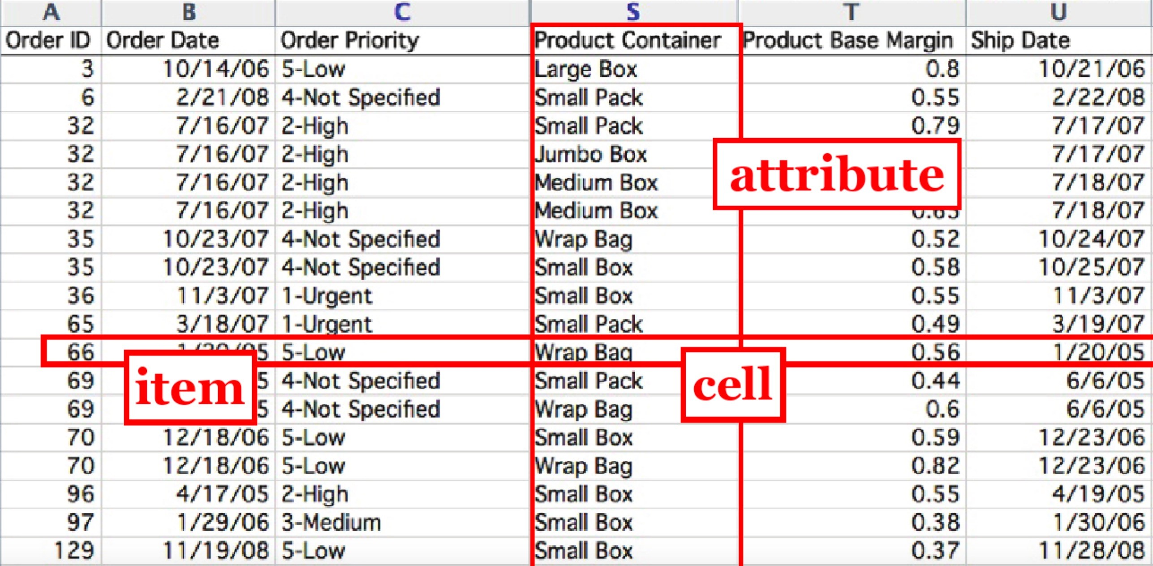

Slide 23
Dataset Types
Multivariate Data: Items and Attributes
Networks & Trees: Items, Attributes, and Relationships
Notes:
In networks and trees, the relationships between data items become a critical component
Multivariate data focuses on attributes
Networks → focus on connections

Slide 24
Semantic Triples for relationships: networks and trees
In the form of a subject-predicate-object (SPO) expression
Subject: An entity or resource that the statement is about (e.g., "Bob").
Predicate: The property or relationship linking the subject and object (e.g., “is the parent of").
Object: The related entity (e.g., “Charlie").
For network or tree data, the link is usually a relationship

Slide 25

Which sentences would you care to emphasize in a visualization?
Attribute
Ticker
Sector
Industry
Change
Value
1.40
MSFT
Technology
Software
-
%
214.25
Item
ADBE
Technology
Software
-
3.12
%
491.94
AAPL
Technology
Consumer
Electronics
+0.07
%
120.96
V
Financial
Credit
Services
-
2.06
%
204.66
What relationships exist in this table?
ADBE is in the technology sector
AAPL is in the Consumer electronics industry
V experienced change of -2.06%
MSFT and ADBE are in the same industry
Notes:
Describe the dataset
Ask students where the relationship exists here

Slide 26
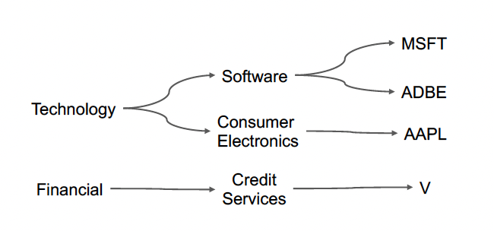
Attribute
Ticker
Sector
Industry
Change
Value
1.40
MSFT
Technology
Software
-
%
214.25
Item
ADBE
Technology
Software
-
3.12
%
491.94
AAPL
Technology
Consumer
Electronics
+0.07
%
120.96
V
Financial
Credit
Services
-
2.06
%
204.66
Notes:
This table can be represented as a tree as well [walk through tree]

Slide 27
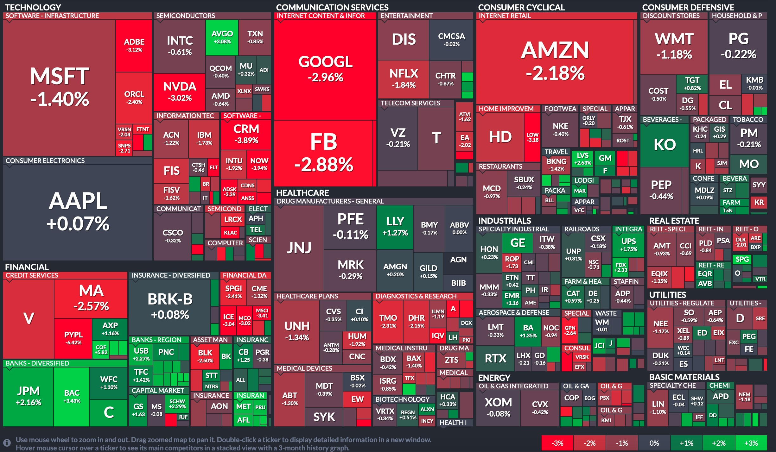
Notes:
This can then be represented in a chart like this. Can you see the relationship? How is it represented here?

Slide 28
A special kind of table
in data science
is what we will call
the standard data table
(sometimes called "tidy data")

Slide 29
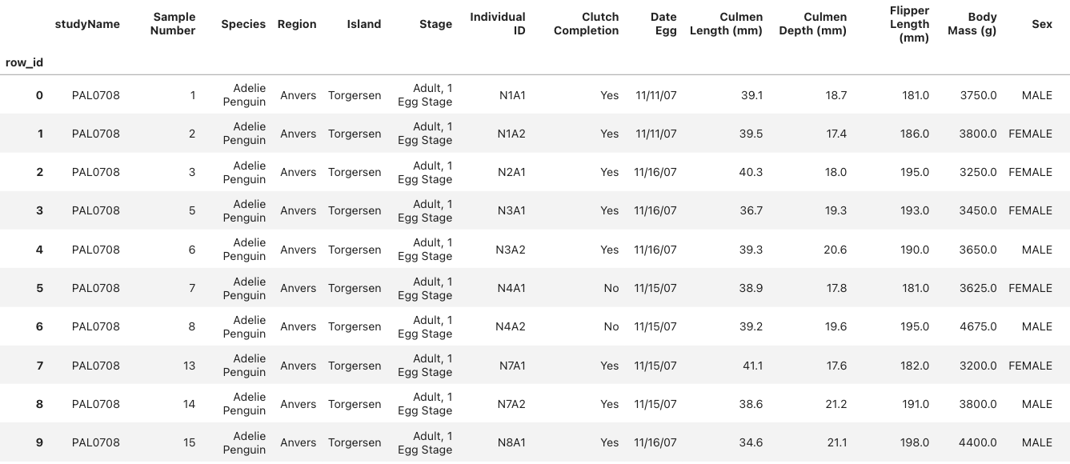
Anatomy of a Data Table
Row names (axis 0) → unique observations
Column names (axis 1) → features, aka variables
and the data formed by their "product"

Slide 30
Reading along Axis 0
Notes:
The Penguins data set contains measurements of three different penguin species collected during the Palmer Station Long Term Ecological Research (LTER) program. The data was originally gathered and prepared by Dr. Kristen Gorman and Dr. Allison Horst as an alternative to the common Iris dataset for data exploration and visualization.

Slide 31



Reading along Axis 0
Looks at one feature at a time
A feature is a variable
All values in the column are of the same type
All the values come from the "domain" of the variable
→ Most visualizations pull data from along axis 0
Ironically, called "column-wise"

Slide 32
Reading along Axis 1
Notes:
The Penguins data set contains measurements of three different penguin species collected during the Palmer Station Long Term Ecological Research (LTER) program. The data was originally gathered and prepared by Dr. Kristen Gorman and Dr. Allison Horst as an alternative to the common Iris dataset for data exploration and visualization.

Slide 33
Reading along Axis 1
Looks at one observation at a time
The values in the row may be of different types
The values together represent a kind of signature
Some visualizations pull data from along axis 1
"row-wise"

Slide 34
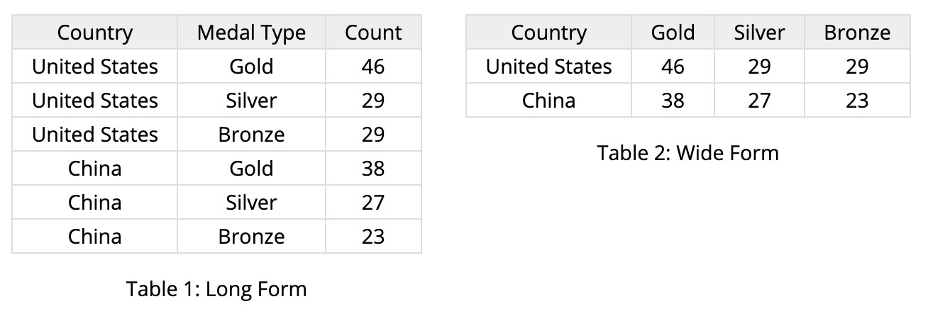
Tidy Data Tables
Wide vs. Long Data Table
Each column is an attribute
Use attribute values as columns
“Tidy Data”, Journal of Statistical Software, by Hadley Wickham
Notes:
There are two forms of tidy data tables, wide and long
Wide and long formats contain the same information—but support different operations and visualizations.
There is no correct format, you choose the format that is fit for your purpose.

Slide 35
Exercise
Discuss prompt in groups of 3
Year | Property_crime_rate
Reported crime in Alabama
2004 | 4029.3
2005 | 3900
2006 | 3937
2007 | 3974.9
Reported crime in Alaska
2004 | 3370.9
2005 | 3615
2006 | 3582
2007 | 3373.9
State | 2004 | 2005 | 2006 | 2007
Alabama | 4029.3 | 3900 | 3937 | 3974.9
Alaska | 3370.9 | 3615 | 3582 | 3373.9
Which format would make it easier to compare trends over time?
Notes:
So in groups of 3, discuss the prompt, and I’ll go through and ask people at random to tell me their thoughts.

Slide 36
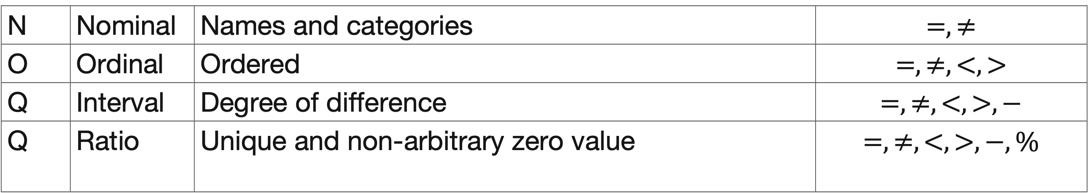
Attribute Types
N | Nominal | Names and categories | $$=,≠$$
O | Ordinal | Ordered | $$=,≠,<,>$$
Q | Interval | Degree of difference | $$=,≠,<,>,−$$
Q | Ratio | Unique and non-arbitrary zero value | $$=,≠,<,>,−, \%$$
Notes:
So. Now, let’s get into the core of data attributes. There are four different types a data attribute can take.
Read slide
Attribute types determine what comparisons are valid—and which visual encodings make sense.

Slide 37
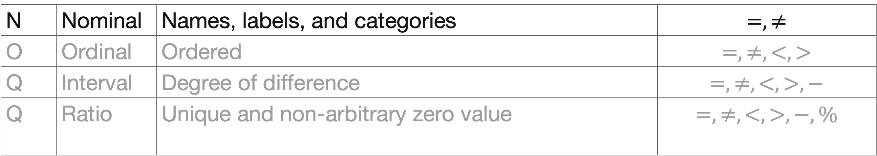
Attribute Types
Nominal
N | Nominal | Names, labels, and categories | $$=,≠$$
O | Ordinal | Ordered | $$=,≠,<,>$$
Q | Interval | Degree of difference | $$=,≠,<,>,−$$
Q | Ratio | Unique and non-arbitrary zero value | $$=,≠,<,>,−, \%$$
Nominal
          Fruits: apples, oranges, ..
Notes:
Nominal attributes are categories with no inherent order.
fruit type, country, color.
You can only compare equivalence with nominal attributes

Slide 38
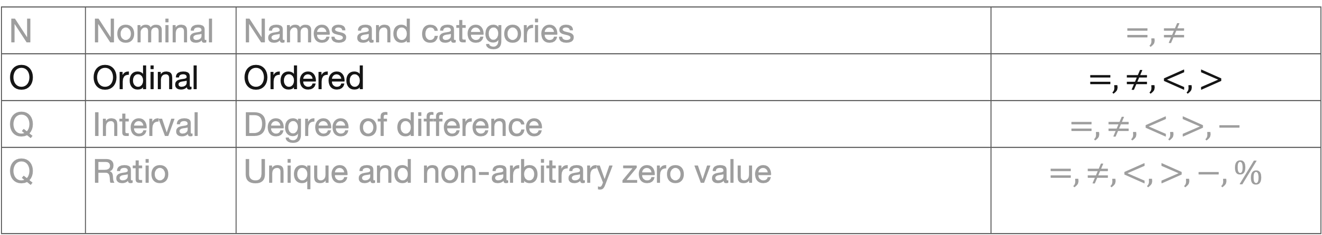
Attribute Types
Ordinal
N | Nominal | Names and categories | $$=,≠$$
O | Ordinal | Ordered | $$=,≠,<,>$$
Q | Interval | Degree of difference | $$=,≠,<,>,−$$
Q | Ratio | Unique and non-arbitrary zero value | $$=,≠,<,>,−, \%$$
Ordinal
          Quality of meat (Grades): A, AA, AAA
Notes:
Ordinal attributes have order, but not meaningful distance
An example would be grades. So >93 is A <70 is an F. The grades A – F are ordinal
Be careful not to treat ordinal values as numeric

Slide 39
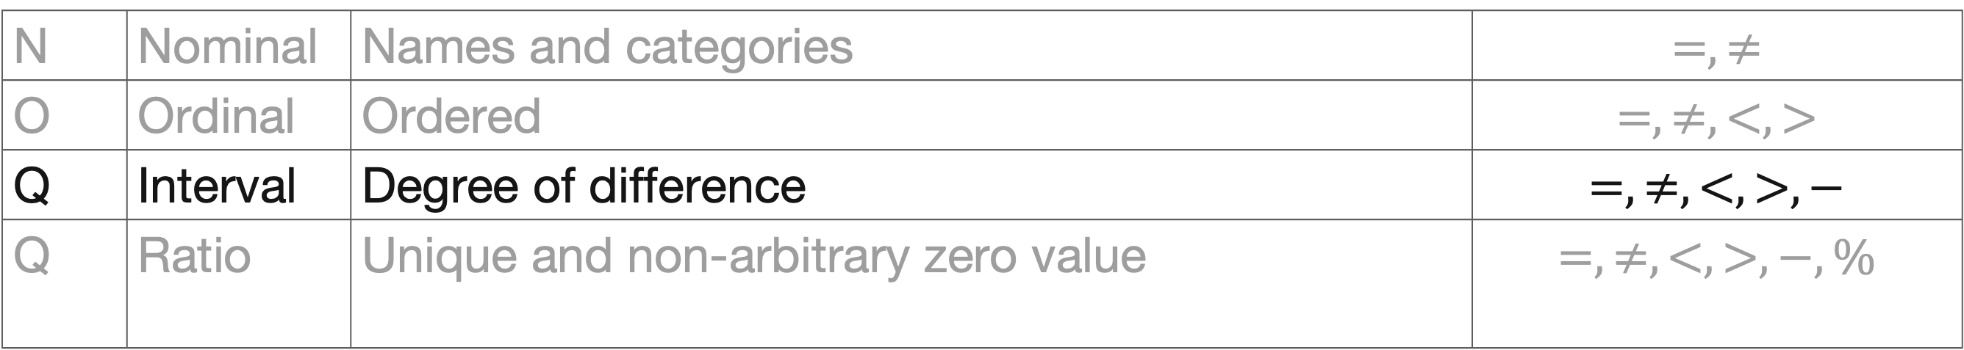
Attribute Types
Q-Interval
N | Nominal | Names and categories | $$=,≠$$
O | Ordinal | Ordered | $$=,≠,<,>$$
Q | Interval | Degree of difference | $$=,≠,<,>,−$$
Q | Ratio | Unique and non-arbitrary zero value | $$=,≠,<,>,−, \%$$
Q-interval
          Dates: Jan 19, 2006
          Location: Lat 33.98, long -118.45
          Only differences can be calculated (e.g., distances or spans)
Notes:
Quantitative Interval data allows differences, but not ratios.
What we mean here is that 0 in quantitative intervals is arbitrary.
For instance, dates or temperature in Celsius. There is no meaningful zero in these measurements

Slide 40
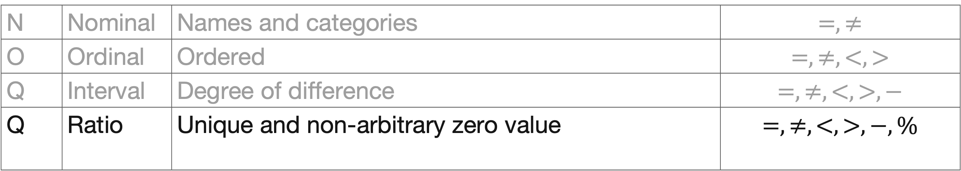
Attribute Types
Q-Ratio
N | Nominal | Names and categories | $$=,≠$$
O | Ordinal | Ordered | $$=,≠,<,>$$
Q | Interval | Degree of difference | $$=,≠,<,>,−$$
Q | Ratio | Unique and non-arbitrary zero value | $$=,≠,<,>,−, \%$$
Q-Ratio (fixed zero)
          Physical measurements: Length, Mass, …
          Includes counts and amounts
          Can measure ratios or proportions
Don’t ask “is there a zero” but instead ask “does zero mean the absence of X?”
e.g. There is a “year 0” in our calendar system but it does not mean “absence of years”
Notes:
On the other hand, quantitative Ratio data has a meaningful zero—so ratios and proportions make sense
Examples here include length, mass, counts
Most statistical operations assume ratio data.

Slide 41

NOIR Scramble
Step 1: figure out what type of data you have
Step 2: Find three other students who have the other three attribute types to make a NOIR group of four
Step 3: Check in with me; if you are right, write your attributes on the board!

Slide 42
Simpsons Paradox
A trend/pattern appears in several groups of data but disappears or reverses when the groups are combined.
See Class Activity
Simpson’s Paradox is a reminder that how we group data is itself a design decision — and a consequential one
Never trust an aggregate trend without checking whether it's stable across the subgroups that make it up
Notes:
Up to this point, we’ve been treating aggregation as something neutral — even helpful.
We summarize, average, and combine data all the time to “see the big picture.”
Simpson’s Paradox is a reminder that how we group data is itself a design decision — and a consequential one.
Real world examples:
Study of gender bias in graduate school admission at UC Berkeley, 1973
Success rates of two treatment for kidney stones, 1994
Batting averages for professional baseball players, 1995, 1996
Some examples of these were seen in a study of UC Berkley admissions. Overall admissions rates suggested bias against women, but department-level data showed women were admitted at similar or higher rates in most departments. The reversal occurred because women applied more often to highly competitive departments with lower acceptance rates.
In a kidney stone study conducted in 1994 One treatment appeared better overall, even though the other was more effective for both small and large kidney stones. This happened because the less effective treatment was used more often for severe cases.
The same paradox was observed in batting averages for baseball players in 1995 and 1996. A player had higher batting averages in each season but ranked lower when seasons were combined. The reversal occurred because seasons with more difficult conditions or fewer attempts were weighted differently in the aggregate.

Slide 43
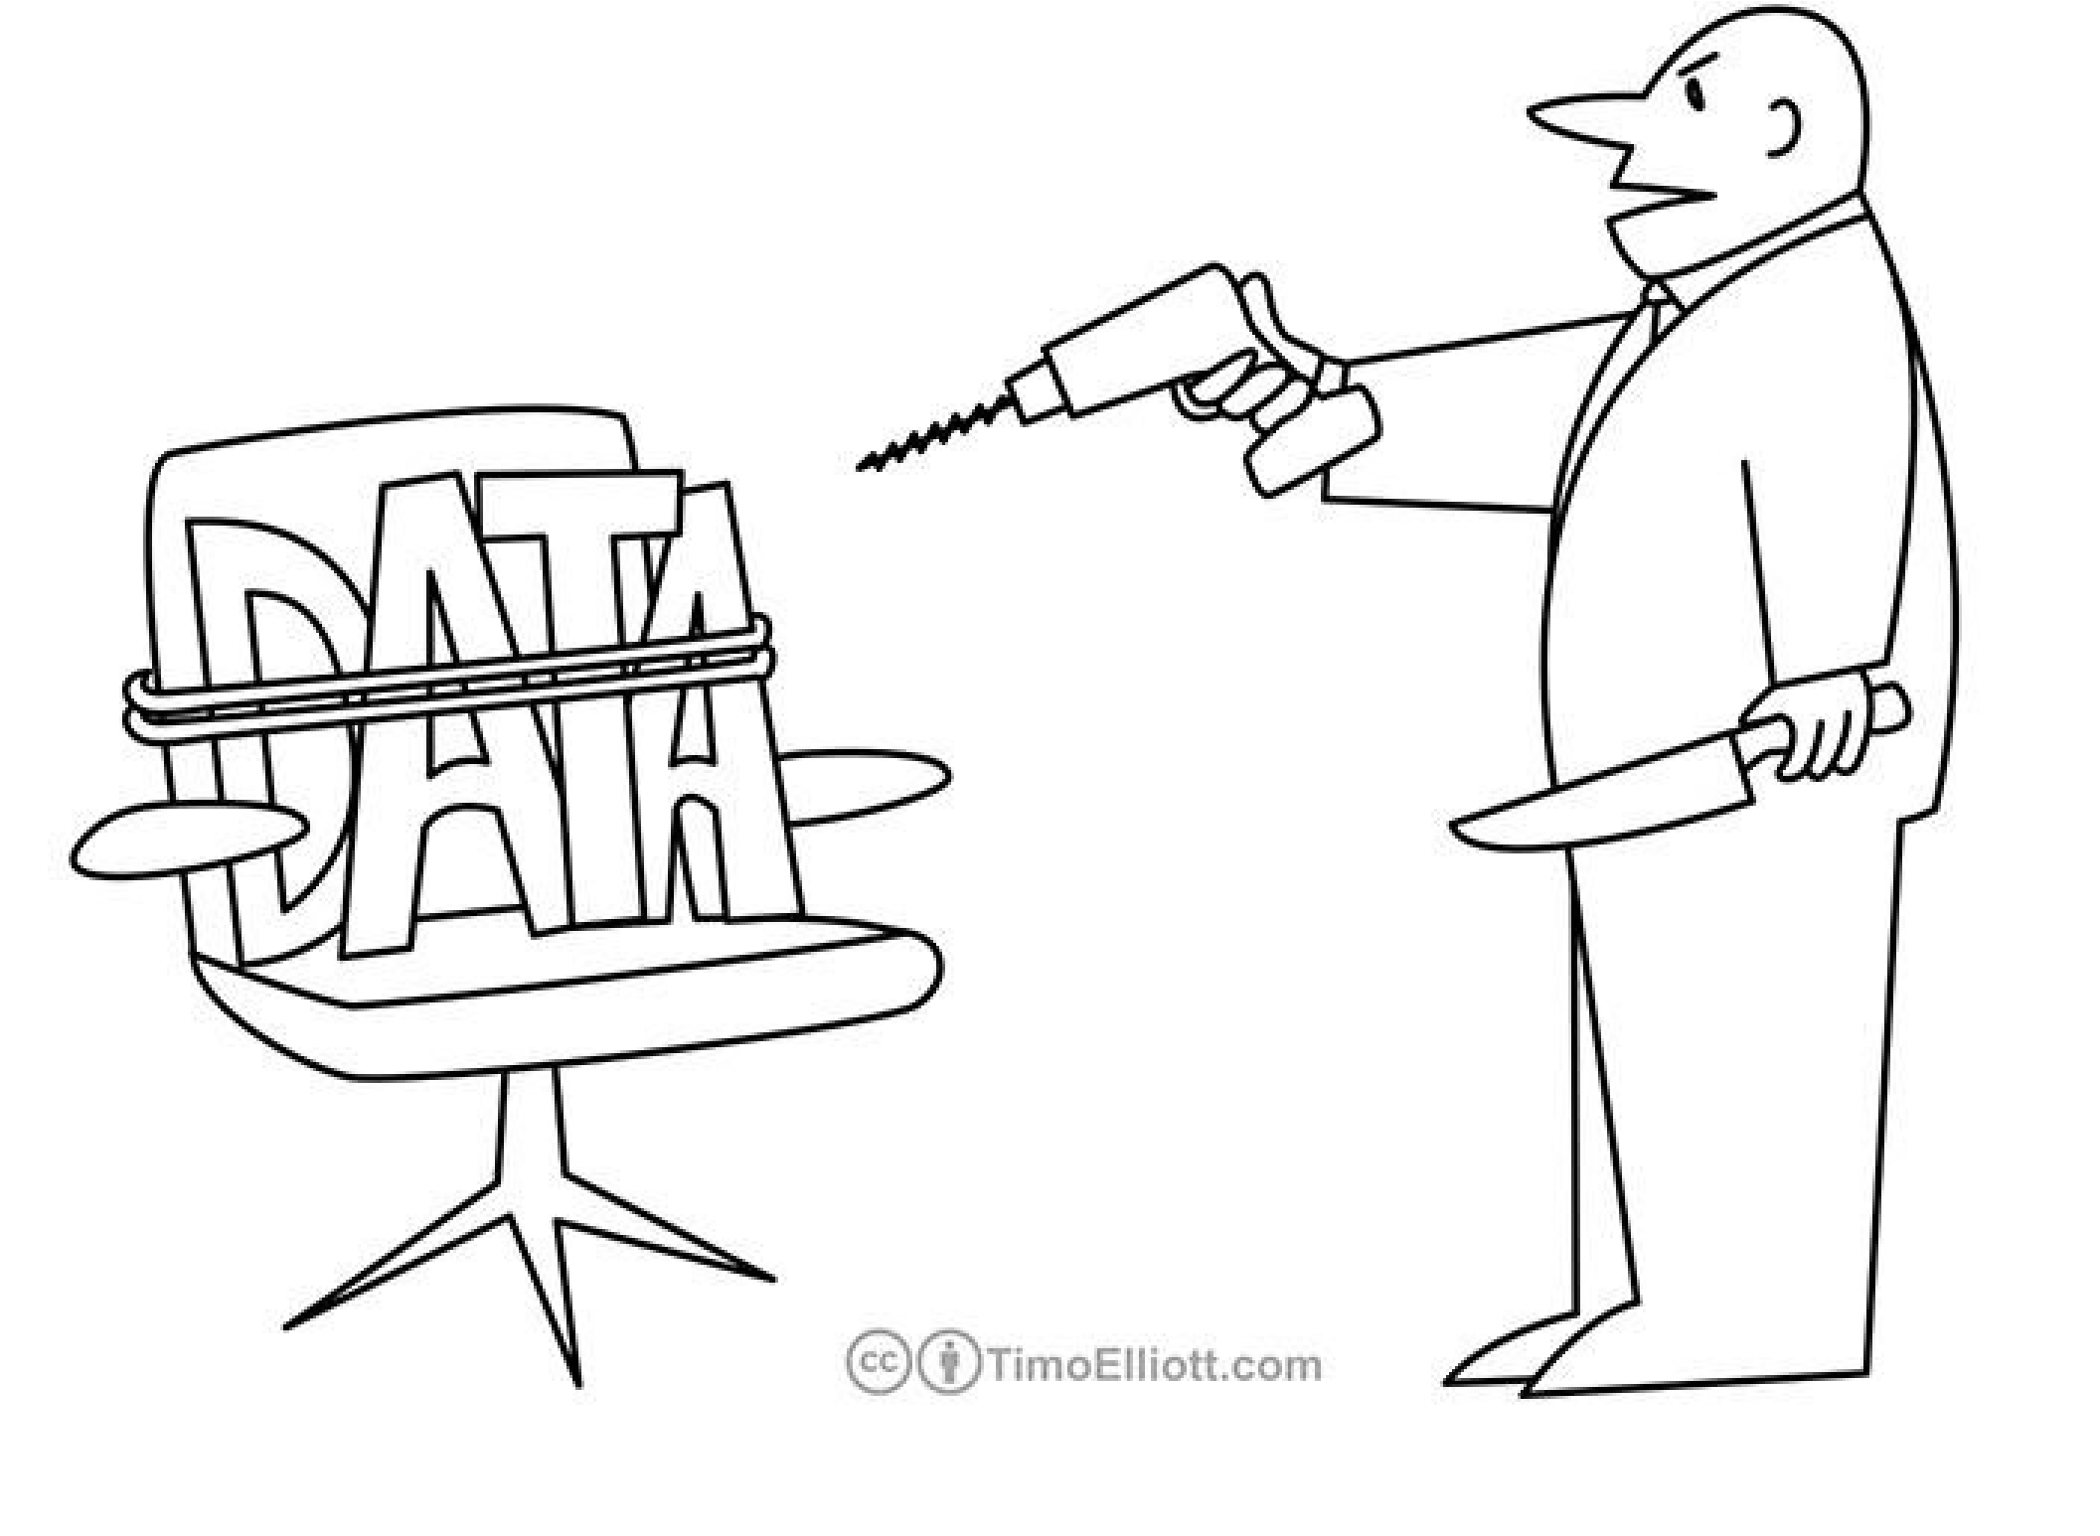
Simpsons Paradox
“If you torture the data long enough, it will confess to anything.”
- Ronald H. Coase (1975)
Notes:
This quote is funny—but also dangerous.
The goal of data analysis and visualization is not to torture data, but to reveal structure honestly.

Slide 44
Takeaways for design
Always interrogate your data first:
    Is the data frame tidy?
    Is it in wide or long format?
    What is an observation? What are the relationships/properties?
    2. For each column, what is the attribute type?
    We will talk more about what encodings/plots are possible and effective for each attribute type
    3. Should the data be grouped in some way?
    4. Are there particular relationships, attributes, or trends you want to highlight with visualization?

Slide 45
What’s next
In the absence of a quiz today, write down your answer to the following question: If you had to explain today’s concepts to a friend, which would be hardest for you to explain?
Friday’s lab will explore these concepts using pandas data frames
Next week:
Read “A Tour through the Visualization Zoo”
Quiz on this and previous material on Wednesday
Your topic and dataset checkpoint for Project 1 is due Sep 13
Notes:
Good visualizations: Creating graphics that accurately represent data, and that are easy to read.

