Slide 1
GRN Benchmarking & Domain-Shift Diagnostics
boba-T vs. CellOracle, SCENIC, and GENIE3 -- network structure, predictive
accuracy, and cross-context generalization
Summary of benchmarking & domain-shift analyses

Slide 2
1
Method Benchmarking
How boba-T's structure recovery and predictive accuracy compare to CellOracle, SCENIC, and
GENIE3 -- on real ChIP-seq ground truth, a real ATAC-informed base GRN, and a literal
Boolean ground truth (HSC).

Slide 3
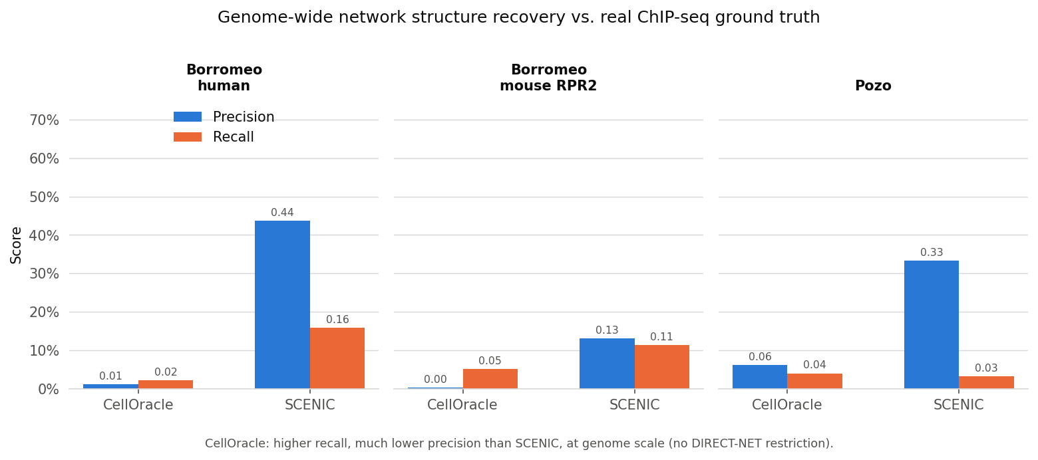
COMPARISON 1 -- NETWORK STRUCTURE
CellOracle wins recall, SCENIC wins precision -- at genome scale
Genome-wide network structure recovery vs. real ChIP-seq ground truth (Borromeo human & mouse RPR2, Pozo).

Slide 4
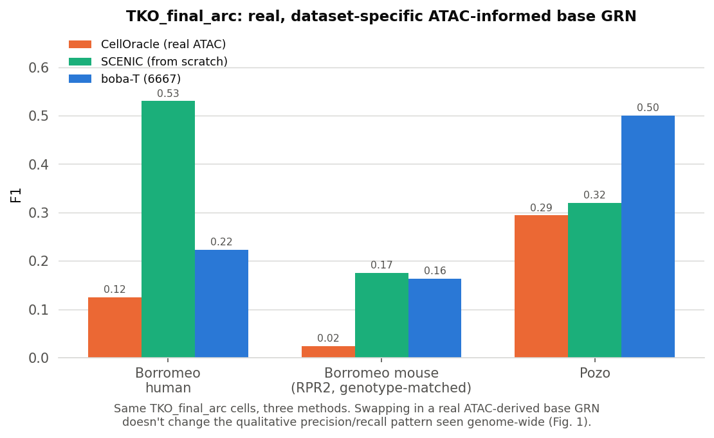
TKO_FINAL_ARC
A real, dataset-specific ATAC-informed base GRN doesn't change the picture
Same TKO cells, three methods -- swapping a real ATAC-derived base GRN in for CellOracle/SCENIC reproduces
the same qualitative pattern seen genome-wide.

Slide 5
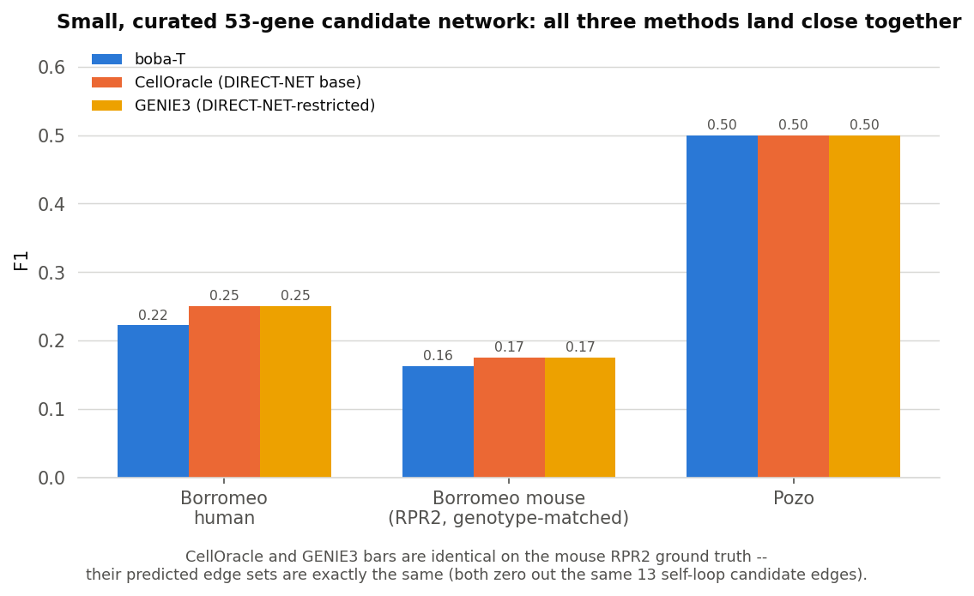
SMALL, CURATED CANDIDATE NETWORK
boba-T, CellOracle, and GENIE3 land close together
On a small, curated 53-gene candidate network, CellOracle and GENIE3 recover the exact same edge set --
both independently zero out the same 13 self-loop candidates.

Slide 6
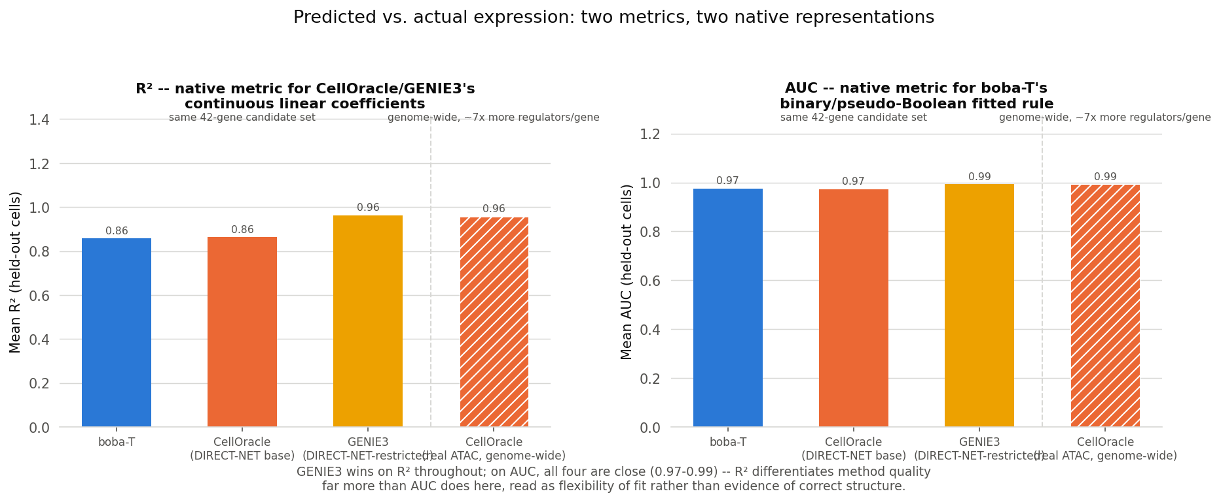
COMPARISON 3 -- PREDICTED VS. ACTUAL EXPRESSION
GENIE3 wins on raw fit throughout -- flexibility, not correct structure
Corrected this session: earlier numbers (0.832 vs. 0.780) had CellOracle's R2 computed on the wrong data representation -- corrected below.
boba-T and CellOracle are essentially tied on a shared 42-gene candidate set; CellOracle catches up once run genome-wide with real ATAC.

Slide 7
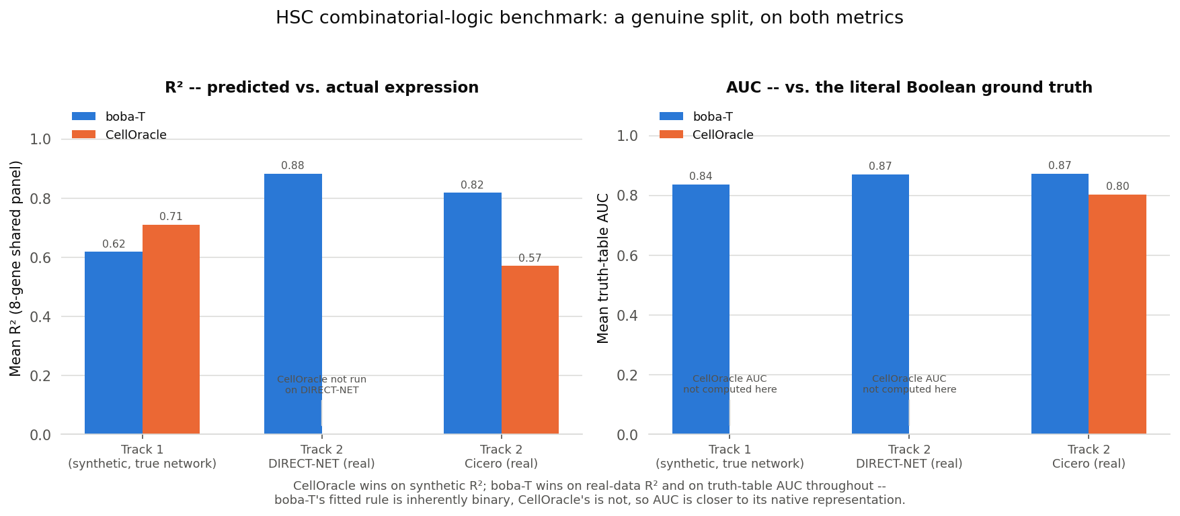
COMBINATORIAL LOGIC -- HSC GROUND TRUTH
A genuine split, not a one-sided result
Corrected this session: earlier numbers (CellOracle R2 = -0.41 synthetic / 0.13 real) had a missing-intercept bug in the verification script -- corrected below.
CellOracle wins on synthetic data with the true network handed to it; boba-T wins on real data it had to discover a network for.

Slide 8
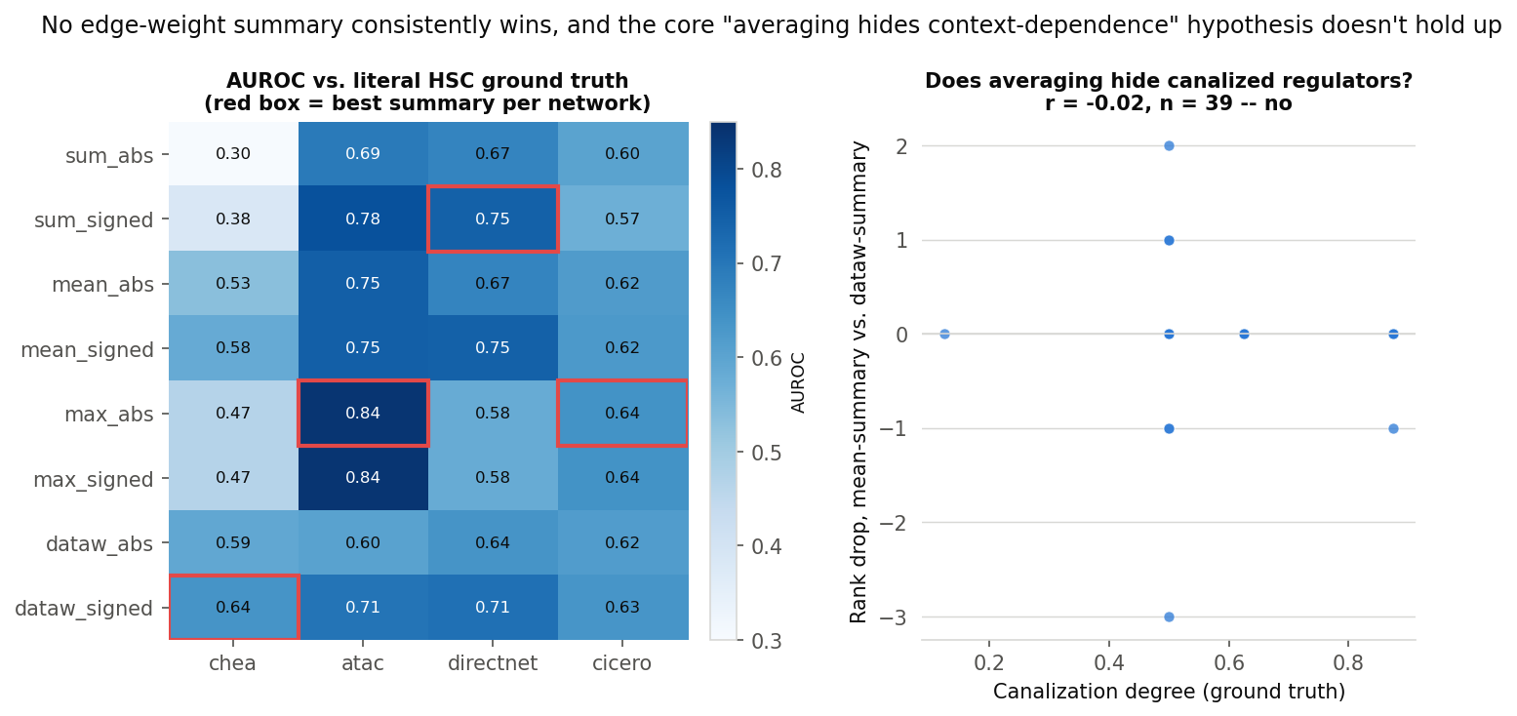
EDGE-WEIGHT SUMMARIZATION
No summary method consistently wins
The "averaging hides context-dependent regulators" hypothesis is a null result (r = -0.02, n = 39) --
dataw_signed/dataw_abs adopted as boba-T's default anyway, for consistency.

Slide 9
2
Domain-Shift Diagnostics
Why external validation (organoid, metastasis, human tumor) scores lower than in-vivo GEMM data --
and which single measurement best predicts it.

Slide 10
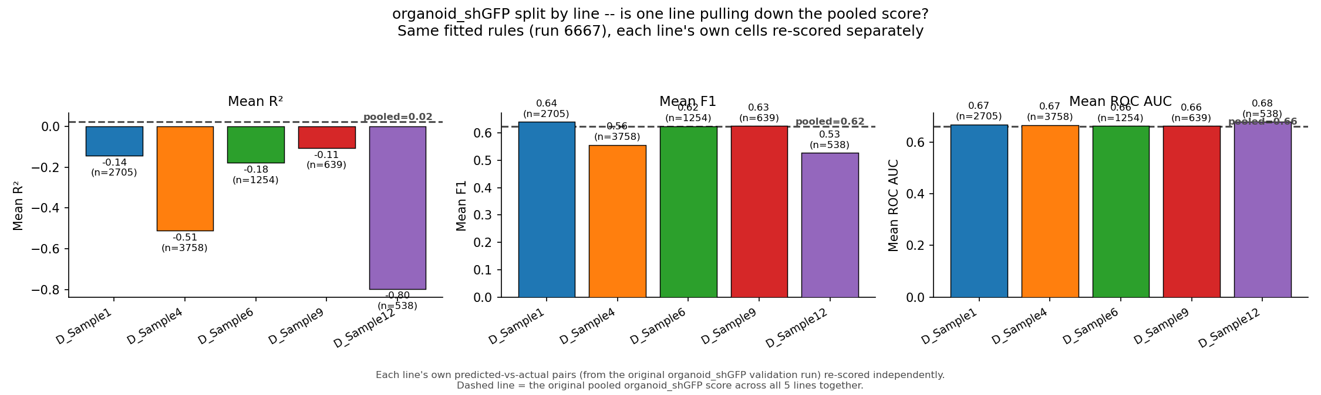
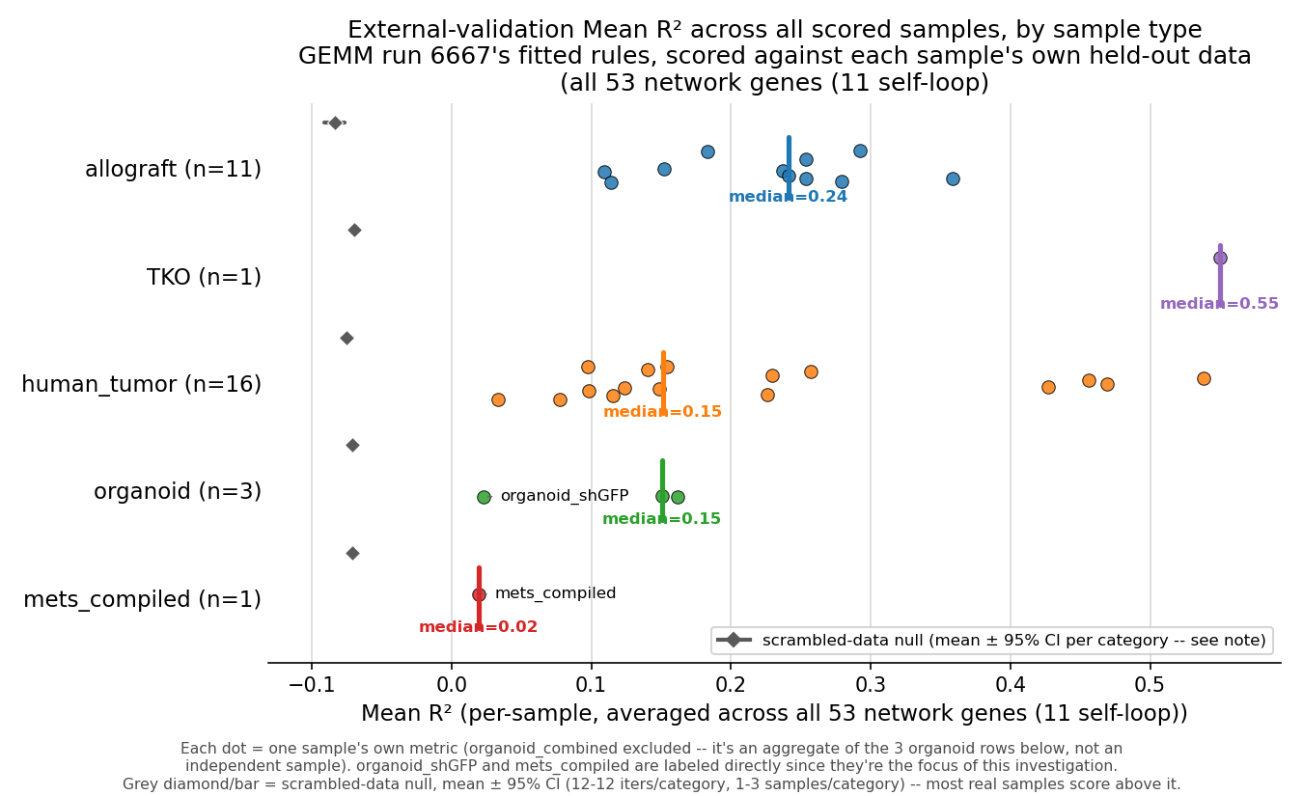
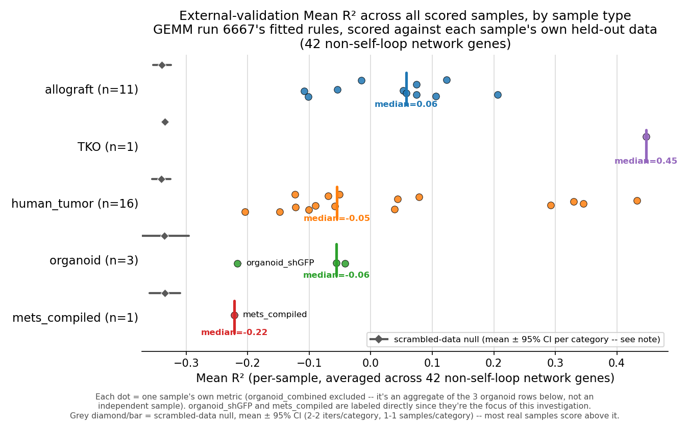
VALIDATION ROBUSTNESS
Real signal, not a metric artifact -- but self-loop genes inflate it
No single organoid_shGFP sequencing line drags down the pooled validation score.
Left: all 53 genes clear a scrambled-data null. Right: excluding the 11 self-loop genes, only allograft/TKO keep real signal.

Slide 11
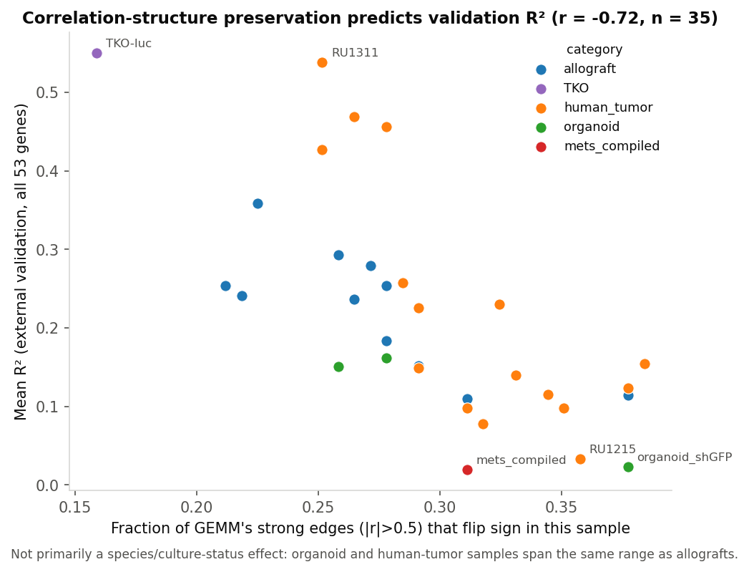
DOMAIN-SHIFT MECHANISM
-0.72
Correlation-structure preservation predicts validation R2
correlation (r)
Not primarily a species/culture-status effect -- organoid and human-tumor samples span the same range as allografts.

Slide 12
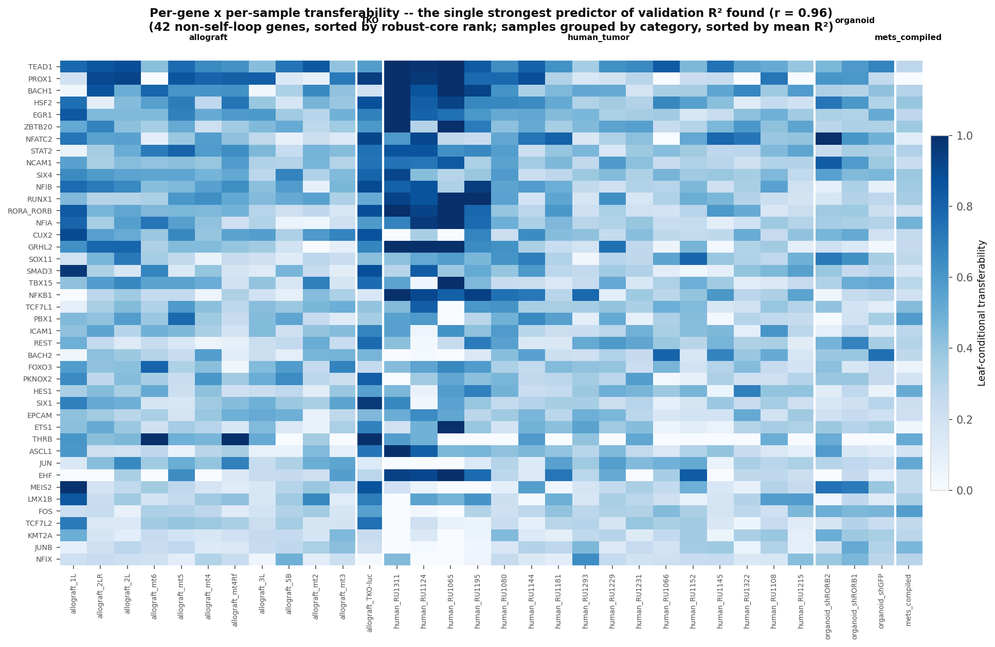
THE STRONGEST PREDICTOR FOUND
0.96
Per-gene x per-sample transferability predicts R2 almost exactly
correlation (r)
"Does the fitted rule actually hold in this sample" -- the most direct possible measurement, with the
population-composition confound removed by construction.

Slide 13
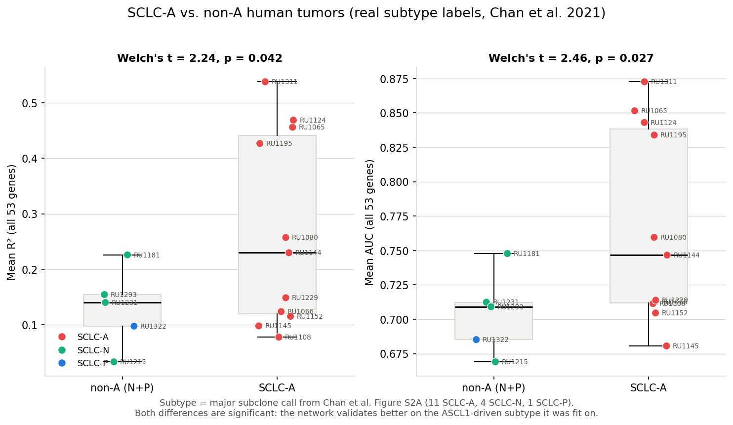
DOES SUBTYPE IDENTITY EXPLAIN DOMAIN SHIFT?
p<0.05
SCLC-A tumors validate significantly better than non-A tumors
both R2 and AUC
Real, published subtype labels (Chan et al. 2021 Fig. S2A) for all 16 human-tumor samples, not a proxy -- the
network was fit on ASCL1-driven mouse tumors, and it validates measurably better on ASCL1-subtype human tumors too.

Slide 14
3
RORB Knockdown & RadViz Validation
Does the fitted network's perturbation-response logic transfer to real organoid data, at the
archetype level -- and does a visual projection confirm it?

Slide 15
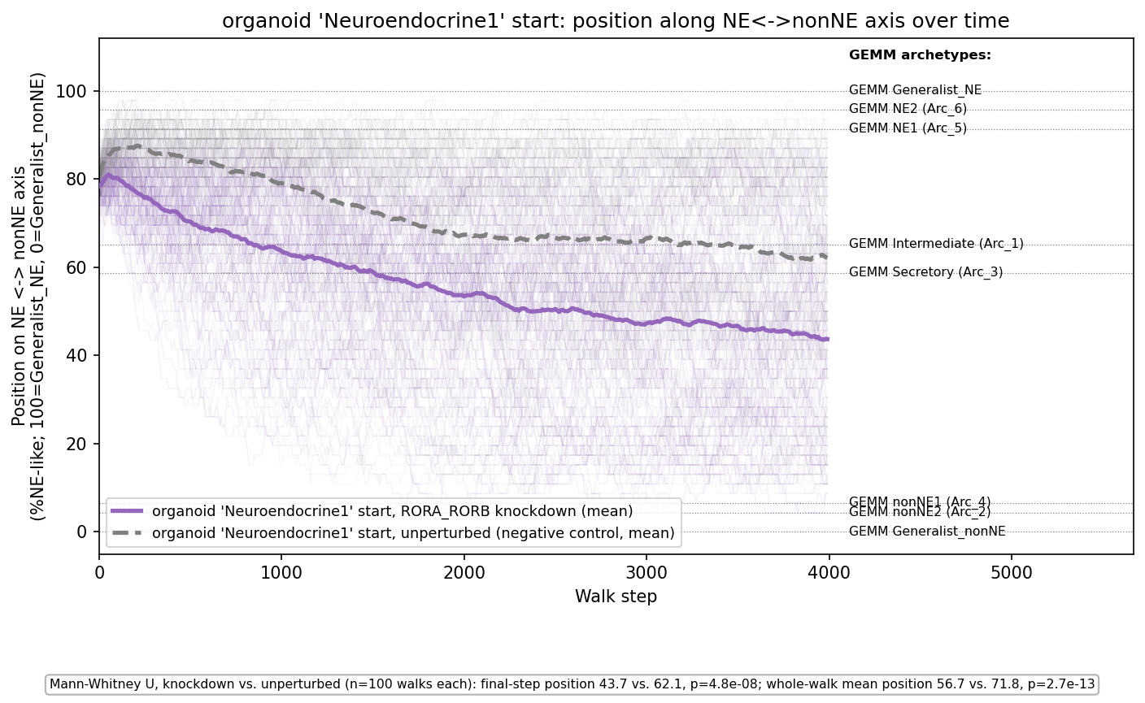
DEFINING THE AXIS
RORB knockdown pushes cells along a single NE <-> nonNE axis
All 8 GEMM archetypes fall on one ordered spectrum (46 genes where Generalist_NE and Generalist_nonNE differ) --
knockdown moves organoid-seeded walks significantly further toward the nonNE end than the unperturbed control
(mean position 56.7 vs. 71.8, p = 2.7e-13).

Slide 16
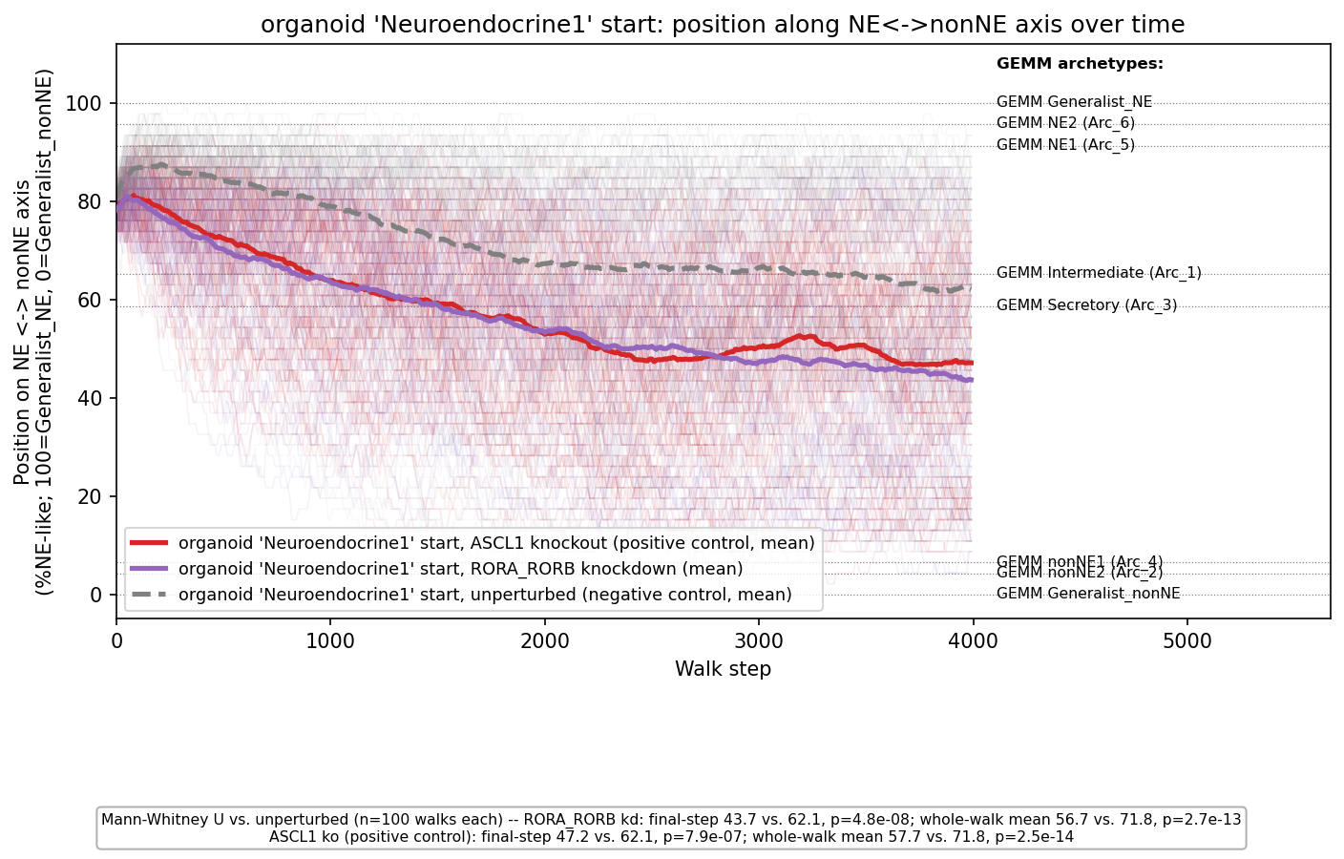
DEFINING THE AXIS -- WITH THE ASCL1 POSITIVE CONTROL
ASCL1 knockout lands at nearly the same position as RORB knockdown
Both perturbations move organoid-seeded walks to a similar final position on the axis (ASCL1: 47.2, RORB: 43.7,
vs. 62.1 unperturbed) -- on this collapsed summary, the two effects are comparable in size, not one dwarfing the other.

Slide 17
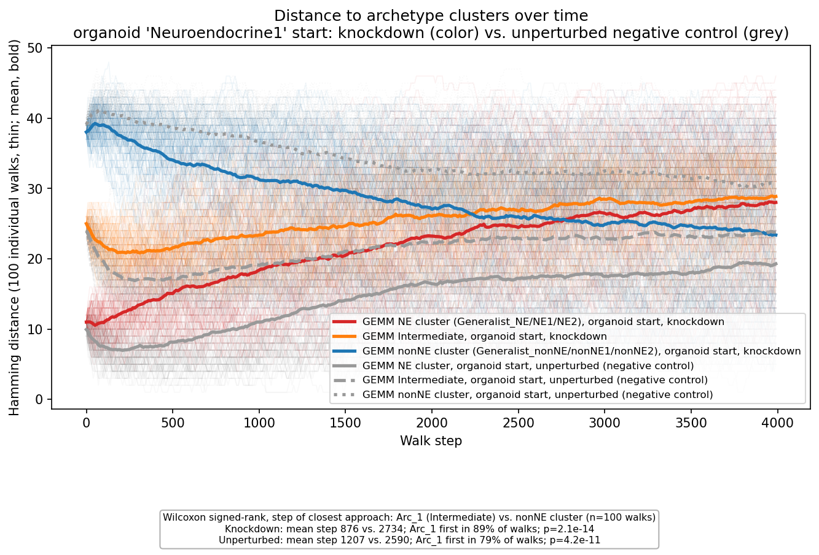
TEMPORAL ORDERING
Walks pass through Intermediate before reaching nonNE
89% of 100 simulated walks reach the Intermediate archetype before the nonNE cluster under RORB knockdown
(mean step 876 vs. 2734, p = 2e-14).

Slide 18
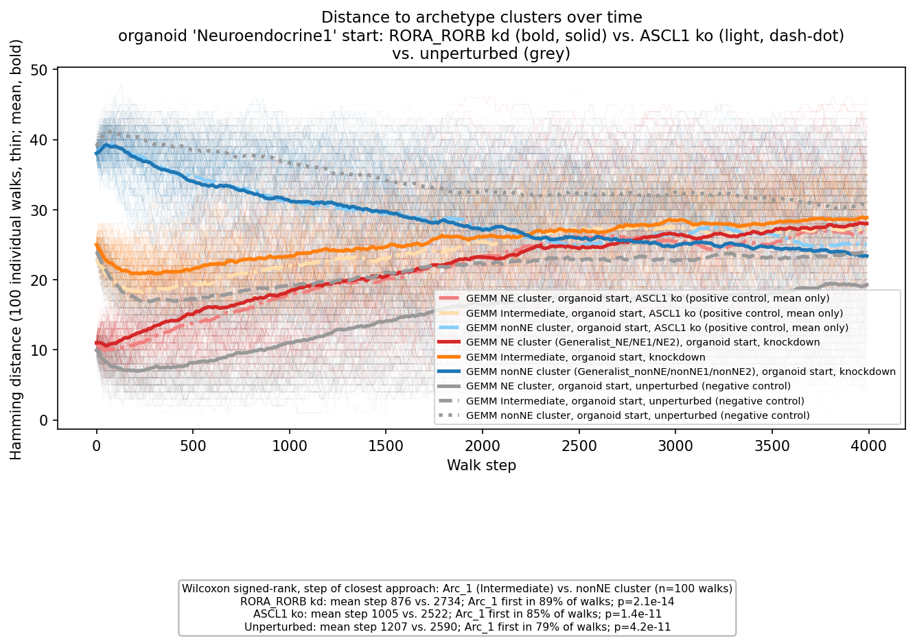
TEMPORAL ORDERING -- WITH THE ASCL1 POSITIVE CONTROL
ASCL1 knockout shows the same passage, at a similar pace
85% of ASCL1-knockout walks also reach Intermediate before nonNE (mean step 1005 vs. 2522, p = 1.4e-11) --
close to RORB's own timing (876 vs. 2734), not a markedly faster or slower transit.

Slide 19
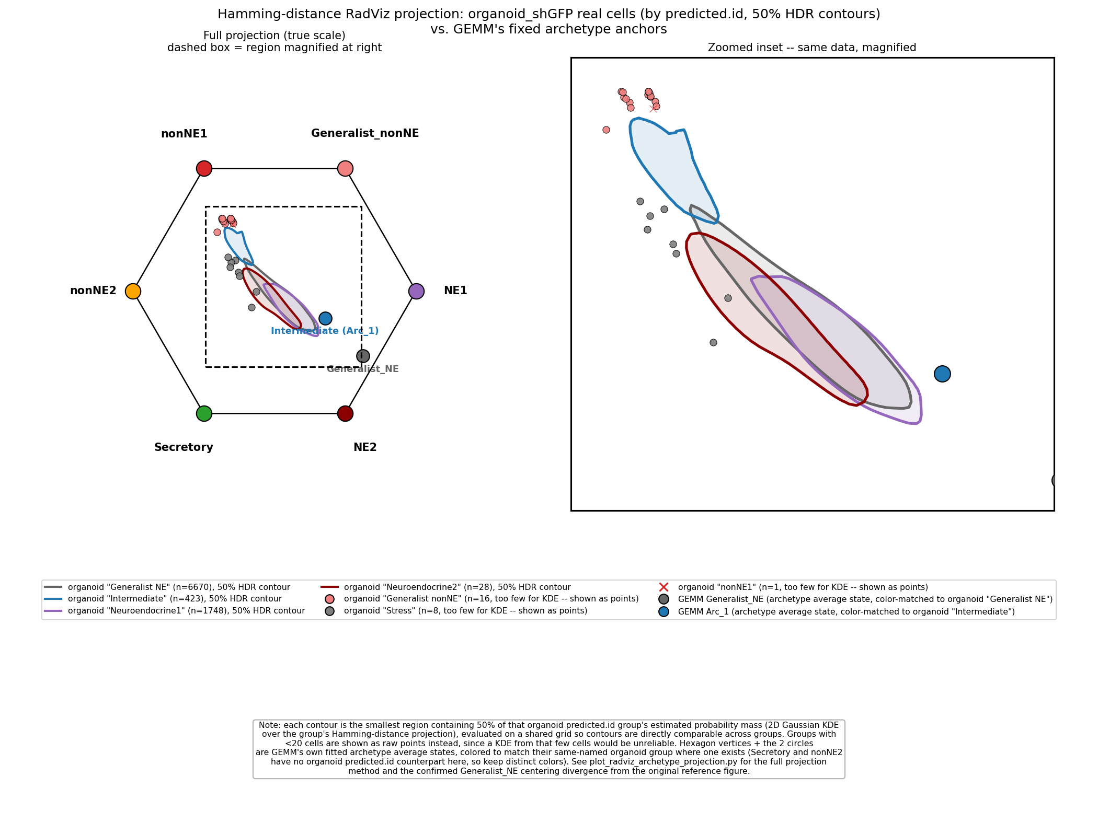
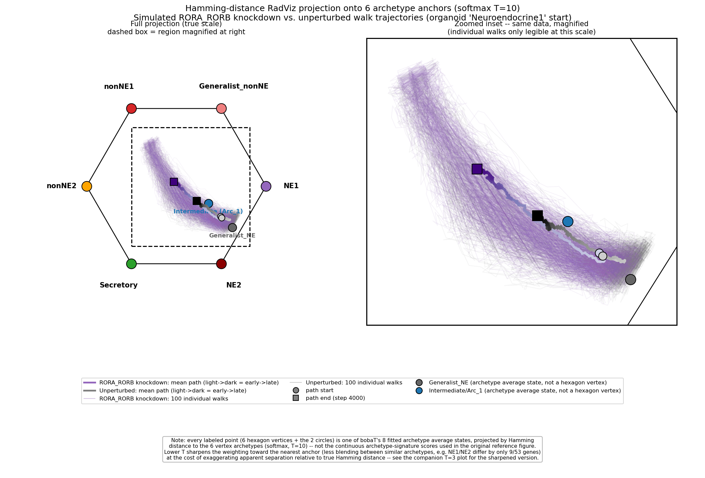
RADVIZ PROJECTION
Simulated trajectories vs. real single-cell data, same fixed anchors
Simulation: 100 walks, knockdown vs. unperturbed
Real cells: 50% density contours by predicted identity

Slide 20
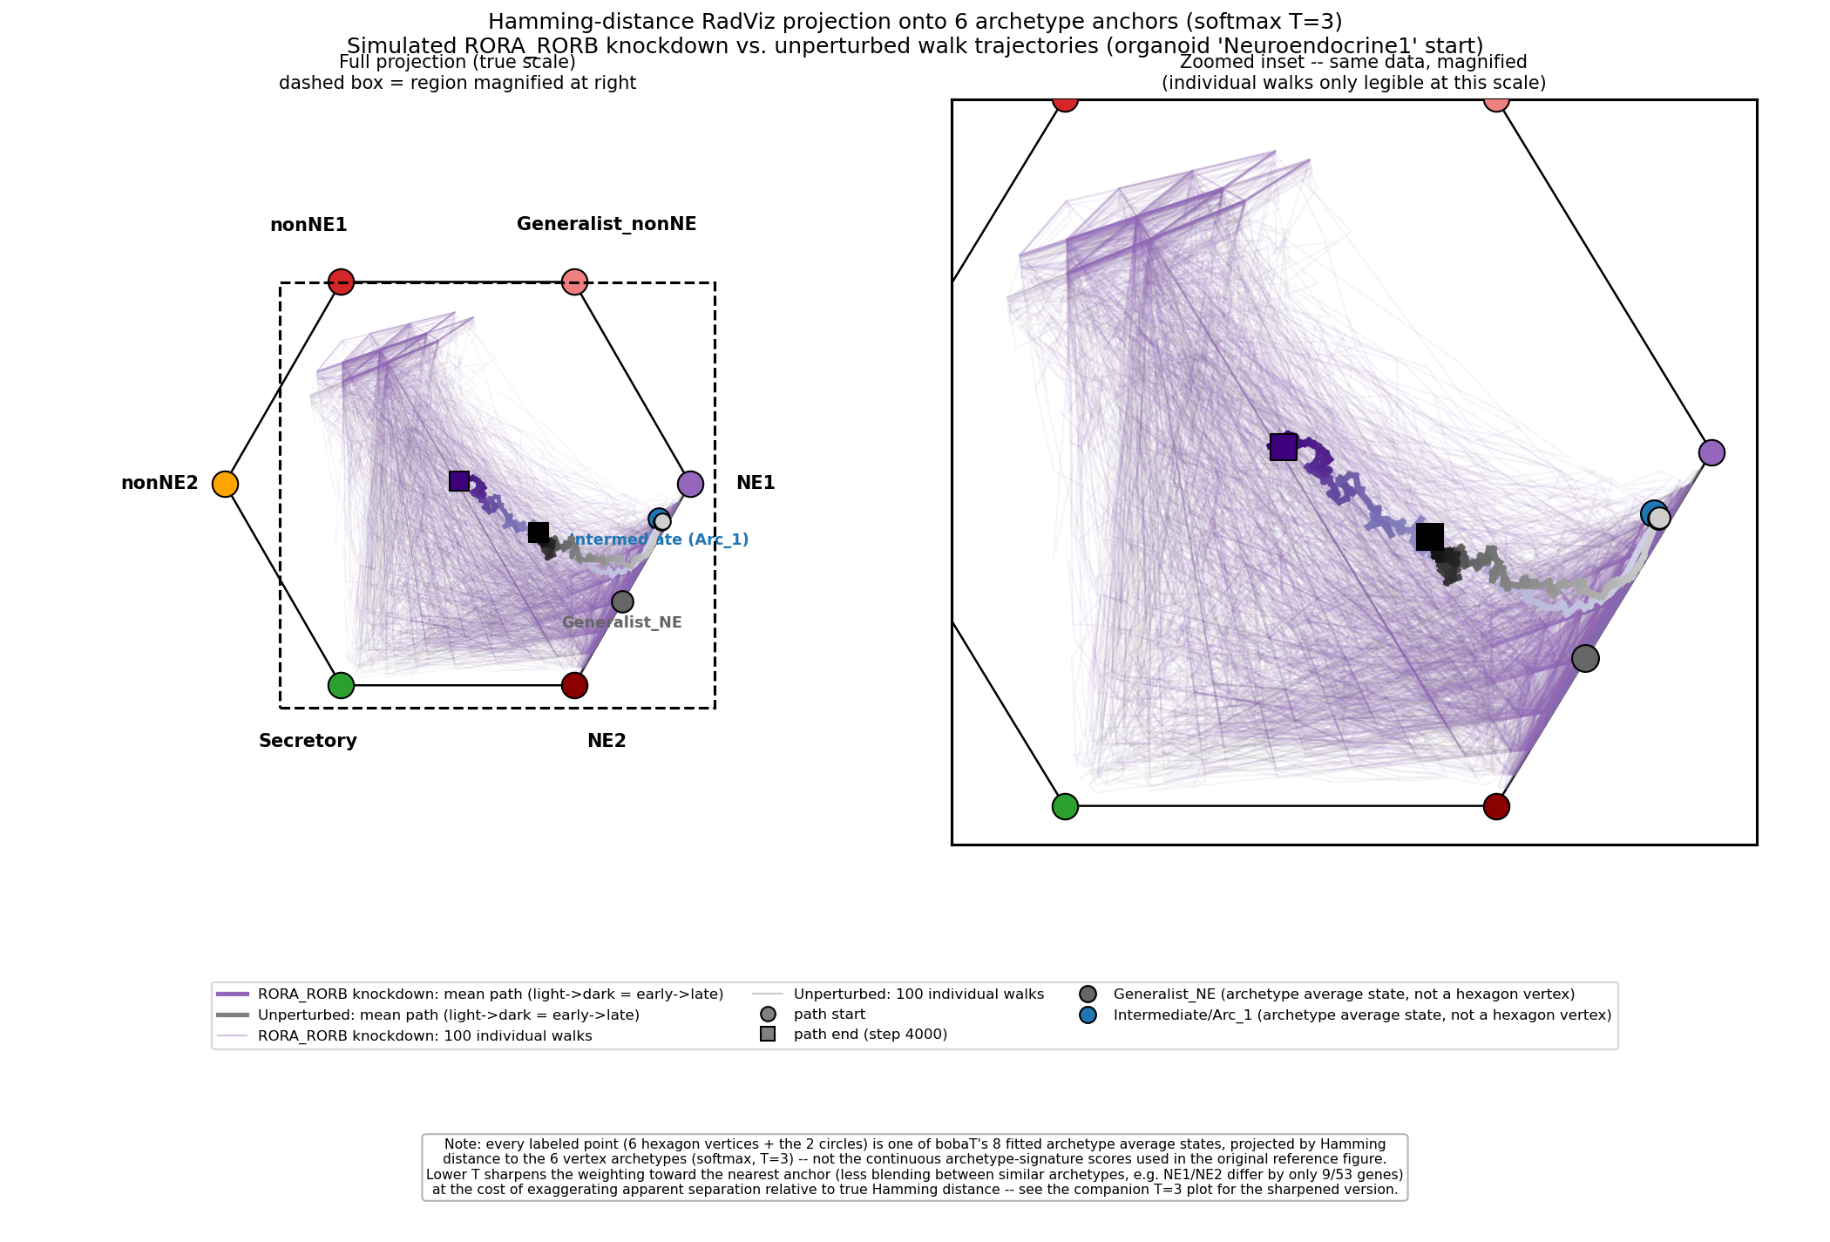
RADVIZ PROJECTION -- SHARPENED (T=3)
Same trajectories, lower softmax temperature
Lower T sharpens weighting toward the nearest anchor (less blending between similar archetypes, e.g. NE1/NE2 differ
by only 9/53 genes) at the cost of exaggerating apparent separation relative to true Hamming distance.

Slide 21
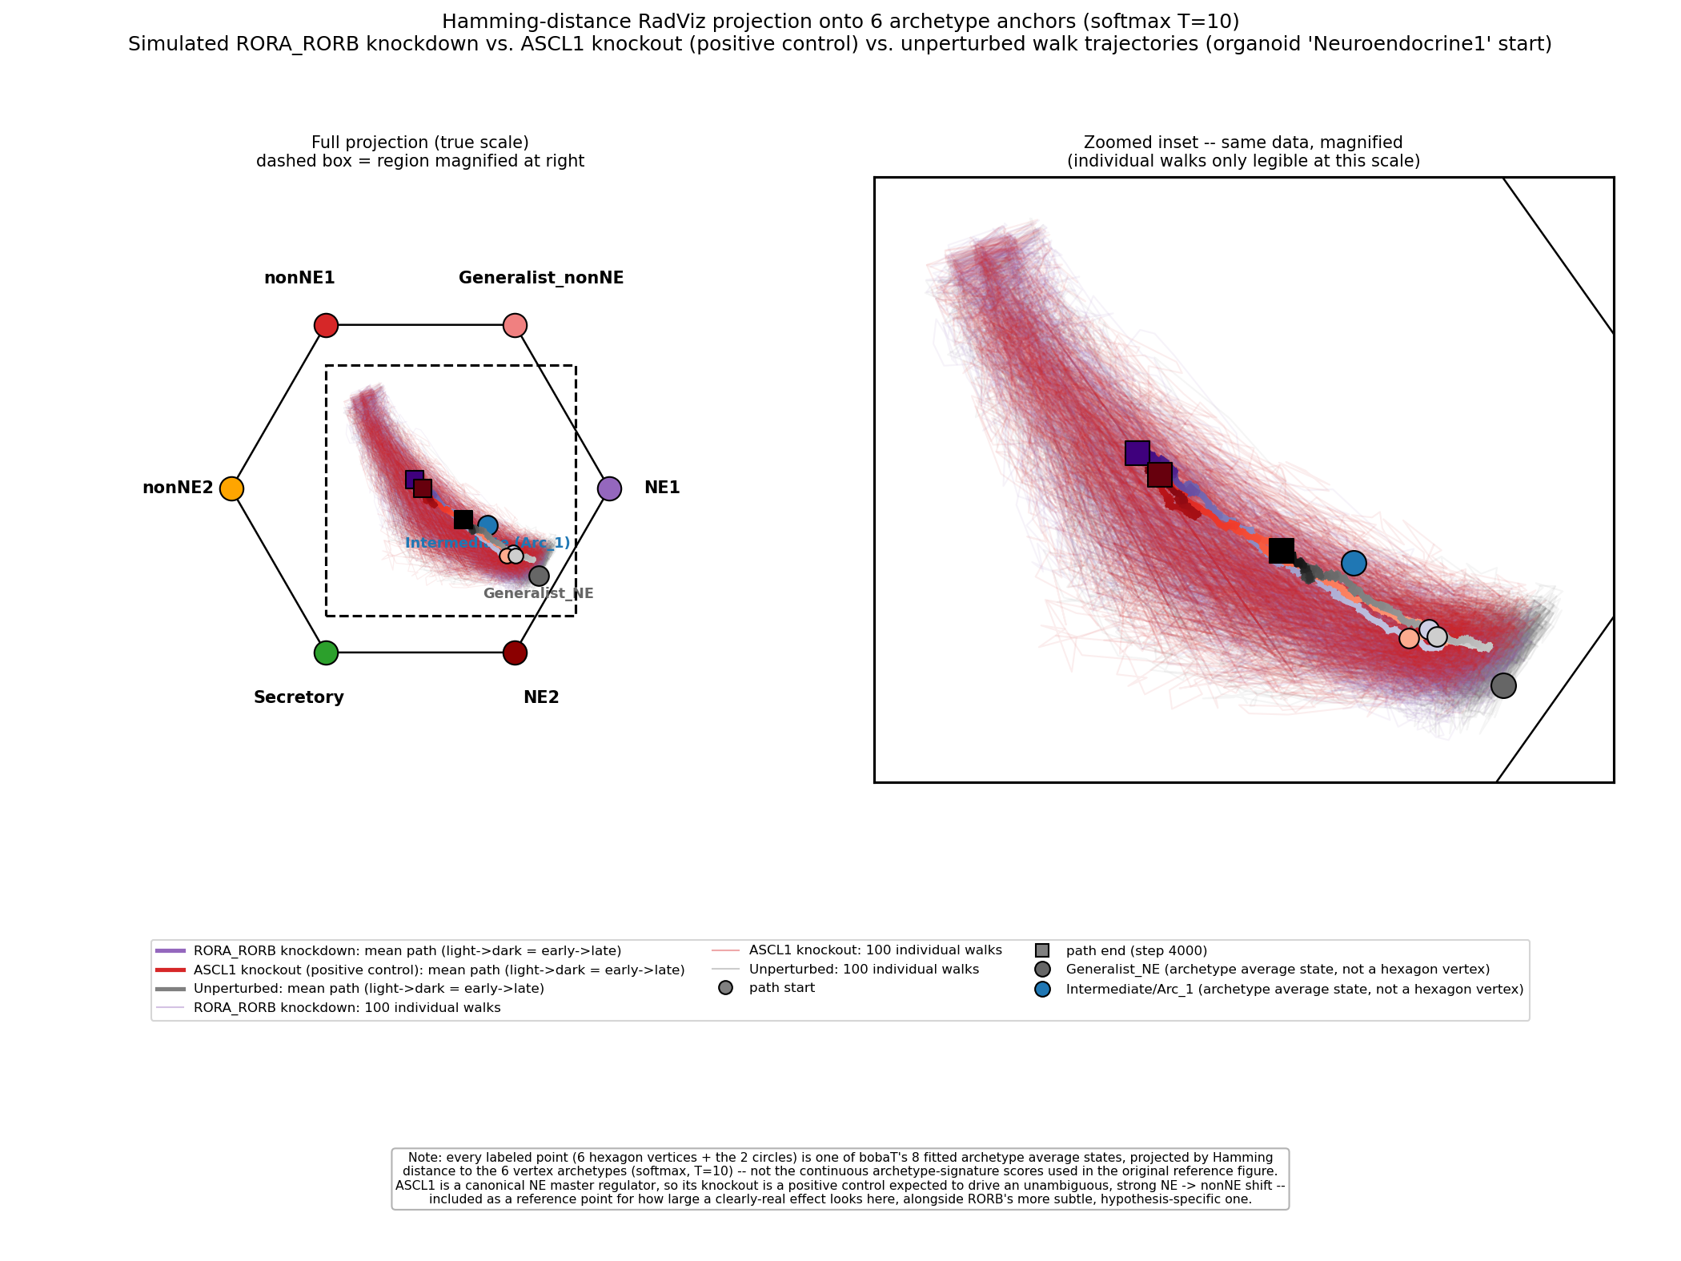
POSITIVE CONTROL
ASCL1 knockout: a similarly-sized shift, not a bigger one
ASCL1 is a canonical NE master regulator, so a much larger effect than RORB's was the expectation going in --
instead its knockout trajectory tracks closely alongside RORB's, ending at a comparable position, not clearly beyond it.

Slide 22
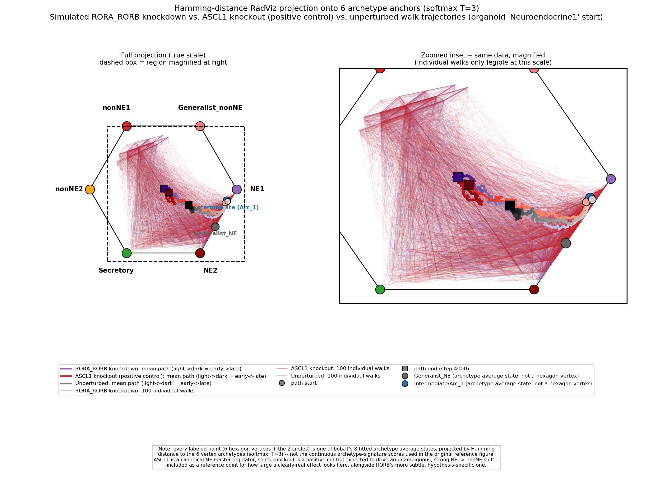
POSITIVE CONTROL -- SHARPENED (T=3)
Same result holds at the sharpened projection
Even with less blending between nearby archetypes, ASCL1's and RORB's end points and paths remain close together --
the similar magnitude isn't an artifact of the softer T=10 projection.

Slide 23
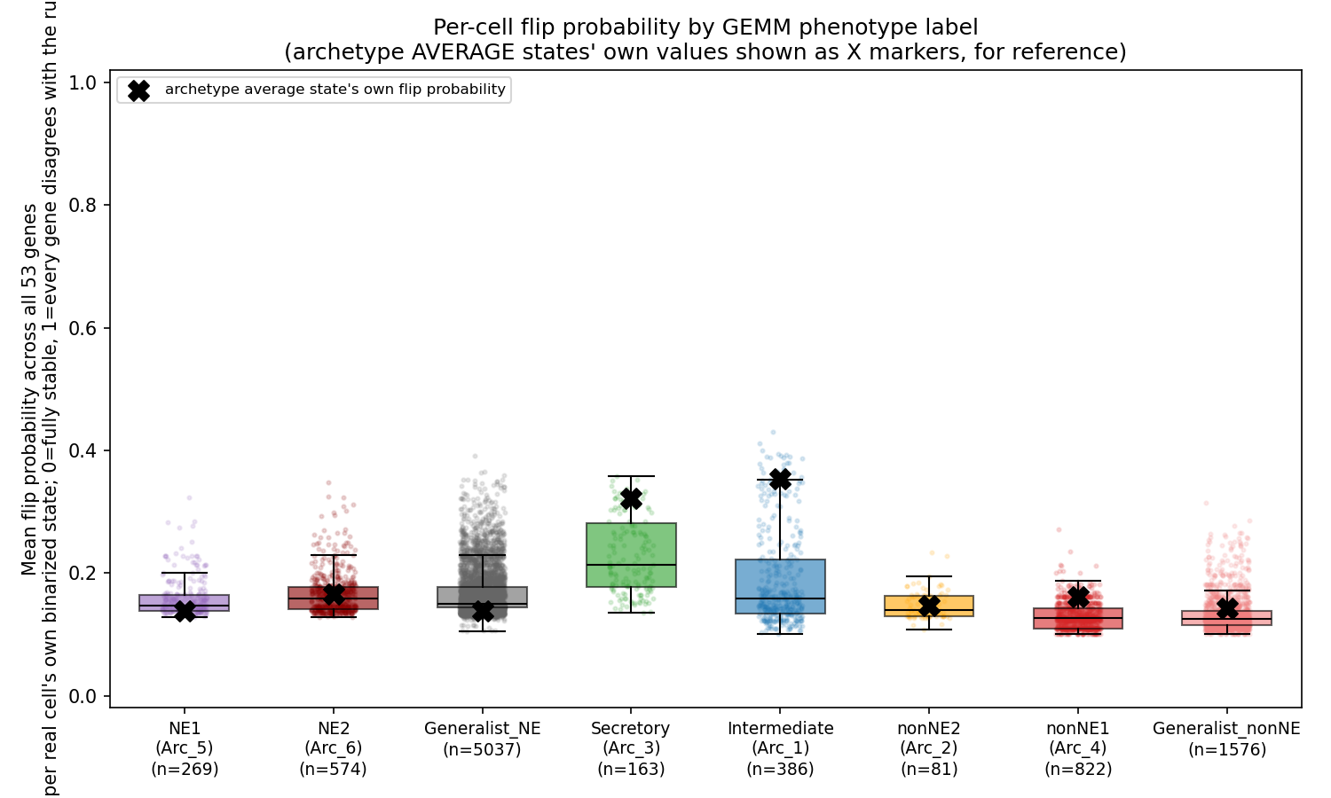
ATTRACTOR STABILITY DIAGNOSTIC
Real cells vary widely in rule-consistency by archetype
Secretory is the most consistently unstable population; Intermediate has high variance, with its own
archetype-average state an outlier even relative to its own real cells. The nonNE side is the most stable overall.

Slide 24
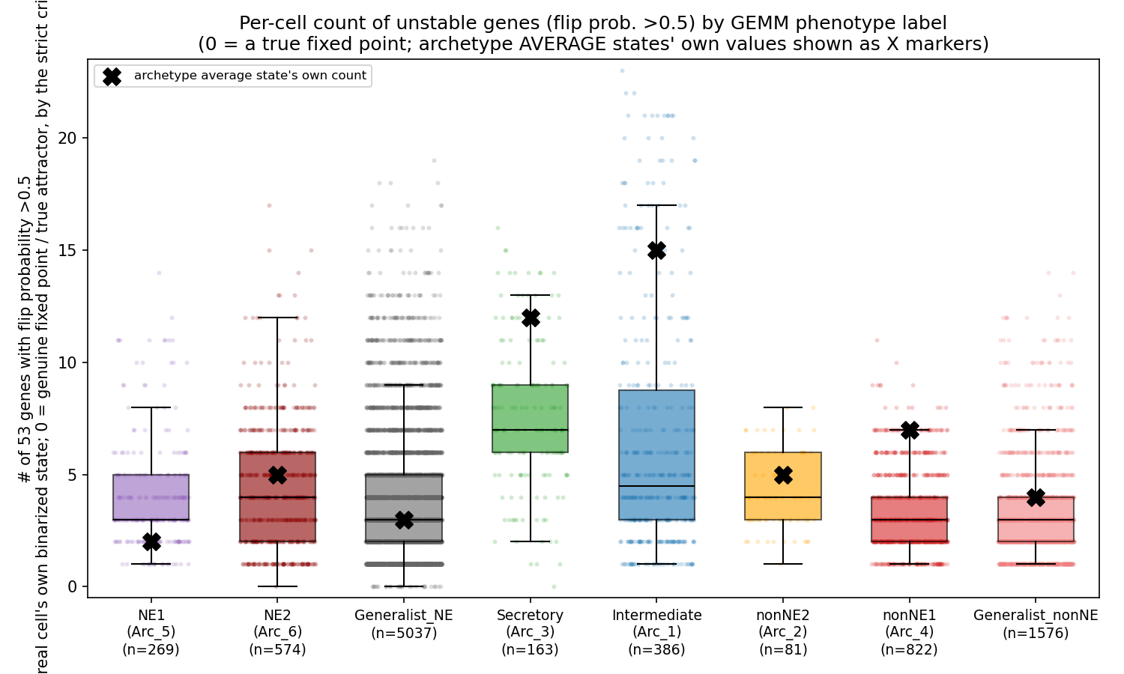
ATTRACTOR STABILITY DIAGNOSTIC
Only 0.3% of real cells are genuine fixed points of the fitted rules
By the strict criterion (0 of 53 genes preferring to flip), Intermediate is significantly less stable than
every other archetype (p < 0.02 vs. all) -- confirmed at the population level, not just at its own average state.

Slide 25
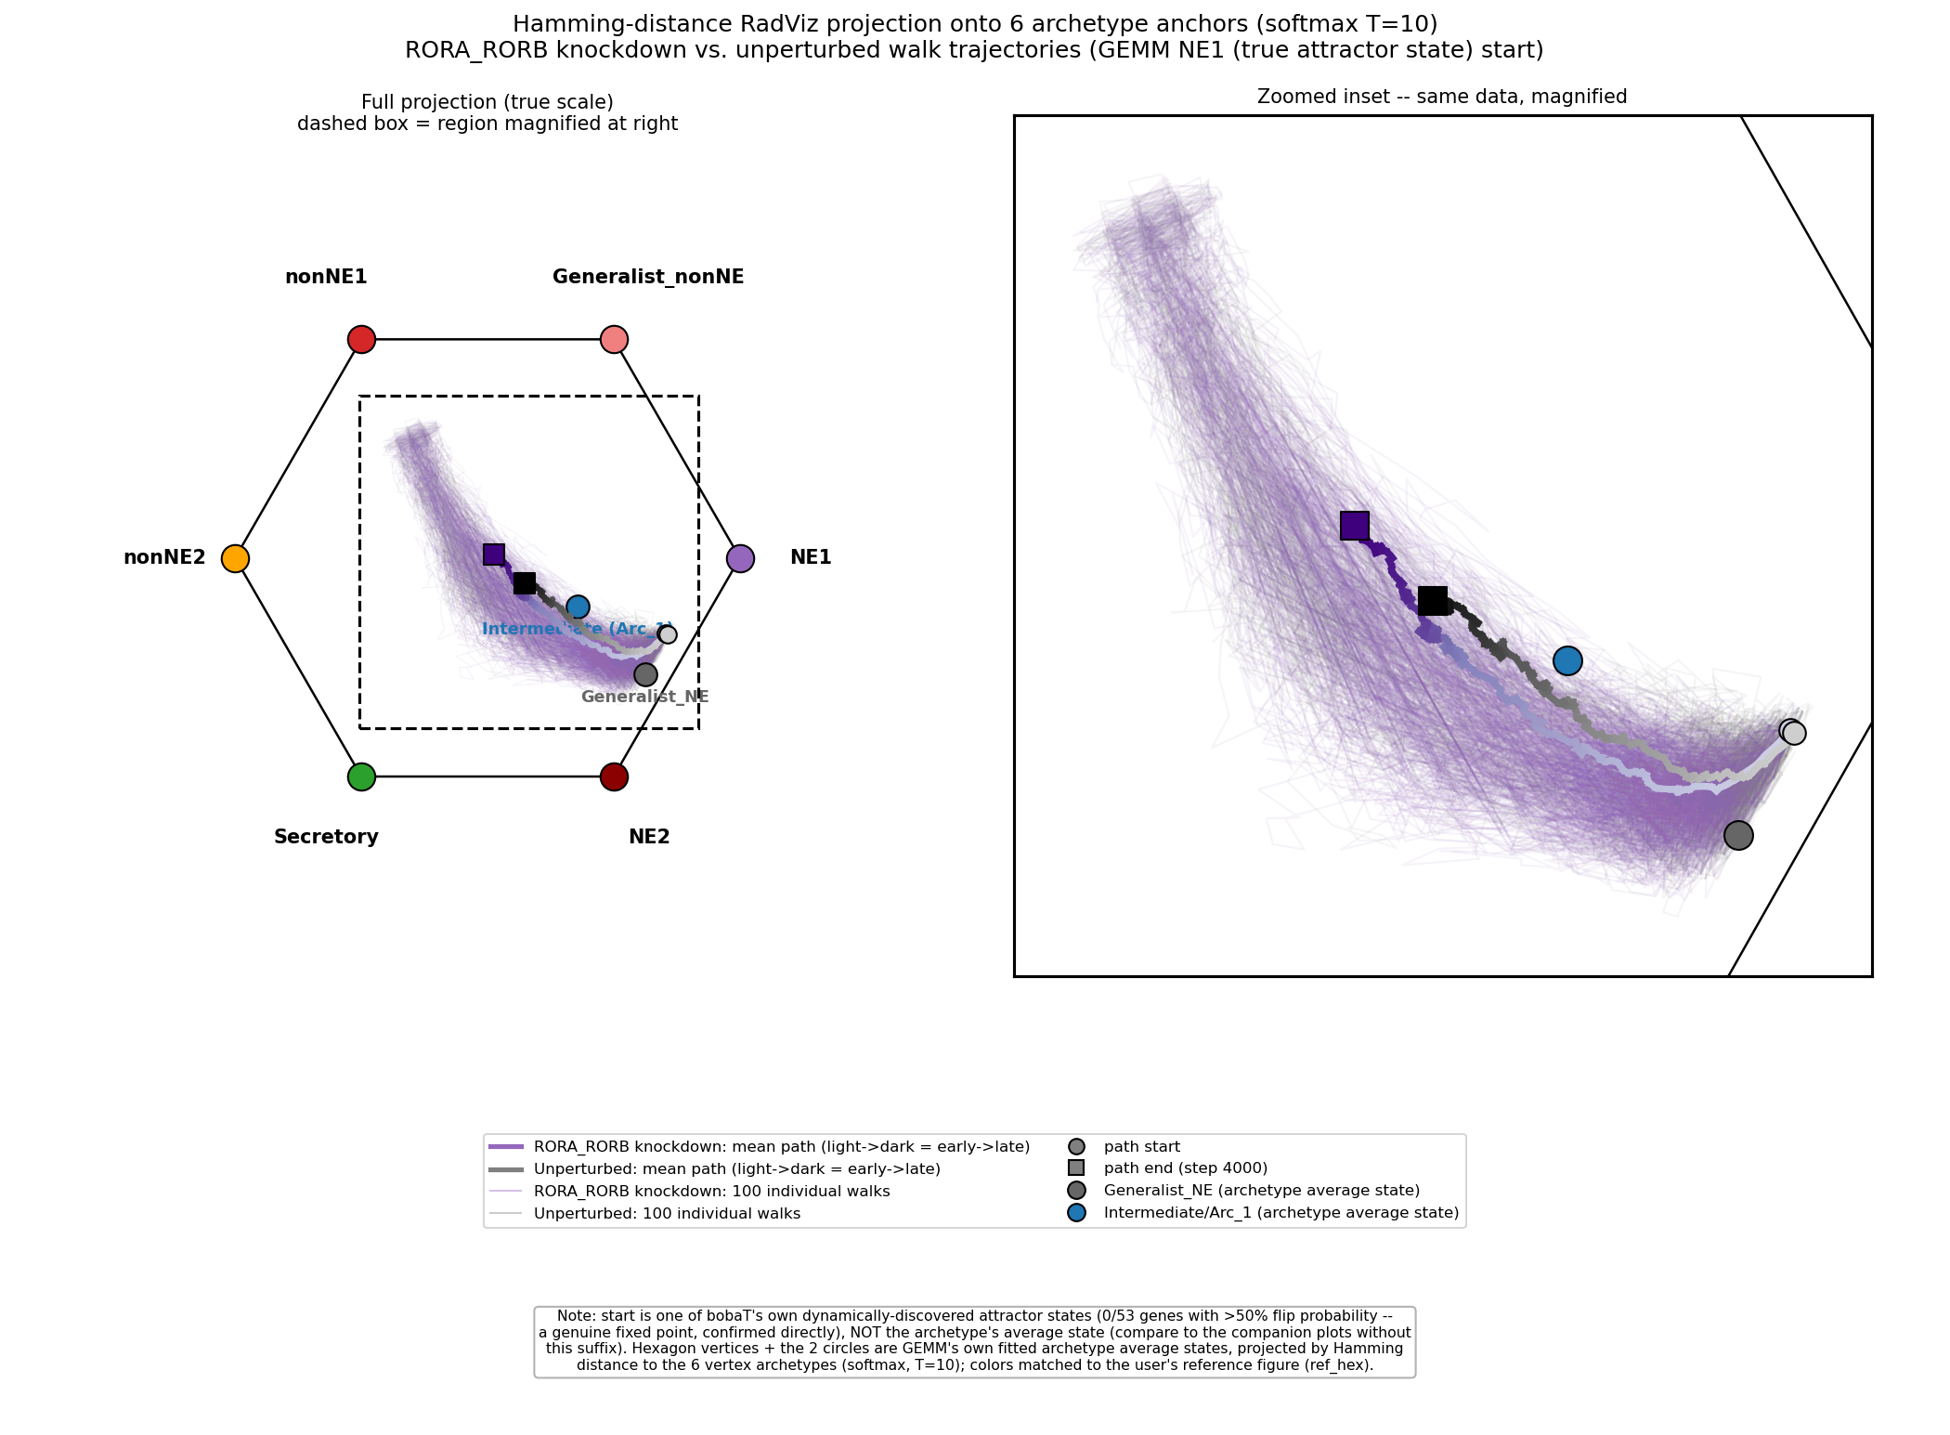
TRUE ATTRACTOR VALIDATION
Starting from a genuine fixed point reproduces the same result
RORB knockdown from NE1's own true discovered attractor state (not the archetype average) still drives
a clear, significant shift toward nonNE -- the earlier result wasn't an artifact of an unstable starting point.

Slide 26
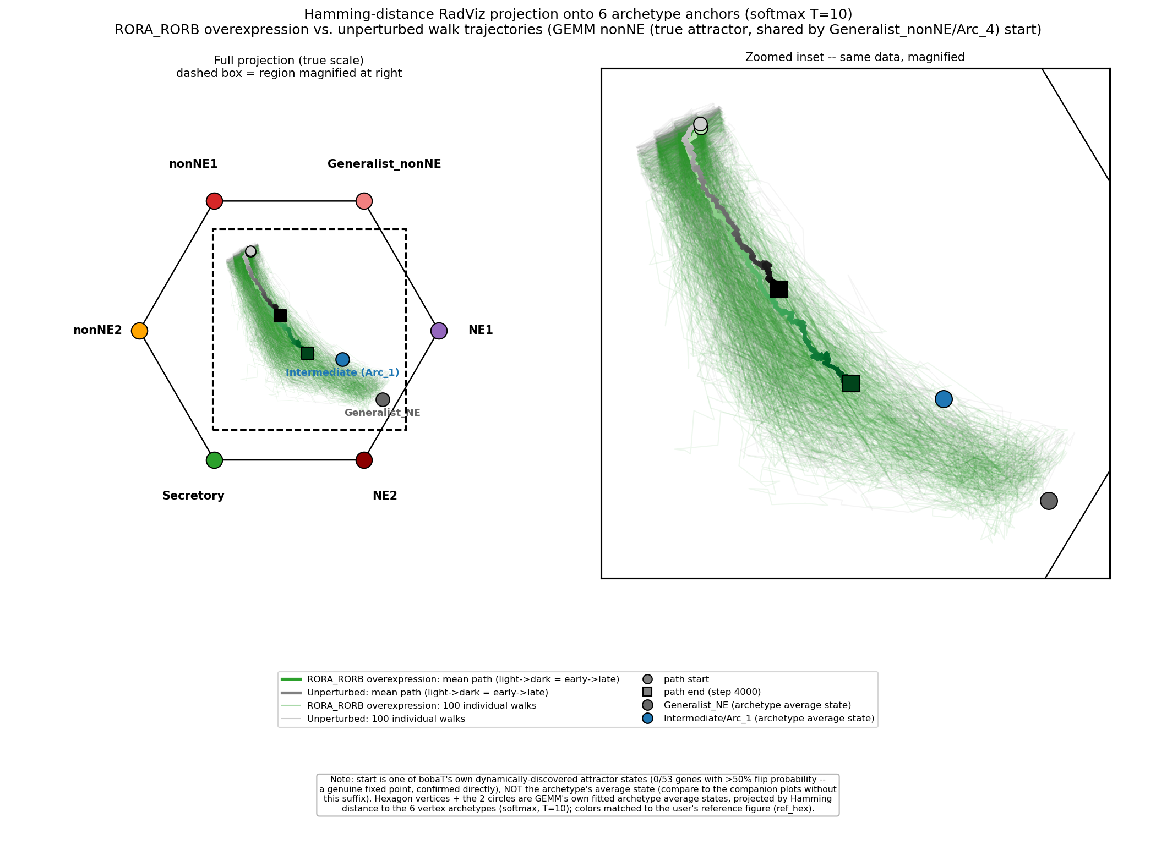
TRUE ATTRACTOR VALIDATION
RORB overexpression still rescues cells from a true nonNE attractor
This state is a confirmed attractor shared by Generalist_nonNE and nonNE1/Arc_4 -- overexpression
still reverses the drift back toward NE, from a genuine fixed point rather than the archetype average.

Slide 27
Key takeaways
• boba-T and CellOracle trade off, not one strictly beating the other: boba-T wins on real data it had to discover a network for; CellOracle/GENIE3 win on synthetic data or genome-wide scale.
• Correlation-structure preservation, and especially per-gene leaf-conditional transferability (r = 0.96), predict external validation quality far better than any distance-from-training-data metric.
• Self-loop genes inflate validation scores across the board -- excluding them, only allograft and TKO-derived samples retain a clearly real cross-gene signal.
• RORB knockdown's predicted archetype-level shift (NE -> Intermediate -> nonNE) is confirmed both in simulation and in real organoid shRNA data, with the correct temporal ordering.
• Human tumors that are themselves ASCL1-subtype (Chan et al. 2021 labels) validate significantly better than non-A tumors (R2 p=0.042, AUC p=0.027) -- direct confirmation that the network's training bias toward ASCL1-driven mouse tumors carries over to which real patients it fits best.

