Slide 1
Welcome to DS5030!
We are glad you are joining us 🎉

Slide 2
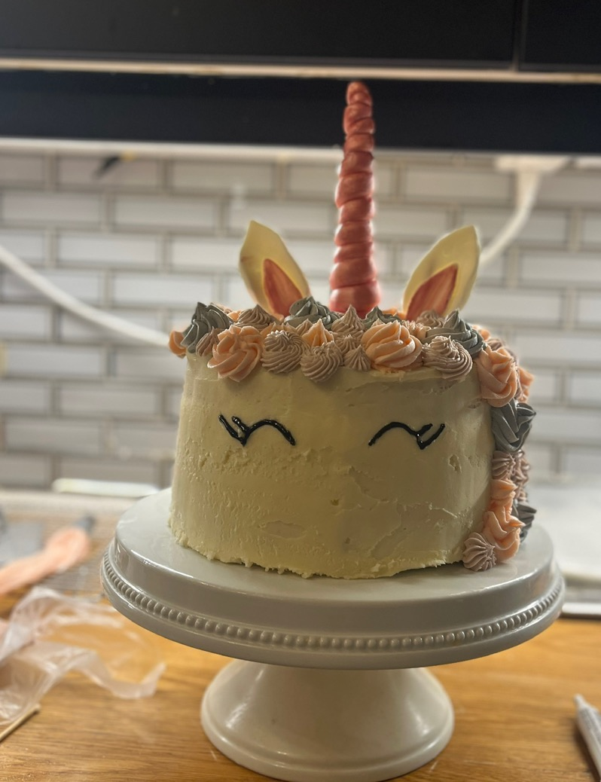
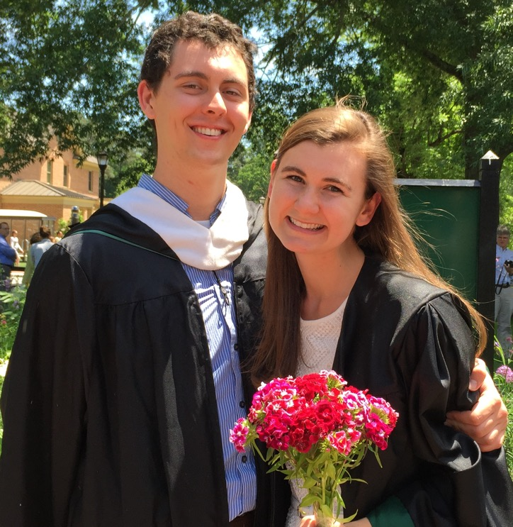
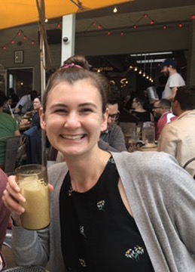
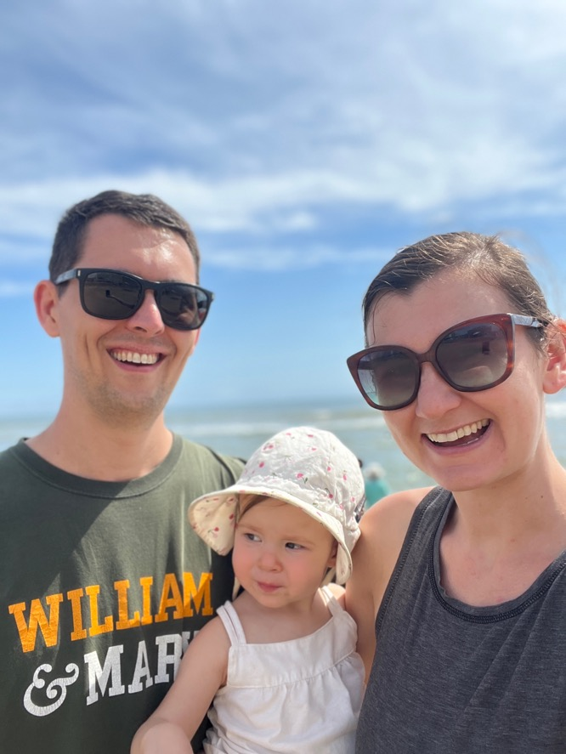

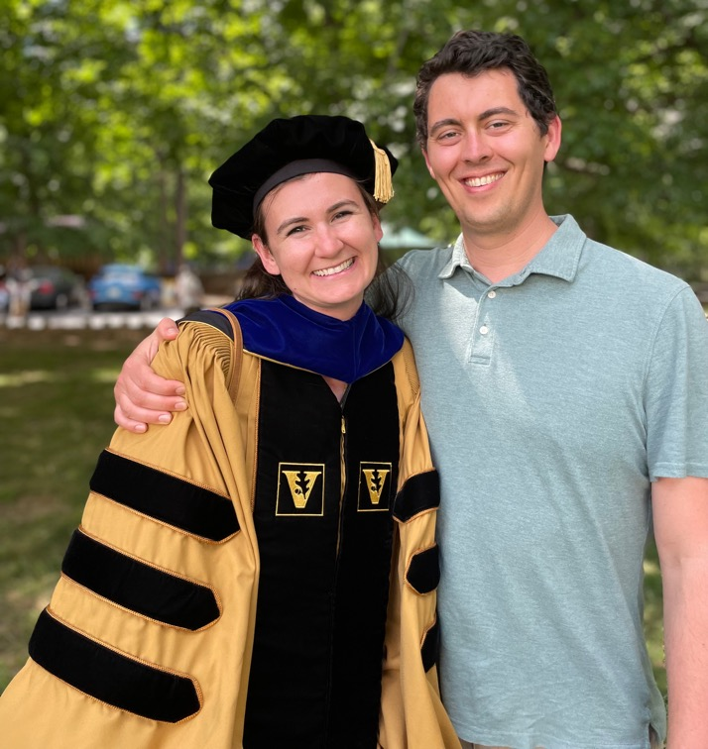
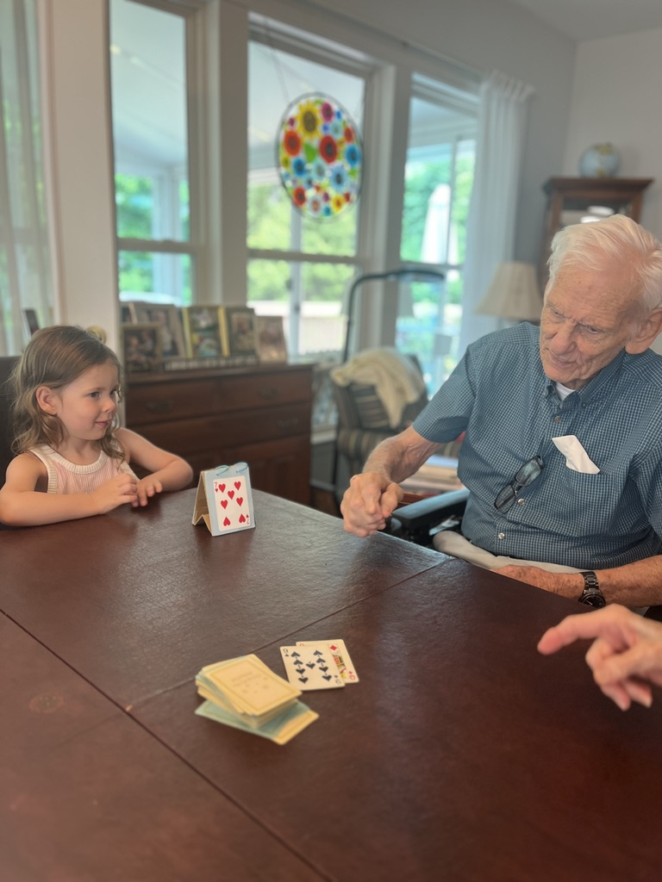
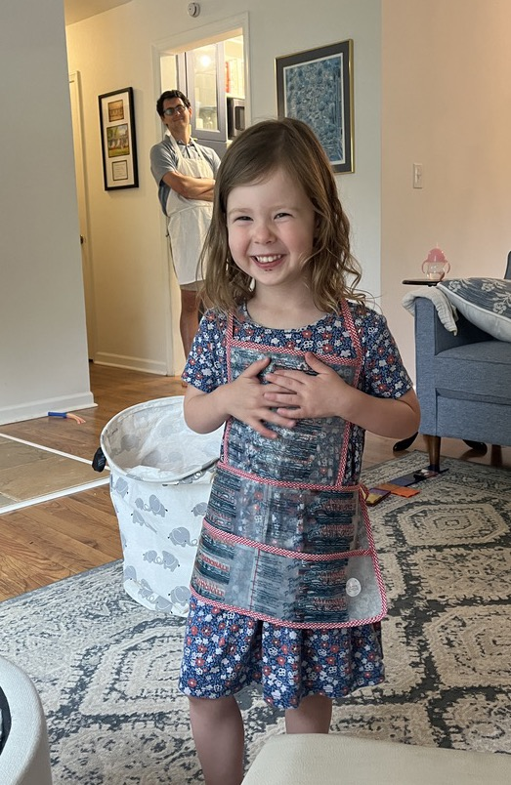


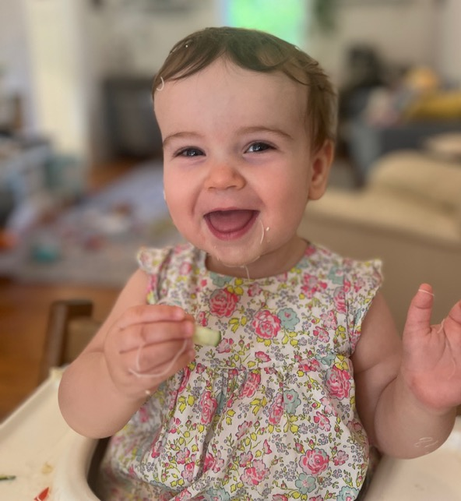
Sarah Groves
Virginia Beach
Biking
W&M
Coffee
Baking
Vanderbilt
Mary, 3.5yo
Hannah, 1 yo
Hiking
Cooking
Card & board games

Slide 3
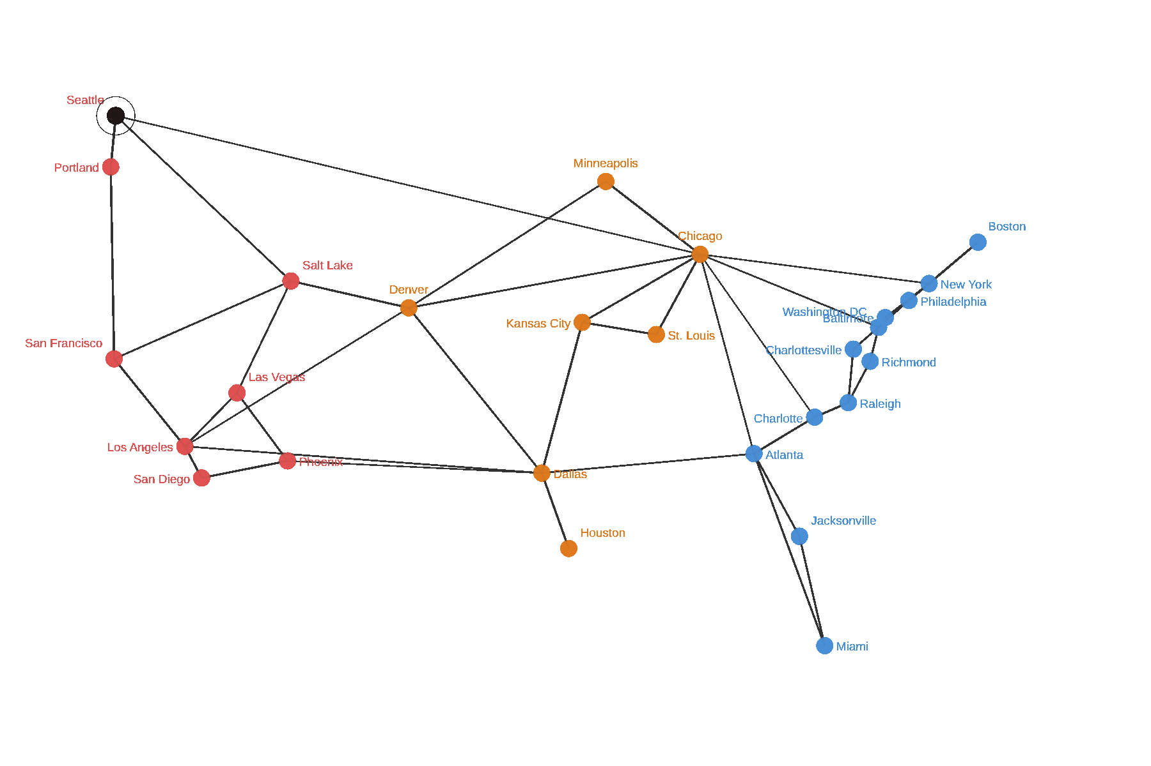

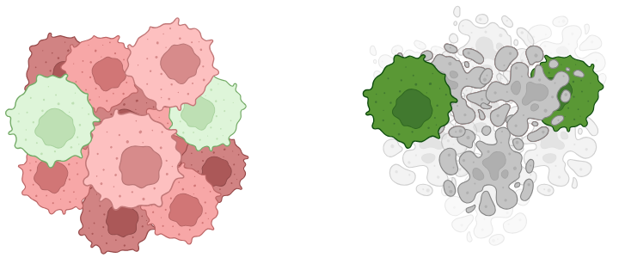
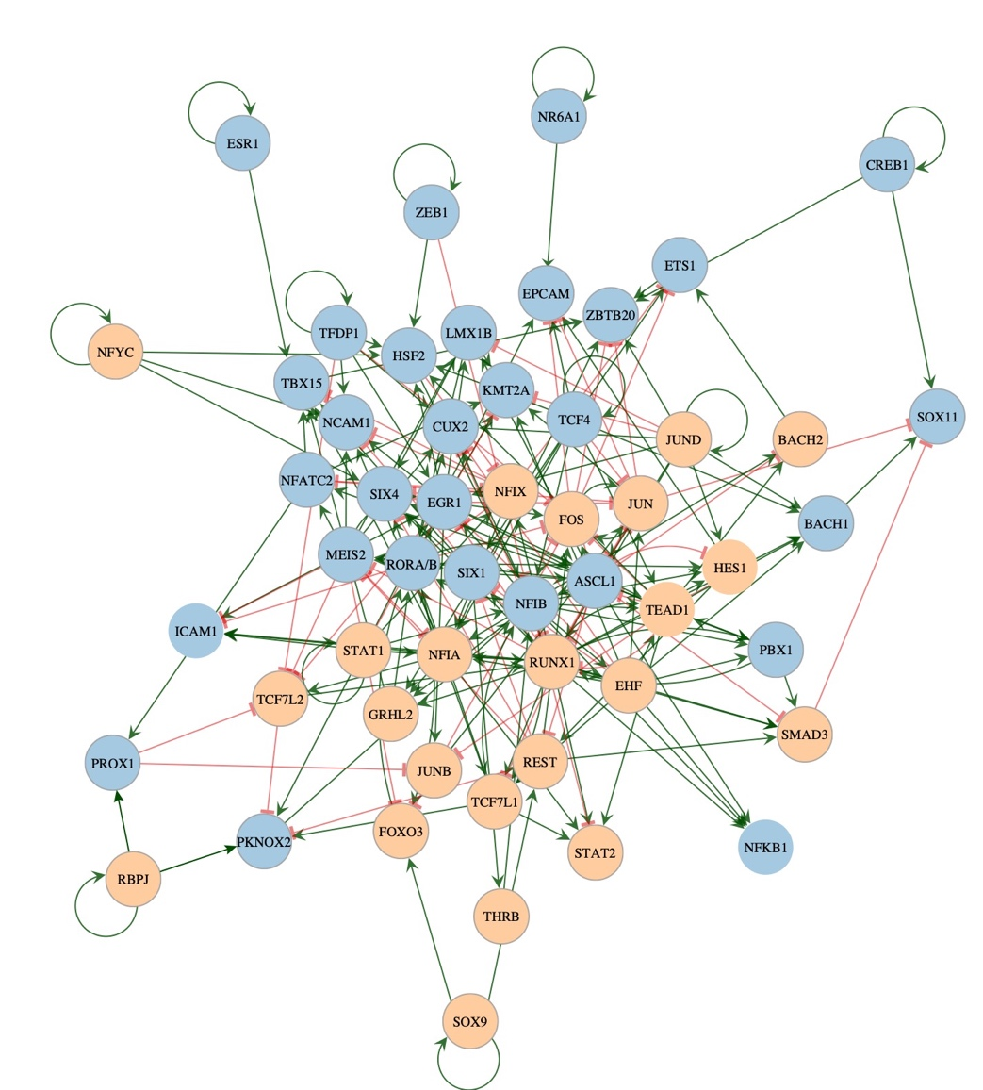
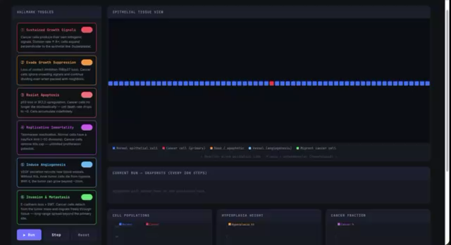

My research: biomedical network science
acquires resistance to therapy
Treatment
Transit networks and traffic
“NETWORKS, NETWORKS EVERYWHERE”
dies under therapy
Visualizations for curriculum design

Slide 4



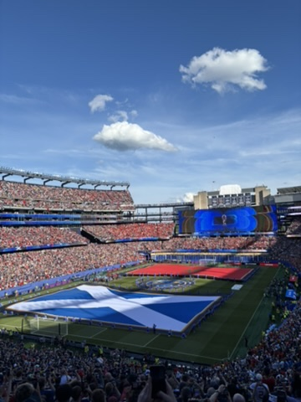
About Me!
Hometown: Sudbury, MA
Undergrad: Stats @ UVA
Grad: MSDS @ UVA ’26
ECs: Club Swim, Graduate Data Science Council, Peer Financial Counseling
Interests: Watching my favorite soccer team lose on Saturday mornings (Chelsea FC), World Cup
Hobbies: Visiting National Parks
- Favorite: Zion
- Dream: Patagonia
Things I Did This Summer: Data Science Internship, Hawaii, Noah Kahan @ Fenway
Instructional Assistant: Jeffrey Zhang

Slide 5
Make a name card!
Your name
What field are you in or interested in?
Notes:
5 min

Slide 6
What is
this class?
Notes:
20 min

Slide 7
Course Learning Objectives:
Complement and foreshadow your machine learning courses
AI-proof your career, as you build foundational knowledge of the inner mathematical workings of modeling approaches that you will learn in other classes and use in your career as a data scientist (or data science-adjacent field)
Develop a mathematical mindset and feel comfortable manipulating variables, working with mathematical equations, and reading/understanding statistical plots
Understand how to work with random variables and uncertainty to mitigate risk
Develop your probabilistic toolbox of common distributions and densities, axioms, and theorems needed for data science
Understand and use maximum likelihood estimation, Markov chain modeling, and optimization

Slide 8
Shape of the semester
Introduction to describing data: data wrangling, vectors, matrices, and probability
Probability, in depth: random variables, densities, and distributions
Uncertainty about estimates: sampling distributions, bootstrapping, the CLT, simulations
Modeling uncertainty: likelihood, MLE, regression
Conditional probability in action: Markov chains
Optimization under uncertainty
almost everything this course estimates is the answer to a minimization problem

Slide 9
Class Schedule & Assignments
Graded assignments in pink
Not all graded for correctness
BEFORE CLASS EACH WEEK
  You will have a video to watch
  Problem set at home, assigned Tuesday and turned in the following Wednesday
TUESDAY: QUIZ, LECTURE, MATH [FIRST QUIZ IS NEXT TUESDAY 9/1]
  Starts with a short quiz; recall of previous weeks’ material, lowest 2 dropped
  No make-ups for unexcused absences
  In class lecture, working through problems
  Don’t let AI learn for you!
THURSDAY: RECAP, LAB [FIRST LAB NEXT CLASS 8/27]
  Short lecture/review and lab (I do, we do, you do): due the following Wednesday
Midterm/Final
  You will have two exams: October 8 (after Fall break) and on December 10 (9-12)

Slide 10
Grading
20%: Problem Sets
10%: Quizzes [drop lowest 2]
30%: Labs
20%: Midterm
20%: Final
If you can’t make class, please email me as soon as possible (preferably before class!)

Slide 11
My expectations of each student:
Show up
Engage
Be kind to peers and yourself; let yourself fail
Trust that the course structure and assessments are intentional for your learning but ask me for my reasoning if it isn’t clear!
Ask questions and reach out for help when you need it
Give me feedback about how your learning is going and how we can help
Be patient with me as I teach this course for the first time
We have a social contract: I will teach to the best of my ability and you will learn to the best of your ability. Neither of us can do our part without the other

Slide 12
Student expectations of me & this class:
Clear communication
Office hours/availability
Making sure you are introduced to the material before an assignment
Flexibility/adaptability
Challenge

Slide 13
AI: the good and bad
GOOD
BAD
Researching and editing/tool
Learning tool/critiquing tool
Brainstorming
Personalization/memory
Don’t use it to learn for you
We need to fail to learn
Takes out critical thinking
Hallucination

Slide 14
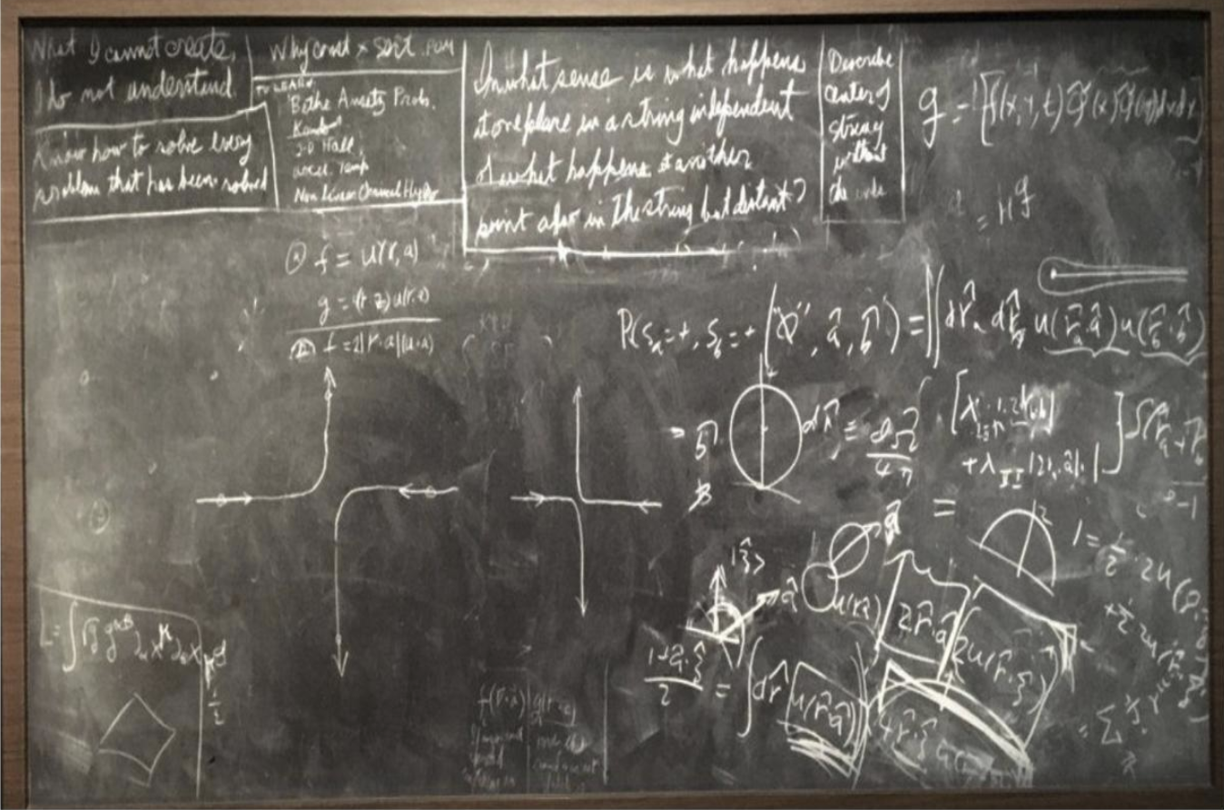
AI Policy: my expectations for you
See the syllabus
In general, you can use AI to help your learning, but don’t use AI to replace your learning
  AI convinces you that you know something, without ever encoding it in long term memory
  Using AI to do things for you handicaps the procedural learning process severely
If you do use AI, cite it
“What I cannot create, I do not understand”
Feynman’s blackboard
AI: your expectations for me
Don’t use it grade
-

