Slide 1
Introduction to Coding in Python
Dr. Sarah Groves

Slide 2
You should have:
  Anaconda/miniconda installed (with Python interpreter)
  VS Code installed (or an IDE you like)
  Git/GitHub account
Today we will add:
  A folder location to organize your files (code files and data files for this class)
  VS Code extensions:
    Jupyter notebook extensions
    Optional extensions: CSV viewer
  Python packages needed for this class
Setting up your computer for this class
Notes:
I have tested the install process I’ll walk through today, but there will always be errors because everyone’s computer set up is different. Make sure you’re able to complete all of these steps and if not, come to office hours tomorrow or reach out to us on piazza
You should have learned coding basics (prompt students?)
What we found last semester was that a lot of students needed help with getting their computer set up in a way that made coding seamless, so they could focus on writing good code that worked well and tied all of the pieces together
We found that even if they could write a for loop or if statement, it was often hard to understand why sometimes code ran in different places, or why they needed anaconda in the first place
A lot of students also needed some coding principles or guiding practices, more than a regurgitation of syntax or basic coding structures that they could google. Where students were struggling was often, I don’t know how to interpret coding errors, writing repetitive code that then made mistakes because things were copied and pasted multiple times, just figuring out how to even structure an approach to the problem they were solving (in plain English)

Slide 3

How do coding tools fit together?
Writing code ≠ running code
Think of coding like running a restaurant
  .py files
  Jupyter notebooks
  VS Code (IDE)
  Python interpreter
  Terminal/Command Prompt
  Anaconda & environments
  GitHub and git
Your code = the recipe
  It describes ingredients and steps, but a recipe does not cook itself!
.py file
Notes:
Start by talking about my rationale for this intro based on the last two semesters of feedback and problems that arose

Slide 4

Folder Organization: The recipe book
Pick one location to make a folder for this class (Documents? UVA Box? Home?)
  Each lab will have its own subfolder that we will put in this folder
  Any extra data/files from Canvas should go here
Think about what you want to name your files!
You will open this folder every time you work on this class!
Notes:
Naming conventions for files and folders
Enumerate code in a pipeline when step-by-step (1_xxx.py, 2_xxx.py, etc)
Python files should have a clear, descriptive name for importing (numerical_solvers.py, statistical_tests.py, classification.py, etc)
No files should have “template” in the title (i.e. rename any files you get from Canvas!)

Slide 5

Python interpreter:
The Chef
The chef reads the recipe line by line and executes each instruction
Different chefs exist:
  Python 3.7
  Python 3.9
  Python 3.11 …
Same recipe with different chef → slightly different outcomes!

Slide 6

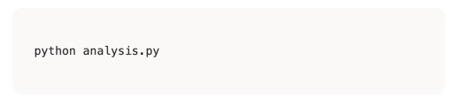
Terminal & Command Prompt:
The Order Counter
The terminal is where orders are placed
Means “Chef Python, make the analysis.py recipe”
We can access the terminal through stand-alone apps (terminal, command prompt) or within VS code
  Like different windows at the same order counter

Slide 7
The Restaurant: The Big Picture
… and put them in a recipe book (folder)…
… which you can send to the order counter (terminal)…
…which tells the chef (Python) what to cook
You write recipes (code)…
I need an analysis.py, stat!
The Restaurant (VS Code)
All of this happens inside the restaurant, VS Code!

Slide 8
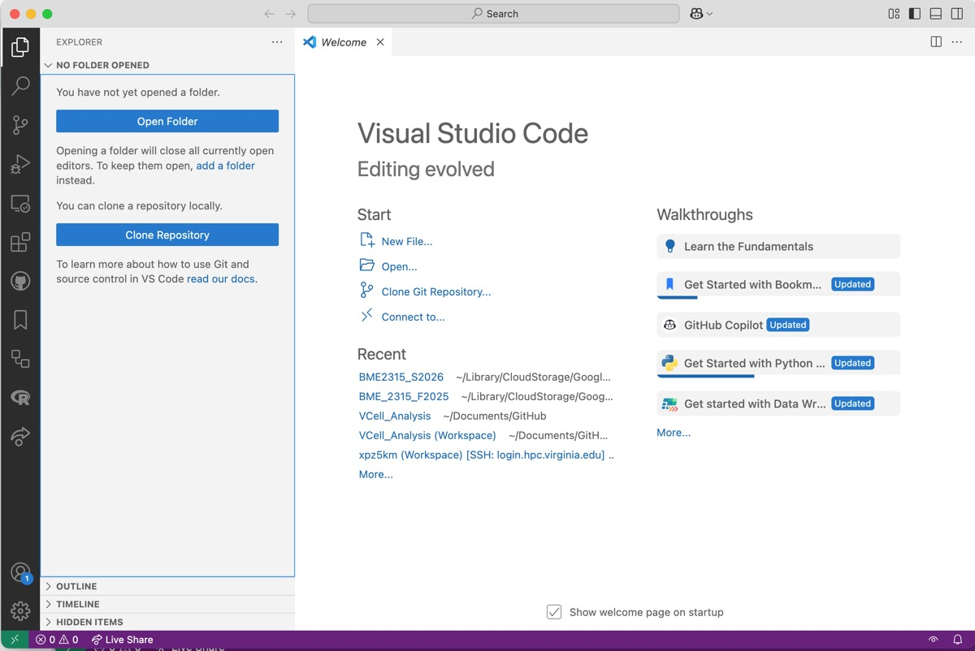
VS Code & Integrated Development Environments:
The Restaurant
VS code is a place to work on code (write recipes), view data files (peek in the kitchen), and run your code through a terminal (tell the chef what to cook)
Integrated: many tools in one place
Development: place to build code
Environment: workspace

Slide 9
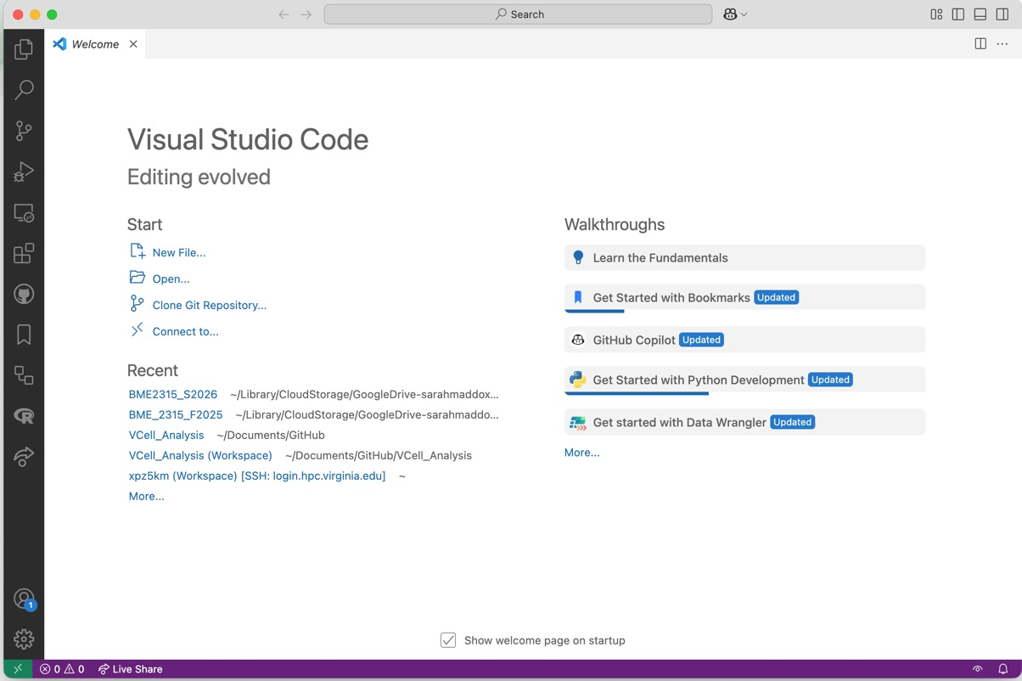
VS Code IDE
Welcome screen
Open a folder
Recently opened folders
Always start by opening your class folder from VS code!

Slide 10
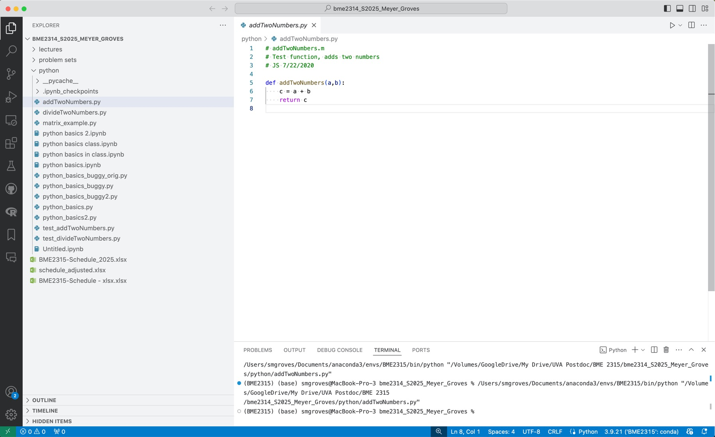

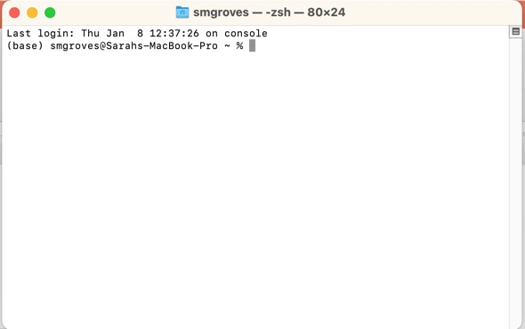
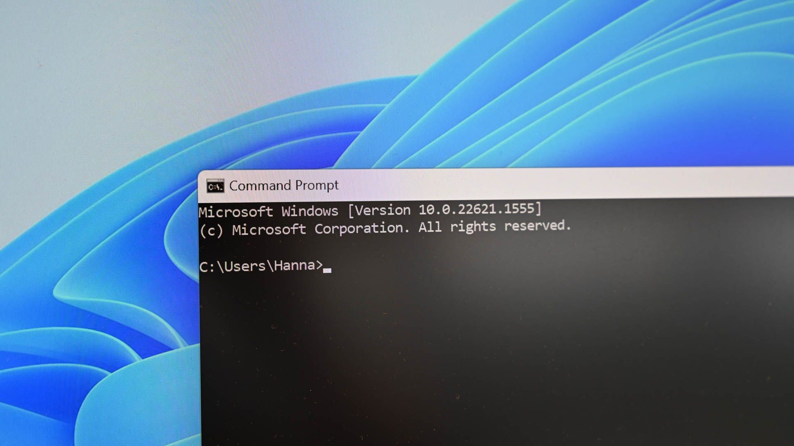
VS Code IDE
Add a file Add a folder Refresh Collapse all folders
Search or run a command
Your chosen folder!
File Explorer
Name of file
Search
Run File
Script Editor
Extensions
Terminal (Mac)
Command Prompt (Windows)
Console/Terminal/Output
Python version

Slide 11
Let’s practice!
STEPS 1-2 from Setup checklist
Make or choose a folder location for this class on your computer (NOT IN DOWNLOADS PLEASE).
Open VS Code (or another editor). If you have a PC + Anaconda, open VS code THROUGH ANACONDA NAVIGATOR.
Stand your name card up on its edge when you are done. Raise your hand for help!

Slide 12


Anaconda:
The supplier & pantry
Conda environments:
The kitchens
Anaconda is the supplier that includes Python and scientific libraries
  The package manager gives you a stocked pantry
Conda environments = separate kitchens
  The base environment is the default
  You can make as many environments as you want. This is useful for organizing projects.
  Each kitchen can have different chefs (Python versions) and different pantries
  Ensures there are no “ingredient conflicts”
VS code works in one kitchen at a time
“This special package requires python 3.7”
conda create …
base (default)
special_env_1
special_env_2
Python 3.11
Numpy 2.4.0
Pandas 2.3.3
…
Python 3.7
Numpy 1.9.1
Special 1.0.0
…
Python 3.11
Matplotlib 3.10.8
Seaborn 0.13.2
…
conda activate …

Slide 13
The Restaurant: The Big Picture
…to different kitchens (environments)…
Anaconda supplies the ingredients…
I need an analysis.py from the blue kitchen!
Orange kitchen, get me a statistics.py!
You write recipes (code)…
… and put them in a recipe book (folder)…
… which you can send to the order counter (terminal)…
…with different chefs (Python versions)…
…which tells the chef (Python) what to cook
The Restaurant (VS Code/IDE)

Slide 14
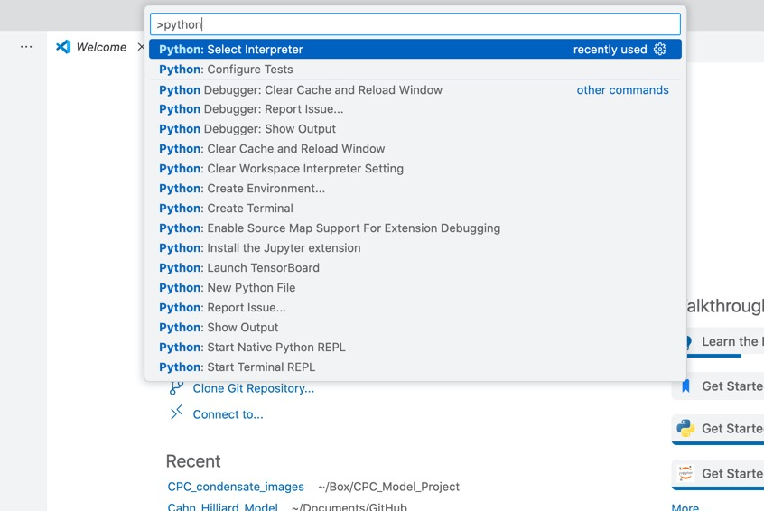
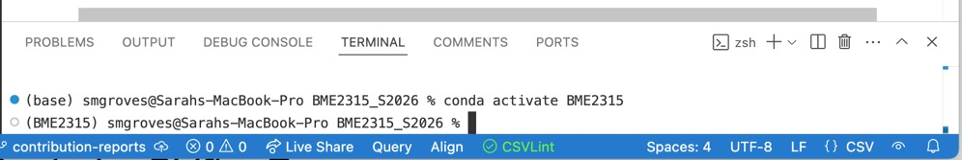
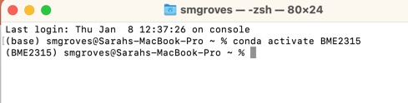
VS Code IDE
Terminal
Which kitchen, chef & pantry do we want?
The base env is already activated
I am activating a special env (BME2315)
“conda activate uu”
“source activate uu”
Command palette: Command/Control + Shift + P
Configures the right version of Python for this specific terminal session
Do this when installing packages
Configures the right version of Python for the entire IDE
Do this once!
Notes:
Selecting the interpreter via the VS Code Command Palette configures the entire IDE experience (linting, debugging, run button, etc.) for that environment, and will automatically activate that environment in any new terminal windows you create. Activating an environment directly in the terminal using commands like source activate only affects that specific, single terminal session.

Slide 15
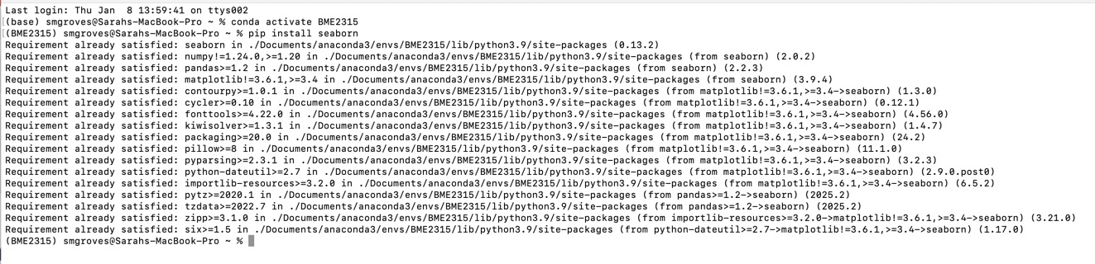
Importing packages (adding food to the pantry)
conda and pip are two major “warehouses”
  Most python packages are hosted on Python Package Index (pypi) and can be installed with pip
  Ensure the right conda environment is activated to add the package in the right location
  If a package is not available through pip, try conda (or look at the install guide)

Slide 16


The Restaurant: The Big Picture
Anaconda
How could we share recipes with other restaurants?
Packages
Code
Local Folder
Terminal
Python
The Restaurant (VS Code/IDE)
Conda environments

Slide 17
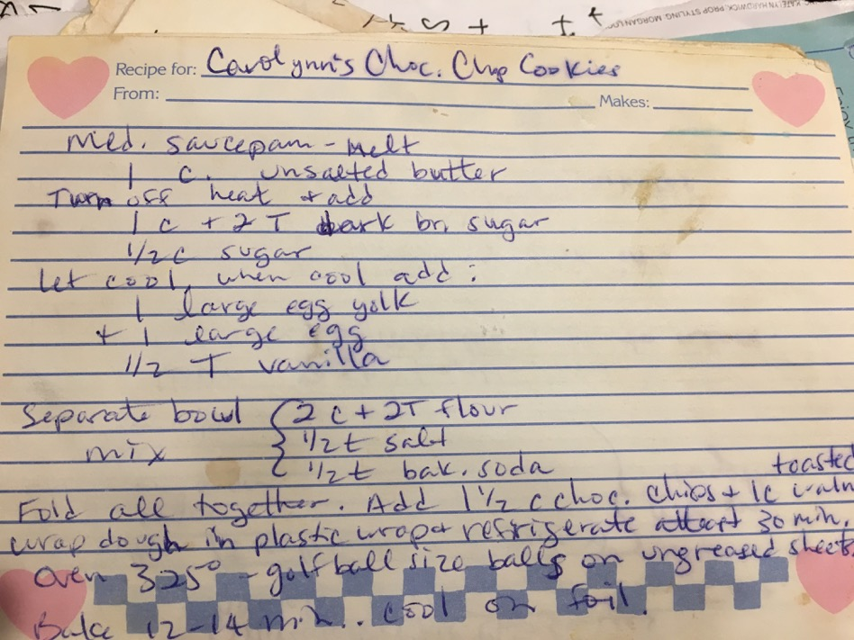
We could share recipes by…
Telling them face to face
  Good when you don’t want to share a secret recipe
  Bad for coding
Handing them a copy or a picture
  What if it’s hard to read?
  What if they want to update the recipe and send it back?
  What if they want to see multiple iterations of the recipe (did they recipe-test?)
Typing up the recipe and sending them the most recent version and past versions with notes about why things changed
Does the butter have to be completely melted?
Can I add more vanilla?

Slide 18

Outside the restaurant: sharing recipes
How do we contribute to the shared recipe book online?
Get a local copy of the shared recipe book (“clone”)
Make changes (“commit”)
Add these changes back to the remote book (“push”)
Regularly check if anyone else made changes to the shared book (“pull”)
If someone made conflicting changes, figure out how to combine them (“merge”)
Shared recipe book online (“remote”)
Code
Local Folder
Code
Local Folder
The Restaurant (VS Code/IDE)
Another Restaurant

Slide 19
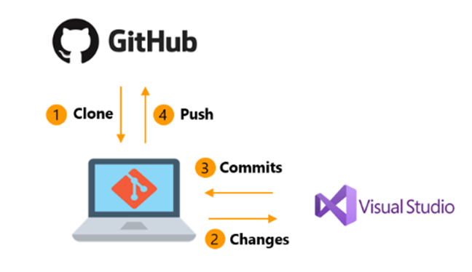
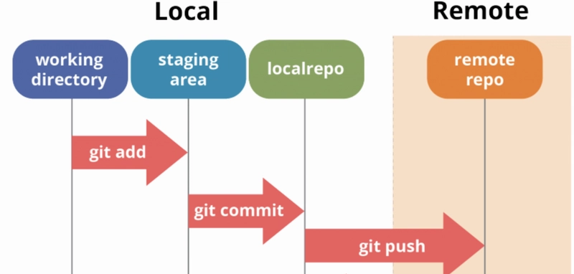
This is how GitHub works
Github hosts your code, git is the version control system
In this class, we will use GitHub to share code (with partners and instructors), code collaboratively, and track changes
Remote, shared
The “commit” process
Local, individual
https://livablesoftware.com/development-process-in-github-basic-infographic/

Slide 20
GitHub Repositories
Entirely different recipe books
In this class, I suggest using a different repository for each lab
Lab 1, git repo
Lab 2 , git repo
Do not NEST git repos!
Do not git init your entire home directory
Your class folder
Lab 3 , git repo
Lab 4 , git repo

Slide 21



GitHub Branches
Different remote versions of the same shared book
In this class, we will use branches for individual work within a shared project (starting with Lab 1)
branch3
branch2
branch1
Main/master: default branch alias
Origin: “remote” alias
Shared recipe book online (“remote”)
Local Folder
Local Folder
The Restaurant
Another Restaurant

Slide 22
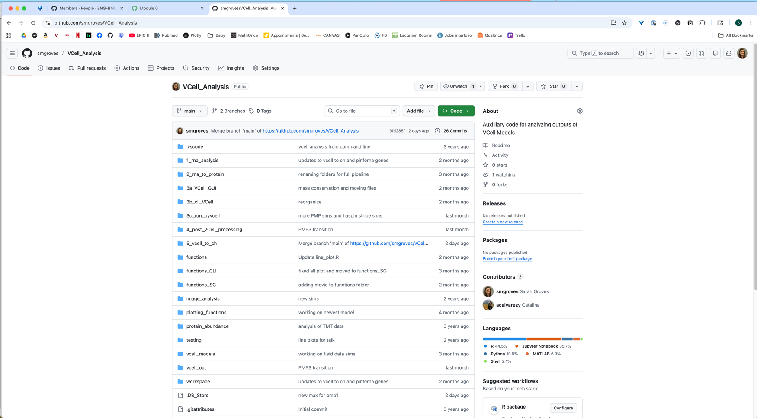
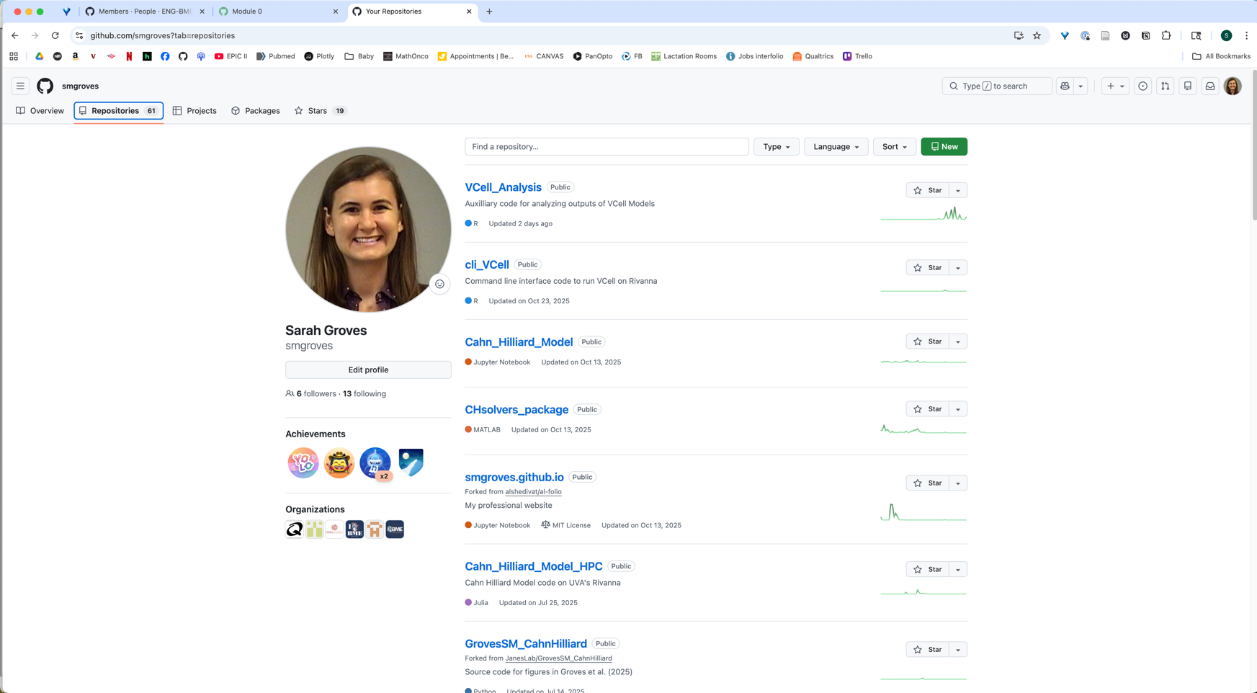
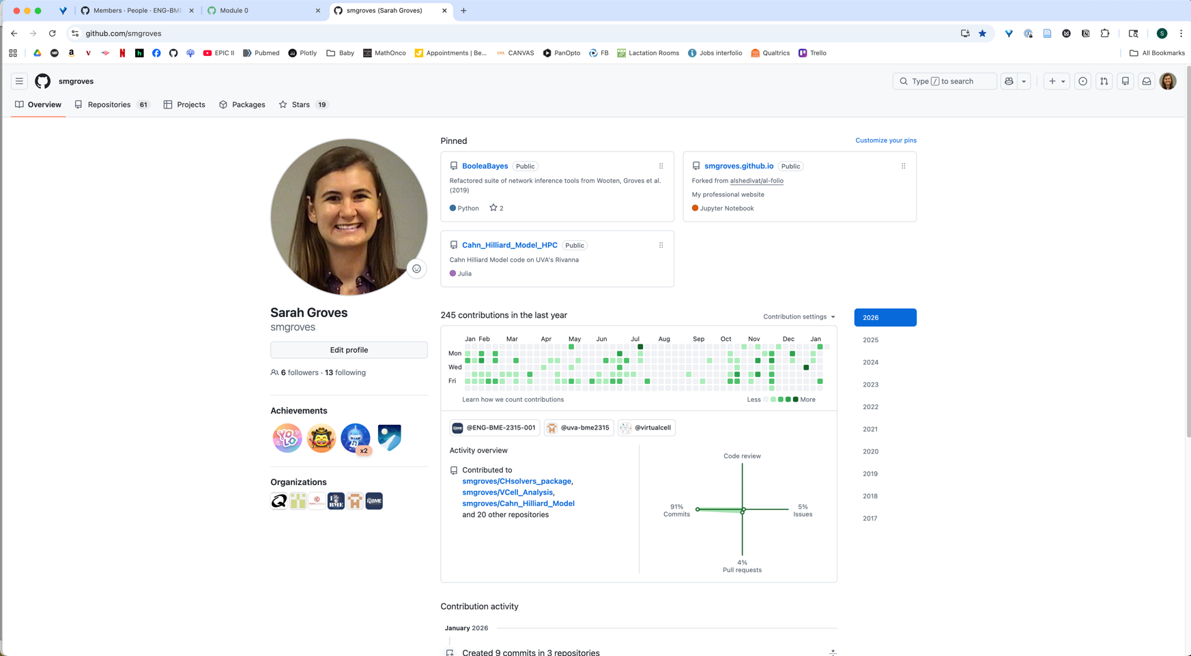
GitHub (remote, online)
Pinned repositories
Settings is in this menu
Full list of your repos
Full list of repos
Download the code or clone repo
Current branch
Most recent commit
Looks like the folder structure on your local computer
Organizations you have joined

Slide 23
LET’S PRACTICE!
Getting set up with GitHub
Complete Steps 3-7 in the checklist.
You will be forking my repo so that you have your own local copy AND your own remote copy. Then when you push/pull, you contribute to YOUR copy. But you can still pull from mine.
You should show completion of these steps before class on Thursday. That means you can complete the steps today and hand in the checklist at the end of class, meet with me before Thursday, or (if everything was successful) turn it in Thursday at the beginning of class.
On Friday/beyond: git init your own repo, add collaborators, and push and pull to your own repos
You will pull content from the repo you are forking today
I suggest making a new repo for each lab, add the appropriate content, and share with peers
Stand your name card on its edge when you are done.
Help your neighbors!
If you need a TA/instructor, raise your hand!
Notes:
https://serverspace.us/support/help/git-pull-fetch-and-clone-whats-the-difference/

Slide 24
General protocol for EVERY coding session
PULL FROM REMOTE
OPEN FOLDER LOCALLY
CODE & SAVE
COMMIT CHANGES, PUSH TO REMOTE
When you’re happy with your code, open a PULL REQUEST

Slide 25
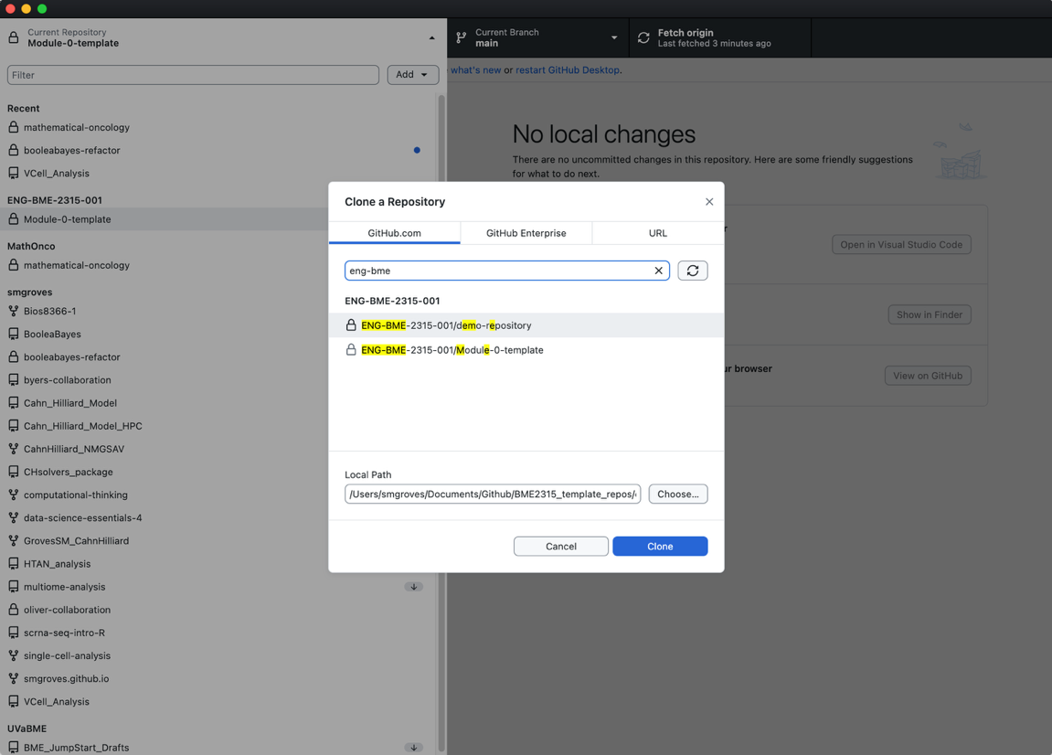
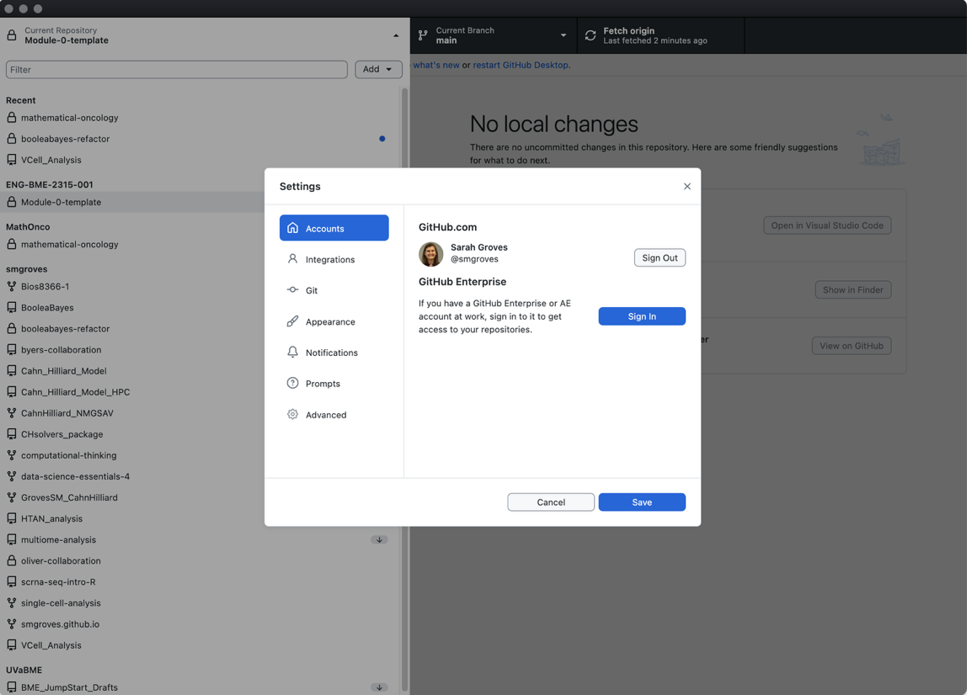
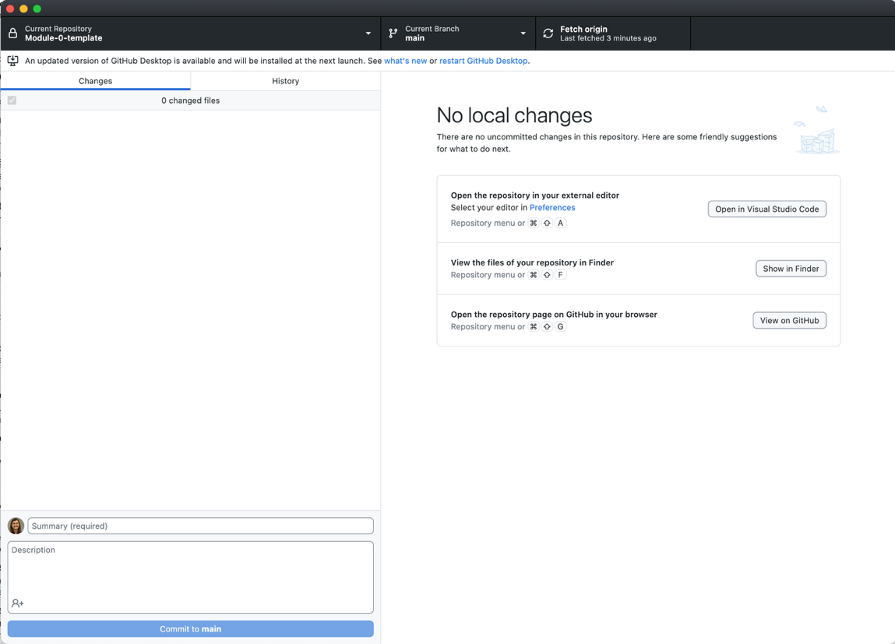

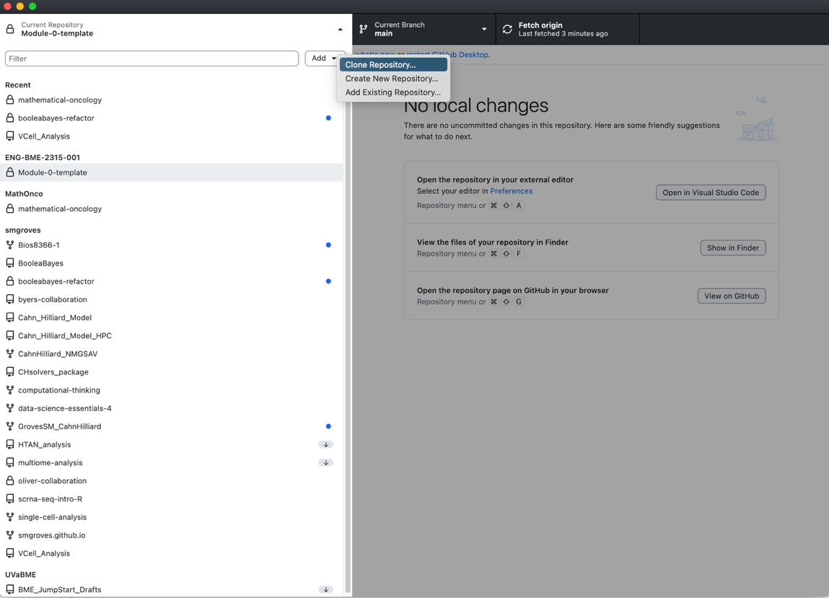
Getting set up with GitHub Desktop & git on command line
Make sure your local path is putting this new repo INSIDE the folder from earlier!
Alternative in terminal:
cd /Your/folder/for/this/class
git clone https://github.com/ENG-BME-2315-001/Module-0-LastName.git
git pull origin main

Slide 26
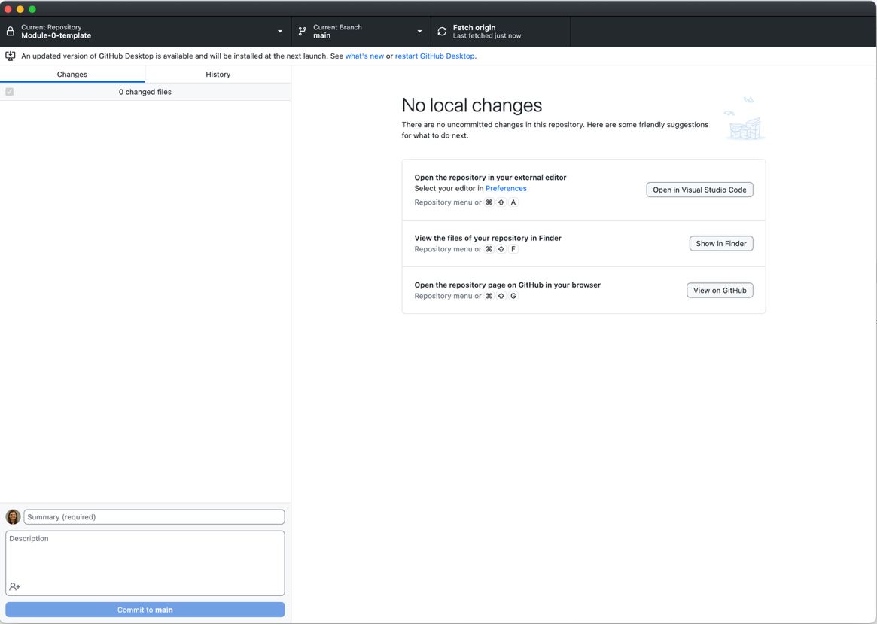
Getting set up with GitHub Desktop & git on command line
1
Fetch/pull will show up here
Local changes will show up here
History of the GitHub repo shows up here
Make sure your local path is putting this new repo INSIDE the folder from last class!
2
Open the repository locally in VS code to make changes and add files
Alternative in terminal:
cd /Your/folder/for/this/class
git clone https://github.com/ENG-BME-2315-001/Module-0-LastName.git
git pull origin main

Slide 27
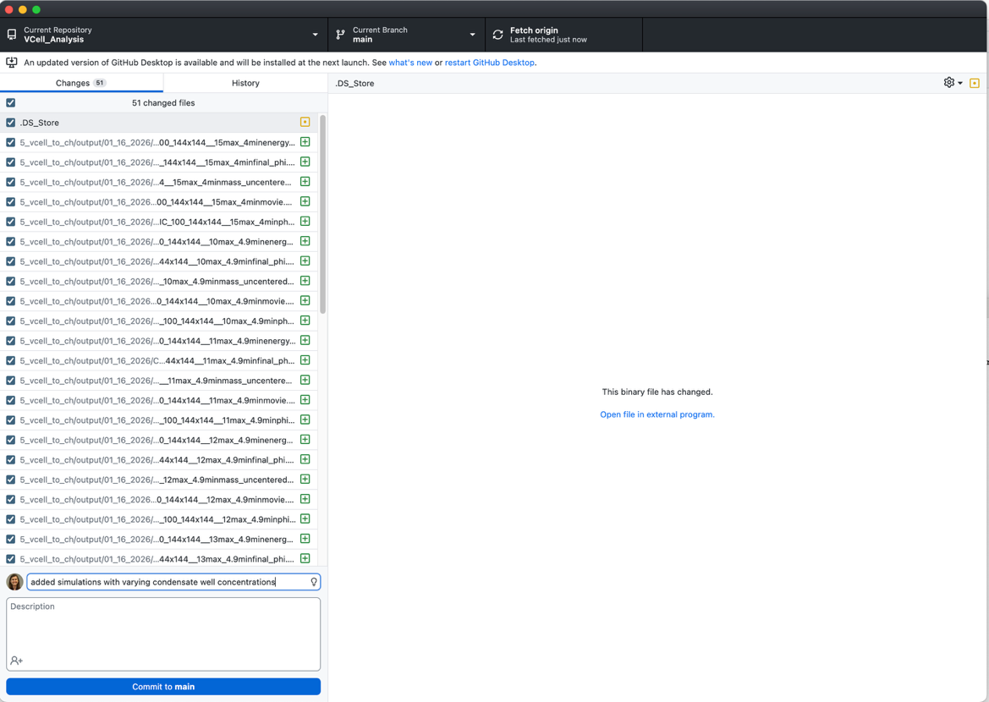
Getting set up with GitHub Desktop & git on command line
1
Fetch/pull will show up here
Local changes will show up here
History of the GitHub repo shows up here
Make sure your local path is putting this new repo INSIDE the folder from last class!
2
Open the repository locally in VS code to make changes and add files
Commit message (required)
3
Commit to current branch
Alternative in terminal:
cd /Your/folder/for/this/class
git clone https://github.com/ENG-BME-2315-001/Module-0-LastName.git
git pull origin main

Slide 28
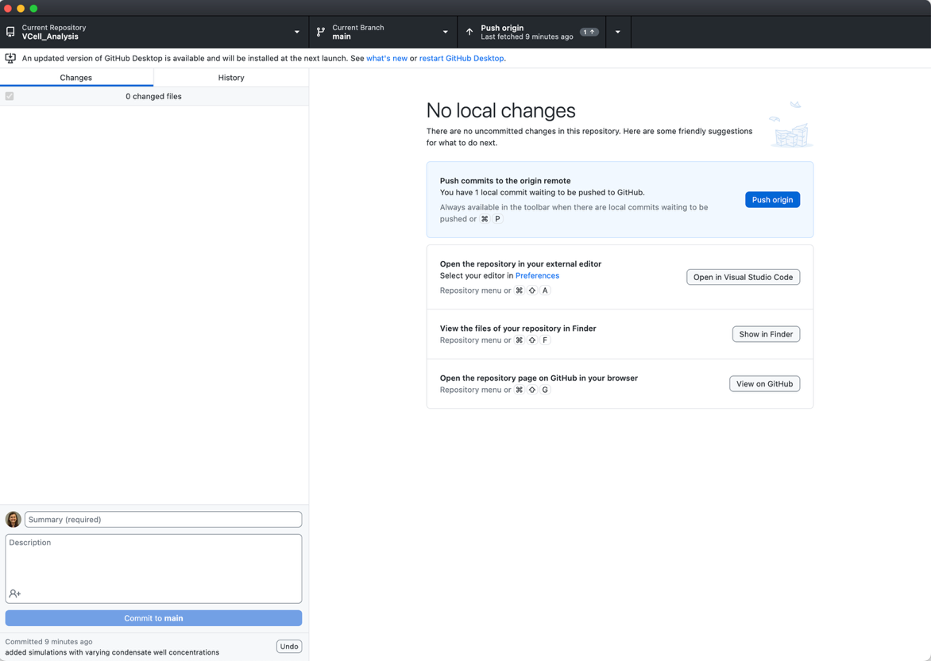
Getting set up with GitHub Desktop & git on command line
1
4
Fetch/pull will show up here
Local changes will show up here
History of the GitHub repo shows up here
Make sure your local path is putting this new repo INSIDE the folder from last class!
2
Open the repository locally in VS code to make changes and add files
Commit message (required)
3
Commit to current branch
Alternative in terminal:
cd /Your/folder/for/this/class
git clone https://github.com/ENG-BME-2315-001/Module-0-LastName.git
git pull origin main
Change your code in VS code & save
git add .
git commit –m “message for commit”
git push origin main

Slide 29
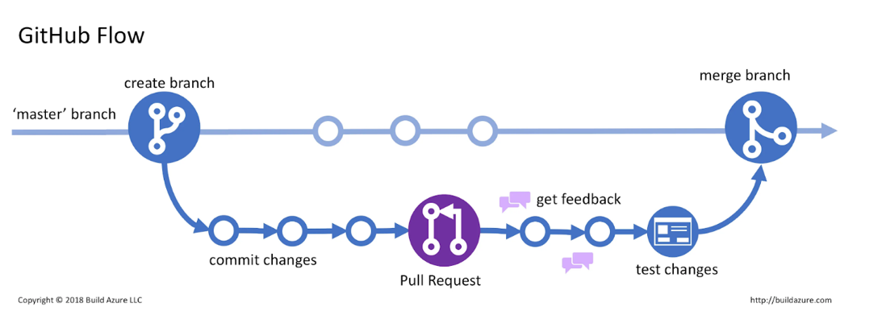
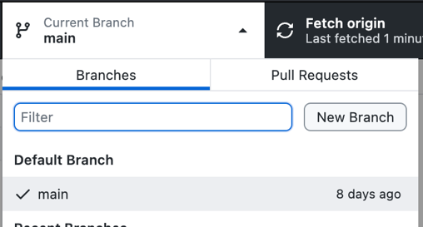
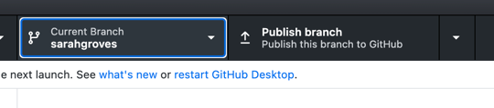
Pull Requests (PRs) and Merging: Recipe testing on a different branch
Whichever branch is “checked out” (showing in GitHub Desktop) is where your edited code will go
Once done pushing to this branch, you will make a “pull request” to merge with the main branch
  Only merge when code is “done”
  Don’t delete your personal branch!

Slide 30
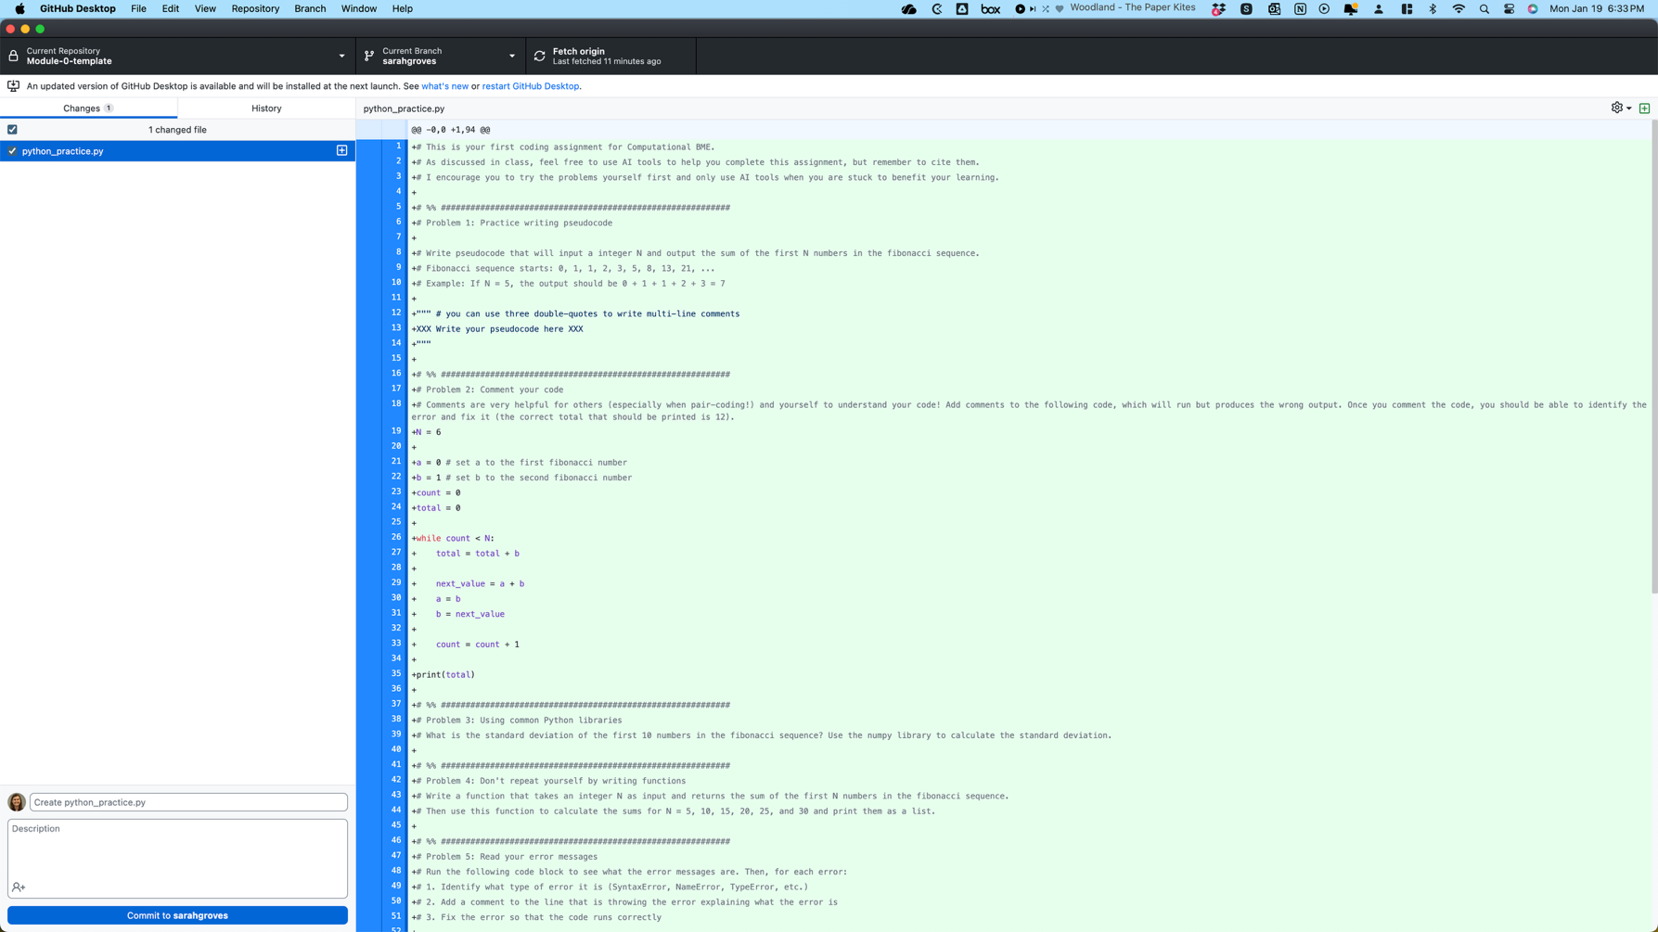
DO THIS (PULL REQUEST) WHEN CODE IS “DONE”

Slide 31
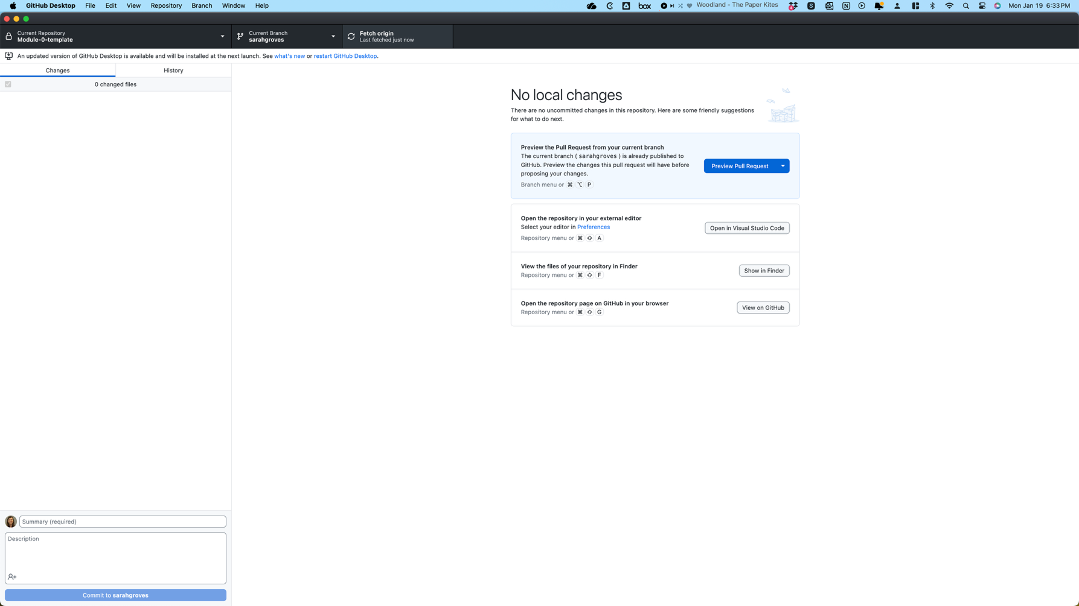
DO THIS (PULL REQUEST) WHEN CODE IS “DONE”

Slide 32
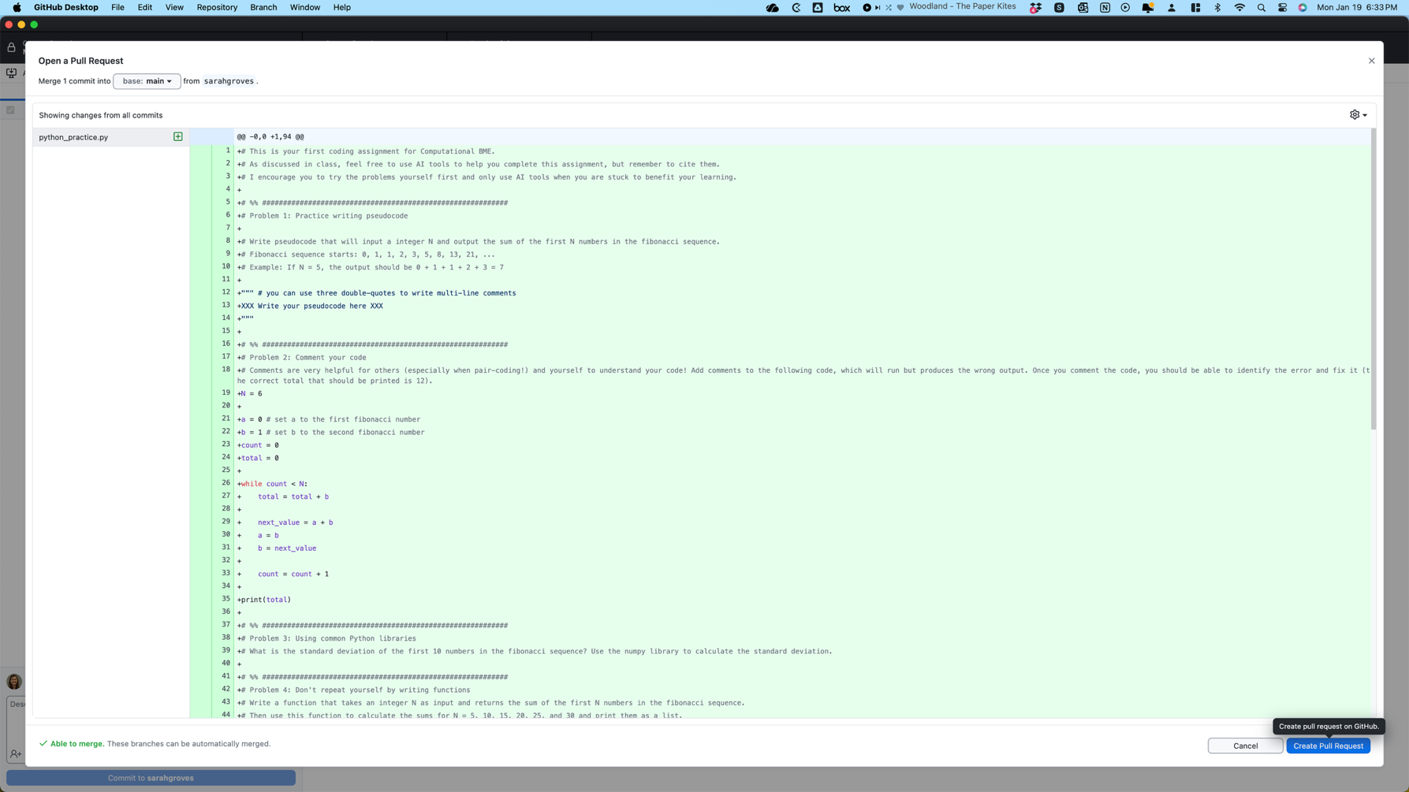
DO THIS (PULL REQUEST) WHEN CODE IS “DONE”

Slide 33
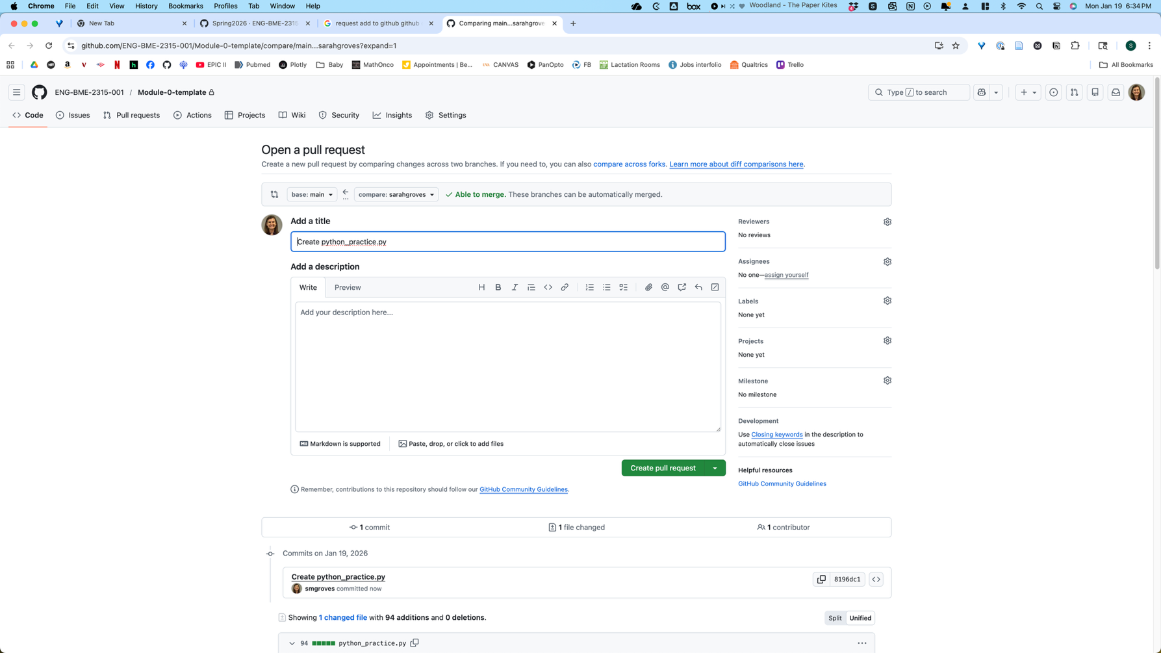
Explain what the pull request is adding
DO THIS (PULL REQUEST) WHEN CODE IS “DONE”

Slide 34
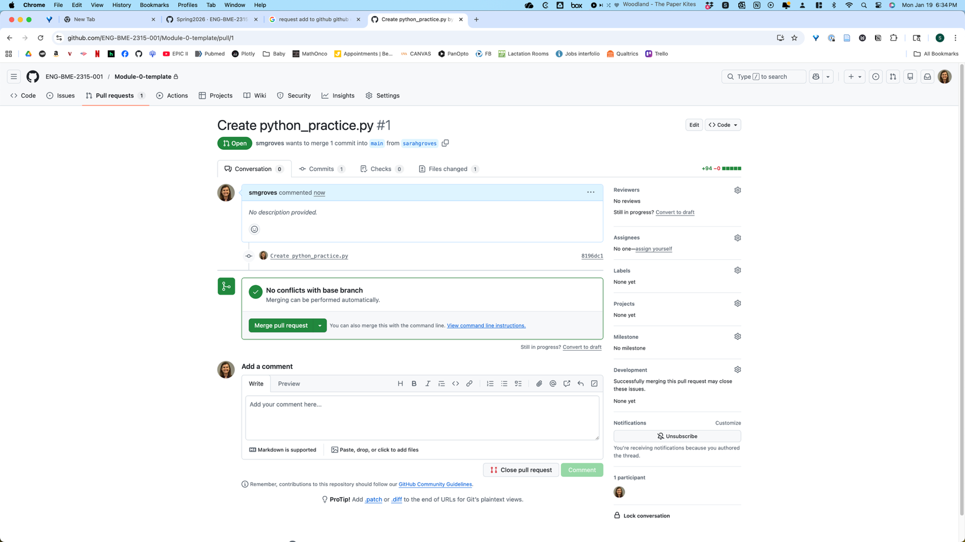
Once your partner approves, merge with main branch
Your partner can comment on your PR here if everything looks good!
DO THIS (PULL REQUEST) WHEN CODE IS “DONE”

Slide 35
When can GitHub be problematic?
Problem | Advice
When you work on the same code in the same file at the same time as another person | As a general rule, do not work on the same file at the same time Alternatively, always work on different files and push and pull back and forth to share code TALK TO YOUR PARTNER WHEN YOU/THEY ARE CODING
When you delete a file some one else is working on | Don’t delete files without talking to your partner first Don’t move files around without talking to your partner first
When you add a file with the same name that someone else has, and try to push them both to the remote branch | Include your first or last name in your own file names For shared files (like your final notebook), do not try to make duplicates Add clear indications to the file name for when code should be used or if it is test code or unused
When you forget to ignore certain files that you really don’t care about | Add things to .gitignore to automatically “lose track” of them
When you are trying to commit a file > GitHub’s file size limit (100Mb) | These files must remain locally on each partner’s computer to be used. You can share them through box. Add these files to .gitignore so you never accidentally push them.
When you test code that doesn’t work, but now you can’t get back to what was working | Work on the outside of the github repo then copy/paste working code into the repo Make a brand-new file (e.g. test_lastname.py) and only change code in that file, then copy/paste when it’s working into the repo Make a branch in your repository for test code Worst case scenario: git reset (advanced, ask for help if you haven’t done this before)

