Slide 1
Steps for using GitHub in BME2315
January 27, 2026
Dr. Groves

Slide 2
When setting up a new repository through GitHub classroom
Ensure you are a member of the organization ENG-BME-2315-001.
Follow the GitHub classroom link sent by the instructor to accept a new assignment.
If the assignment is a pair assignment, either:
Make a team called “LastName1_LastName2” for you and your partner OR
Join your partner’s team if they have already made one.
This should make a GitHub repo in the ENG-BME-2315-001 organization that you can access.
Go to GitHub Desktop and clone the repository to your local folder for this class. Remember to put the repository folder INSIDE your class folder on your computer.
In GitHub Desktop, make a new branch for your own code (with your name) and publish branch or push origin. You will be pushing and pulling to this branch until you are happy with your code, at which point you will do a pull request.
After this set up, follow the steps on the next slide.

Slide 3
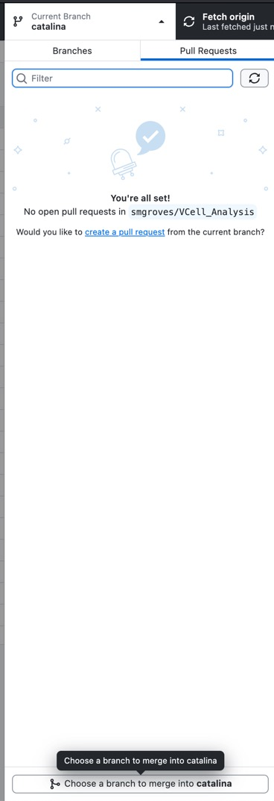
Every time you code
Go to GitHub Desktop
Make sure your current branch is your own
Pull origin to get any changes from the remote repository.
If you partner has pushed code to the main branch that you want to fetch into your branch, click on Current branch and then “Choose a branch to merge into YourName.” Then merge main into YourName. (See right). Alternatively, you can open and close branches for each coding session (so you would always make a branch from main before coding).
Open VS Code.
Open your folder (from the intro to python lecture) for this class. Look into the appropriate repository subfolder (where you’ve clone the repo).
Open your files that you want to edit or make a new file.
Make sure your environment is correct (you should see your conda environment “base” and the Python version in the bottom right or upper right corner)
Code & save the files!
Open GitHub desktop again.
You should see the changes you’ve made.
Write a commit message (summary), commit, and push origin.
You can now double check on Github.com that the remote version of your branch is the same as what’s on your local computer. If it is, the instructors and your partner can see your changes!

Slide 4
When you are ready to add code from your branch to the main branch
Open GitHub desktop. Make sure you are on your own branch.
Open a pull request.
Follow the screens (clicking blue or green buttons) to make the pull request (it will automatically open github.com in the internet browser)
Add comments to explain what the pull request is doing.
Wait for your partner to accept your pull request or add comments.
Merge your code into the main branch if your partner hasn’t yet.
Go back to GitHub desktop. Your main branch and personal branch should now be the same.
Remind your partner to pull main to get your code!

Slide 5


This is an example of a single repository with multiple branches.
Remember that this means there are multiple versions of the same project code.
“Remote”
“Origin”
On www.github.com
Shared
Online (can think of this as in the cloud)
your_branch
main
pull request & merge
publish branch &
push origin
pull origin
your_branch
Start a new branch for each coding session
OR
main
“Local”
On your own computer
Not shared
What will show up in VS code
Tracked automatically by git
Where you should be coding in VS code most of the time
“choose a branch to merge into your_branch”

