Slide 1
Module 2
Announcements
Sarah Groves
2/17/2026

Slide 2
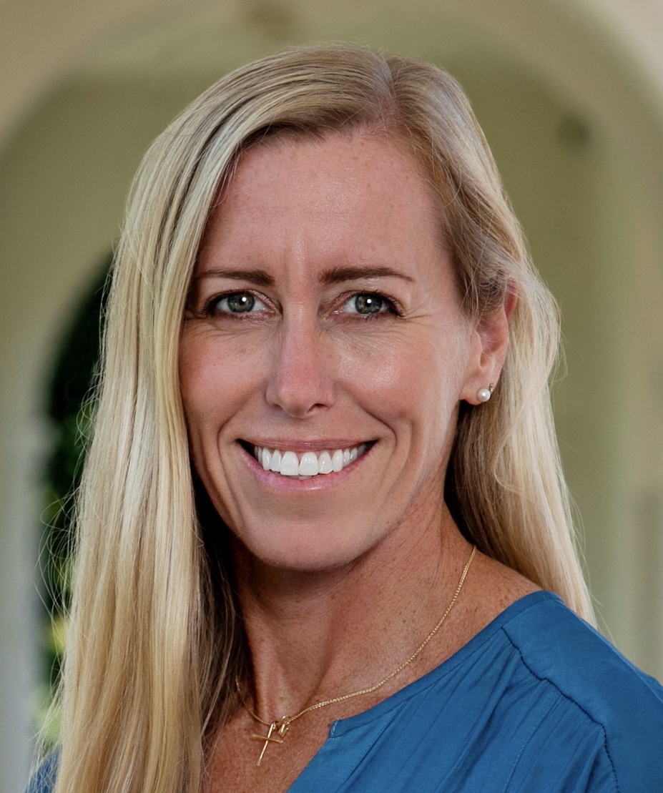
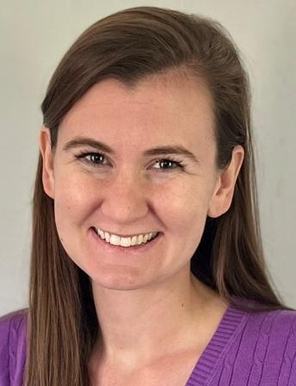
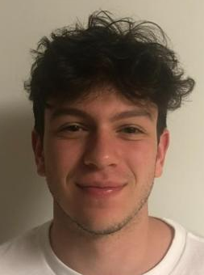
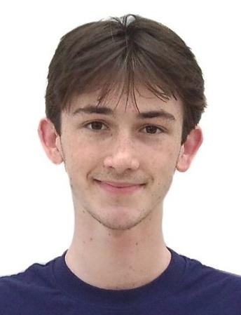
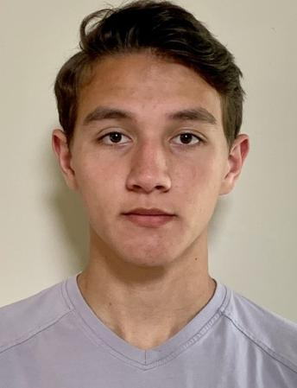
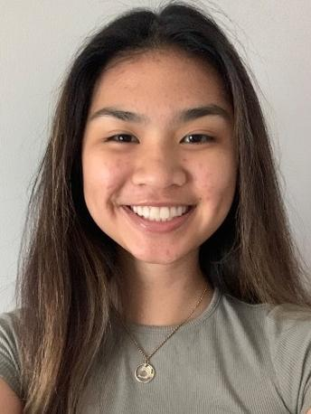
Module 2:
56 students
CEO
President
Directors
of Product
Development
Sam
Micaiah
Katrina
Hudson
Team 1
Team 1
Elmqvist
Langer
Kamen
Fung
Team 1
Team 1
1 | Kaitlyn Cole
 | Jake Carnell
2 | Priya Shan
 | Owen Sines
3 | Aryan Mhaskar
 | Lauren McElfresh
4 | Jack Marchesi
 | Yancy Martinez Alfaro
5 | Abhiram Ruthala
 | Tahseen Azad
6 | Conner Looney
 | Delaney Broderick
1 | Tomas Daniel
 | Theresa Breckley
2 | Kai-Tang Tseng
 | Makayla Adams
3 | Karinna Fink
 | Roy Chen
4 | Sara Elster
 | Dani Folks
5 | William Marschall
 | Reagan Oswald
6 | Mohamed Elfaki
 | Isabel Vikesland
1 | Christian Grosso
 | Vish Ramineni
2 | Kat Horn
 | Kiran Spencer
3 | Luke Friscola
 | Christina Johnson
4 | Isabella Imburgia
 | Amelia Luongo
5 | Grace Lee
 | Zain Abed
6 | Isabella Orlando
 | Hayden Rue
1 | Molly Janousek
 | Dane Wleklinski
2 | Makayla Adams
 | Kidus Belay
3 | Eunela Manzano
 | Ashley Hayden
4 | Oge Ikem
 | Megan Sullivan
5 | Asma Sannulah
 | Melis Ozdemir
Engineers
Oral Presenters for Module #2

Slide 3
Module 2: Skills you will learn/apply
Biology & Medicine
Math
Coding
Virus biology
Immune system: innate and adaptive immunity
Epidemics & parameters describing the spread
  R0
  Prevalence
  Incidence
  Transmission rate
  Incubation rate
  Recovery rate
Optimization/parameter fitting
Solving ODEs with numerical methods (Euler’s method)
Predicting into the future
Error calculations
Using pandas with a csv dataset
Scatterplots and line plots from model data
Writing functions for solving systems of ODEs

Slide 4
GitHub plan for the rest of the semester
We are sorry you were the guinea pigs for GitHub Classroom and it didn’t work well!
We still want to encourage GitHub use
Modules 2-4 will utilize GitHub repos the way you normally would in the future
  You make or fork a repository and share it with collaborators
  You contribute to this by pushing and pulling (you all are becoming pros at this!)
  You can use your own branch if you want, but not required in this class
  You will submit the repo as your final project, which will include python files, your ipynb file, and a pdf version of the notebook
  You can include a README: for this class, use this as a space to ask TAs/instructors questions, get help or advice, etc. or keep notes for your partner

Slide 5
Homework for Thursday
Fork my Module 2 code into a PUBLIC github repo with your partner by following the instructions on Canvas (video tutorial and step-by-step instructions)
  This will give you all the files you will need, a project structure, and an ability to easily get more files from me as I upload them!
The link should be submitted as the Module 2 Repository assignment in Canvas by Thursday 12:30pm
Finish your code from class today and add the files to your repository

