Slide 1

Module 2
Lecture 1
Modeling the Spread of Viruses
Sarah Groves, Ph.D.
Shayn Peirce-Cottler, Ph.D.

Slide 2
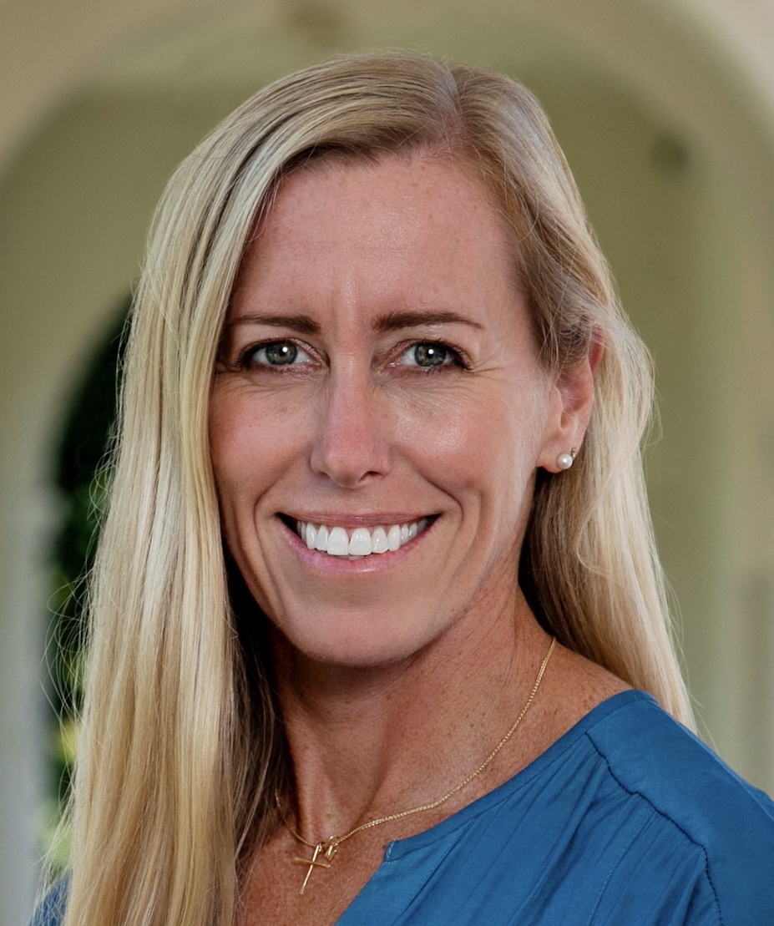
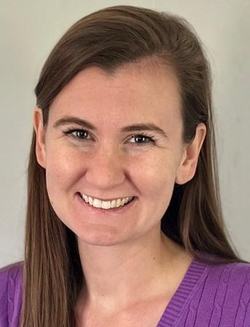
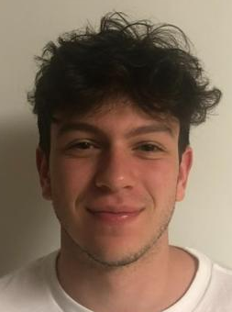

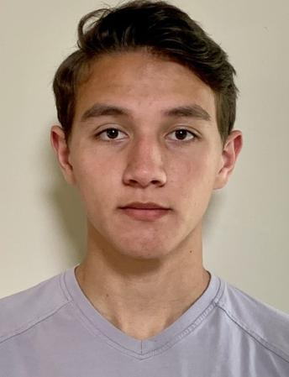
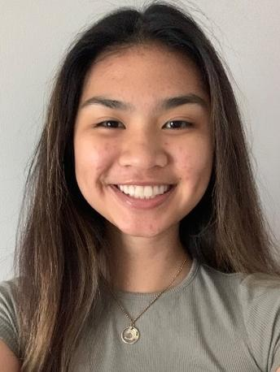
Module 2:
56 students
CEO
President
Directors
of Product
Development
Sam
Micaiah
Katrina
Hudson
Team 1
Team 1
Elmqvist
Langer
Kamen
Fung
Team 1
Team 1
1 | Kaitlyn Cole
 | Jake Carnell
2 | Priya Shan
 | Owen Sines
3 | Aryan Mhaskar
 | Lauren McElfresh
4 | Jack Marchesi
 | Yancy Martinez Alfaro
5 | Abhiram Ruthala
 | Tahseen Azad
6 | Conner Looney
 | Delaney Broderick
1 | Tomas Daniel
 | Theresa Breckley
2 | Kai-Tang Tseng
 | Lauren Kim
3 | Karinna Fink
 | Roy Chen
4 | Sara Elster
 | Dani Folks
5 | William Marschall
 | Reagan Oswald
6 | Mohamed Elfaki
 | Isabel Vikesland
1 | Christian Grosso
 | Vish Ramineni
2 | Kat Horn
 | Kiran Spencer
3 | Luke Friscola
 | Christina Johnson
4 | Isabella Imburgia
 | Amelia Luongo
5 | Grace Lee
 | Zain Abed
6 | Isabella Orlando
 | Hayden Rue
1 | Molly Janousek
 | Dane Wleklinski
2 | Makayla Adams
 | Kidus Belay
3 | Eunela Manzano
 | Ashley Hayden
4 | Oge Ikem
 | Megan Sullivan
5 | Asma Sannulah
 | Melis Ozdemir
Engineers
Oral Presenters for Module #2

Slide 3
Structure for this module’s assignments
You will have 2 GitHub check-ins + your final project.
  First check-in: due Friday, 2/27 at Midnight
  Second check-in: due Monday, 3/9 at Midnight
  Final project: due Tuesday, 3/17 at Midnight.
  I suggest you complete the homework from each lecture by the following class time to keep up with the Module (in red on last slide of lecture)
  This may require you to work outside of class with your partner
You will have a few smaller assignments on GitHub. These should not take longer than 30 min and I will try to give a week/weekend notice!
  First smaller assignment: making the repo + optimization code ✅
  Next smaller assignment: watch ODE lectures and comprehension quiz due 2/24 at class time

Slide 4
Module 2: Skills you will learn/apply
Biology & Medicine
Math
Coding
Virus biology
Immune system: innate and adaptive immunity
Epidemics & parameters describing the spread
  R0
  Prevalence
  Incidence
  Transmission rate
  Incubation rate
  Recovery rate
Optimization/parameter fitting
Solving ODEs with numerical methods (Euler’s method)
Predicting into the future
Error calculations
Using pandas with a csv dataset
Scatterplots and line plots from model data
Writing functions for solving systems of ODEs

Slide 5
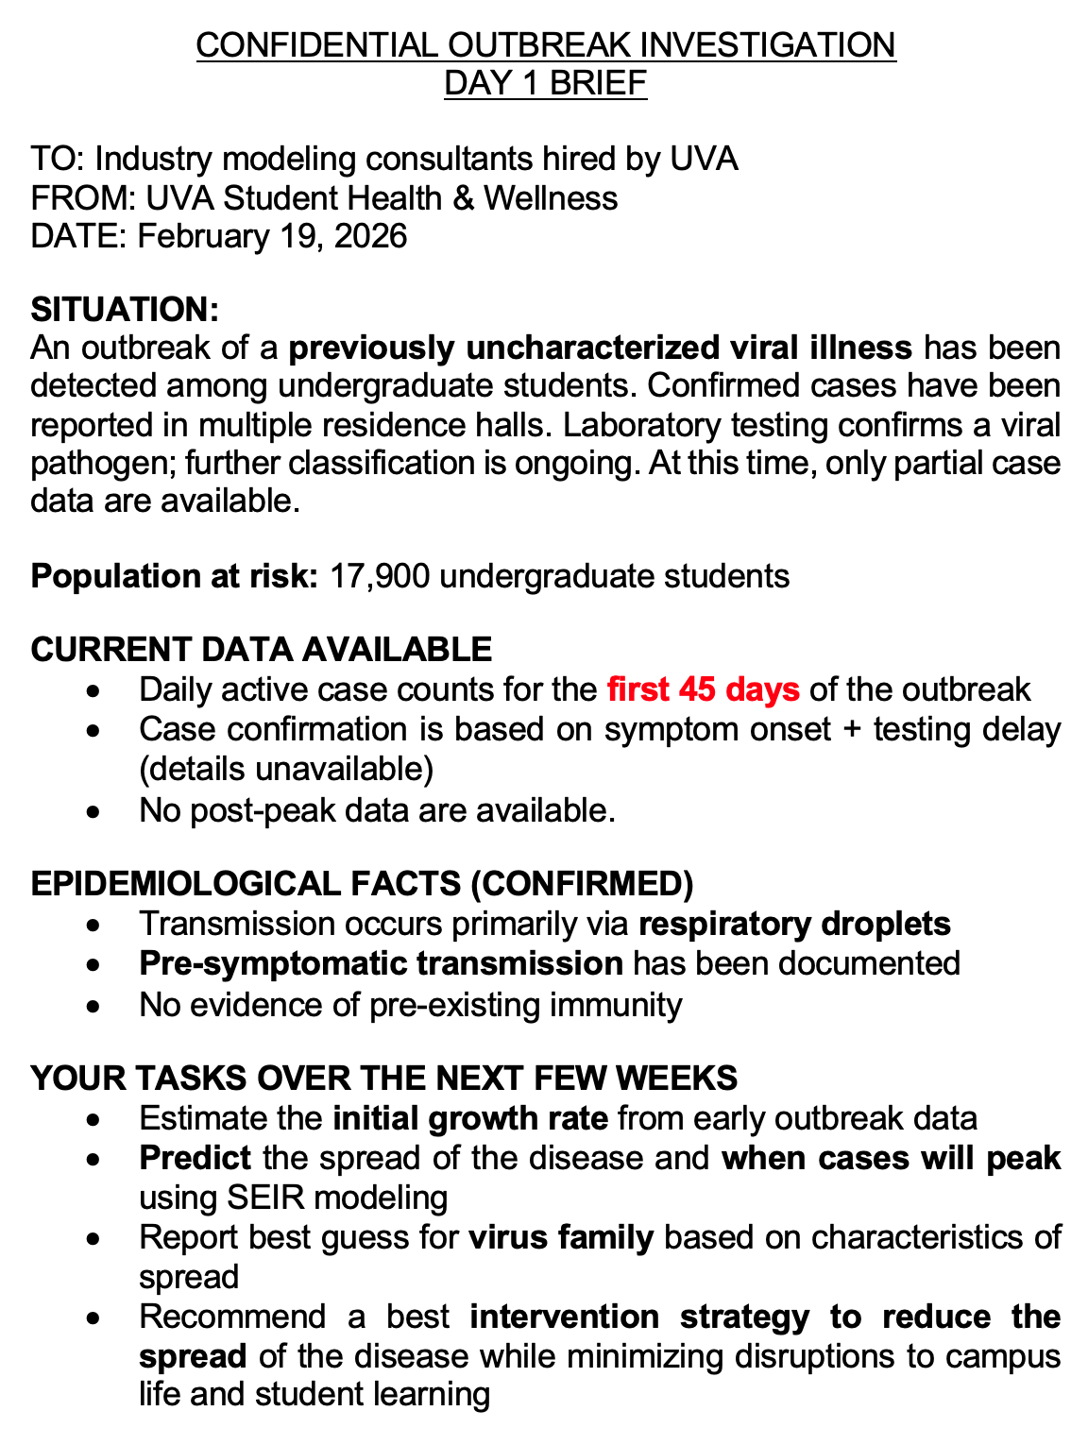
URGENT NOTICE: NOVEL VIRUS OUTBREAK
What we need to know to meet our goals?
How do viruses spread within a person and between people?
  Within a person: immune system activation
  Between people: epidemiological modeling of disease spread
How do we interpret data about outbreaks?
  Prevalence rate
  Incidence rate
How do properties of viruses affect the timing of symptoms?
  Latent period: without symptoms, exposed but not contagious
  Infected period: with symptoms & contagious
  Recovered period: can recovered people become susceptible again?

Slide 6
What’s coming up (see ipynb template for structure)
Day 1 2/19: Intro to mystery virus + virus biology
Day 2 2/24: Intro to epidemic modeling parameters (SEIR); estimate initial growth rate/R0
Day 3 2/26: Intro to Euler’s method; predict spread of disease and when peak will occur
Day 4 3/10: Modeling interventions; recommend best intervention strategy!
Day 5 3/12: Verification/validation, best guess for virus identification, and tying up loose ends
Biology hat
Math hat
Coding hat
Project presentations: 3/17

Slide 7
URGENT NOTICE: NOVEL VIRUS OUTBREAK
What we need to know to meet our goals?
How do viruses spread within a person and between people?
  Within a person: immune system activation
  Between people: epidemiological modeling of disease spread
How do we interpret data about outbreaks?
  Prevalence rate
  Incidence rate
How do properties of viruses affect the timing of symptoms?
  Latent period: without symptoms, exposed but not contagious
  Infected period: with symptoms & contagious
  Recovered period: can recovered people become susceptible again?

Slide 8
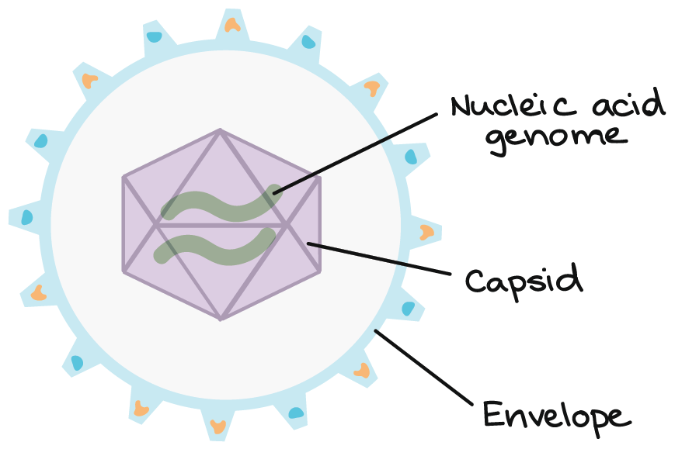
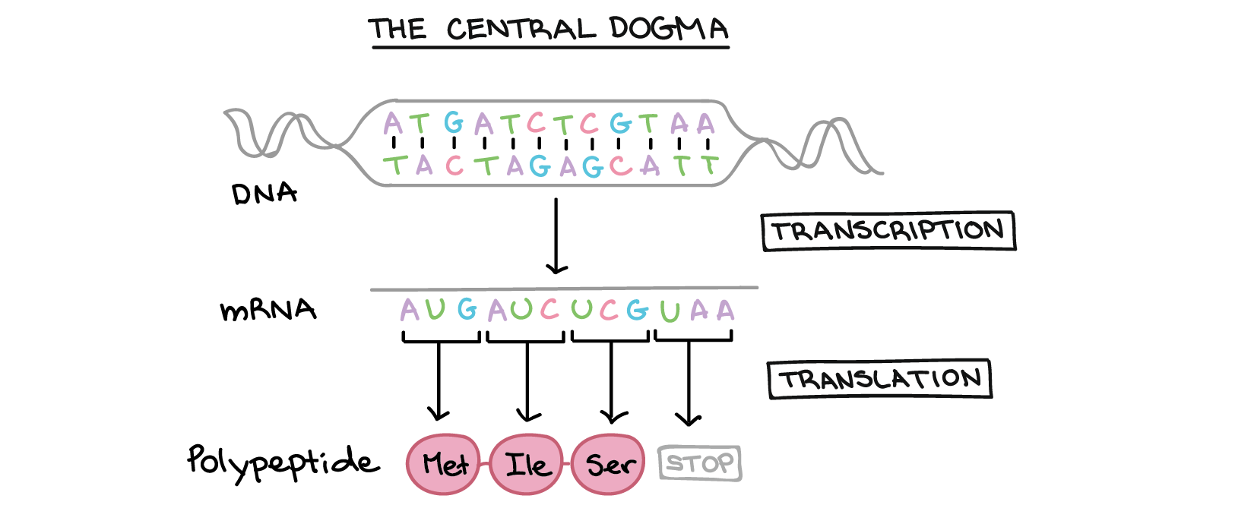
What is a virus?
Viruses are NOT cells, so they cannot reproduce on their own.
The goal of a virus: get your cells’ machinery to replicate its genome.
DNA or RNA
Protein shell
Lipid membrane
(Using ribosomes)
Images from Khan academy
Notes:
Analogy: "A virus is like a USB drive with malicious code. It needs to plug into a computer (your cell) to do anything. Once inside, it forces the computer to make copies of itself."

Slide 9
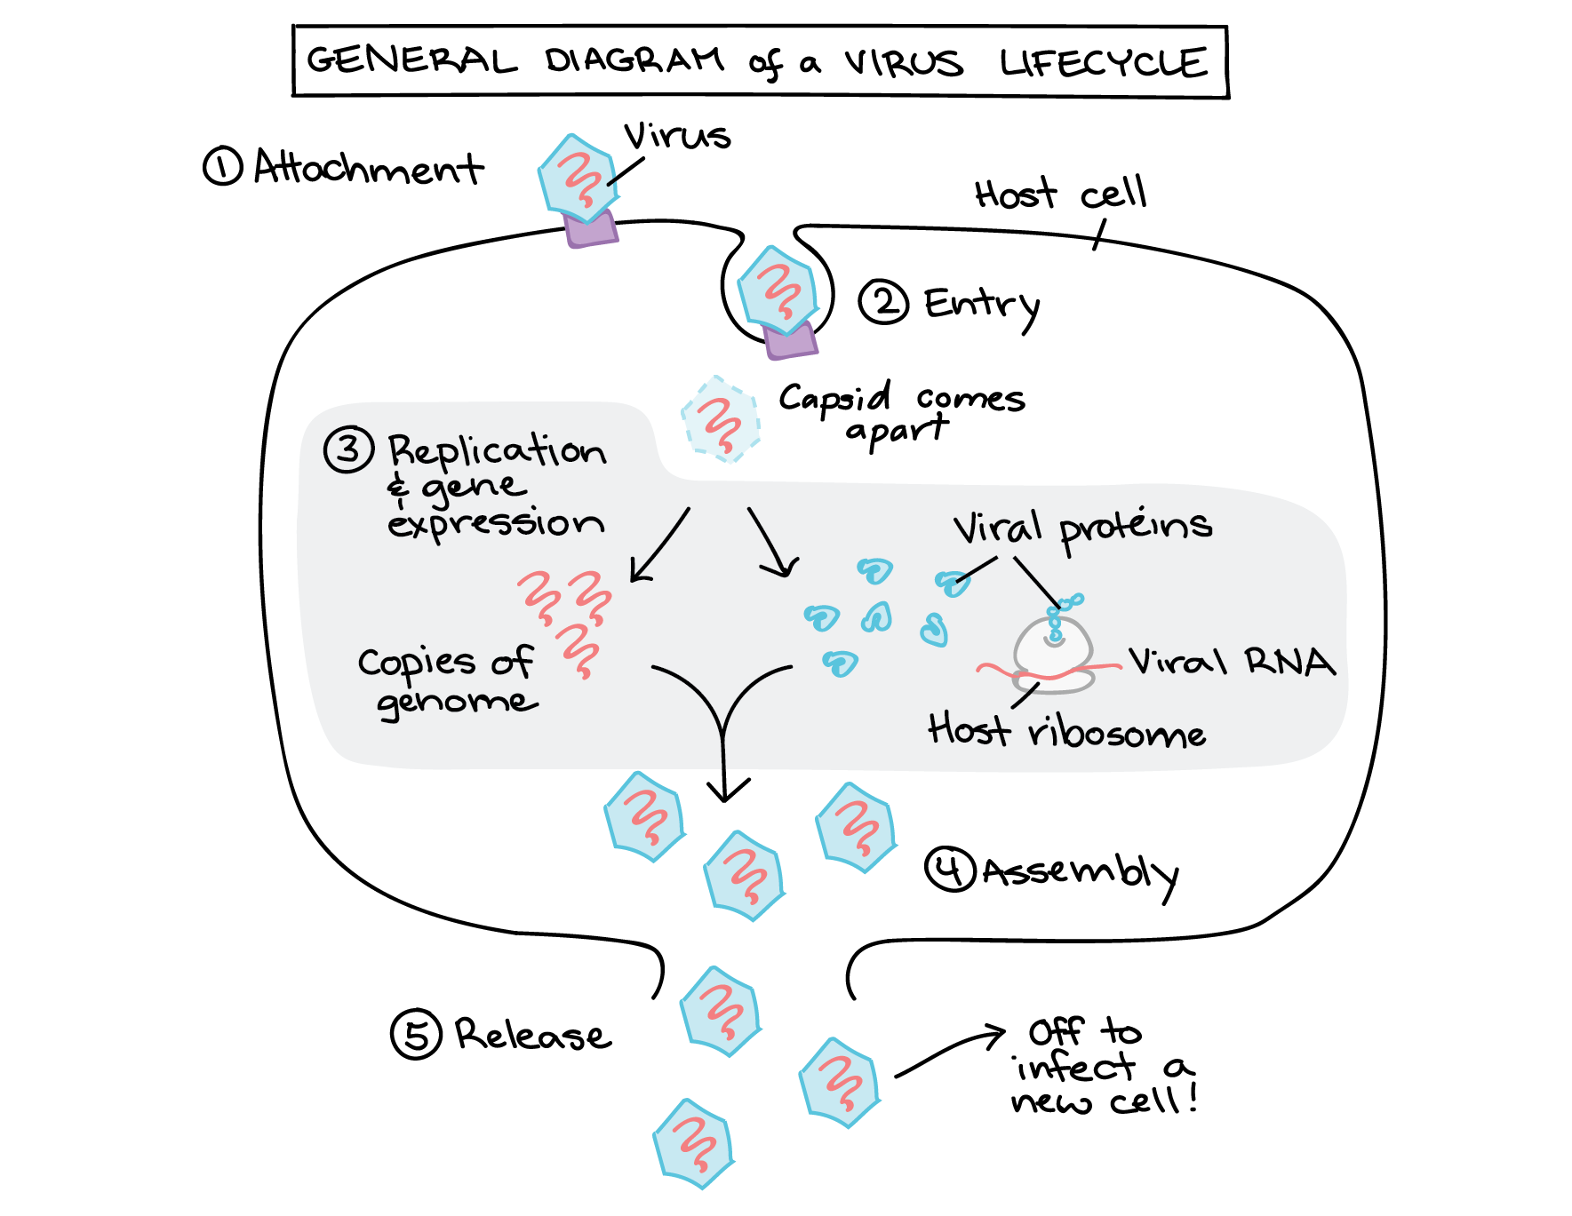
The infection process
Step 2: Virus hijacks your cells
Step 1: Entry into the body
Infected person coughs, etc.
Respiratory droplets contain millions of virus particles → you inhale
Virus reaches cells lining respiratory tract
The speed of this replication cycle determines how quickly infection spreads WITHIN your body.
Fast replication = symptoms appear sooner = you become infectious sooner.
Sometimes compartmentalized in “virus factories”
Step 3: Infect new cells!
Notes:
Central dogma of biology
Attachment. The virus recognizes and binds to a host cell via a receptor molecule on the cell surface.
Entry. The virus or its genetic material enters the cell.
Genome replication and gene expression. The viral genome is copied and its genes are expressed to make viral proteins.
Assembly. New viral particles are assembled from the genome copies and viral proteins.
Release. Completed viral particles exit the cell and can infect other cells.

Slide 10
Timeline of infections: Exposure to recovery
Day 0: Exposure
1-3+ Weeks: Incubation Period
~1-2 weeks: Infectious Period
Recovery Period
Definition: Time from virus entering your body to when symptoms appear
Biologically:
  Virus replicating in initial infection site
  Beginning to spread to new cells and tissues
  Viral load increasing
  Usually no symptoms yet
  Usually not infectious yet
Length of incubation period depends on:
  Replication speed
  Viral travel within body
  Initial dose of virus
  Immune system activation
Examples
  Flu: 1-4 days (fast replicator, stays local)
  COVID19: ~5 days (slow initially, spreads further)
  Measles: 10-14 days (travel to lymph nodes → blood → back to respiratory tract
Definition: Time when you can transmit the virus to others
Biologically:
  Viral load peaks in respiratory tract
  Producing millions-billions of particles
  Symptomatic, usually
  Immune system is fighting back
Biological factors affecting infectiousness:
  Viral shedding
  Location of infection
  Symptoms that spread virus
    Coughing = aerosolize virus
    Runny nose = contaminate surfaces
Examples
  Measles: 100K viruses per cough (very high!)
  COVID19: can be infectious 2 days before symptoms
Definition: No longer infectious + gained immunity
Biologically:
  Immune system has cleared most/all virus
  Symptoms resolving
  Memory cells forming
  Viral load drops below transmission threshold
We will use this timeline information to fit our model parameters later!

Slide 11
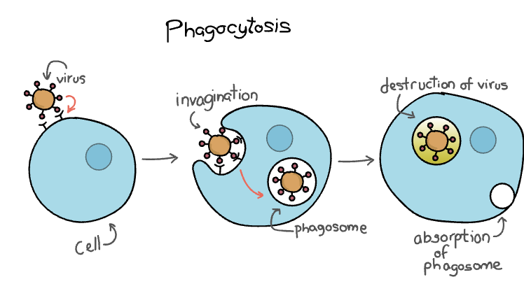
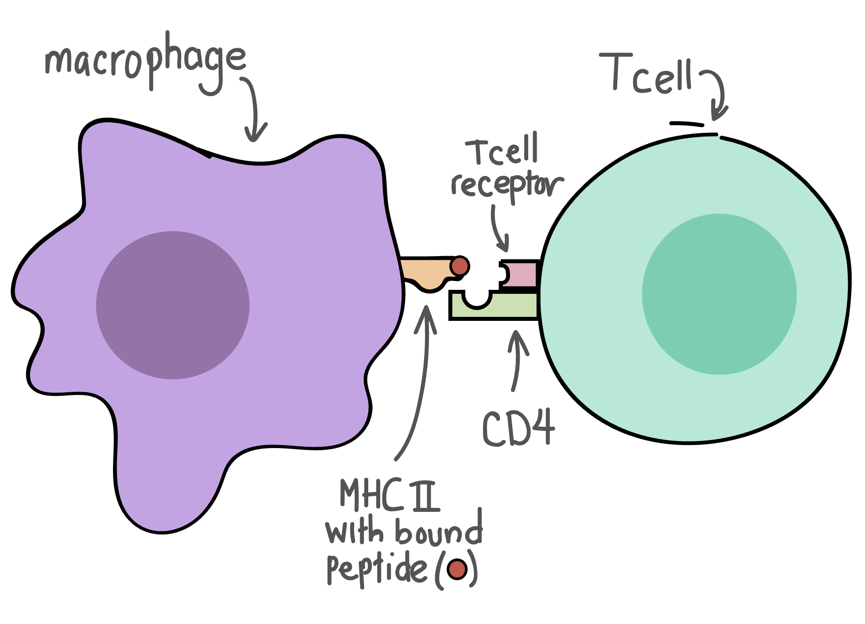
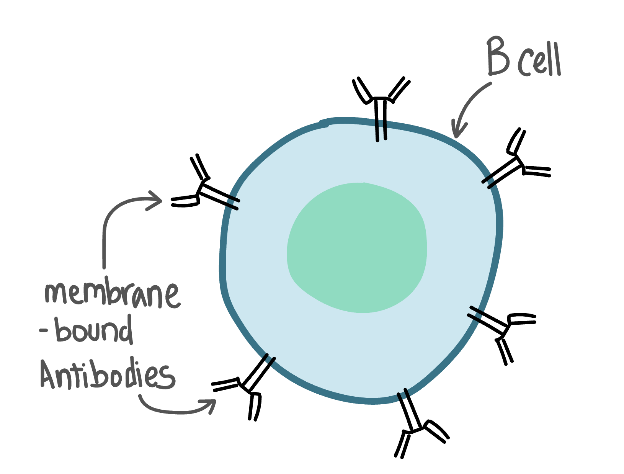
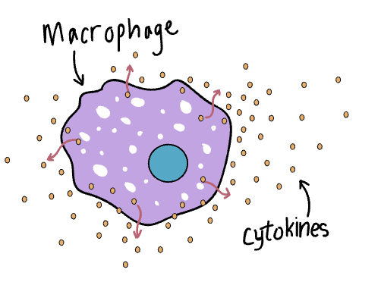
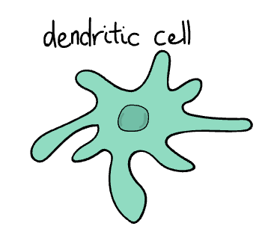
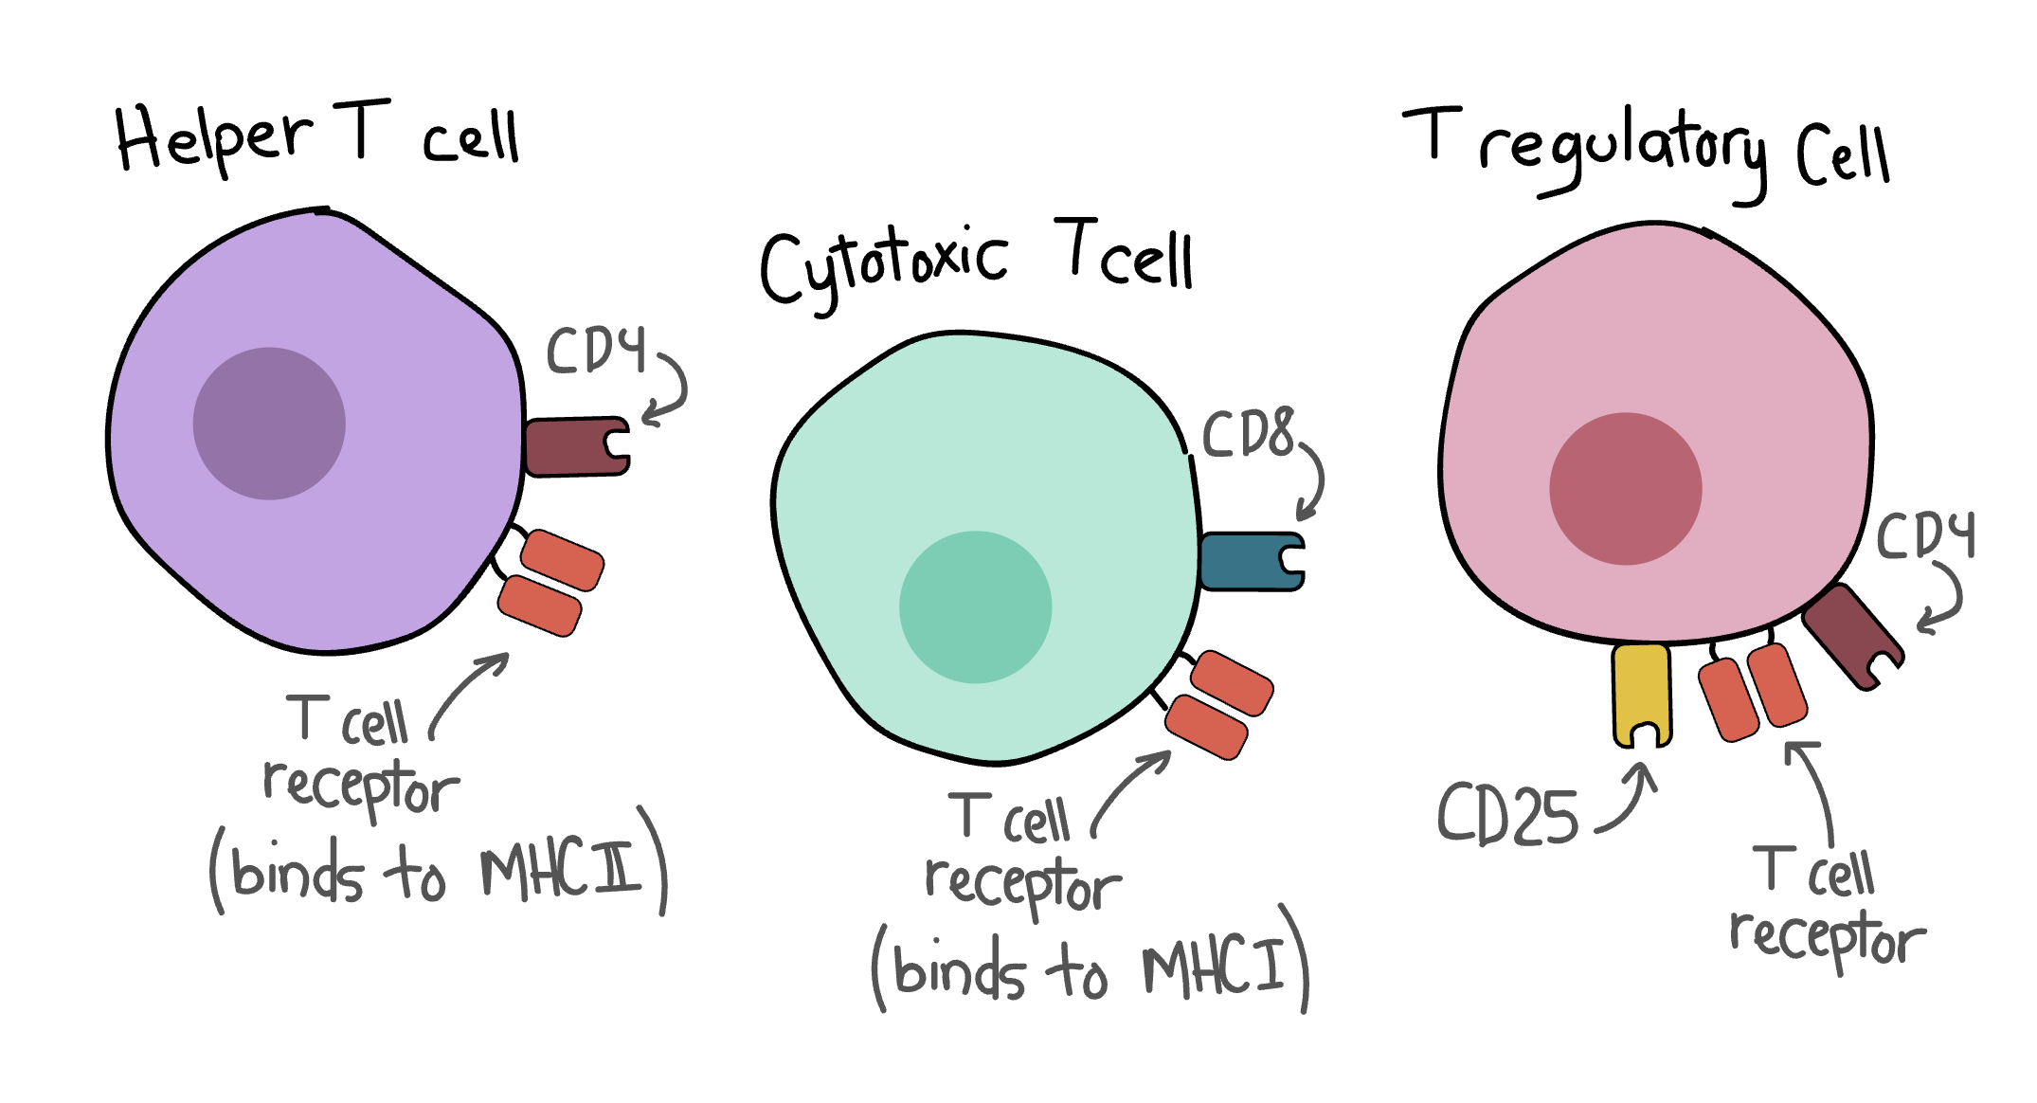
How does the immune system respond?
Immunity happens at the cellular level (within your body)
  Viruses have antigens that you body recognizes as “not self”
When enough individuals are immune, it affects population-level transmission (next class)
Innate immunity
Adaptive immunity
Remember the pathogen
T cells recognize receptors on macrophages & become active
Phagocytose
Recruit through cytokines
Coordinate attack
Antigen-presenting cells
Activate B cells and killer T cells
Put the breaks on immune system
+ many more that kill threat and virus-infected cells!
Kill infected cells & pathogens
Notes:
Macrophages can eat threats outside of blood vessels and recruit others with cytokine signals
NK cells destroy infected host cells to stop infection spread
Dendritic cell: antigen-presenting cell: messengers for immune system; bridge between innate and adaptive

Slide 12
The Immune System Game
We are going to act as immune system cells, healthy cells, and infected cells to play out the immune response.

Slide 13
Game play
The game is played over two rounds: innate and adaptive immunity. In round 1, only healthy cells, infected cells, and macrophages play.
The game mechanism is rock paper scissors (RPS).
  “Rock paper scissors shoot” [reveal on shoot]
Walk up to another player, “challenge” them, play RPS, and then reveal identities to decide each player’s fate!
When you reveal your identities & determine your cell fates, you can be as secretive or not secretive as you want. You never know who is paying attention!

Slide 14
Rules for everybody
You cannot lie.
You should not reveal your identity, unless an activated B cell (in Round 2) requires you to do so.
  After you play RPS, you quietly reveal your identities to each other to determine what each person’s fate is.
If you are challenged to RPS, you must play.
You cannot challenge the same player to RPS two times in a row. (i.e. after playing, go find a different person to play against!)

Slide 15
Innate Immunity Round:
Virus-Infected cells VS Healthy Cells + Macrophages
The goal of the infected cells is to infect all healthy cells by winning RPS against them.
The goal of the healthy cells is to avoid being infected by winning RPS against infected cells.
The goal of the macrophages cells is to eliminate infected cells by winning RPS against them.
However… you don’t know who is who!
The game is over when:
  All healthy cells have been infected
  All infected cells have been eliminated
  After the round time is over, whoever has more players (healthy vs immune) wins.
The adaptive immunity cells don’t play round 1; they hang out in the “lymph nodes.” But they can strategize and decide who wants to be each cell type.

Slide 16
Round 1 end
Was it easy to complete your goal?
What was your strategy for this round?
How did this mirror what cells in the body look like under threat from a viral infection?
Adaptive immunity: did you watch what was happening to come up with any strategies for round 2?
Notes:
When healthy cells "occupy each other's time" by playing RPS, they're essentially:
Tight Junctions - Physically staying together, making it harder for viruses to access them
Herd Immunity at the Cellular Level - Reducing available susceptible targets
Tissue Structure - Cells packed together tightly are harder to infect than isolated cells
This Is Actually Smart Biology!
In real tissues:
Cells with tight junctions (like epithelial cells lining your gut or lungs) are harder for pathogens to penetrate
Clustered cells in dense tissue are less accessible than scattered cells
Cells can send paracrine signals to neighbors, creating local zones of resistance
This is such a cool question! Here are some emergent strategies students might discover that actually mirror real biology:
1. "Infected Cells Hiding in Plain Sight"
Student Strategy:
Infected cells realize if they AVOID challenging anyone and just walk around quietly, they're harder to detect
They only attack when they find an isolated healthy cell
Real Biology:
Latent viral infections! Some viruses (herpes, chickenpox/shingles, HIV) hide inside cells with minimal activity, avoiding immune detection
They only reactivate and spread when conditions are favorable
This is why shingles can emerge decades after chickenpox
Teaching moment: "You discovered viral latency! Some viruses hide dormant in cells for years."
2. "Macrophage Exhaustion"
Student Strategy:
Infected cells gang up and repeatedly challenge the same macrophage
Even if they lose, they keep the macrophage constantly busy (in cooldown)
Other infected cells spread freely while macrophages are tied up
Real Biology:
Immune exhaustion - when immune cells are overwhelmed by persistent infection
Macrophages get "exhausted" and less effective with continuous stimulation
Happens in chronic infections (TB, HIV) and cancer
Teaching moment: "You overwhelmed the innate immune system! This is why chronic infections are so hard to clear."
3. "Killer T Cell Hunting Patterns"
Student Strategy:
Killer T Cells learn to patrol in systematic patterns rather than randomly
They focus on areas where labeled infected cells cluster
They become more efficient hunters
Real Biology:
Immunological memory and cell trafficking - T cells learn to patrol specific tissues where they've encountered antigens before
Tissue-resident memory T cells stay in previously infected areas
Chemotaxis - immune cells follow chemical signals to infection sites
Teaching moment: "You're doing what memory T cells do - they remember WHERE infections happen and patrol those areas!"
4. "Infected Cell Kamikaze Strategy"
Student Strategy:
Infected cells realize they'll probably get eliminated in Round 2
So they sprint around challenging as many healthy cells as possible before being caught
"If I'm going down, I'm taking others with me!"
Real Biology:
High viral replication before immune clearance - viruses maximize reproduction before the host cell dies
Cytopathic effect - some viruses cause cells to burst, spreading maximum virions
This is why early infection (before adaptive immunity kicks in) is when viral load peaks
Teaching moment: "This is exactly what viruses do! They replicate like crazy in the first few days before your adaptive immune system stops them."
5. "Helper T Cell Resource Management"
Student Strategy:
Helper T Cells realize they shouldn't activate ALL the B Cells and Killer T Cells at once
They space out activations strategically
Maybe save some for later if infection resurges
Real Biology:
Immunological regulation - the body carefully balances immune activation
Too much immune response = autoimmunity and tissue damage
Regulatory T Cells control the response to prevent overactivation
Teaching moment: "You discovered immune regulation! Too much immune response can damage healthy tissue (like in cytokine storms)."
6. "Healthy Cells Spacing Out"
Student Strategy:
Healthy cells notice infected cells are less effective when they have to travel farther
Students spread out across the playing field rather than clustering
Forces infected cells to waste time moving between targets
Real Biology:
This is actually WRONG biology but teaches an important lesson!
In reality, scattered cells are MORE vulnerable (easier to pick off individually)
Dense tissue with tight junctions is protective
Teaching moment: "Interesting strategy! But in real biology, the opposite is true - clustered cells with tight connections are actually more protected. Your strategy works in the game because of movement time, but viruses in the body don't have to 'walk' - they diffuse quickly through fluids!"
7. "B Cell Prioritization"
Student Strategy:
B Cells learn to check high-traffic areas first
They focus on cells that are moving around a lot (more likely to be infected and spreading)
Ignore cells standing still
Real Biology:
Antigen presentation bias - dendritic cells and macrophages present antigens from the most abundant/dangerous pathogens
Immune system prioritizes threats based on "danger signals"
More active infections generate stronger responses
Teaching moment: "You're triaging like the real immune system! It focuses resources on the biggest threats."
8. "Macrophage Sacrifice Play"
Student Strategy:
In Round 1, macrophages realize they can't win
But they intentionally challenge infected cells just to slow them down
Even losing RPS, they eat up the infected cell's time
Real Biology:
Innate immunity buying time - this is EXACTLY what happens!
Innate immunity can't usually clear infections alone
But it slows viral spread for 3-7 days until adaptive immunity arrives
Macrophages sacrifice themselves fighting overwhelming infections
Teaching moment: "This is the most important strategy! Innate immunity's job isn't always to win - it's to buy TIME for adaptive immunity. You just discovered why Round 1 struggles but Round 2 succeeds!"
9. Immune Cell Clustering at Infection Sites
What happens:
Immune cells release chemokines (chemical signals) that attract other immune cells
They form immune aggregates around infection sites
Macrophages, neutrophils, and T cells cluster together at wounds/infections
Real biology term: "Immunological synapse" and "inflammatory foci"
Game parallel: If students playing immune cells discover "let's all group up in this corner," they're mimicking how immune cells chemotactically aggregate at infection sites!
10. Killer T + B Cell Teams
What happens:
B Cells produce antibodies that tag targets
Killer T Cells and macrophages follow antibody signals to find tagged cells
They work as a coordinated team around labeled targets
Real biology term: "Antibody-dependent cell-mediated cytotoxicity (ADCC)"
Game parallel: If students figure out "B Cells should label, then Killer Ts should hunt those labeled cells together," that's EXACTLY ADCC!
11."Immune Cell Pack Hunting"
B Cell finds and labels an infected cell
B Cell "calls over" nearby Killer Ts and Macrophages
They all converge on the labeled target together
Real Biology: This is EXACTLY what happens with antibody opsonization and immune cell cooperation!
Teaching moment: "You just discovered teamwork in the immune system! B Cells mark targets, then other immune cells swarm them. This is why adaptive immunity is so powerful - it's coordinated!"
12. "Infected Cell Wolf Pack"
Multiple infected cells coordinate to surround and challenge isolated healthy cells
They move as a group
Take turns challenging the same healthy cell
Is This Realistic?
NO - infected cells can't actively coordinate or move toward each other
BUT - you could reframe it as realistic with this teaching moment:
Teaching moment: "You're clustering together, which infected cells don't actually do - they're stuck in tissues. BUT what you've discovered is viral load - when many infected cells are in one area, they overwhelm the immune system. In real infections, patches of heavy viral infection are much harder to control!"

Slide 17
Adaptive Immunity Round:
Macrophages have a NEW role. When they win RPS, they eliminate an infected cell AND can go activate a helper T cell.
When a helper T cell gets activated, they can choose to activate a B cell or a killer T cell.
When a B cell is activated, their goal is to label infected cells by telling others to reveal their identities. If they find an infected cell, they can announce it- “I found an infected cell!”– and give them a sticker label.
  Note, you can only ask others who are not actively playing RPS.
When a killer T cell is activated, they:
  Automatically eliminate any labeled infected cell by tapping them on the shoulder
  Win ties in RPS against unlabeled infected cells.

Slide 18
Round 2 end
How did this round compare to round 1?
What was your strategy for this round?
How did this mirror what cells in the body look like under threat from a viral infection?
Notes:
"Who started as infected? How did your strategy work?" Let infected players share
"Macrophages, what was it like in Round 1 vs Round 2?" Round 1: alone, overwhelmed
Round 2: could call for backup
"B Cells, how did labeling help?" Made infected cells visible to everyone
Killer Ts could target them
"Healthy cells, did you develop any strategies?" Clustering together?
Avoiding suspicious players?
"What was different between the two rounds?" Lead them to discover: coordination, labeling, specialist cells

Slide 19
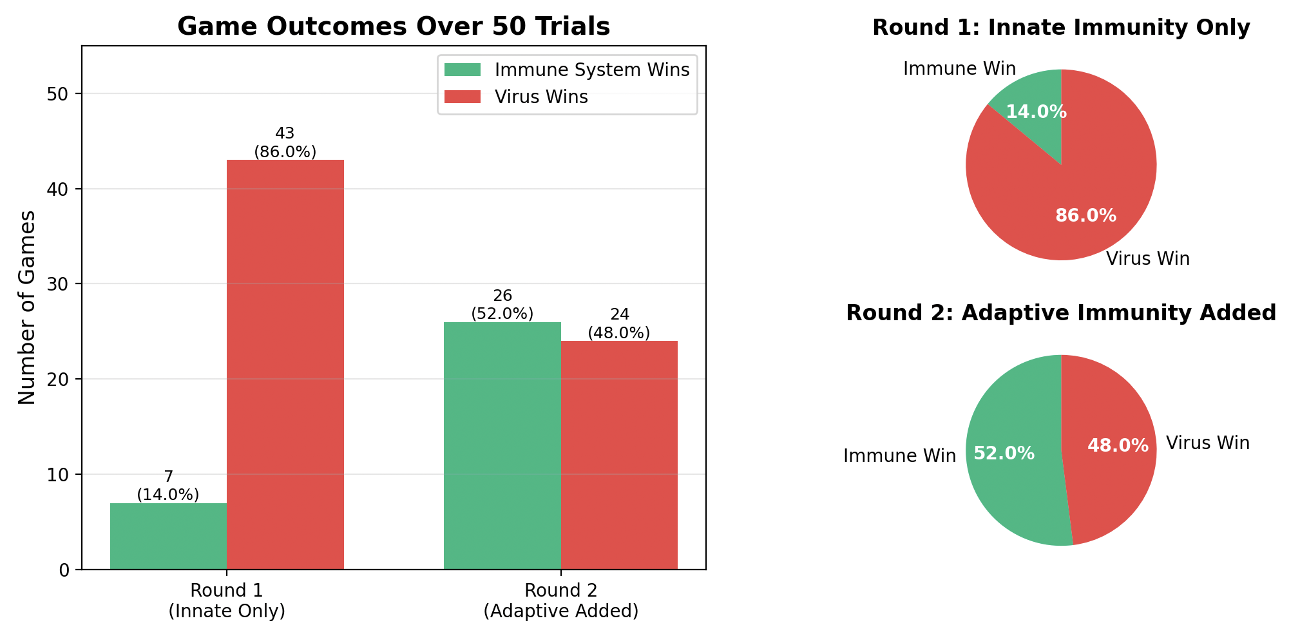
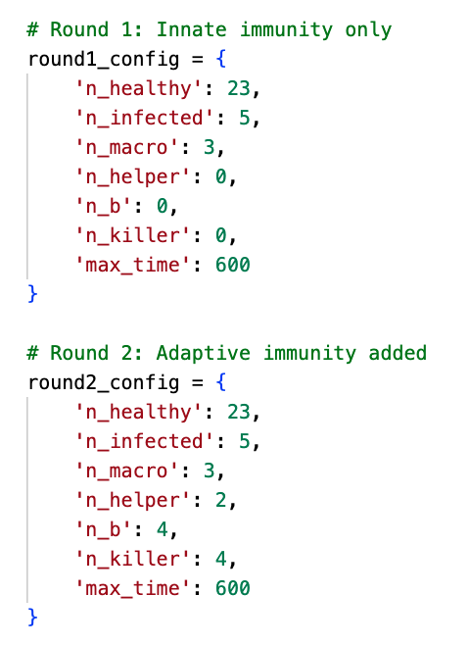
Simulated game play after 10 minutes

Slide 20
Looking ahead…
How do we use biology at the individual level to understand outbreaks at the population level?
What does the initial data release look like?
  HOMEWORK: Plot the DATA RELEASE #1 data: day vs. active infections, and answer the following questions:
  What do you notice about the initial infections?
  How could we measure how quickly its spreading?
  What information about the virus would be helpful in determining the shape of the outbreak curve?
HOMEWORK due next class: Watch ODEs background video and take video comprehension quiz

