Slide 1

Module 2
Lecture 2
Epidemics &
The SIR model
Sarah Groves, Ph.D.
Shayn Peirce-Cottler, Ph.D.

Slide 2
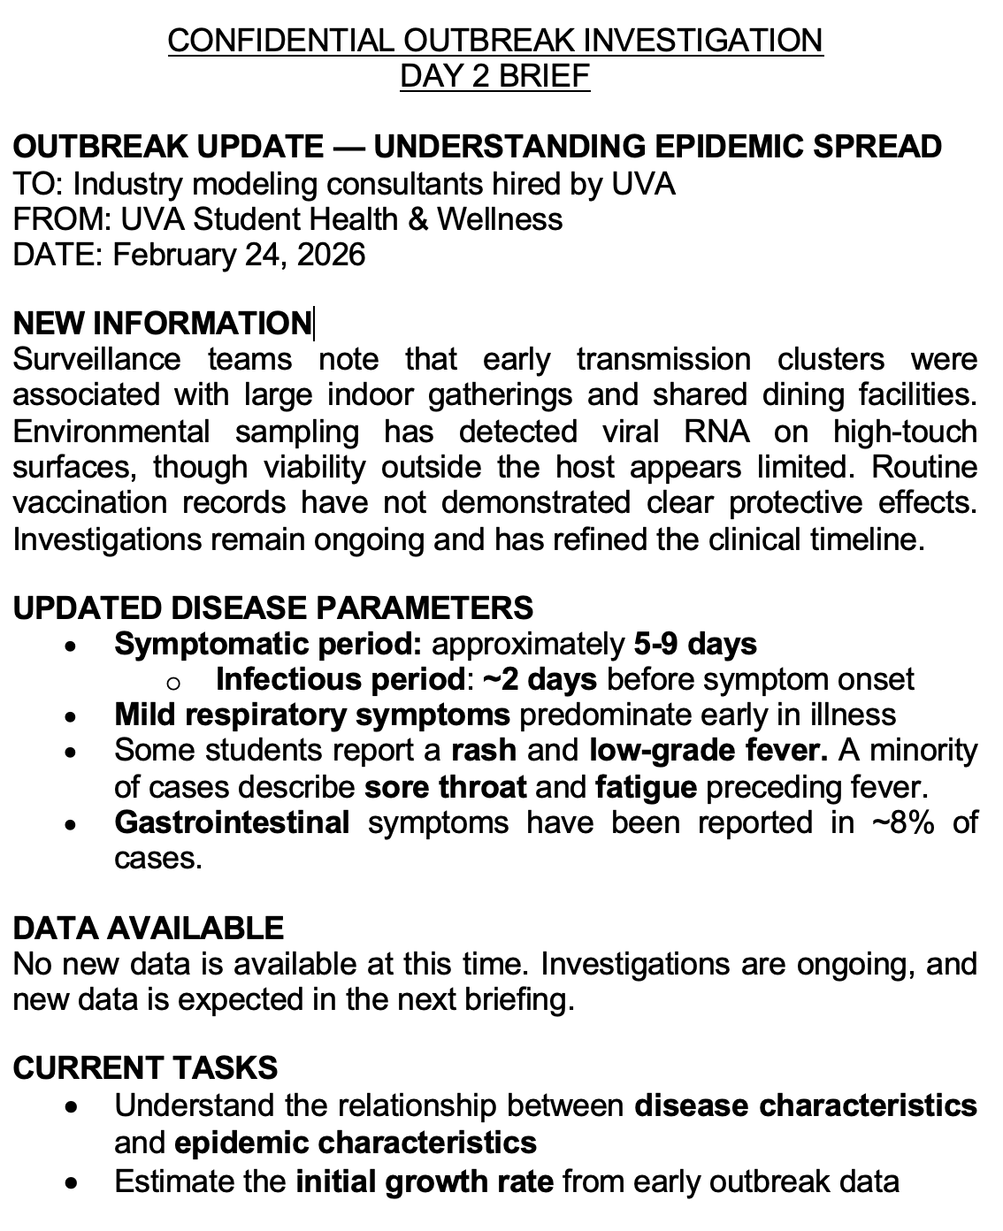
New information about our mystery virus
Symptomatic period: 5-9 days, with 2 days infectious before symptoms appear
Symptoms can help us better understand what type of virus it is
  Is it in the same family as a known virus?

Slide 3
Using Biology to Understand Outbreaks
Key parameters we can estimate from biological characteristics:
  R₀ (Basic reproduction number): How many people will one case infect?
  Incubation period: How long after someone is exposed can they infect others?
  Infectious period: How long can someone transmit the disease?
  Recovery rate: How quickly does population become immune?
Notes:
Teaching soundbite you can use
“The incubation period tells you when symptoms appear.
The latent period tells you when transmission begins.
SEIR cares about transmission — so it uses the latent period.”
Bottom line
Incubation period does not necessarily equal time in E
E corresponds to latent period
They are equal only if no presymptomatic spread exists
Your outbreak intentionally breaks that equality
Bridge concept: "Everything we've learned about viral biology helps us understand and predict how diseases spread through populations."

Slide 4
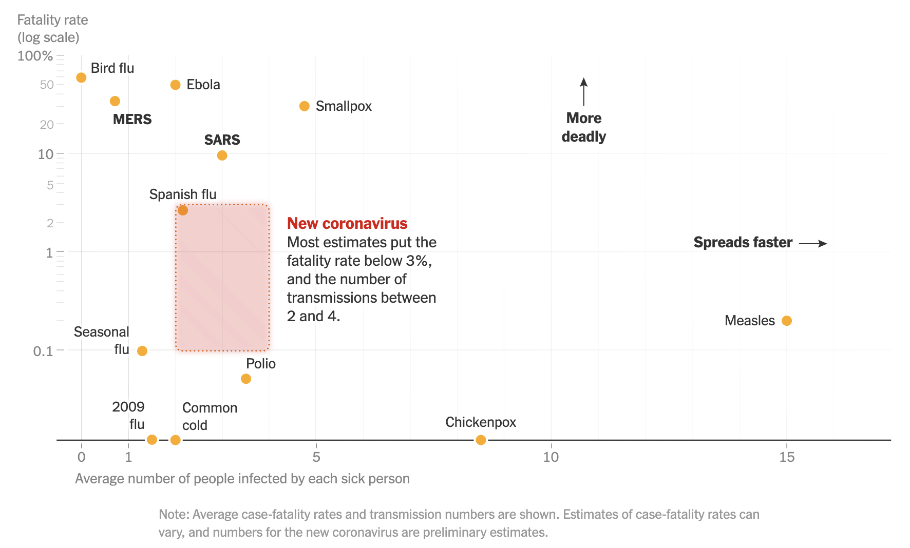
Why do some viruses spread faster than others?
Transmission route (airborne? Respiratory droplets?)
Infectious dose: min # of virus particles needed to start an infection
Viral shedding: high shedding + long infectious period = higher R0
Host susceptibility (cross-immunity, genetic factors)
See more with viruses.html in your GitHub repo
February 2020
https://www.nytimes.com/interactive/2020/world/asia/china-coronavirus-contain.html
Notes:
Airborne (aerosols): Tiny particles float in air for hours Measles, tuberculosis
Can spread through ventilation systems
Hardest to prevent
Respiratory droplets: Larger particles, travel ~6 feet COVID-19, influenza, common cold
Fall to ground within minutes
Prevented by distance and masks
Direct contact: Requires touching Easier to prevent with hygiene
Why measles is so contagious:
Airborne transmission
Extremely high viral shedding
Can linger in room for 2 hours after infected person leaves!
Examples:
Measles: ~1-10 viruses (incredibly low!)
Influenza: ~100-1,000 viruses
Norovirus: ~18 viruses (very low)

Slide 5
Infectiousness: β= transmission rate
Day 0: Exposure
1-3+ Weeks: Incubation Period
~1-2 weeks: Infectious Period
Recovery Period
How fast infectious people transmit the disease to susceptible people
β = “beta” = “transmission rate” = contact rate X transmission probability per contact
Hard to estimate directly from data
If transmission probability is 0.5 and contact rate is 5 per day, β = 2.5 people/day

Slide 6
Latency: σ = Incubation rate
Day 0: Exposure
1-3+ Weeks: Incubation Period
~1-2 weeks: Infectious Period
Recovery Period
How fast exposed people become infectious
σ = “sigma” = 1/latent period
Remember this depends on biological factors like replication speed of the virus, initial dose received, and speed of immune system activation
Sometimes can estimate based on virus biology & testing vs symptoms
If latent period is 10 days, σ is 0.1/day, meaning “on average it takes ten days for an exposed person to be become infectious”

Slide 7
Infectious period: 𝛄 = Recovery rate
Day 0: Exposure
1-3+ Weeks: Incubation Period
~1-2 weeks: Infectious Period
Recovery Period
How fast infectious people recover
𝛄 = “gamma” = 1 / infectious period
Usually have an estimate of 𝛄 based on symptoms
If the infectious period is 7 days (until recovery), 𝛄 is 1/7, meaning on average 1 out of 7 infected people will recover each day

Slide 8
R0: Basic reproduction number
R₀ = “Average number of people one infected person will infect in a completely susceptible population”
R0 = transmission probability per contact X contact rate X infectious period
Can also define this as R0 = β / 𝛄
Early in the epidemic, we can use the exponential growth in infections to predict R0
Day 0: Exposure
1-3+ Weeks: Incubation Period
~7 days: Infectious Period
Recovery Period
Transmission probability = 0.2
Contact rate = 5 per day
β = 1 person /day
Infectious period = 7 days
R0 = 7

Slide 9
From individual to population
Imagine a population of 10,000 people:
  Day 1: 1 person exposed
  Day 4: Original person now infectious, plus 2 new people exposed
  Day 7: Original person + 2 new people now infectious, plus 4 more exposed
  Day 10: 7 people infectious, plus 8 more exposed...
How many people will be infected by next week?
When will the epidemic peak?
We need to track groups of people, not just individuals

Slide 10

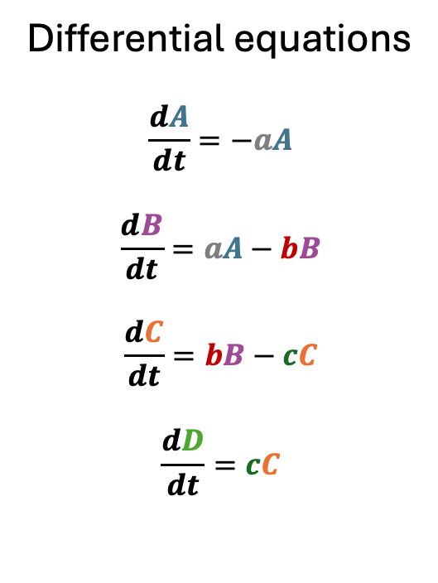
Compartmental Models
(Finite) difference equations
Bucket A (t+1) = Bucket A (t) – flow A→B
Bucket B (t+1) = Bucket B(t) + flow A→B - flow B→C
Bucket C (t+1) = Bucket C(t) + flow B→C - flow C→D
Bucket D (t+1) = Bucket D(t) + flow C→D
Flow A → B
Bucket A
Flow B → C
Differential equations
$$\frac{dA}{dt}=−aA$$
$$\frac{dB}{dt}=aA−bB$$
$$\frac{dC}{dt}=bB−cC$$
$$\frac{dD}{dt}=cC$$
Bucket B
Flow C → D
Epidemiological compartment models: Group the population into compartments depending on disease status
Bucket C
Bucket D

Slide 11
The SIR model
Susceptible
λ
Exposed
σ
Infected
𝛄
Recovered
How would you write the differential equations given the flowchart above?
Notes:
https://www.cdc.gov/cfa-modeling-and-forecasting/about/explainer-transmission-models.html
(infectiousness ⇤ P(contact with infectious person))S

Slide 12
Epidemic activity
Susceptible population: the entire class! (minus one…)
Exposed population: ignore for this game (we are assuming exposure quickly leads to infection)
Infectious population : 1 (Patient zero!)
Recovered population: 0 (beginning of epidemic)
Transmission probability = 0.5 (“finger matching game”)
Length of infection = 3 days (recovery rate 𝛄 = 1/3 days)

Slide 13
Game play
During the day, infections can spread if infected & susceptible individuals choose the same number
  Infected individuals challenge susceptible neighbors; can’t challenge the same person twice in a row
  “1 2 3 shoot”
  When you are infected, wait until the next day (round) to start infecting others
During the night, we will keep track of how many people are in each compartment & figure out each person’s status for the upcoming day.
  If you were not infected, write “S”: you are still susceptible
  If you were infected during the day, write “I” for the upcoming day (i.e. day 1 of infection)
  Once you’ve written “I” three times, you are recovered (“R”)

Slide 14
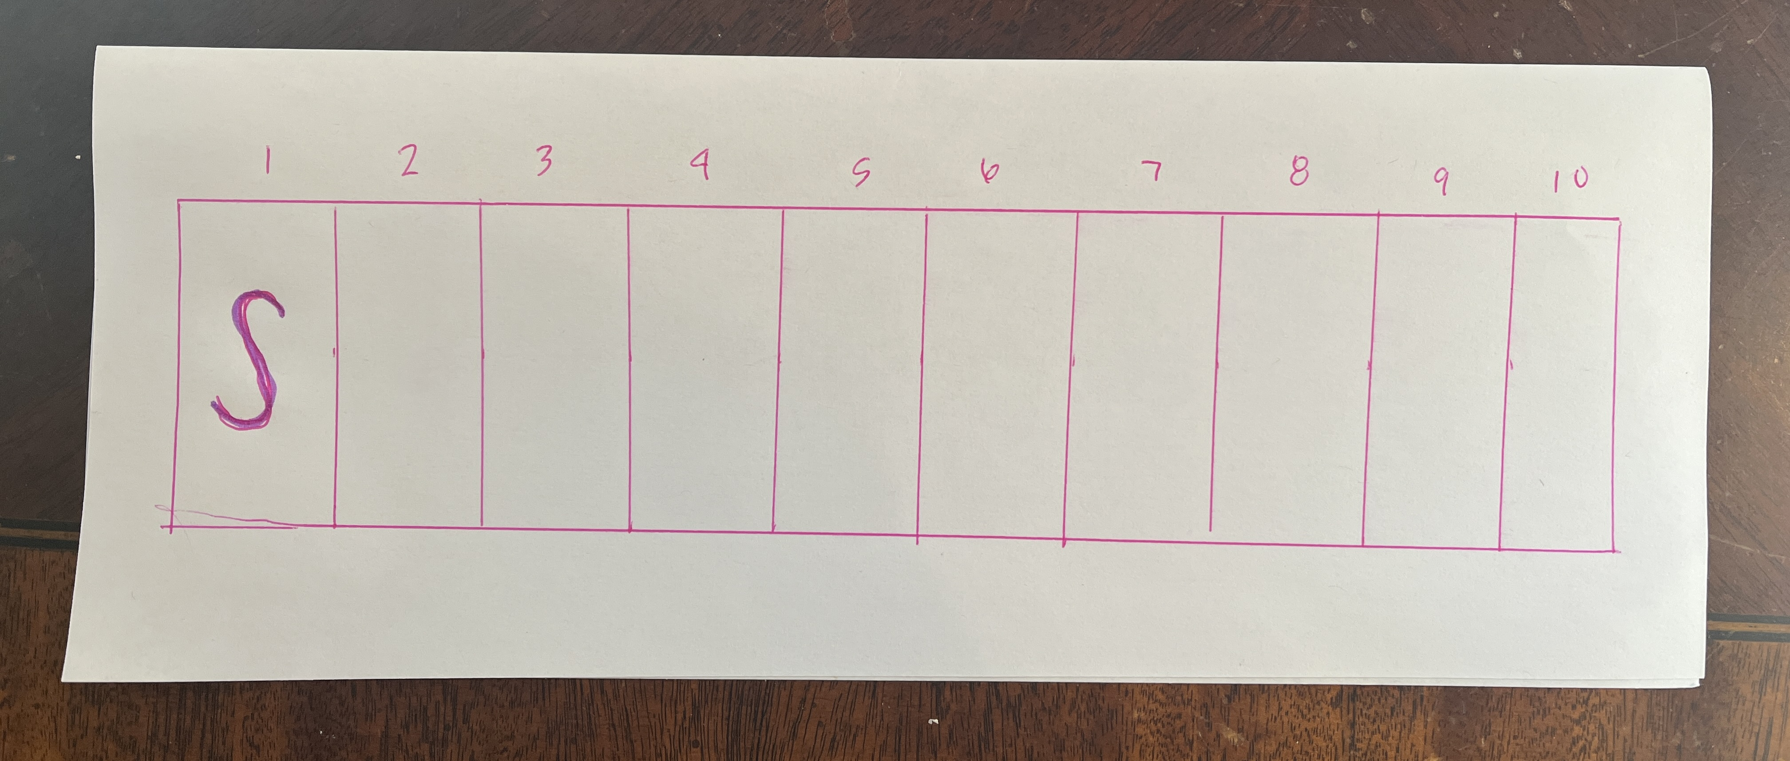
Game set up and predicting SIR data: 5 min break
Add 10 squares to the inside of your name-tag and number them.
  Turn it inside-out and place in front of you so others can see your status
  Unless you are patient zero, write “S” in the first box under Day 1.
Go up to the board and draw a guess for what the data will look like for ONE of the compartments: S, I, or R. Label your guess with your name.
Take a little stretch break if you need ☺

Slide 15
Calculating R0 from parameters
Transmission probability = 0.5 (“finger matching game”)
Contact rate = ~3 neighbors per day
Length of infection = 3 days (recovery rate = 1/3 days)
β = 0.5 * 3 = 1.5 contacts per day
𝛄 = 1/3 days
R0 = β / 𝛄 = 4.5 people, on average, are infected by each infectious person in total

Slide 16
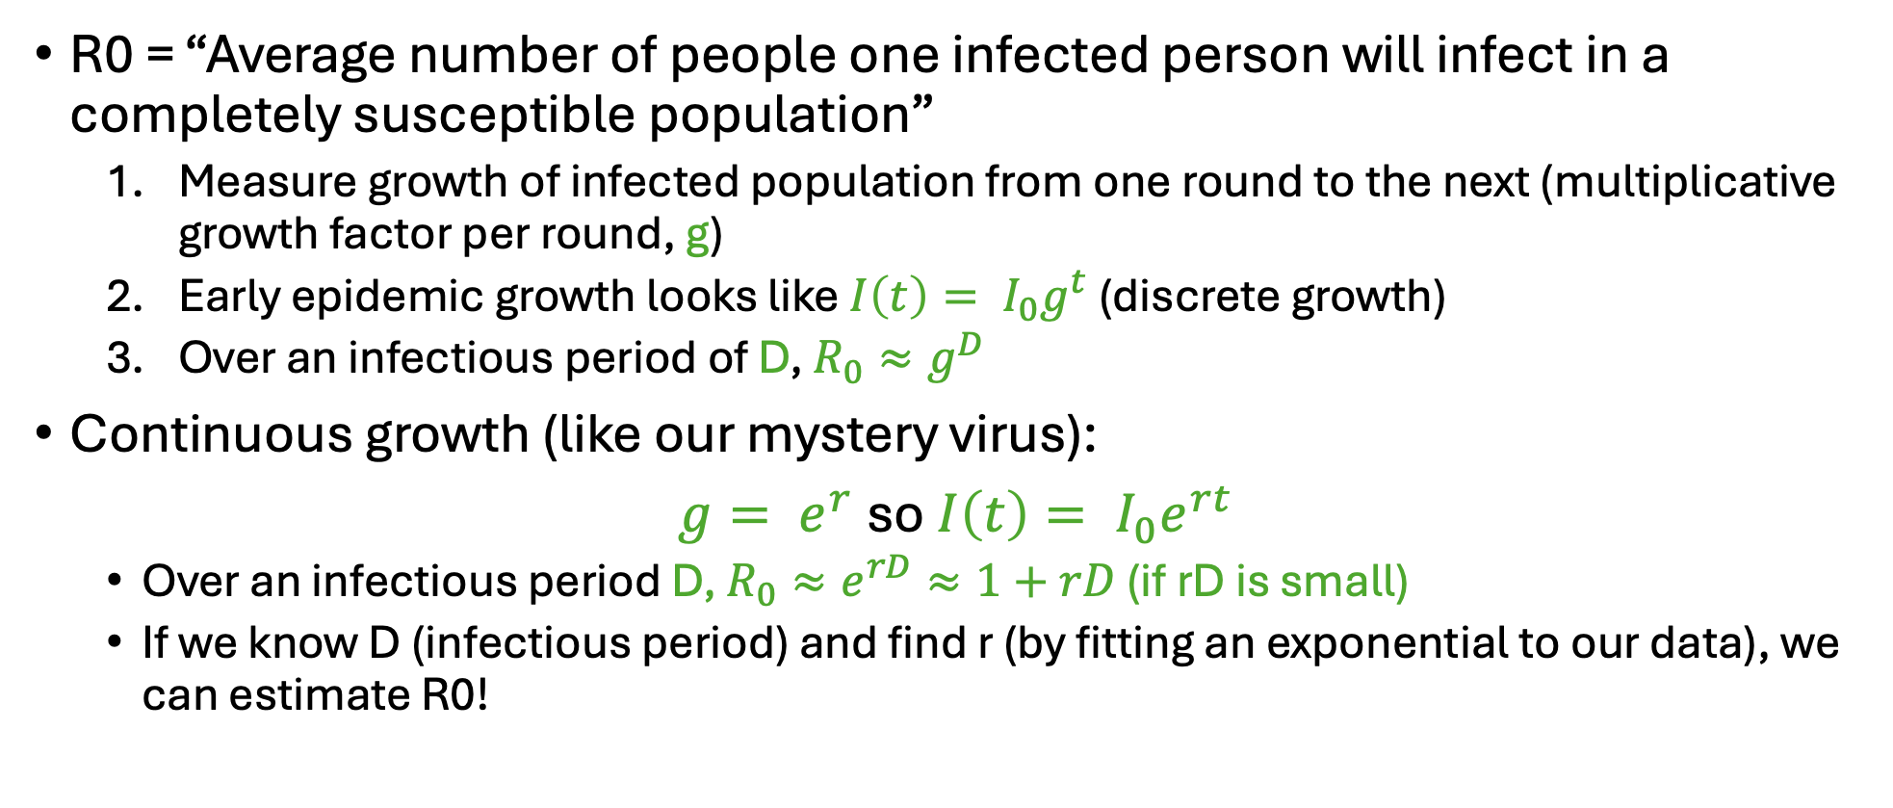
Predicting R0 from game data
R0 = “Average number of people one infected person will infect in a completely susceptible population”
  Measure growth of infected population from one round to the next (multiplicative growth factor per round, g)
  Early epidemic growth looks like $I\left(t\right)= I_{0}g^{t}$ (discrete growth)
  Over an infectious period of D, $R_{0}≈g^{D}$
Continuous growth (like our mystery virus):
$g= e^{r}$ so $I\left(t\right)= I_{0}e^{rt}$
  Over an infectious period D, $R_{0}≈e^{rD}≈1+rD$ (if rD is small)
  If we know D (infectious period) and find r (by fitting an exponential to our data), we can estimate R0!

Slide 17
Looking ahead & Homework
In a .py file (that will be copied to your final notebook): Estimate R0 for the mystery virus data using a fit to the exponential growth in I.
  We don’t know the transmission rate or recovery rate for the mystery virus, like we do in the game → we will estimate these parameters based on the data (working backwards from what we did in the game)
  Plot the estimated exponential curve over your scatterplot from last class.
In your final notebook:
  What viruses have a similar R0? Use the viruses.html file to find a virus or 2 with a similar R0 and give a 1-2 sentence background of the diseases.
  How accurate do you think your R0 estimate is?
(This will all be part of your Github check in #1 due Friday 2/27)

