Slide 1

Module 4
Lecture 4
Predicting the effect of interventions
Sarah Groves, Ph.D.
Shayn Peirce-Cottler, Ph.D.

Slide 2
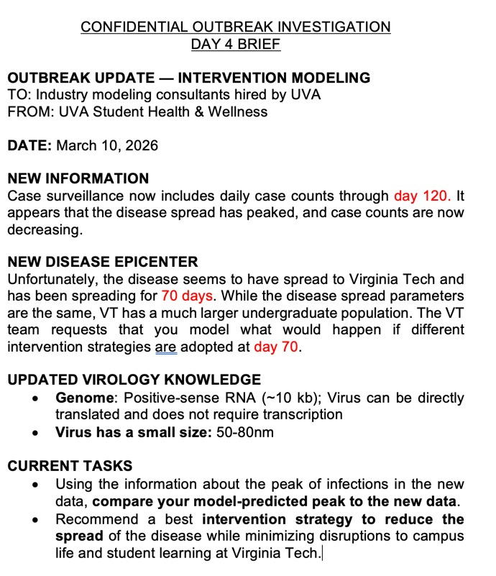
New briefing– new data!
Data to day 120
Pull from GitHub upstream remote
What you should have at this point:
  A fitted ODE model with best values for beta, gamma, & sigma
What we will do next:
  Calculate the error of your model against the true data
  For recommending interventions at VT:
    Use VT’s student population as S0
    I0 = 1
    R0 = 0
    E0(VT) = E0(UVA)
    Use the same best fit parameters from above to model the epidemic for 70 days
    At day 70 (until day 120), we will model different interventions
    Compare the baseline (no intervention) to each intervention to recommend one to implement

Slide 3
Calculating error
Two main sources of error when comparing our dataset to our model:
Numerical error
Definition: Errors arising from the inability of a computer to represent real numbers precisely and the approximation techniques used to solve equations.
Model error
Definition: The gap between the mathematical model's predictions and the actual, real-world system being studied.
Round-off error
Truncation error
Model is limited, incomplete, & makes assumptions
Data is noisy

Slide 4
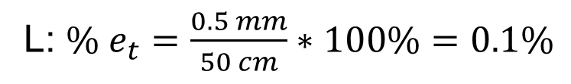

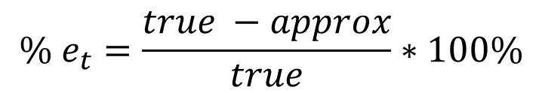

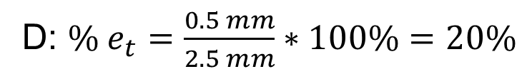
True error & percent relative error
When you know the true value.
true error (E_{t})
true % relative error (% e_{t})
Approximate % relative error
Iterative error approx.
$$E_{t}=true value−approximation$$
$${\% e}_{t}=\frac{true −approx}{true}∗100\%$$
Find $\% e_{t}$ for both L and D:
L = 50 cm, D = 2.5 mm, E_{t} = 0.5 mm
L: ${\% e}_{t}=\frac{0.5 mm}{50 cm}∗100\%=0.1\%$
Example of a commercially developed tissue-engineered blood vessel. http://cytograft.com/tebv.html
D: ${\% e}_{t}=\frac{0.5 mm}{2.5 mm}∗100\%=20\%$

Slide 5
Find the true % relative error between the data and your model prediction…
For the peak # of cases (error in y)
For the peak day in days since the beginning of the epidemic (error in x)
With your partner and in your report, discuss why your model has the error it does (i.e. model limitations) and whether the error level is too high to trust your predictions.

Slide 6
Modeling interventions at day 70
Your group should pick 3 of the 5 possible interventions (over the next few slides)
Each intervention will change some parameter (or move a population to a new compartment) at day 70
You will compare these changes to the baseline prediction for VT
As you model them from days 70-120, compare the following to no intervention:
  Peak infections with intervention
  Total cases (over days 70-120) prevented with intervention
Cost & feasibility
Compliance risk?
Which would you recommend to VT?

Slide 7
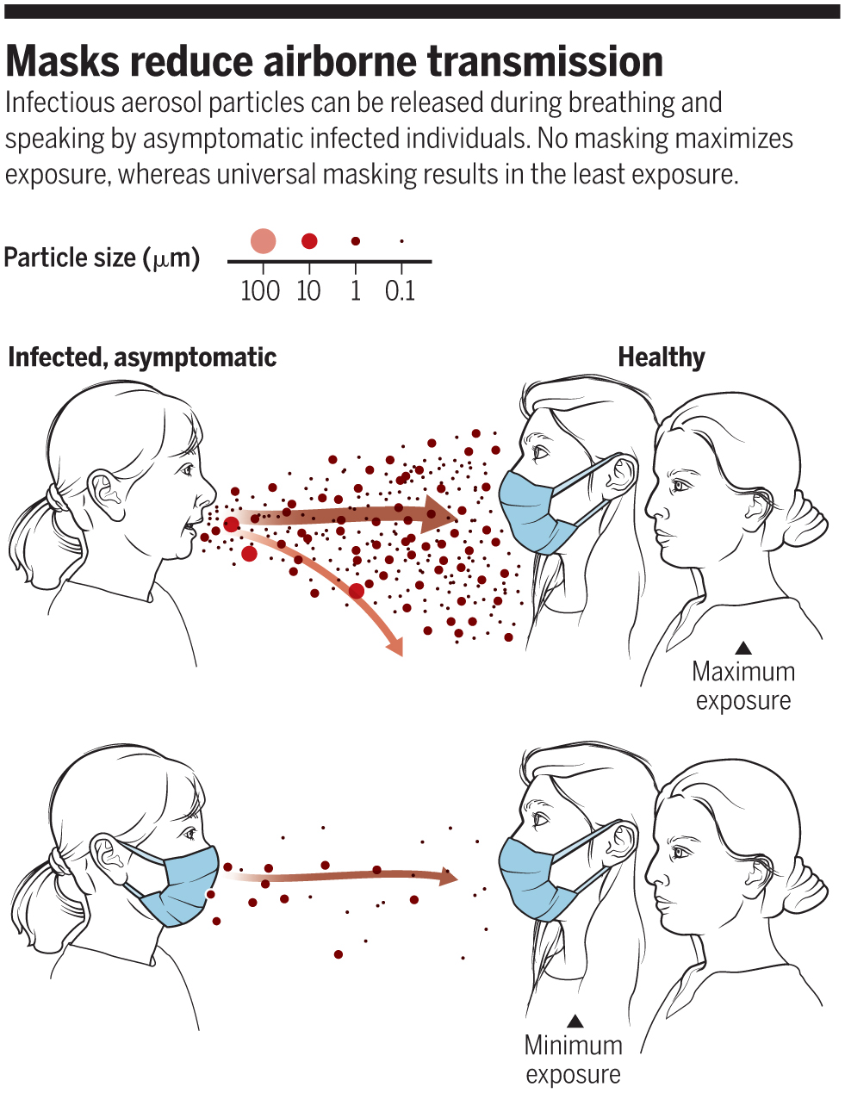
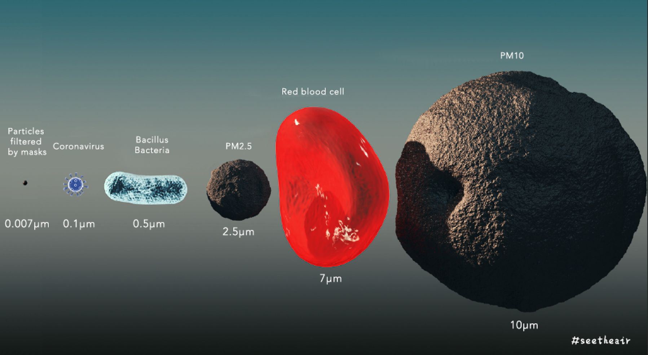
Masking mandates
Immediate masking mandate implemented from day 70 on
  Reduces transmission by 40%
https://www.sciencedirect.com/science/article/pii/S2352431620301802?via%3Dihub#appSB
Notes:
Humans produce droplets in various ways (e.g. sneezing, coughing, singing) and these droplets vary in size. Large droplets (> 5 µm) comprise most of the volume of expelled respiratory droplets and they tend to fall rapidly to the ground. Droplets smaller than 5 µm are referred to as droplet nuclei and may remain suspended in the air for significant periods of time and move with air currents. Respiratory viruses, including COVID-19 viruses are usually transported in large particle droplets. As enveloped viruses, they are usually not viable in small droplet-nuclei. Droplet transmission occurs when bacteria or viruses travel on relatively large respiratory droplets that people sneeze, cough, or exhale. They travel only short distances (usually less than 2 meters) before settling. These droplets may be loaded with infectious particles and can infect another person if the bacteria/viruses contact their eyes, nose or mouth. They may also fall on surfaces and then be transferred onto someone’s hand who then rubs their eyes, nose or mouth. Airborne transmission occurs when bacteria or viruses travel in droplet nuclei that become aerosolized. Healthy people can inhale the infectious droplet nuclei into their lungs.

Slide 8
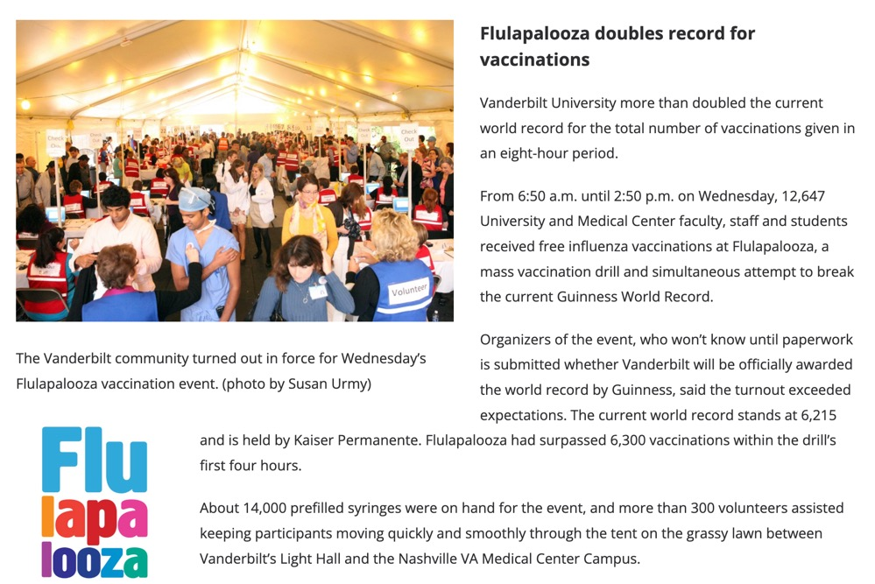
Vaccine interventions
Vaccine campaign: single event on day 70
  Vaccinate 2000 students on day 70 with 90% efficacy
Vaccine rollout:
  Vaccinate 1000 students on each: day 70, day 80, day 90
https://ajph.aphapublications.org/doi/10.2105/AJPH.2017.303953
Notes:
8 hour period

Slide 9
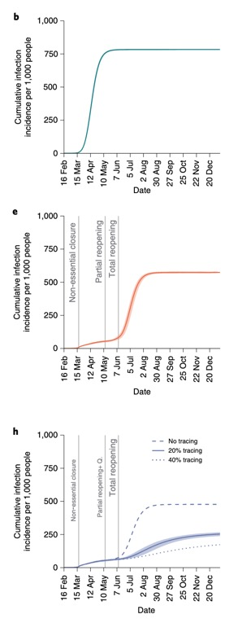
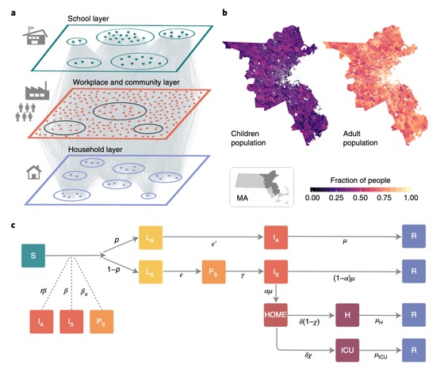
Testing & quarantine
Testing, contact-tracing, and quarantining for COVID19
Testing + quarantine starting day 70
  Reduces infectious period by 2 days (due to delays in testing & low compliance)
Close school for 2 weeks
  During closure, only 20% of normal contacts
  After closure, contact rate returns to normal
https://www.nature.com/articles/s41562-020-0931-9.epdf
https://news.mit.edu/2020/modeling-impact-of-testing-contact-tracing-quarantine-0908
Notes:
Fig. 1 | Model components. a, Schematic illustration of the weighted multilayer synthetic population built from mobility data in the metropolitan
area of Boston. The agent-based system comprises around 64,000 adults and 21,000 children. b, Geographical distribution of the agents in a. MA,
Massachusetts. Nodes in a are connected by more than five million weighted edges. Community layers (which include workplaces), are further classified
into categories according to Foursquare’s taxonomy of places. c, The compartmental model used to describe the natural history of the disease and the
transition rates (represented alongside the connecting arrows, and described in Methods, “Stochastic simulations of COVID-19 dynamics”) between
the different states. Specifically, we consider susceptible (S), latent asymptomatic (LA), latent symptomatic (LS), presymptomatic (PS), infectious
asymptomatic (IA), infectious symptomatic (IS), hospitalized (H), hospitalized in intensive care (ICU) and recovered (R) individuals. More details of the
model and the transitions between compartments are provided in Methods and the Supplementary Information.
unmitigated scenario (a–c) and the two social-distancing interventions considered: LIFT (d–f) and LET (g,h) scenarios. In both LIFT and LET scenarios, we
considered the closure of schools and non-essential places for eight weeks. This is the strictest lockdown period, which is followed by a partial lifting of the
stay-at-home policy, the duration of which is set to four weeks. During the partial lifting, all places in the community layer are open except mass-gathering
locations (such as restaurants, theatres, and others; see Supplementary Information). Finally, a full reopening takes place after the period of partial lifting
ends (relevant events are marked with vertical lines). In d–f, no other measures are adopted concurrently to the lifting of the restrictions, whereas in g–i,
the reopening is accompanied by an active policy consisting of testing the symptomatic individuals, home isolating them and quarantining (Q.) their
household and the households of a fraction of their contacts, as indicated. Note that the vertical scales of graphs in a,d,g are not the same and that both the
number of new cases and total cases are per 1,000 inhabitants. x-axes show dates in 2020. Feb, February; Mar, March; Apr, April; Jun, June; Jul, July; Aug,
August; Sep, September; Oct, October; Nov, November; Dec, December. In all panels, the solid line represents the average over 10,000 simulations and the
shaded region represents the 95% CI.
Lift scenario (LIFT): the stay-at-home order is lifted after eight
weeks by reopening all work and community places, except for
mass-gathering locations such as restaurants, theatres and simi-
lar locations (see Supplementary Information). The latter partial
reopening is enforced for another four weeks, which is followed
by a full lifting of all the remaining restrictions. We consider
that schools will remain closed, given the impending summer
break in July and August 2020. Indeed, some school systems,
such as the Boston public schools, have announced that they
will remain closed for the rest of the 2019–2020 school year.
• Lift and enhanced tracing (LET) scenario: The stay-at-home
order is lifted as in the previous scenario. Once partial reopening
is implemented, we assume that 50% of symptomatic COVID-
19 cases can be diagnosed with SARS-CoV-2 infection, on aver-
age, within 2 d after the onset of symptoms and that they are
isolated at home and their household members are quarantined
successfully for 2 weeks (a sensitivity analysis for lower rates
of isolation and quarantine is presented in the Supplementary
Information). Although COVID-19 tests are highly specific, our
50% detection rate also accounts for imperfect testing. We also
assume that a fraction of the non-household contacts (we show
results for 20% and 40%) of the symptomatic infections can be
traced and quarantined along with their household—note that
we consider that the contacts are identified with a rate propor-
tional to the duration of the interaction with the symptomatic
individual.

Slide 10
Some questions you could answer to “exceed expectations”
How does the % reduction in cases depend on the effectiveness of masking?
  What about if masking was implemented earlier?
How does the % reduction in cases depend on the length of the school closure?
How does earlier testing & quarantine effect the number of cases?
  What if compliance for testing was only 50%?
What if the vaccines were available earlier?
  How does the peak number of infections depend on the timing of a vaccination event?
Which interventions would burden certain groups disproportionately?
Are any of the changes to the I(t) plot surprising to you?
Try modeling all 5 interventions!
Anything else you are interested in comparing!

Slide 11
Looking ahead…
Next Tuesday: final project due
  Look at the notebook template and make sure it is completed.
  It can reference code from other python files (methods/functions), but all of the plots, results, and your thought processes should be in the single notebook as a report
  Section 3 should include plotting the full dataset against your model; error estimates and discussion, and intervention strategies
Presentations:
  Follow the same template as Module 1 (or a variation!)
  You can present as if you are giving recommendations to the UVA epidemiological modeling team about the mystery virus (the background section of your presentation will look a little different!)

