Slide 1

Module 4
Lecture 5
More accurate numerical solvers for ODEs
Sarah Groves, Ph.D.
Shayn Peirce-Cottler, Ph.D.

Slide 2





Why do we have numerical error?
When we can’t solve an ODE analytically, we must approximate a solution numerically
We can think back to calculus of how to approximate a function: Taylor series!
F(x) is equal to an infinite sum of terms including the derivatives of the function:
$$f\left(x\right)=y_{i+1}$$
$$f\left(a\right)=y_{i}$$
$$f\left(x\right)=$$
Interval (h=x_{i+1}-x_{i})
$$y_{i+1}=y_{i}+hf′(t_{i},y_{i})$$
Better approximating higher order terms = lower (truncation) error from numerical method

Slide 3
Predicting the future
What is the error associated with our predictions?
Euler’s Method
Approximate solution using slope at current location
Error depends on step size, and we decrease error with smaller step size

Slide 4
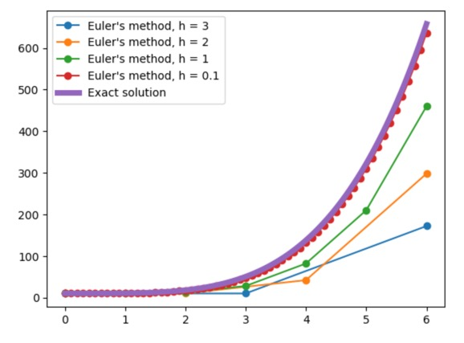
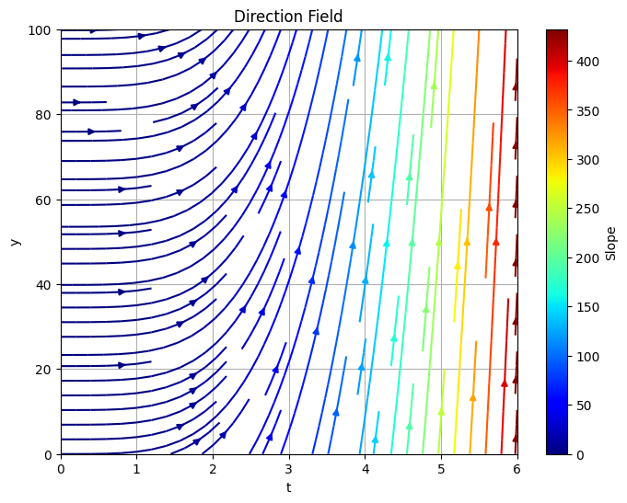
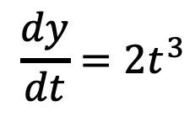
Choosing step size and comparing error
$$\frac{dy}{dt}=2t^{3}$$
Why are the predictions for y_{i+1} underestimating the true value?

Slide 5
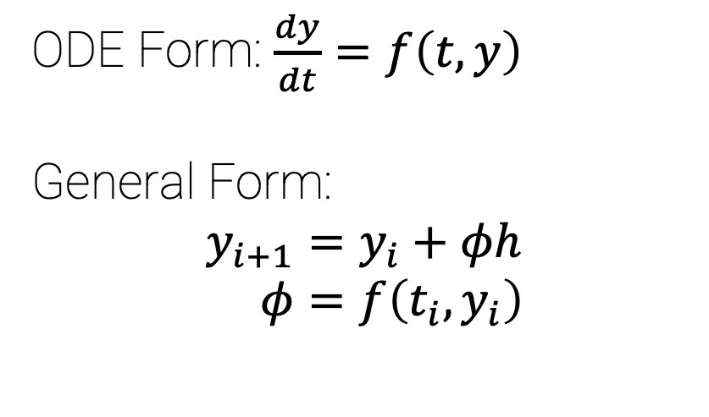
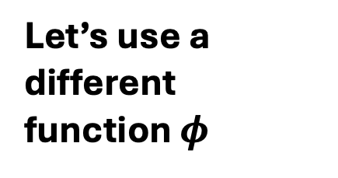
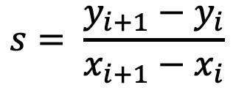
We can get a better estimate by approximating the slope differently
ODE Form: $\frac{dy}{dt}=f\left(t,y\right)$
General Form:
$$y_{i+1}=y_{i}+φh \\ φ=f\left(t_{i},y_{i}\right)$$
Want to approximate this slope
Let’s use a different function $φ$
But we usually only know (x_{i},y_{i}) and x_{i+1}
If we knew y_{i+1}, the problem would be solved!
In this case,
S_{i} is too small
S_{i+1} is too big
$$s= \frac{y_{i+1}−y_{i}}{x_{i+1}−x_{i}}$$

Slide 6
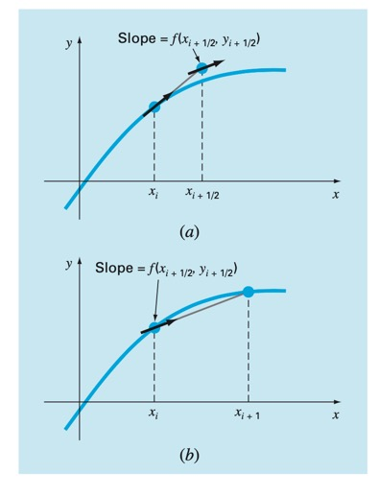
Midpoint Method (2nd order Runge Kutta)
ODE Form: $\frac{dy}{dx}=f\left(x,y\right)$
General Form: $φ=f\left(x_{i+1/2},y_{i+1/2}\right)$
$$y_{i+1/2}=y_{i}+f(x_{i},y_{i})\frac{h}{2}$$
$y_{i+1}=y_{i}+f\left(x_{i}+\frac{h}{2},y_{i+1/2}\right)h$

Slide 7


Recap: Euler’s method (RK1) and Midpoint method (RK2)
Euler’s Method
Approximate solution using slope at current location
Error depends on step size
  Throws out Taylor series terms higher than 1st order
  Decrease step size by 2 → decrease error by 2
Midpoint Method
Approximate solution using slope at current location and approximate slope at midpoint of h interval
Decrease step size by 2 → decrease error by 4!
ODE Form: $\frac{dy}{dx}=f\left(x,y\right)$
General Form: $φ=f\left(x_{i+1/2},y_{i+1/2}\right)$
$$y_{i+1/2}=y_{i}+f(x_{i},y_{i})\frac{h}{2}$$
$y_{i+1}=y_{i}+f\left(x_{i}+\frac{h}{2},y_{i+1/2}\right)h$
ODE Form: $\frac{dy}{dt}=f\left(t,y\right)$
General Form:
$$y_{i+1}=y_{i}+φh \\ φ=f\left(t_{i},y_{i}\right)$$

Slide 8

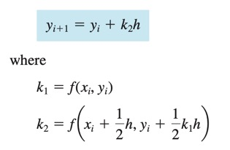
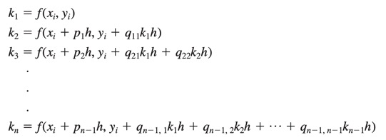

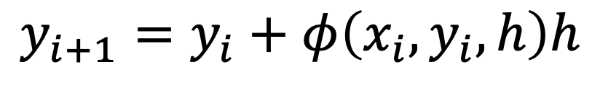
Runge Kutta Methods: generalized form
$$y_{i+1}=y_{i}+φ\left(x_{i},y_{i},h\right)h$$
$$y_{i+1}=y_{i}+φh \\ φ=f\left(t_{i},y_{i}\right)$$
n = 1 → Euler’s method
n = 2 with a₂=1 → Midpoint method
a = weight
k = derivative evaluated at some point

Slide 9
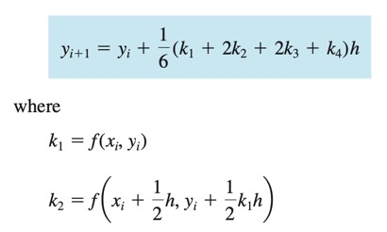
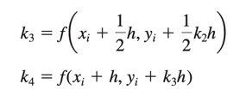
4th order Runge Kutta Method
Most popular method
Infinite number of versions, but the most common is the classical 4th order RK method
a_{i} weights and k functions are chosen to cancel out terms in the Taylor series, giving lower error for the approximation

Slide 10
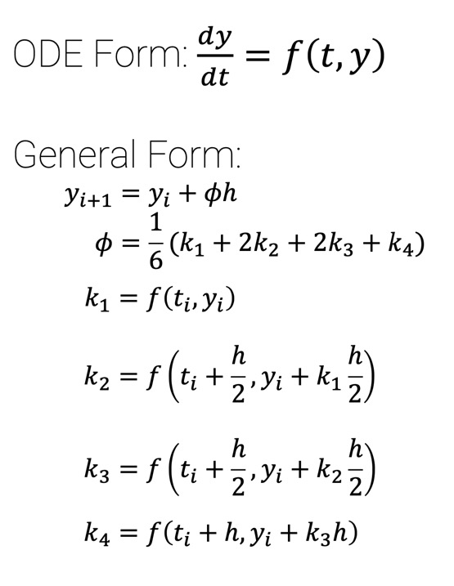
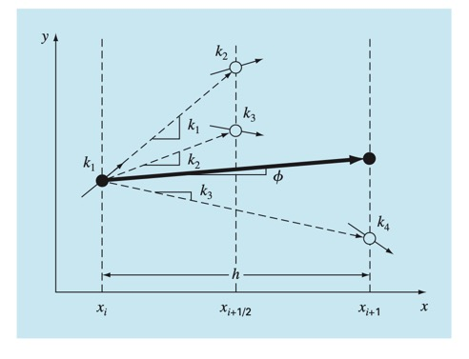
Runge-Kutta 4th Order

Slide 11
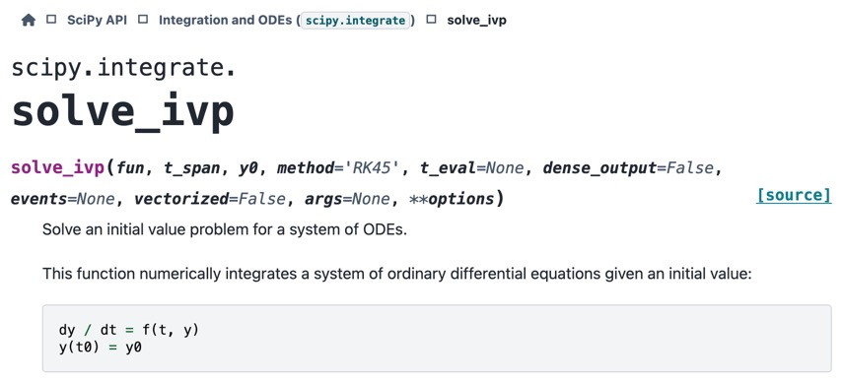
Implementing RK4 in Python
fun: system of ODEs
t_span: Interval of integration (two numbers, t0 and tf)
y0: Initial state for system (S0, I0, and R0) in an array
Default method is RK4!
We could call solve_ivp a functional: function of a function
fun is a function that takes in t, S, I and, R and outputs dS, dI, and dR (i.e. the system of ODEs)
#EXAMPLE
import numpy as np
from scipy.integrate import solve_ivp
def exponential_decay(t, y): return -0.5 * y
sol = solve_ivp(exponential_decay, [0, 10], [2])
print(sol.t)
print(sol.y)
t_span
y0
https://docs.scipy.org/doc/scipy/reference/generated/scipy.integrate.solve_ivp.html

Slide 12
In class work time
Tuesday at midnight: All code for your final project (ipynb and pdf) should be SUBMITTED TO CANVAS (both file types)
  You do not need to submit other python files, but everything should already be run so we can see your output
This module “tells a story” rather than explores a single aim, and you can structure your project report that way as well
  Ensure your conclusions recommend interventions, report any errors calculated, guess viral family, and report epidemic parameters from your best fit model

