Slide 1

Module 2 recap
Module 3 repo
Sarah Groves, Ph.D.
Shayn Peirce-Cottler, Ph.D.

Slide 2
And the virus is…
A novel, rubella-like togavirus!
R0 = 5.4
Incubation period = 14 → sigma = 0.071
Infectious period = 8 → gamma = 0.125
Beta = R0 * gamma = 0.675

Slide 3
Module 2 Survey

Slide 4

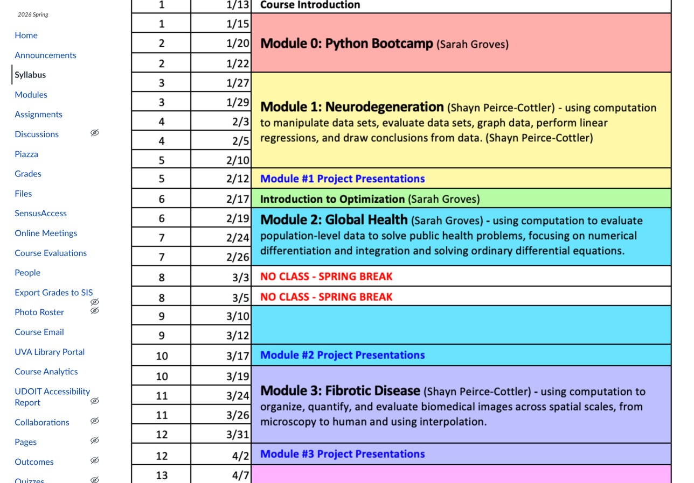
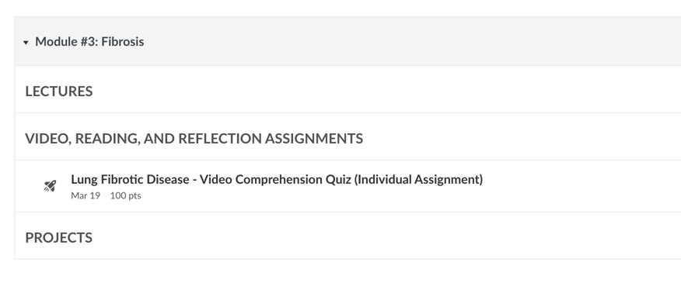
Feedback from you
We will make an effort to have all assignments up at the beginning of the module
Dr. Groves office hours Thursday after class or Monday by appt (zoom)
“Modules” tab has assignments organized
“Assignments” tab is organized by type

Slide 5
Module 3: Fork the repo and share with your new partner!
PARTNER A:
Step 1: Go to https://github.com/smgroves/Module-3-Fibrosis
  Click the "Fork" button (upper-right corner)
  Your fork will be at: https://github.com/YOUR-USERNAME/Module-2-Epidemics-SIR-Modeling
Step 2: Add Partner B as Collaborator
  On your fork's page, click "Settings" tab
  Click "Collaborators" in left sidebar and Click "Add people”
  Enter Partner B's GitHub username
  Click "Add [username] to this repository”
PARTNER B: Accept invitation in email
BOTH PARTNERS:
Step 3: Clone to Your Computer
  On your fork's page, click green "Code" button
  Click "Open with GitHub Desktop”
  Choose where to save it (e.g., Documents/CLASS FOLDER)
  Click "Clone"
  When asked "How are you planning to use this fork?": Select "For my own purposes”
Step 4: Check upstream
  In GitHub Desktop, click current branch and check if “upstream” is in the list
  If not, open a terminal and type:
  git remote add upstream https://github.com/smgroves/Module-3-Fibrosis

Slide 6
Assignments coming up this module

