Slide 1
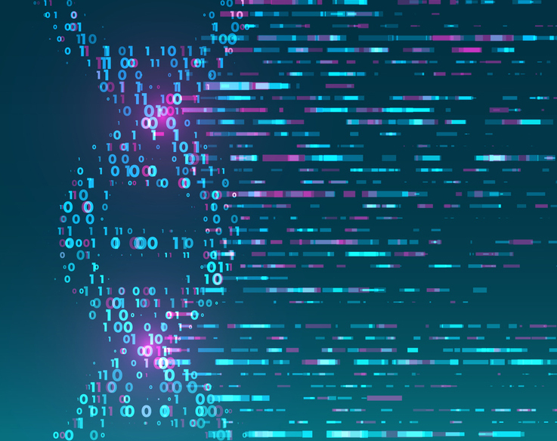
Module 4
Lecture 1 Introduction to Cancer
Sarah Groves, Ph.D.
Shayn Peirce-Cottler, Ph.D.

Slide 2
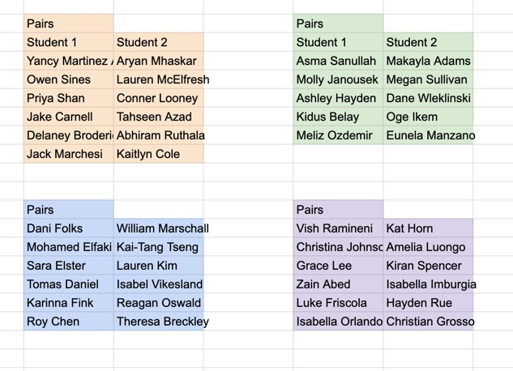
Fork my repo
Add your partner
Confirm upstream remote!
https://github.com/smgroves/Module-4-Cancer

Slide 3
Learning Objectives for Module 3: Cancer
I can answer the question “what is cancer?” and explain what the hallmarks of cancer are.
I can use pandas and scikit-learn to work with RNA-seq data, apply a machine learning method to a dataset, and validate the model.
I understand how machine learning methods use optimization of a cost function to determine the best answer to my research question.
I understand the difference between supervised and unsupervised learning methods and know when to use them.
I know how to avoid overfitting and determine if my model is “good enough” using quantitative metrics.

Slide 4
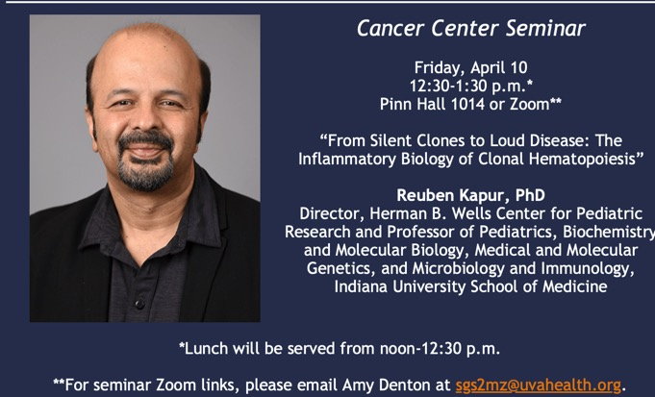
Cancer center seminar on Fridays!

Slide 5
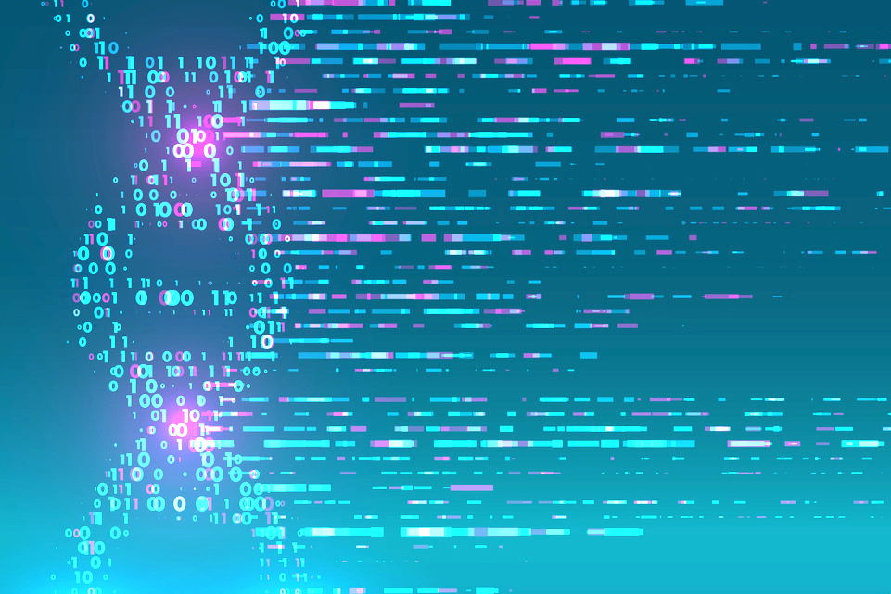
Module 3 – Step-by-Step process for each set of pairs
STEP 1: Learn about cancer (and a specific cancer type if desired!)
STEP 2: Explore the data-set (you will be given one)
STEP 3: Ask a question related to the data set that you are curious about
STEP 4: Visualize the data with dimensionality reduction (unsupervised)
STEP 5: Implement clustering, regression, or classification using Python/scikit-learn to answer the question (supervised)
STEP 6: Verify and validate the answer using ML metrics
STEP 7: Draw conclusions and reflect on the ethical implications
STEP 8: Communicate your question’s background, methods, conclusions, limitations, implications, and future work
Due Thursday April 9 by class:
Cancer Hallmark ABM simulations activity
Week 1
Due Friday April 10 midnight:
GitHub Check-in #1
Due Tuesday April 14 by class:
Video comprehension quiz
Week 2
Due Friday April 17 midnight:
GitHub Check-in #2
Week 3
Due Friday April 24 midnight:
GitHub Check-in #3
Week 4
Due Tuesday May 5 midnight:
Final Project
Presentations: May 5 2pm (Final exam block)

Slide 6
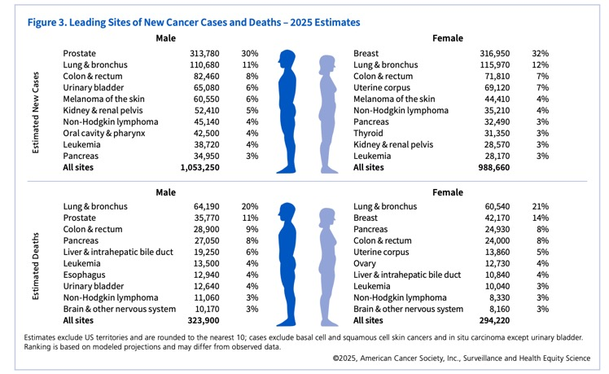
The problem of cancer
1 in 3 people will get cancer in their lifetime
1/5 related to tobacco use, another 1/5 tied to obesity, alcohol, or infection
#2 killer of Americans, accounting for 1 in 4 deaths in the US
200 billion dollars per year

Slide 7
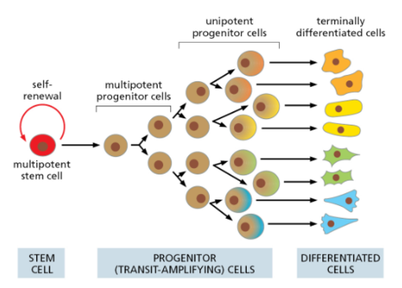



Let’s think about what normal cells do
Normal cells start as stem cells
  This self-renewal is under tight control
  “Infinite” replicability, but checkpoint control
  No specialized functions yet, but strict lineage commitment
Genes for stem cell turn OFF and genes for specialized functions turn ON
  May have a few possible final identities (multipotent)
Differentiated cells: locked into one cell type that performs a particular job
  No division or tightly controlled
  Anchored in proper location
  One main cell “task”
  Can die by apoptosis
Notes:
Emphasize: Stem cells are NORMAL and NECESSARY during development and tissue repair
The problem: Adult cells should NOT return to stem-like behavior
Preview: The hallmarks of cancer are essentially hallmarks of inappropriate stem cell behavior in differentiated tissues
This explains why cancer cells often look "less differentiated" under the microscope—they've lost their specialized appearance

Slide 8


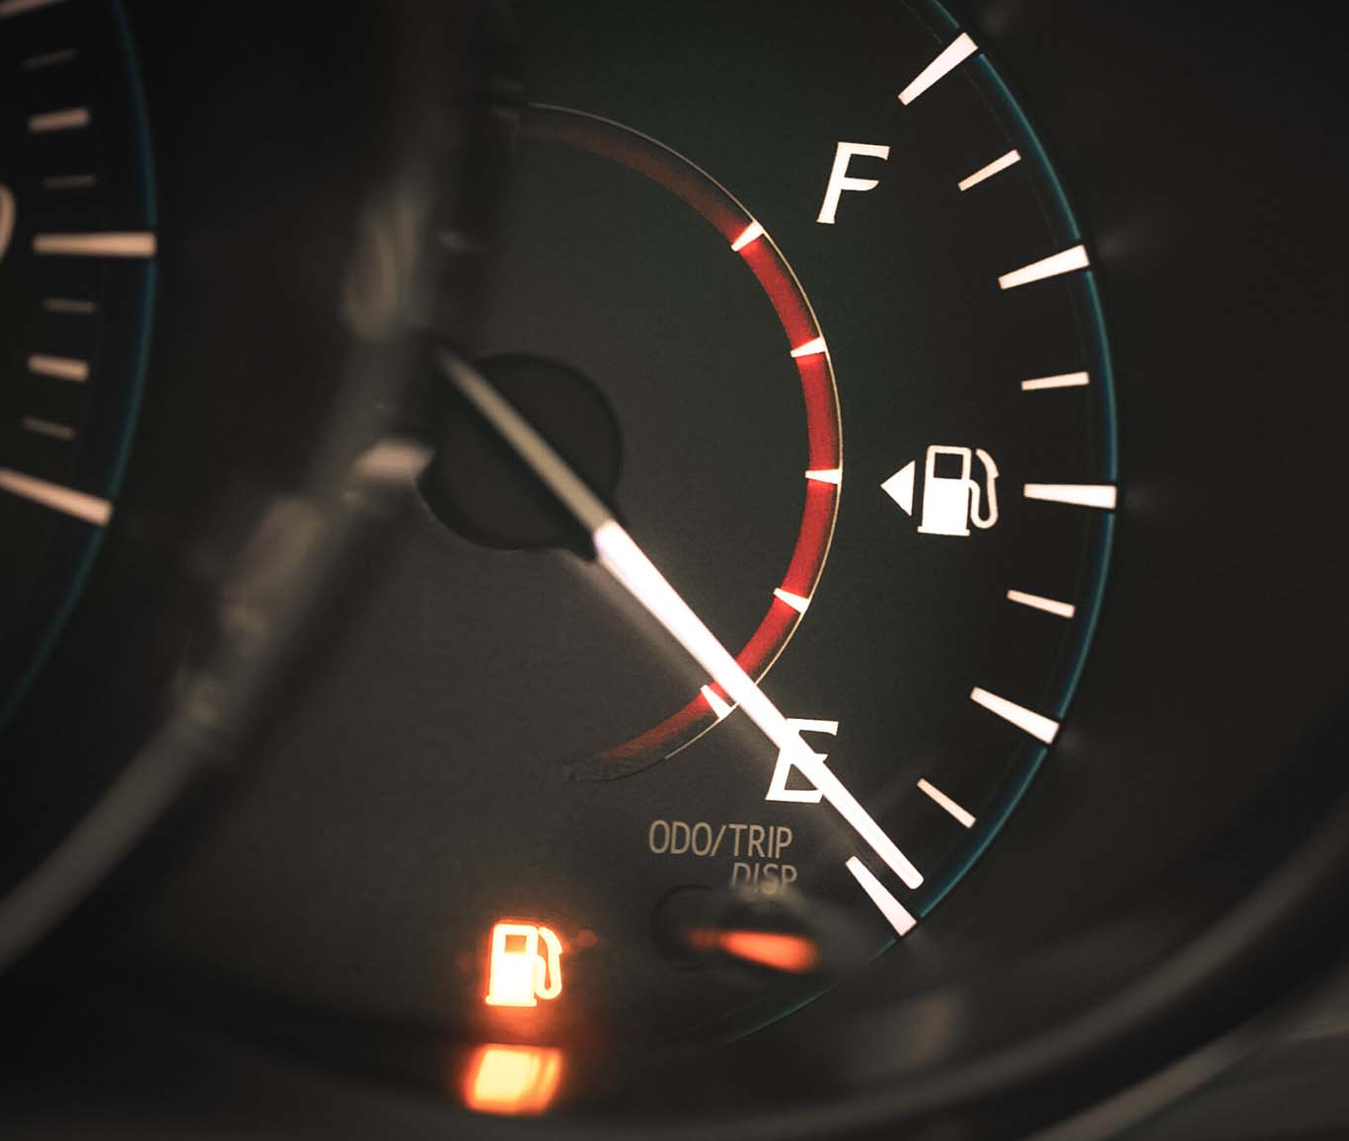
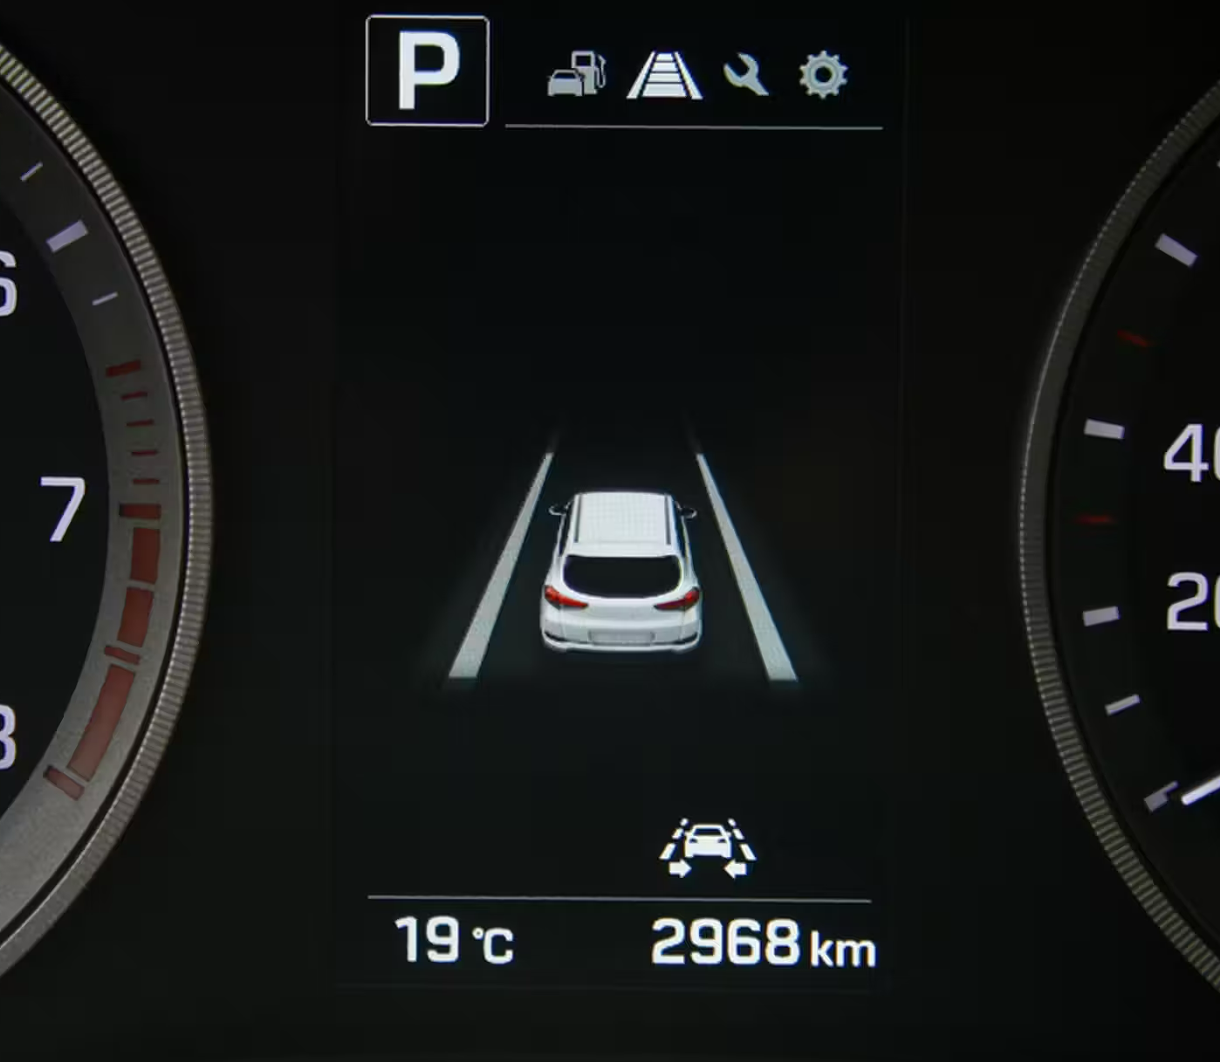
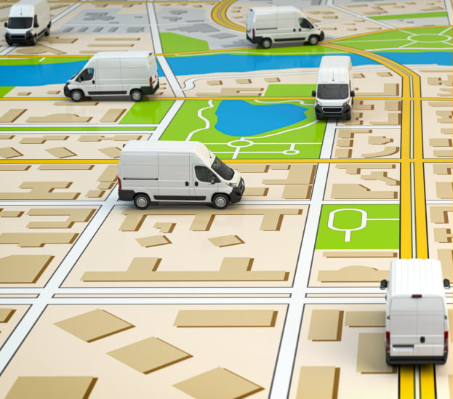
Core rules of normal cells
1. Grow only when told
“Gas Pedal”
Growth factors provide “permission” to grow, and without this signal, the cell doesn’t divide
Ex: Growth factor → receptor activation → division genes turn ON → cell divides
2. Die when you should
“Brake pedal”
Programmed cell death (apoptosis) is triggered by cell damage
Ex: UV damage →
cellular DNA has errors
p53 activation →
cell dies
3. Replicate a limited number of times
“Limited fuel tank”
Telomere shortening limits divisions (~50 max for a normal cell) and prevents endless replication
4. Stay where you belong
“Lane sensors”
Contact inhibition and tissue architecture keep cell from dividing when packed with neighbors & cells don’t migrate without permission
5. Maintain cell identity
“Carrier route for delivery truck”
Differentiated cells stay differentiated and genes for other cell types stay OFF

Slide 9
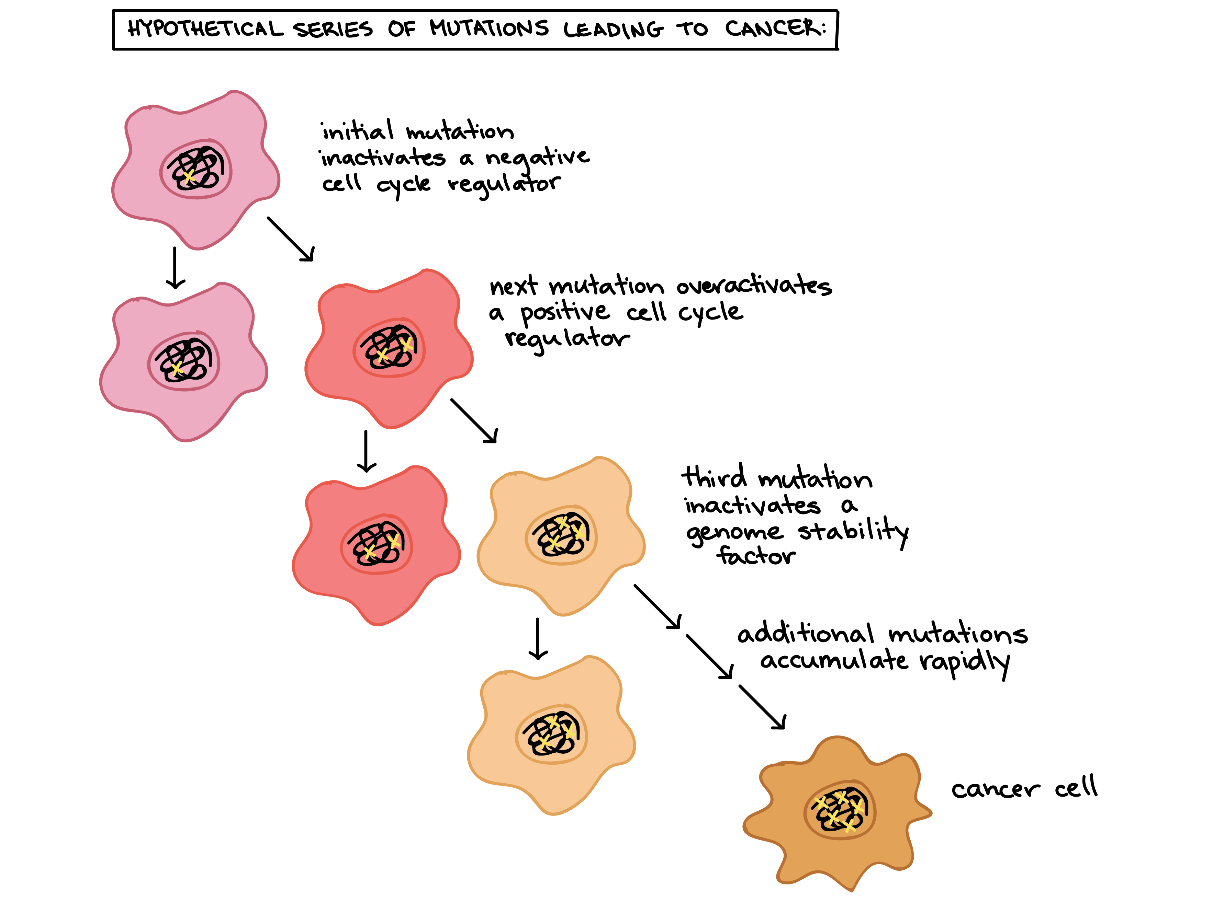
Cancer occurs when a cell breaks multiple rules via mutations.
3 billion base pairs copied every cell division
Human body has 37 trillion cells (3.7x10¹³)
Lifetime total divisions approximated at 10¹⁶
https://bio1220.biosci.gatech.edu/death-01/why-and-how-does-cancer-affect-humans-and-other-animals/
Notes:
3 billion bp = 1 Gb data
Lifetime divisions = retyping the works of Shakespeare 10 quadrillion times

Slide 10
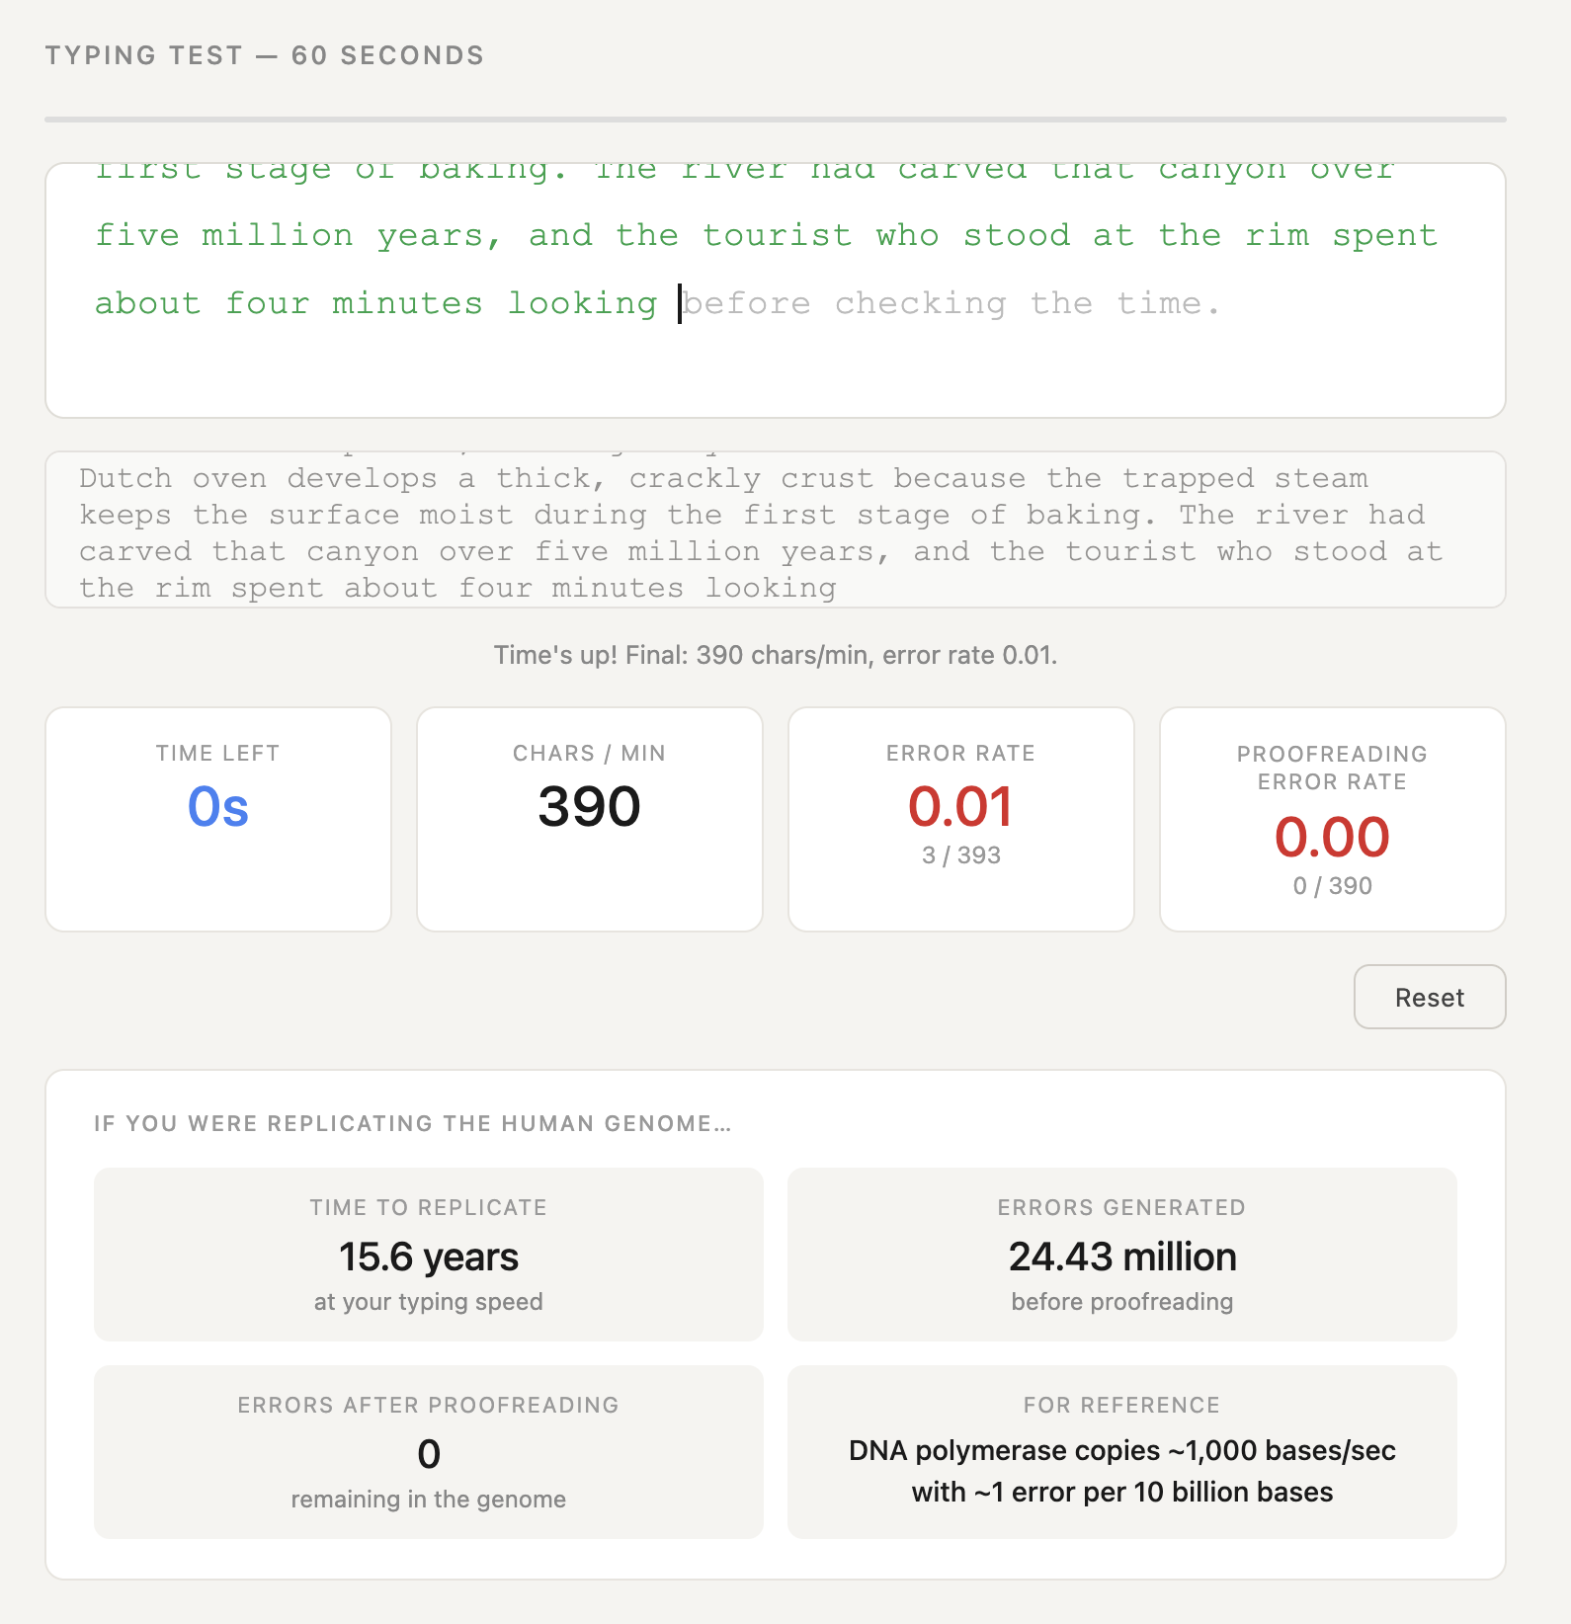
What if you were copying the genome?
With proofreading and mismatch repair:
  1-3 mutations per cell division (1 error per 10⁹ bases)
  = 10⁷ total mutations across the body over a lifetime
Only need 4-10 mutations in the right genes to transform a normal cell to cancer
Notes:
1 error in 10^9 v a single typo in 1000 encyclopedia volumes; most typists have one error per 300 keystrokes → DNA replication sits between a supercomputer and perfection
1-3 mutations per cell division = a single type in a city’s worth of books
1 error per 10 5-10 7 before proofreading

Slide 11
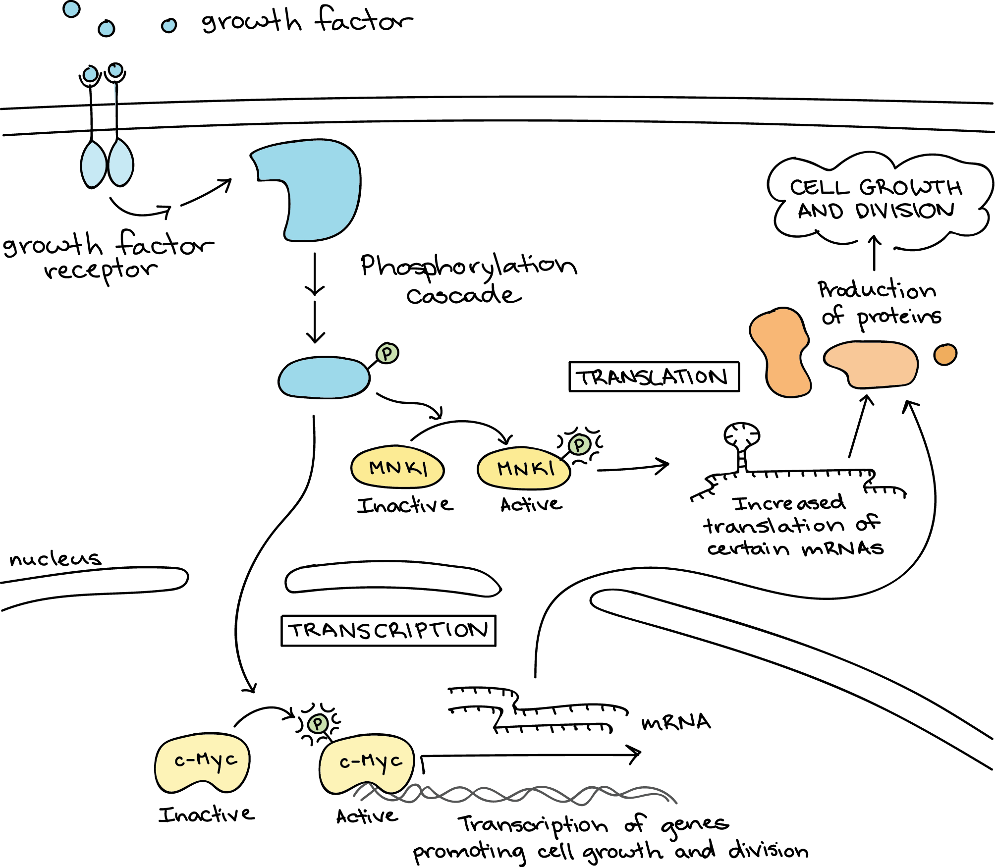
Gain-of-function mutations & overactivation of oncogenes
Gas pedal gets stuck on
Growth/division promoting genes
  Growth factors: stimulate cells to grow and divide (e.g. EGF)
  RTKs: receptors that receive growth signals (e.g. EGFR, HER2)
  Signal transducers: pass growth signals from receptors to the nucleus (e.g. RAS, BRAF)
  Transcription factors that activate genes necessary for cell division (e.g. MYC, FOS, JUN)
  Apoptosis blockers (e.g. BCL-2)

Slide 12
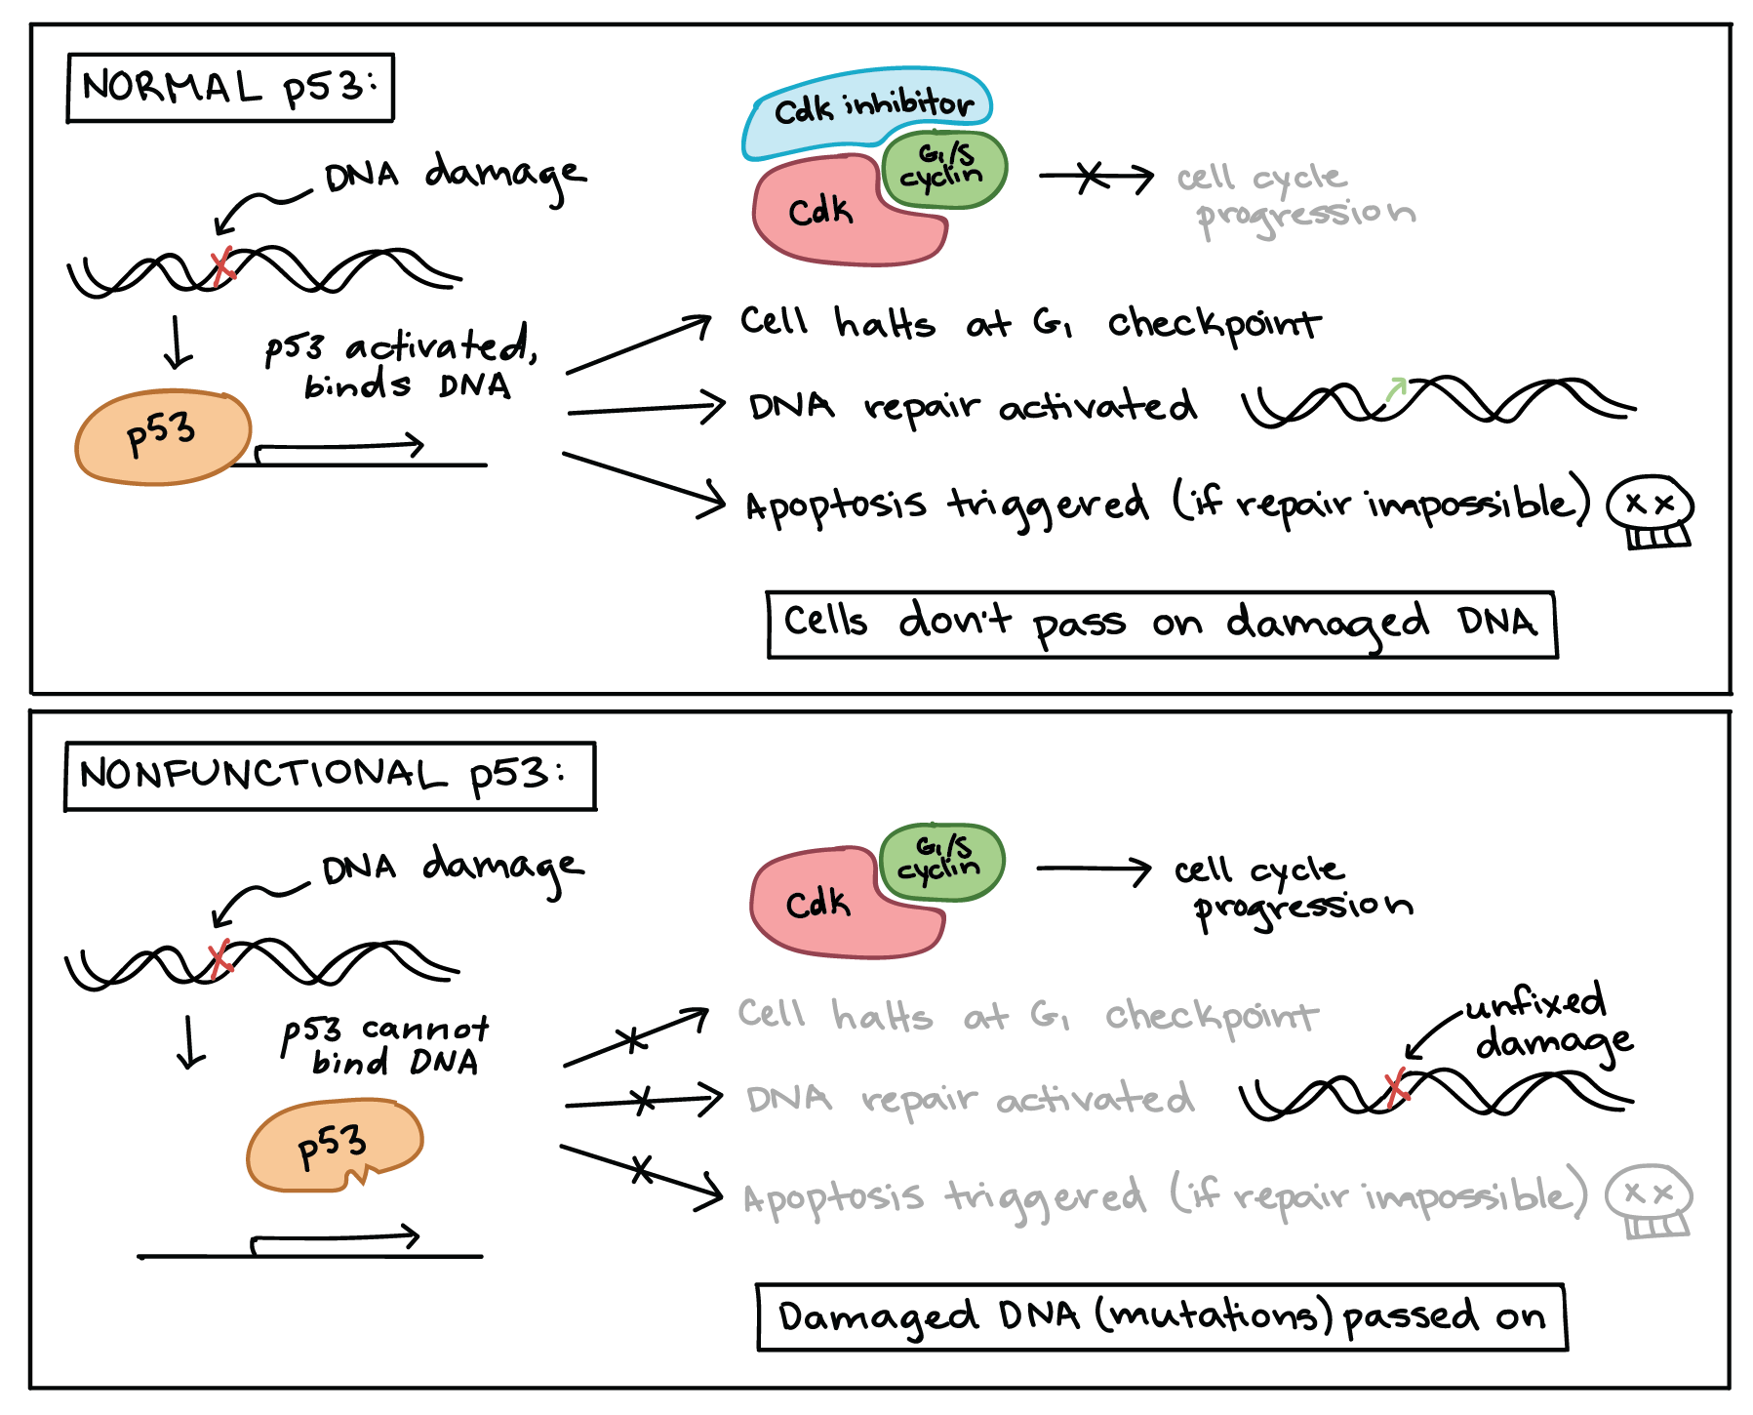
Inactivating mutations in tumor suppressors
Brake pedal broken
Normally suppress growth or maintain overall genetic stability
  Cell cycle regulators: checkpoint control genes that prevent division if there are issues (e.g. p53, Rb1)
  Apoptosis inducers: Trigger programmed cell death if cell is beyond repair
  DNA repair: these fix errors in DNA before a cell divides (e.g. BRCA1/2)

Slide 13
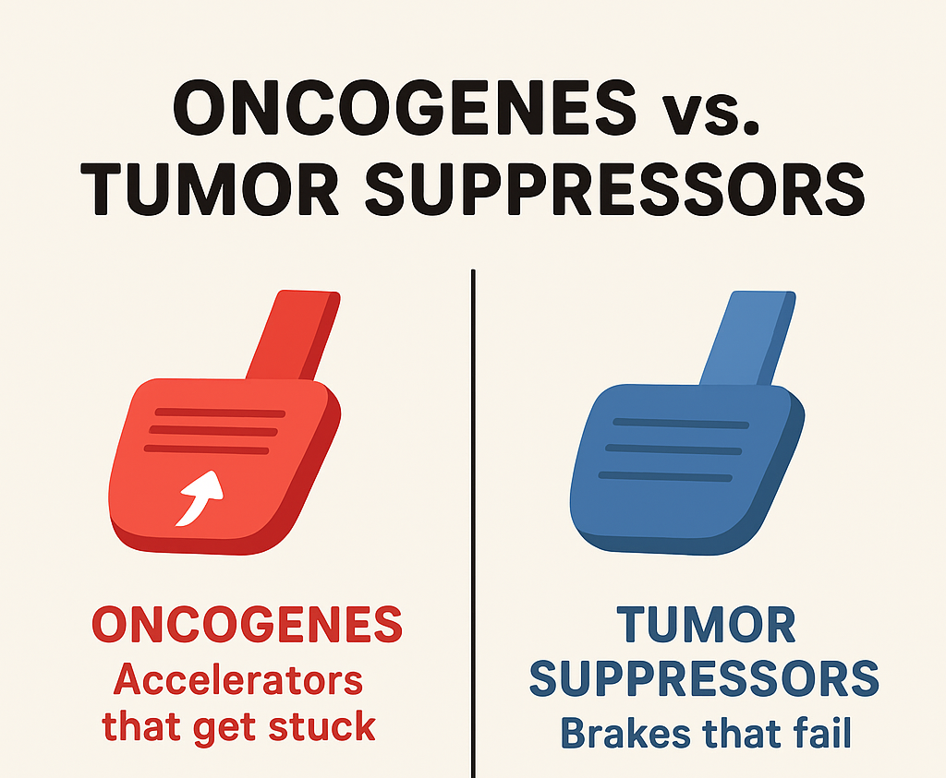
We only need 4-10 mutations to cause cancer!!
But they need to be in the “right genes”
Humans have ~20,000 protein-coding genes
~723 genes are listed as having evidence for a role in cancer
  ~250–300 are tumor suppressor genes
  ~100–150 are oncogenes
Gene (and what it normally does) | ONC | TS
P53: if DNA damage, cell halts at G1 checkpoint (or damage is fixed)
KRAS: when on, it changes shape to interact with downstream proteins that send growth signals to the nucleus.
Rb1: inhibits E2F transcription factors (E2F allows DNA replication)
BRAF: activates MEK, which promotes cell growth
PIK3CA: creates part of the enzyme PI3K which promotes protein synthesis and inhibits apoptosis
cMYC: Binds to DNA and recruits proteins that open chromatin, allowing transcription of genes involved in cell cycle progression
Gain of function/
overactivation
Loss of function/
inactivation
Notes:
Humans have ~20,000 protein-coding genes.
According to the latest COSMIC Cancer Gene Census (v97, 2024):
~723 genes are listed as having evidence for a role in cancer.
~250–300 are tumor suppressor genes (TSGs).
~100–150 are oncogenes.
The remainder have dual or context-dependent roles (they can act as either depending on mutation type or tissue).
So:
🧩 Only about 3–4% of all human genes are currently known to be oncogenes or tumor suppressors.
Every gene is a page in a 20,000-page manual.
Only ~700 pages are about “safety systems” and “growth controls.”
Cancer happens when just a few sentences (driver mutations) on those pages get rewritten — out of millions of total typos (passenger mutations).

Slide 14
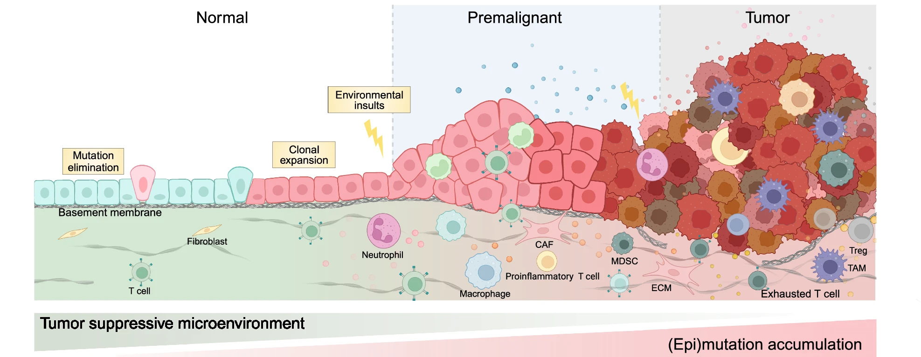
Cancer development progresses over years and years
Cells accumulate mutations from the environment + inherited + random errors
“Tumor development proceeds via a process formally analogous to Darwinian evolution, in which a succession of genetic changes, each conferring one or another type of growth advantage, leads to the progressive conversion of normal human cells into cancer cells.” – Hallmarks of Cancer
https://doi.org/10.1038/s41392-024-01848-7

Slide 15
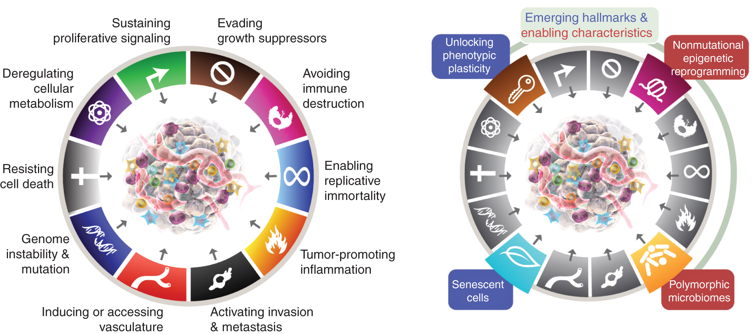
Mutations in oncogenes and tumor suppressors lead to cancer cells with certain “hallmarks”
These are the ways cancer cells break the “rules”
Rule 1: Grow when you are told
Rule 2: Die when you should
Rule 3: Replicate a limited number of times
Rule 4: Stay where you belong
Rule 5: Maintain cell identity
https://www.cancer.org/research/cancer-facts-statistics/all-cancer-facts-figures/2025-cancer-facts-figures.html
Hanahan and Weinberg, 2000; 2011; Hanahan, 2022
Notes:
Cancer is a HUGE topic and we can only touch on a tiny piece of it

Slide 16





Breaking rule #1: grow only when told
Sustaining proliferative signaling
HOW:
Cancer cells produce their own growth signals (autocrine signaling) OR hyperactivate growth factor receptors
MECHANISM/GENES INVOLVED:
Mutate RAS/KRAS/etc to always be on
EGFR pathway upregulated
EXAMPLES:
Pancreatic cancer ~90% have KRAS mutations
Breast cancers often have HER2 upregulated (~30%)
Evading growth suppression
Reprogramming energy metabolism
Senescent cells promote growth
https://www.figma.com/board/RyPLxKcCUJ3g46xwpIoNsv/The-Hallmarks-of-Cancer?node-id=0-1&t=kuFV2fuiY1HE2mLT-1

Slide 17


Breaking rule #2: Die when you should
Resist Cell Death
HOW:
MECHANISM/GENES INVOLVED:
EXAMPLE:
Evade immune destruction
HOW:
MECHANISM/GENES INVOLVED:
EXAMPLE:

Slide 18

Breaking rule #3: Replicate a limited number of times
Enable replicative immortality
HOW:
MECHANISM/GENES INVOLVED:
EXAMPLE:

Slide 19


Breaking rule #4: Stay where you belong
Induce angiogenesis
HOW:
MECHANISM/GENES INVOLVED:
EXAMPLE:
Activate invasion and metastasis
HOW:
MECHANISM/GENES INVOLVED:
EXAMPLE:

Slide 20

Breaking rule #5: Maintain cell identity
Unlocking phenotypic plasticity
HOW:
MECHANISM/GENES INVOLVED:
EXAMPLE:

Slide 21

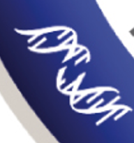
Hallmarks that promote breaking all the rules
Tumor-promoting inflammation
HOW:
MECHANISM/GENES INVOLVED:
EXAMPLE:
Genome instability and mutation
HOW:
MECHANISM/GENES INVOLVED:
EXAMPLE:

Slide 22
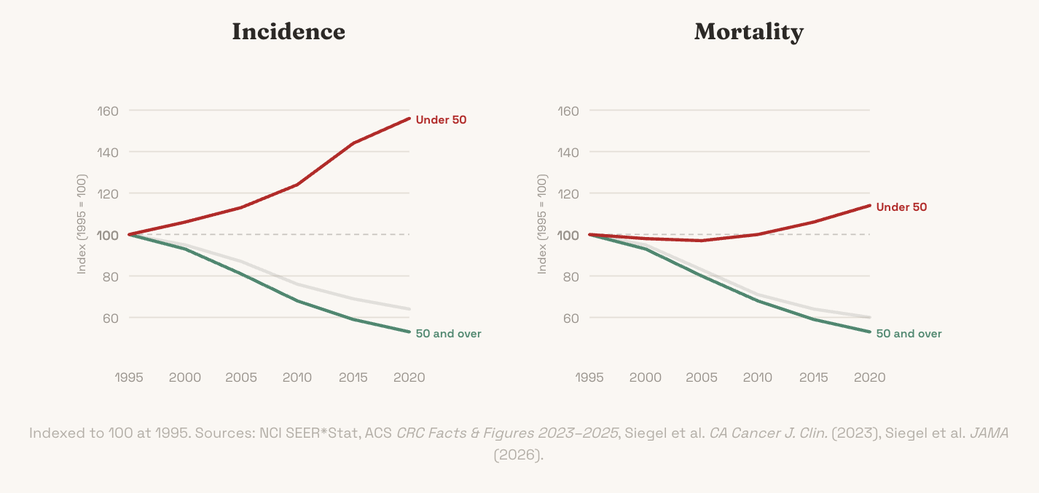

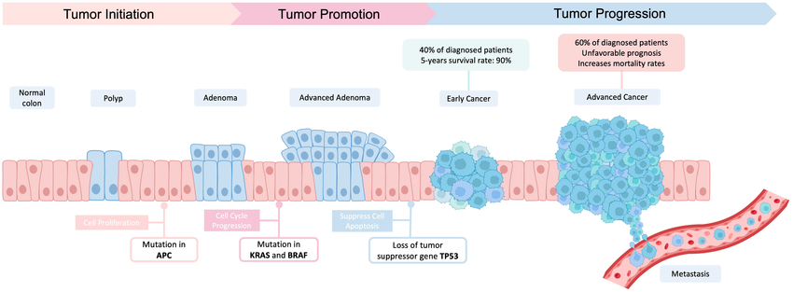
Exploring the hallmarks: everything is connected!
Colorectal Cancer (CRC)
Try running with only one of the hallmarks “active.”
  What happens when you only turn on “sustained growth signals” – and what keeps the cell from dividing?
  If the cell can only “resist apoptosis,” does it eventually spread?
Try different combinations
  How many hallmarks do you need for the cancer to grow?
  What about for it to metastasize (reach new sites)?
Once you feel comfortable with the first version, try the advanced version (extra six hallmarks added)
https://pmc.ncbi.nlm.nih.gov/articles/PMC11714384/#bib14
https://www.hankgreen.com/crc

Slide 23
Tumor staging (clinical data)
TNM Staging
T = Primary Tumor
TX Primary tumor cannot be evaluated
T0 No evidence of primary tumor
Tis Carcinoma in situ (early cancer that
has not spread to neighboring tissue)
T1, T2, T3, T4 Size and/or extent of the
primary tumor
N = Regional Lymph Nodes
NX Regional lymph nodes cannot be
evaluated
N0 No regional lymph node involvement
N1, N2, N3 Involvement of regional lymph
nodes (number and/or extent of spread)
M = Distant Metastasis
MX Distant metastasis cannot be
evaluated
M0 No distant metastasis
M1 Distant metastasis
STAGE
• Stage 0: Carcinoma in situ
• Stage I, Stage II, and Stage III:
Higher numbers indicate more extensive
disease: greater tumor size, and/or spread
of the cancer to nearby lymph nodes and/or
organs adjacent to the primary tumor.
• Stage IV The cancer has spread to
another organ.
SUMMARY STAGE
• In situ: early cancer present only in the
layer of cells in which it began
• Localized: limited to the organ in which it
began
• Regional: spread to nearby lymph nodes or
organs and tissues.
• Distant: spread to distant organs or distant
lymph nodes.
• Unknown

Slide 24
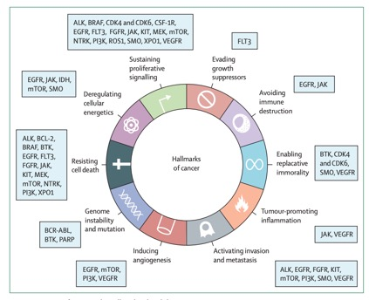
Treatment options
Chemotherapy: kills fast growing cells
Radiotherapy: radiation applied to specific organ/region containing tumor
  Causes DNA damage to kill proliferative cells
Targeted therapy: Targeting a specific deregulated or mutated gene, like growth factor receptors that are overactive
  Hormone therapy: targeting hormones that drive tumor growth
  Epigenetic therapy: targeting epigenetic mechanisms like DNA methylation/gene silencing
Immunotherapy: Enlisting immune cells to help kill the tumor
Targeted therapies by Hallmark Focus
https://doi.org/10.1016/S0140-6736(20)30164-1
Notes:
Chemotherapy: kills fast growing cells
Will preferentially kill cancer cells due to their proliferation but has many side effects/toxicities
Many target replication machinery directly to cause cell division to go haywire (this can actually lead to secondary cancers too!)
Radiotherapy: radiation applied to specific organ/region containing tumor
Causes DNA damage to kill proliferative cells
Targeted therapy: Targeting a specific deregulated or mutated gene, like growth factor receptors that are overactive
Hormone therapy: targeting hormones that drive tumor growth
Epigenetic therapy: targeting epigenetic mechanisms like DNA methylation/gene silencing
Immunotherapy: Enlisting immune cells to help kill the tumor
Removing the “don’t attack me” signals from cancer cells

Slide 25
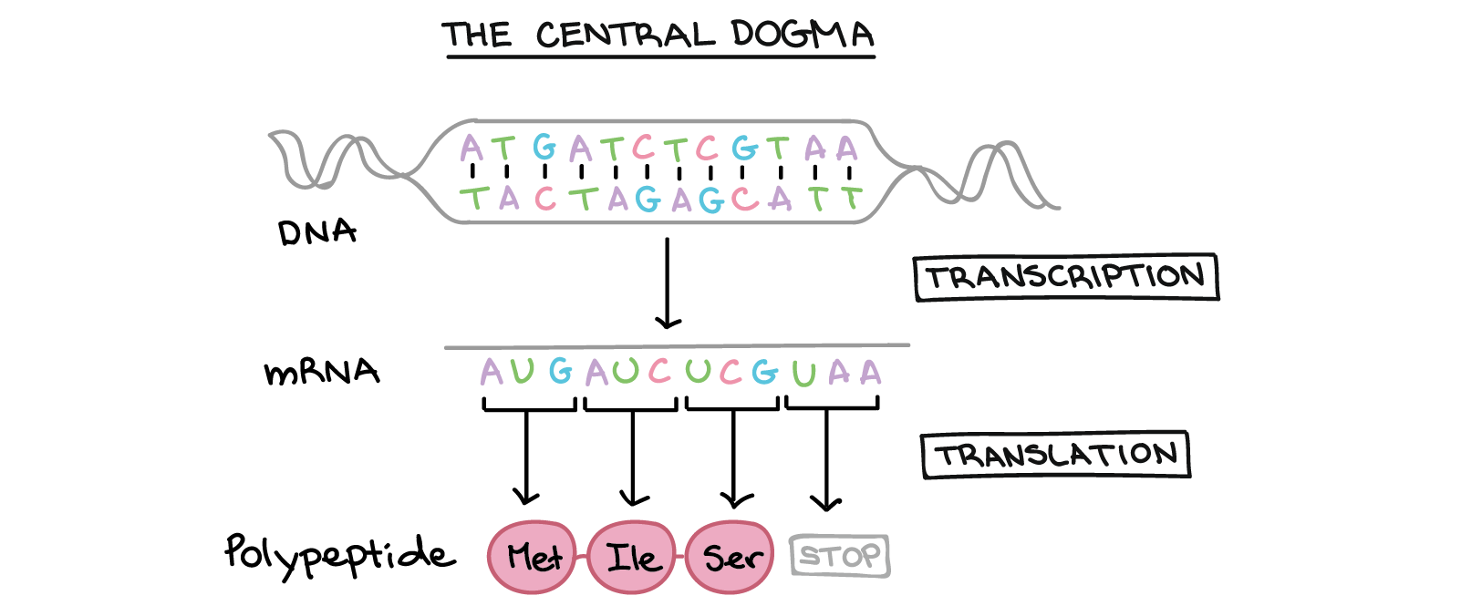
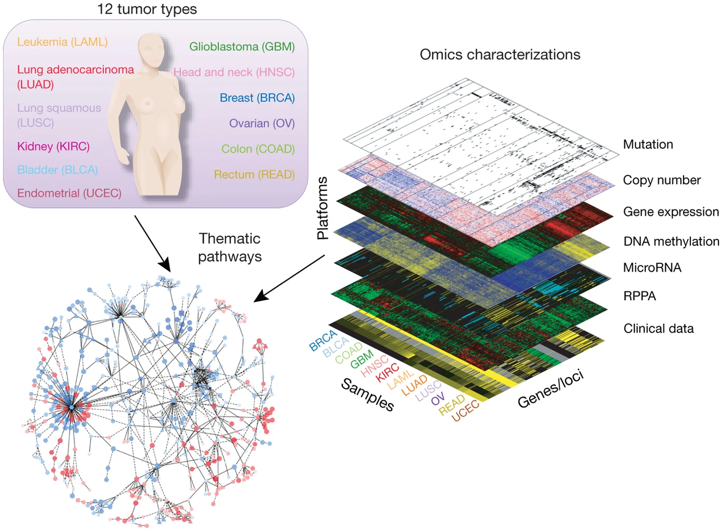
Preview of what’s coming… how do we know which rules are broken in different cancers?
We’ll use RNAseq data (gene expression data)
Mutations in oncogenes and tumor suppressors → abnormal gene expression patterns
Hallmarks organize data into “gene expression modules” = related genes that tend to be correlated or anti-correlated
  Often upregulated (turned UP) or turned OFF altogether
Mutations on this level (genome)
Affect “cell identity” on RNA level (transcriptome) “Live feed”
Proteins are made and accumulate to act as little machines
“Highlights reel”
The Cancer Genome Atlas (TCGA)
Notes:
Why RNA-seq is easy:
Universal chemistry: All RNA is the same chemistry (A, U, G, C nucleotides)
One protocol captures everything
Sequence-based detection works universally
Amplification is straightforward (PCR)
Comprehensive coverage:
RNA-seq captures the entire transcriptome in one experiment
~20,000 genes measured simultaneously
Unbiased - you see everything
Why proteomics is hard:
No universal chemistry: 20 different amino acids with wildly different chemical properties
Hydrophobic vs hydrophilic proteins need different extraction methods
No single protocol captures everything
Some proteins are membrane-bound, some cytoplasmic, some nuclear - need different prep
No amplification:
Can't amplify proteins like you can with PCR for RNA
You get what you get - if protein is low abundance, you might miss it
RNA: 1 gene → 1000s of copies → easy to detect
Mass spec limitations:
Mass spec (current gold standard) can detect maybe 5,000-10,000 proteins per sample
RNA-seq easily detects 15,000-20,000 transcripts
Missing ~half the proteome
Dynamic range problem:
Some proteins are super abundant (actin, tubulin)
Some are super rare (transcription factors)
Mass spec struggles to detect both in the same run
RNA-seq handles this better with deep sequencing

Slide 26
Deciding on a project goal: choices to make!
What hallmark of cancer will you focus on?
Do you want to focus on a single cancer type or look for patterns across cancer types?
Start to think about what kind of question you want to ask. Example question “scaffolds”:
  Is hallmark X predictive of survival in Y cancer type?
  Is hallmark X related to hallmark Y in Z cancer type?
  Can different cancer types be distinguished by X hallmark alone?
  Are there distinct groups of cancer types with hallmark X expression that respond to treatment in different ways?
  Does patient history of X predict expression of hallmark Y in Z cancer?
  Does expression of X hallmark predict Y tumor stage or Z treatment response?
Due Friday by midnight:
First GitHub Check-in with disease background, data background, and first pass at a question/project goal

