Slide 1

Module 4
Lecture 2
Introduction to RNA sequencing data
Sarah Groves, Ph.D.
Shayn Peirce-Cottler, Ph.D.

Slide 2
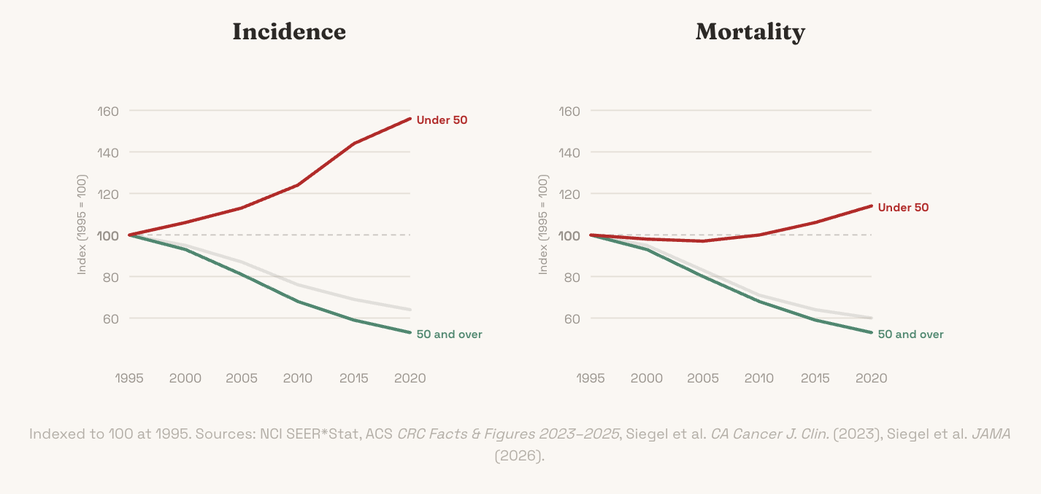
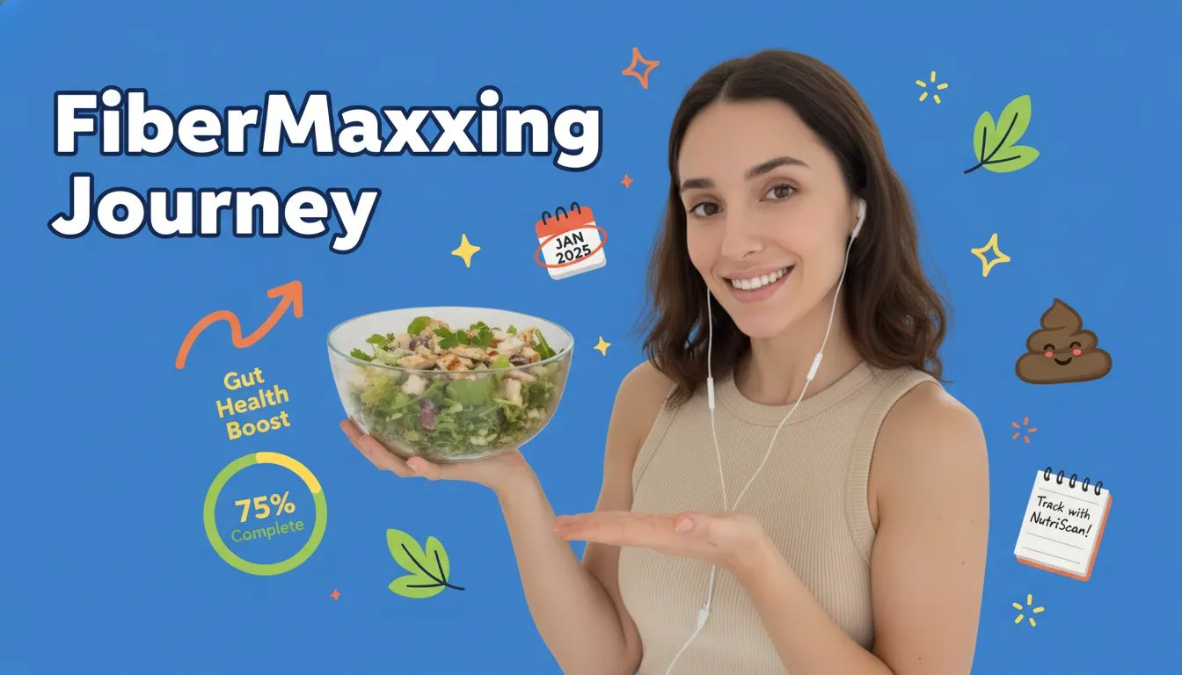
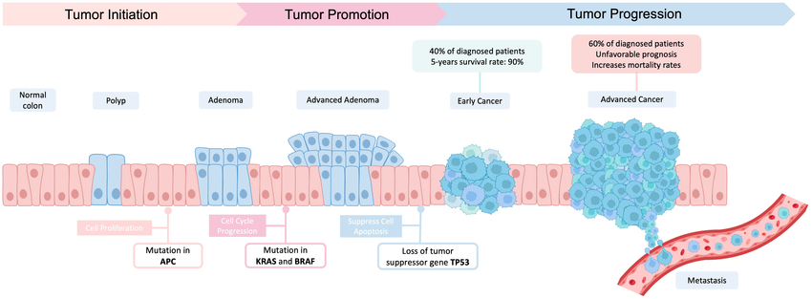
Exploring the hallmarks: everything is connected!
Colorectal Cancer (CRC)
Try running with only one of the hallmarks “active.”
  What happens when you only turn on “sustained growth signals” – and what keeps the cell from dividing?
  If the cell can only “resist apoptosis,” does it eventually spread?
Try different combinations
  How many hallmarks do you need for the cancer to grow?
  What about for it to metastasize (reach new sites)?
Once you feel comfortable with the first version, try the advanced version (extra six hallmarks added)
https://pmc.ncbi.nlm.nih.gov/articles/PMC11714384/#bib14
https://www.hankgreen.com/crc

Slide 3
In class discussion
What did you learn about the hallmarks and how they are connected?
  Need sustained growth signals in combo with any other ones
  Advanced sim: needed immune evasion
  Need more than one: normal cells are redundant
Which combination gave you the most interesting results and why?
  Sometimes killer t cells can still kills the cancer cells
  Immune evasion and genome instability

Slide 4
Tumor staging (clinical data)
TNM Staging
T = Primary Tumor
TX Primary tumor cannot be evaluated
T0 No evidence of primary tumor
Tis Carcinoma in situ (early cancer that
has not spread to neighboring tissue)
T1, T2, T3, T4 Size and/or extent of the
primary tumor
N = Regional Lymph Nodes
NX Regional lymph nodes cannot be
evaluated
N0 No regional lymph node involvement
N1, N2, N3 Involvement of regional lymph
nodes (number and/or extent of spread)
M = Distant Metastasis
MX Distant metastasis cannot be
evaluated
M0 No distant metastasis
M1 Distant metastasis
STAGE
• Stage 0: Carcinoma in situ
• Stage I, Stage II, and Stage III:
Higher numbers indicate more extensive
disease: greater tumor size, and/or spread
of the cancer to nearby lymph nodes and/or
organs adjacent to the primary tumor.
• Stage IV The cancer has spread to
another organ.
SUMMARY STAGE
• In situ: early cancer present only in the
layer of cells in which it began
• Localized: limited to the organ in which it
began
• Regional: spread to nearby lymph nodes or
organs and tissues.
• Distant: spread to distant organs or distant
lymph nodes.
• Unknown

Slide 5
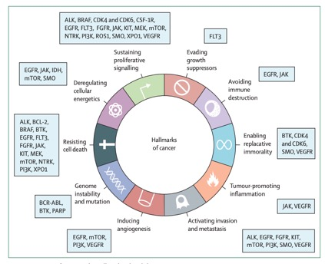
Treatment options
Chemotherapy: kills fast growing cells
Radiotherapy: radiation applied to specific organ/region containing tumor
  Causes DNA damage to kill proliferative cells
Targeted therapy: Targeting a specific deregulated or mutated gene, like growth factor receptors that are overactive
  Hormone therapy: targeting hormones that drive tumor growth
  Epigenetic therapy: targeting epigenetic mechanisms like DNA methylation/gene silencing
Immunotherapy: Enlisting immune cells to help kill the tumor
Targeted therapies by Hallmark Focus
https://doi.org/10.1016/S0140-6736(20)30164-1
Notes:
Chemotherapy: kills fast growing cells
Will preferentially kill cancer cells due to their proliferation but has many side effects/toxicities
Many target replication machinery directly to cause cell division to go haywire (this can actually lead to secondary cancers too!)
Radiotherapy: radiation applied to specific organ/region containing tumor
Causes DNA damage to kill proliferative cells
Targeted therapy: Targeting a specific deregulated or mutated gene, like growth factor receptors that are overactive
Hormone therapy: targeting hormones that drive tumor growth
Epigenetic therapy: targeting epigenetic mechanisms like DNA methylation/gene silencing
Immunotherapy: Enlisting immune cells to help kill the tumor
Removing the “don’t attack me” signals from cancer cells

Slide 6
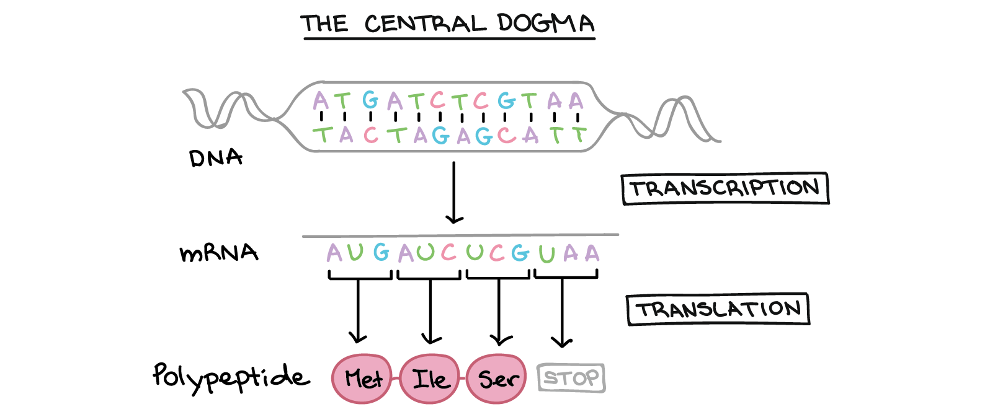
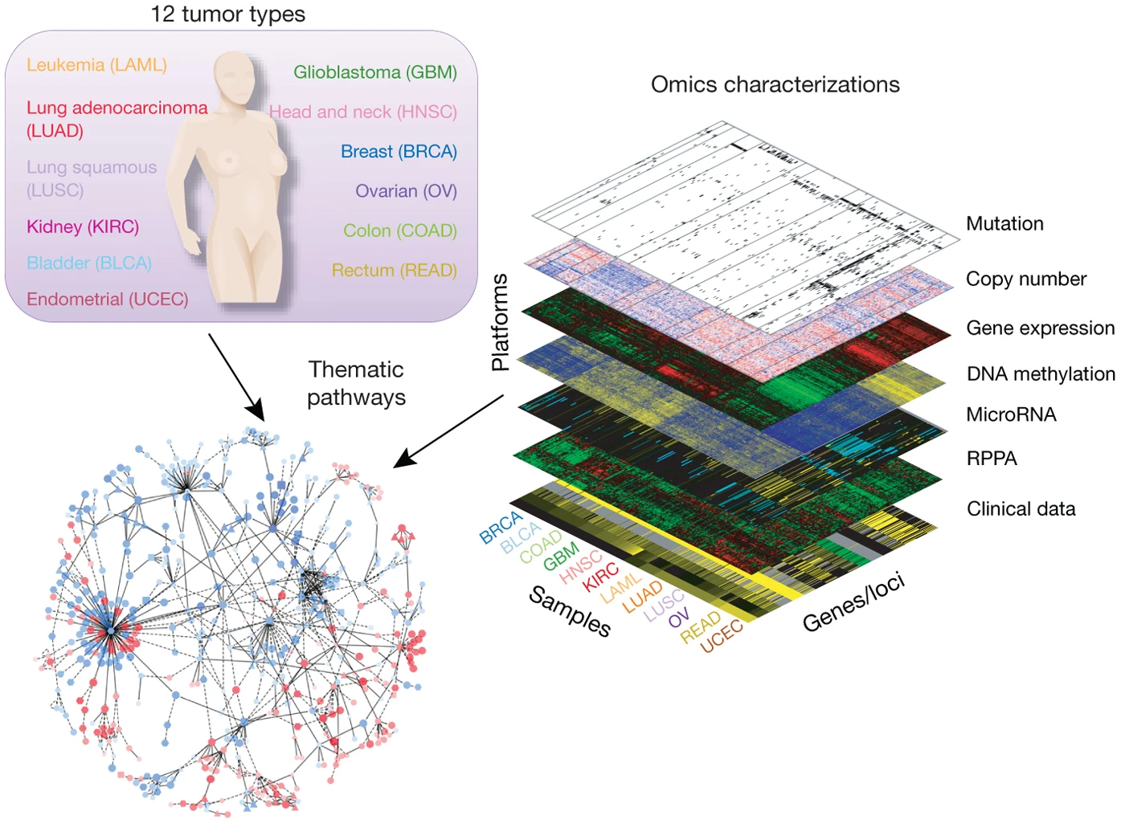
Preview of what’s coming… how do we know which rules are broken in different cancers?
We’ll use RNAseq data (gene expression data)
Mutations in oncogenes and tumor suppressors → abnormal gene expression patterns
Hallmarks organize data into “gene expression modules” = related genes that tend to be correlated or anti-correlated
  Often upregulated (turned UP) or turned OFF altogether
Mutations on this level (genome)
Affect “cell identity” on RNA level (transcriptome) “Live feed”
Proteins are made and accumulate to act as little machines
“Highlights reel”
The Cancer Genome Atlas (TCGA)
Notes:
Why RNA-seq is easy:
Universal chemistry: All RNA is the same chemistry (A, U, G, C nucleotides)
One protocol captures everything
Sequence-based detection works universally
Amplification is straightforward (PCR)
Comprehensive coverage:
RNA-seq captures the entire transcriptome in one experiment
~20,000 genes measured simultaneously
Unbiased - you see everything
Why proteomics is hard:
No universal chemistry: 20 different amino acids with wildly different chemical properties
Hydrophobic vs hydrophilic proteins need different extraction methods
No single protocol captures everything
Some proteins are membrane-bound, some cytoplasmic, some nuclear - need different prep
No amplification:
Can't amplify proteins like you can with PCR for RNA
You get what you get - if protein is low abundance, you might miss it
RNA: 1 gene → 1000s of copies → easy to detect
Mass spec limitations:
Mass spec (current gold standard) can detect maybe 5,000-10,000 proteins per sample
RNA-seq easily detects 15,000-20,000 transcripts
Missing ~half the proteome
Dynamic range problem:
Some proteins are super abundant (actin, tubulin)
Some are super rare (transcription factors)
Mass spec struggles to detect both in the same run
RNA-seq handles this better with deep sequencing

Slide 7
Deciding on a project goal: choices to make!
What hallmark of cancer will you focus on?
Do you want to focus on a single cancer type or look for patterns across cancer types?
Start to think about what kind of question you want to ask. Example question “scaffolds”:
  Is hallmark X predictive of survival in Y cancer type?
  Is hallmark X related to hallmark Y in Z cancer type?
  Can different cancer types be distinguished by X hallmark alone?
  Are there distinct groups of cancer types with hallmark X expression that respond to treatment in different ways?
  Does patient history of X predict expression of hallmark Y in Z cancer?
  Does expression of X hallmark predict Y tumor stage or Z treatment response?
Due Friday by midnight:
First GitHub Check-in with disease background, data background, and first pass at a question/project goal

Slide 8
Learning Objectives for Module 3: Cancer
I understand how machine learning methods use optimization of a cost function to determine the best answer to my research question.
I can use pandas and scikit-learn to work with RNA-seq data, apply a machine learning method to a dataset, and validate the model.
I understand the difference between supervised and unsupervised learning methods and know when to use them.
I know how to avoid overfitting and determine if my model is “good enough” using quantitative metrics.

Slide 9
Getting the data
Pull my upstream repo to get the metadata and sample EDA code
IMPORTANT: >100MB is TOO BIG to push and pull from Github
Instead, you should download the training and validation datasets from Canvas and add them to the data subfolder of your repository
  .gitignore set up so they don’t get tracked

Slide 10
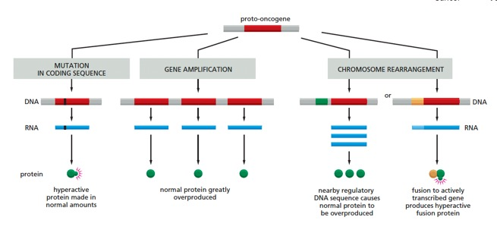
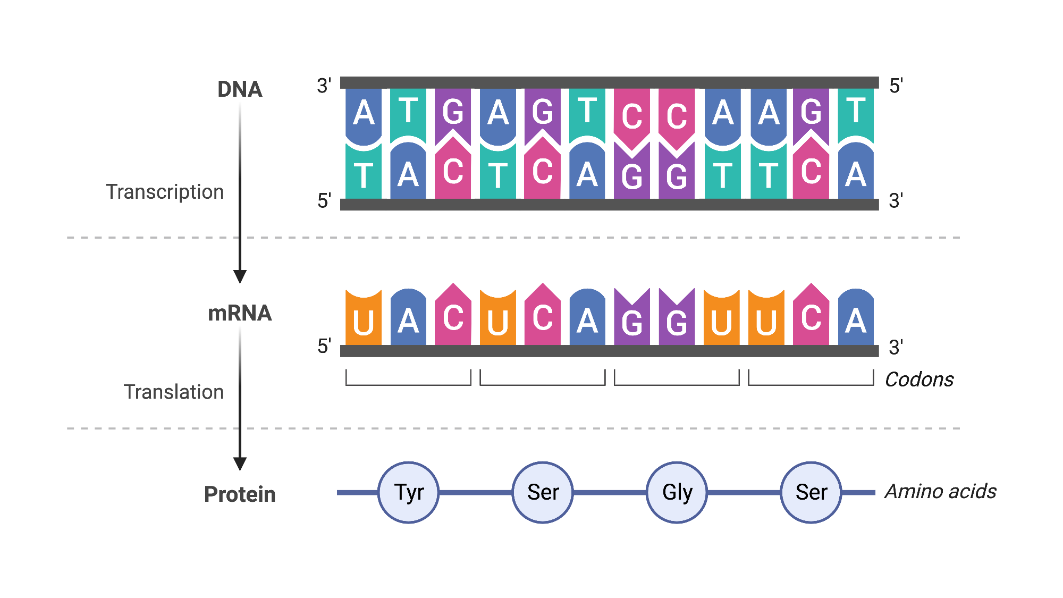
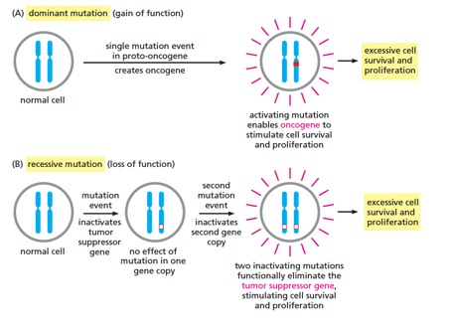
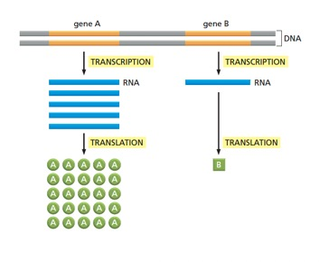
How mutations can affect gene expression
“Cell’s genome”
“Cell’s identity”
“Cell’s behavior”
Cell identity can be measured with sequencing

Slide 11
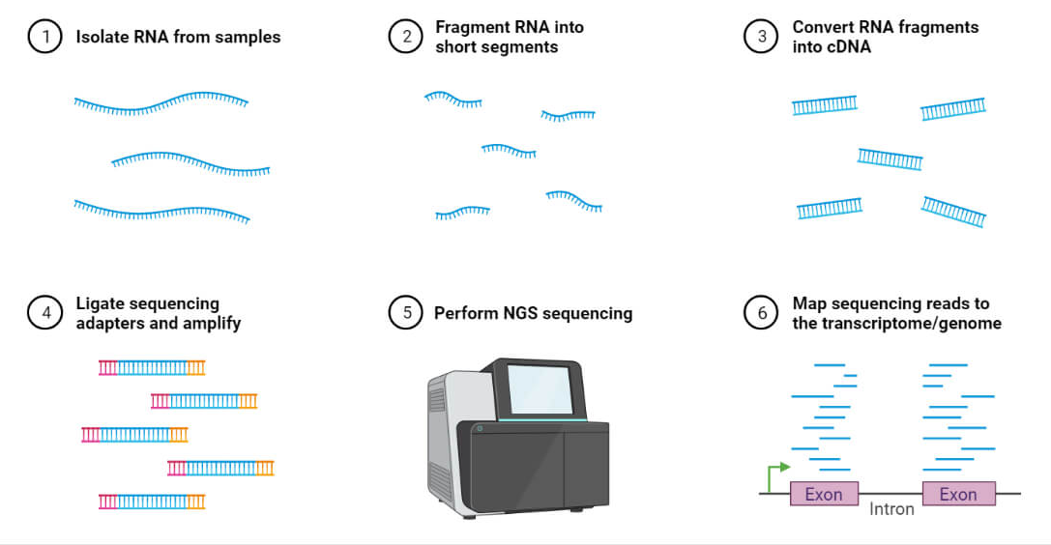
A brief overview of RNA sequencing
https://microbenotes.com/rna-sequencing-principle-steps-types-uses/
https://www.rna-seqblog.com/rpkm-fpkm-and-tpm-clearly-explained/
Notes:
When you use TPM, the sum of all TPMs in each sample are the same. This makes it easier to compare the proportion of reads that mapped to a gene in each sample. In contrast, with RPKM and FPKM, the sum of the normalized reads in each sample may be different, and this makes it harder to compare samples directly.
Here’s an example. If the TPM for gene A in Sample 1 is 3.33 and the TPM in sample B is 3.33, then I know that the exact same proportion of total reads mapped to gene A in both samples. This is because the sum of the TPMs in both samples always add up to the same number (so the denominator required to calculate the proportions is the same, regardless of what sample you are looking at.)
With RPKM or FPKM, the sum of normalized reads in each sample can be different. Thus, if the RPKM for gene A in Sample 1 is 3.33 and the RPKM in Sample 2 is 3.33, I would not know if the same proportion of reads in Sample 1 mapped to gene A as in Sample 2. This is because the denominator required to calculate the proportion could be different for the two samples.

Slide 12
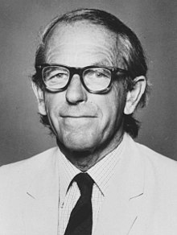
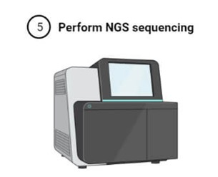
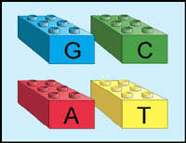
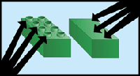
Sequencing DNA
Sanger sequencing
First generation sequencing technology
The technology used to sequence the human genome
Still used widely today (though not for large-scale applications)
Depends on dideoxynucleotides – analogous to a faulty lego that doesn’t stack
Frederick Sanger
1980 Nobel Prize for Sequencing Research

Slide 13
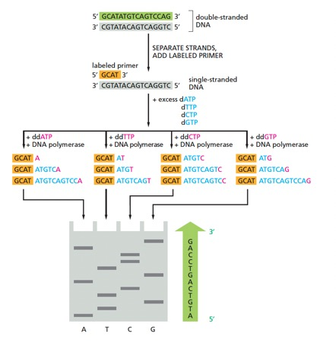
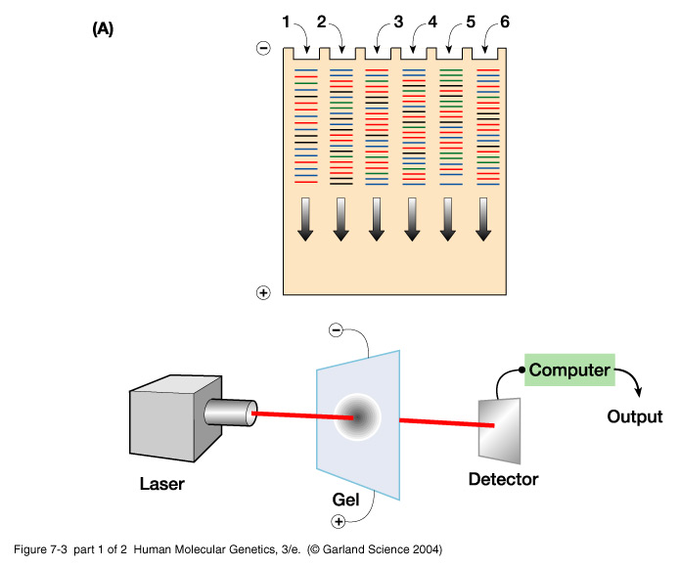
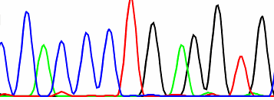
Sanger sequencing & automated Sanger sequencing

Slide 14
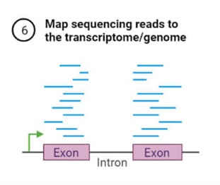

From raw sequencing reads to “gene counts”
Counts per exon (transcribed gene chunk)
Longer genes will generate more fragments even if the gene isn’t transcribed more
→ normalize by gene length
Reads / length of gene = RPK
Tumor samples wont all have the same total number of reads
→ normalize by “library size”
Divide by $\frac{total RPK}{1,000,000}$
Alignment (FASTQ to BAM)
TPM
Our data is log-transformed TPM values

Slide 15
Dataset and metadata
The Cancer Genome Atlas RNA-seq dataset, re-processed by Rahman et al. (see paper on Canvas)
  24 cancer types (abbreviations are spelled out in paper)
I subsetted the data to include:
  ~50-100 tumors per cancer type (1802 out of 9264 total tumor samples)
Metadata includes ~20 columns from original 526
  Note that not all metadata has values across cancer types!

Slide 16
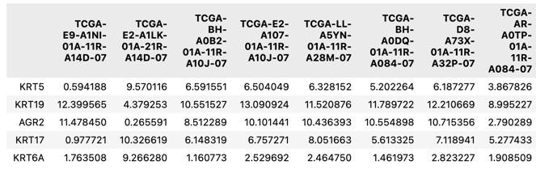
Data: genes X samples, log₂(TPM+1)

Slide 17
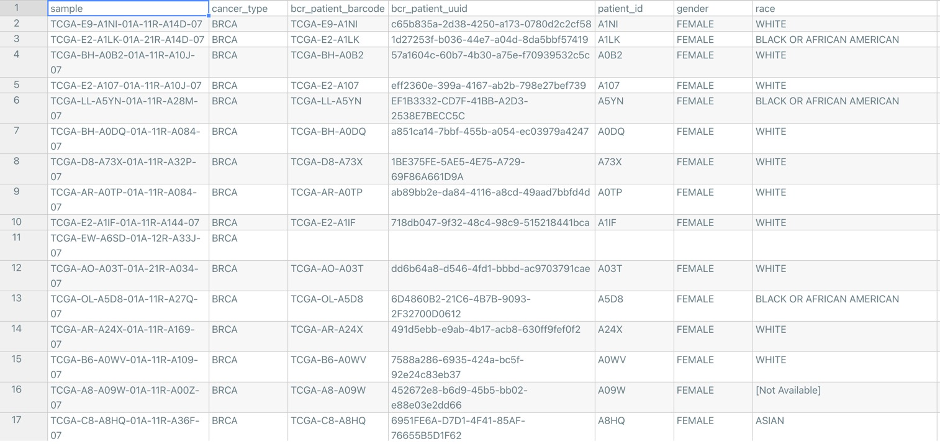
Metadata: tumor samples X features

Slide 18
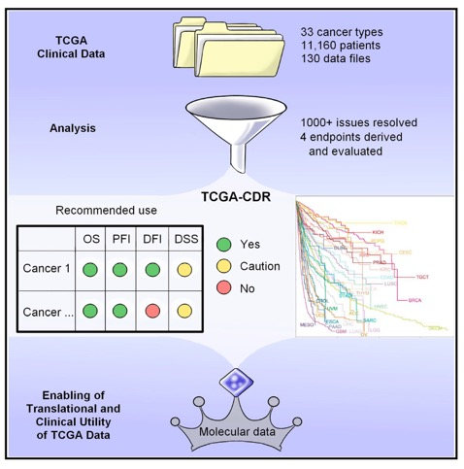
Survival data for each sample from Pan-Cancer Clinical Data Resource (Liu et al. 2018)
Overall survival (OS): the period from the date of diagnosis until the date of death from any cause
  Requires long follow ups not available for all TCGA samples
Disease-specific survival (DSS): death from the diagnosed cancer type
  Avoids counting deaths that are not due to the cancer
Progression-free interval: the period from the date of diagnosis until the date of the first occurrence of a new tumor event (NTE)
Disease-free interval: the period from the date of diagnosis until the date of the first new tumor progression event subsequent to the determination of a patient’s disease-free status after their initial diagnosis and treatment
“Definitions and derivation of clinical survival outcome endpoints”
If you want to use this survival data, look at the paper to determine which metric can be used for your cancer type!

Slide 19
Using pandas to explore a dataset
See example_EDA.py file for example exploratory data analysis
What data is missing in the dataset or metadata?
What is the minimum log(TPM+1) value? The maximum in the dataset?
What is the average expression across all genes?
Can you find the genes with the highest average expression?
Can you make a scatterplot comparing the expression of two genes of interest?
NOTE: FOCUS YOUR ANALYSIS ON THE TRAINING DATA!!
WE WILL NOT NEED THE VALIDATION DATA UNTIL WE BUILD AN ML MODEL
WE WILL NOT NEED THE TEST DATA UNTIL EVALUATION OF THE MODEL

Slide 20
Homework
Due tomorrow 11:59pm: Jupyter notebook check-in
  Disease background (including hallmark chosen and cancer type chosen)
  Dataset background
    You should have information about what genes you will be looking at
    For machine learning to “work well,” we want a good number of “features” (genes)
    You should ensure that the gene/gene set you chose is actually in the dataset! Sometimes protein and gene names are different, so you may need to look for a few different names
    Answer some of the exploratory data analysis questions as you write about the data.
  Preliminary question you’d like to answer
Due 4/14 (by next class): Andrew Ng videos (intro level) and comprehension quiz
  These intro videos give overviews of supervised and unsupervised learning methods so we can hit the ground running next class!

