Slide 1

Module 3
Lecture 4
Introduction to Machine Learning:
Unsupervised Learning
Sarah Groves, Ph.D.
Shayn Peirce-Cottler, Ph.D.

Slide 2
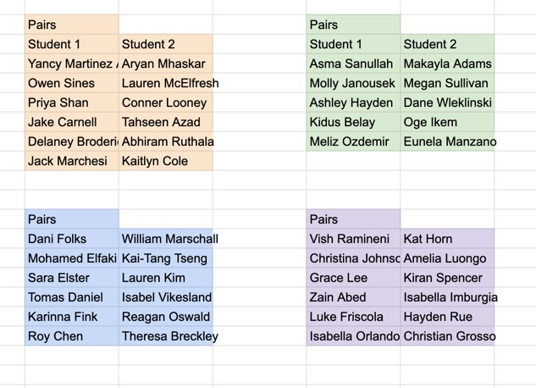

Slide 3
Learning Objectives for Module 3: Cancer
I can answer the question “what is cancer?” and explain what the hallmarks of cancer are.
I can use pandas and scikit-learn to work with RNA-seq data, apply a machine learning method to a dataset, and validate the model.
I understand the difference between supervised and unsupervised learning methods and know when to use them.
I understand how machine learning methods use optimization of a cost function to determine the best answer to my research question.
I know how to avoid overfitting and determine if my model is “good enough” using quantitative metrics.

Slide 4
Where we are so far…
STEP 1: Learn about cancer (and a specific cancer type if desired!)
STEP 2: Explore the data-set (you will be given one)
STEP 3: Ask a question related to the data set that you are curious about
STEP 4: Visualize the data with dimensionality reduction (unsupervised)
STEP 5: Implement clustering, regression, or classification using Python/scikit-learn to answer the question (supervised)
STEP 6: Verify and validate the answer using ML metrics
STEP 7: Draw conclusions and reflect on the ethical implications
STEP 8: Communicate your question’s background, methods, conclusions, limitations, implications, and future work
Due Thursday April 9 by class:
Cancer Hallmark ABM simulations activity
Week 1
Due Friday April 10 midnight:
GitHub Check-in #1
Due Tuesday April 14 by class:
Video comprehension quiz
Week 2
Due Friday April 17 midnight:
GitHub Check-in #2
Week 3
Due Friday April 24 midnight:
GitHub Check-in #3
Week 4
Due Tuesday May 5 midnight:
Final Project
Presentations: May 5 2pm (Final exam block)

Slide 5
Let’s pick genes specific to our hallmark of interest
Pull my upstream remote branch
Open EDA.py and in_class_DR_clustering.ipynb
  How many total genes are in the dataset?
  How do we visualize this?
To get a comprehensive picture of the hallmark activity, use a “gene set”: genes with coordinated expression related to a hallmark
  https://cancerhallmarks.com/download

Slide 6
Using sci-kit learn for machine learning
Check out the User Guide on sklearn website!
conda activate BME2315
pip install scikit-learn
https://scikit-learn.org/stable/modules/generated/sklearn.linear_model.LinearRegression.html
Notes:
Done by 9:50

Slide 7
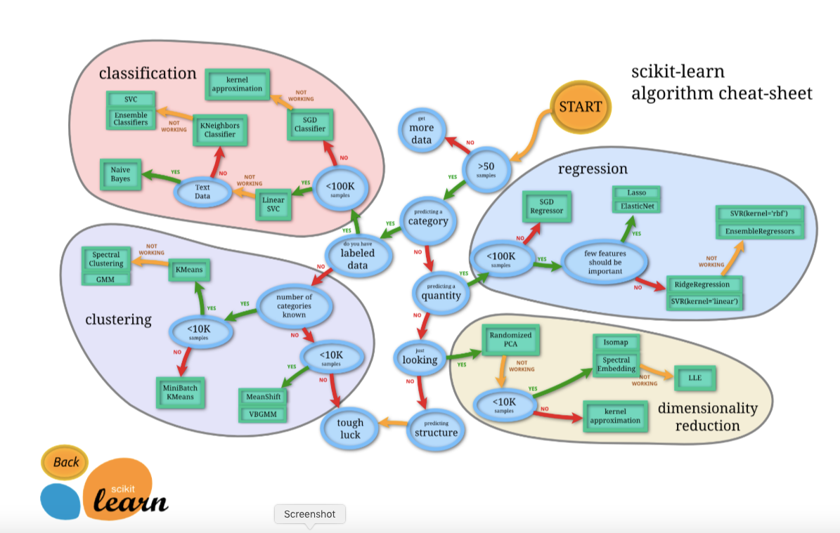

Slide 8
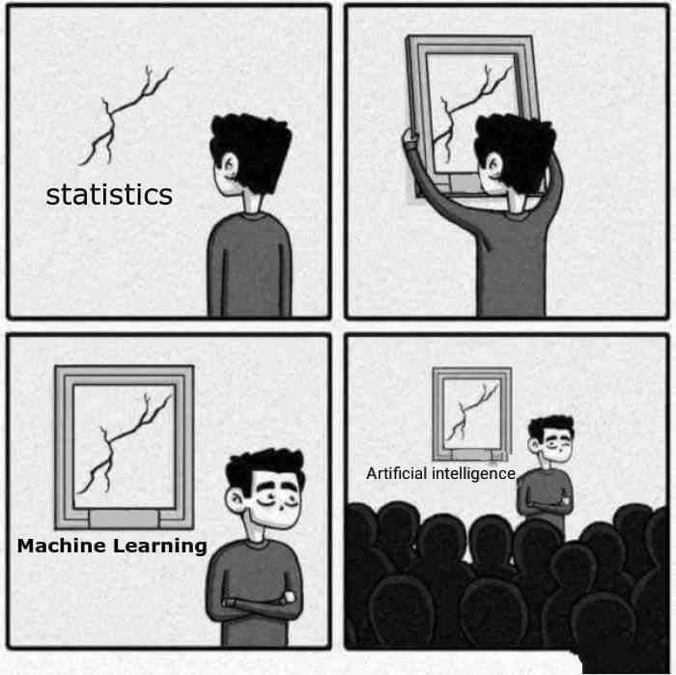
Unsupervised learning methods
I have “unlabeled” data
  No labels or “right answers” (or the labels given are irrelevant to my question)
  I want to find patterns or structure in the data
Dimensionality reduction
  Preserve information while reducing features
  PCA
  Manifold learning (UMAP, tSNE)
Clustering
  K-means
  Hierarchical clustering
  DBSCAN
Anomaly detection
  Finding unusual data points
Notes:
9:50

Slide 9
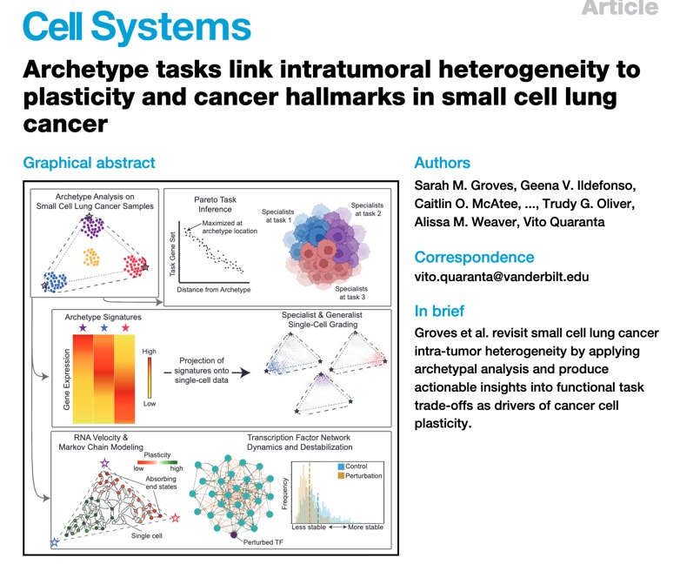
Dimensionality reduction and manifold learning
Problem: our data has thousands of features (genes)
  Even after subsetting to a hallmark,
  We need a way to look at the “most important” dimensions in 2D or 3D
“What gene shows the most variable expression across breast cancer?” (PCA)
“Is there a pattern of continuous cell identity (i.e. plasticity) connecting small cell lung cancer subtypes?” (manifold learning)
WE ARE ALL GOING TO USE DIMENSIONALITY REDUCTION TO VISUALIZE OUR DATA!

Slide 10
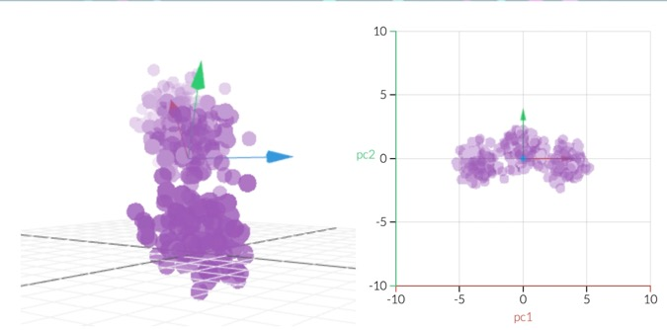
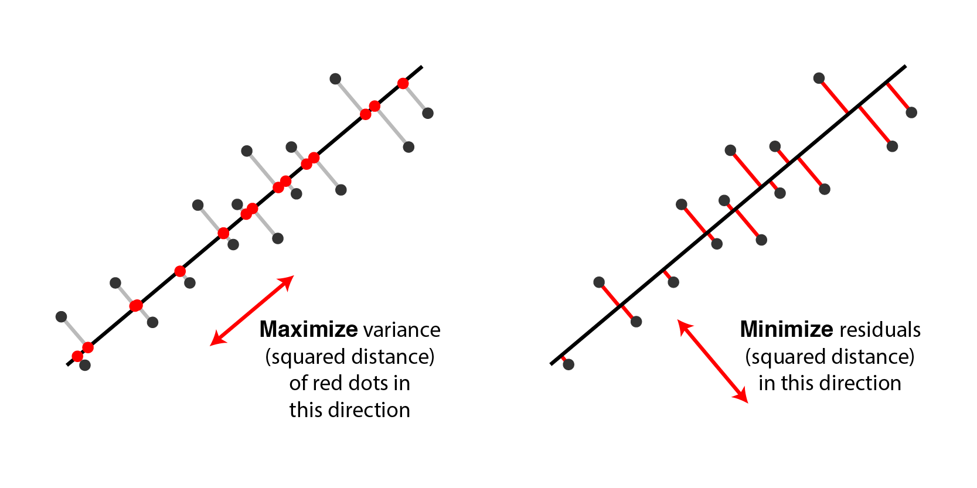
Matrix Factorization/Decomposition: PCA
Find the “directions” in the dataset that give the most information (have the most variance)
  Done by “decomposing” the matrix of data (genes/features x samples) into new features (PC1, PC2, etc)
  Each PC is a combination of the old features
  Each PC is orthogonal (90deg) from others
  Maximizing variance ~ minimizing the distance of the projection in a least-squares sense
Very useful for visualizing high-dimensional data
  Can plot things like cluster labels on top of the PCA for communicating clustering results visually
https://setosa.io/ev/principal-component-analysis/
https://alexhwilliams.info/itsneuronalblog/2016/03/27/pca/
Notes:
10

Slide 11
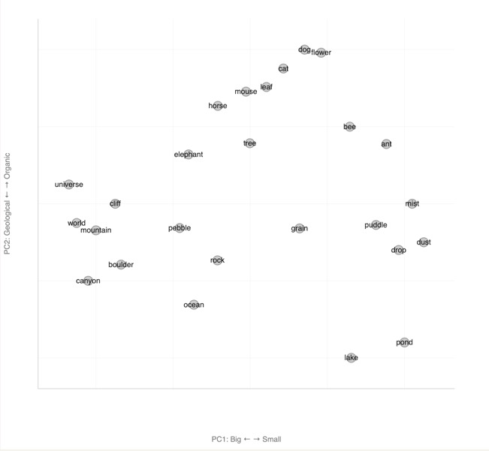
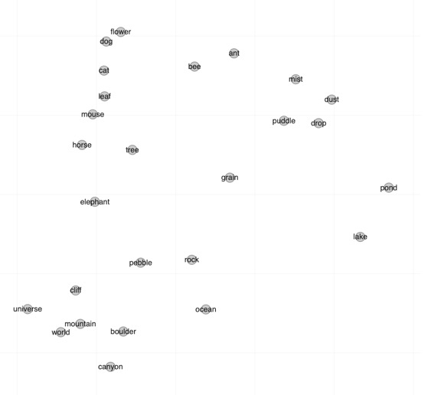

Slide 12
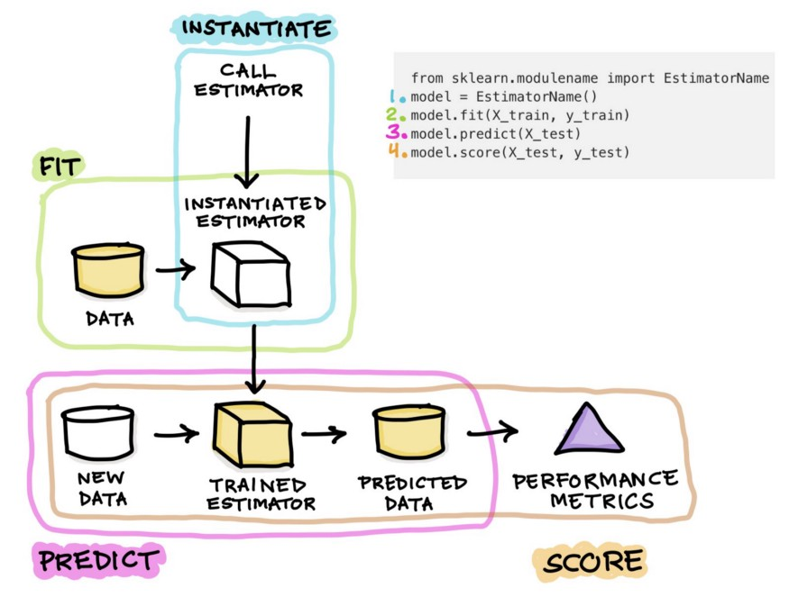
How to use ANY sklearn model/estimator
X_train = features you want to train the model on
y_train = if you have labeled data, this is the “target”
X_test & Y_test = new dataset
Or transform

Slide 13
How to use PCA from the sklearn.decomposition module
X = data # features X samples
#instantiate model
pca = PCA(n_components=2)
#fit the PCA to data AND transform that same data
X_pca = pca.fit_transform(X)
#X_pca = transformed dataset
#pca.Attribute = info about model

Slide 14

Understanding sci-kit learn via the API
conda activate BME2315
pip install scikit-learn
https://www.menti.com/al29szz58jmf

Slide 15
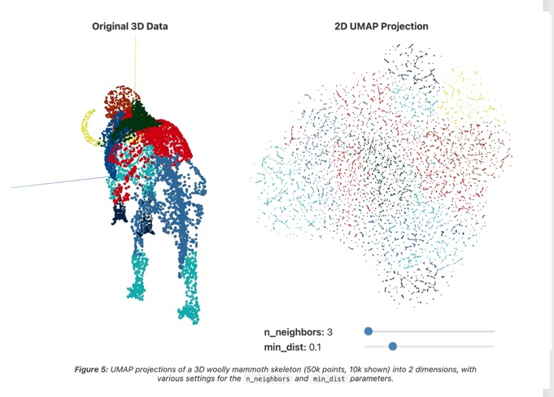
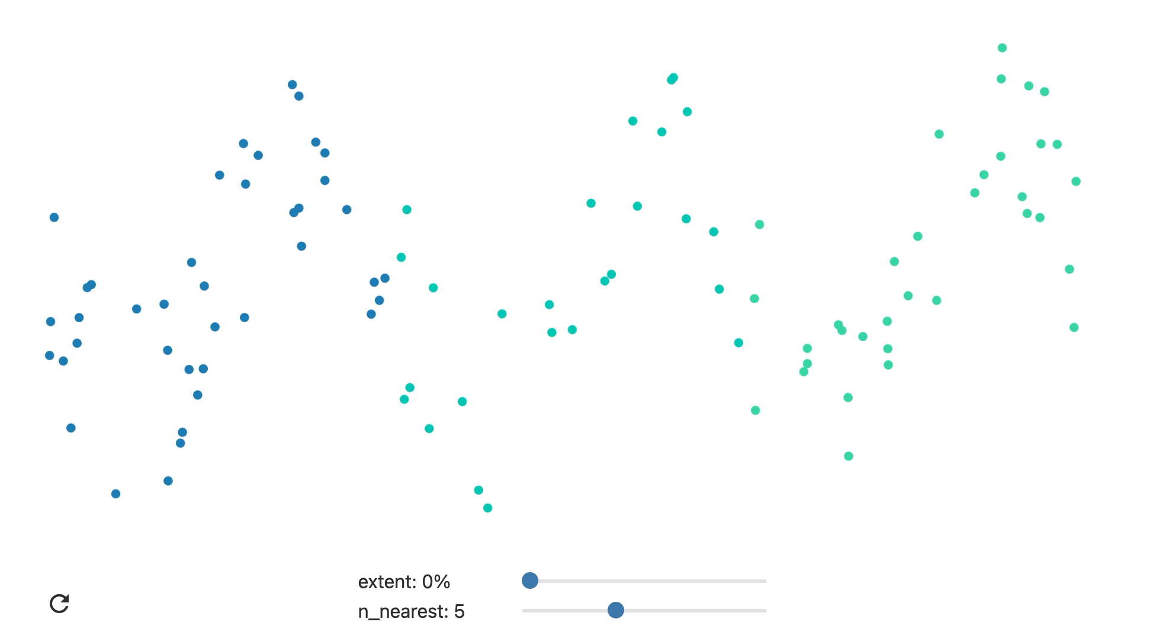
Manifold learning: UMAP
High-dimensional data often lies on a lower-dimensional, non-linear “manifold” (like a curved surface)
“Fuzzy graph” where each data point is connected to its nearest neighbors
  Preserves high-dimensional structure
Optimize the layout of the graph in 2D
https://biostatsquid.com/umap-simply-explained/
https://pair-code.github.io/understanding-umap/
Notes:
10:05
The most important parameter is n_neighbors - the number of approximate nearest neighbors used to construct the initial high-dimensional graph. It effectively controls how UMAP balances local versus global structure - low values will push UMAP to focus more on local structure by constraining the number of neighboring points considered when analyzing the data in high dimensions, while high values will push UMAP towards representing the big-picture structure while losing fine detail.
The second parameter we’ll investigate is min_dist, or the minimum distance between points in low-dimensional space. This parameter controls how tightly UMAP clumps points together, with low values leading to more tightly packed embeddings. Larger values of min_dist will make UMAP pack points together more loosely, focusing instead on the preservation of the broad topological structur

Slide 16
Where we are so far…
STEP 1: Learn about cancer (and a specific cancer type if desired!)
STEP 2: Explore the data-set (you will be given one)
STEP 3: Ask a question related to the data set that you are curious about
STEP 4: Visualize the data with dimensionality reduction (unsupervised)
STEP 5: Implement clustering, regression, or classification using Python/scikit-learn to answer the question (supervised)
STEP 6: Verify and validate the answer using ML metrics
STEP 7: Draw conclusions and reflect on the ethical implications
STEP 8: Communicate your question’s background, methods, conclusions, limitations, implications, and future work
Week 1
Due Thursday April 9 by class:
Cancer Hallmark ABM simulations activity
Due Friday April 10 midnight:
GitHub Check-in #1
Week 2
Due Tuesday April 14 by class:
Video comprehension quiz
Due SUNDAY APRIL 19 midnight:
GitHub Check-in #2
Week 3
Due SUNDAY APRIL 26 midnight:
GitHub Check-in #3
Week 4
Due Tuesday May 5 midnight:
Final Project
Presentations: May 5 2pm (Final exam block)

Slide 17
Recap from last class
PCA
Find axes of highest variance(pca.fit()) and rotate the datato view it from the new axes (pca.transform())
Each new axis is meaningful and tells you something about the underlying patterns in the features
UMAP
Perform a nonlinear transformation by:
  building a “fuzzy graph” that connects the neighbors in high-dimensional space
  Figure out a good way to “smoosh” this graph into two dimensions that preserves the high-dimensional structure
Visualizes a manifold through the data

Slide 18
Implementing PCA with sklearn
in_class_DR_clustering.ipynb

Slide 19
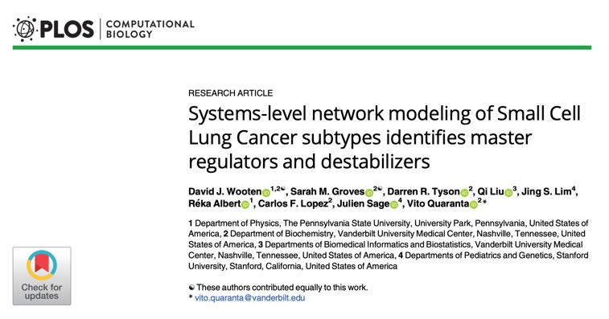
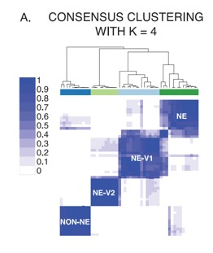
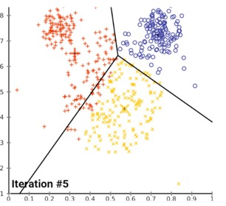
K-means clustering
Used when we want to find groups of commonality in the data
“Are there subgroups of small cell lung cancer based on the expression of key transcription factors?”
We need to tell the algorithm how many clusters to look for
Randomly place “centroids”
Assign each sample to the closest centroid
Move the centroids so they are actually in the middle of all the points assigned to them
Cost function: minimize the mean distance (norm) between samples and centroids
https://www.naftaliharris.com/blog/visualizing-k-means-clustering/
Notes:
10:10

Slide 20
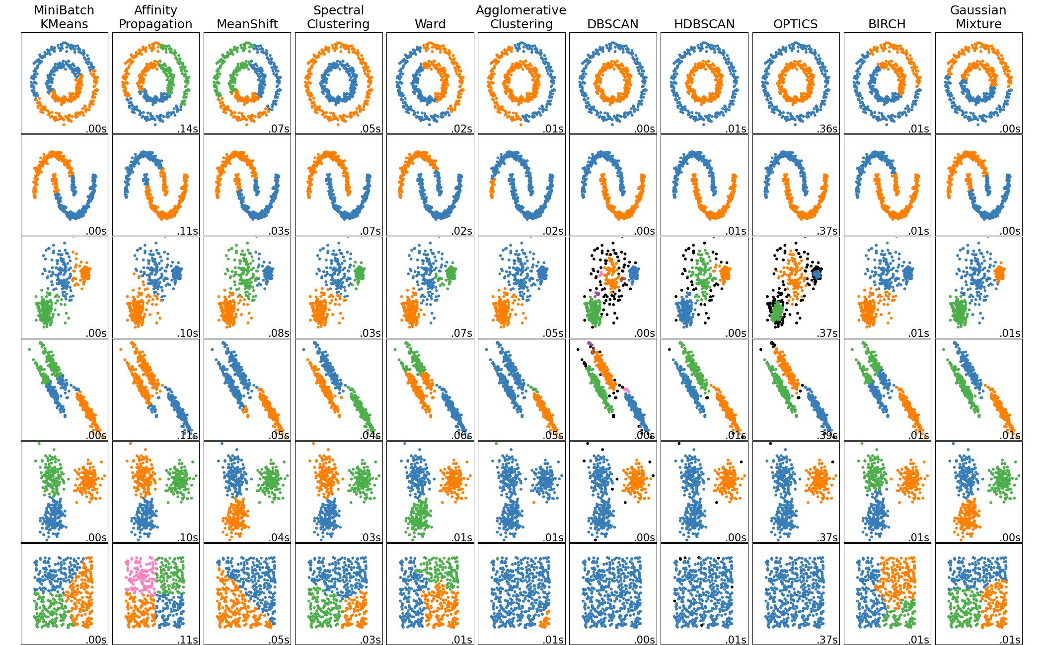
Hierarchical clustering and DBSCAN
HC: group most similar samples and then groups of groups
DBSCAN: groups densely packed points while avoiding low-density regions

Slide 21
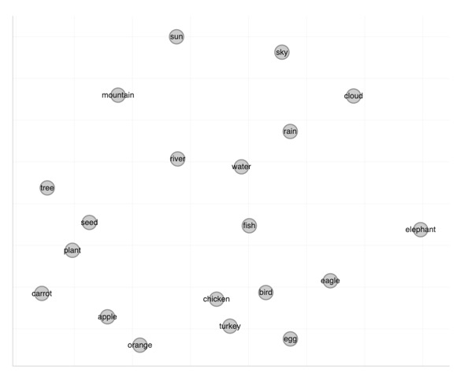
Hierarchical clustering and DBSCAN

Slide 22
Understanding sci-kit learn via the API
conda activate BME2315
pip install scikit-learn
https://www.menti.com/al29szz58jmf

Slide 23
In class work time on your projects
Reduce the dataset to the cancer type(s) of interest and genes of interest related to your hallmark(s).
  You should have >10 genes, but >100 is even better!
Visualize your data with a PCA
  Color the PCA by important features (at least two different views related to your project goal)
Choose one of the following:
  Visualize your data with a UMAP
  Use clustering on your data and visualize the clusters on the PCA
If you need to refine your question/project goal, do so!
2nd check-in: All the red should be completed!

