Slide 1

Module 4
Lecture 4
Introduction to Machine Learning:
Clustering & Supervised Learning
Sarah Groves, Ph.D.
Shayn Peirce-Cottler, Ph.D.

Slide 2
Where we are so far…
STEP 1: Learn about cancer (and a specific cancer type if desired!)
STEP 2: Explore the data-set (you will be given one)
STEP 3: Ask a question related to the data set that you are curious about
STEP 4: Visualize the data with dimensionality reduction (unsupervised)
STEP 5: Implement clustering, regression, or classification using Python/scikit-learn to answer the question (supervised)
STEP 6: Verify and validate the answer using ML metrics
STEP 7: Draw conclusions and reflect on the ethical implications
STEP 8: Communicate your question’s background, methods, conclusions, limitations, implications, and future work
Week 1
Due Thursday April 9 by class:
Cancer Hallmark ABM simulations activity
Due Friday April 10 midnight:
GitHub Check-in #1
Week 2
Due Tuesday April 14 by class:
Video comprehension quiz
Due SUNDAY APRIL 19 midnight:
GitHub Check-in #2
Week 3
Due SUNDAY APRIL 26 midnight:
GitHub Check-in #3
Week 4
Due Tuesday May 5 midnight:
Final Project
Presentations: May 5 2pm (Final exam block)

Slide 3
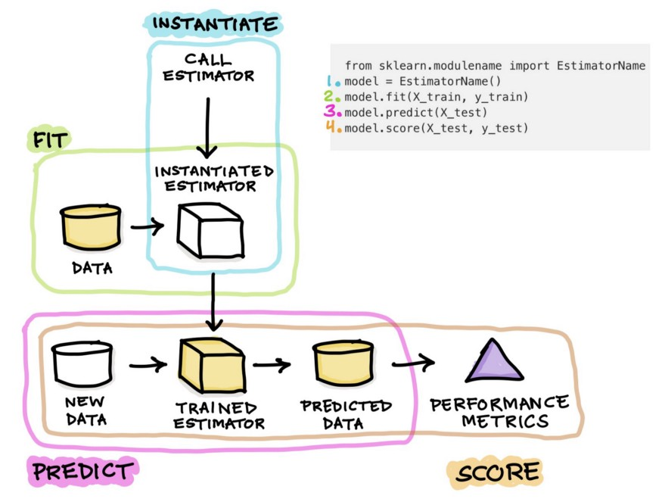
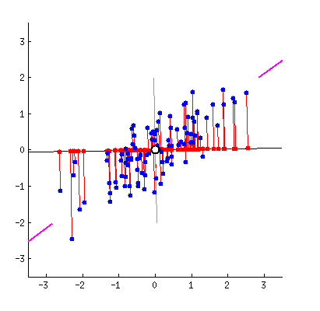
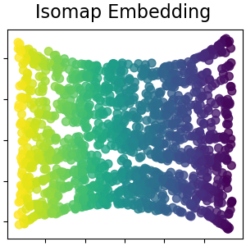
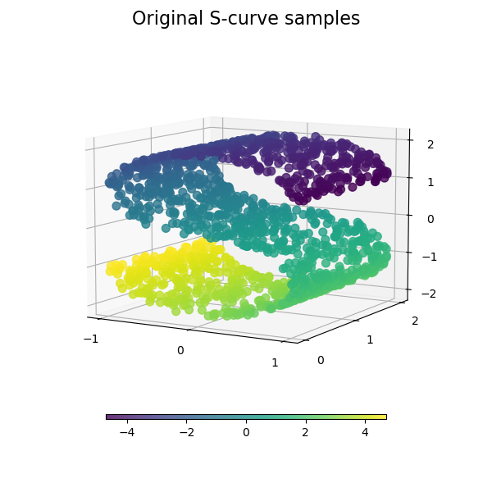
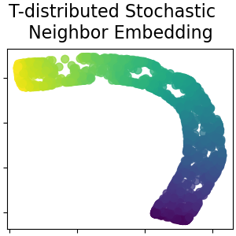
Recap from last class
PCA
Find axes of highest variance(pca.fit()) and rotate the datato view it from the new axes (pca.transform())
Each new axis is meaningful and tells you something about the underlying patterns in the features
Manifold learning (UMAP)
Perform a nonlinear transformation by:
  building a “fuzzy graph” that connects the neighbors in high-dimensional space
  Figure out a good way to “smoosh” this graph into two dimensions that preserves the high-dimensional structure
Learns a manifold through the data

Slide 4
Implementing PCA with sklearn
in_class_DR_clustering.ipynb

Slide 5
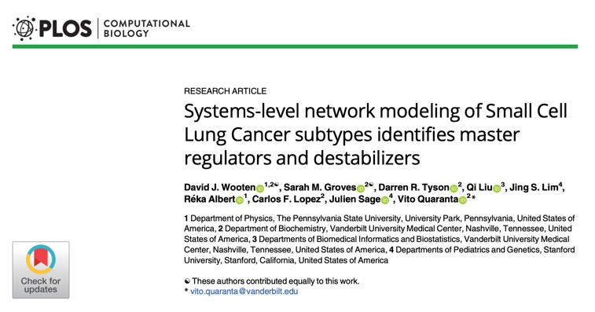
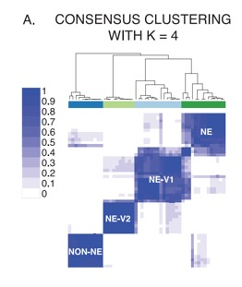
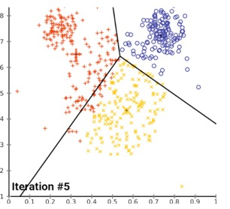
K-means clustering
Used when we want to find groups of commonality in the data
“Are there subgroups of small cell lung cancer based on the expression of key transcription factors?”
We need to tell the algorithm how many clusters to look for
Randomly place “centroids”
Assign each sample to the closest centroid
Move the centroids so they are actually in the middle of all the points assigned to them
Cost function: minimize the mean distance (norm) between samples and centroids
https://www.naftaliharris.com/blog/visualizing-k-means-clustering/
Notes:
10:10

Slide 6
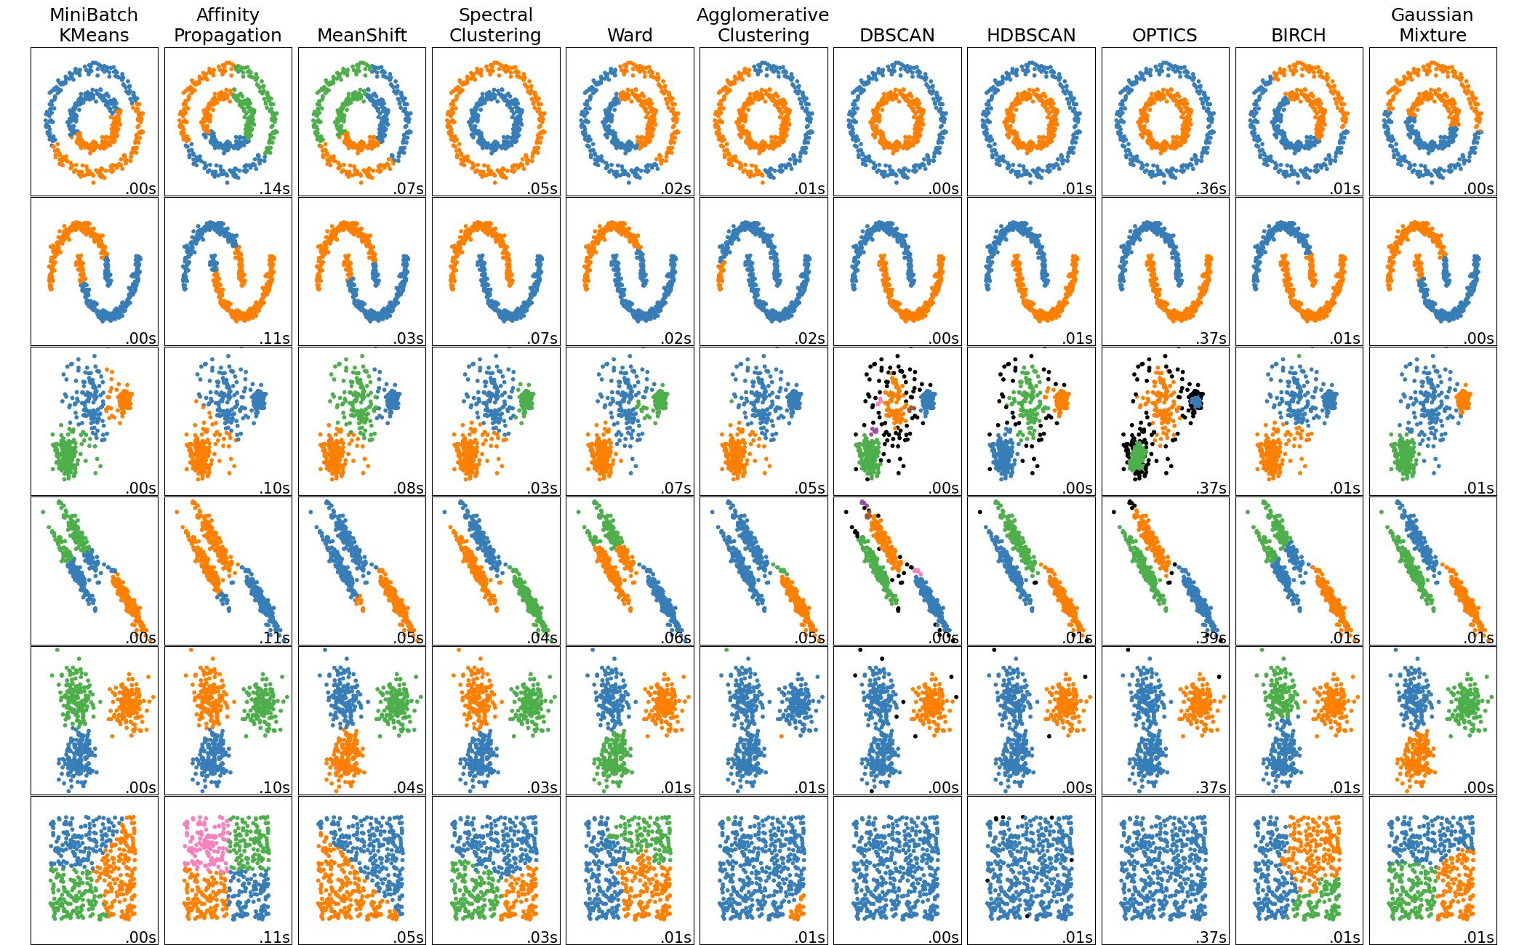
Hierarchical clustering and DBSCAN
HC: group most similar samples and then groups of groups
DBSCAN: groups densely packed points while avoiding low-density regions

Slide 7
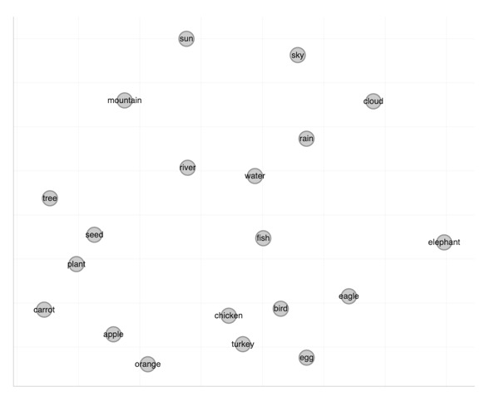
Hierarchical clustering and DBSCAN

Slide 8
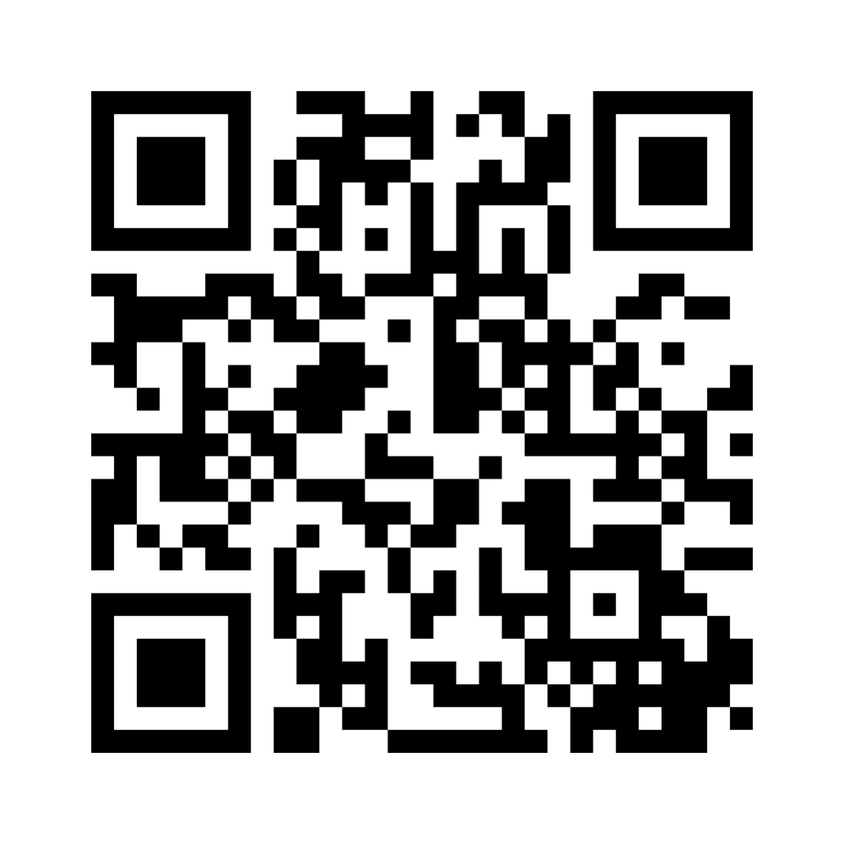
Understanding sci-kit learn via the API
conda activate BME2315
pip install scikit-learn
https://www.menti.com/al29szz58jmf

Slide 9
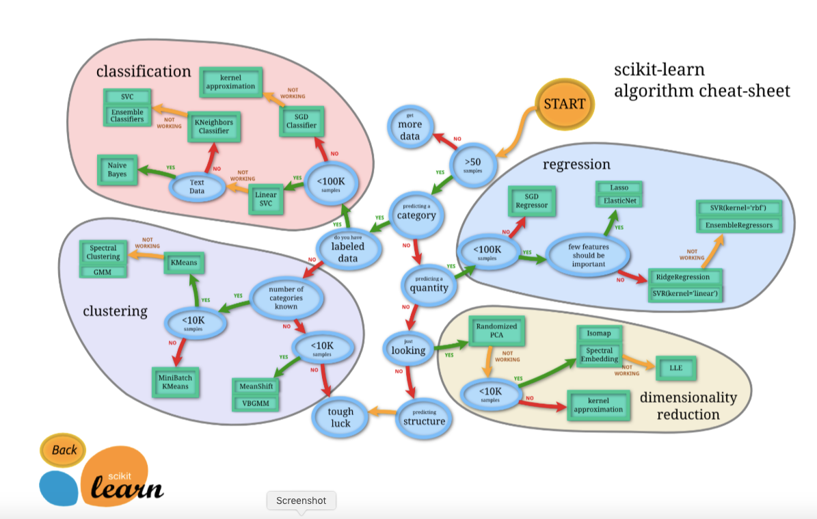
Preview of supervised learning methods
Data is “labeled,” and we are trying to predict the label (“target”)
If target is a continuous numerical value → regression
If target is categorical → classification
“Does X predict categorical Y?”
“Does X predict continuous numerical Y?”
“Are there groups in the data?”
“what patterns exist in the data?”
What category of methods will you use to answer your question?

Slide 10
In class work time on your projects
Reduce the dataset to the cancer type(s) of interest and genes of interest related to your hallmark(s).
  You should have >10 genes, but >100 is even better!
Visualize your data with a PCA
  Color the PCA by at least 1 important feature related to your project goal:
    Average expression of gene set
    1 key gene’s expression
    Metadata label
    Cancer type (if using multiple cancer types)
Choose one of the following:
  Visualize your data with a UMAP (does this give you new/different information than the PCA?)
  Use clustering on your data and visualize the clusters on the PCA (what do the clusters mean?)
If you need to refine your question/project goal based on the patterns you are seeing in the data, do so!
  You should now be able to state which method(s) you will use (clustering, classification, regression)
2nd check-in: All the red should be completed!

