Slide 1

Module 3
Lecture 5
What makes a good ML model?
Sarah Groves, Ph.D.
Shayn Peirce-Cottler, Ph.D.

Slide 2
Announcements
I looked over your notebooks, and they are looking good!
  Many of you have already done train-test splitting and/or predictions with scoring
  Today we will go into the “why” behind these methods and metrics
  If you have not implemented a model yet, come see us for assistance!
Coding workshop: November 14th, 5-6:30pm with pizza and snacks!
  Let us know if you can attend via PIAZZA or EMAIL BY TOMORROW!

Slide 3
Machine Learning Model Validation
I know how to tell if my model is performing well or needs improvement.
I understand why scoring the performance of my model is important for communicating the reliability of my results.
I can split my data into two for training and testing the model.

Slide 4
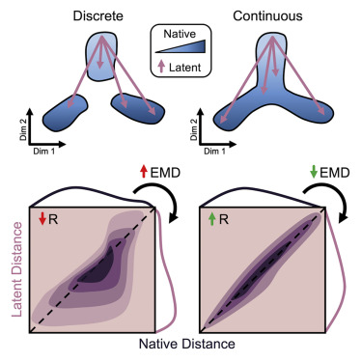
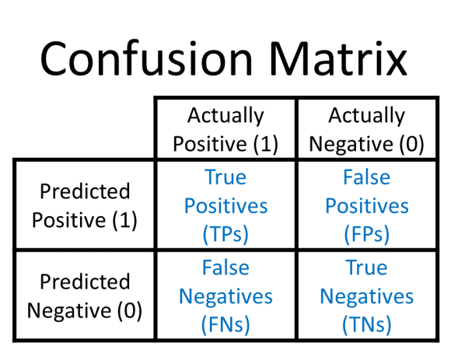
Is my model “good enough?”
Loss and scoring metrics across model types
Regression
  R²: coefficient of determination
  Errors: mean absolute error, mean squared error, etc.
  Visualization of residual: PredictionErrorDisplay class
PCA
  Sanity check: How much variance is explained by PC1 and PC2? How many components do you need to explain a large percentage of the variance? What genes make up each PC loading?
Manifold learning
  Active area of research; often un-validated
Classification
  Accuracy score
  Confusion matrix
  Precision, recall, AUC
Clustering
  Evaluate the model without ground truth: silhouette coefficient
  Compare score against a dummy classifier
Heiser et al. 2020

Slide 5
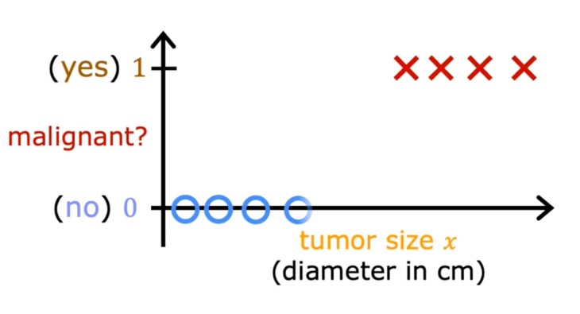
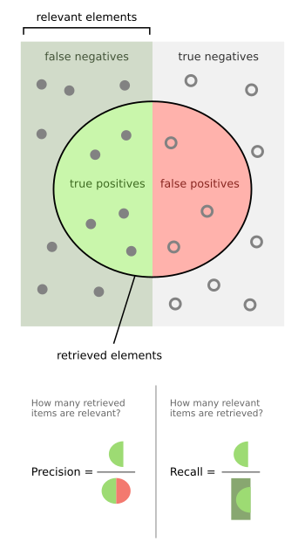
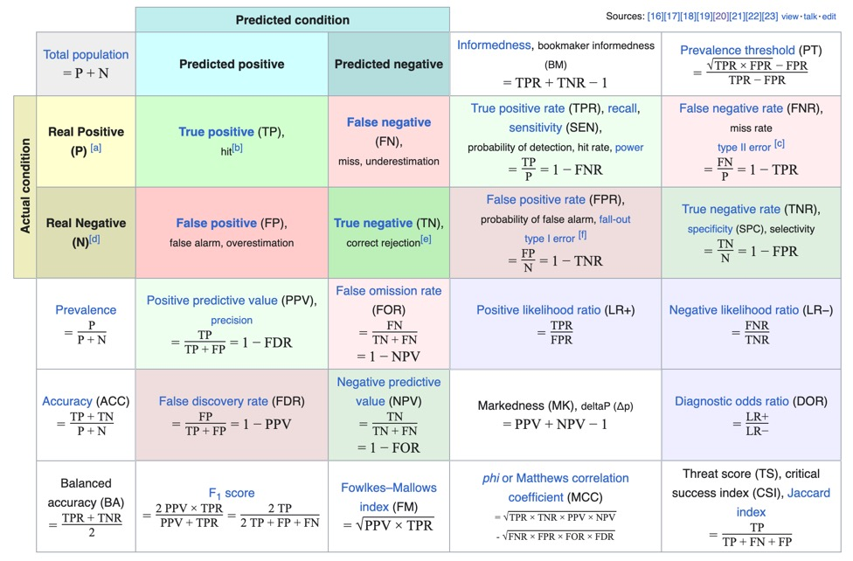
Precision and recall (and much more…)
Decision boundary
There is a trade-off between precision and recall
In this example with a clear best boundary in between these examples, you can get 100% recall and precision!
Predicted 1
Predicted 0
Precision
100% recall
66% precise
FPR = 2/4
Recall
75% recall
100% precise
FPR = 0/4 (better)
There is a trade-off between TPR/recall and FPR!

Slide 6
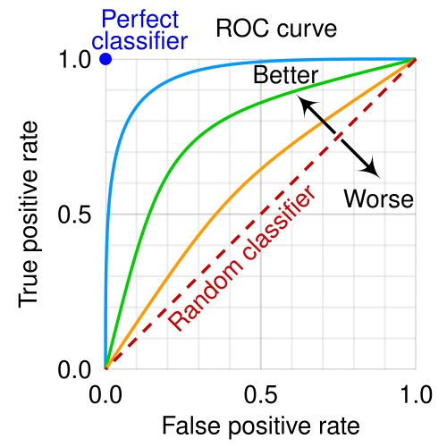
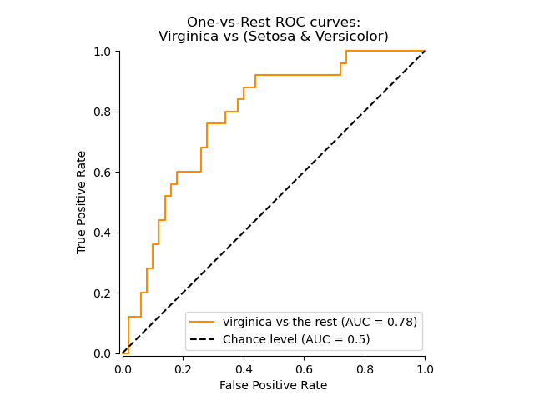
Area under the curve of the ROC plot
Two parts to classification: (1) make the model predictions and then (2) decide on a cutoff/decision boundary
After fitting your model and making predictions, you can sweep the decision boundary over different values to see the tradeoff between true positive rate (recall) and false positive rate
This is visualized as a receiver-operating characteristic (ROC) curve
Decision boundary
Predicted 1
Predicted 0
Everything labeled 1 (all positives)
AUC = 1: PERFECT
AUC = 0.5: RANDOM
Everything labeled 0 (no positives)

Slide 7
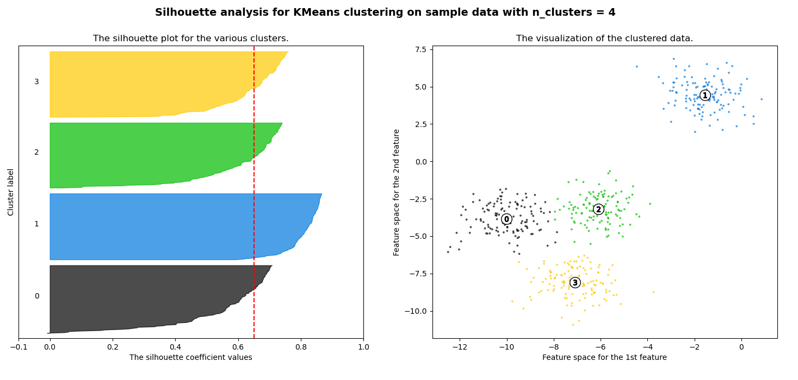
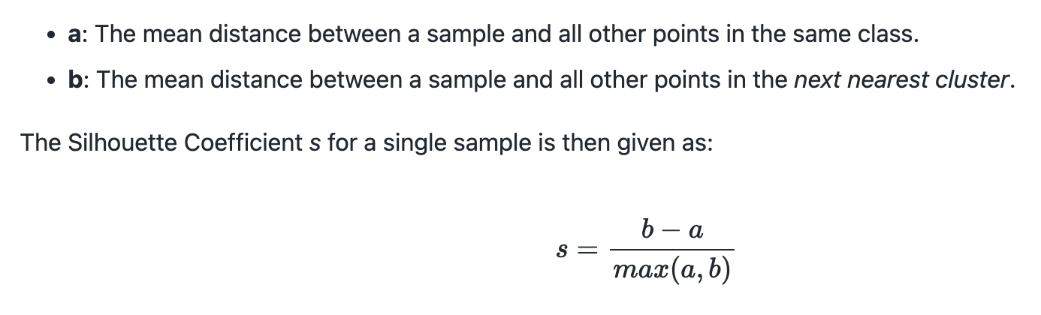
Scoring unsupervised clustering (when you don’t know the “right” answer)
Unlabeled data means we can’t compare predictions to known labels
Silhouette coefficient compares the distance between clusters with the distances within clusters
For k-means: choose k that gives higher average silhouette score
Good clustering: b-a >>0
Meh clustering: b-a ~ 0
Bad clustering: b-a <0
A
A
B
B
A
B

Slide 8
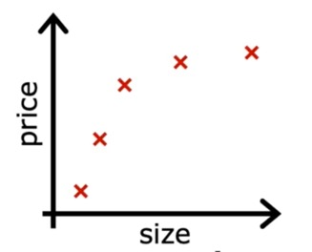
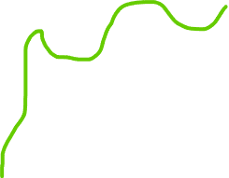
In sample versus out of sample error
Each of these scoring metrics can be used to approximate:
  “in sample error”– the error in the predictions made for the same data the model was built on
  “Out-of-sample error”– the error in predictions on new data that was not used to build/fit the model
In sample: used with the .fit() or .fit_predict() method
Out of sample: used with the .predict() method
In sample error: very low
Out of sample error: much higher
Why do we care about in sample AND out of sample error?

Slide 9
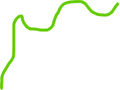
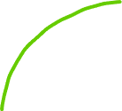

Picking the right model: in sample vs out of sample error
Low complexity model
Medium complexity model
High complexity model
Underfit model
Does not fit the training set well
Not generalizable
Well-fit model
Fits the training set well
Generalizable to new data
Overfit model
Fits the training set extremely well
Does not generalize well

Slide 10
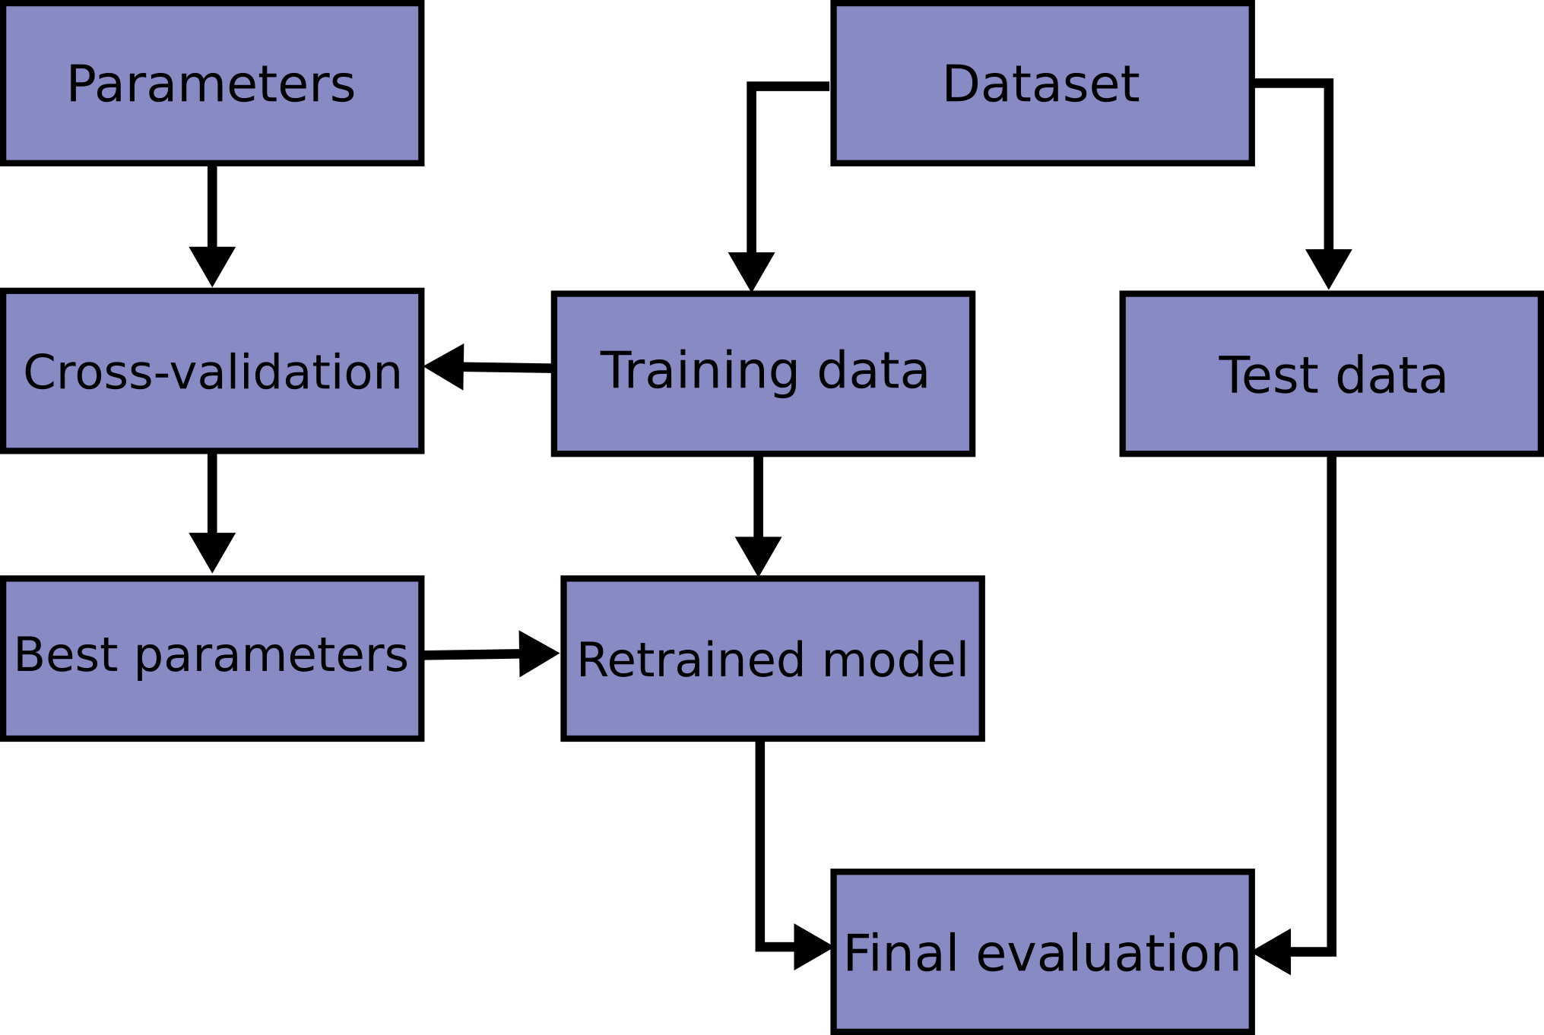
The train-validation-test split
Sklearn.model_selection.train_test_split
Training set: Build the model on a subset of the data
Validation set: Tune the model to work better by changing “hyperparameters” of the model
Test set: Predict using the final version of the model on unseen data to get a true out-of-sample error estimate
You should use train-test split before fitting your model to any data (or use the provided test set)
  Make sure you apply the same preprocessing steps to the training and testing data (rescaling, subsetting to genes and cancer type, etc)
Stratified train-test split
https://scikit-learn.org/stable/modules/generated/sklearn.model_selection.train_test_split.html

Slide 11
Jupyter notebooks: model scoring and validation
For check-in #3: you are expected to have
  A train-test split of the data or use the new dataset posted as your validation dataset if you already fit a model to the full data! (We are not requiring the full train-validate-test split unless you want to do so)
  You should predict on the new dataset and then score using sklearn.metrics
  If supervised ML:
    you can get a measure of how good your model does on the training set and validation set and use these results to decide if your model is overfitting (TRY AN ROC PLOT!)
    If regression, report multiple scoring metrics
  If unsupervised clustering:
    Metrics should be applied across different numbers of clusters and the best model with n clusters is chosen based on the optimum of the metric (TRY A SILHOUETTE SCORE)
  You should have some kind of visualization of your scoring metric(s)

Slide 12
Homework
Let us know by tomorrow if you can attend the coding workshop next week!
Third notebook check-in due on Saturday 11:59pm November 8!
  You should have predictions on a test dataset and scoring for both training and test data (in the model validation section)
  You should have a written section about what the outcomes of the scoring metrics mean (Is your model good enough? How do you know? Is it overfitting?)
Final notebooks due on Thursday 9:30am November 13
  These will include the final sections of the notebook– you should explore the literature to see if you can validate your model results externally (i.e. does the literature draw the same conclusions as you?)
  What do your model predictions mean for answering your project question? What would be the next steps for making your model better? (next class)
  Ethics and conclusions section of the notebook

