Slide 1


Module 4
Lecture 7
How do I make my ML model better?
1. DOWLOAD TEST DATA FROM CANVAS
2. FILL OUT SET COURSE EVALUATION (email)
3. FILL OUT MODULE 4 SURVEY ⬇
Sarah Groves, Ph.D.
Shayn Peirce-Cottler, Ph.D.

Slide 2
How do I fix my model? (Validation step)
If your model is underfitting…
  If you aren’t seeing clear differences between classes in training or validation data
  If your regression model doesn’t predict well on your training or validation data
  Increase model complexity (linear → nonlinear regression, change decision boundary or model type)
  Add features (new genes)
  Change/Increase the number of the features
  Change/decrease the number of classes
  May signify your data is a continuum, not distinct clusters (can you try regression?)
  Change classification threshold
  Some classification methods support regularization (like Logistic Regression)
If your model is overfitting…
  Low error for training data but high for validation data
  You can visually see distinct clusters but out of sample error is high
  Try regularization
  Reduce model complexity: cutoff decision trees earlier, change classification threshold
TRAINING DATASET
Build model
No
VALIDATION DATASET
Evaluate
Compare in-sample error to out-of-sample error: Good model?
Yes
TEST DATASET
Predict and report
Once your model performs well, apply to unseen test data to get final out-of-sample error!
Notes:
The most important parameter is n_neighbors - the number of approximate nearest neighbors used to construct the initial high-dimensional graph. It effectively controls how UMAP balances local versus global structure - low values will push UMAP to focus more on local structure by constraining the number of neighboring points considered when analyzing the data in high dimensions, while high values will push UMAP towards representing the big-picture structure while losing fine detail.
The second parameter we’ll investigate is min_dist, or the minimum distance between points in low-dimensional space. This parameter controls how tightly UMAP clumps points together, with low values leading to more tightly packed embeddings. Larger values of min_dist will make UMAP pack points together more loosely, focusing instead on the preservation of the broad topological structure.

Slide 3
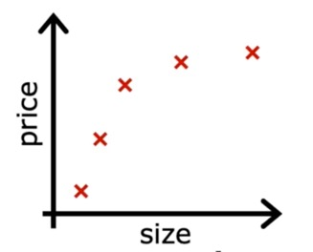



Picking the right model: in sample vs out of sample error
Low complexity model
Medium complexity model
High complexity model
Underfit model
Does not fit the training set well
Not generalizable
Well-fit model
Fits the training set well
Generalizable to new data
Overfit model
Fits the training set extremely well
Does not generalize well

Slide 4
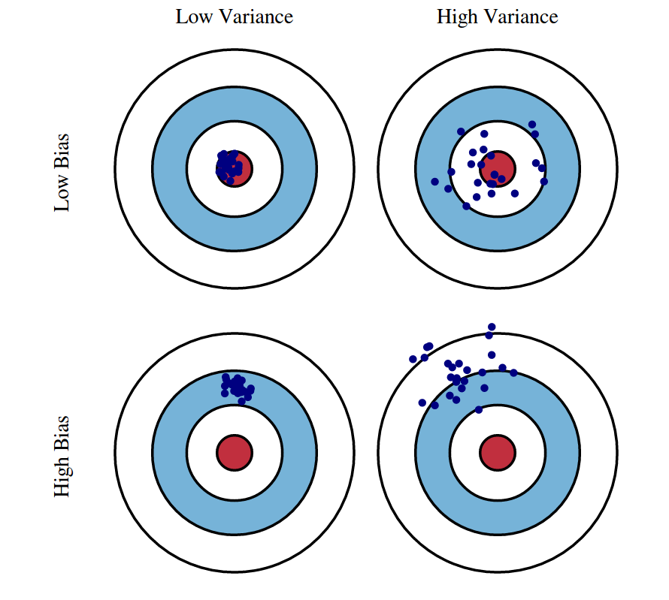
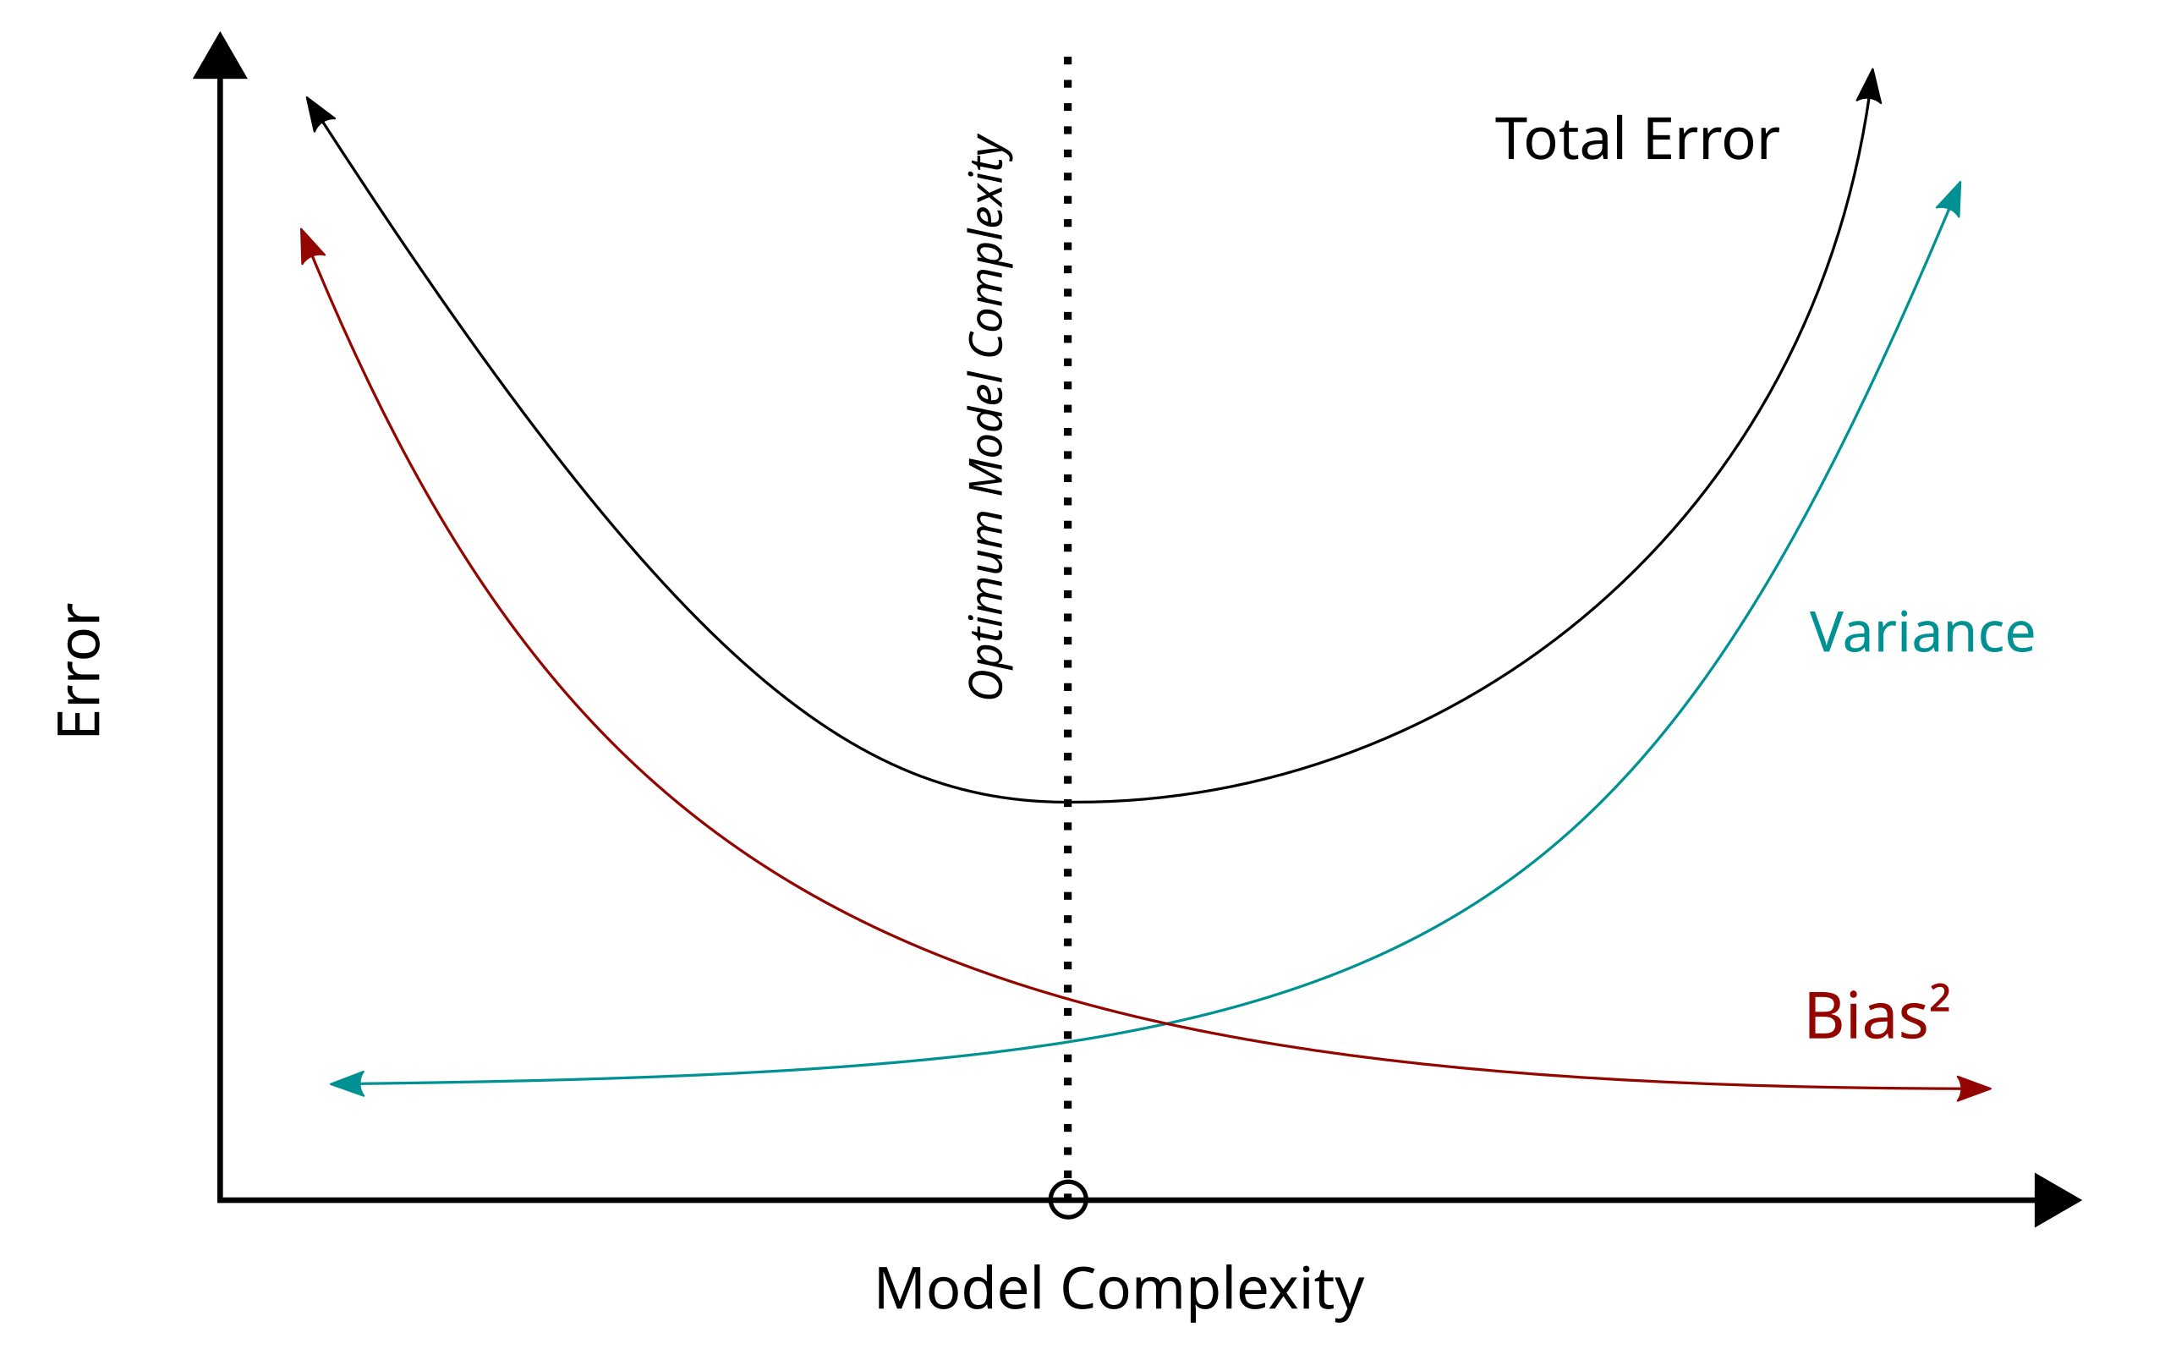


What do I do if my model is overfitting?
Bias:
  error from overly simplistic assumptions in the model
  how far off is the average prediction from the true value?
Variance:
  error from the model's sensitivity to small fluctuations in the training data
  how much would the model's predictions change if it were trained on a different dataset?

Slide 5
Regularization on regression models
Overfitting occurs when a model that is too complex is used, resulting in high variance
Regularization is used to control the size of features
  Forcing some feature coefficients to be close to zero reduces the complexity of the model, reducing possible overfitting
E(train) = bad
E(test) = meh
E(train) = (too) good
E(test) = bad
E(train) = meh
E(test) = good

Slide 6
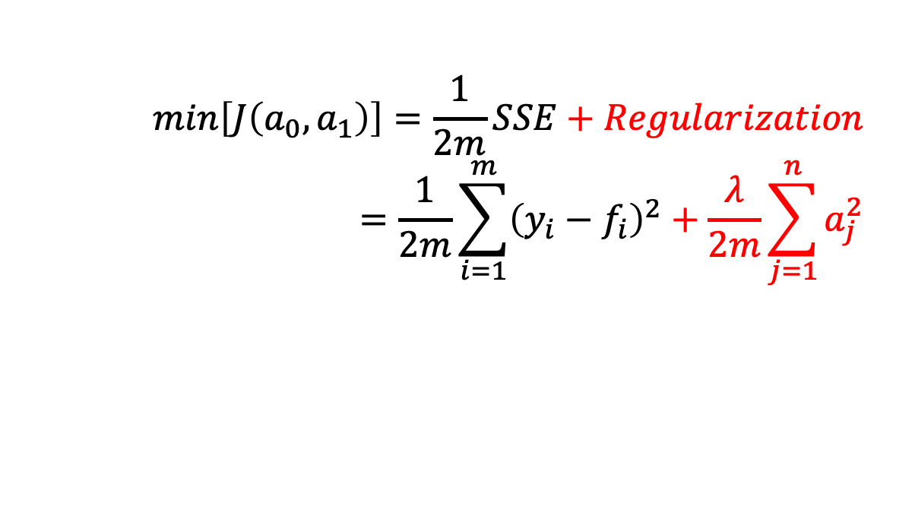
How do we implement regularization?
Add it to the cost function!
Now our cost function balances between minimizing the SSE (or other cost, depending on application) and choosing small coefficients so we don’t over-fit
Linear Regression
$$min\left[J\left(a_{0},a_{1}\right)\right]=\frac{1}{2m}SSE+Regularization=\frac{1}{2m}\sum_{i=1}^{m}{{\left(y_{i}−f_{i}\right)}^{2}+\frac{λ}{2m}\sum_{j=1}^{n}{a_{j}^{2}}}$$
“Ridge regression”
“L2 norm regularization”

Slide 7

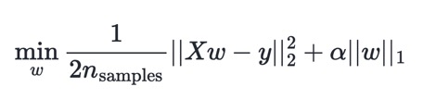
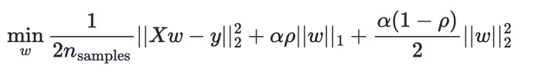
Lots of options for regularization that you might hear about
From sklearn API
Xw is the prediction from our function f (i.e. f(x) that we are comparing to true labels y)
Ridge regression: decrease coefficients (i.e. w → small)
Lasso regression: fewer coefficients (i.e. w → 0)
Elastic net regression
||x||2 = Euclidean distance
||x||₁ Manhattan distance
Tradeoff between Lasso and Ridge

Slide 8
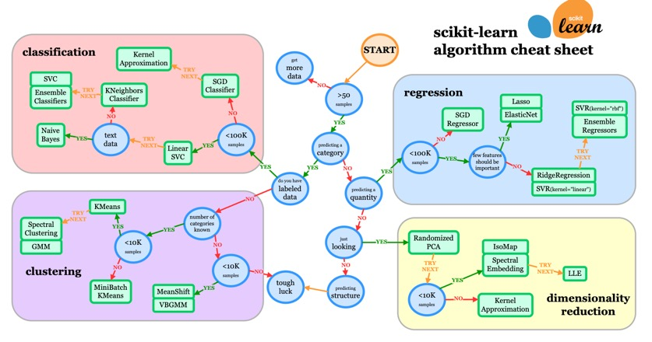
Use the cheat sheet if you want to try a more complex model!

Slide 9
Is your model overfitting, underfitting, or performing well?
You and your partner should discuss with one other pair in your company
If your model is overfitting or underfitting, decide on a technique to try to improve your model
If your model is performing well, try to make it even better with a small change in either direction, and be ready to defend its performance!
Help each other!
Ask a TA if you are unsure how your model is doing

Slide 10
Final push on final project!
Final notebooks due on Tuesday MIDNIGHT May 5
  You should try to make AT LEAST ONE improvement to your model to lower errors before predicting on test data
    If your model performs poorly no matter what you try, you should explain in conclusions/future directions why you think that is.
  Final predictions on test data reported with error estimates/metrics
  Explore the literature to see if you can externally validate your model results (i.e. does the literature draw the same conclusions as you?)
  What do your model predictions mean for answering your project question?
  Ethics and conclusions section of the notebook
KAMEN: Presentations on Tuesday 2PM

