Slide 1

BME 2315: Computational Biomedical Engineering
Python Bootcamp
Sarah Groves
Adapted from Jeff Saucerman

Slide 2
Outline
IDEs
Command line operations
Control structures
Data structures
Unit tests
Debugging code
Jupyter notebooks

Slide 3
Integrate Development Environment (IDE)
A combination of a text editor and a Python (or other language) runtime implementation
Some IDEs work for multiple languages (like VSCode), some only work for one or focus on one language (like PyCharm, Spider)
You must tell your IDE where python is located on your computer, and may want to set up a virtual environment to do so
Some IDEs automatically find python on your computer
https://www.fullstackpython.com/development-environments.html
https://www.reddit.com/r/Python/comments/8n6cep/what_is_in_your_python_development_environment/

Slide 4
Anaconda installation
You should all have Anaconda installed, which installed Python, some basic Python packages, and some applications (including some IDEs like Spyder)
Anaconda allows you to set up virtual environments where you can keep all of the packages for a single project together (to avoid dependency errors, for reproducibility and reuse by other programmers)
The base environment is the default, where anaconda packages are installed
You can make as many environments as you want. This is useful for organizing projects.
We will practice making a conda environment for this class that you should activate for this class. After you are done working on code for this class, you should deactivate the environment. You will need to activate the environment when installing new packages or running Jupyter Notebook!
When working in an IDE, you can automatically tell the IDE to use Python from a specific environment.

Slide 5
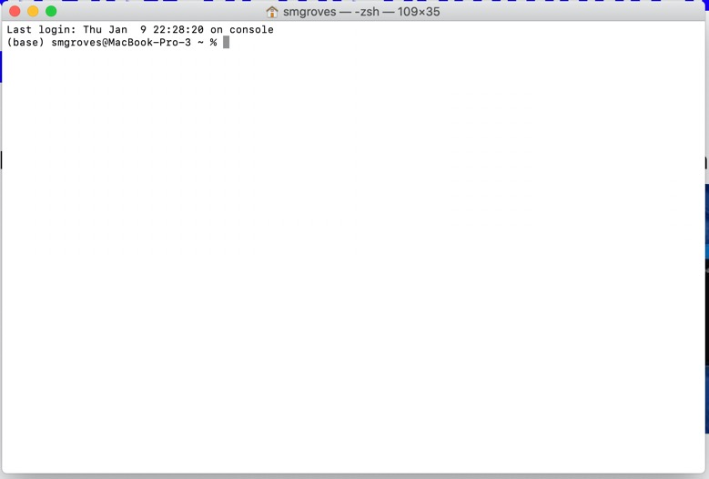
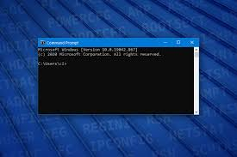
Quick overview of the command line: don’t be scared to use it!
Mac: Terminal
Windows: Command Prompt
Location (current folder)
Tells you which conda environment you are in (default)

Slide 6
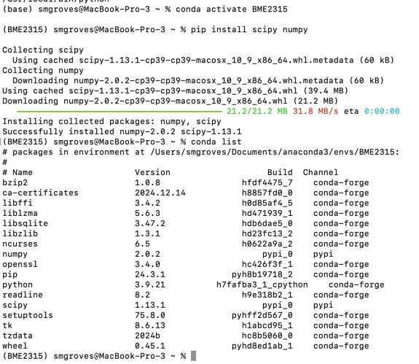
Conda environment creation with the command line
#conda create --name [ENVNAME] python=3.9
conda create --name BME2315 python=3.9
conda activate BME2315
pip install scipy numpy ipykernel jupyterlab
conda list
Once a conda environment is activated, any packages installed will go to that location!

Slide 7
More conda commands
conda env list: list all environments
conda list: list all packages in current environment
conda env create --file environment.yml: create an environment from a yml file (lists needed packages)
pip install [package]: if in correct environment this should install a package in the conda environment
conda install [package]: will install package in active conda environment

Slide 8
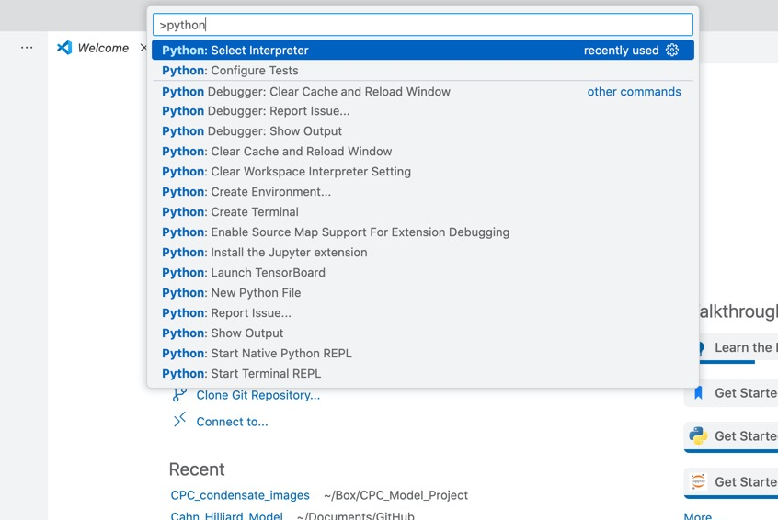
Getting your IDE to use the right Python
You probably have multiple versions of Python installed: type where python in command line to see all of them
Command palette: Command + Shift + P
Python: Select Interpreter
Find the newly made virtual env

Slide 9
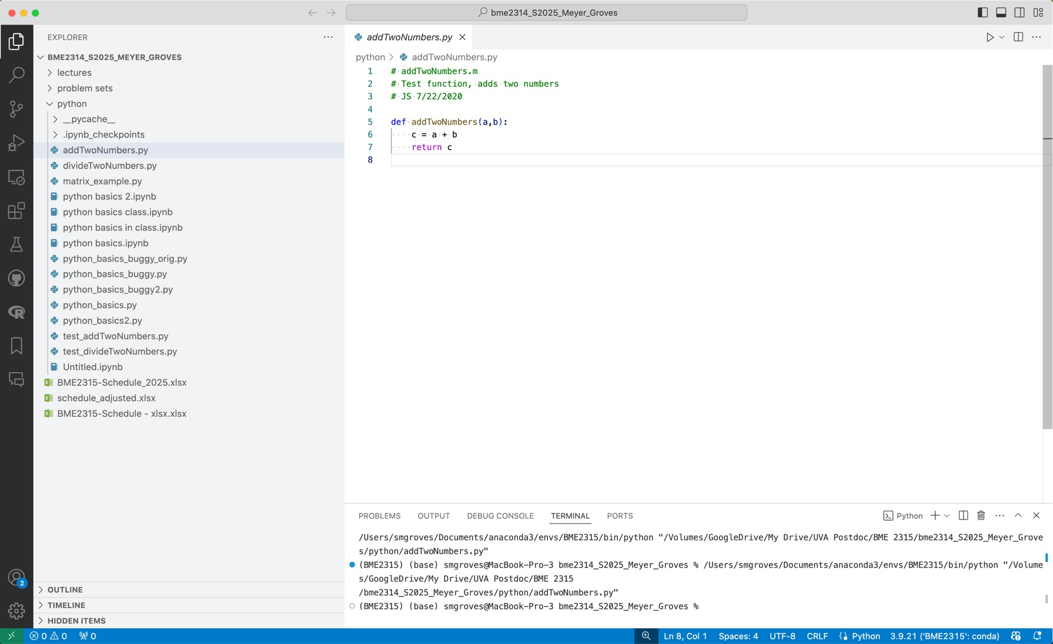
VS Code IDE
Working directory
Script Editor
Run File
Debug
Console

Slide 10
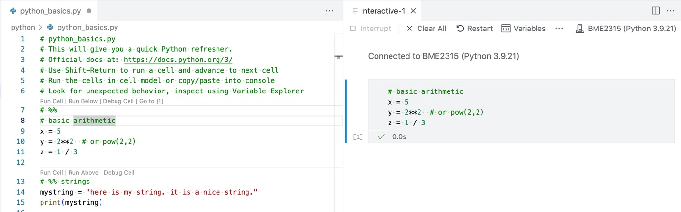
Interactive mode in Python
#%% will make code cells that can run in interactive mode
Hover over cell to Run or Debug or click Shift + Enter to run cell
Interactive “notebook”
Script
Variable explorer
Python version
Code cell
Plots would show up here
https://code.visualstudio.com/docs/python/jupyter-support-py

Slide 11
Python_basics.py
Arithmetic
+, -, *, /
** = power
% = remainder; // = divide (discard remainder)
Relational
<, <= : is less than
>, >= : is greater than
== : is equal to
!= : is not equal to
Logical
and
or
Not
Assignment
= : assign a variable
A += B : add B and reassign new sum to A
-=, *=
Identity
Is
Is not
Membership
In
Not in

Slide 12
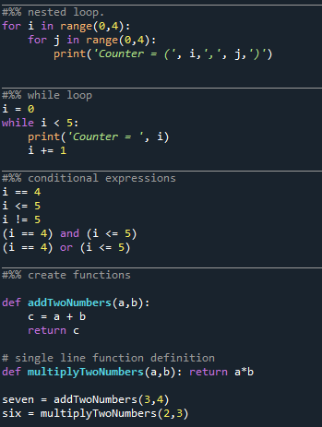
Python_basics.py: basic control structures
While loop: Loop until the condition is not met
These can be dangerous and lead to never-ending code! Make sure you have a break condition that will be met for all inputs.
For loop: Loop through a set number of iterations defined in condition
If/elif/else: If a condition is met, do an action.
Break: exit the loop if the condition is met
Continue: skips the current iteration and proceeds to the next iteration of the loop
Pass: does nothing (placeholder)

Slide 13
Open the Lockbox Challenge!
Reminder:
Arithmetic
+, -, *, /
** = power
% = remainder; // = divide (discard remainder)
Relational
<, <= : is less than; less than or equal to
>, >= : is greater than; greater than or equal to
== : is equal to
!= : is not equal to
Logical
(A) and (B)
(A) or (B)
Not A
Assignment
= : assign a variable
A += B : add B and reassign new sum to A
-=, *=
Identity
Is
Is not
Membership
In
Not in
Step 1: Solve your problem (without a computer) and find others who have the same answer as you.
Step 2: Get 4 new problems and solve as a group (without a computer). Go to smgroves.github.io/codebreak and enter your answers as a code.
Step 3: If you unlocked the Final Challenge page, follow the instructions on the page.
Goal: Open the lockbox!!

Slide 14
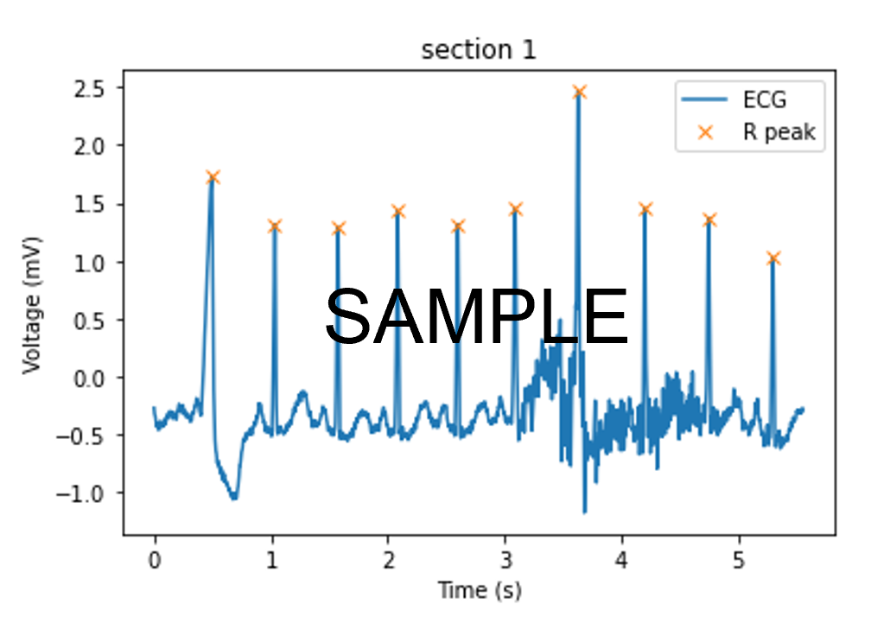
Problem Set 2 due 1/28
Programming challenges: writing functions
Fibonacci sequence
Plotting and analyzing electrocardiogram (ECG) data
Conda activate BME2315
Pip install numpy matplotlib
Pip install seaborn
Pip install pandas
Conda deactivate

Slide 15
Data structures: Lists, arrays, etc.
List
Built into Python
Can store elements of different types
Dynamic size (can easily change size)
Best for 1D lists of things
Array
Use numpy
Store a single datatype
Fixed size (not a good idea to change its size)
More memory efficient (contiguous memory)
Can be multidimensional
Dataframes
Use pandas
Best for 2D data, especially with named columns and rows
Sets
Built into Python
Only has unique elements
Unordered
Dictionary
Key-value pairs; both keys and values can be any data type!
Ordered (as of Python 3.7)

Slide 16
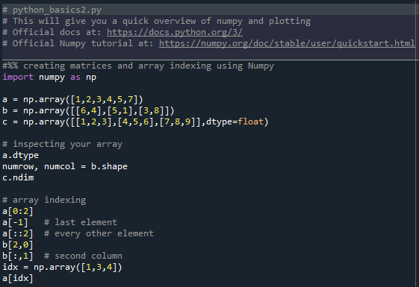
Python_basics2.py: arrays etc.

Slide 17
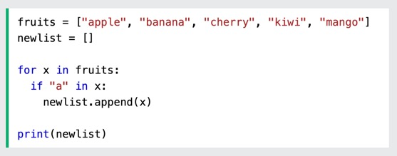
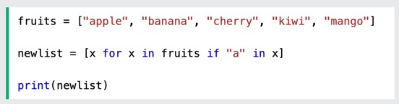
List comprehension: the Pythonic way to code
Make a list based on the values of an existing list using for loops, if statements, etc. all in one line!

Slide 18
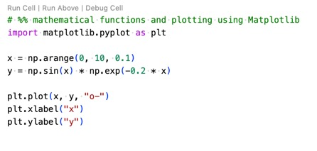

Plotting: matplotlib and seaborn

Slide 19
Unit Tests
Checks code in small chunks (units) for errors
Always test that your code works in known conditions before applying it to unknown conditions (e.g. real data)
Can compare computed answer to:
Exact analytical solution when available
Numerical solution obtained by hand
When answer is unknown, convergence to a stable answer
Notes:
It’s important to recognize that this is a very challenging time for you to come back to UVA. The violent actions of white supremacists both on campus and in Charlottesville last week was extremely concerning and distressing. Quite understandably many students feel a sense of uncertainty regarding their safety and the future of the community here. Bias and hate have no place at the University, and it’s essential that all students feel safe, and know that they are supported and valued members of our community, and are able to focus on learning.
Care about the students, vital to have a supportive educational environment where all are encouraged to participate.
Things happening in life that affect your ability to learn and participate, it’s important that you’re able to take advantage of the resources provided by the University.
Discussion: What else can our class do to promote a bias-free and supportive learning environment? Follow up in office hours.

Slide 20
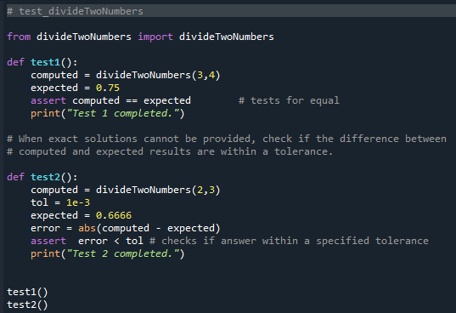
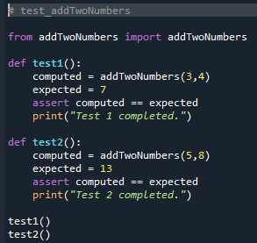
Example unit tests

Slide 21
Unit Tests
Requirements of a test function
Unit test filename starts with “test_”
Unit test functions (inside unit test file) start with “test_”
Test functions have no input arguments
Test functions evaluate a Boolean expression using assert
Notes:
It’s important to recognize that this is a very challenging time for you to come back to UVA. The violent actions of white supremacists both on campus and in Charlottesville last week was extremely concerning and distressing. Quite understandably many students feel a sense of uncertainty regarding their safety and the future of the community here. Bias and hate have no place at the University, and it’s essential that all students feel safe, and know that they are supported and valued members of our community, and are able to focus on learning.
Care about the students, vital to have a supportive educational environment where all are encouraged to participate.
Things happening in life that affect your ability to learn and participate, it’s important that you’re able to take advantage of the resources provided by the University.
Discussion: What else can our class do to promote a bias-free and supportive learning environment? Follow up in office hours.

Slide 22
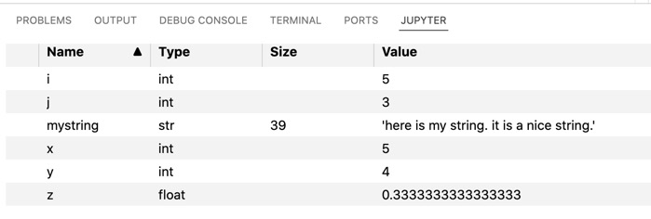
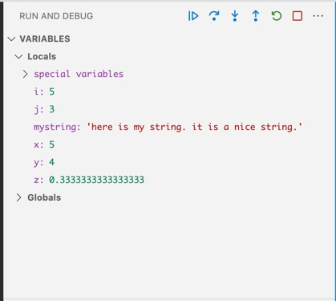
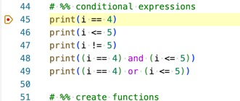
Debugging Code
For simple programs, may be able to debug by adding print statements
Interactive Mode Variable Explorer helps you see current variable states.
Cell mode runs code in chunks
Debugger mode lets you run code interactively by adding breakpoints

Slide 23
Jupyter Notebooks (Jupyter Lab)
Combines text descriptions, graphs, and working code in the same document.
It is best for telling a “code story” from data input to data output.
Runs within your browser, enables you to dynamically change the code and get new results.
Highly useful for documenting what the code does.
*Not recommended for writing complex functions that may require debugging. Instead I recommend Jupyter notebooks for documenting working code to share the outputs.
Good Tutorial: https://www.youtube.com/watch?v=jZ952vChhuI
Notes:
It’s important to recognize that this is a very challenging time for you to come back to UVA. The violent actions of white supremacists both on campus and in Charlottesville last week was extremely concerning and distressing. Quite understandably many students feel a sense of uncertainty regarding their safety and the future of the community here. Bias and hate have no place at the University, and it’s essential that all students feel safe, and know that they are supported and valued members of our community, and are able to focus on learning.
Care about the students, vital to have a supportive educational environment where all are encouraged to participate.
Things happening in life that affect your ability to learn and participate, it’s important that you’re able to take advantage of the resources provided by the University.
Discussion: What else can our class do to promote a bias-free and supportive learning environment? Follow up in office hours.

Slide 24
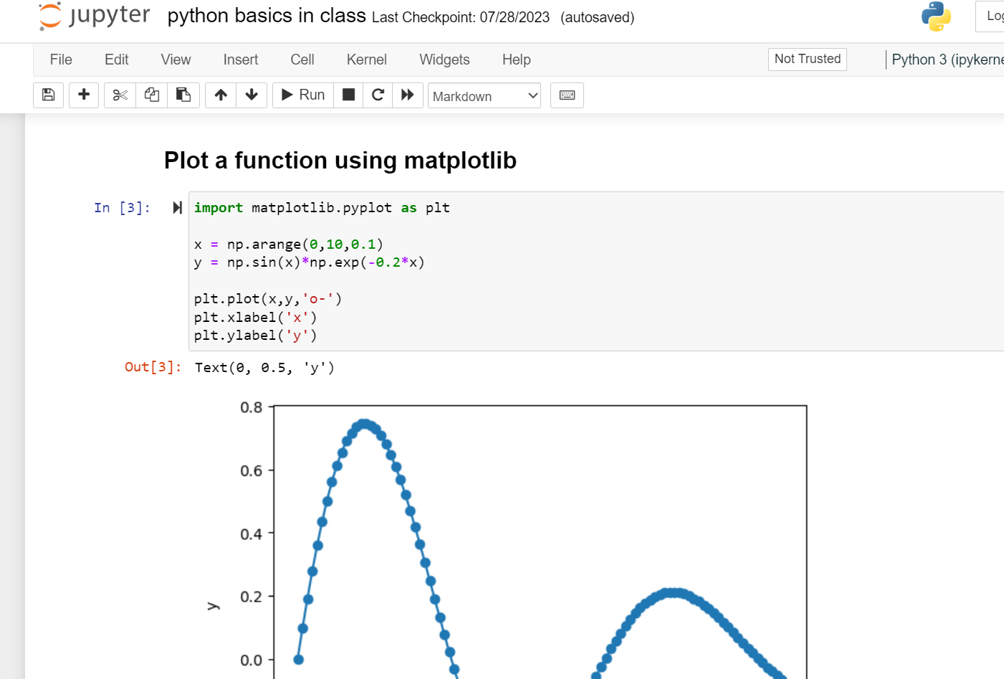

Slide 25
Problem Set 2 due 1/28
Programming challenges: writing functions
Fibonacci sequence
Plotting and analyzing electrocardiogram (ECG) data

