Slide 1
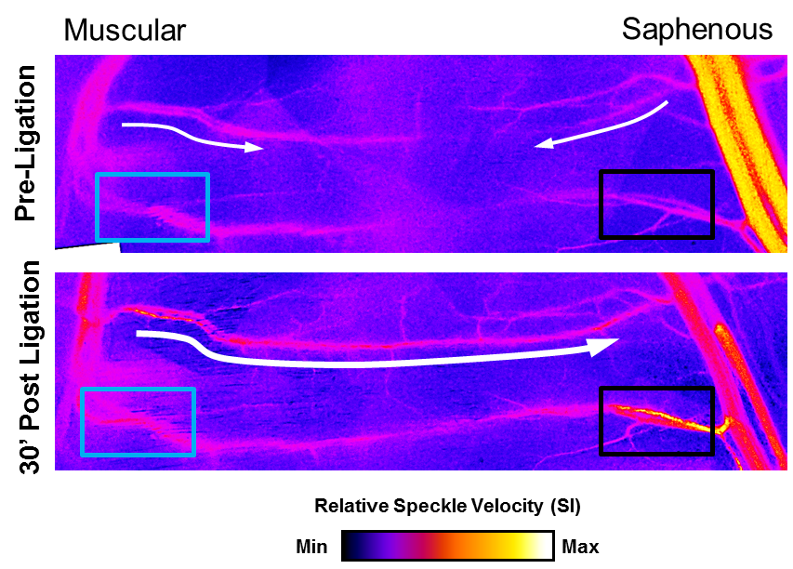
BME 2315: Computational Biomedical Engineering Gaussian Elimination
Announcements
Problem Set 5 due next Tuesday
drop deadline is 2/27
Sarah Groves
Adapted from Jeff Saucerman

Slide 2
Brief review of linear algebra basics
I really recommend you watch the 3blue1brown series to get an intuitive understanding of matrices as linear transformations
Vectors: “arrows pointing in space” or ordered list of numbers → two ways to think about vectors
Matrices: linear transformations of vectors
Systems of equations can be represented as a matrix
https://www.youtube.com/watch?v=fNk_zzaMoSs&list=PLZHQObOWTQDPD3MizzM2xVFitgF8hE_ab
Chapters 1-6 and 12 (optional)

Slide 3

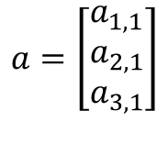
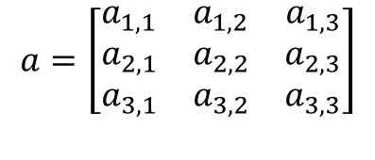
Matrices and Vectors
Matrix
Vectors
$$a=\left[\begin{matrix}a_{1,1} & a_{1,2} & a_{1,3} \\ a_{2,1} & a_{2,2} & a_{2,3} \\ a_{3,1} & a_{3,2} & a_{3,3}\end{matrix}\right]$$
$$a=\left[\begin{matrix}a_{1,1} & a_{1,2} & a_{1,3}\end{matrix}\right]$$
$$a=\left[\begin{matrix}a_{1,1} \\ a_{2,1} \\ a_{3,1}\end{matrix}\right]$$

Slide 4
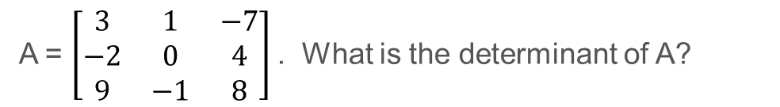
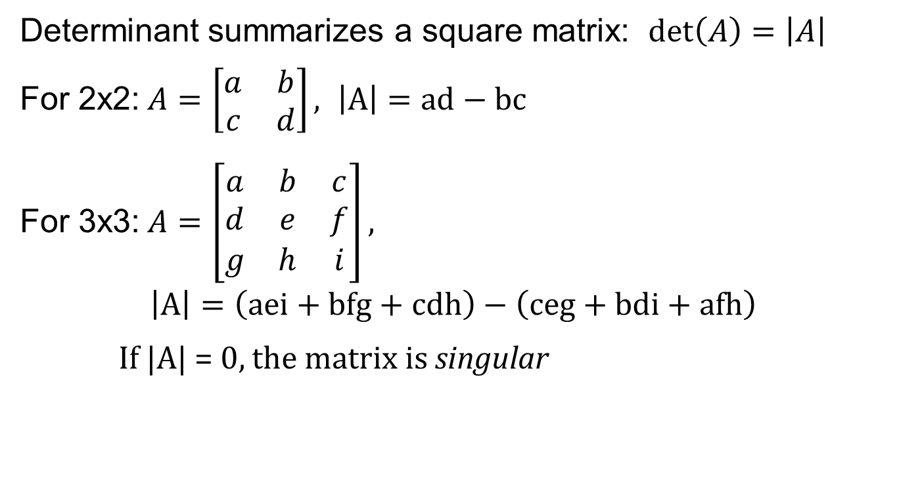
Determinant of a Matrix
Determinant summarizes a square matrix: $\det\left(A\right)=\left|A\right|$
For 2x2:$A=\left[\begin{matrix}a & b \\ c & d\end{matrix}\right], \left|A\right|=ad−bc$
For 3x3:$A=\left[\begin{matrix}a & b & c \\ d & e & f \\ g & h & i\end{matrix}\right],$
$$\left|A\right|=\left(aei+bfg+cdh\right)−\left(ceg+bdi+afh\right)$$
If |A| = 0, the matrix is singular
A = $\left[\begin{matrix}3 & 1 & −7 \\ −2 & 0 & 4 \\ 9 & −1 & 8\end{matrix}\right]$. What is the determinant of A?

Slide 5
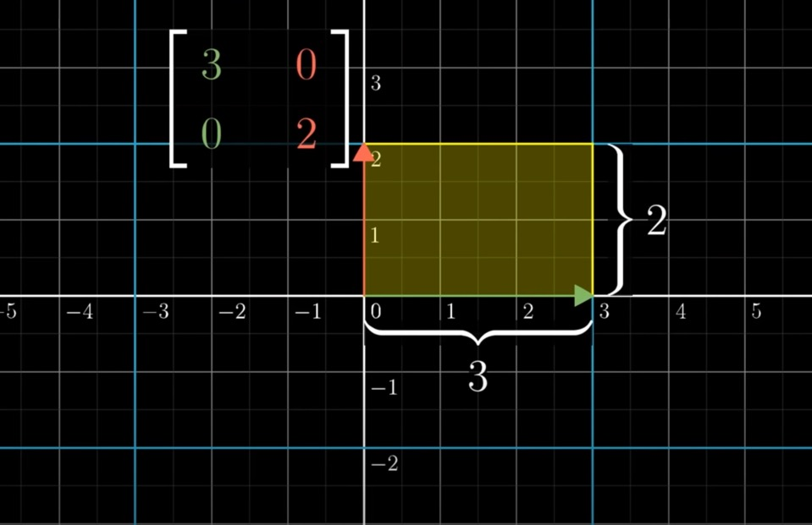
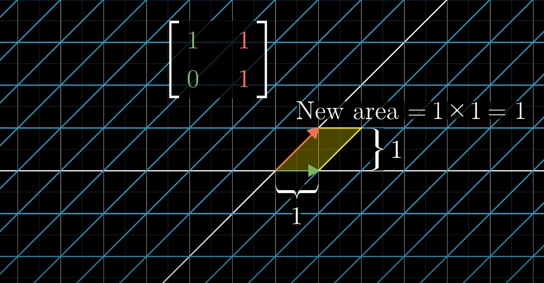
Determinant, intuitively

Slide 6
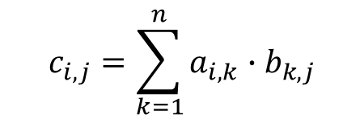

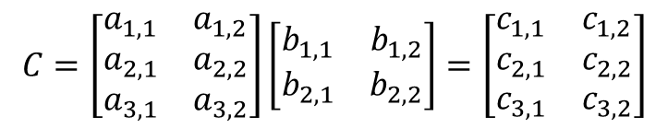
Matrix Multiplication
2 matrices:
$$C=\left[\begin{matrix}a_{1,1} & a_{1,2} \\ a_{2,1} & a_{2,2} \\ a_{3,1} & a_{3,2}\end{matrix}\right]\left[\begin{matrix}b_{1,1} & b_{1,2} \\ b_{2,1} & b_{2,2}\end{matrix}\right]=\left[\begin{matrix}c_{1,1} & c_{1,2} \\ c_{2,1} & c_{2,2} \\ c_{3,1} & c_{3,2}\end{matrix}\right]$$
$$C=A∙B$$
c(row i, column j) = sum [ a(row i) .* b(column j) ]
h x m
h x n
n x m
Inner dimensions must agree!
$$c_{i,j}=\sum_{k=1}^{n}{a_{i,k}∙b_{k,j}}$$
https://www.youtube.com/watch?v=XkY2DOUCWMU&list=PLZHQObOWTQDPD3MizzM2xVFitgF8hE_ab&index=4

Slide 7
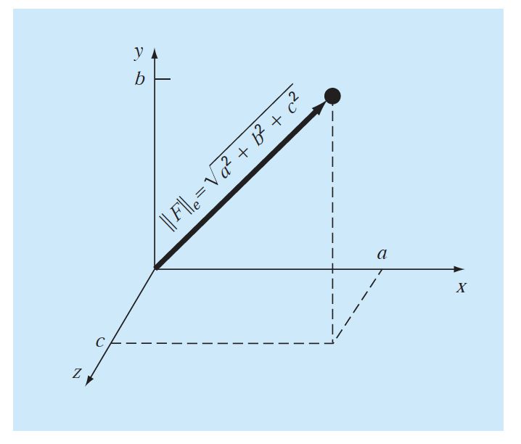

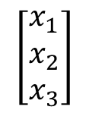
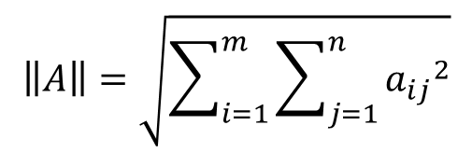

Vector and Matrix Norms
Magnitude of a vector
Matrix norm
$$\left[\begin{matrix}x_{1} \\ x_{2} \\ x_{3}\end{matrix}\right]$$
Length = $\sqrt{{x_{1}}^{2}+{x_{2}}^{2}+{x_{3}}^{2}}$
$$\left\|A\right\|=\sqrt{\sum_{i=1}^{m}{\sum_{j=1}^{n}{{a_{ij}}^{2}}}}$$
$$=\sqrt{{\left[X\right]}^{T}\left[X\right]}=\left\|X\right\|$$
“Norm”
Vector norm as Euclidean distance
*there are many other types of norms. These are technically Euclidean and Frobenius norms, respectively. Here we’ll just say ‘norm’.

Slide 8



Representing systems of equations as a matrix
$$2∙x_{1}+1∙x_{2}−3∙x_{3}=8$$
$$−3∙x_{1} +2∙x_{3}=−2$$
$$8∙x_{1}−1∙x_{2}+4∙x_{3}=12$$

Slide 9

Solving Systems of Linear Equations
Conservation equations for complicated systems
$$\left[A\right]\left[x\right]=[b]$$
Biomechanics
Bioelectrics
Blood flow through vessels
Mass transport

Slide 10
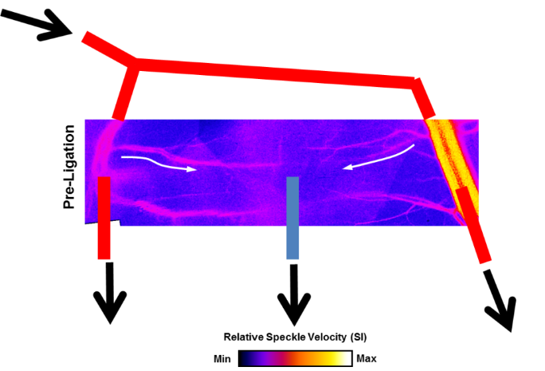
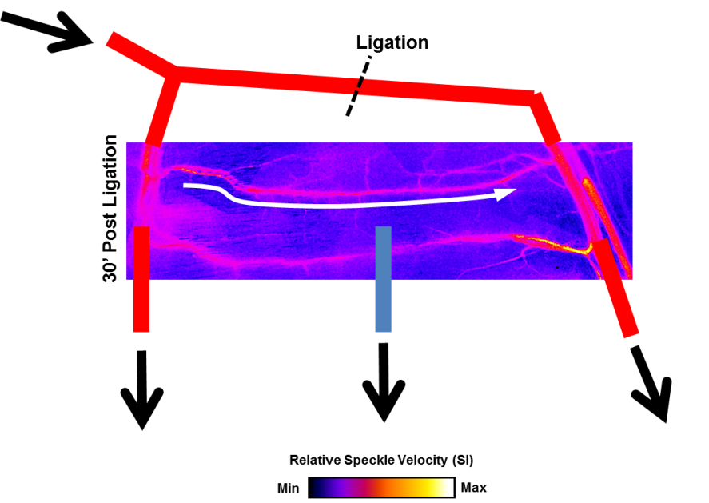
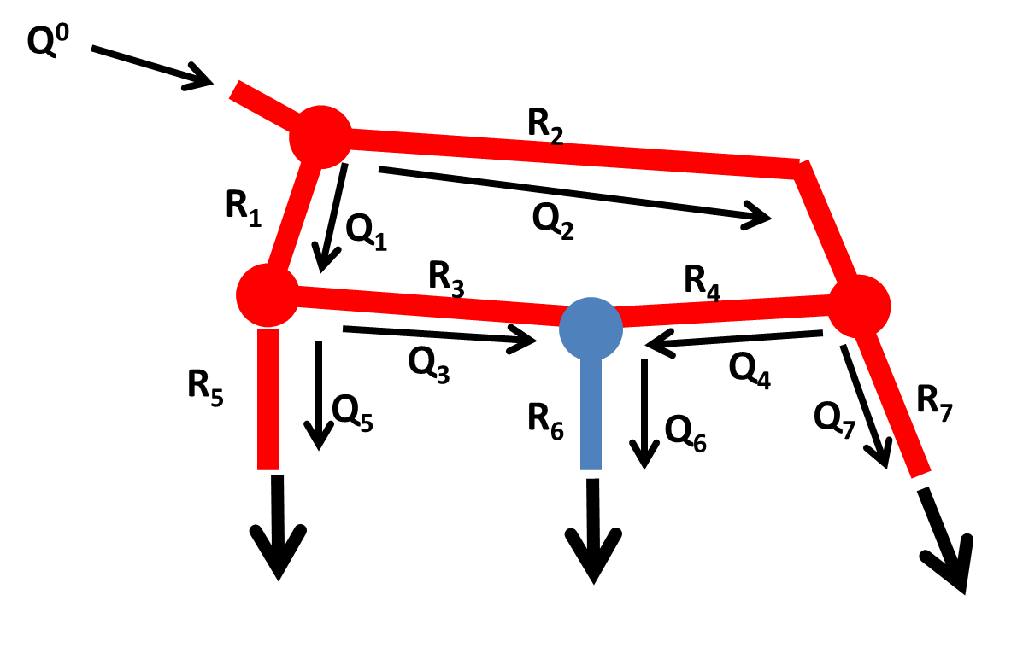
PS #5: Modeling redistribution of blood flow after loss of an artery
Data from lab of Rich Price,
Heuslein et al ATVB 2015

Slide 11
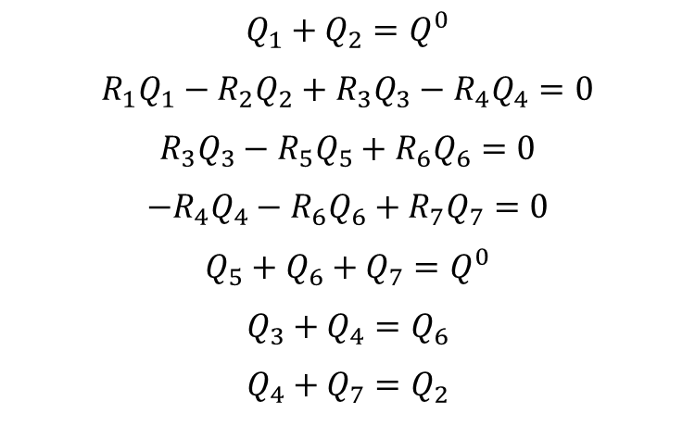
PS #5: Modeling redistribution of blood flow after loss of an artery
$$Q_{1}+Q_{2}=Q^{0}$$
$$R_{1}Q_{1}−R_{2}Q_{2}+R_{3}Q_{3}−R_{4}Q_{4}=0$$
$$R_{3}Q_{3}−R_{5}Q_{5}+R_{6}Q_{6}=0$$
$${−R}_{4}Q_{4}−R_{6}Q_{6}+R_{7}Q_{7}=0$$
$$Q_{5}+Q_{6}+Q_{7}=Q^{0}$$
$$Q_{3}+Q_{4}=Q_{6}$$
$$Q_{4}+Q_{7}=Q_{2}$$
Data from lab of Rich Price,
Heuslein et al ATVB 2015
R2 goes from 2 to 100

Slide 12


Graphical Strategies
Solutions to systems of equations are where they intersect
Eq. 1
$$3x_{1}+2x_{2}=8$$
Eq. 2
$$1.5x_{1}−x_{2}=−1$$
More complicated system would be difficult to solve using this method

Slide 13
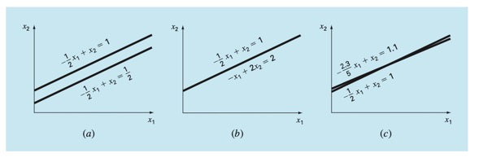
Graphical strategies
No solutions
Infinite solutions
Ill-conditioned
Singular
Determinant = 0
Determinant = very small

Slide 14
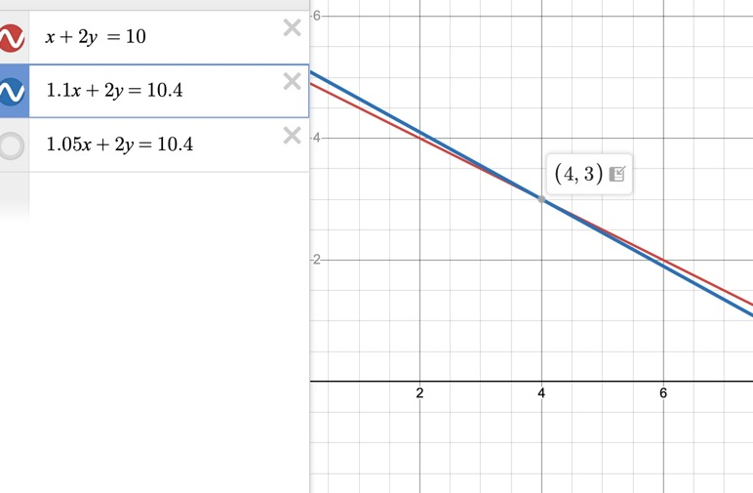
Ill-conditioned systems
https://www.desmos.com/calculator/jcg5g9ionl
Changing the input a little bit changes the output a lot!

Slide 15






Algebraic Strategies
Can solve an equation for one variable and plug into another equation
Can add two equations to eliminate variables
Can multiply equations by constants
Eq. 1
$$3x_{1}+2x_{2}=8$$
Eq. 2
$$−1.5x_{1}+x_{2}=1$$
Eq. 1
$$3x_{1}+2x_{2}=8$$
Eq. 2
$$−3x_{1}+2x_{2}=2$$
Eq. 1
$$3x_{1}+2x_{2}=8$$
Eq. 2
$$1.5x_{1}−x_{2}=−1$$

Slide 16
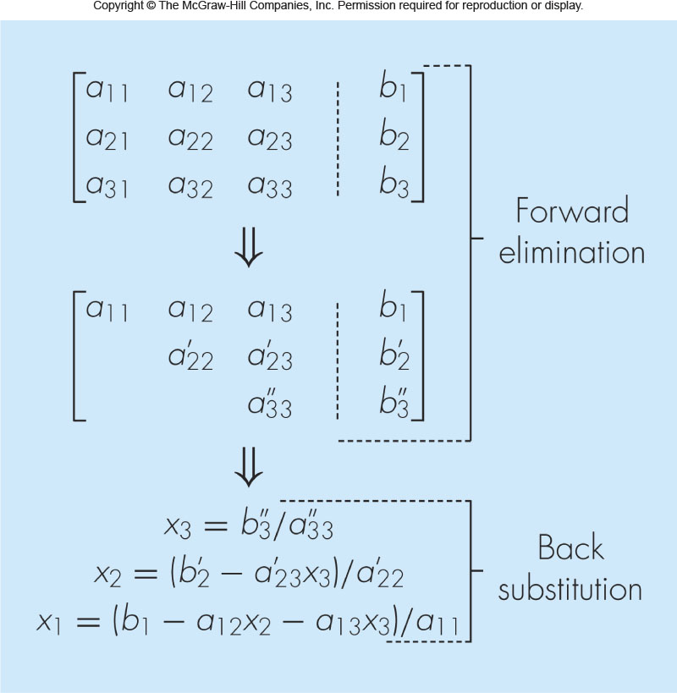
Gaussian Elimination Overview
Gaussian Elimination generalizes this approach to solve for [x] for large [A][x]=[b].
Augment matrices [A|b]
n-1 rounds of forward elimination
Back substitution

Slide 17
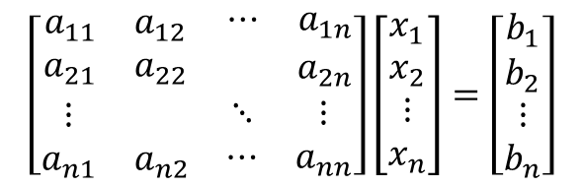



Gaussian Elimination: Augmented Matrix
For Ax=b, make the augmented matrix [A|b]
${row}_{1}$:
$$a_{11}x_{1}+a_{12}x_{2}+a_{13}x_{3}+⋯+a_{1n}x_{n}=b_{1}$$
$$a_{21}x_{1}+a_{22}x_{2}+a_{23}x_{3}+⋯+a_{2n}x_{n}=b_{2}$$
$$⋮ ⋮ ⋮ ⋮ ⋮$$
$${row}_{n}:$$
$$a_{n1}x_{1}+a_{n2}x_{2}+a_{n3}x_{3}+⋯+a_{nn}x_{n}=b_{n}$$
$$\left[\begin{matrix}\begin{matrix}a_{11} & a_{12} \\ a_{21} & a_{22}\end{matrix} & \begin{matrix}⋯ & a_{1n} \\ & a_{2n}\end{matrix} \\ \begin{matrix}⋮ & \\ a_{n1} & a_{n2}\end{matrix} & \begin{matrix}⋱ & ⋮ \\ ⋯ & a_{nn}\end{matrix}\end{matrix}\right]\left[\begin{matrix}\begin{matrix}x_{1} \\ x_{2}\end{matrix} \\ \begin{matrix}⋮ \\ x_{n}\end{matrix}\end{matrix}\right]=\left[\begin{matrix}\begin{matrix}b_{1} \\ b_{2}\end{matrix} \\ \begin{matrix}⋮ \\ b_{n}\end{matrix}\end{matrix}\right]$$
$$\left[\begin{matrix}\begin{matrix}a_{11} & a_{12} \\ a_{21} & a_{22}\end{matrix} & \begin{matrix}⋯ & a_{1n} & b_{1} \\ & a_{2n} & b_{2}\end{matrix} \\ \begin{matrix}⋮ & \\ a_{n1} & a_{n2}\end{matrix} & \begin{matrix}⋱ & ⋮ & ⋮ \\ ⋯ & a_{nn} & b_{n}\end{matrix}\end{matrix}\right]$$
Gaussian elimination steps will
be performed on matrix rows

Slide 18

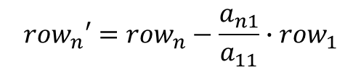

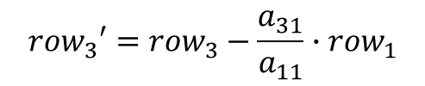
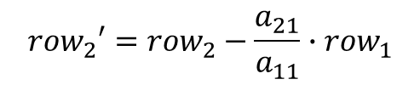


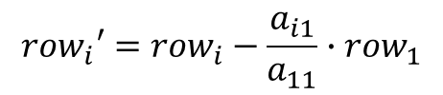
Gaussian Elimination: Forward Elimination, Round 1
Goal: Eliminate x₁ from equations 2 to n:
$${row}_{1}:$$
$$a_{11}x_{1}+a_{12}x_{2}+a_{13}x_{3}+⋯+a_{1n}x_{n}=b_{1}$$
$${row}_{2}:$$
$$a_{21}x_{1}+a_{22}x_{2}+a_{23}x_{3}+⋯+a_{2n}x_{n}=b_{2}$$
$${row}_{2}′={row}_{2}−\frac{a_{21}}{a_{11}}∙{row}_{1}$$
$${row}_{3}:$$
$$a_{31}x_{1}+a_{32}x_{2}+a_{33}x_{3}+⋯+a_{3n}x_{n}=b_{3}$$
$${row}_{3}′={row}_{3}−\frac{a_{31}}{a_{11}}∙{row}_{1}$$
$$⋮ ⋮ ⋮ ⋮ ⋮$$
$${row}_{n}:$$
$$a_{n1}x_{1}+a_{n2}x_{2}+a_{n3}x_{3}+⋯+a_{nn}x_{n}=b_{n}$$
$${row}_{n}′={row}_{n}−\frac{a_{n1}}{a_{11}}∙{row}_{1}$$
In general, for round 1 forward elimination:
$${row}_{i}′={row}_{i}−\frac{a_{i1}}{a_{11}}∙{row}_{1}$$

Slide 19
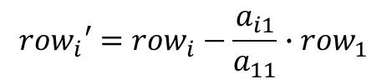
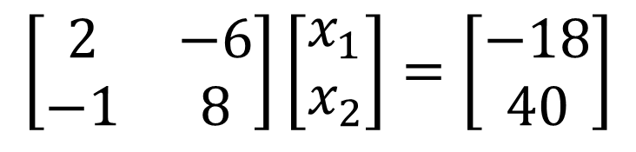
Example 1
$$\left[\begin{matrix}2 & −6 \\ −1 & 8\end{matrix}\right]\left[\begin{matrix}x_{1} \\ x_{2}\end{matrix}\right]=\left[\begin{matrix}−18 \\ 40\end{matrix}\right]$$
Perform forward elimination, round 1:
$${row}_{i}′={row}_{i}−\frac{a_{i1}}{a_{11}}∙{row}_{1}$$

Slide 20

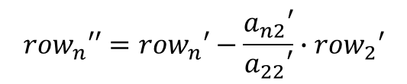
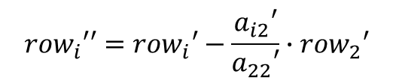
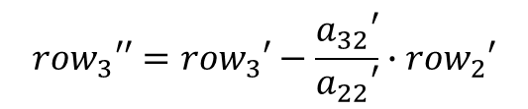



Gaussian Elimination: Forward Elimination, Round 2
$${row}_{1}:$$
$$a_{11}x_{1}+a_{12}x_{2}+a_{13}x_{3}+⋯+a_{1n}x_{n}=b_{1}$$
Goal: Eliminate x₂ from equations 3 to n:
$${row′}_{2}:$$
$$a_{22}{′x}_{2}+a_{23}{′x}_{3}+⋯+a_{2n}{′x}_{n}=b_{2}′$$
$${row′}_{3}:$$
$$a_{32}′x_{2}+a_{33}′x_{3}+⋯+a_{3n}{′x}_{n}=b_{3}′$$
$${row}_{3}′′={row}_{3}′−\frac{a_{32}′}{a_{22}′}∙{row}_{2}′$$
$$⋮ ⋮ ⋮ ⋮$$
$${row}_{n}′′={row}_{n}′−\frac{a_{n2}′}{a_{22}′}∙{row}_{2}′$$
$${row′}_{n}:$$
$a_{n2}{′x}_{2}+a_{n3}′x_{3}+⋯+a_{nn}′x_{n}=b_{n}′$
In general, for round 2 forward elimination:
$${row}_{i}′′={row}_{i}′−\frac{a_{i2}′}{a_{22}′}∙{row}_{2}′$$

Slide 21


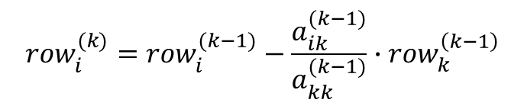



Gaussian Elimination: Forward Elimination, Cont’d
$${row}_{1}:$$
$$a_{11}x_{1}+a_{12}x_{2}+a_{13}x_{3}+⋯+a_{1n}x_{n}=b_{1}$$
Continue shifting pivot rows until all variables are eliminated up to x_{n} in the n^{th} equation
$${row}_{2}:$$
$$a_{22}{′x}_{2}+a_{23}{′x}_{3}+⋯+a_{2n}{′x}_{n}=b_{2}′$$
$$row_{3}:$$
$${{ a}_{33}}^{′′}x_{3}+⋯+{a_{3n}}^{′′}x_{n}={b_{3}}^{′′}$$
$$⋮ ⋮$$
$${row}_{n}:$$
$${a_{nn}}^{(n−1)}x_{n}={b_{n}}^{(n−1)}$$
In general, for round k of forward elimination:
$${row}_{i}^{(k)}={row}_{i}^{(k−1)}−\frac{a_{ik}^{(k−1)}}{a_{kk}^{(k−1)}}∙{row}_{k}^{\left(k−1\right)}$$
**Determinant of triangular matrix = product of diagonal elements**

Slide 22
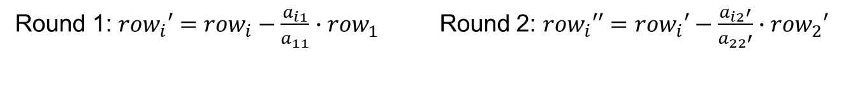
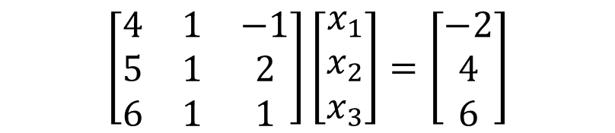
Example 2
$$\left[\begin{matrix}4 & 1 & −1 \\ 5 & 1 & 2 \\ 6 & 1 & 1\end{matrix}\right]\left[\begin{matrix}x_{1} \\ x_{2} \\ x_{3}\end{matrix}\right]=\left[\begin{matrix}−2 \\ 4 \\ 6\end{matrix}\right]$$
Perform forward elimination.
Round 1: ${row}_{i}′={row}_{i}−\frac{a_{i1}}{a_{11}}∙{row}_{1}$ Round 2: ${row}_{i}′′={row}_{i}′−\frac{a_{i2}′}{a_{22}′}∙{row}_{2}′$

Slide 23
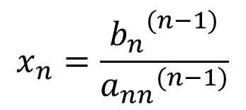
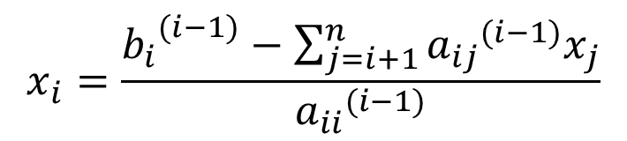
Gaussian Elimination: Back Substitution
For n = 3:
In general:
$$x_{n}=\frac{{b_{n}}^{(n−1)}}{{a_{nn}}^{(n−1)}}$$
$$x_{i}=\frac{{b_{i}}^{(i−1)}−\sum_{j=i+1}^{n}{{a_{ij}}^{(i−1)}x_{j}}}{{a_{ii}}^{(i−1)}}$$
for i = (n-1), (n-2), …, 1

Slide 24
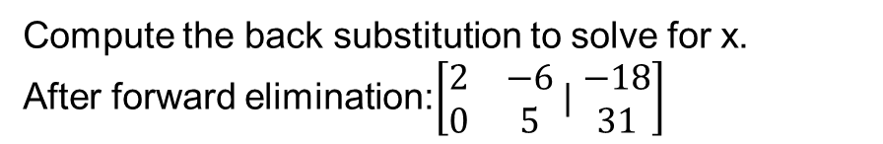
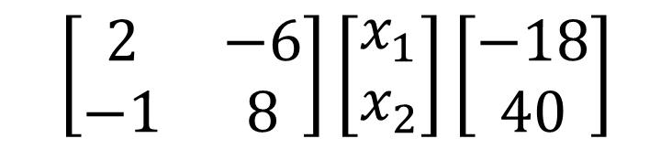
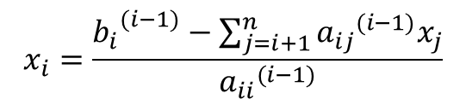
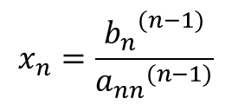
Example 1
$$\left[\begin{matrix}2 & −6 \\ −1 & 8\end{matrix}\right]\left[\begin{matrix}x_{1} \\ x_{2}\end{matrix}\right]\left[\begin{matrix}−18 \\ 40\end{matrix}\right]$$
$$x_{n}=\frac{{b_{n}}^{(n−1)}}{{a_{nn}}^{(n−1)}}$$
Compute the back substitution to solve for x.
After forward elimination:$\left[\begin{matrix}2 & −6 \\ 0 & 5\end{matrix} | \begin{matrix}−18 \\ 31\end{matrix}\right]$
$$x_{i}=\frac{{b_{i}}^{(i−1)}−\sum_{j=i+1}^{n}{{a_{ij}}^{(i−1)}x_{j}}}{{a_{ii}}^{(i−1)}}$$

Slide 25
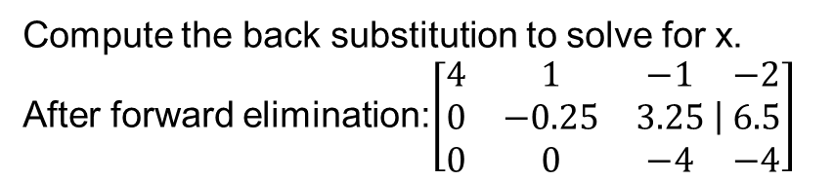
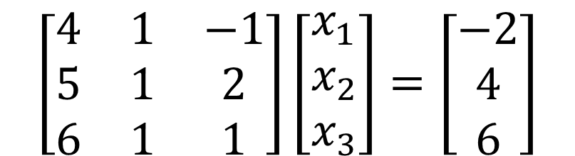
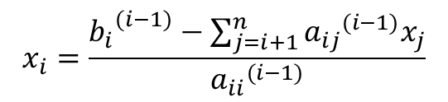
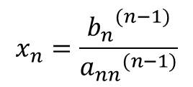
Example 2
$$\left[\begin{matrix}4 & 1 & −1 \\ 5 & 1 & 2 \\ 6 & 1 & 1\end{matrix}\right]\left[\begin{matrix}x_{1} \\ x_{2} \\ x_{3}\end{matrix}\right]=\left[\begin{matrix}−2 \\ 4 \\ 6\end{matrix}\right]$$
$$x_{n}=\frac{{b_{n}}^{(n−1)}}{{a_{nn}}^{(n−1)}}$$
Compute the back substitution to solve for x.
After forward elimination:$\left[\begin{matrix}4 & 1 & −1 \\ 0 & −0.25 & 3.25 \\ 0 & 0 & −4\end{matrix} | \begin{matrix}−2 \\ 6.5 \\ −4\end{matrix}\right]$
$$x_{i}=\frac{{b_{i}}^{(i−1)}−\sum_{j=i+1}^{n}{{a_{ij}}^{(i−1)}x_{j}}}{{a_{ii}}^{(i−1)}}$$

Slide 26
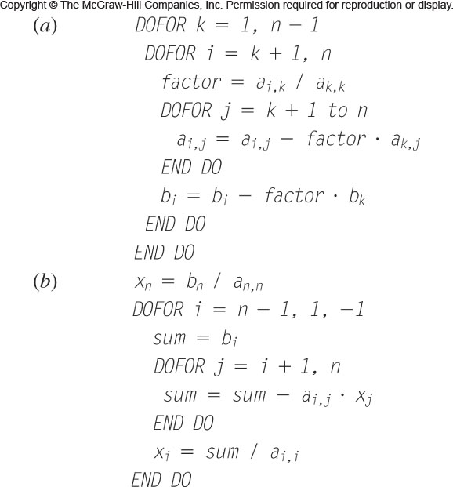
Gaussian Elimination Pseudocode

Slide 27
Caveats to (Naïve) Gauss Elimination
Division by zero
It is possible to divide by 0 if any pivot coefficients are 0
→ pivoting: use the largest available coefficient in the column as the pivot point
Round-off errors
Important especially when you have large numbers of equations
→ Use more sig figs (and use pivoting)
Ill-conditioned systems
Determinant is close to zero (or equal to zero)-
→ Scaling 1 or more equations increases the determinant
→ Use consistent units across equations so coefficients are on the same order of magnitude
If det = 0, Gauss elimination should be stopped
**Determinant of triangular matrix = product of diagonal elements**

Slide 28
Key Points
Mathematical models of biological systems can be represented as linear systems
Linear systems can be expressed in matrix form as [A][x]=[b]
Gaussian Elimination
Solves [x]=inv([A])*[b]
Eliminate variables through forward elimination
Back substitution to solve for variables

