Slide 1
Solving Maze Problem Using Different Algorithms
COMP 8700: Intro Artificial Intelligence
Instructor: Dr. Dan Wu
Team: Problem Solvers of the 21st Century
Presenters:
MohammadEhsan Akhavanpour & Mohammad Hashemi

Slide 2
Agenda
Introduction
The two first algorithms
Heuristics
The two last algorithms
Expected outputs and comparison
What has been done
What is to be done

Slide 3

Introduction
Intro
Two first algos
Heuristics
Two last algos
Expected outputs
What is done
What is to be done
Finding the shortest route between two points.
Relating closely to the shortest path in Graph.
Meeting some Criteria (Shortest, Cheapest, Fastest)
Being relevant across all gaming programming theory
Solving by several Algorithm (BFS, DFS, A*, Greedy Best First Search)

Slide 4
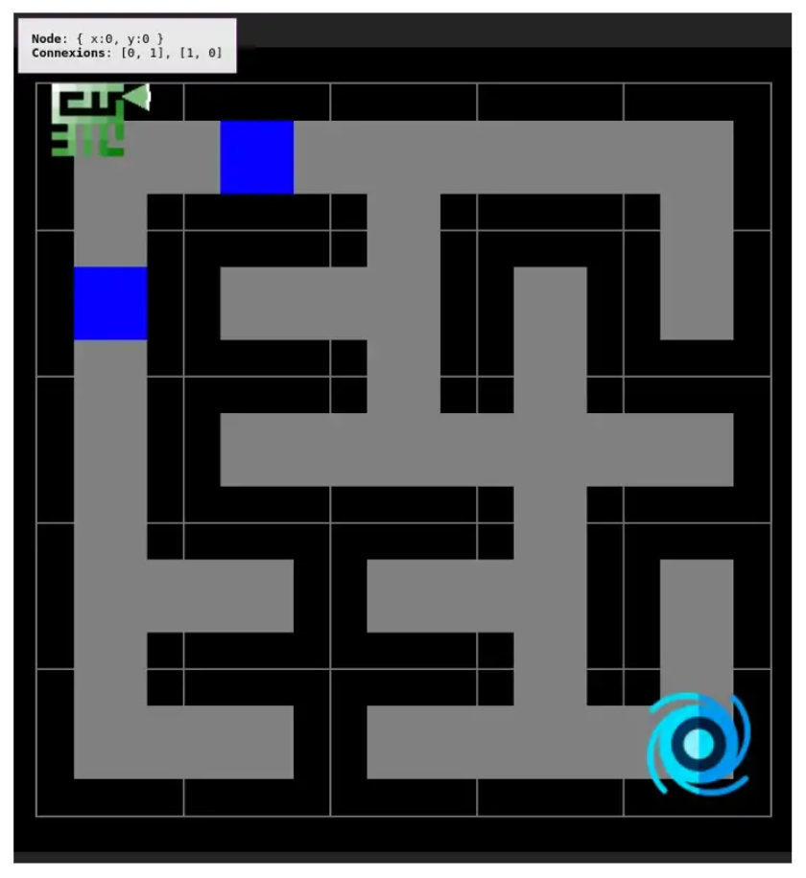
Problem Definition
Intro
Two first algos
Heuristics
Two last algos
Expected outputs
What is done
What is to be done
States
Initial State
Goal State
Actions
Transition

Slide 5
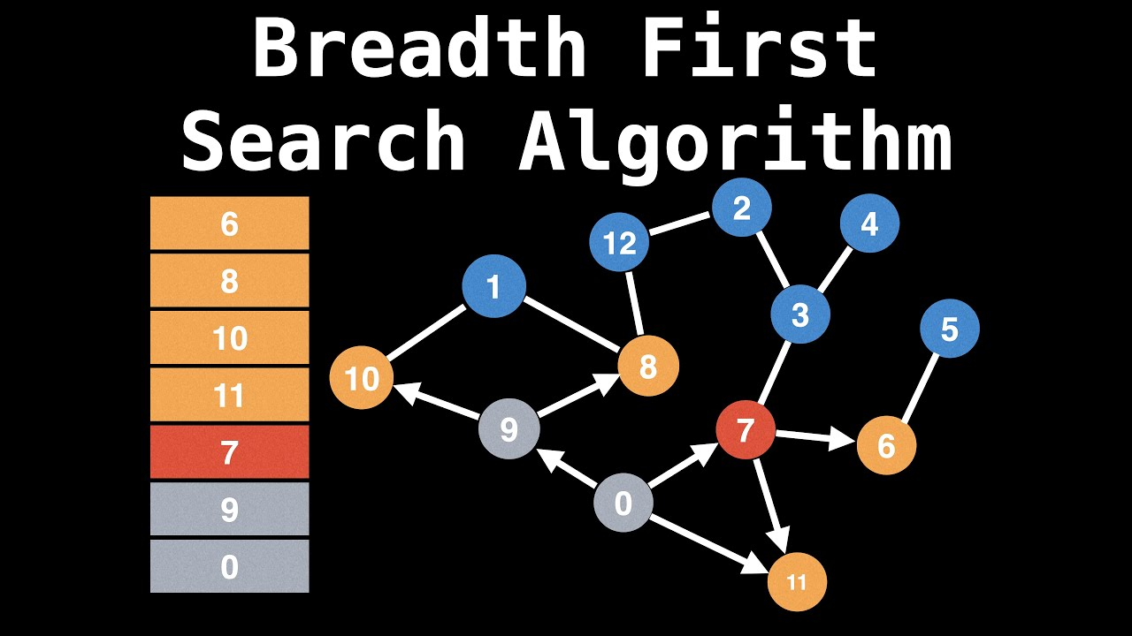
Breadth First Search (BFS)
Intro
Two first algos
Heuristics
Two last algos
Expected outputs
What is done
What is to be done
BFS is traversal algorithms
First published in 1959 by Edward F. Moore
Using for traversal problems, network, GPS, Search engine
BFS explores equally in all direction
BFS guarantees the shortest path
Starts from a chosen node and examines all its neighbors

Slide 6
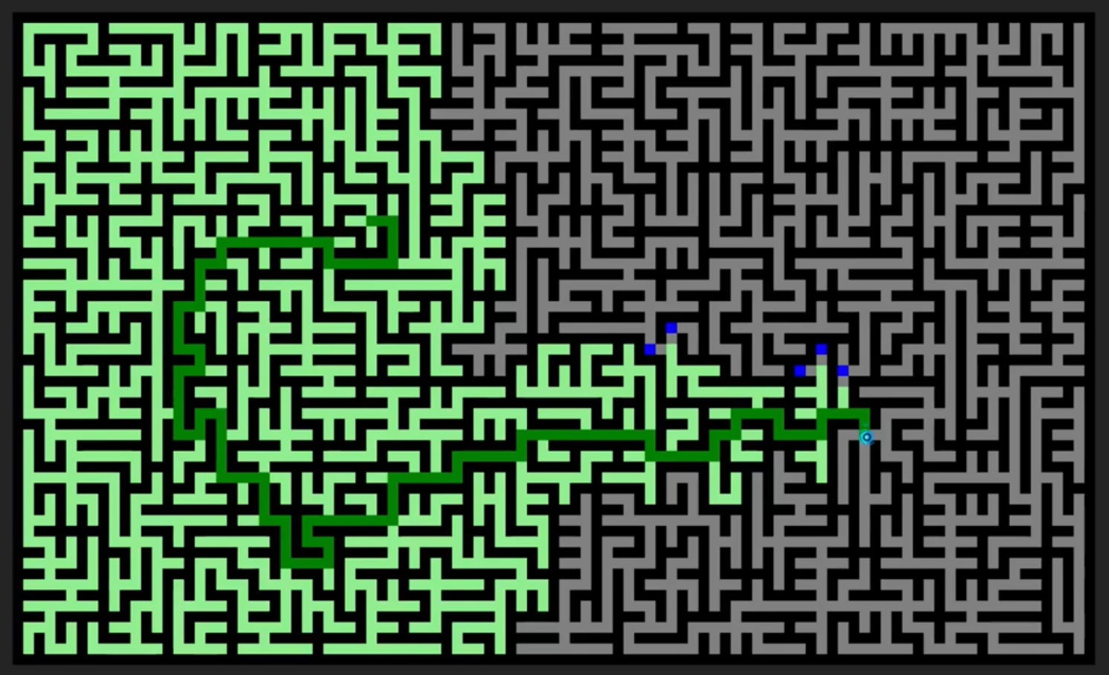

Slide 7
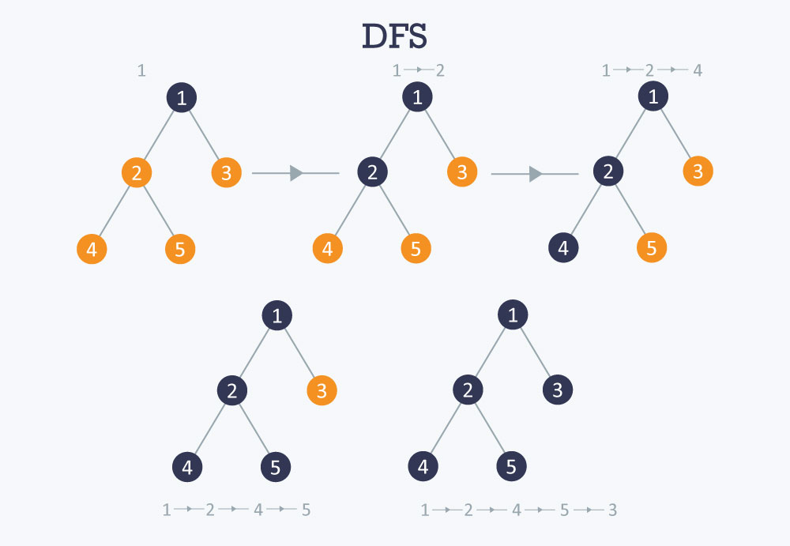
Depth First Search (DFS)
Intro
Two first algos
Heuristics
Two last algos
Expected outputs
What is done
What is to be done
DFS is traversal algorithms
Generate a topological ordering, to generate mazes
Build decision trees, to discover a solution path with hierarchical choices
NOT guarantee the shortest path
DFS known as Backtracking (Explores down before going back)

Slide 8
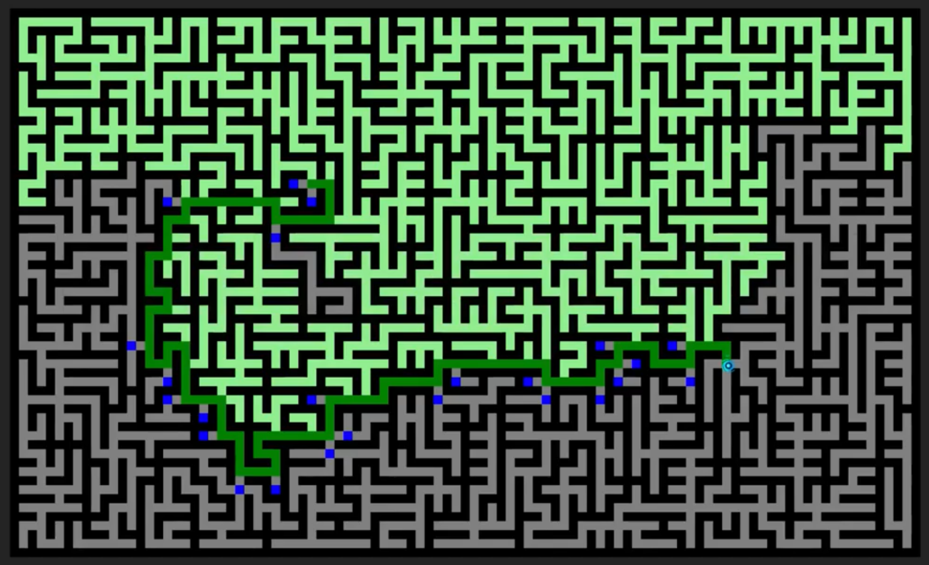

Slide 9
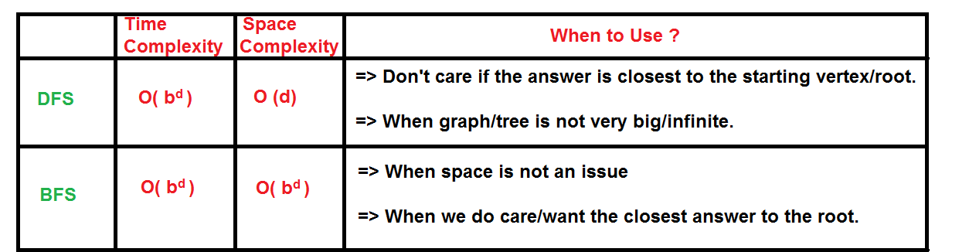
Depth-First Search (DFS) vs Breadth-First Search (BFS)
Intro
Two first algos
Heuristics
Two last algos
Expected outputs
What is done
What is to be done

Slide 10
What are heuristic and heuristic search?
Intro
Two first algos
Heuristics
Two last algos
Expected outputs
What is done
What is to be done
"A process that may solve a problem, but offers no guarantees of doing so, is called a heuristic for that problem." [1]
Heuristic search: The search guided by heuristics.
In finding minimum cost path to the goal, heuristic is an estimation for the cost of the path from each cell to the goal.
"There is no guarantee that heuristic search will be successful, but when it is successful, it eliminates much otherwise fruitless search effort." [1]

Slide 11
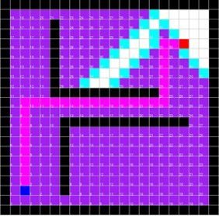
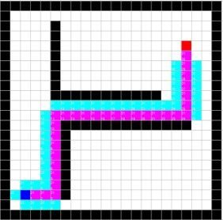
Why heuristic search?
Intro
Two first algos
Heuristics
Two last algos
Expected outputs
What is done
What is to be done
Eliminating useless paths.
Going through better-estimated path
to reach the goal.
Experiment different cases to
understand how using heuristic can
cover the disadvantages of
DFS and BFS.

Slide 12
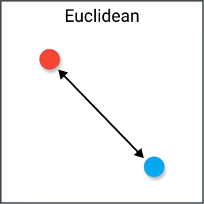
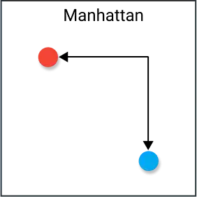
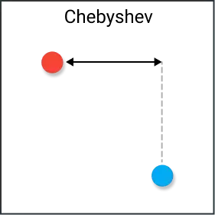
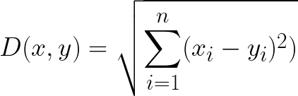
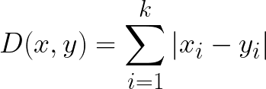

What are our heuristics?
Intro
Two first algos
Heuristics
Two last algos
Expected outputs
What is done
What is to be done
We have 3 heuristics:
1. Euclidean distance 2. Manhattan distance 3. Chebyshev distance

Slide 13
Greedy Best First Search
Intro
Two first algos
Heuristics
Two last algos
Expected outputs
What is done
What is to be done
A form of best-first search that expands the node with the lowest h(n) value (the closest node to the goal by estimation) with the hope that this is likely to lead to the goal very soon [2].
Not optimal but often efficient.
The worst-case time and space complexity: O(|V|).

Slide 14
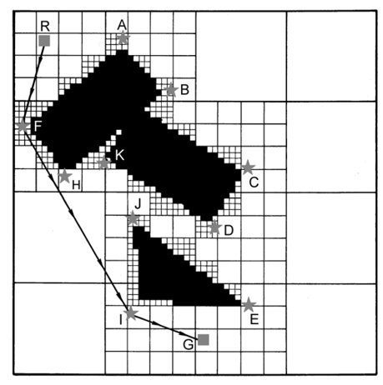
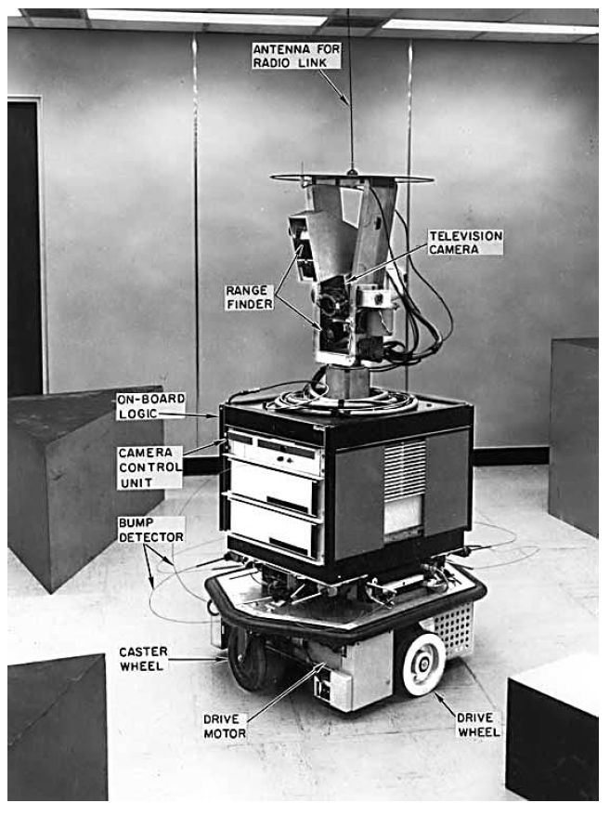
A* Search
Intro
Two first algos
Heuristics
Two last algos
Expected outputs
What is done
What is to be done
A means algorithm, and * refers to its outstanding property of finding the shortest path.[1]
Shakey's navigation problem.
First introduced in 1968. [3]
F(n) = g(n) + h(n)

Slide 15
A* Search
Intro
Two first algos
Heuristics
Two last algos
Expected outputs
What is done
What is to be done
Complete & Optimal
"If the estimate of remaining distance (whatever it might be) was never larger than the actual remaining distance, then the use of such an estimate in our new scoring scheme would always a path having the shortest distance to the goal." [1]
"The inclusion of the estimate of remaining distance (or cost) to the goal contributes to searching in the general direction of the goal. The inclusion of the actual distance (or cost) incurred so far ensures that the search process will not forever be led down promising but perhaps futile paths." [1]

Slide 16
Are our heuristics admissible?
Intro
Two first algos
Heuristics
Two last algos
Expected outputs
What is done
What is to be done
All of them are consistent!
Our actions are move in one of the four directions: N, E, S,W
For example: Manhattan
we have two adjacent a and b:
Case 1: a = (x, y), b = (x, y+1)
Case 2: a = (x, y), b = (x+1, y)
Case 3: a = (x, y), b = (x, y-1)
Case 4: a = (x, y), b = (x-1, y)
MD(a, T) = |xT-xa|+|yT-ya|and MD(b, T) = |xT-xb|+|yT-yb|
In all cases, based on the location of the Target:
MD(b, T) = MD(a, T) - 1 or MD(a, T) + 1
So, if h = MD then h(a) ≤ h(b) + cost of action(which is 1)

Slide 17
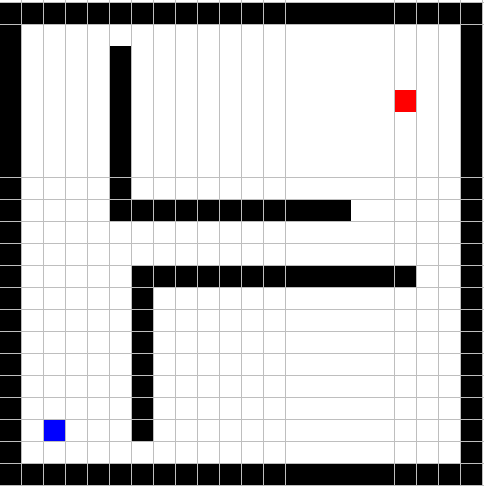
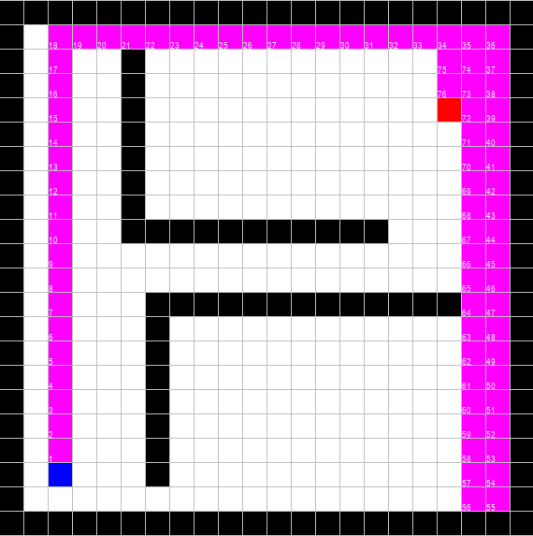
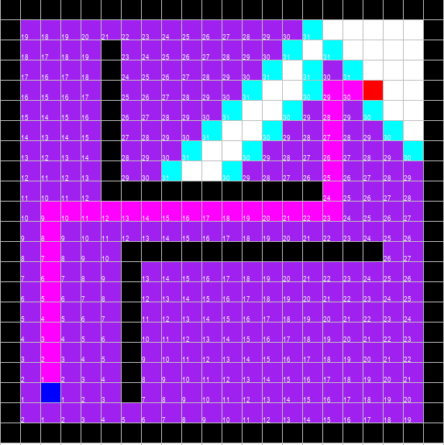

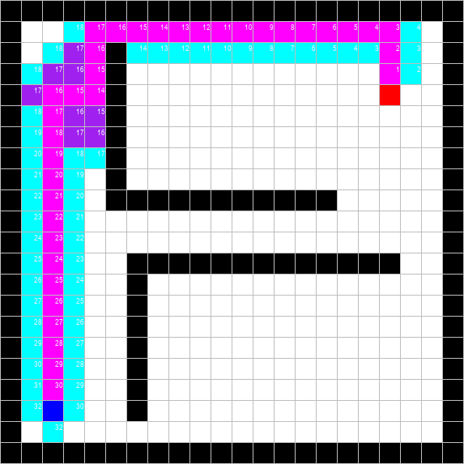
Output, Comparison, and Experiments
Intro
Two first algos
Heuristics
Two last algos
Expected outputs
What is done
What is to be done
From Left to Right: Input, DFS, BFS, A*, and Greedy Best-First Search:

Slide 18
What has been done?
Intro
Two first algos
Heuristics
Two last algos
Expected outputs
What is done
What is to be done
Searching for various approaches solving maze
Literature Review of both problem and techniques
Implementation of the selected algorithms.
Designing some mazes to discover how we can compare different algorithms
Distributing tasks and schedule our work on Github.

Slide 19
What is to be done?
Intro
Two first algos
Heuristics
Two last algos
Expected outputs
What is done
What is to be done
Running algorithms on many different mazes (especially our challenging ones)
Visualizing the maze and the path we have found for each maze.
Comparing the results from different aspects, including (time, space, completeness, optimality, …)
Survey our experiment results

Slide 20
Bibliography
Nilsson, Nils J., 1933-2019. The Quest for Artificial Intelligence : a History of Ideas and Achievements. Cambridge ; New York :Cambridge University Press, 2010.
Russell Stuart J and Peter Norvig. Artificial Intelligence : A Modern Approach. 4th ed. Pearson 2020.
P. E. Hart, N. J. Nilsson and B. Raphael, "A Formal Basis for the Heuristic Determination of Minimum Cost Paths," in IEEE Transactions on Systems Science and Cybernetics, vol. 4, no. 2, pp. 100-107, July 1968, doi: 10.1109/TSSC.1968.300136.

Slide 21
Any Questions?
Thank you for your time and consideration!
Feel free to ask us your questions.

