Slide 1


Covid-19 Detection From X-ray Images Using Convolutional Neural Network
SUBMITTED BY:
Md. Ahsan Habib-181003312
Shudipta Banik-181006112
SUPERVISED BY:
Promila Haque
Lecturer,
School of science,
Engineering and technology,
East Delta University

Slide 2
GOAL
To propose a deep learning model where machines can identify the patients having COVID-19 from their chest X-ray images.

Slide 3
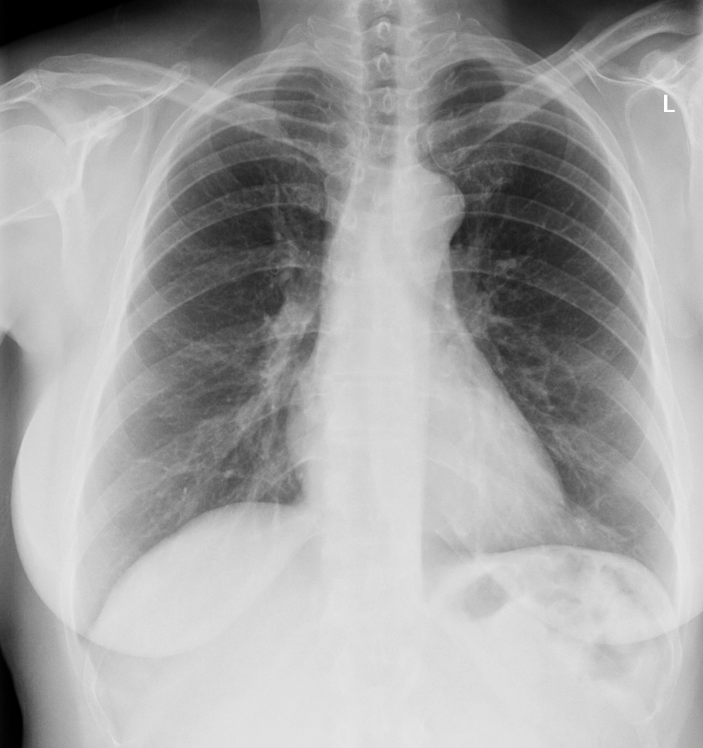
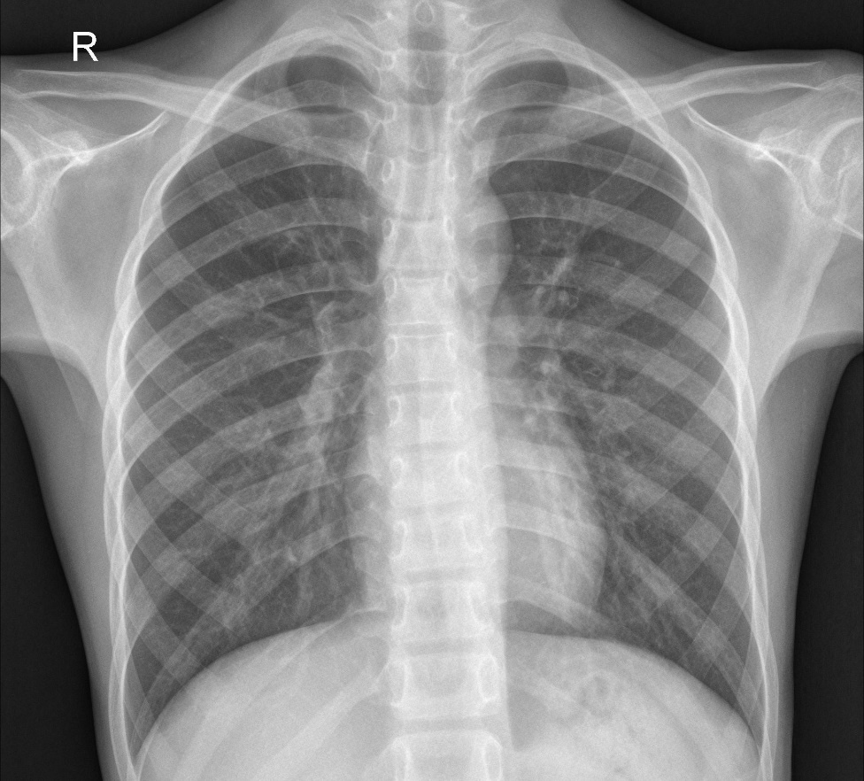
GOAL
?

Slide 4
GOAL
COVID-19 Positive
Normal Patient
After Training The Model

Slide 5
Motivation
Blood Tests are costly
Blood Tests take 4-6 hours time per patient
Unavailability of RT-PCR testing
Can provide vast number of test results in minimum time

Slide 6
Application
Covid-19 detection
Extend of spread can be detected
Diagnosis through medical image processing
Massive potential in healthcare applications

Slide 7
Challenges
Being a new topic, there is a shortage of datasets.
Medical Datasets are so sensitive that’s why help of professional radiologist needed.
Final result can’t be evaluated until a professional radiologist checks it.

Slide 8
Literature Survey
Reference Number | Work | Methodology | Limitations
[1] | An overview of deep learning in medical imaging focusing on MRI | ANN,CNN | Not on any specific field
[2] | A depth-wise separable deep neural network with white balance and CLAHE for detection of COVID-19 | COVIDLite (DSCNN and CLACHE) | Dataset was very small
[3] | Deep learning system to screen coronavirus disease and pneumonia | combination of pre-trained network ResNet and Location Attention method | High cost
[4] | A deep learning algorithm using CT images to screen for corona virus disease | modified Inception network (M-Inception) | Poor accuracy
[5] | A novel stacked CNN for malarial parasite detection in blood smear images | CNN | The efficiency of the model drops in some cases

Slide 9
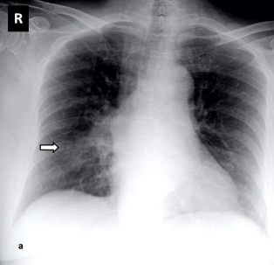
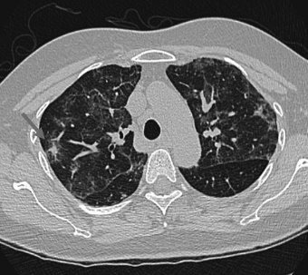

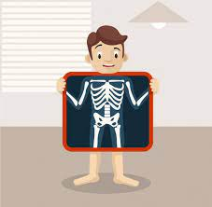
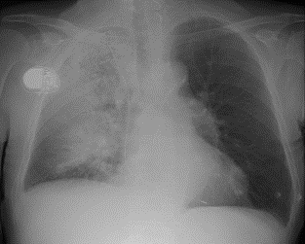
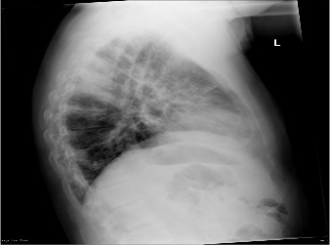
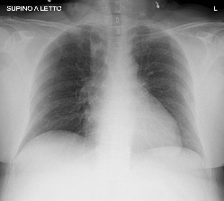
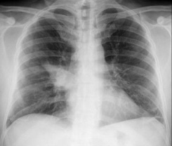
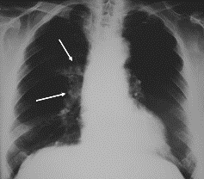
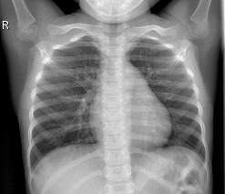
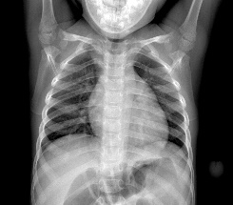
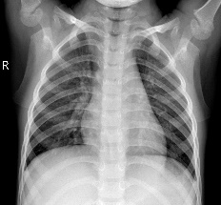
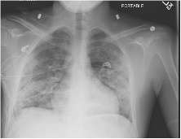
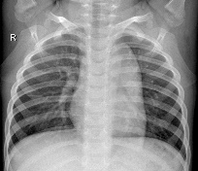
Workflow
Find out more accurate images containing COVID-19
X-ray of COVID-19 patient
COVID-19 patient’s X-ray dataset
COVID-19
COVID
Positive
Model
prediction
Data
augmentation
Model
training
Trained
model
Normal
Normal
Fig 1: System Development Workflow
X-ray images for testing

Slide 10
Proposed Framework
Dataset
Architecture of proposed CNN model
Normal
images
Covid-19 positive images
Convolutional layer
ReLU layer
Max-pooling
Pre-processing
Dropout layer
Activation function
Batch normalization
Predicted Output
Flatten matrix
generation
Covid-19/Normal
Fully connected layer
Fig 2: Proposed Framework

Slide 11
Data Pre-Processing
Pre-Processing
Normalization
Augmentation
Rescale=1./255
shear_range=0.2
zoom_range=0.2
horizontal_flip=True
Fig 3: Data Pre-processing

Slide 12
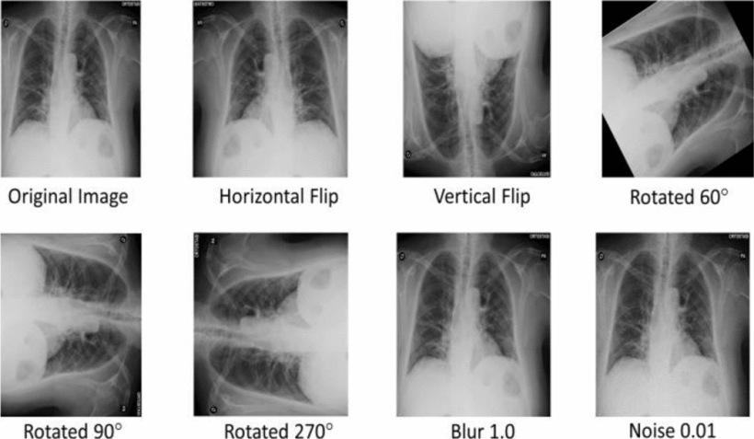
Data Pre-Processing(Cont.)
Data Augmentation Techniques

Slide 13
Training Phase
Conv2D Layers
[Kernel Size=3,3]
conv2d
conv2d_1
conv2d_2
conv2d_3
32 Filters
64 Filters
64 Filters
128 Filters
MaxPooling 2D
MaxPooling 2D
MaxPooling 2D
MaxPooling 2D
Pooling Size=2,2
Fig 4: CNN Layers

Slide 14
Training Phase(Cont.)
Dropout Layer
25% dropout rate
Z=i
3
2
1
Activation Function
z=0
-3
-2
-1
1
2
3
ReLU
Batch Normalization
axis=-1 argument
Fig 5: CNN Layers(Cont.)

Slide 15
Training Phase(Cont.)
Final Pooling
Layers
Final Pooling
Layers
3D Matrix(Output)
Flattening Layer
Vector
Dense Layer
Sigmoid Function
Predicted Output(0,1)
Fig 6: CNN Layers(Cont.)

Slide 16
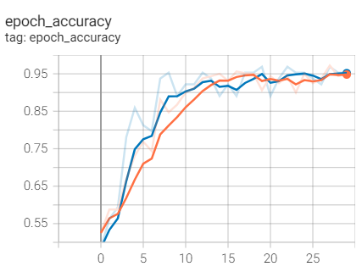
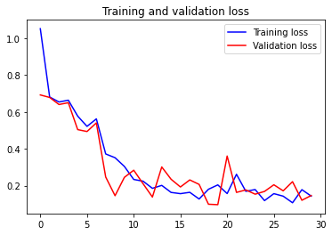
Result Analysis
accuracy
loss
epoch
epoch
Fig 7: Visualization of accuracy and loss history

Slide 17
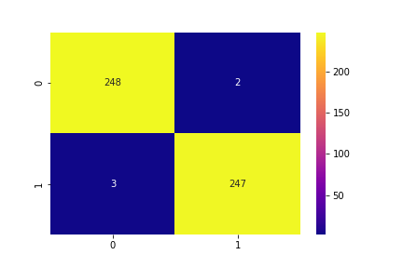
Result Analysis(Cont.)
COVID:0
Normal:1
True Positive
False Negative
True label
True Negative
False Positive
Predicted label
Figure 8: Confusion Matrix

Slide 18
Comparison
Method Used | Image Type | Image Distribution | Accuracy
VGG19 | CXR | 224 COVID-19+, 700 Pneumonia, 504 Normal | 93.4%
DRE-Net | CT | 777 COVID-19+, 708 Normal | 86.00%
Dark COVID Net | CXR | 125 COVID-19, 500 Pneumonia, 500 Normal | 87.02%
Deep CNN ResNet | CXR | 50 COVID-19+ 50 Normal | 98%
U-Net+3D Deep Network | CT | 313 COVID-19+, 229 Normal | 90.80%
Proposed Model | CXR | 930 COVID-19+, 930 Normal | 96.88%

Slide 19
Conclusion
An effective and reliable model to detect COVID-19 using Convolutional Neural Network(CNN) was proposed.
The model doesn’t need to rely on any other health test data.
Identify particularly normal and COVID positive patient.

Slide 20
Future Work
Working with more algorithms and deep learning approaches even for better result.
Testing with an enriched dataset.
Implement our model on different disease detection.

Slide 21
References
[1] Siddhartha, Manu, and Avik Santra. "COVIDLite: A depth-wise separable deep neural network with white balance and CLAHE for detection of COVID-19." arXiv preprint arXiv:2006.13873 (2020).
[2] A. S. Lundervold and A. Lundervold, “An overview of deep learning in medical imaging focusing on MRI,” Zeitschrift f¨ur Medizinische Physik, vol. 29, no. 2, pp. 102–127, 2019.
[3] Q. Li, W. Cai, X. Wang, Y. Zhou, D. D. Feng, and M. Chen, “Medical image classification with convolutional neural network,”
[4] I. D. Apostolopoulos, T. A. Mpesiana, Covid-19: automatic detection from x-ray images utilizing transfer learning with convolutional neural networks, Physical and Engineering Sciences in Medicine (2020)
[5] Y. Song, S. Zheng, L. Li, X. Zhang, X. Zhang, Z. Huang, J. Chen, H. Zhao, Y. Jie, R. Wang, et al., Deep learning enables accurate diagnosis of novel coronavirus (covid-19) with ct images, medRxiv (2020).

Slide 22
References
[6] T. Ozturk, M. Talo, E. A. Yildirim, U. B. Baloglu, O. Yildirim, U. R. Acharya, Automated detection of covid-19 cases using deep neural networks with x-ray images, Computers in Biology and Medicine (2020) 103792.
[7] C. Zheng, X. Deng, Q. Fu, Q. Zhou, J. Feng, H. Ma, W. Liu, X. Wang, Deep learning-based detection for covid-19 from chest ct using weak label, medRxiv (2020).
[8] J. P. Cohen, “Github Covid19 X-ray dataset,” 2020, https:// github.com/ieee8023/covid-chestxray-dataset, 2020. Online.
[9] P. Mooney, “Kaggle X rays dataset,” 2020, https://www.kaggle. com/paultimothymooney/chest-xray-pneumonia Online.

Slide 23
Thank You

