Slide 1
Recurrent to Neural Network
Mohammad Akhavan Anvari

Slide 2
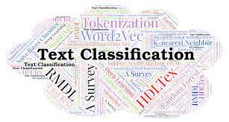
Motivations and Applications

Slide 3
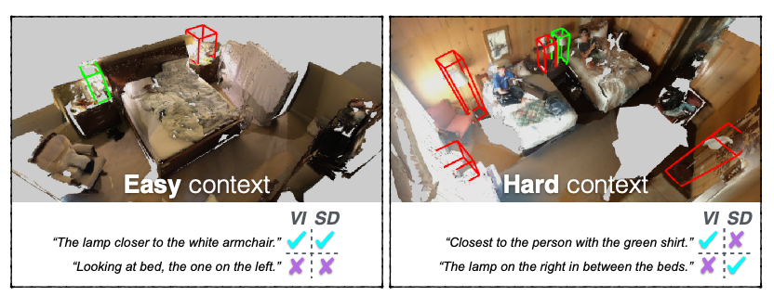
Image Captioning

Slide 4
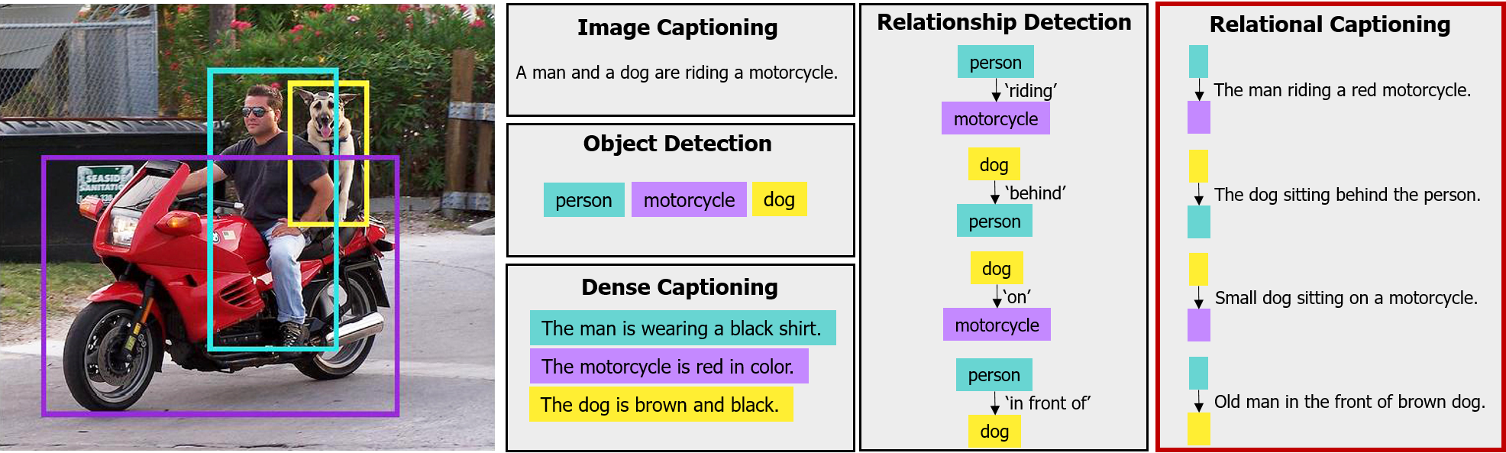
Dense Relational Image Captioning

Slide 5
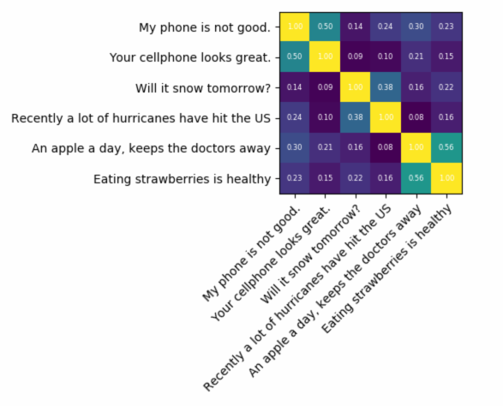
Textual Similarity

Slide 6
Recurrent Neural Networks (RNN)

Slide 7
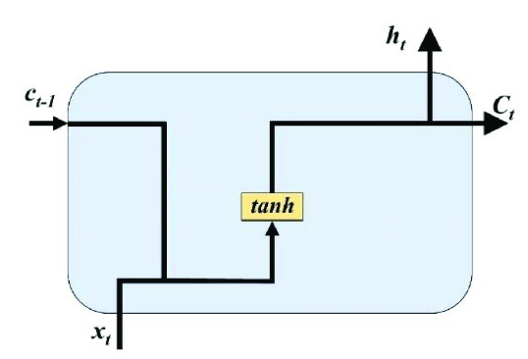
RNN Unit

Slide 8
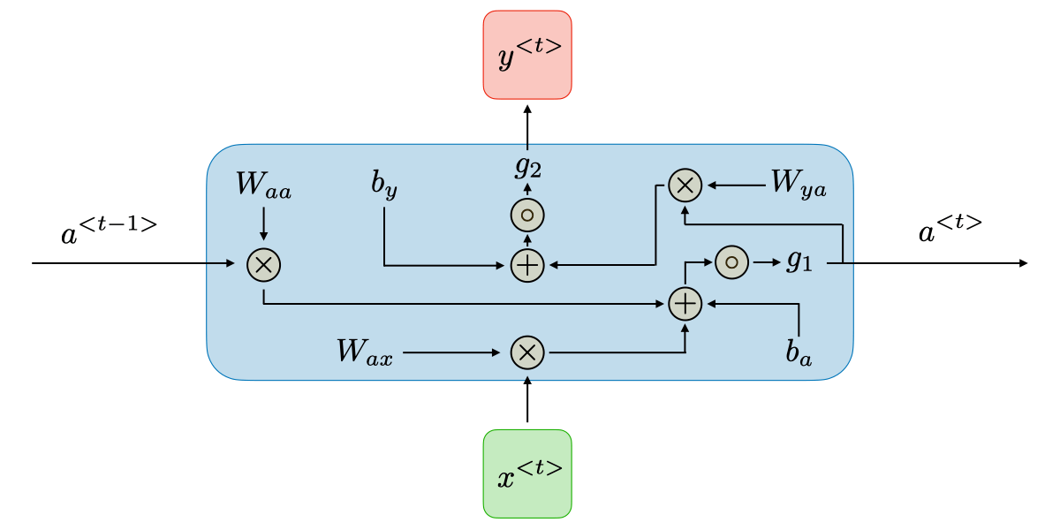
RNN Unit Parameters

Slide 9

RNN Unit Calculations
$a^{<t>}=g_{1}(a^{<t−1>}∗W_{aa}+ x^{<t>}∗W_{ax}+ b_{a})$
$y^{<t>}=g_{2}(a^{<t>}∗W_{ya}+ b_{y})$

Slide 10
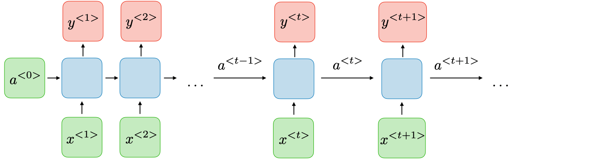
One Layer of RNN

Slide 11
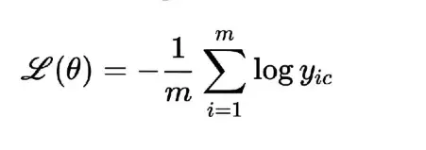
Loss function of RNN
For single unit

Slide 12
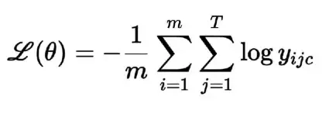
Loss function of RNN
For multi unit

Slide 13
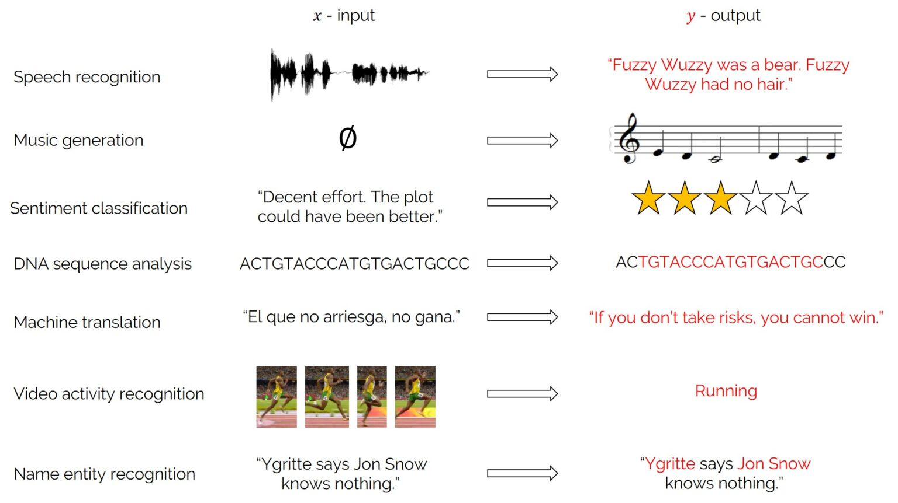
Applications

Slide 14
Type of Architectures Based on Applications
One to One (Traditional neural network)
One-to-Many (Music generation)
Many-to-One (Sentiment classification)
Many-to-Many (Name entity recognition)
Many-to-Many (Machine translation)

Slide 15
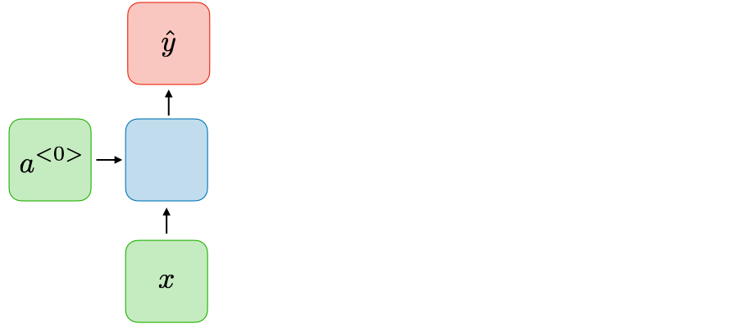
One to One Arch

Slide 16
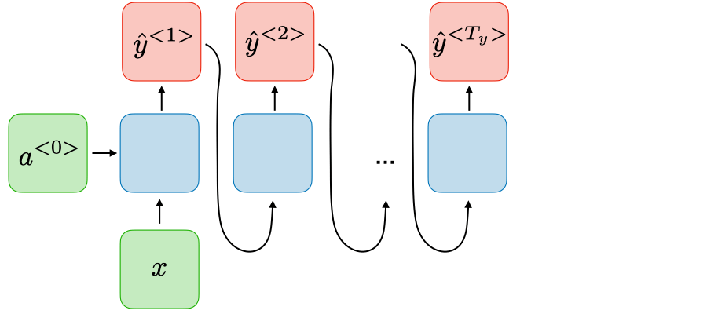
One-to-Many

Slide 17
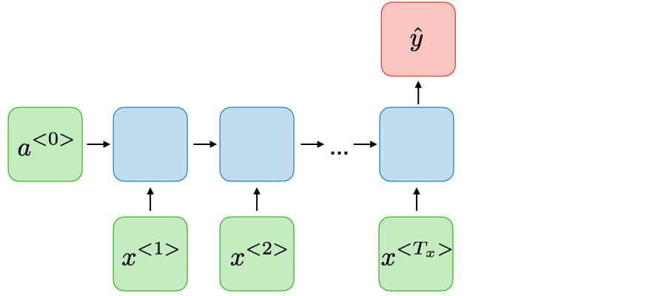
Many-to-One

Slide 18
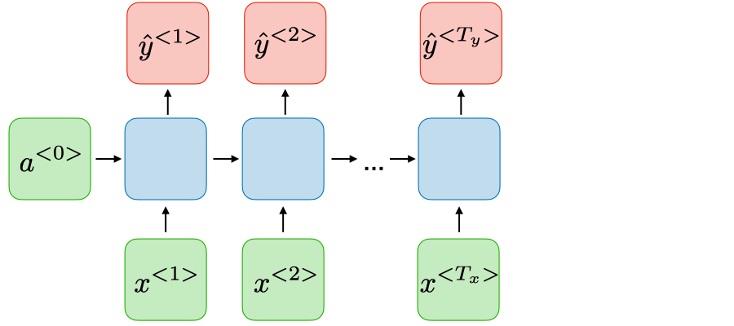
Many-to-Many

Slide 19
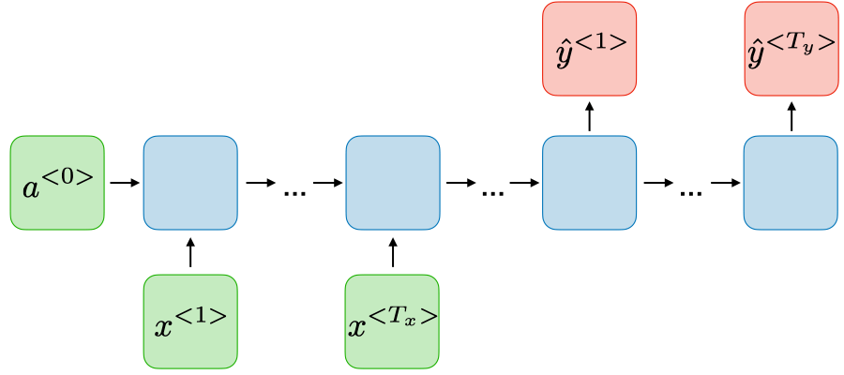
Many-to-Many

Slide 20
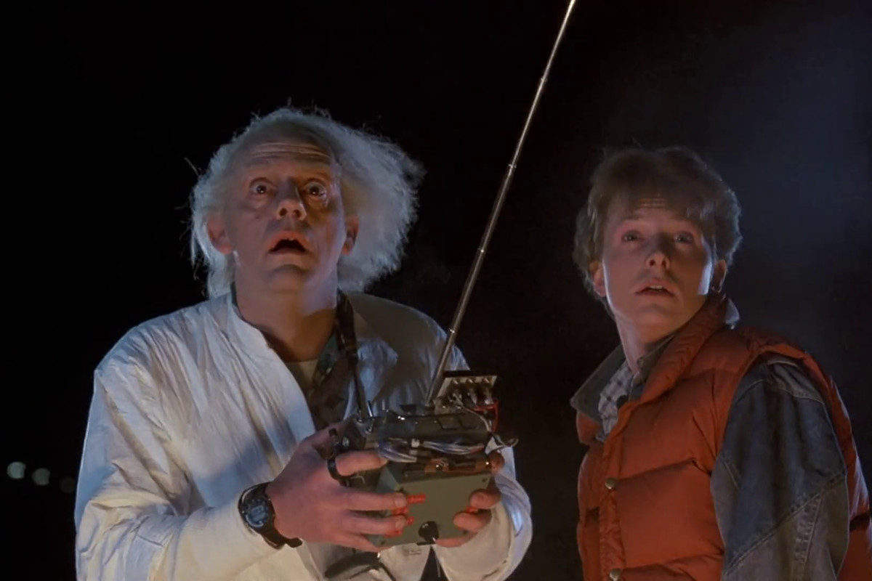
Backpropagation Through Time

Slide 21
Backpropagation Through Time
RNN processes sequences one step at a time
During backpropagation the gradients flow backward across time steps

Slide 22
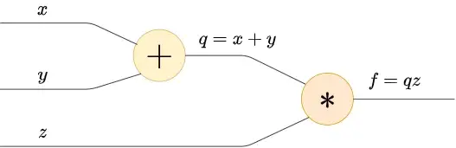
Backpropagation with Chain Rule

Slide 23
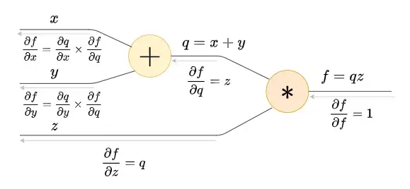
Backpropagation with Chain Rule

Slide 24
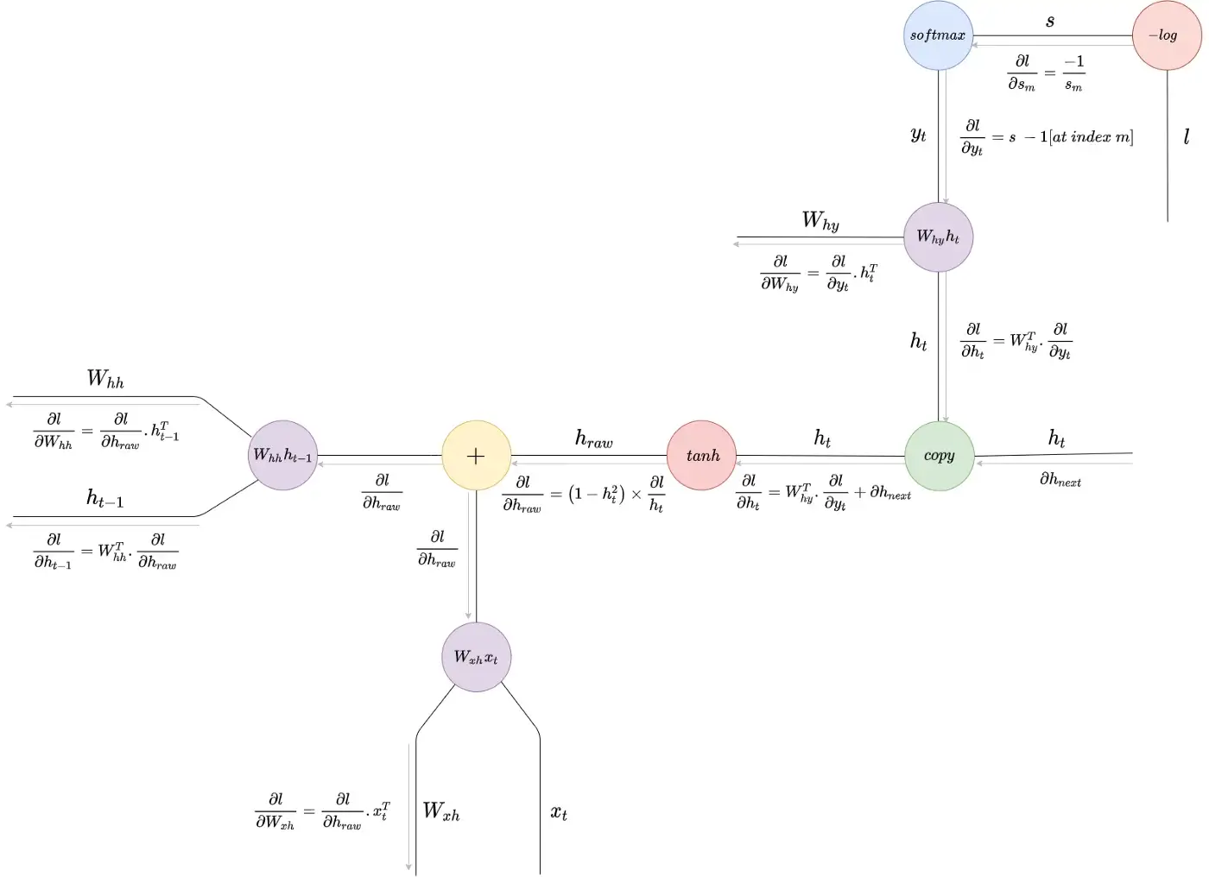
Backpropagation Through Time

Slide 25

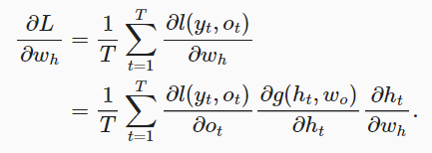

Backpropagation Through Time

Slide 26
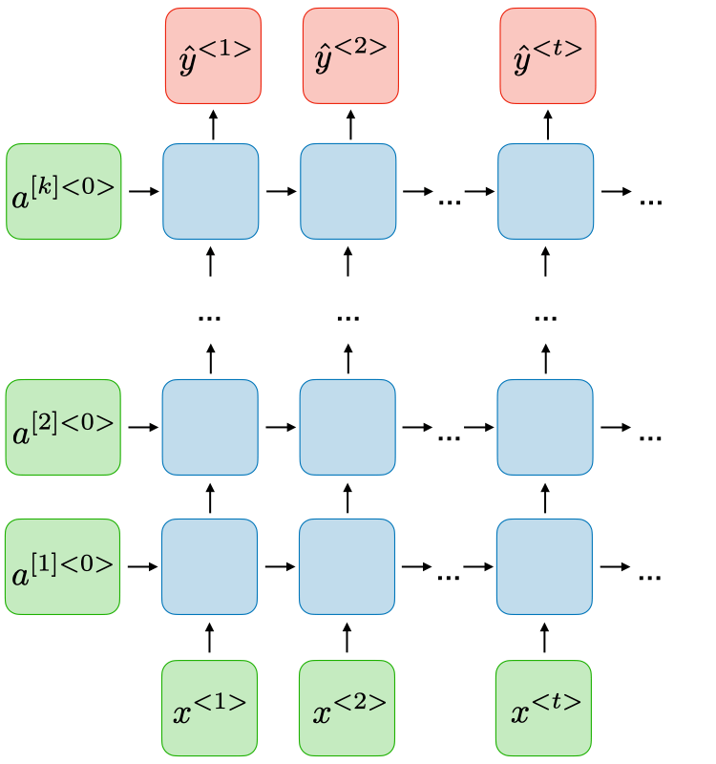
Deep RNN

Slide 27
Problems of Simple RNNs
Gradient vanishing
Exploding gradient
Difficult to process longer sequences

Slide 28
Gradient Exploding
What should we use with gradient exploding?
Gradient clipping.
Just place a threshold for gradient vector parameters.

Slide 29
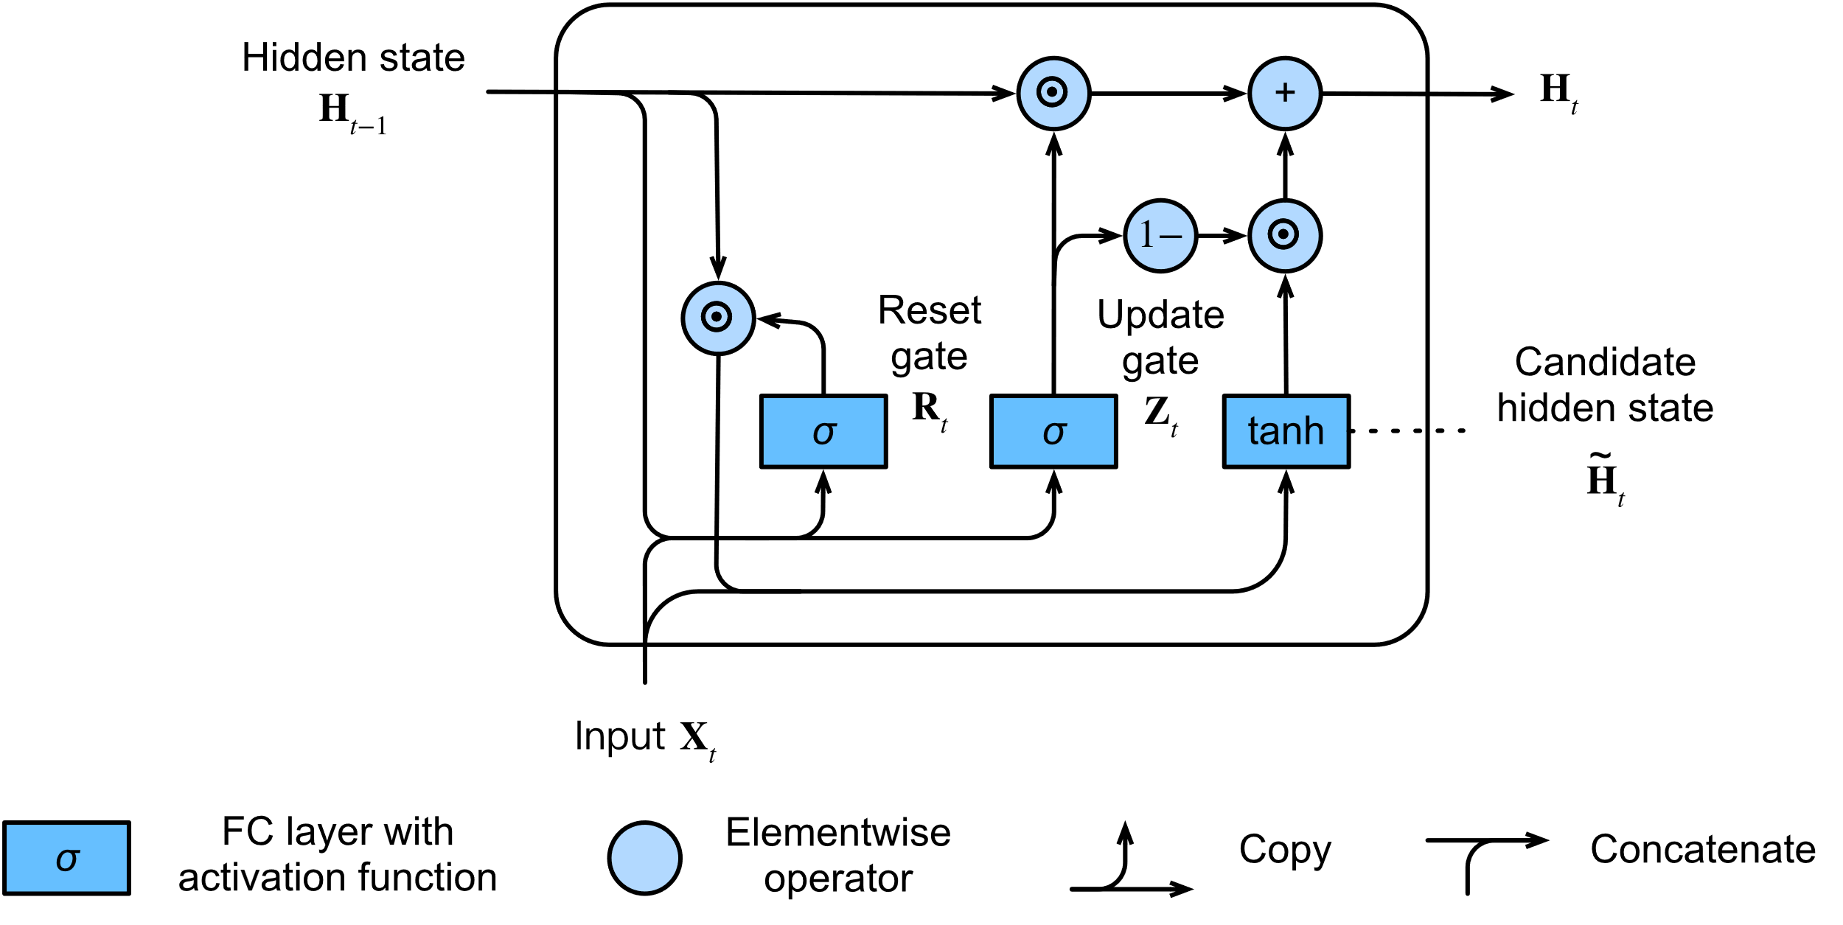
Gated Recurrent Unit (GRU)

Slide 30

Gated Recurrent Unit (GRU)
$${\tilde{H}}^{<t>}=tanh⁡(w_{h}[{Γ_{r},H}^{<t−1>}, x^{<t>}]+b_{h})$$
$$Γ_{u}=σ\left(w_{u}\left[H^{<t−1>}, x^{<t>}\right]+b_{u}\right)$$
$$Γ_{r}=σ\left(w_{r}\left[H^{<t−1>}, x^{<t>}\right]+b_{r}\right)$$
$$H^{<t>}=Γ_{u}∗{\tilde{H}}^{<t>}+\left(1−Γ_{u}\right)∗H^{<t−1>}$$

