Slide 1

UI / UX Design Principle
System Analysis and Design
Final Content 02

Slide 2

SDLC Steps
Idea Generation (optional)
Planning
System Information/Requirement Gathering
Analysis
Design
Development/Construction/Coding
Testing
Deployment
Post–Implementation & Maintenance

Slide 3
UI Design
User Interface is the front-end application view to which the user interacts to use the software.
Can be graphical user interface or other forms, such as voice-controlled interfaces or command-line interfaces.

Slide 4
Steps of UI Design
Planning – Understand the customer’s requirements; Benchmark Analysis; Set the theme and navigation
Prototyping & Sketching – Use tools such as Figma, Canva, Proto.io, etc, to create rough demo
Optimization – Investigate and analyze to make the prototypes more efficient
Implement – Finalize the prototype based on feedback and implement

Slide 5
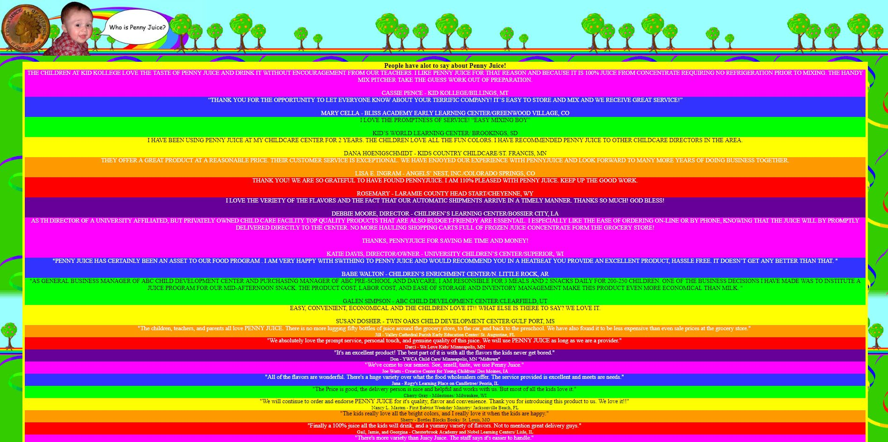
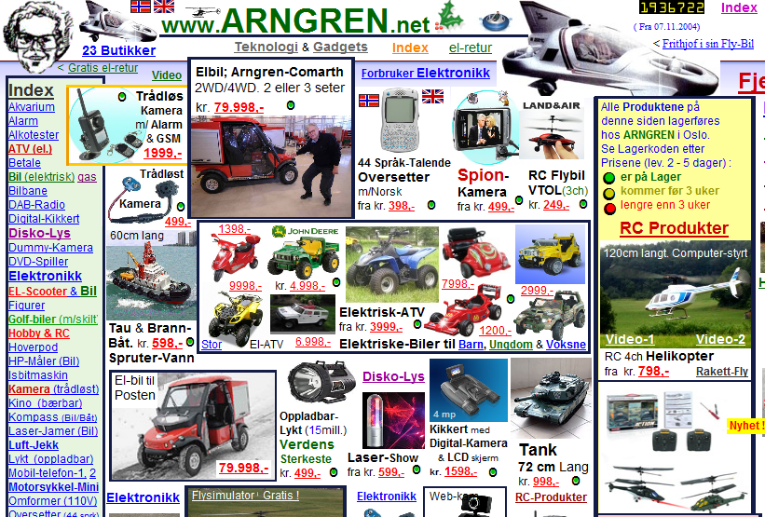
Is it a good UI?

Slide 6
Rules of UI Diagram
There are quite a few set of rules created by different people that address the best practices and requirements of UI Design, such as
Three Golden Rules
Shneiderman’s Eight Golden Rules
Norman’s Design Principles

Slide 7

Three Golden Rules

Slide 8
Three Golden Rules of UI Design
Place Users In Control
Reduce Users’ Memory Load
Make the interface consistent

Slide 9
Three Golden Rules of UI Design
1. Place Users In Control
1.1. Modeless
1.2. Flexibility
1.3. Interruptible
1.4. Helpful
1.5. Forgiving
1.6. Navigable
1.7. Accessible
1.8. Facilitative
1.9. Preferences
1.10. Interactive

Slide 10
Three Golden Rules of UI Design
        2.Reduce Users’ Memory Load
        2.1. Relieve short-term memory
        2.2. Rely on recognition, not recall
        2.3. Provide visual cues
        2.4. Forgiving
        2.5. Frequency
        2.6 Promote an object-action syntax
        2.7. Use real-world metaphors
        2.8. User progressive disclosure
        2.9. Organize

Slide 11
Three Golden Rules of UI Design
3. Make the interface consistent
3.1. Continuity
3.2. Maintain consistency within and across products
3.3. Keep interaction results the same
3.4. Provide aesthetic appeal and integrity
3.5. Encourage exploration

Slide 12

Shneiderman’s Eight Golden Rules of UI Design

Slide 13

Shneiderman’s Eight Golden Rules of UI Design
1. Strive For Consistency
Same design patterns and sequences of actions in similar situations throughout an application’s workflows.
Identical terminology should be used in prompts, menus, and help screens;
Consistent colors, layout, capitalization, fonts, etc, should be employed throughout.

Slide 14
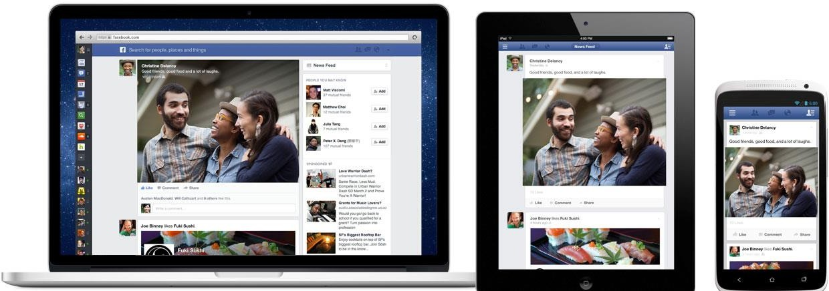
Shneiderman’s Eight Golden Rules of UI Design

Slide 15
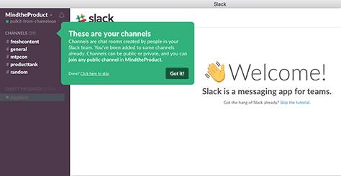
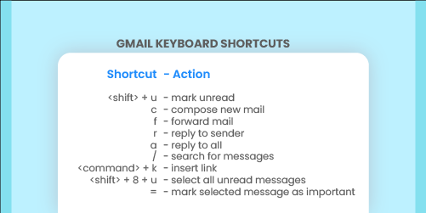
Shneiderman’s Eight Golden Rules of UI Design
2. Seek Universal Usability
A user-interface design is good only when all new users can find their way through the application without any problems and can quickly achieve their goals.
Users may be of different ages or from different cultures. Can be done by the use of navigation tips and shortcuts.

Slide 16
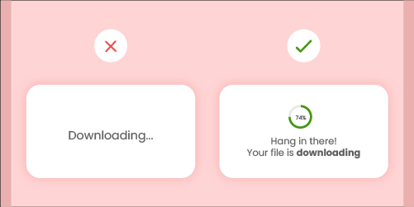
Shneiderman’s Eight Golden Rules of UI Design
3. Offer Informative Feedback
The design should always keep users informed about what is going on. Don’t keep the users guessing — tell them what’s happening.
When users know the current system status, they learn the outcome of their prior interactions and determine next steps.
Creates trust in the product and the brand.

Slide 17

Shneiderman’s Eight Golden Rules of UI Design
4. Design Dialog To Yield Closure
Make sure that the user sees an appropriate message or maybe even receives some kind of reward at the end of a process.
Gives users a sense of satisfaction on completing the task.

Slide 18
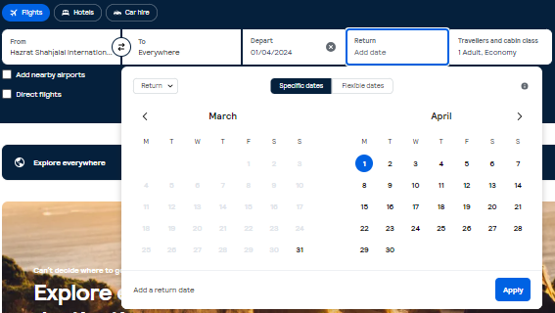
Shneiderman’s Eight Golden Rules of UI Design
5. Prevent Errors
Guide your users through an entire process, smoothly and seamlessly.
Good error messages are important, but the best designs carefully prevent problems from occurring in the first place.

Slide 19
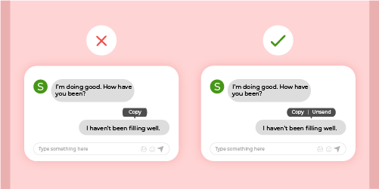
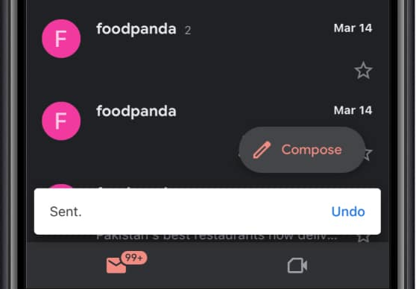
Shneiderman’s Eight Golden Rules of UI Design
6. Permit Easy Reversal Of Actions
Relieves anxiety, since the user knows that errors can be undone; it thus encourages exploration of unfamiliar options.
Ability to cancel a current action or go back and undo their actions.
(Back,Cancel,Close,Undo,Redo,etc)

Slide 20
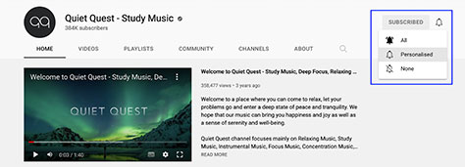
Shneiderman’s Eight Golden Rules of UI Design
7. Let The Users Be In Control
Experienced users strongly desire the sense that they are in charge of the interface and that the interface responds to their actions.
Give users the ability to use your application in whatever way they want to use it and enable them to customize the user interface to suit their needs.

Slide 21
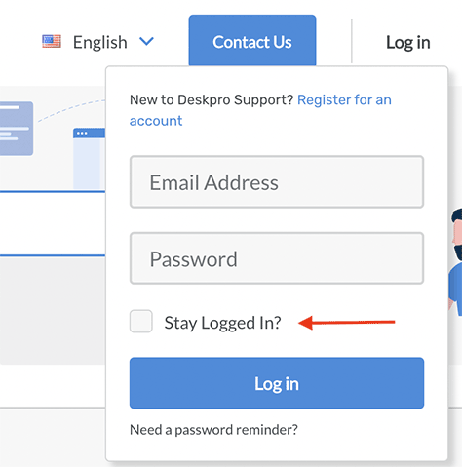
Shneiderman’s Eight Golden Rules of UI Design
8. Reduce Short-Term Memory Load
Don’t make your users remember any information except what’s absolutely necessary.
Recognizing something is easier than remembering it.
Use iconography and other visual aids such as themed coloring and consistent placement of items. Avoid requiring overly long sequences of actions.

Slide 22
Norman’s Seven Fundamental Design Principles

Slide 23

Norman’s Seven Fundamental Design Principles
1. Discoverability/Visibility
Determine the current state of the system and discover which actions are possible at the moment.
Easy to see so users know what actions are possible.

Slide 24
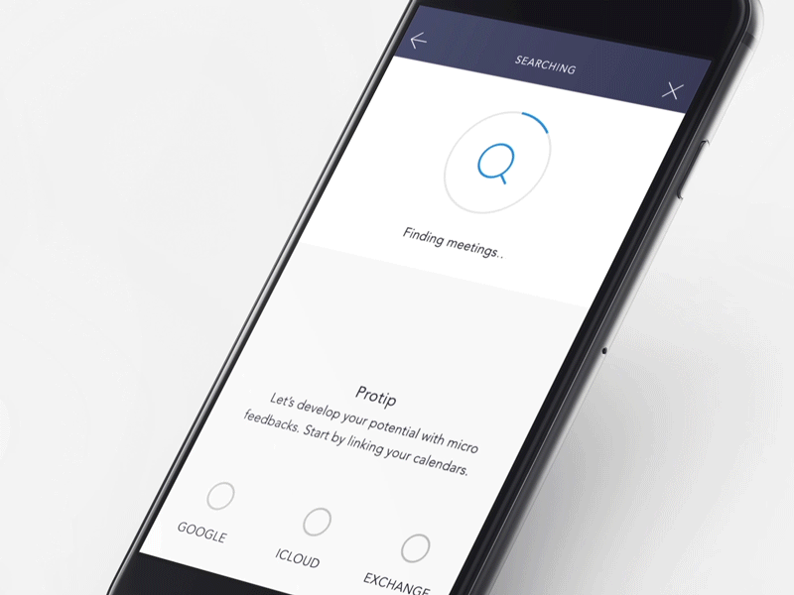
Norman’s Seven Fundamental Design Principles
2. Feedback
The system should tell the user what is happening after an action
After clicking Submit, a message appears:
“Form submitted successfully.”
When a file is uploading, a progress bar is shown.

Slide 25
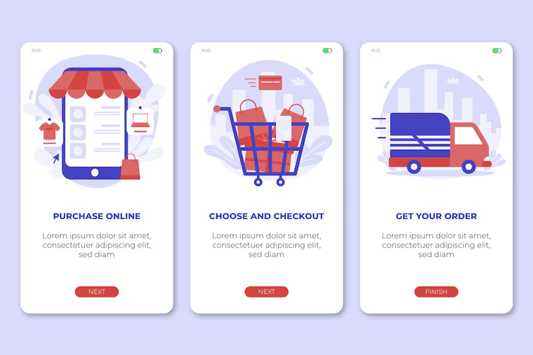
Norman’s Seven Fundamental Design Principles
3. Conceptual Model
How does this system work?
A simple explanation or mental picture that helps users understand how a system works and what will happen when they use it.
Browse products → Add to cart → Checkout → Pay

Slide 26
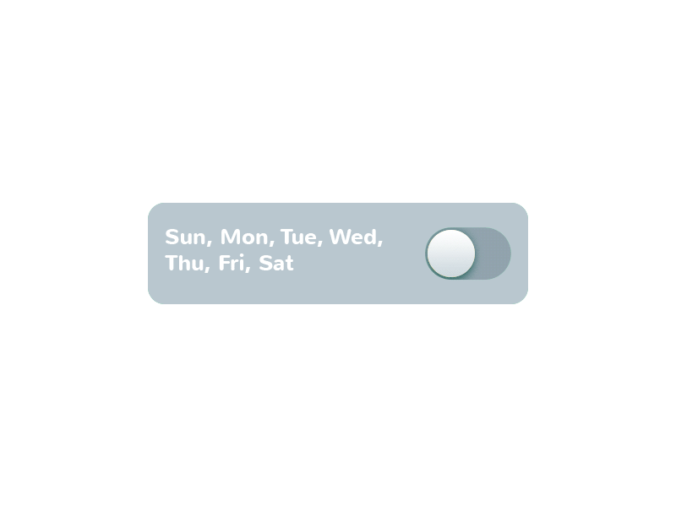
Norman’s Seven Fundamental Design Principles
4. Affordance
How can I use this?
An object’s perceived action and its properties should match. Affordance refers to how the design of an object suggests its use.
A button looks raised → user knows it can be clicked

Slide 27

Norman’s Seven Fundamental Design Principles
5. Mapping
There should be a clear relationship between controls and their effects.
In a music player:
▶ plays music
⏸ pauses music

Slide 28
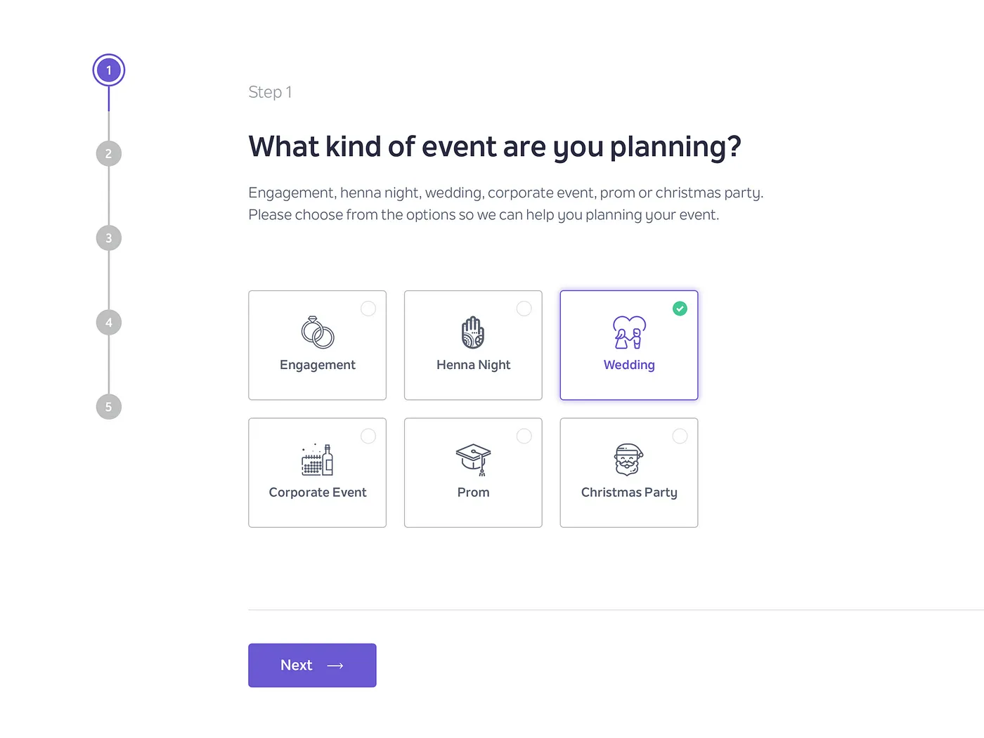
Norman’s Seven Fundamental Design Principles
6. Constraints
The design should limit incorrect actions.
A date field allows only numbers.
A “Submit” button is disabled until all required fields are filled.

Slide 29
Norman’s Seven Fundamental Design Principles
7. Consistency
Similar actions should work in similar ways throughout the system.
All Save buttons are green across the app.
All Delete buttons are red.

Slide 30
https://morioh.com/a/42dc6d4ad6a5/user-interface-design-ui-in-software-engineering
https://www.uxmatters.com/mt/archives/2022/10/applying-the-8-golden-rules-of-user-interface-design.php
https://yellowchalk.com/blog/8-golden-rules-of-interface-design/
https://www.linkedin.com/pulse/creating-consistency-ui-design-manjesh-yadav-
https://www.chameleon.io/inspiration/slack-product-tour-tooltips
Skyscanner | Find the cheapest flights fast: save time, save money!
Don Norman's seven fundamental design principles | UX Collective (uxdesign.cc)
References

Slide 31

Thank You!

