Slide 1

Software Requirement Specifications (SRS)
System Analysis and Design
Content 02

Slide 2
Software Requirement Specifications
(SRS)

Slide 3
Software Requirement Specifications (SRS)
A complete specification and description of requirements of the software that need to be fulfilled for the successful development of the software system.
Generated as output of Requirements Analysis.
A formal report that enables the customers to review whether it is according to their requirements.

Slide 4
Software Requirement Specifications (SRS)
It is a formal document that describes:
what the software should do,
how the system should behave,
the features and functions,
constraints and requirements of the system.
Think of it as a blueprint of the software project before development starts.

Slide 5
Structural Components of an SRS
Purpose : Main aim of why the system is necessary
Scope : Describes the main goals, features, and benefits of the system. And what value it will provide to customer is described
Overview : Gives a brief description of the product/system.

Slide 6
Components of an SRS
Functional Requirements
- Specify the expected behavior of the system - which outputs should be produced from the given inputs.
- Include features, technical details, calculations, data processing, etc.
The system will calculate students’ GPA from entered marks.
Interface Requirements
- How software program communicates with each other or users either in form of any language, code, or message.
- Shared memory, data streams, etc.
The payment system will communicate with the bank server through an API.

Slide 7
Components of an SRS
Performance Requirements
- How well software system performs desired functions under specific conditions
- Required time, required memory, maximum error rate, accuracy, etc.
The system should load results within 2 seconds.
Design Constraints
- Limitations or restrictions are specified
- Particular algorithm, hardware and software limitations, etc.
The system must use MySQL database.
Preliminary Schedule & Budget
- Gives an initial estimate of project time and cost.

Slide 8
Components of an SRS
Non-Functional Attributes
Describe the quality and performance of the system. Focus on how the system should work rather than what it should do.
— Attributes for better performance
— Reusability, Application Compatibility, Data Integrity, Scalability, etc.
— Operational Requirements (portability, maintainability)
— Performance Requirements (speed, capacity)
— Security Requirements (digital certificate, access control, reliability)
— Cultural and Political Requirements (social, language, legal, unstated norms etc.)

Slide 9
Users of an SRS
Project manager base their plans and estimates of schedule, effort and resources on it.
Development team require it for developing product according to the need.
Test plans are generated by testing group based on the describe external behaviour.
Maintenance and support staff need it to understand what the software product is supposed to do.

Slide 10
Users of an SRS
Customers rely on it to know that product they can expect.
As a contract between developer and customer.
Publications group writes documents, manuals, etc.
Training personnel can use it to help develop educational material.

Slide 11
Validation of an SRS Document
It is extreamely important to detect errors in the SRS document before going to other phases.
The major objective of SRS validation is to ensure Completeness and Correctness.

Slide 12
Validation of an SRS Document
In validation checking phase, we have to avoid the following errors:
1. Omission: Some user requirement is not included in the SRS. This error directly affects the external completeness of the system.
2. Inconsistency: Due to contradictions in requirements or incompatibility of state requirements.
3. Incorrect Fact: Some facts recorded in the SRS are not correct.
4. Ambiguity: Some requirements have multiple meanings.

Slide 13
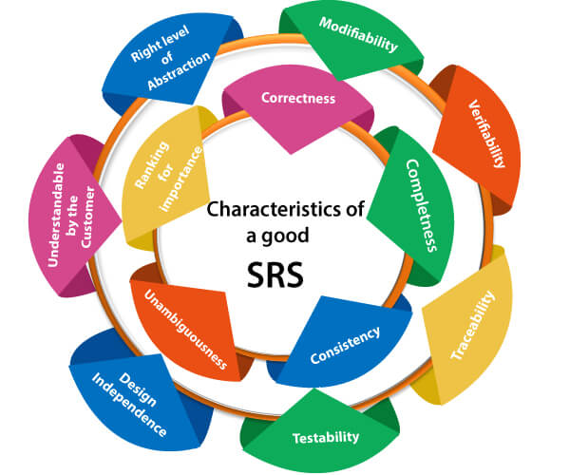

Slide 14
Characteristics of a Good SRS Document
Correctness :
— SRS is said to be perfect if it covers all the needs that are truly expected from the system.
Completeness :
— Contains all essential requirements, whether relating to goals & objectives, functionality, performance, design, constraints, attributes, or external interfaces.
— Contains definition of responses of the software to all realizable classes of input data in all available categories of situations.
— Involves all stakeholders

Slide 15
Characteristics of a Good SRS Document
Consistency :
— The use of standard terms and definitions.
— The consistent application of business rules in all functionalities.
Unambiguity :
— Every fixed requirement has only one interpretation.
Modifiability :
— Should be capable to quickly obtain changes to the system to some extent.

Slide 16
Characteristics of a Good SRS Document
Traceability :
— The origin of each of the requirements is clear and it facilitates the referencing of each condition in future development.
Verifiability :
— There exists some cost-effective process that can check whether the final product meets the requirements.
Testability :
— Should be written in such a method that it is simple to generate test cases and test plans from the report.

Slide 17
Characteristics of a Good SRS Document
Comprehensibility :
— Written in such a way that the customer understands.
Feasibility :
— Confirmed on technical and operational feasibility.

Slide 18
https://www.geeksforgeeks.org/software-requirement-specification-srs-format/
https://www.javatpoint.com/software-requirement-specifications
References

Slide 19

Thank You!

