Slide 1
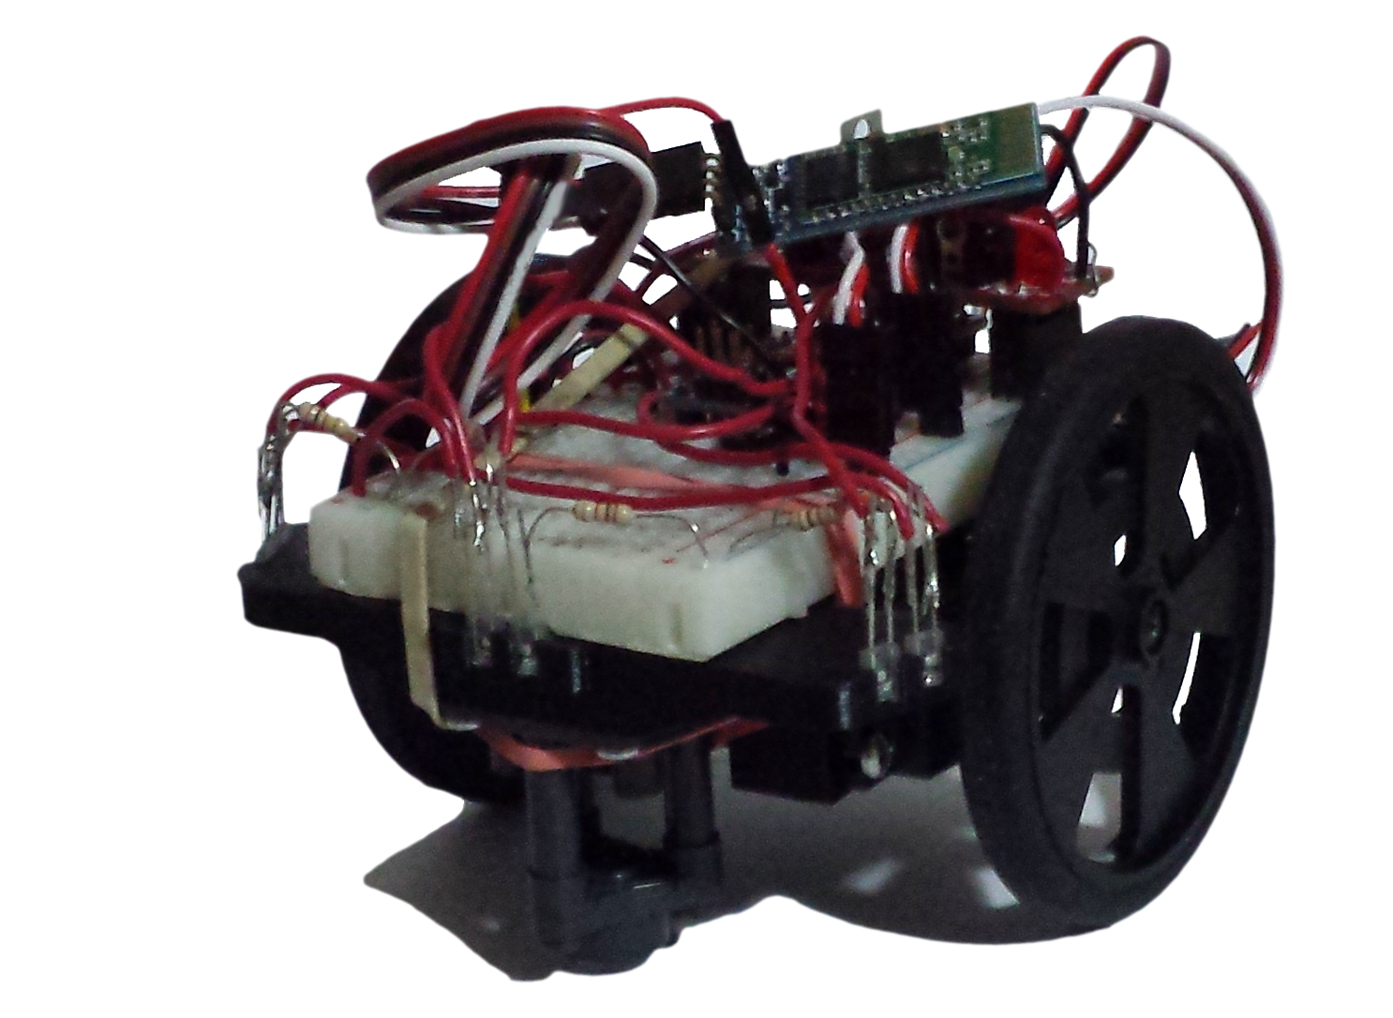
Nanomouse
Group Members: Jason Nixon, Mohammad Sameeh, Guillermo Fabian

Slide 2
Introduction - Hardware Production

Slide 3
Algorithm – Placeholder 1

Slide 4
Algorithm – Placeholder 2

Slide 5
Algorithm – Placeholder 3

Slide 6
Database – Placeholder 1

Slide 7
Database – Placeholder 2

Slide 8
Database – Placeholder 3

Slide 9
Application – Placeholder 1

Slide 10
Application – Placeholder 2

Slide 11
Application – Placeholder 3

Slide 12
Conclusion

