Slide 1

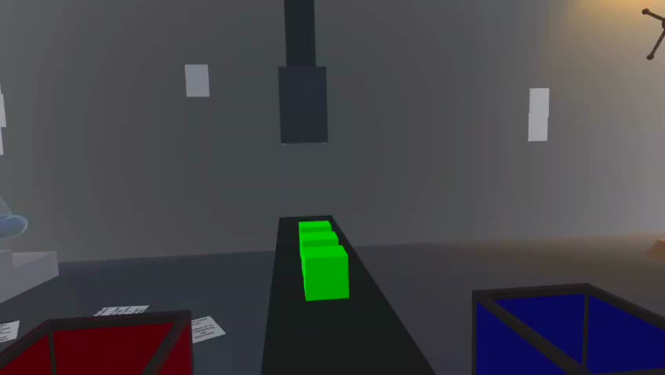

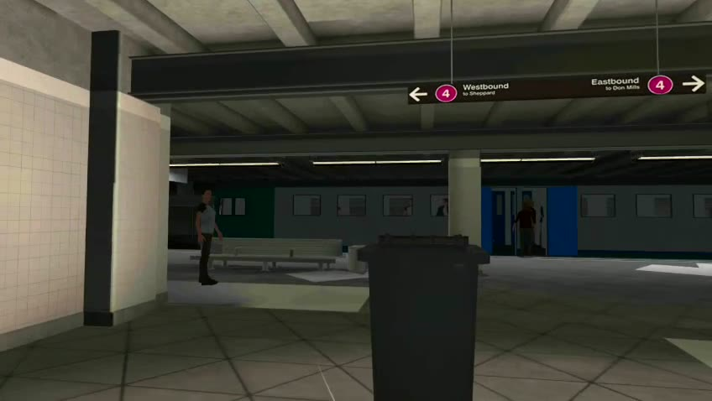
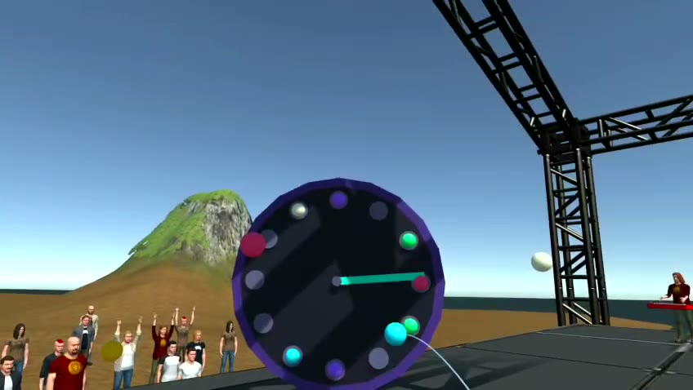
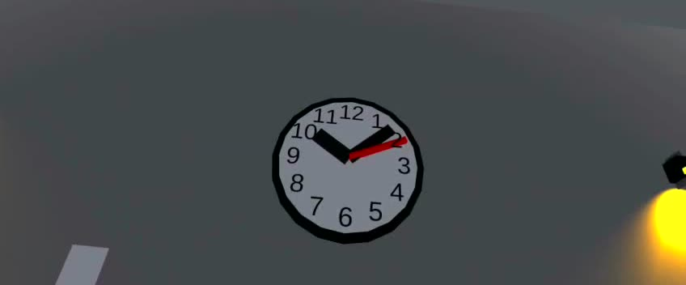
01 · MUS 442 FINAL PRESENTATION
A first-person VR sound narrative about maladaptive daydreaming, everyday repetition, and the clocks hidden inside escape.
1 — The Shift
2 — Playground
Scene 1: The Shift
Author: Semiha Paksoy · semihapaksoy.com
Project supervisor: Tolga Tüzün
Course instructors / advisor jury: Tolga Tüzün, Oğuz Usman, Enis Gümüş, Yiğit Özatalay, Cem Ömeroğlu, Semin Tunalı
3 — The Platform
4 — The Loop
factory
playground
platform
concert
clock
Meta Quest 3S | Unity 6 | OpenXR | Sound Installation and Multimedia Project | June 2026
All stills captured from the original Quest 3S headset recording
Mind Palace · Semiha Paksoy · MUS 442 Senior Project II
semihapaksoy.com · 01

Slide 2
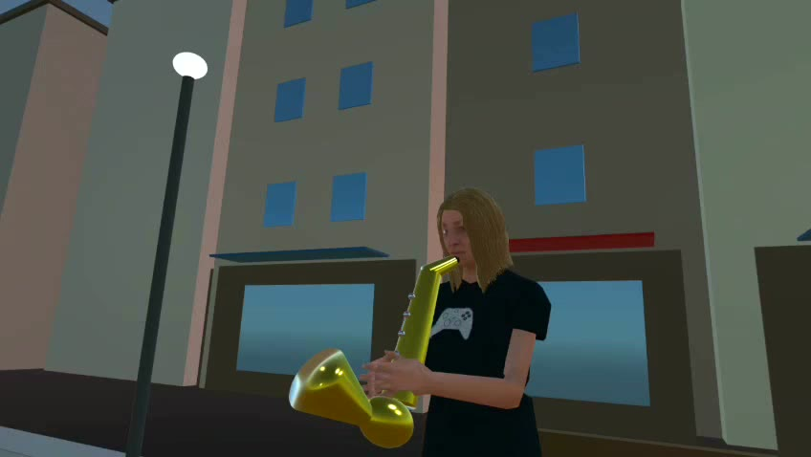
02 · SUBMISSION FRAME
Video can document the work, but the project has to be experienced.
Bilgi Learn submission note: a screen recording can show representative moments, but Mind Palace is designed around first-person embodiment, headset scale, hand action, and spatial audio.
watch
wear
video evidence
headset presence
The assessment object is not only an exported video; it is the performed VR experience.
act
feel
sorting, throwing, cleaning, composing
the loop become personal
watch → wear → act → feel
Street performance en route to the metro
The radial sequencer in play
Mind Palace · Semiha Paksoy · MUS 442 Senior Project II
semihapaksoy.com · 02

Slide 3
03 · CENTRAL THESIS
Everyday repetition makes daydreaming necessary.
work
The mundane, everyday, quotidian work-leisure cycle becomes the pressure that pushes the player toward maladaptive daydreaming.
return
commute
The fantasy is real relief, but it gradually inherits the same rhythms: chores, transit, spectacle, repetition, clock time.
the daily cycle
consume
recover
This loop is the antagonist. Mind Palace lets the player live one full revolution of it — first in the world, then inside their own daydream.
Mind Palace · Semiha Paksoy · MUS 442 Senior Project II
semihapaksoy.com · 03

Slide 4
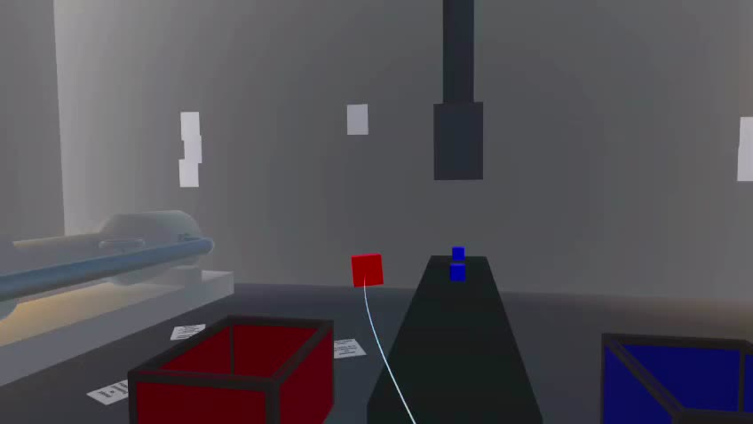
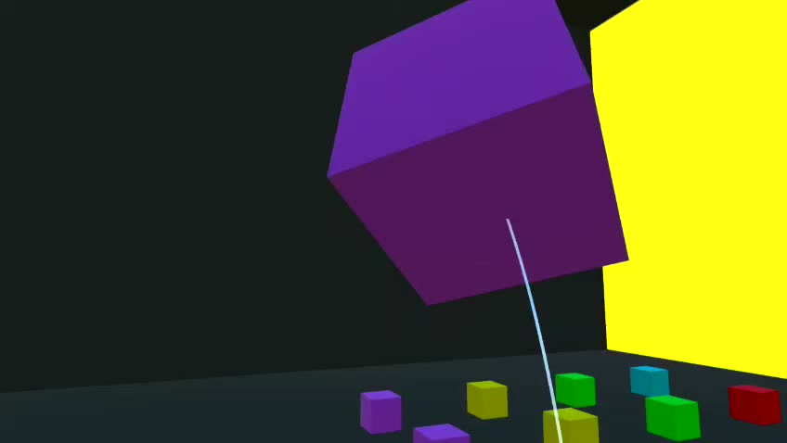
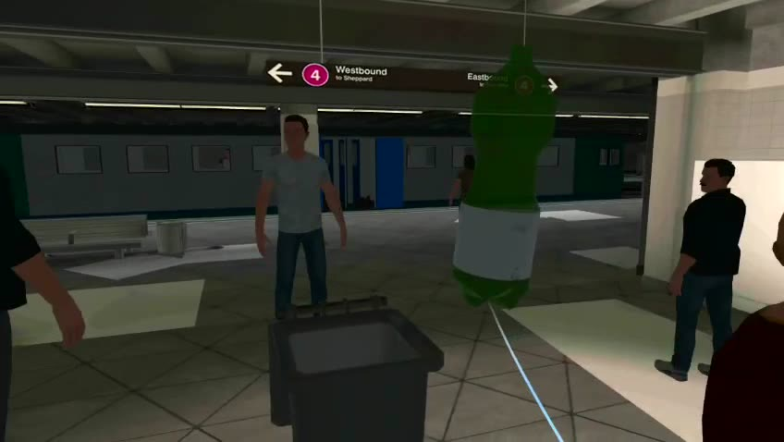
04 · NARRATIVE SYSTEM
One repeated gesture changes meaning four times.
Scene 1 — The Shift
→
Scene 2 — Playground
→
Scene 3 — The Platform
→
Scene 4 — The Loop
sort
throw
clean
compose
obedience
release
compulsory work
capture
The ending is not a cutscene. The player performs the loop that becomes the clock.
Mind Palace · Semiha Paksoy · MUS 442 Senior Project II
semihapaksoy.com · 04

Slide 5
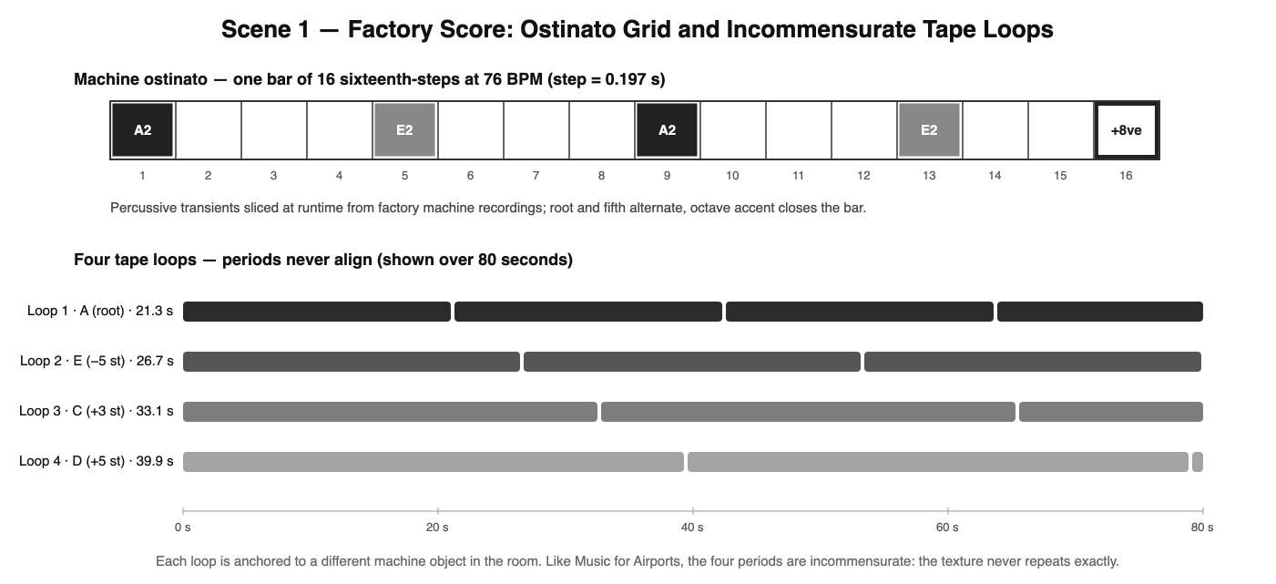
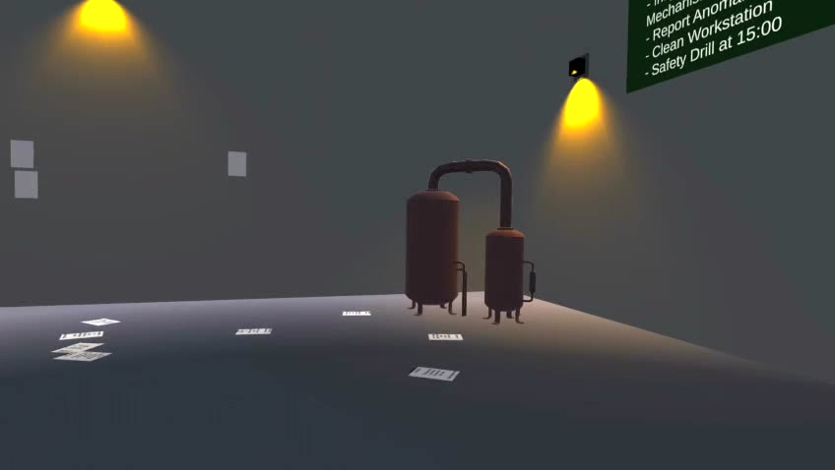
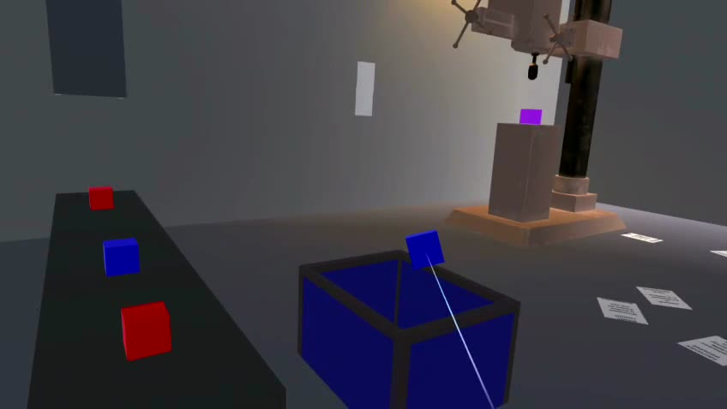
05 · SCENE 1 PROOF
The Shift turns obedience into music.
30
76 BPM
standard cubes before anomaly cubes appear
sample-accurate DSP grid
▸ machine recordings sliced into ostinatos and tape loops
▸ correct sorts play quantized pentatonic notes
▸ green anomaly cube cannot be classified
▸ second shift returns faster and slightly detuned
Factory score — ostinato grid and incommensurate tape loops
Sorting under the quota
The anomaly arrives
Mind Palace · Semiha Paksoy · MUS 442 Senior Project II
semihapaksoy.com · 05

Slide 6
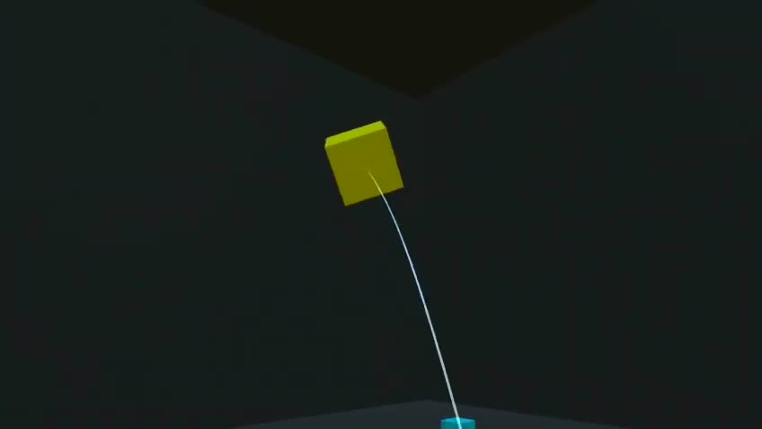
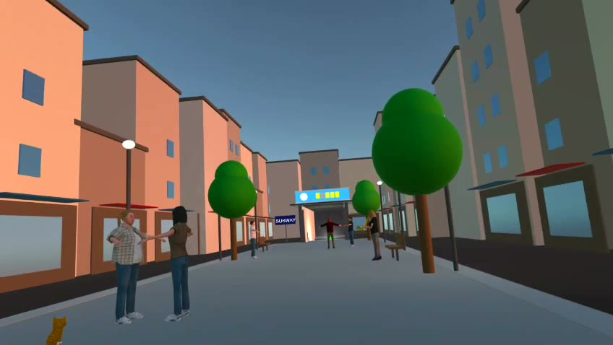
06 · SCENE 2 PROOF
Color removes the quota, then repetition breaks the room.
Current report correction: the room collapse is visual. The current build does not feature a prominent destruction sound, and the writeup no longer claims one.
red
blue
green
yellow
purple
each color carries its own synth voice
The post-collapse transition opens into city rumble and street ambience, without describing passing traffic.
20 wall hits
the playful action becomes a progression system
Twenty cubes in the dark
Throwing paints the wall
The room saturates
Collapse opens the city
Mind Palace · Semiha Paksoy · MUS 442 Senior Project II
semihapaksoy.com · 06

Slide 7
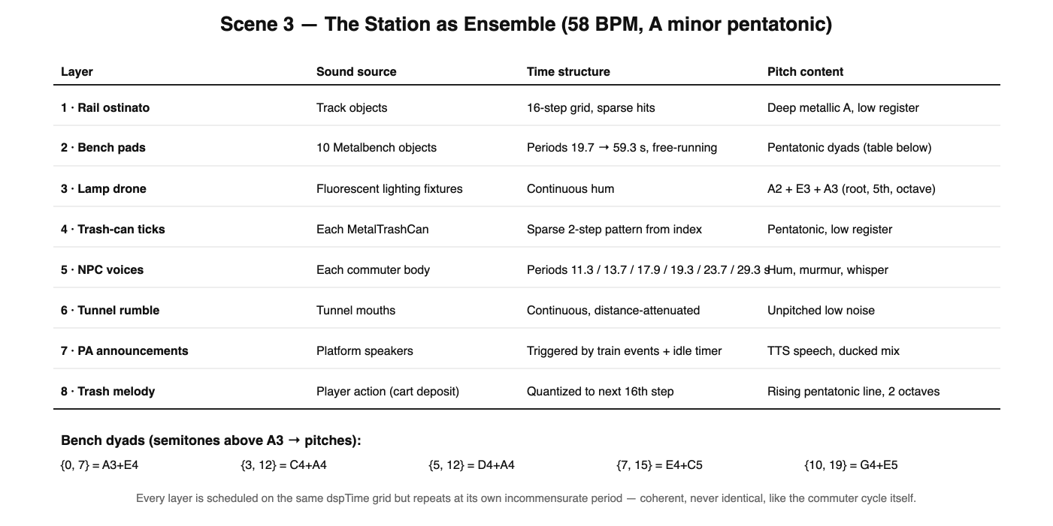
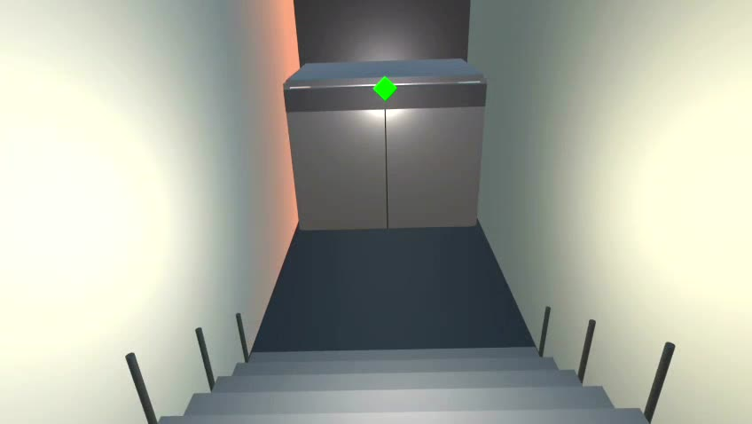
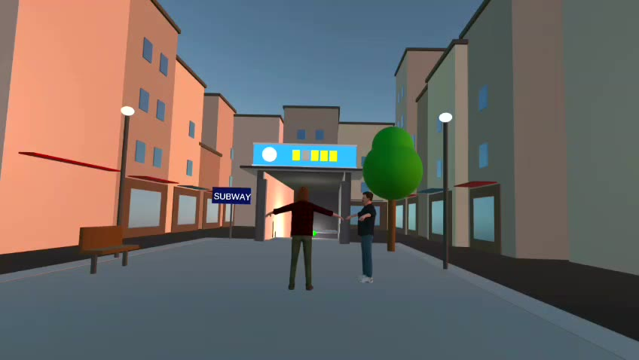
07 · SCENE 3 PROOF
Routine returns as a metro ensemble and cleaner role.
The player is not volunteering. The scene positions them as a cleaner inside a compulsory work cycle.
▸ NPCs wander, board, exit, and reset cyclically
▸ trash deposits add quantized melody notes
▸ bench pads, rail ostinato, drones, ticks, voices
▸ 58 BPM A minor pentatonic station grid
The station as ensemble — 58 BPM, A minor pentatonic
Descent into the station
Cleaner duty on the platform
Mind Palace · Semiha Paksoy · MUS 442 Senior Project II
semihapaksoy.com · 07

Slide 8
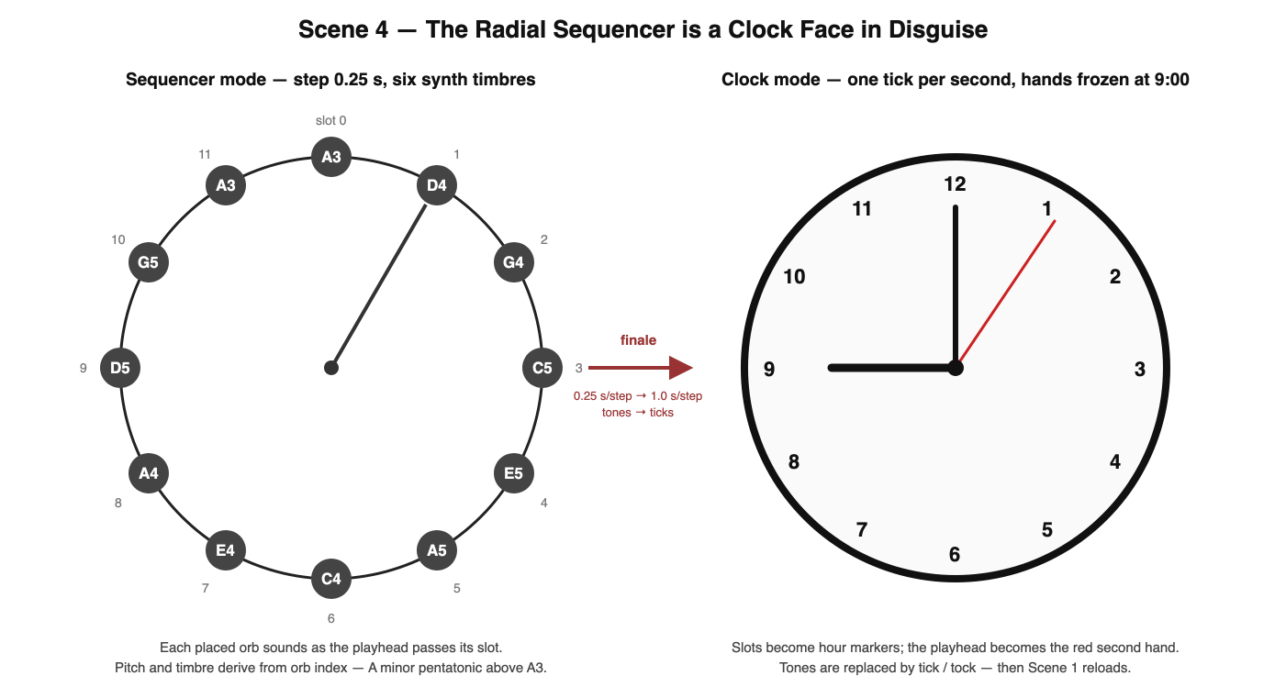
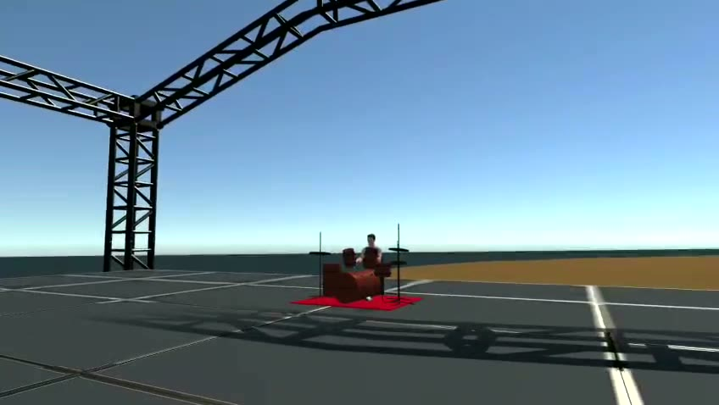
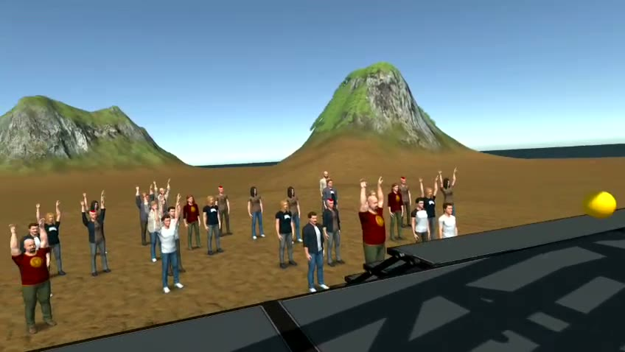
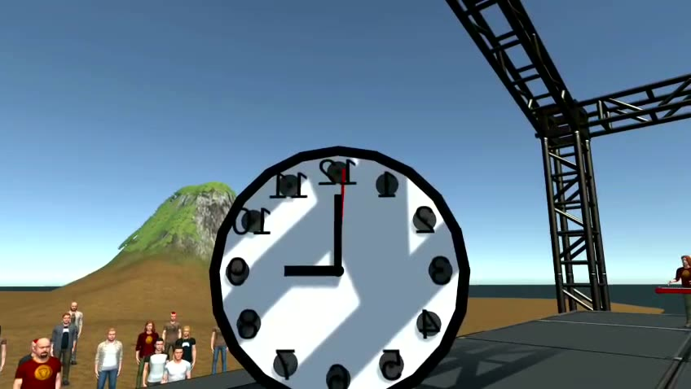
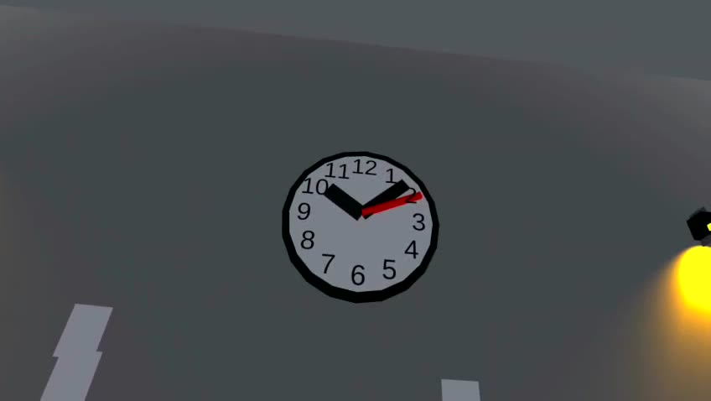
08 · SCENE 4 PROOF
The player's composition is a clock face in disguise.
12 slots
0.25s to 1.0s
each orb removes 1/12 of the concert
sequencer slows into clock time
Tones become ticks. The factory reloads at 9:00. The loop is authored by the player, then captures the player.
The radial sequencer is a clock face in disguise
The band performs
The crowd turns to the player
Mind Palace · Semiha Paksoy · MUS 442 Senior Project II
semihapaksoy.com · 08

Slide 9
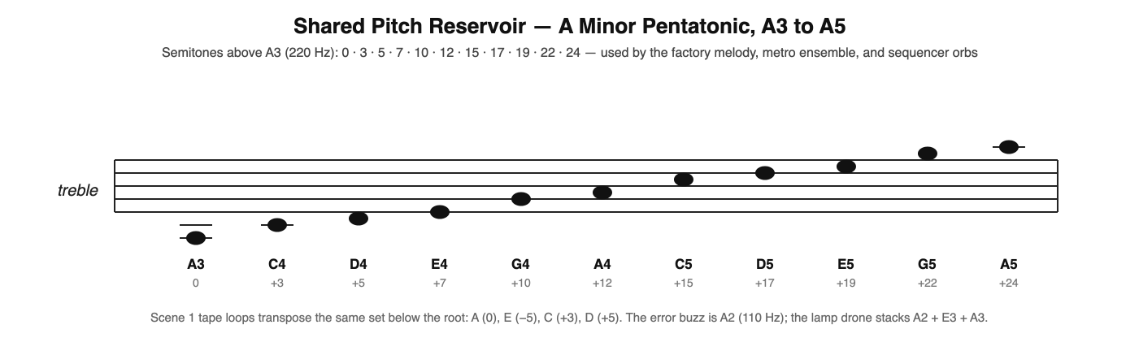
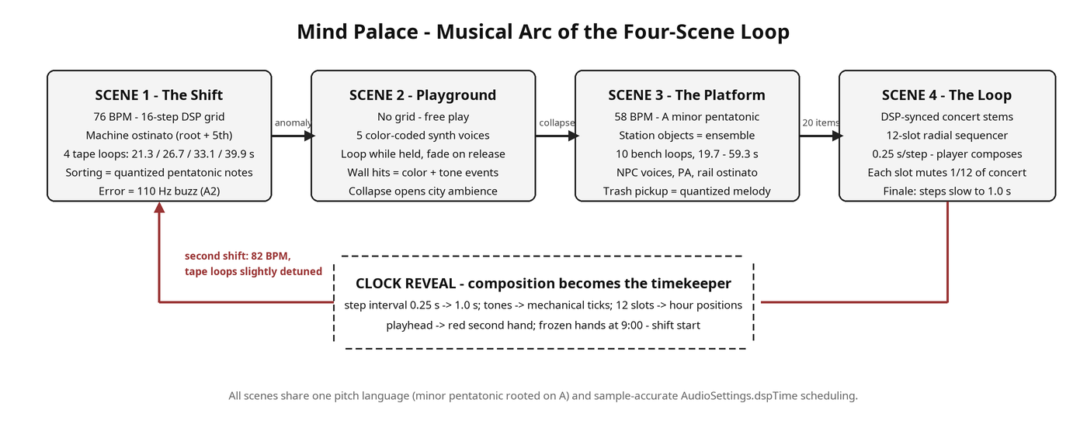
09 · MUSICAL LANGUAGE
One pitch reservoir ties the daydream together.
Shared pitch reservoir — A minor pentatonic, A3 to A5
Scene 1
factory composes; player obeys its grid
Scene 2
player improvises; no global grid
Musical arc of the four-scene loop — the clock reveal closes the cycle
Scene 3
world performs; player joins the ensemble
All scenes share one pitch language and sample-accurate dspTime scheduling.
Scene 4
player composes; loop becomes timekeeper
Mind Palace · Semiha Paksoy · MUS 442 Senior Project II
semihapaksoy.com · 09

Slide 10
10 · TECHNICAL SYSTEM
The implementation connects XR interaction, scene tools, and audio clocks.
XR input
Scene logic
Audio directors
Quest build
— hands
— controllers
— grab / release / throw
— quota
— wall hits
— train loop
— sequencer
— DSP scheduling
— runtime slicing
— stems
— synthesis
— OpenXR
— Android
— VR diagnostics
4
69
14
~16k
root-level scenes
runtime scripts
editor tools
project C# lines
Mind Palace · Semiha Paksoy · MUS 442 Senior Project II
semihapaksoy.com · 10

Slide 11
11 · SEMESTER DELTA
MUS 442 turned a contrast study into a circular VR music system.
Narrative
Systems
▸ two scenes became four
▸ metro replaced old Scene 3
▸ concert finale became clock reveal
▸ cyclic train and NPC boarding
▸ compulsory cleanup cart
▸ Scene 4 sequencer, band, audience tools
Sound
Device polish
▸ factory and metro generative scores
▸ city ambience after visual collapse
▸ DSP-synced concert stems
▸ Quest physics/grab repairs
▸ LOD, blob shadow, diagnostics
▸ cross-scene final verification pending
From MUS 441 contrast study → to a four-scene circular music system, performed in first person.
Mind Palace · Semiha Paksoy · MUS 442 Senior Project II
semihapaksoy.com · 11

Slide 12

12 · SUBMISSION PACKAGE
The materials now match the corrected project identity.
Report
MUS442_Final_Report.docx / .pdf
FINAL CHECKS BEFORE LIVE SUBMISSION
☐ run full Quest 3S regression
☐ verify Scene 4 serialized setup
☐ complete the loudness pass
☐ export the final recording
Deck
MUS442_Final_Presentation.pptx
System map
MUS442_Musical_System_Map.docx / .pdf
Board
MUS442_Final_Presentation_Board.png / .pdf
Media
90-second teaser + original Quest 3S headset recording
semihapaksoy.com
project page, teaser and full documentation online
Bilgi Learn note
video is evidence; headset is the full experience
Mind Palace · Semiha Paksoy · MUS 442 Senior Project II
semihapaksoy.com · 12

Slide 13
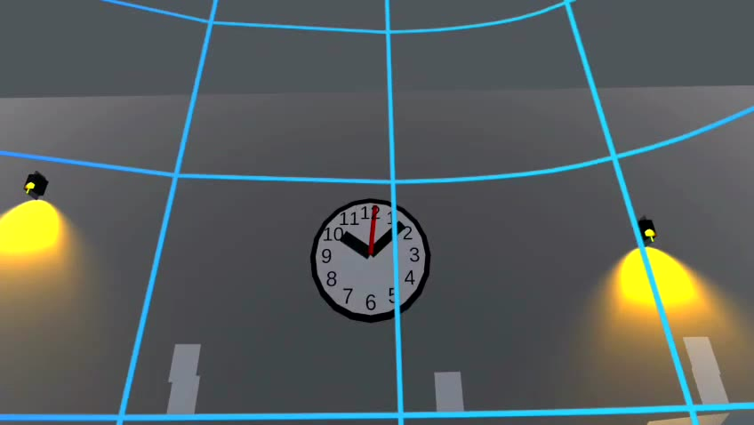
13 · REFERENCES
The influence list now includes Dancer in the Dark.
— Somer (2002), Maladaptive Daydreaming
— Marx (1844), Economic and Philosophic Manuscripts
— Breton (1924), Manifesto of Surrealism
— Eno (1978), Ambient 1: Music for Airports
— Radiohead and Epic Games (2021), Kid A Mnesia Exhibition
— von Trier (Director, 2000), Dancer in the Dark [Film]
— Unity and Meta Quest developer documentation
Thank you.
Semiha Paksoy · semihapaksoy.com
Mind Palace — a VR loop about the clocks hidden inside escape.
Mind Palace · Semiha Paksoy · MUS 442 Senior Project II
semihapaksoy.com · 13

