Slide 1


Sarat Maharjan
2026.06.15

Slide 2

Outline
Executive Summary
Introduction
Methodology
Results
Conclusion
Appendix

Slide 3
Executive Summary
The data is collected through SpaceX Api and Web Scraping. Data Wrangling and Exploratory Analysis are performed on the collected data by using appropriate python modules and SQL. The data visualizations are used to further understand data. Both EDA and Visual Analytics using Folium and Interactive dashboards with Plotly Dash are use. At last different ML Algorithms are investigated to decide best model for future predictions.
EDA on collected and cleaned data indicate increased success rate over time.

Slide 4
Introduction
The next big thing in science and technology is space exploration. One of the leading company in this field is SpaceX. They claim the cost of Falcon 9 rocket to be 62 million dollars compared to 165-million-dollar cost for the rivals.
The objective of this research is to investigate the success probability of landing of the first stage. For our company SpaceY to compete with SpaceX, we need to perform better than SpaceX. Therefore, determining success rate and hence cost for SpaceX is critical.

Slide 5

Section 1

Slide 6
Methodology
Executive Summary
Data collection methodology:
Retrieve data from SpaceX Api and Web Scraping
Perform data wrangling
Clean data for missing and incorrect data. Transform categorical data to numerical if necessary.
Perform exploratory data analysis (EDA) using visualization and SQL
Calculate statistical properties for the collected data by using python modules and SQL. Gather better insights from the visualizations.
Perform interactive visual analytics using Folium and Plotly Dash
Gather information about Launch site, geographical factors, vicinity and effect on success rate.
Perform predictive analysis using classification models
Investigate various predictive models with optimal parameters and select best one for the future predictions.

Slide 7
Data Collection
Data was collected by two methods:
SpaceX API – past launch data and individual results were obtained from several SpaceX API endpoints.
Wikipedia – web scraping on wiki page was used to get list of Falcon 9 Launches.
SpaceX Api
Json Data
Jupyter Notebook
DataFrame
Web Scraping
HTML Page

Slide 8
Data Collection – SpaceX API
The json data is obtained from SpaceX Api using request library. The json is normalized and converted to pandas Dataframe for further investigation.
Github link for the web scraping notebook: SpaceX API Notebook
SpaceX Api
Get Request
Jupyter Notebook
Jsont Data
DataFrame

Slide 9
Data Collection - Scraping
The webpage from Wikipedia was received by HTTP get request and BeatifulSoup was used to parse and populate pandas DataFrame.
GitHub URL of the completed web scraping notebook
Get Request
Jupyter Notebook
Wikipedia Webpage
HTML Data as Text
DataFrame
BeatifulSoup

Slide 10
Data Wrangling
After data was loaded as DataFrame in Jupyter Notebook, following steps are used for data wrangling:
Identifying missing data. Remove or add data appropriately for missing data.
Identifying numerical and categorical data
Transforming categorical data to numerical data as required
Calculate various statistical parameters and gather insights.
Completed data wrangling notebook

Slide 11
EDA with Data Visualization
Summarize what charts were plotted and why you used those charts
GitHub URL of your completed EDA with data visualization

Slide 12
EDA with SQL
Using bullet point format, summarize the SQL queries you performed
GitHub URL of your completed EDA with SQL

Slide 13
Build an Interactive Map with Folium
Summarize what map objects such as markers, circles, lines, etc. you created and added to a folium map
Explain why you added those objects
GitHub URL of your completed interactive map with Folium map

Slide 14
Build a Dashboard with Plotly Dash
Summarize what plots/graphs and interactions you have added to a dashboard
Explain why you added those plots and interactions
GitHub URL of completed Plotly Dash lab

Slide 15
Predictive Analysis (Classification)
Summarize how you built, evaluated, improved, and found the best performing classification model
You need present your model development process using key phrases and flowchart
GitHub URL of completed predictive analysis lab

Slide 16
Results
Exploratory data analysis results
Interactive analytics demo in screenshots
Predictive analysis results

Slide 17

Section 2

Slide 18
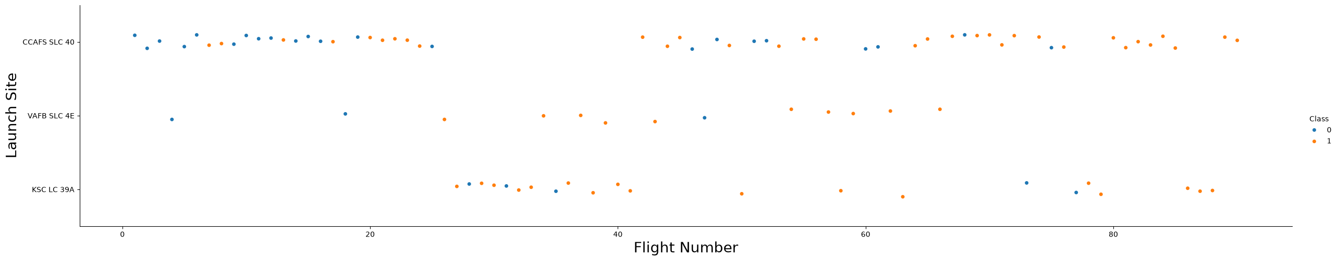
Flight Number vs. Launch Site
Flight Number has no clear relation with success rate. However, flights after number 80 show 100% success.
Flight number has no relation with Launch Site.
However, total flights in site CCAFS SLC 40 is larger than other two sites.

Slide 19
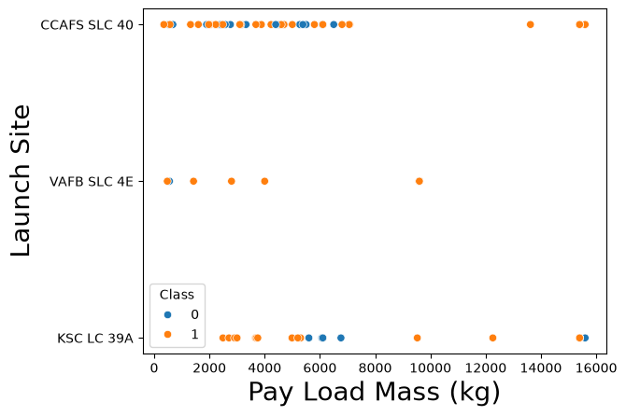
Payload vs. Launch Site
No clear relationship between payload and launch success rate for all sites.

Slide 20
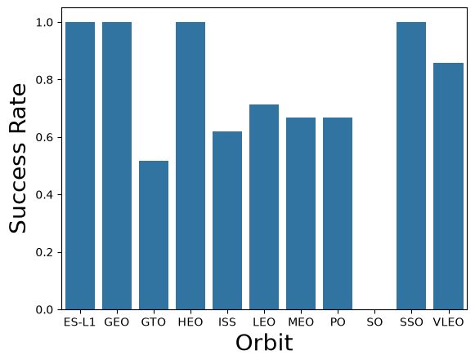
Success Rate vs. Orbit Type
Show a bar chart for the success rate of each orbit type
Show the screenshot of the scatter plot with explanations

Slide 21
Flight Number vs. Orbit Type
Show a scatter point of Flight number vs. Orbit type
Show the screenshot of the scatter plot with explanations

Slide 22
Payload vs. Orbit Type
Show a scatter point of payload vs. orbit type
Show the screenshot of the scatter plot with explanations

Slide 23
Launch Success Yearly Trend
Show a line chart of yearly average success rate
Show the screenshot of the scatter plot with explanations

Slide 24
All Launch Site Names
Find the names of the unique launch sites
Present your query result with a short explanation here

Slide 25
Launch Site Names Begin with 'CCA'
Find 5 records where launch sites begin with `CCA`
Present your query result with a short explanation here

Slide 26
Total Payload Mass
Calculate the total payload carried by boosters from NASA
Present your query result with a short explanation here

Slide 27
Average Payload Mass by F9 v1.1
Calculate the average payload mass carried by booster version F9 v1.1
Present your query result with a short explanation here

Slide 28
First Successful Ground Landing Date
Find the dates of the first successful landing outcome on ground pad
Present your query result with a short explanation here

Slide 29
Successful Drone Ship Landing with Payload between 4000 and 6000
List the names of boosters which have successfully landed on drone ship and had payload mass greater than 4000 but less than 6000
Present your query result with a short explanation here

Slide 30
Total Number of Successful and Failure Mission Outcomes
Calculate the total number of successful and failure mission outcomes
Present your query result with a short explanation here

Slide 31
Boosters Carried Maximum Payload
List the names of the booster which have carried the maximum payload mass
Present your query result with a short explanation here

Slide 32
2015 Launch Records
List the failed landing_outcomes in drone ship, their booster versions, and launch site names for in year 2015
Present your query result with a short explanation here

Slide 33
Rank Landing Outcomes Between 2010-06-04 and 2017-03-20
Rank the count of landing outcomes (such as Failure (drone ship) or Success (ground pad)) between the date 2010-06-04 and 2017-03-20, in descending order
Present your query result with a short explanation here

Slide 34

Section 3

Slide 35
<Folium Map Screenshot 1>
Replace <Folium map screenshot 1> title with an appropriate title
Explore the generated folium map and make a proper screenshot to include all launch sites’ location markers on a global map
Explain the important elements and findings on the screenshot

Slide 36
<Folium Map Screenshot 2>
Replace <Folium map screenshot 2> title with an appropriate title
Explore the folium map and make a proper screenshot to show the color-labeled launch outcomes on the map
Explain the important elements and findings on the screenshot

Slide 37
<Folium Map Screenshot 3>
Replace <Folium map screenshot 3> title with an appropriate title
Explore the generated folium map and show the screenshot of a selected launch site to its proximities such as railway, highway, coastline, with distance calculated and displayed
Explain the important elements and findings on the screenshot

Slide 38

Section 4

Slide 39
<Dashboard Screenshot 1>
Replace <Dashboard screenshot 1> title with an appropriate title
Show the screenshot of launch success count for all sites, in a piechart
Explain the important elements and findings on the screenshot

Slide 40
<Dashboard Screenshot 2>
Replace <Dashboard screenshot 2> title with an appropriate title
Show the screenshot of the piechart for the launch site with highest launch success ratio
Explain the important elements and findings on the screenshot

Slide 41
<Dashboard Screenshot 3>
Replace <Dashboard screenshot 3> title with an appropriate title
Show screenshots of Payload vs. Launch Outcome scatter plot for all sites, with different payload selected in the range slider
Explain the important elements and findings on the screenshot, such as which payload range or booster version have the largest success rate, etc.

Slide 42

Section 5

Slide 43
Classification Accuracy
Visualize the built model accuracy for all built classification models, in a bar chart
Find which model has the highest classification accuracy

Slide 44
Confusion Matrix
Show the confusion matrix of the best performing model with an explanation

Slide 45
Conclusions
Point 1
Point 2
Point 3
Point 4
…

Slide 46
Appendix
Include any relevant assets like Python code snippets, SQL queries, charts, Notebook outputs, or data sets that you may have created during this project

Slide 47


